Slide 2
Overall, no problems plotting the data

Slide 3
Overlapping data sets
there are “new data” from some of the same dates as the previous dataset
a large portion of the new data also have two similar sets of data
seem to be overlapping dates and times

Slide 4
sdc_0321071901_0x700_sci.lbl
START_TIME = 2015-01-19T17:06:27.695
STOP_TIME = 2015-01-19T18:50:47.695
SPACECRAFT_CLOCK_CNT_PARTITION = 3
SPACECRAFT_CLOCK_START_COUNT = "0283993105:00000"
SPACECRAFT_CLOCK_STOP_COUNT = "0283999364:49996"
sdc_0284233918_0x700_sci.lbl
START_TIME = 2015-01-19T17:50:20.695
STOP_TIME = 2015-01-19T20:51:04.695
SPACECRAFT_CLOCK_CNT_PARTITION = 3
SPACECRAFT_CLOCK_START_COUNT = "0283995738:00000"
SPACECRAFT_CLOCK_STOP_COUNT = "0284006581:49994"
sdc_0284233919_0x700_sci.lbl
START_TIME = 2015-01-19T20:51:05.696
STOP_TIME = 2015-01-20T01:28:06.696
SPACECRAFT_CLOCK_CNT_PARTITION = 3
SPACECRAFT_CLOCK_START_COUNT = "0284006583:00000"
SPACECRAFT_CLOCK_STOP_COUNT = "0284023203:49990"
sdc_0284233920_0x700_sci.lbl
START_TIME = 2015-01-20T01:28:07.696
STOP_TIME = 2015-01-20T10:07:31.696
SPACECRAFT_CLOCK_CNT_PARTITION = 3
SPACECRAFT_CLOCK_START_COUNT = "0284023205:00000"
SPACECRAFT_CLOCK_STOP_COUNT = "0284054368:49982"
sdc_0284233921_0x700_sci.lbl
START_TIME = 2015-01-20T10:07:33.696
STOP_TIME = 2015-01-20T10:13:43.696
SPACECRAFT_CLOCK_CNT_PARTITION = 3
SPACECRAFT_CLOCK_START_COUNT = "0284054371:00000"
SPACECRAFT_CLOCK_STOP_COUNT = "0284054741:00000"
sdc_0321071902_0x700_sci.lbl
START_TIME = 2015-01-19T18:50:48.695
STOP_TIME = 2015-01-19T23:07:14.695
SPACECRAFT_CLOCK_CNT_PARTITION = 3
SPACECRAFT_CLOCK_START_COUNT = "0283999366:00001"
SPACECRAFT_CLOCK_STOP_COUNT = "0284014751:49991"
sdc_0321071903_0x700_sci.lbl
START_TIME = 2015-01-19T23:49:07.696
STOP_TIME = 2015-01-20T03:57:51.696
SPACECRAFT_CLOCK_CNT_PARTITION = 3
SPACECRAFT_CLOCK_START_COUNT = "0284017265:00000"
SPACECRAFT_CLOCK_STOP_COUNT = “0284032188:49992”

Slide 5
Overlapping data sets
in slimindx.tab:
^{line 377-378:}
"DUST ","NEW ","DATA/20160323_032106/","SDC_0321069736_0X700_SCI "
"DUST ","NEW ","DATA/20150119_032107/","SDC_0321071901_0X700_SCI “
^{line 897-898:}
"DUST ","NEW ","DATA/20160807_033289/","SDC_0332895148_0X700_SCI "
"DUST ","NEW ","DATA/20160325_033598/","SDC_0335986328_0X700_SCI "
^{line 1105-1106:}
"DUST ","NEW ","DATA/20161009_033836/","SDC_0338363538_0X700_SCI "
"DUST ","NEW ","DATA/20160912_033900/","SDC_0339000728_0X700_SCI "

Slide 6
blue data points are from the 20150119_028423 directory
red data points are from the 20150119_032107 directory
for both, * are the first set, º are the second set
green points are from 20150120_028423 directory
black diamonds are from 20150120_032107 directory
Charge
MET

Slide 7
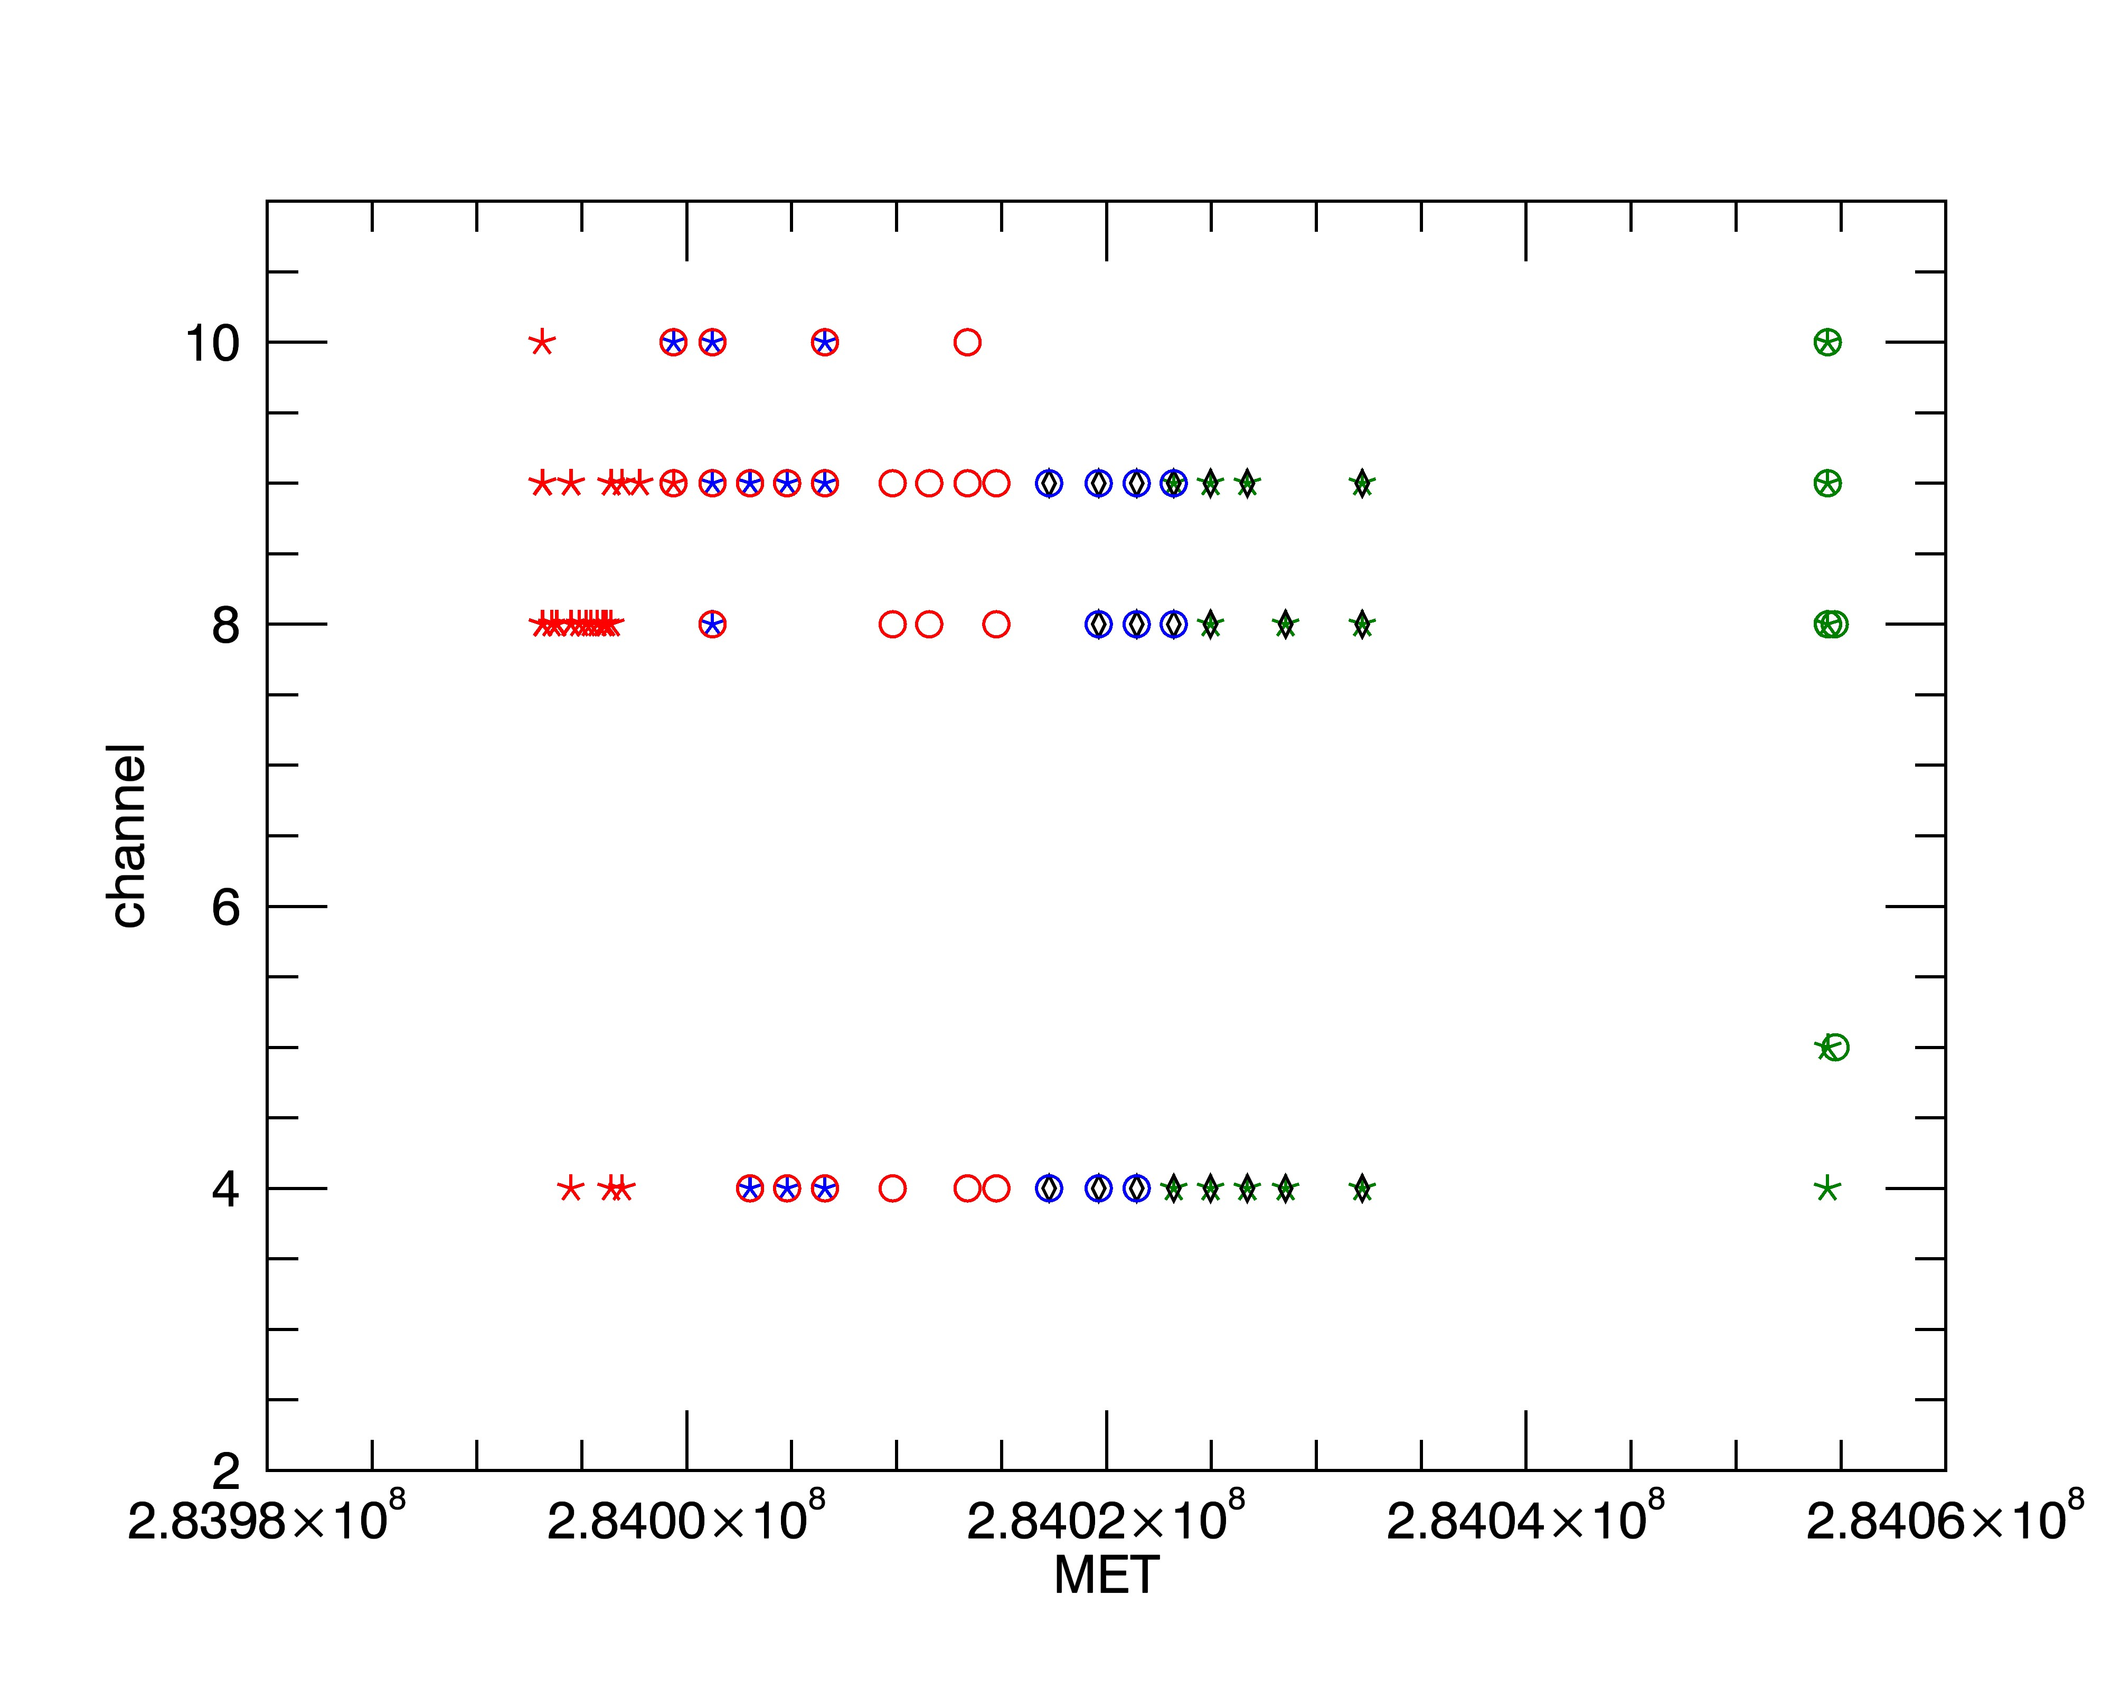
blue data points are from the 20150119_028423 directory
red data points are from the 20150119_032107 directory
for both, * are the first set, º are the second set
green points are from 20150120_028423 directory
black diamonds are from 20150120_032107 directory

Slide 8
Documentation corrections
in sdc_stim_v0002.tab
(includes a 2016 date)
NAME = “SDC_STIM_TABLE_V0001”
“ This is Version 0001 of this PDS TABLE; we have confirmed with the SDC
instrument team that no stimulus activities were planned from the end
of this table (ca. 2014-11-28) until May, 2016.
Each row of the TABLE represents one stimulus calibration, derived from
sequences of stimulus events occuring within thirty minutes of each other
throughout the mission.

Slide 9
Small typos
sdcpower.lbl
Object MET
spacecraft is spelled wrong (spacecraaft)
Object PROVENANCE
safely is spelled wrong (savely)
slimindx.lbl
important spelled wrong (improtant)

