Slide 1
New Horizons Alice PDS-SBN Review
Lori Feaga
June 19, 2017

Slide 2
NH Alice Data
Overall – in good shape
Minor typos that don’t affect the usability of the data, but should be cleaned up

Slide 3
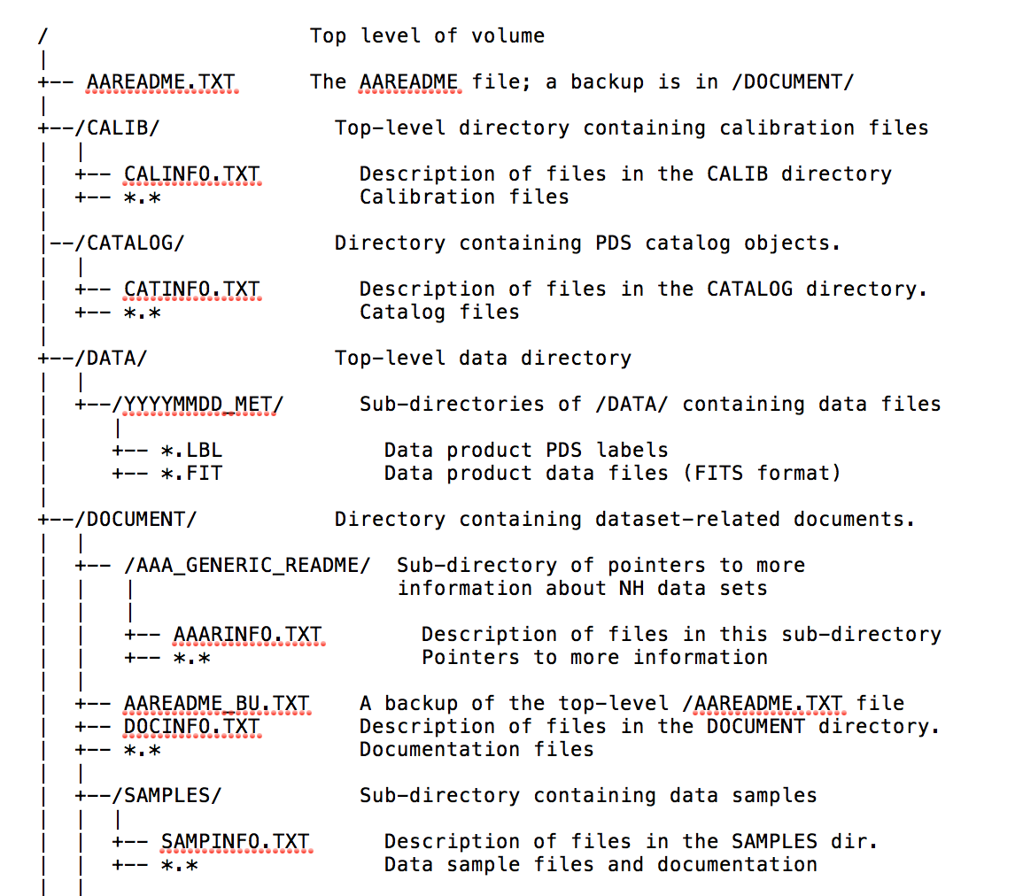
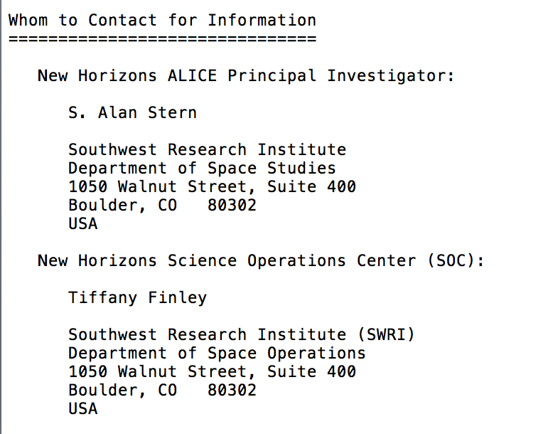
aareadme.txt (and document/aareadme_bu.txt)
Both Level 2 & 3 data sets
Period/punctuation use is random in the Volume Contents organization table
Alan Stern’s contact listing doesn’t give the SwRI abbreviation like Tiffany Finley’s does

Slide 4
catalog/alice.cat
Both Level 2 & 3 data sets
In INSTRUMENT OVERVIEW, Description, Rosetta in the present tense as a current mission
In Scientific Objectives, the punctuation is random in the listing of the Objectives

Slide 5
catalog/dataset.cat
Both Level 2 & 3 data sets
“Pixel List”, “Pixel list”, “pixel list”, and “pixellist” are used interchangeably
In ABSTRACT_DESC, typo in the word calibrated in the phrase “calibration file (pa_aeff_007.txt) changed the calbrated data”
TARGET_NAME = “RHO LEO” but in the index files (index.tab and slimindx.tab) both “RHO LEO” and “RHOLEO” are used

Slide 6
calib/calinfo.txt
Both Level 2 & 3 data sets
Suggest a LABEL_REVISION_NOTE be added or change the PUBLICATION_DATE, clearly it has changed since 2007-09-11
To punctuate or not, that is the question
pa_aeff_socc_001.tab is superseded yet still has an “*” indicating its current use in the pipeline
remove the “*”
For posterity, were there ever pa_wave_001, pa_aeff_001, 002, or 003 files?

Slide 7
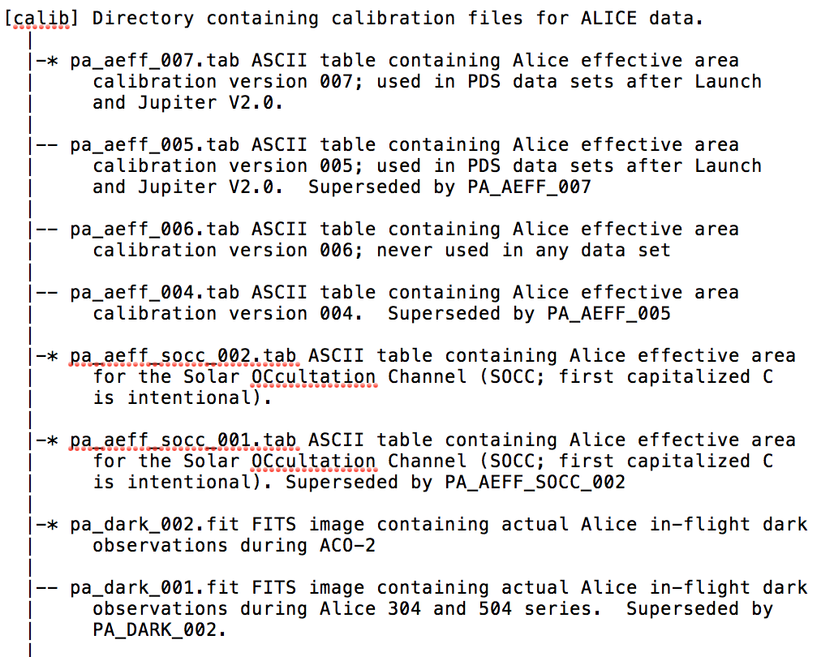
calib/calinfo.txt

Slide 8
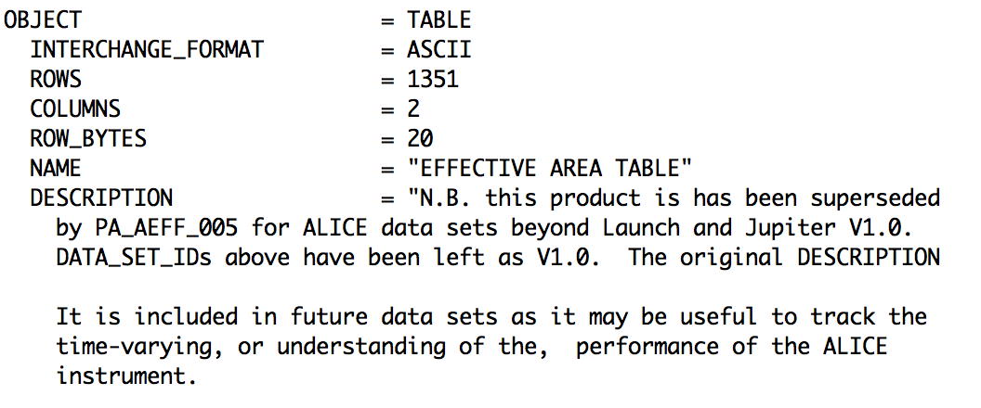
calib/pa_aeff_*
Both Level 2 & 3 data sets
004.lbl: In DESCRIPTION end of first paragraph, incomplete thought
005.lbl: Consider noting that this file is superseded
socc_001 & 002: Consider noting that these files are for the 2° x 2° SOCC

Slide 9
Examining the Effective Areas

Slide 10
Effective Area Continued

Slide 11
index/slimindx.tab & .lbl
Slim index file has 4 columns but the label describes 3 – cut and paste error when trimming the index file, grabbed too much real estate

Slide 12
Alice Slit Shape
Solar
Occultation
Channel
Row 25 (zero indexed)
Row 19 (zero indexed)
Row 18 (zero indexed)
Row 6 (zero indexed)

Slide 13
Lollipop “fuzz”
To reduce sensitivity at the bright HI Lyman-α emissions at 1215 Å, a 70 Å band of the photocathodes were not coated with KBr or CsI. However, in the 2°x2° box portion of the slit, the HI Lyman-α spreads out beyond the uncoated portion of the detector an additional ~110 Å. So, for ~90 Å [(70 + 110 )/2] on either side of the coated photocathodes, there is contamination from HI Lyman-α that has been dubbed the lollipop fuzz.
λ ➔

Slide 14
Lollipop Fuzz Verified Spectrally

Slide 15
Checked data with NASAVIEW, SAOImage ds9, IDL ReadPDS
could display data with labels as expected

Slide 16
Spectrum of Pluto on Final Approach

