Slide 1
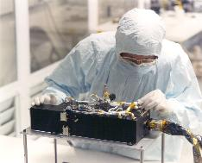
P-Alice PDS Data Review Pluto Mission Phase
Cesare Grava
2017-06-19

Slide 2
Characteristics of P-Alice
520-1870 Angstroms (though only 780 columns are active, starting from 130th)
Spectral dispersion: 1.832 Å/pixel
Lollipop-shaped slit: 0.1x4.0° for the AirGlow Channel (AGC) + 2.0x2.0° for the Solar Occultation Channel (SOCC)
Two modes of operation:
Pixel list mode: preserves time information
Histogram: 2D histogram (integration) of pixel list mode; loses info on timing but allows to observe faint objects (e.g. calibration stars);
You can create a histogram from pixel list but not vice versa
Very similar to the LRO/LAMP UV spectrograph I work with.

Slide 3
Objectives of P-Alice
To determine or constrain:
The mixing ratios of N2, CO, CH4 and noble gases;
The vertical density and temperature structure (e.g., gradient) of the upper atmosphere;
The atmospheric haze optical depth;
The atmospheric escape rate and escape regime;
The brightness of airglow emissions from Pluto’s atmosphere

Slide 4
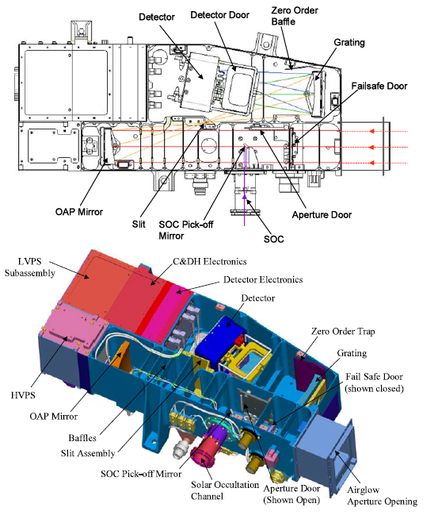

Slide 5
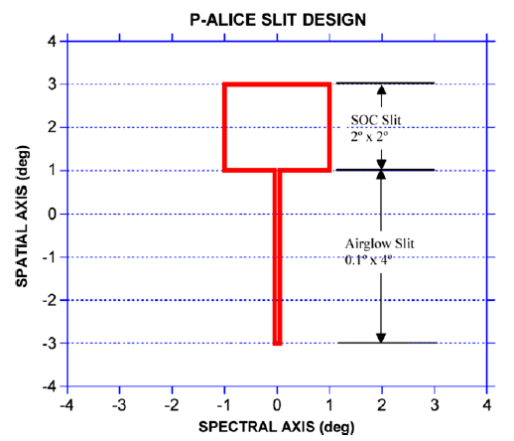

Slide 6
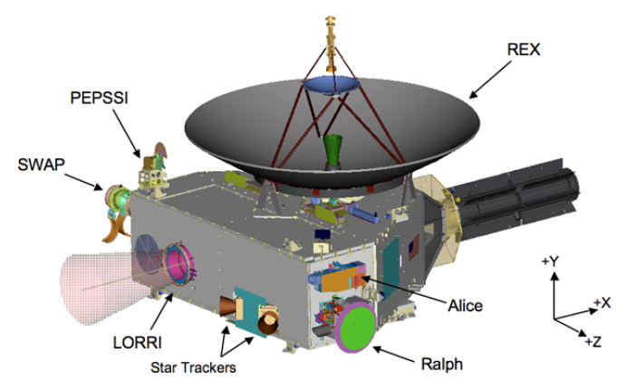

Slide 7
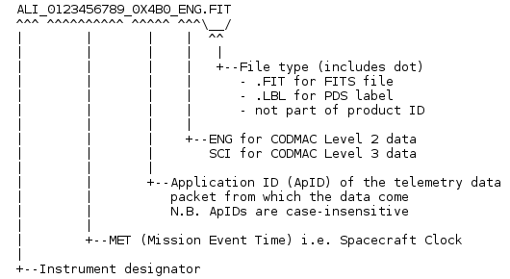
Datasets Reviewed
nh-p-alice-2-pluto-v3.0
nh-p-alice-3-pluto-v3.0
No cruise phase in this review
New data downlinked between the end of Jan. 2016 and the end of Oct. 2016
Analysis of the files is performed by comparison with previous delivery
Naming convention:

Slide 8
Document\, including samples\ & aaa_generic_readme\ subdirectories
Docinfo.txt, which explains what’s in here and recommends the following 3 files;
The 2 SSR paper(s) + lunineetal1995.pdf: ok
Seq_alice_pluto(cruise).tab:
Nh_mission_trajectory.tab: not understood why s/c and dust particle, but file is ok.
Aareadme_bu.txt: Backup copy of top-level AAREADME.TXT
Quat_axyz_instr_to_j2k.asc: OK
Codmac_level_definitions.pdf: ok
nh_fov.png: ok
Nh_met2utc.tab: converts MET to date (neat, but wouldn’t it be better if they included a routine?)
nh_alice_v200_ti.txt
Samples\ & aaa_generic_readme\ directories: ok
Analysis of the files is performed by comparison with previous delivery

Slide 9
Document\, including samples\ & aaa_generic_readme\ subdirectories
All are identical except the following:
Docinfo.txt: expanded the “ with actual words
Removed file Nh_trajectory.tab (incorporated in nh_mission_trajectory.tab)
Seq_alice_pluto.tab: added the timings of subsequent observations (all stars, all ~ 1 year after closest approach). CoccEgress (Charon occultation egress time) still missing;
Soc_inst_icd.pdf: fixed the link to the FITS in page 1
Codmac_level_definitions.pdf: now the link is working

Slide 10
Index\
Slimindx.tab is very useful to know the target of each file! This has to be used after you checked in Seq_alice_pluto(cruise).tab the type of sequence you want (i.e. Pluto airglow, Pluto occultation, Charon occultation, etc.)
Checksum.tab: MD5 checksums for each file on this volume
Indxinfo.txt: explains what’s in here
Index.tab: location of each data file on this volume

Slide 11
Catalog\
Alice.cat: describes the instrument and its 2 operating modes and explains the PHDs; this is the only file, in this directory, that didn’t change from 2016;
Catinfo.txt : explains the files contained here; changed minimally (date) from 2016;
Dataset.cat: phases (sequences) of the mission (AP1, NEP, DP1, etc.), caveat on TARGET ID, etc.; added explanation of the “slot”; the “version” paragraph has changed, and now it states that calibration may have changed because the geometry was changed (in April 2017); typo: pa_aeff_007.txt should be replaced with pa_aeff_007.tab;

Slide 12
Catalog\
Nh.cat: explains the mission goals and phases; added Calibration Campaign and Extended mission;
Nhsc.cat: explains the s/c (checked only Alice section); minor: add the wavelength coverage of Alice, as it was done (wrt last review) for other instruments;
Ref.cat: references; removed references to ITAR-restricted documents; many more papers could be added (Stern et al. 2015, Gladstone et al. 2016, etc.);

Slide 13
Calib\
Calinfo.txt: explains what’s in here
Added new effective area file pa_aeff_socc_002.tab
Airglow Aeff is unchanged;

Slide 14
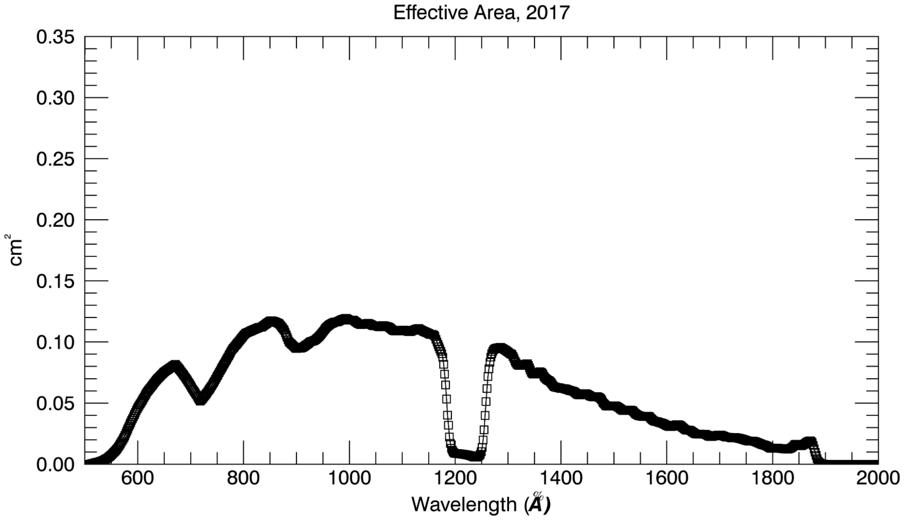
Calib\
Effective area airglow (pa_aeff_007.tab):
Good: slightly more sensitive than what reported in fig. 21 (top) of Stern et al. 2008

Slide 15
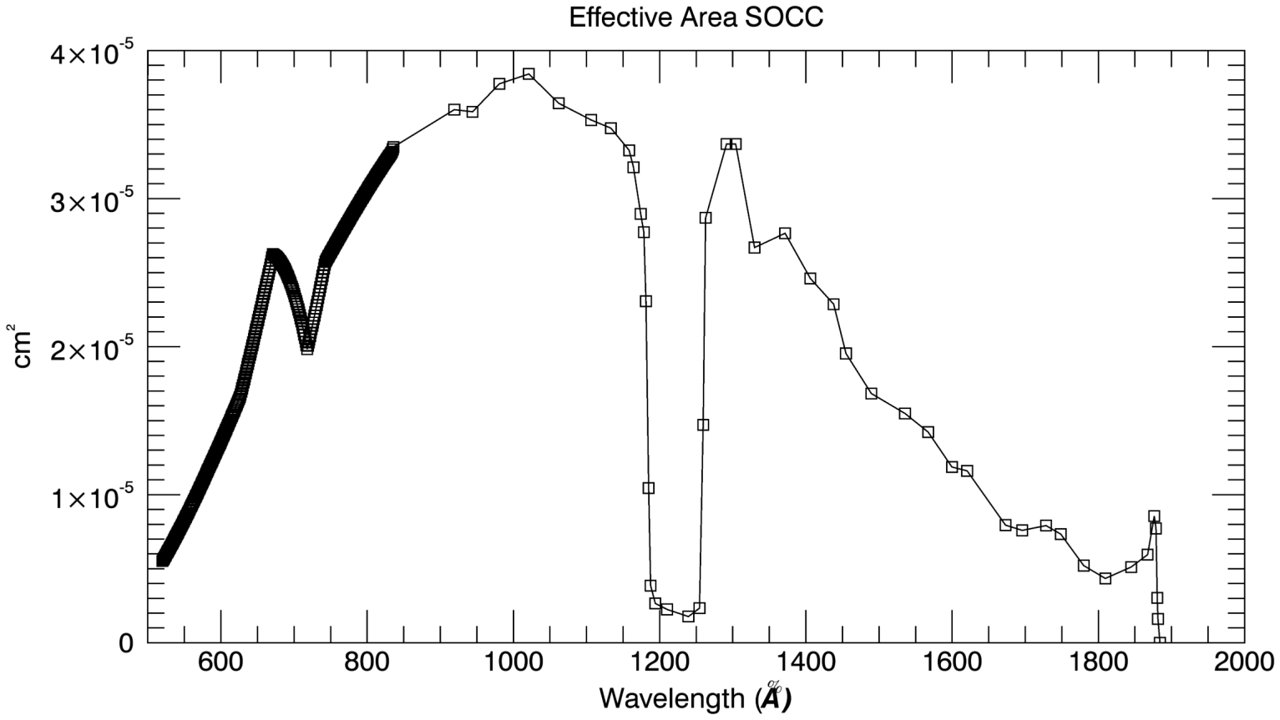
Calib\
Effective area SOCC (pa_aeff_socc_001.tab):
OLD, ☹
Resolution is not sampled as the previous Aeff (every ~1.8 Å). Instead, it is sampled every 1.0 Angstrom until ~836 Å
Afterwards, it is defined every ~30-40 Å
Why?

Slide 16
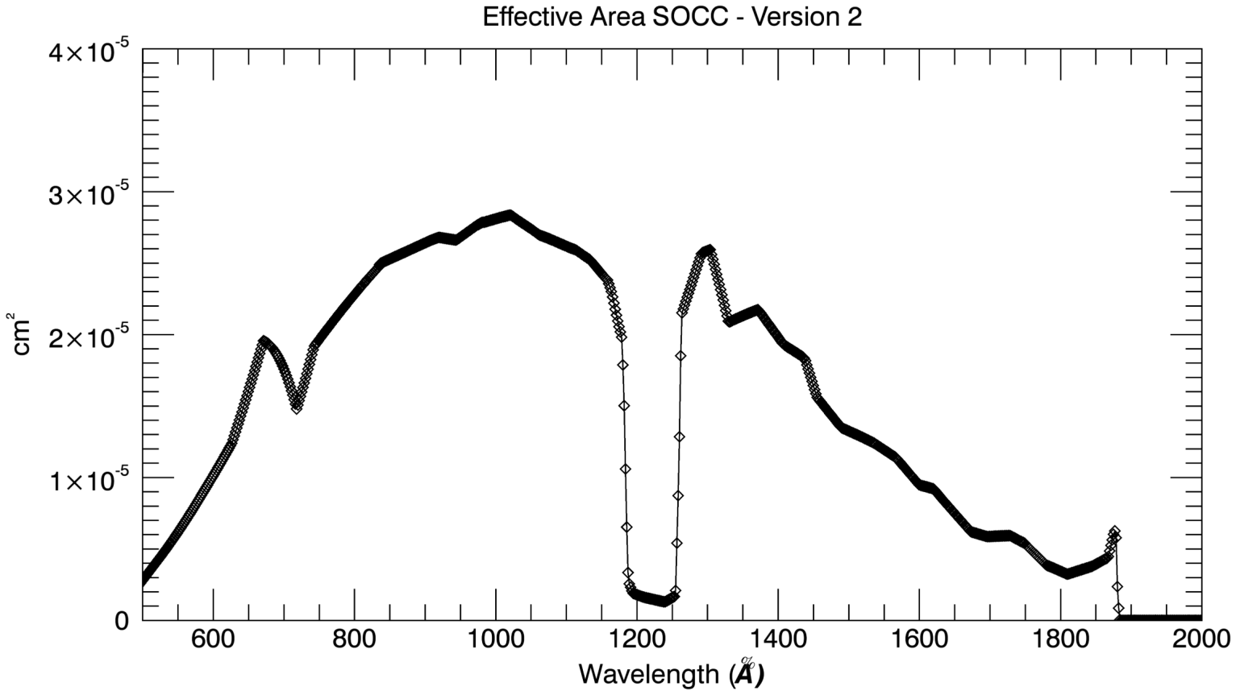
Calib\
Effective area SOCC (pa_aeff_socc_002.tab):
Solved ☺
Resolution is now sampled as the previous Aeff (every ~1.8 Å).
Although it has a smaller value. The change from the previous version of Aeff is documented in catalog/dataset.cat

Slide 17
Calib\: no change
nh-p-alice-3-pluto-v3.0\calib\pa_dark_002.fit
Dark: ~3 hrs integration time; mean ~0.004 counts/sec

Slide 18
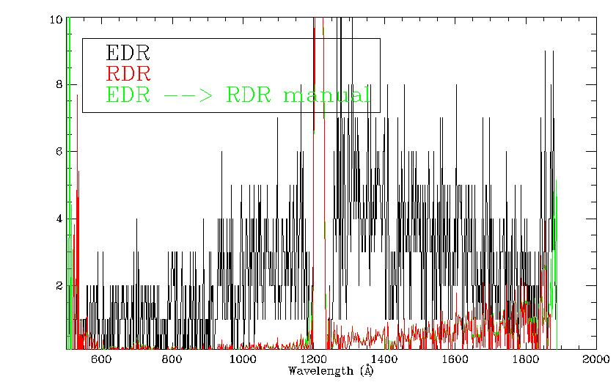
Data\
nh-p-alice-3-pluto-v3.0\data\20150714_029921\ali_0299219555_0x4b2_sci.fit
SAPNAME: P_LORRI_ALICE_DEP_2_AH
SAPDESC: Alice Ride-Along
VISITDSC: Alice Airglow, 12x 150sec
DATE = 2015-07-14T22:39:20.876
APERTURE = AIRGLOW
TARGET = PLUTO
Possible to reconstruct the RDR from ENG file: good

Slide 19
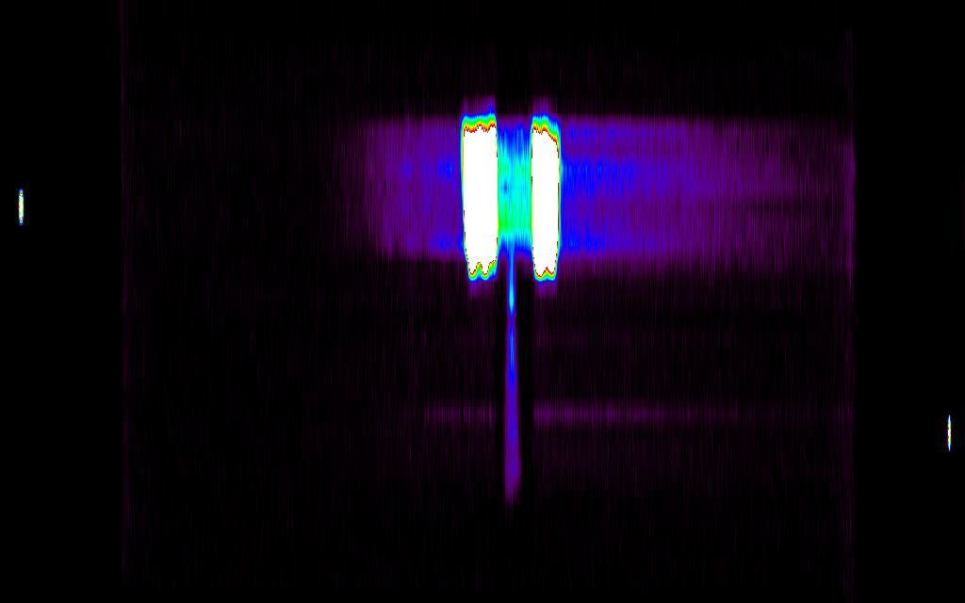
Data\
nh-p-alice-3-pluto-v2.0\data\20150718_029950\ali_0299509700_0x4b2_sci.fit
SAPNAME: P_AIRGLOW_DEP_A_3
SAPDESC: Alice 45m airglow observation of Pluto+Charon (histogram)
VISITNAM: P_Airglow_Dep_A_3
VISITDSC: Alice Airglow, 9x 300sec
DATE = 2015-07-18T07:13:50.880
Lollipop-shaped fuzz is SOCC aperture

Slide 20
Data\
nh-p-alice-2-pluto-v3.0/data/20160715_033091/ali_0330918179_0x4b2_eng.fit
SAPNAME: SOCC_Eff_Area_Spica
SAPDESC: Alice 3x1800sec airglow
VISITNAM: SOCC_Eff_Area_Spica
VISITDSC: Alice Airglow, 3x 1800sec
TARGET: SPICA
All light concentrated on a single row

Slide 21
Data\
nh-p-alice-2-pluto-v3.0/data/20160715_033090/ali_0330903809 _0x4b2_eng.fit
SAPNAME: Airglow_Eff_Area_RhoLeo
SAPDESC: Alice 1x1800sec airglow
VISITNAM: Airglow_Eff_Area_RhoLeo
VISITDSC: Alice Airglow, 1x 1800sec
TARGET: RHOLEO
Lollipop-shaped fuzz is SOCC aperture

Slide 22
Rummaging through the headers
type of observation (histogram/pixel list)
EPHEMERIS
SUB-PHASE
START & STOP TIMES
EXPOSURE TIME
S/C POSITION WRT SUN
DARK FRAME USED
EFFECTIVE AREA USED
FLAT FIELD, BIAS
TARGET NAME
All looked good.
Read the files with rdfits_struct, mrdfits, readpds IDL routines. No problem

Slide 23
Evaluation Tools
Laptop Lenovo Thinkpad:
Virtual Machine Oracle Fedora 25
Windows 7
IDL 8.4
Readpds v4.9 (PDS3)
Astron library

Slide 24
RIDs

Slide 25
RID 101
RID Classification: Minor
Location: Document
Dataset: ALL
Title: missing CoccEgress info.
Description: The Charon occultation egress sequence is missing from the files Seq_alice_pluto(cruise).tab
Recommended Solution: insert details of Charon occultation egress

Slide 26
RID 102
RID Classification: Minor
Location: Catalog
Dataset: ALL
Title: Wavelength coverage of Alice.
Description: wavelength coverage of Alice detector is not mentioned in the nhsc.cat file
Recommended Solution: add wavelength coverage of Alice detector, as was done for other NH instruments

Slide 27
RID 103
RID Classification: Editorial
Location: Catalog
Dataset: ALL
Title: Typo
Description: the file pa_aeff_007.txt mentioned in dataset.cat does not exist
Recommended Solution: replace pa_aeff_007.txt with by pa_aeff_007.tab

Slide 28
END

