Slide 1
Review of the LEISA Data Set
Karl Hibbitts
June 19, 2017

Slide 2
Calibrated V3 data
FITS files open easily and data extracted via Matlab
Data files
Metadata files
AAReadme: clear information
AARINFO: clear information
SOC Instrument ICD: Oct 2016; Useful and accurate
54 high res channels
198 nominal res channels
Details are left to the user to determine

Slide 3
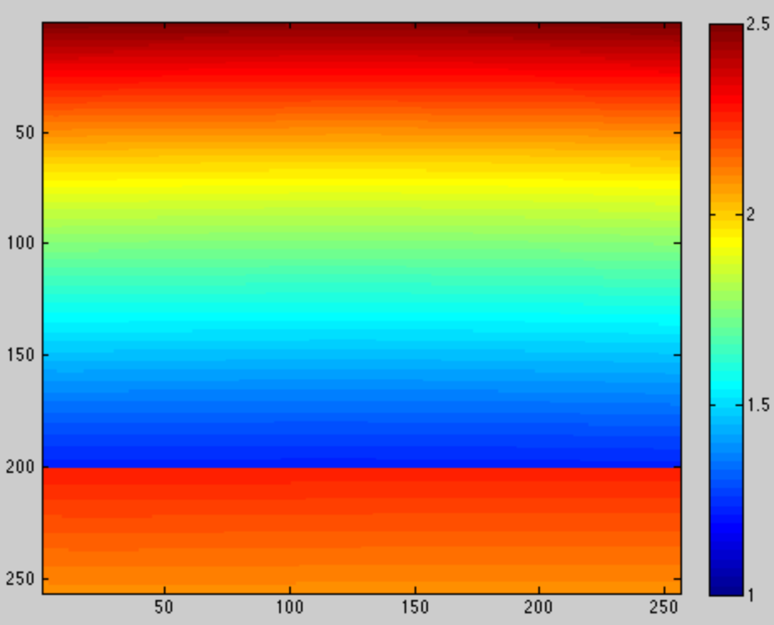
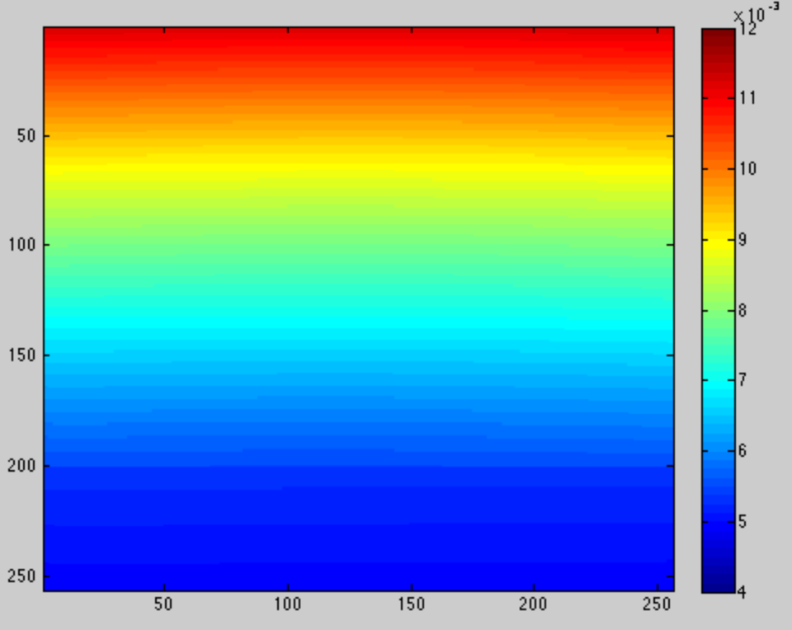
Review of Metadata Files
Wavelength information
Appears idealized. Is this measured information or modeled?
Out of band transmission information not provided.
Bandwidth information is a single number; information not provided on the shape of the bandpass.

Slide 4
Review of Metadata Files
BadPixel Map
Clear
BondJoint Map
Not sure what to do with this information other than discarding the affected data.

Slide 5
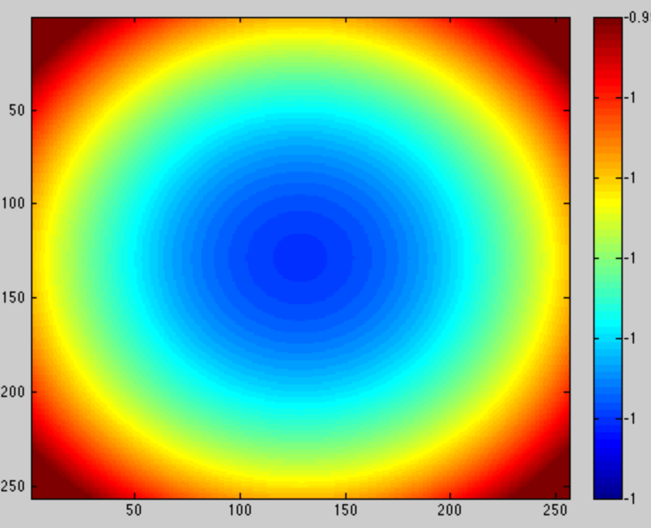
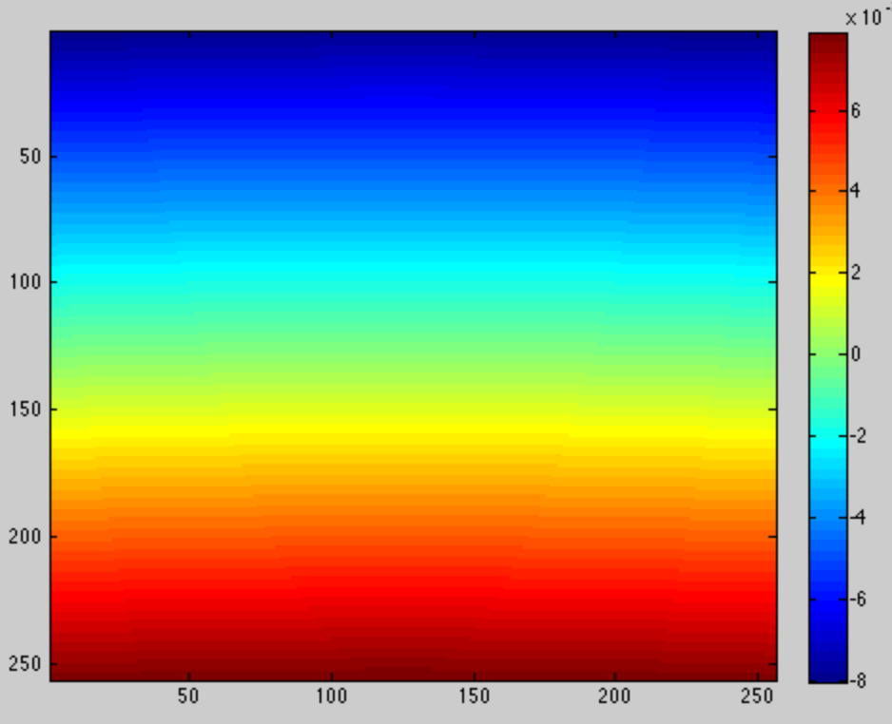
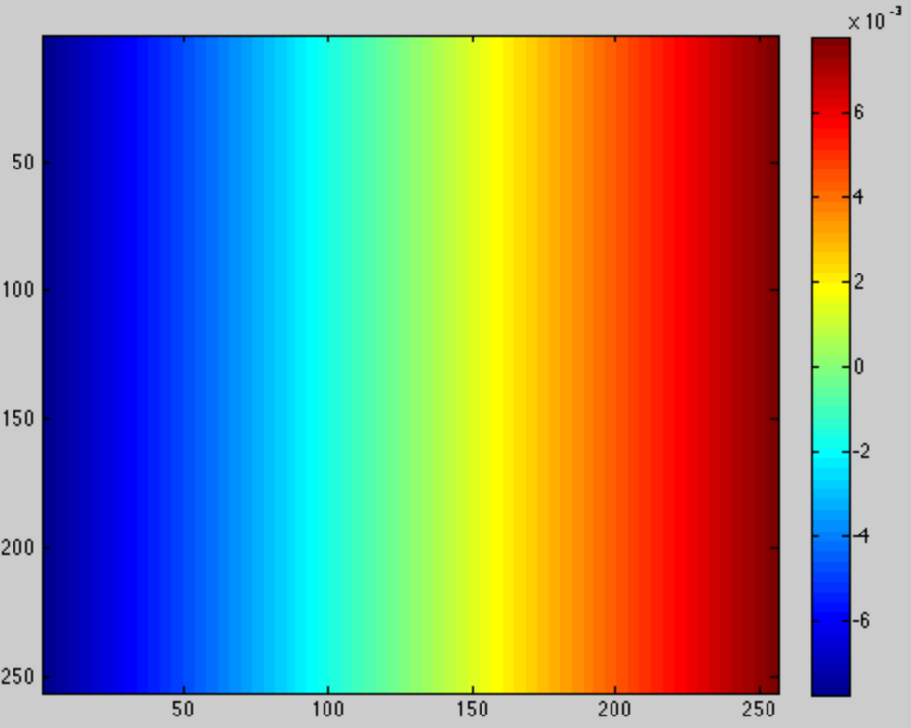
Review of Metadata Files
Pointing information
Does not appear to contain valid geometric information on LEISA’s FOV. Both the numbers and the ‘perfectness’ are suspect.
????
+- 10 mrad (if those are the units)

Slide 6
Data Useability
Simple to read in.
Motion of Spacecraft and nature of instrument requires use of Spice data, etc. for detailed analysis, which I did not perform.
Although the data is calibrated, significatn work (time varying NUCs, and corrections for s/c pointing) would need to be done to make the data useful. This is a typical ‘feature’ of IR spectral imaging data.

Slide 7
Review of Data File
Chose the high resolution image from July 14
Data file only contains radiance data
Data quality is consistent with MCT detectors. Much residual detector non uniformity, secular variations, and apparent ‘popcorn noise’. Insufficient time to characterize in detail.
Radiance appears to be higher than expected (compared to Thekaekara, 1973)
Briefly looked at more distant obsevations

Slide 8
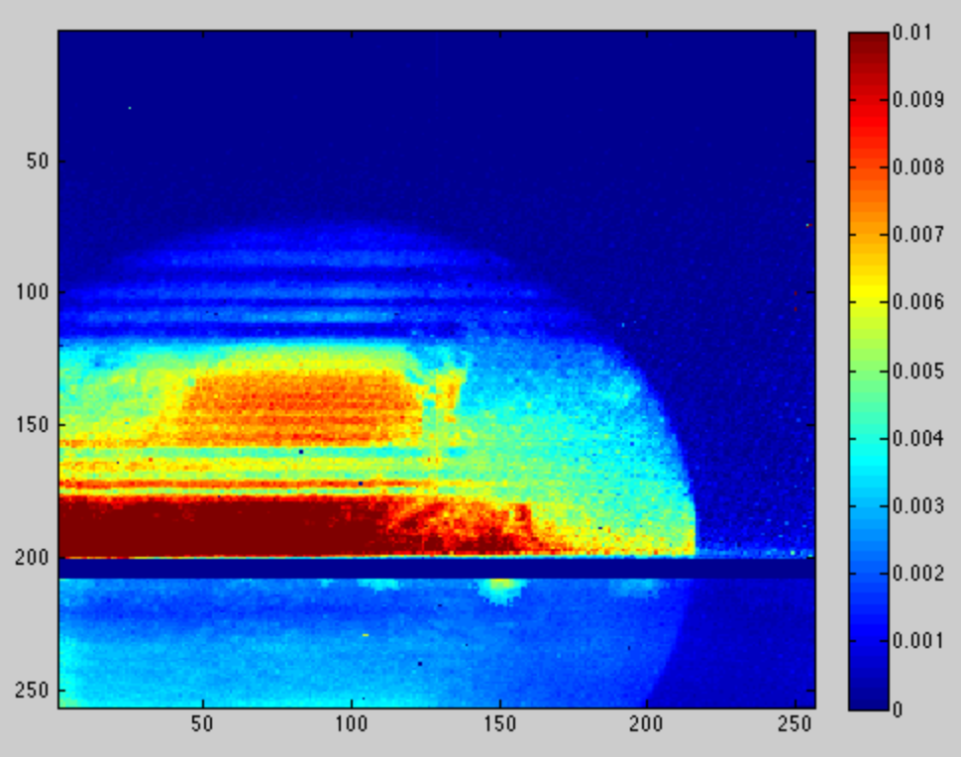
Resolution = 240
Line number & Wavelength Position
Resolution = 560
Column Number

Slide 9
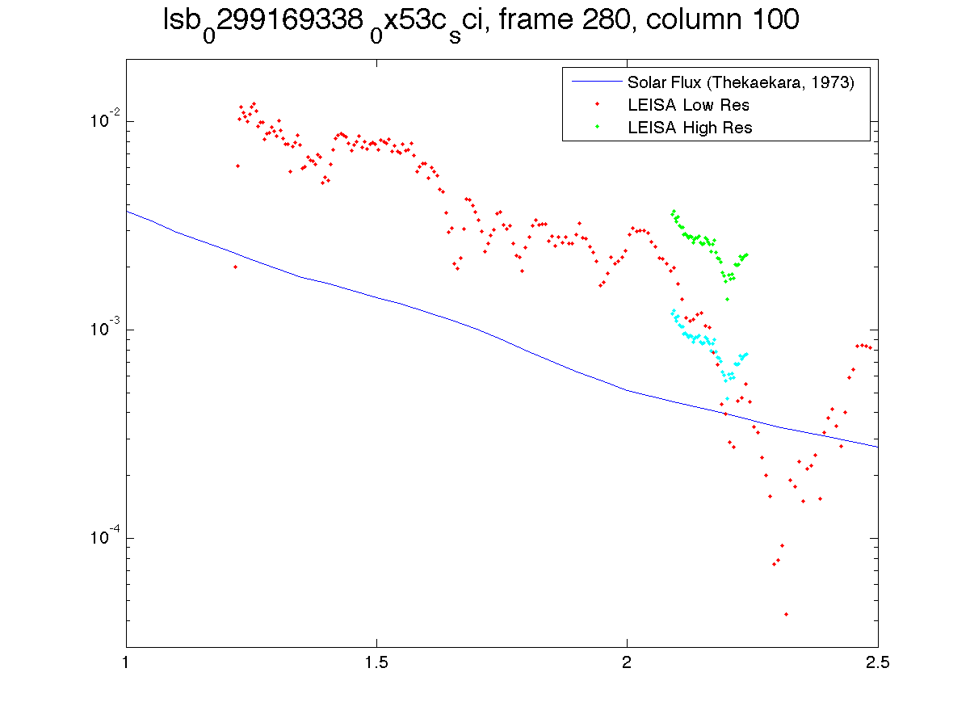
Radiance (ergs/cm2/s/A/Sr
Wavelength (microns)

Slide 10
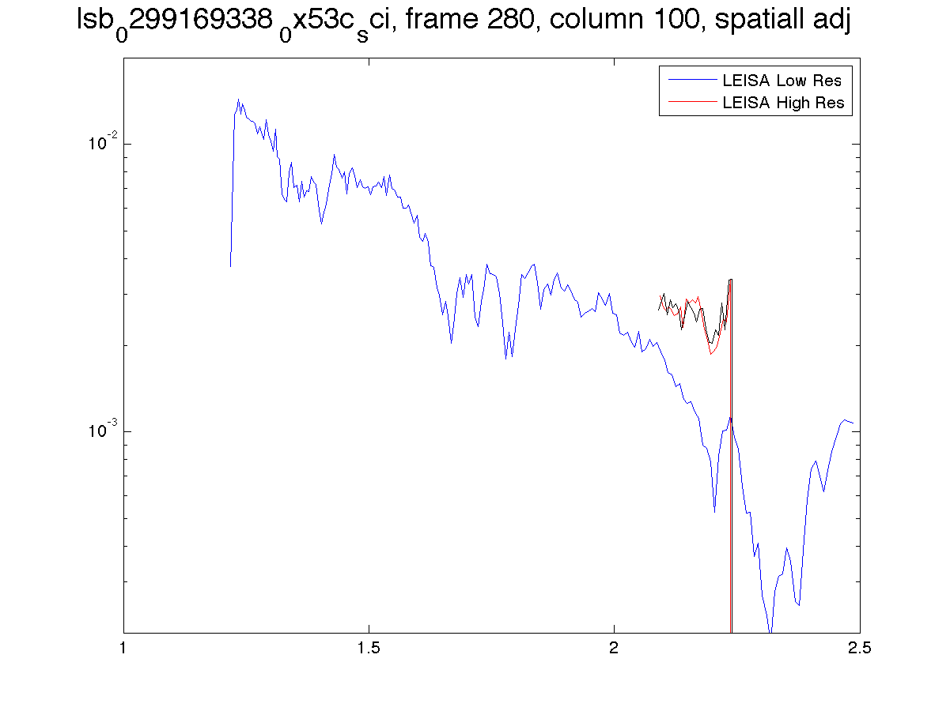
Radiance (ergs/cm2/s/A/Sr
Wavelength (microns)

Slide 11
Additional Information I would find of use if analyzing the data
For each cube, provide an accompanying cube of:
Darks used in the calibration
Flat field used in the calibration
Gain used in the calibration
Offset used in the calibration
For each line on the detector, provide:
A filter transmission spectrum to aid in developing custom spectral deconvolution procedures

