Slide 1
NH REX Pluto Encounter PDS/SBN Data Review
Dick Simpson
19 June 2017
University of Maryland
College Park, MD

Slide 2
REX Science Objectives
Pluto:
Atmospheric/Ionospheric Structure
Radius from length (time) occultation chord
Day and night side surface temperature from radiometry
Mass from trajectory deflection*
Charon:
Same as for Pluto (to the extent possible)
Late Addition:
Pluto surface electrical properties from BSR#
* Not included in these data sets
# Bistatic radar — oblique reflection from Pluto’s surface

Slide 3
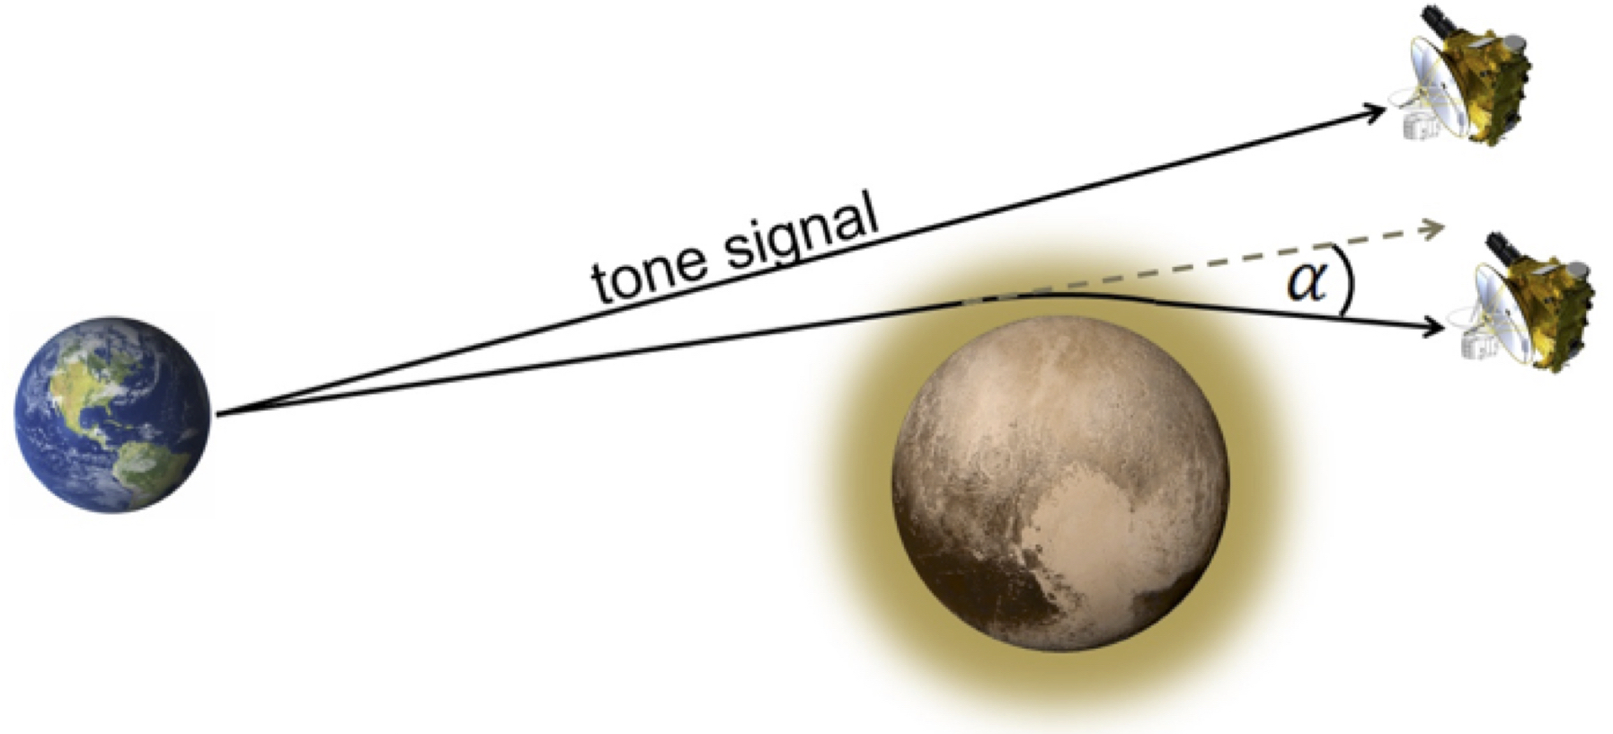
Observation Geometry
Pre-encounter tracking for gravity
Signal refraction for atmosphere and ionosphere
Dark side radiometry and chord
v
Exit occultation
Repeat for Charon
Post-encounter tracking for gravity
Adapted from https://blogs.nasa.gov/pluto/2015/11/13/radio-signals-from-earth-probe-plutos-atmosphere/ by W. Woods

Slide 4
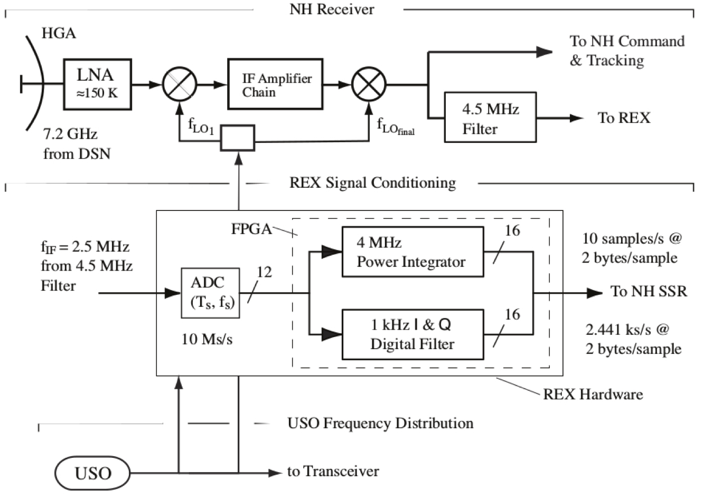
Spacecraft Instrumentation
GRAVITY
40
RADIOMETRY
5
OCCULTATION
REDUNDANT REX SIGNAL CONDITIONING UNITS
One for RCP, one for LCP
RAW ARCHIVAL DATA:
5 byte radiometry samples
2x2 byte I/Q voltage samples
3 byte time tags
CALIBRATED ARCHIVAL DATA:
Same as above as 4-byte floats
Adapted from Tyler et al., SSR, 2008

Slide 5
REX Output Frame (ROF)
FPAG samples from one time unit (1.024 s)
1250 pairs of 2-byte I, 2-byte Q voltage samples — 5000 B
10 5-byte accumulations* of radiometry ‘power’ — 50 B
10 3-byte time tags** — 30 B
ROF ID byte — 1 B
Input select status byte (science + 7 tests) — 1 B
Spares — 6 B Total — 5058 B
Stored in one FITS file with 2880 byte records
* Reset to 0 every 1.024 s
** Reset to 0 at every REX initialization

Slide 6
ROF Stucture (raw data starting in FITS record 7)
ID | I[1] MSB | I[1] LSB | STATUS | Q[1] MSB | Q[1] LSB
R[1] MSB | I[2] MSB | I[2] LSB | R[1] 4SB | Q[2] MSB | Q[2] LSB
R[1] 3SB | I[3] MSB | I[3] LSB | R[1] 2SB | Q[3] MSB | Q[3] LSB
R[1] LSB | I[4] MSB | I[4] LSB | T[1] MSB | Q[4] MSB | Q[4] LSB
T[1] 2SB | I[5] MSB | I[5] LSB | T[1] LSB | Q[4] MSB | Q[4] LSB
I[6] MSB | I[6] LSB | Q[6] MSB | Q[6] LSB | I[7] MSB | I[7] LSB
Q[7] MSB | Q[7] LSB | I[8] MSB | I[8] LSB | Q[8] MSB | …
I/Q pairs continue through Q[125] LSB.
The structure repeats with R[2], T[2], and more I/Q pairs.
The ROF ends in the middle of FITS record 8 with Q[1250] LSB.
The remainder of record 8 is undefined.

Slide 7
FITS File Organization (raw data)
PDS_VERSION_ID = PDS3
RECORD_TYPE = FIXED_LENGTH
RECORD_BYTES = 2880
FILE_RECORDS = 26
^HEADER = “FILE”
^ARRAY = (“FILE”, 7) ROF is here (2 recs)
^EXTENSION_IQVALS_HEADER = (“FILE”, 9)
^EXTENSION_IQVALS_TABLE = (“FILE”, 10) unpacked I/Q samples
^EXTENSION_RAD_TIME_TAGS_HEADER = (“FILE”, 12)
^EXTENSION_RAD_TIME_TAGS_TABLE = (“FILE”, 13) unpacked time tags
and radiometer values
…

Slide 8
EXTENSION_RAD_TIME_TAGS_TABLE (unpacked raw data in FITS record 13) Radiometry and time tag values are unpacked and stored as pairs of 8-byte and 4-byte (respectively) unsigned integers in time order (120 B total)
EXTENSION_IQVALS_TABLE (unpacked raw data, starting in FITS record 10)
I and Q pairs are unpacked and stored as pairs of 2-byte MSB signed integers in time order (5000 B total)

Slide 9
FITS File Organization (calibrated data)
PDS_VERSION_ID = PDS3
RECORD_TYPE = FIXED_LENGTH
RECORD_BYTES = 2880
FILE_RECORDS = 26
^HEADER = “FILE”
^IMAGE = (“FILE”, 7) ROF repeats here
^EXTENSION_IQVALS_HEADER = (“FILE”, 9)
^EXTENSION_IQVALS_TABLE = (“FILE”, 10) I/Q samples REAL*4
^EXTENSION_RAD_TIME_TAGS_HEADER = (“FILE”, 14)
^EXTENSION_RAD_TIME_TAGS_TABLE = (“FILE”, 15) unpacked time tags
and radiometer REAL*4
…

Slide 10
EXTENSION_RAD_TIME_TAGS_TABLE (calibrated data in FITS record 15) Radiometry and time tag values are unpacked and stored as pairs of 4-byte MSB REAL*4 numbers in time order (80 B total). Calibration scales radiometer to power in dBm and time tags to seconds since REX initialization. Radiometry values may differ by 10x from previous review Time tags may not increase monotonically
EXTENSION_IQVALS_TABLE (calibrated data, starting in FITS record 10)
I and Q samples are unpacked and stored as pairs of 4-byte MSB REAL*4 numbers in time order (10 kB total).
Calibration scales sample values to ±1000 mv at input to ADC.

Slide 11
2017 Review Approach
Re-read documentation
Have looked at little or no data (this time)
Concentrated on the new Calibration Report (CR)
CR was added late to the Pluto/Charon Level 3 data set
Not included with any other data set
Lots of good information
Suffers from
Different writing styles
Lack of internal consistency
Careless development of numerical examples
Start with REX radiometery amplitude conversion equation
Work backwards

Slide 12
CR 4.0 Conversion of REX Units to Physical Units
(from pages 34-35 of the Calibration Report)
Total power in receiver’s 4.5 MHz bandwidth in units of watts
Measured power is receiver self-noise plus whatever comes in through the antenna

Slide 13
Power in Terms of REX Raw Measurement Units
Dropped B so this becomes a per unit frequency expression.
Converted to log₁₀ in preparation
for expression as dB (or dBm)
calibration coefficient
convert dB to dBm
+ 30
xxxxxxxxxxxxxxxxxxxx
power density in dBm/Hz
(in whatever units)
(less? see Figure 2.2.1)
for RCP and 163 for LCP
= 10*log₁₀(k/G_{P})
R_{G} has no place in this equation; omit.

Slide 14
RCP Cold Sky Example
= -176 + 10*log10(1.289e10) – 0.475*(167 – 167) - 106.6 = -181.5
different;
no explanation
Different; use -106.6
G_{RCP} from Table 3.3.1 is 82.149e6 R_{0_RCP} is then -307.75, not -106.6

Slide 15
LCP Cold Sky Example
sign error
= -176 + 10*log₁₀(2.892e10) – 0.475*(163 – 163) - 104.2 = -175.59
different;
no explanation
G_{LCP} from Table 3.3.1 is 192.492e6
R_{0_LCP} is then -311.44, not -104.2

Slide 16
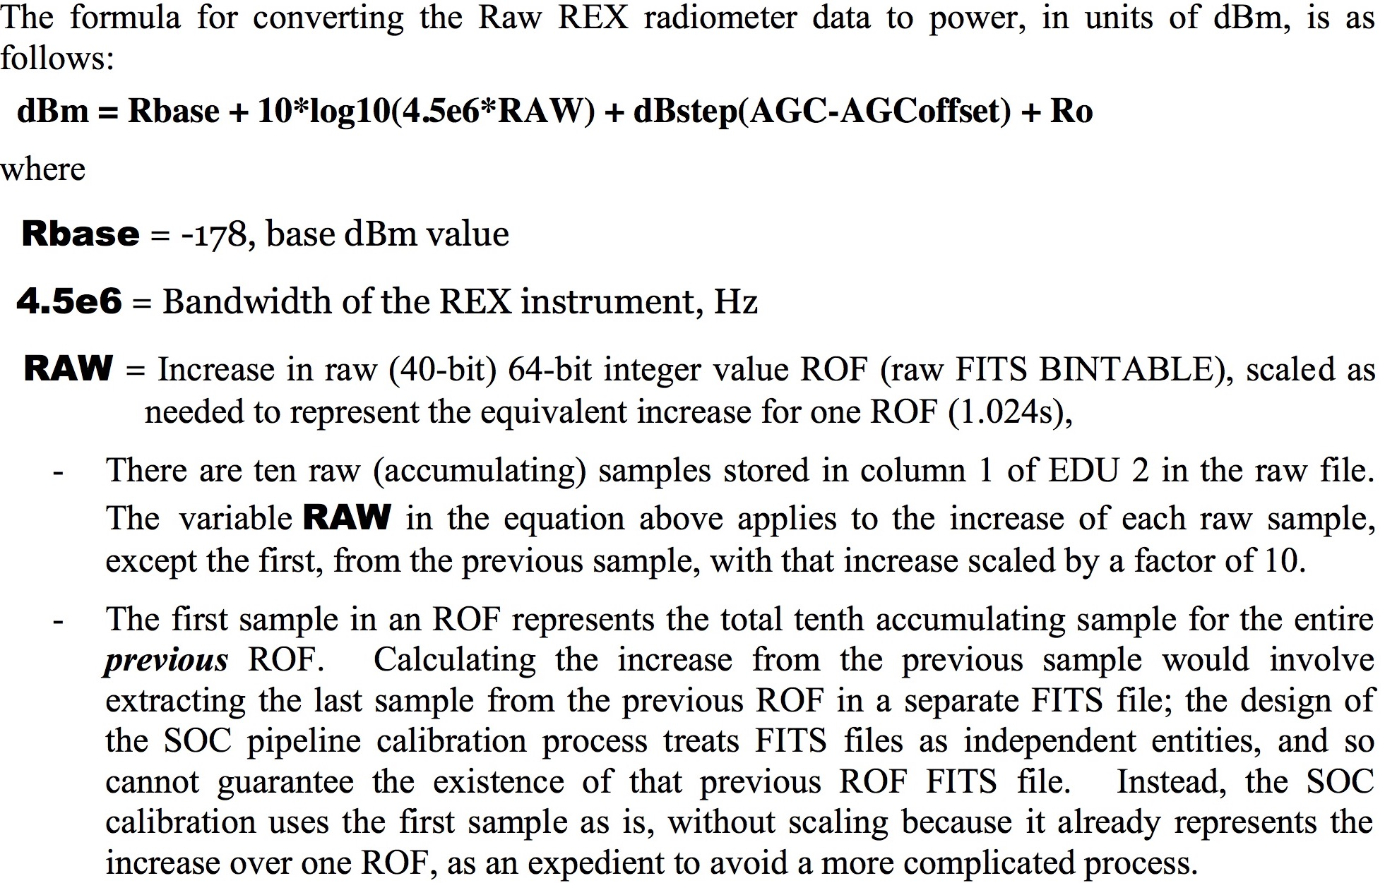
ICD 12.3.1.2 Calibrating the REX Radiometry
Total power (dBm),
not power density
CR Section 4 used -176
Origins of Rbase and Ro not explained
. . .
RCP LCP
CR Section 4 used -106.6 (or -106.2) and -104.2

Slide 17
Example ICD Calculations with CR Section 4 Values
dBm = Rbase + 10*log10(4.5e6*RAW) + dBstep(AGC – AGCOffset) + Ro
= -178 + 10*log10(4.5e6*1.289e10) + 0.475*(167 – 167) – 100.19 = -110.56 (RCP)
or dBm/Hz = -177.09
Slide 14 had -181.50
=-178 + 10*log10(4.5e6*2.892e10) + 0.475*(163 – 163) – 103.7 = -110.56 (LCP)
Or dBm/Hz = -177.09
Slide 15 had -175.59
RCP: ICD and CR differ by ~4.4 dB (linear 2.75x) for same inputs
LCP: ICD and CR differ by ~1.5 dB (linear 1.41x) for same inputs
surprisingly alike

Slide 18
Radiometer Operation and Calibration
ROF #0
ROF #1
ROF #2
ORIGINAL RAW
ROF #1
AFTER DIFFERENCING
ROF #1
AFTER SCALING (increase 9 samples 10x)
Note: In 2016 the 1.024 s sample was divided by 10

Slide 19
Radiometer Integration Time and Effective Time Tag
+-------+-----------------+--------------------+---------------------+
| Index |Original Time Tag| Integration Time | Cal Radiometer Time |
+-------+-----------------+--------------------+---------------------+
| 0 | S0 + 0.0 ms | 1024.0 ms | S0 - 512.0 ms |
| 1 | S0 + 102.4 ms | 102.4 ms | S0 + 51.2 ms |
| 2 | S0 + 204.8 ms | 102.4 ms | S0 + 153.6 ms |
| 3 | S0 + 307.2 ms | 102.4 ms | S0 + 256.0 ms |
| 4 | S0 + 409.6 ms | 102.4 ms | S0 + 358.4 ms |
| 5 | S0 + 512.0 ms | 102.4 ms | S0 + 460.8 ms |
| 6 | S0 + 614.4 ms | 102.4 ms | S0 + 563.2 ms |
| 7 | S0 + 716.8 ms | 102.4 ms | S0 + 665.6 ms |
| 8 | S0 + 819.2 ms | 102.4 ms | S0 + 768.0 ms |
| 9 | S0 + 921.6 ms | 102.4 ms | S0 + 870.4 ms |
| 10 | S0 + 1024.0 ms | 1024.0 ms | S0 + 512.0 ms |
| 11 | S0 + 1146.4 ms | 102.4 ms | S0 + 1075.2 ms |
| 12 | S0 + 1248.8 ms | 102.4 ms | S0 + 1177.6 ms |
| 13 | ... | ... | ... |
+-------+-----------------+--------------------+---------------------+
Every tenth radiometer sample has 10x integration time and
an effective time tag in the previous ROF

Slide 20
scan across discrete source of known radio energy
Unknowns are P_{RX} and REX-to-P scale factor
0.5*P_{S}
measurable baseline =
receiver self noise (P_{RX}) +
cosmic microwave background (P_{CMB})
0.5*P_{CMB}
self-noise baseline
P_{RX}

Slide 21
Calibrating Radiometry (has to be done for each polarization)
P_{TOTAL} = P_{RU}/G_{P} = P_{RX} + 0.5*(P_{CMB} + P_{S})
P_{TOTAL} Measured power
P_{RU} Measured power in REX units
G_{P} Scale factor (to be determined)
P_{RX} Receiver self-noise (to be determined)
P_{CMB} Cosmic Microwave Background (P_{CMB} = k*T_{CMB}*B, where T_{CMB} = 2.7 K)
B Receiver bandwidth (4.5 MHz for REX)
P_{S} Needs to be interpolated from literature (frequency, time, …)
assumes unpolarized sources

Slide 22
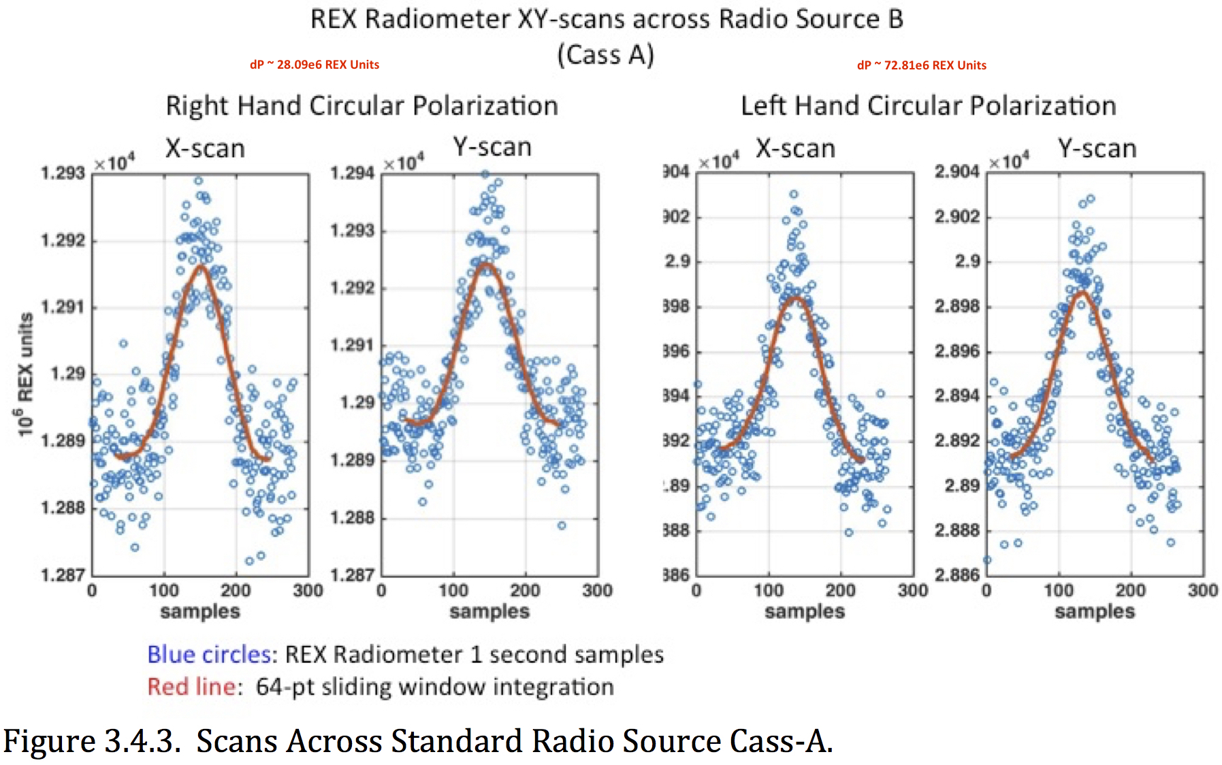
Cosmic Radio Sources (used to determine G_{P})
Cass A is estimated to have radio flux 459 Jy (10⁻²⁶ W/m²/Hz) at New Horizons during Pluto encounter

Slide 23
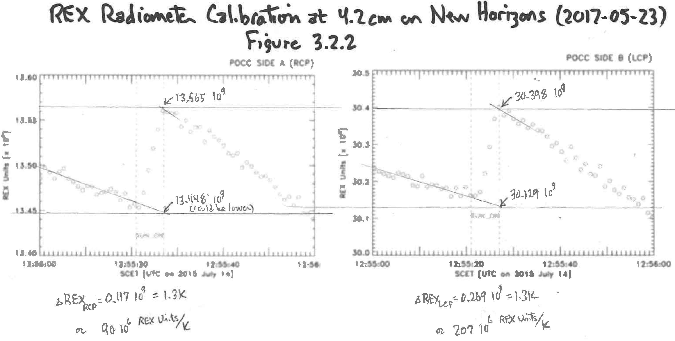
Solar Calibration (alternate method to determine G_{P})
REX units to equivalent temperature (RCP channel)
REX units to equivalent temperature (LCP channel)

Slide 24
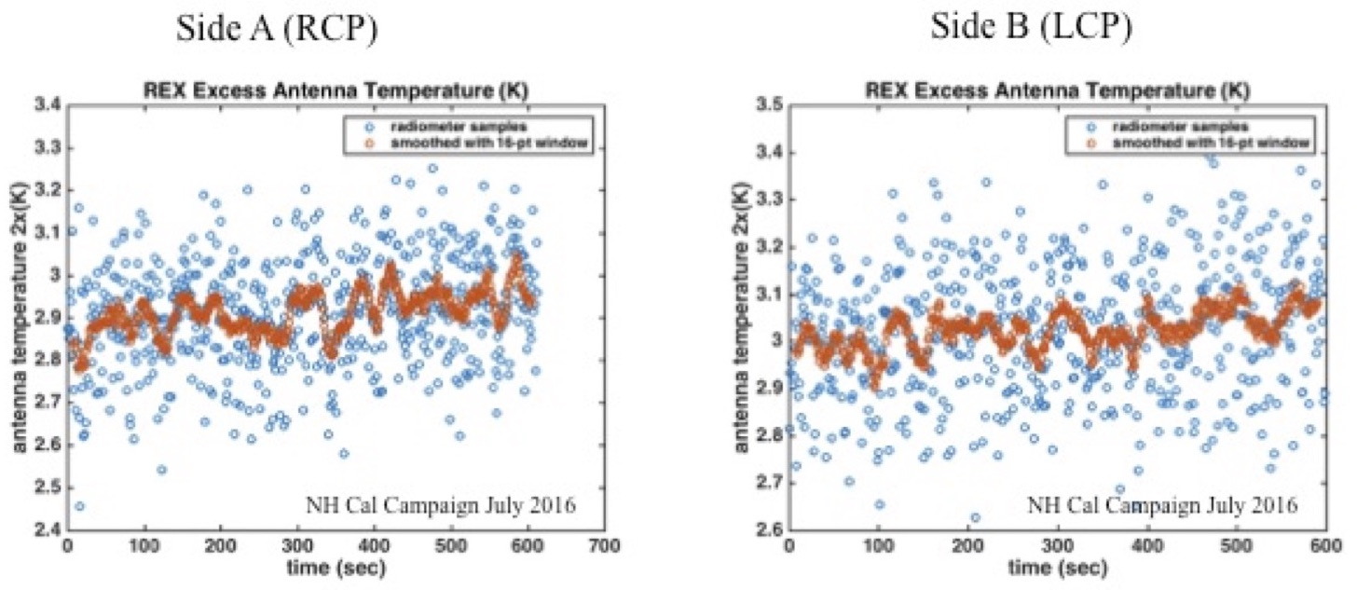
Long Dwells on Cosmic Microwave Background (to find receiver self noise)

Slide 25
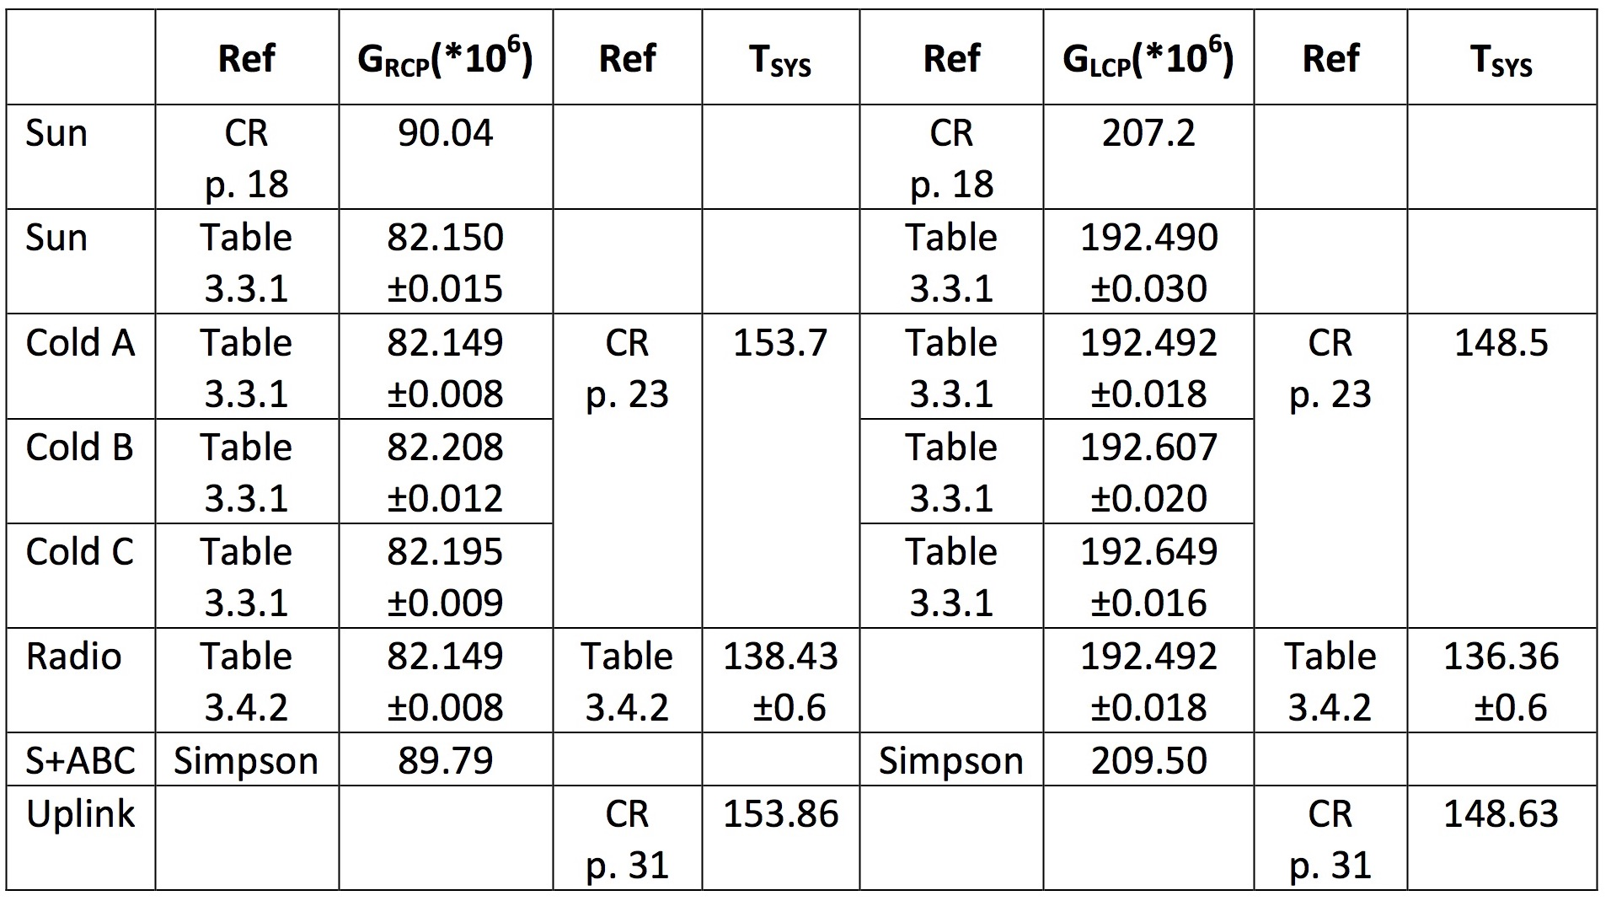
Summary of Calibration Solutions
Most of these are presented without derivation; there is no discussion about how to choose among them. Uncertainties tend to exclude other solutions.

Slide 26
Other Issues — Linearity and Long-Term Receiver Stability
Figure 2.2.1
If gain does not step linearly (or the step is not 0.475 dB), then an apparent problem with relating calibration measurements acquired at different times during the mission (with different gain settings) might be resolved.

Slide 27
Other Issues — Reservoir of Calibration Data
4. When were calibration data collected? The abstract says calibration data were collected "during Integration and Test, … after launch in April 2006, and [during] an 'additional' Calibration Campaign in July 2016." But the next page refers to "four calibrations over the course of the mission" and expands the post-launch campaign to April-June 2006, while Figure 2.2.1 shows data from January 2013 and Section 2.1 says the "X-band receiver was measured … at every annual checkout". This is very confusing to the reader who is trying to understand what measurements were taken, when, and how they fit together to nail down the conversion of REX units to dBm (or antenna temperature) for both channels/polarizations.

Slide 28
Other Issues — Long-Term Receiver Stability
7. Complete List of Power Measurements Is Needed: A summary table showing cold sky and radio source measurements (average and standard deviation) in each polarization over the length of the mission would be an important addition. Gain settings should be included in the table. There is no information in this report about amplitude stability of the receiving system over time scales of months to years; that is important because Pluto/Charon measurements are being calibrated using measurements made years earlier and later. This table could be combined with the table mentioned in Comment 5 above.

Slide 29
Other Issues — Editorial and Similar
Unproofed cut and paste:
Missing sections and figures
Two figures with the same number
Incorrect referencing of figures
Illegible figures (Figures 3.2.1 and 3.2.2 are the worst)
Reversed frequency axes (Figs. 3.5.2, 3.5.4, 3.5.5)
Capitalization of units and abbreviations
Awkward sentences; misuse of commas, parentheses, etc.

