Slide 1
PDS-SBN Review of New Horizons LEISA Data
M. DiSanti
19 June 2017

Slide 2
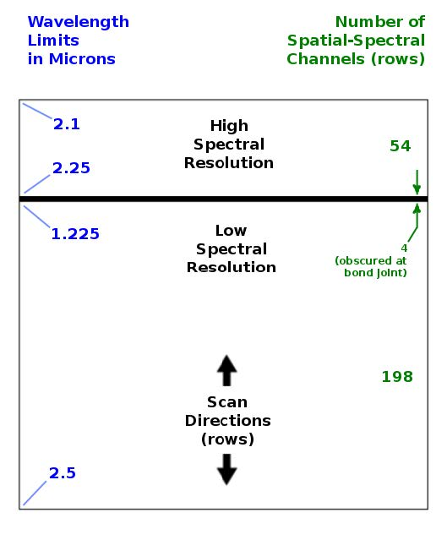
LEISA
A near-IR (1.2 – 2.5 micron) spectrometer that uses a 256x256 Rockwell PICNIC array, with 40 micron square pixels.
It produces low-resolution (λ/Δλ ~ 240)* and higher-resolution (λ/Δλ ~ 560)* spectra over separate sections (ranges of approximately 200 and 50 rows) that are separated by several rows obscured by a bond joint.
Note: Spectral channels 0 – 199 run from λ ≈ 2.48 – 1.22 µm, at low resolution (λ/Δλ ≈ 242). Channels 200 – 206 are dead (bond joint). Channels 207 – 255 run from λ ≈ 2.23 – 2.09 µm, at high resolution (λ/Δλ ≈ 557).
* Specific spectral resolving power and wavelength assignments are presented above, and on slide #5.

Slide 3
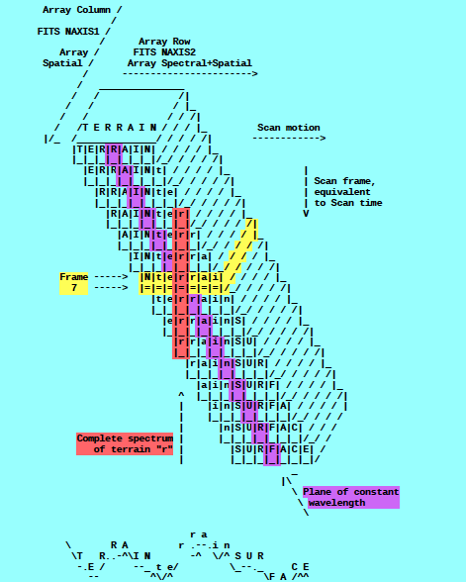
A spatial-spectral data cube is created by scanning the FOV across the target in a “push-broom” fashion. The data cube is a 3-dimensional array having 256x256xN elements, where N is the number of 256x256 files (‘bands’ in the .lbl file) accumulated over the scan.
e.g., read in calibrated FITS file = ‘nh-p-leisa-3-pluto-v3.0/data/20150714_029917/lsb_0299172889_0x53c_sci.fit’
file = file(x,y,z),
x=spatial (256 elements),
y=lambda(256 elements),
z=spectral/spatial “bands”
(N=elements; e.g., N=962 in the above-named file)
(i.e., lambda varies spatially)
[figure from ‘leisa_data.pdf’ in
folder ‘document’]

Slide 4
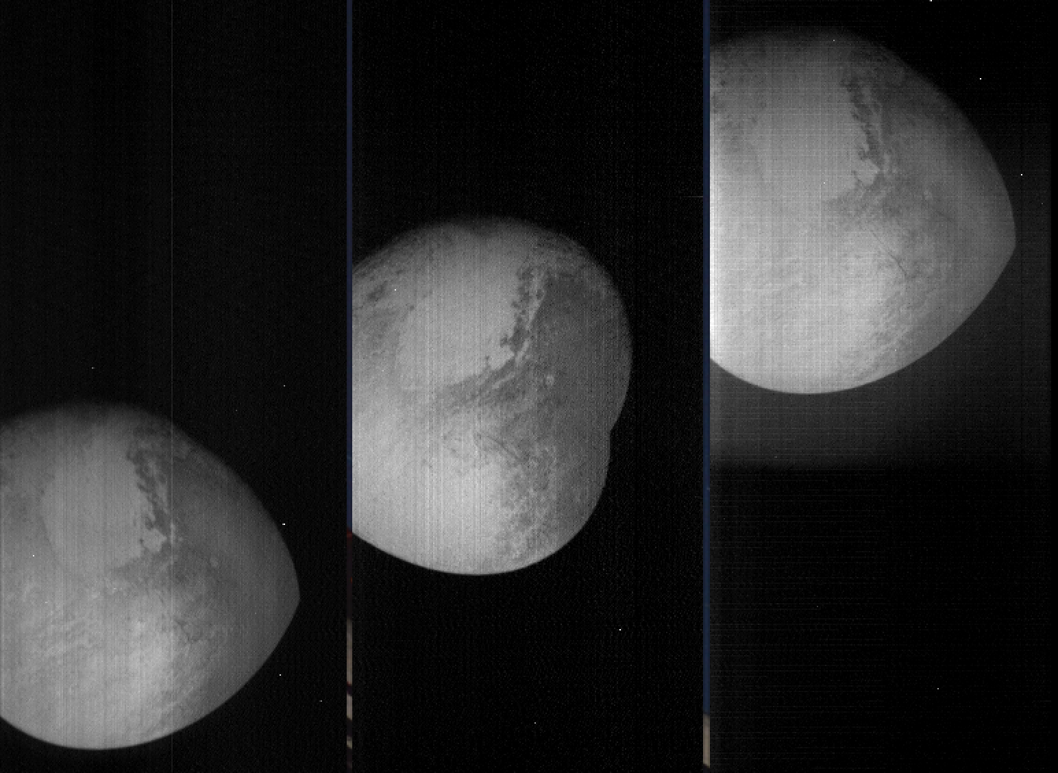
Transpose file(x,y,z) [256,256,N] → file_tr(x,z,y) [256,N,256]
N == number of “Bands”, as termed in label (*.lbl) file
→
shift -
register
file(0:255,0:N-1,0)
(λ = 2.48 µm;
λ/Δλ = 241)
file(0:255,0:N-1,127)
(λ = 1.57 µm;
λ/Δλ = 221)
file(0:255,0:N-1,255)
(λ = 2.09 µm;
λ/Δλ = 536)
file_tr_sh(0:255,0:N-1,Σ[0:255])
(i.e., over all lambda)
Some residual wobble in x-dim (not addressed here)

Slide 5
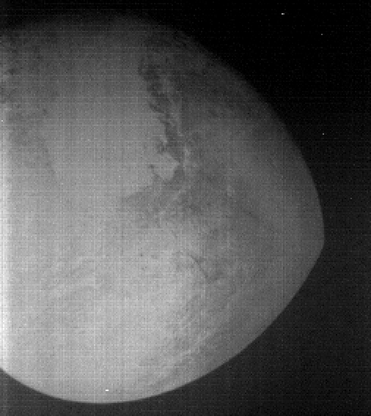
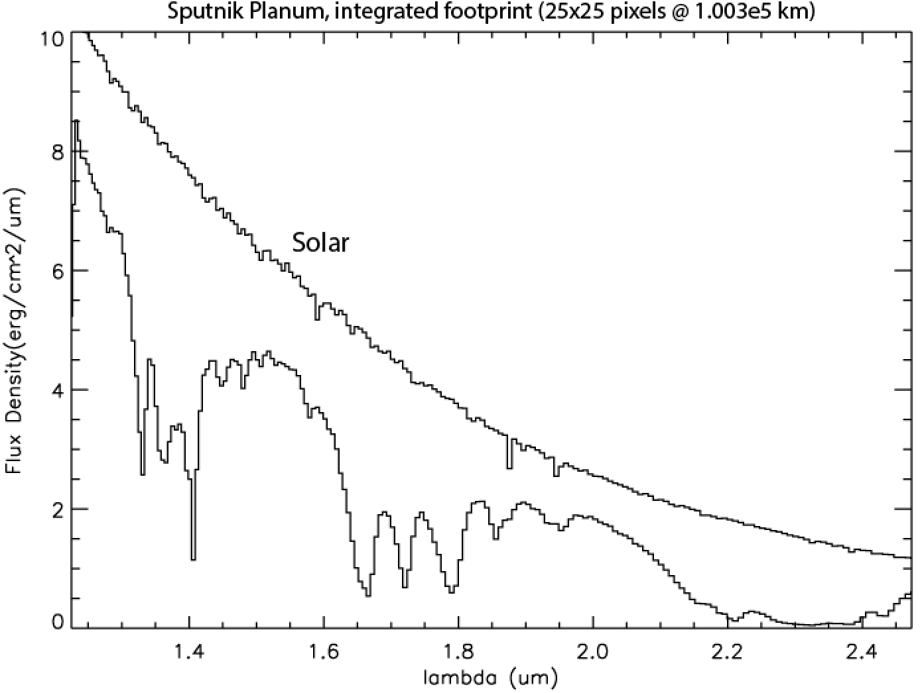
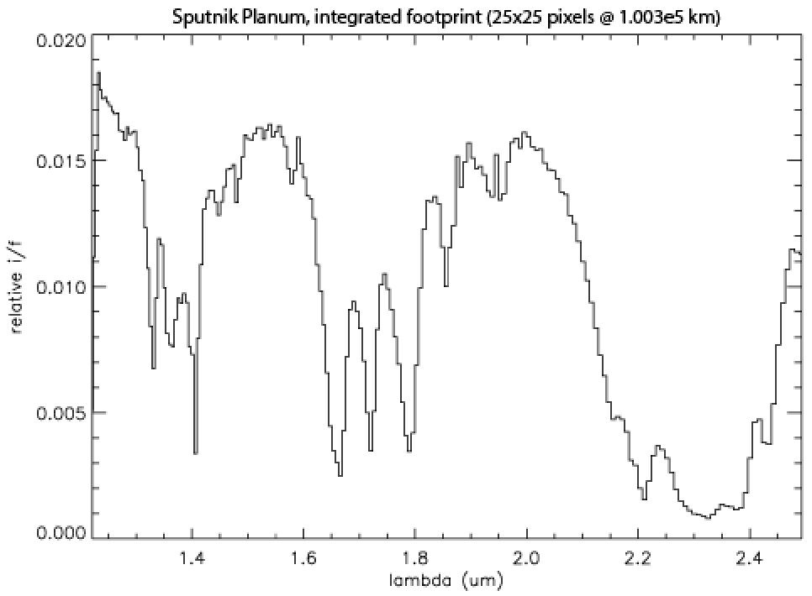
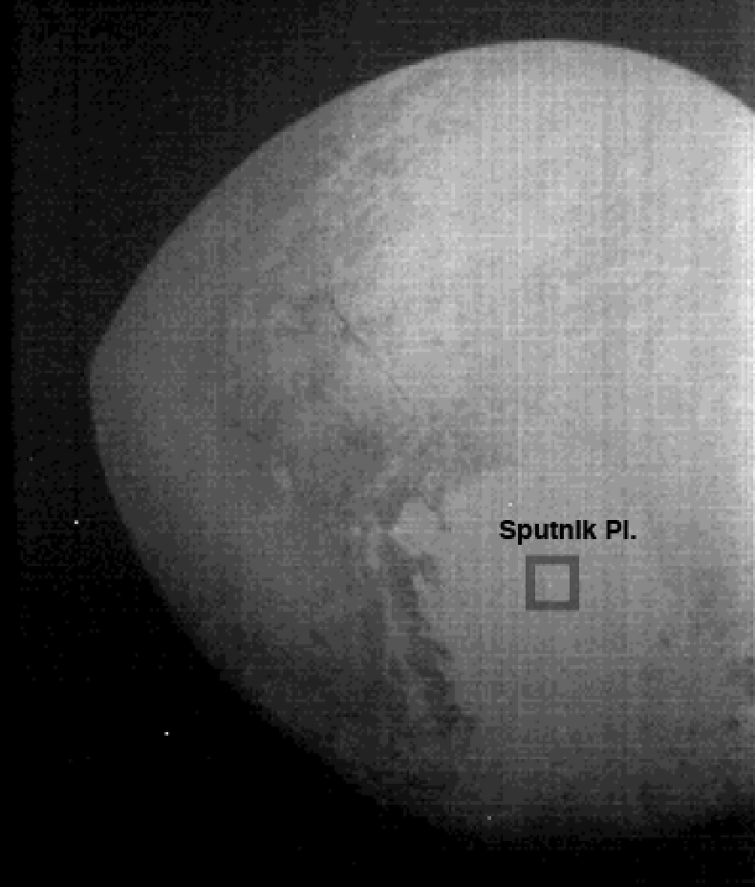
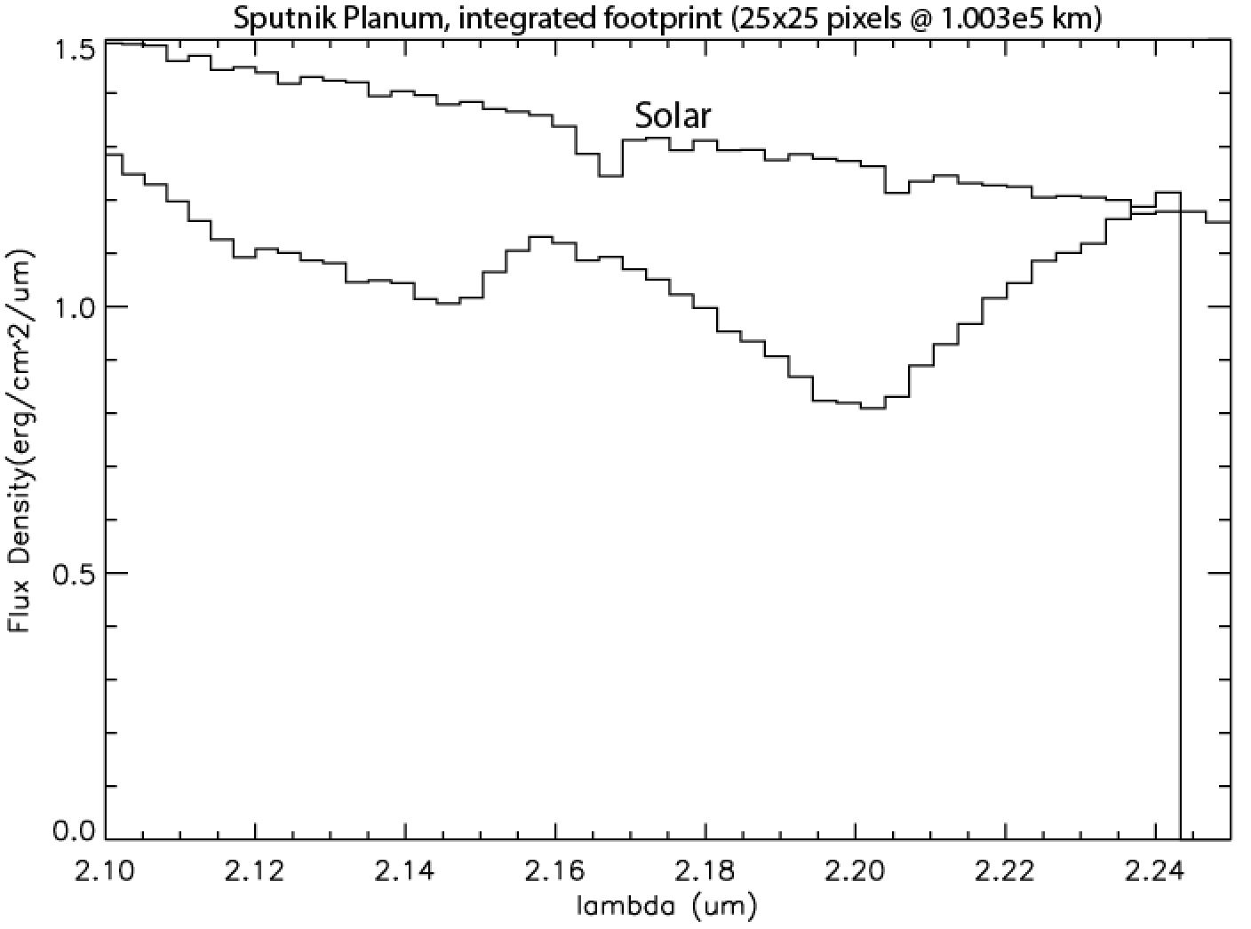
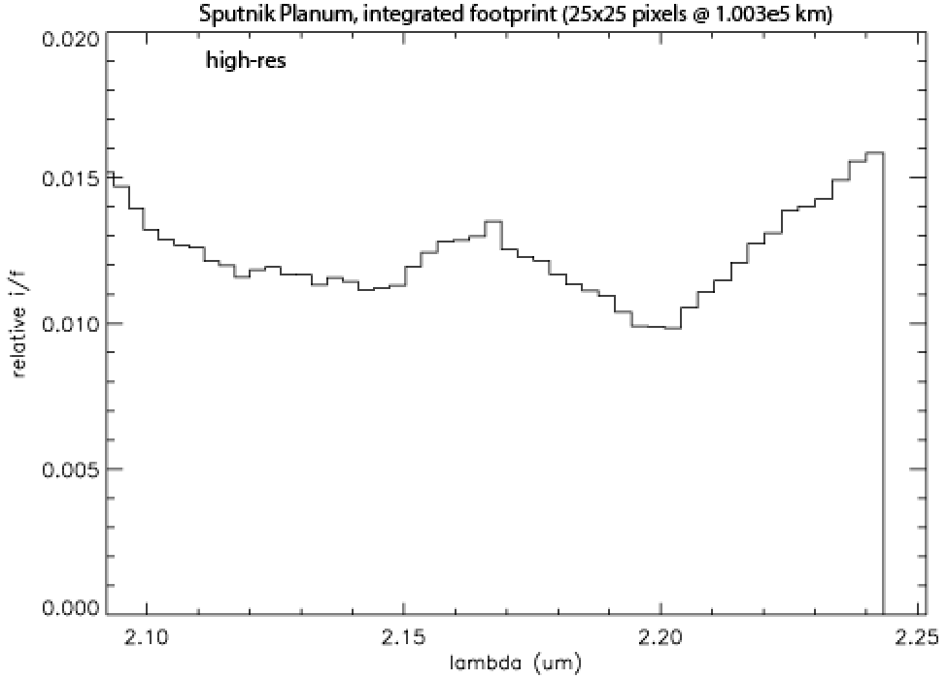
Spatially-registered image, summed over/contains all λ’s.
North Pole of Pluto (N.P.) is towards the bottom.
Rotate by 180°, to orient like usually shown, w/ N.P.
towards top, and Sputnik Planatia towards lower right.
Extracted spectrum over Sputnik Planum
Pluto and solar
Pluto / solar
Low Res
(λ/Δλ = 242)
High Res
(λ/Δλ = 557)

Slide 6
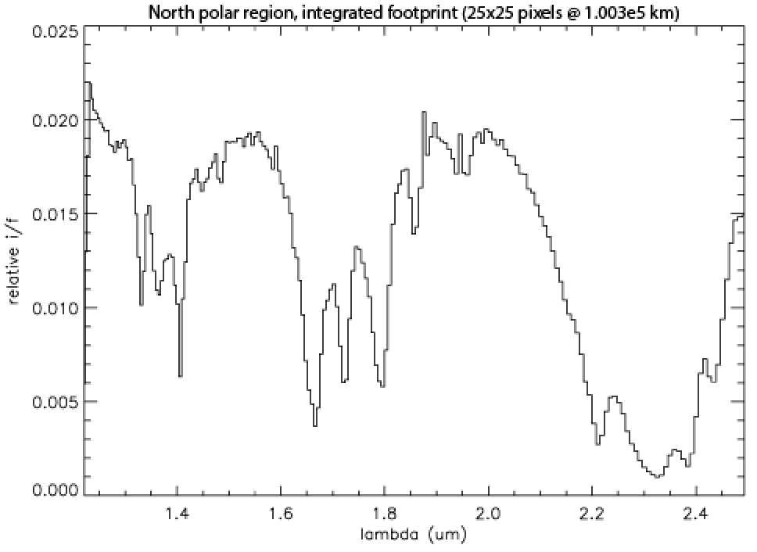
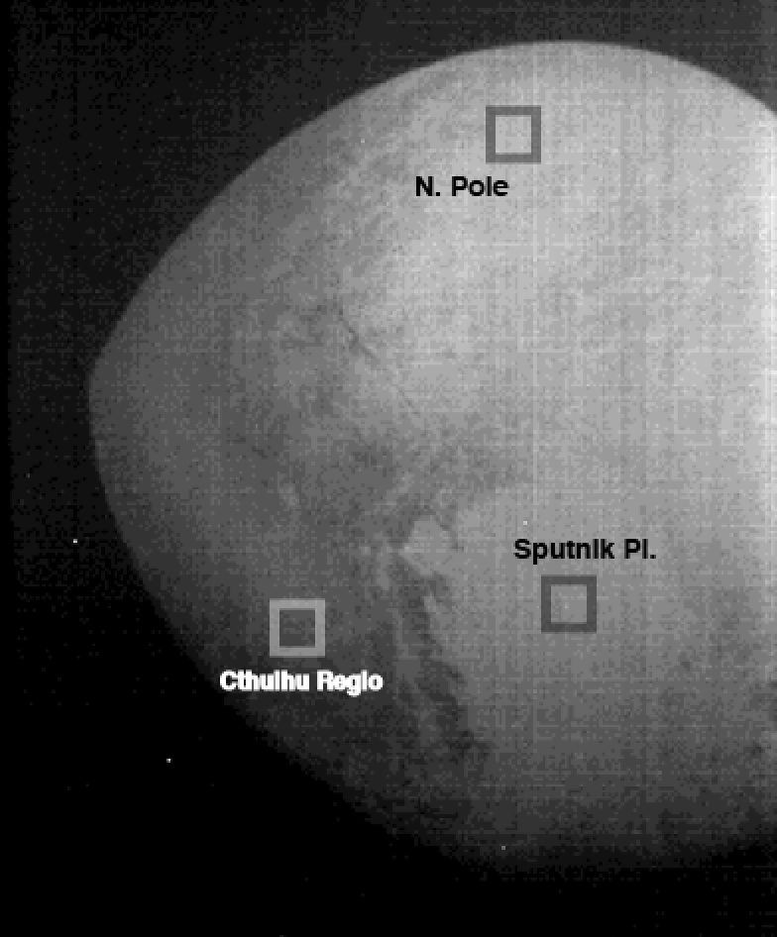
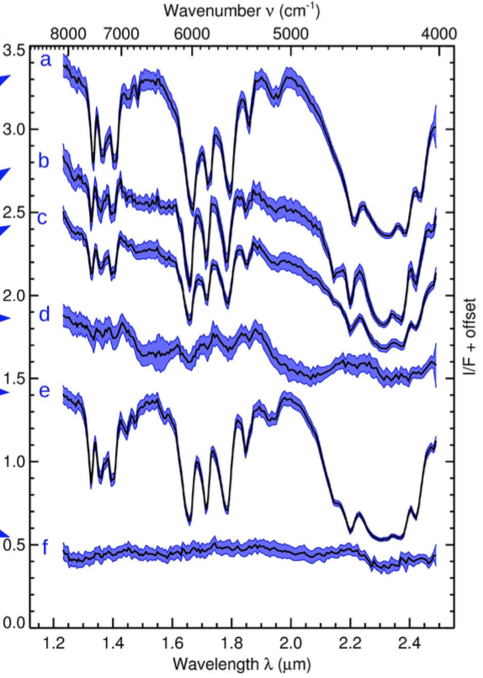
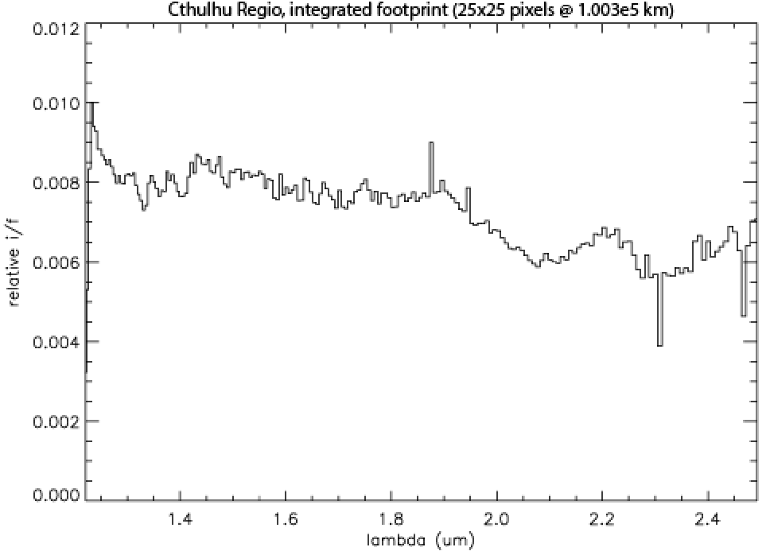
Extract spectra over different regions
Grundy et al. 2016, Fig. 3B
N.P.
Sputnik Pl.
Cthulhu R

Slide 7
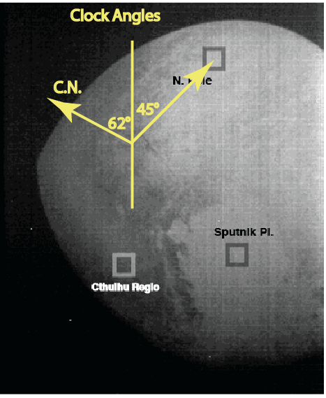
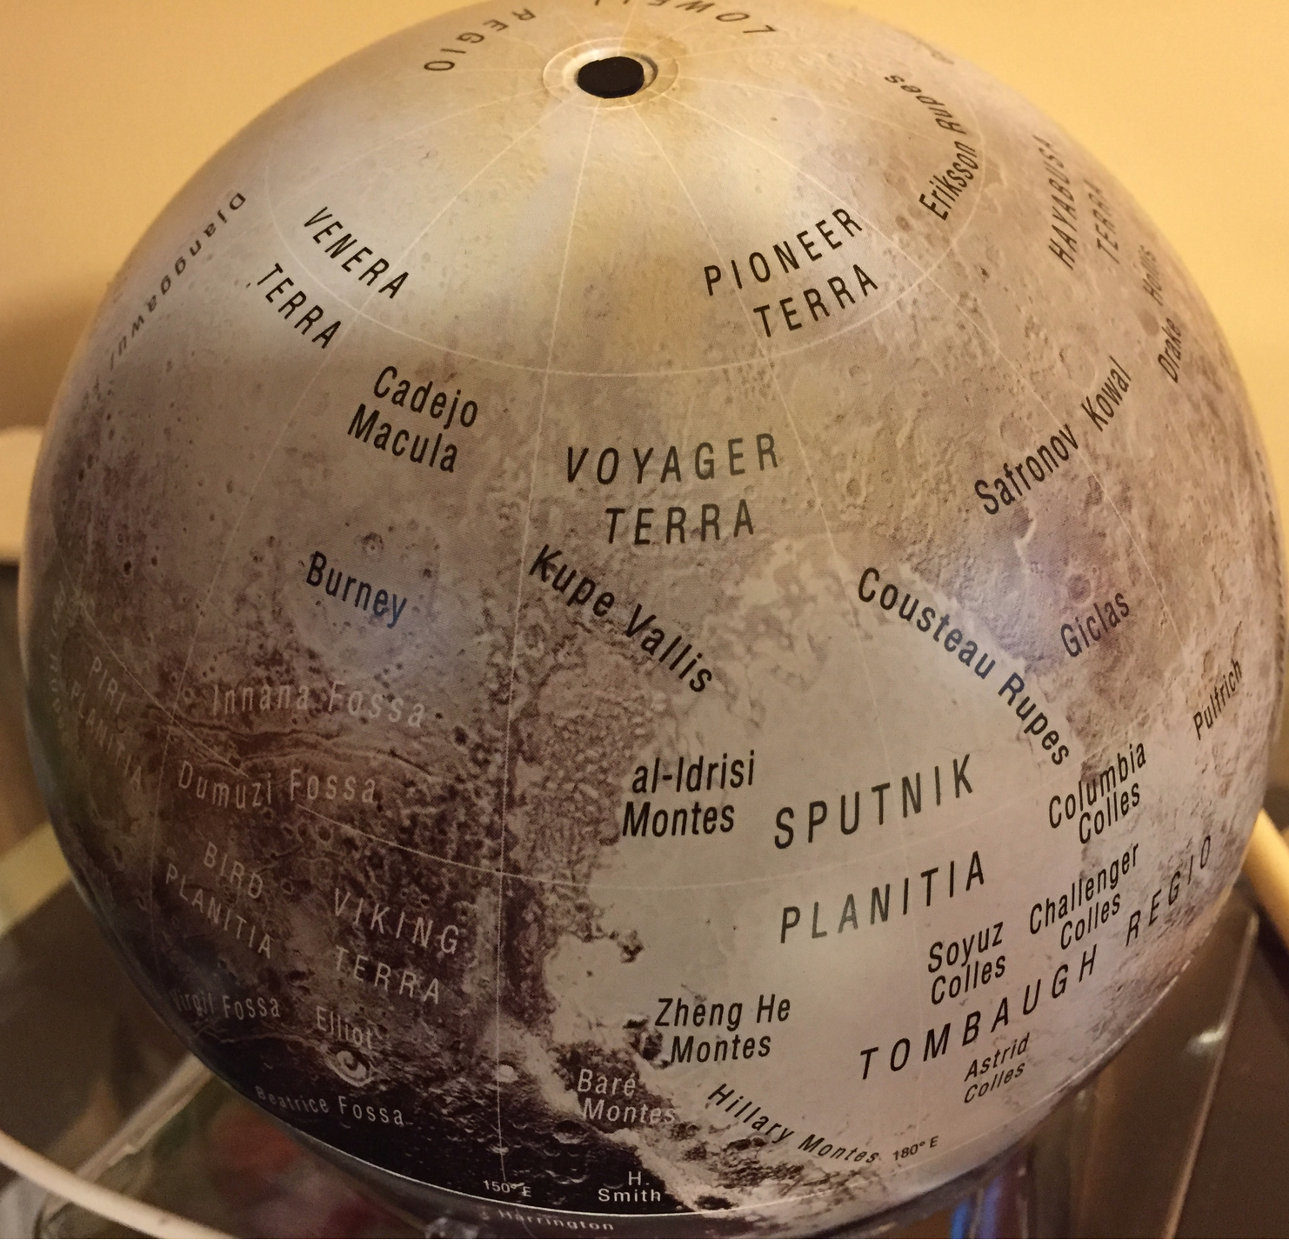
Directional Referencing / Orientation (from .lbl files)
Celestial North clock angle = 298°;
Body Pole clock angle = 45°
But where is this referenced to?
Sub S/C [lat, long (= 38°, 159°)]? Or
Sub-solar [lat, long (= 52°, 133°)]?
Sub-solar seems closer!

Slide 8
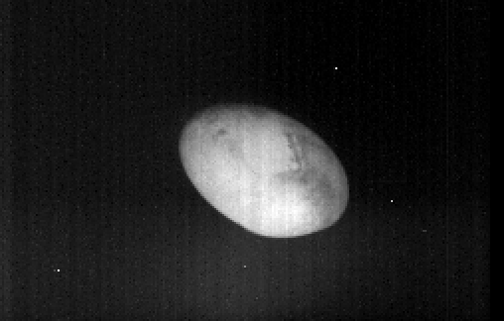
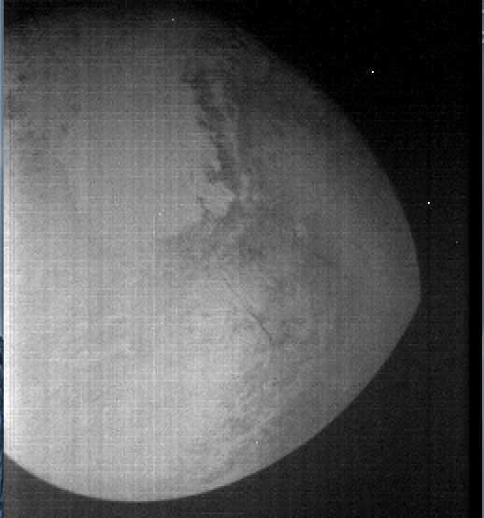
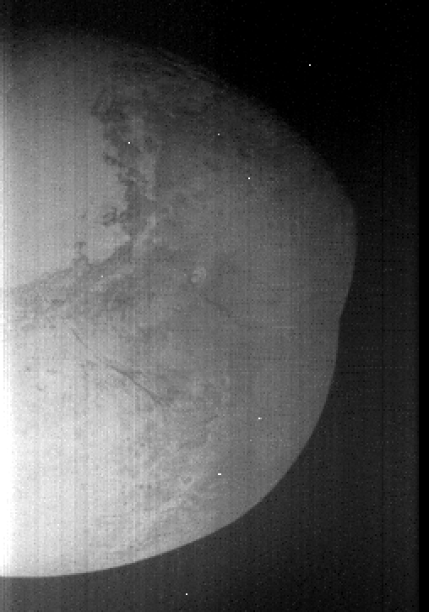
Temporal evolution of spatial scale at Pluto/Pluto System
Pluto
Charon
20150714_0299144829
dist = 4.851e5 km; w = 7.70d3 km
20150713_0299127869
d = 7.190e5 km; w = 1.14e4 km
20150714_0299169338
d = 1.497e5 km; w = 2.38e3 km
20150714_0299193339
d = 1.814e4 km; w = 2.88e3 km
High phase angle (β=169°); other files have β=16-33°]
20150714_0299172889
d = 1.003e5 km; w = 1.59e3 km
20150714_0299176809
d = 4.523e4 km; w = 7.18e2 km

Slide 9
Summary and Issues
Wavelength calibration/assignment . The λ and λ/Δλ from extension number 1 of the FITS file is what I used; this results in values of 220 and 425 for low- and high-resolution segments, respectively, as on the previous slides.
These values from those given in the file ‘introdoc.pdf’ in the main LEISA folder of the previously reviewed datasets (v2), namely 280 and 580 respectively, but the actual v2 values were 220 and 425 [this file (introdoc.pdf) is not included in v3, at least I didn’t find it there].
The initial calib files had the sense of λ reversed! This is where we left things in December 2016.
(lambda-calibration, version2)
X
←→
, vs.
calib/initial/wavemap.fit
lsb_0299172889_0x53c_sci.fit, exten_no = 1

Slide 10
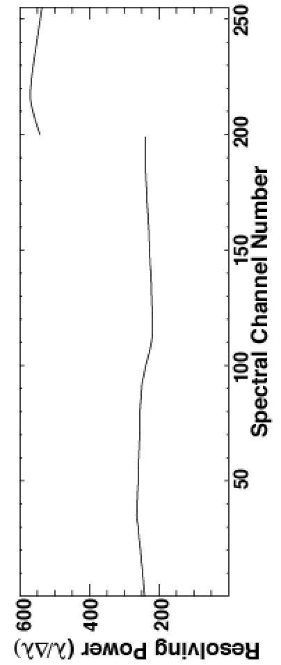
Summary and Issues
Beautiful data sets, somewhat conceptually challenging but manageable once one realizes what variables are what in the data cubes.
Extracted spectra agree well with corresponding spectra from specific regions on Pluto, as published, e.g., in Grundy et al. 2016 Science 351/6279:aad9189 (8pp.).
Wavelength calibration/assignment . The λ and λ/Δλ from extension number 1 of the FITS file is what I used; this results in values of 220 and 425 for low- and high-resolution segments, respectively, as on the previous slides.
The current (v3) mean values are 242 and 557 for low- and high-resolution regions, very close to the advertised values of 240 and 560, respectively. So it seems all is ok w/ the lambda-calibration.
X
←→
, vs.
(lambda-calibration, from version2)
lsb_029917288resolving_power_v39_0x53c_sci.fit, exten_no = 1

Slide 11
Summary and Issues (cont’d)
To get dimensions of (256-pixel) images at the Pluto system, use the LEISA pixel angular subtense, which is 0.062 mrad (as listed in the “leisa.cat” file)
This translates to ~ 6.2 km/pixel at a S/C-Pluto distance (d) of 1.00E5 km. In other words the 25x25-pixel boxes used for the previously shown spectral extracts are approximately 155 km on a side at Pluto.
Issues:
S/C Solar and S/C Geocentric distances in the .lbl file are identical, at least for the six files (cubes) I looked at in detail.
Not clear about directionality in the files. The ‘introdoc.pdf’ file states that “EDU 2 is a cartesian coordinate pointing vector in the LEISA SPICE reference frame (256x256x3, 64-bit floating point).” So I did the following:
v1 = readfits(‘../data/20150714_029917lsb_0299172889_0x53c_sci.fit',exten_no=2), and see that indeed v1=double[256,256,3], but I don’t know how to use it to orient myself regarding lat./long. on Pluto.
I found the file ‘introdoc.pdf’ useful, especially for describing the data cubes and what was in their extensions.

Slide 12
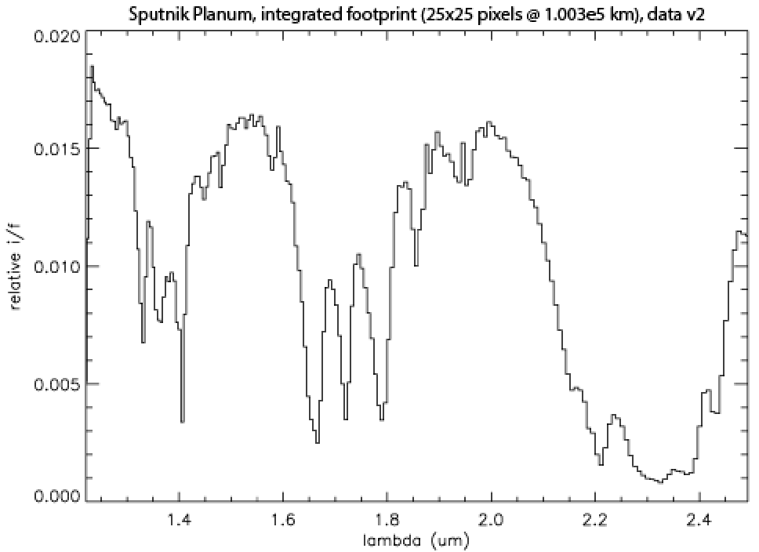
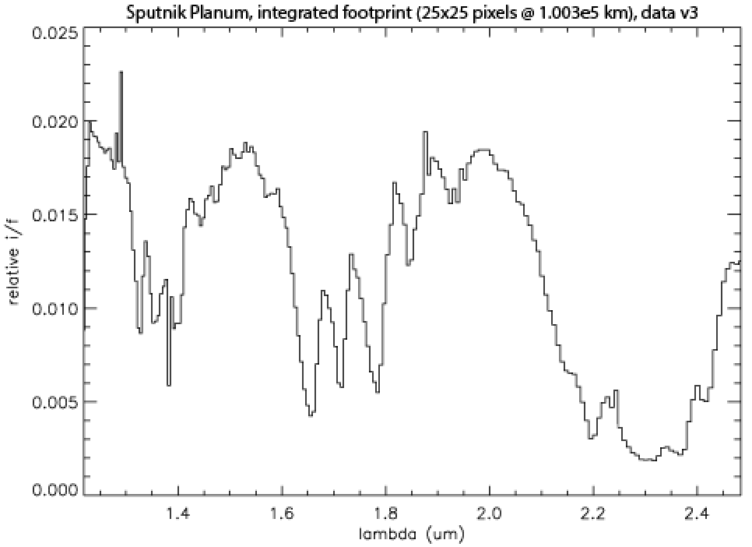
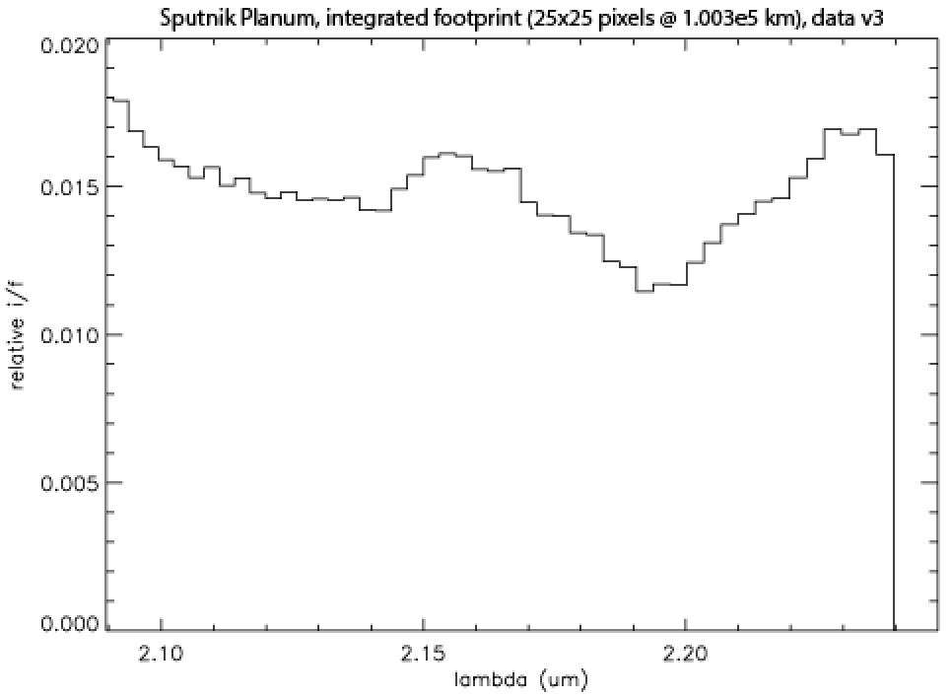
Lambda-calibration, v2 (previous) versus v3 (current)
v2
v3

