Slide 1
SDC PDS Review Post-Pluto Data: January 2015 to October 2016
A.R. Poppe
U.C. Berkeley
June 19, 2017

Slide 2
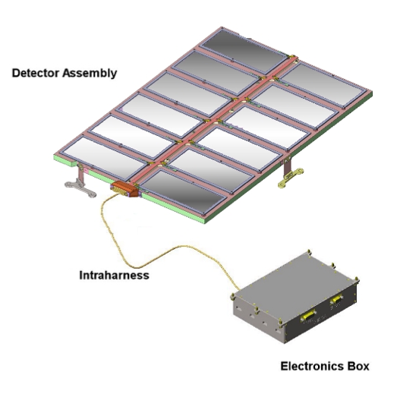
SDC Instrument
SDC instrument:
- 14 detectors: 12 science (with 1 defunct), 2 reference
- electronics box for signal processing, telemetry/commands

Slide 3
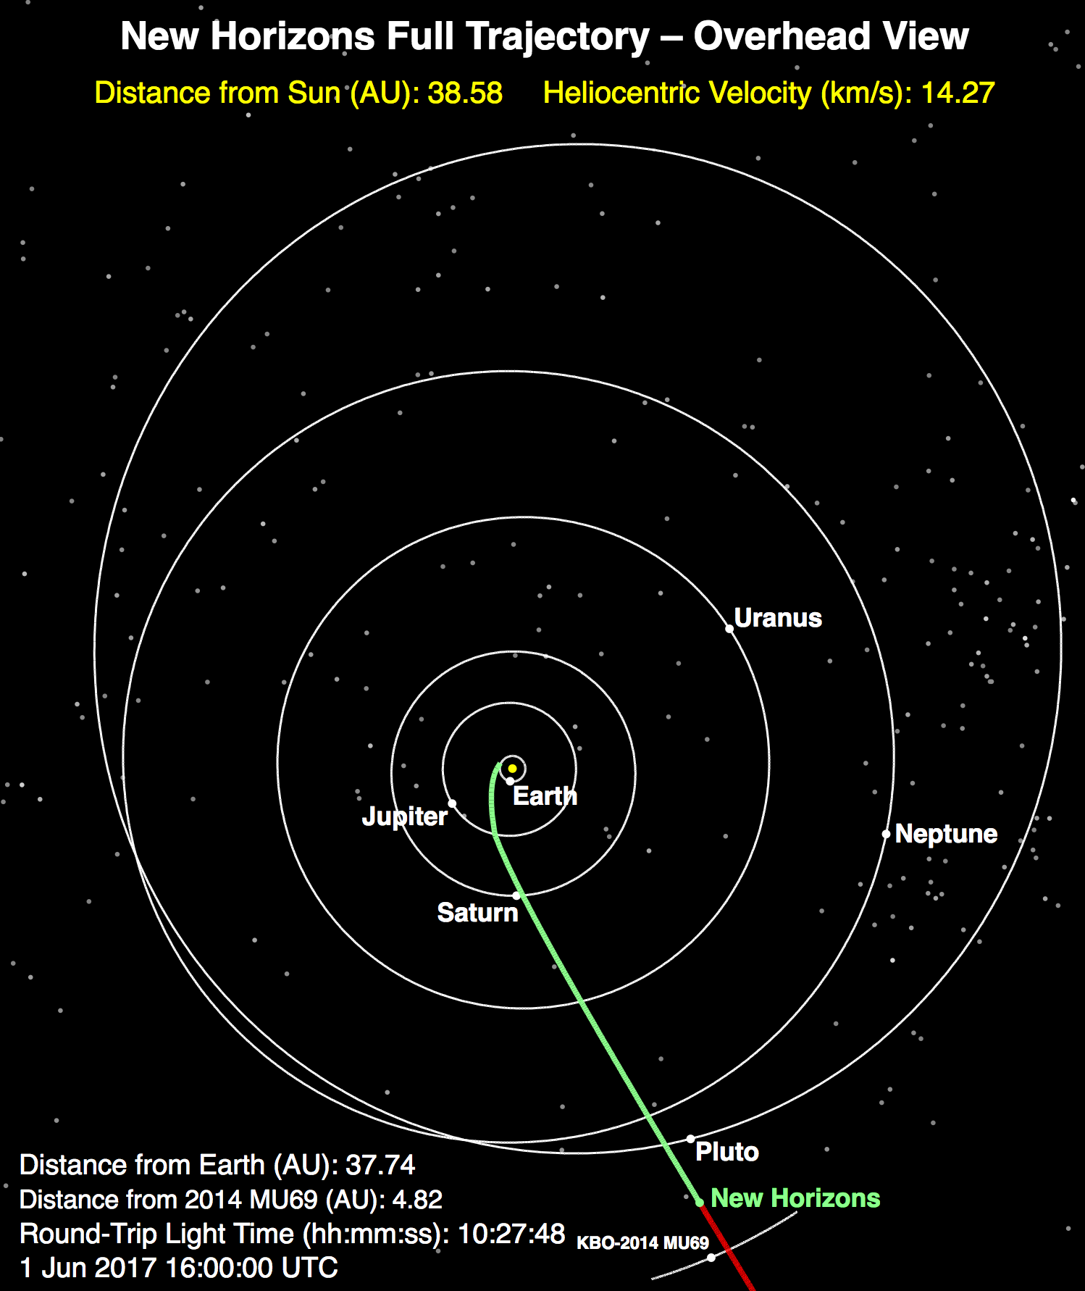
Previous & Current Releases
Three main data periods previously released by SDC:
Launch: March 2006 – Dec 2006, mainly testing and checkout of instrument
Jupiter: Dec 2006 – June 2007, small chunk of data taken post-Jupiter fly-by (note SDC was not on during close approach of Jupiter)
Pluto-cruise: June 2007 – July 2014, main period of scientific data collection by SDC between the orbits of Jupiter and Pluto
Current dataset:
Pluto Encounter: Jan 2015 – Oct 2016, Pluto approach, encounter, post-encounter
SDC launch, jupiter, and cruise datasets cover 1/2006 to 7/2014, Earth to approximately the orbit of Neptune

Slide 4
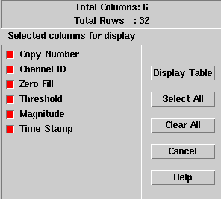
SDC Raw Data
Includes SDC raw scientific data, SDC housekeeping (engineering telemetry), New Horizons spacecraft housekeeping (0x004, 0x00D, 0x00A), and New Horizons thruster firing fata
The SDC raw scientific data includes channel (detector) number, data threshold, data magnitude, and time stamp

Slide 5
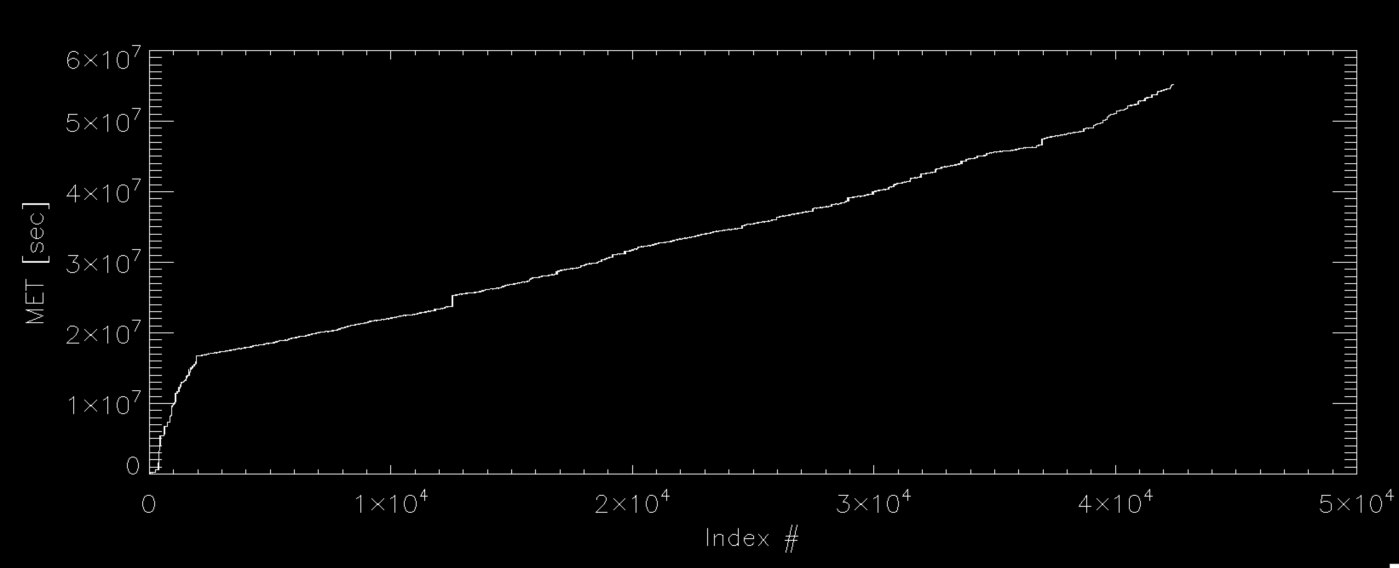
SDC Raw Data
Plot of Mission Elapsed Time vs. entry looks good
Total number of events: 24,240
Time period covers: Jan 17, 2015 – Oct 17, 2016

Slide 6
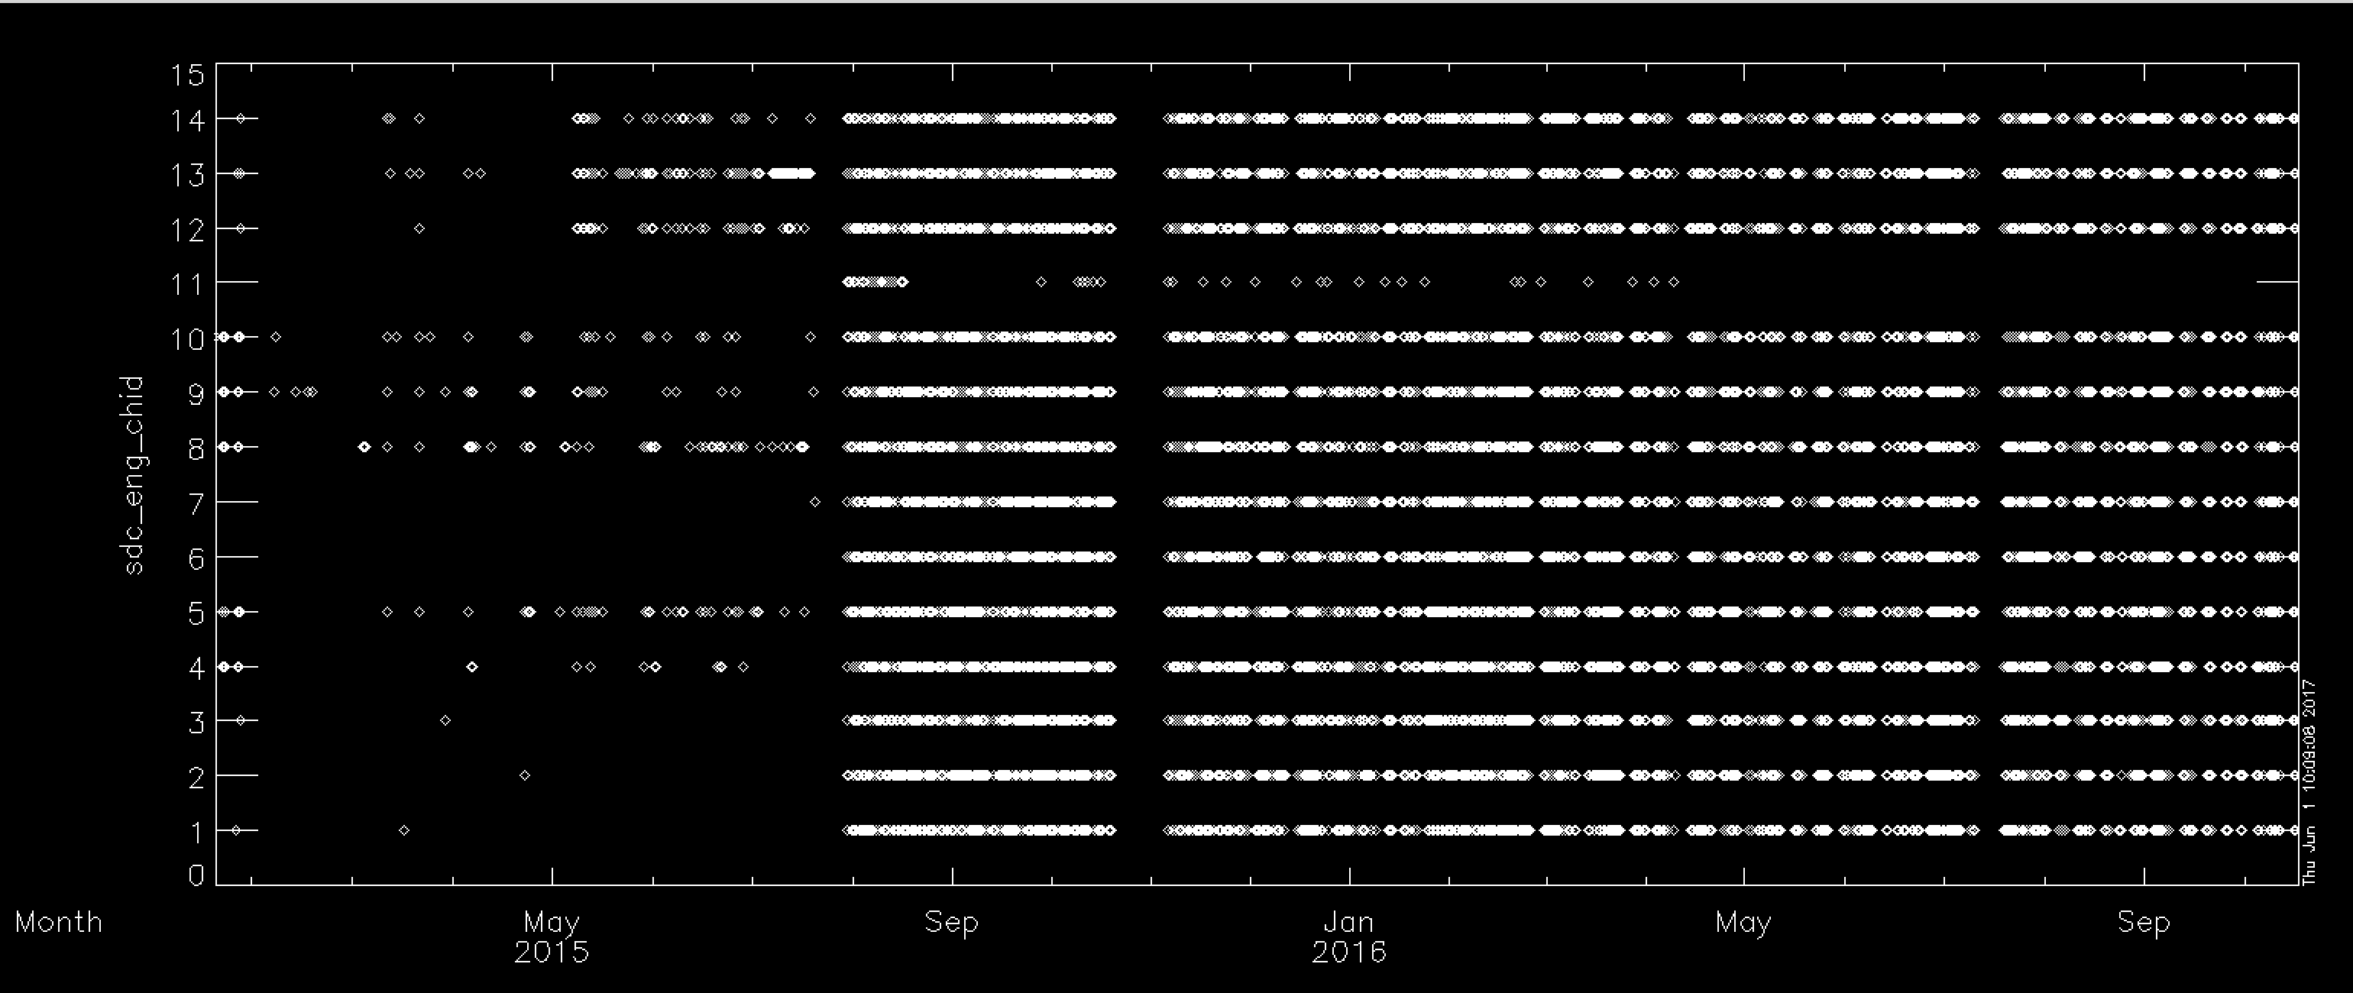
SDC Raw Data
Channel ID# versus Time looks good
Total number of events: 24,240
Time period covers: Jan 17, 2015 – Oct 17, 2016

Slide 7
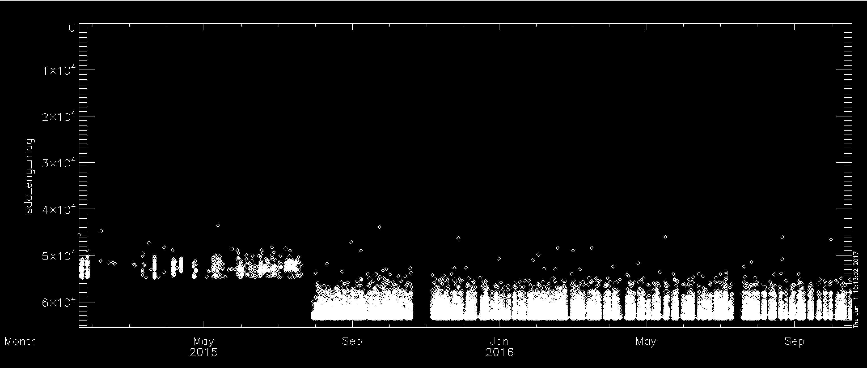
SDC Raw Data
Magnitude versus Time looks good – note threshold change post Pluto encounter
Total number of events: 24,240
Time period covers: Jan 17, 2015 – Oct 17, 2016

Slide 8
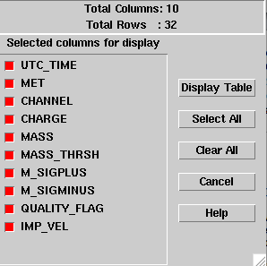
SDC Calibrated Data
Includes SDC calibrated scientific data
The SDC calibrated scientific data includes time, channel, charge, mass, mass threshold, error bars, quality flag, and theoretical SDC-dust relative impact velocity

Slide 9
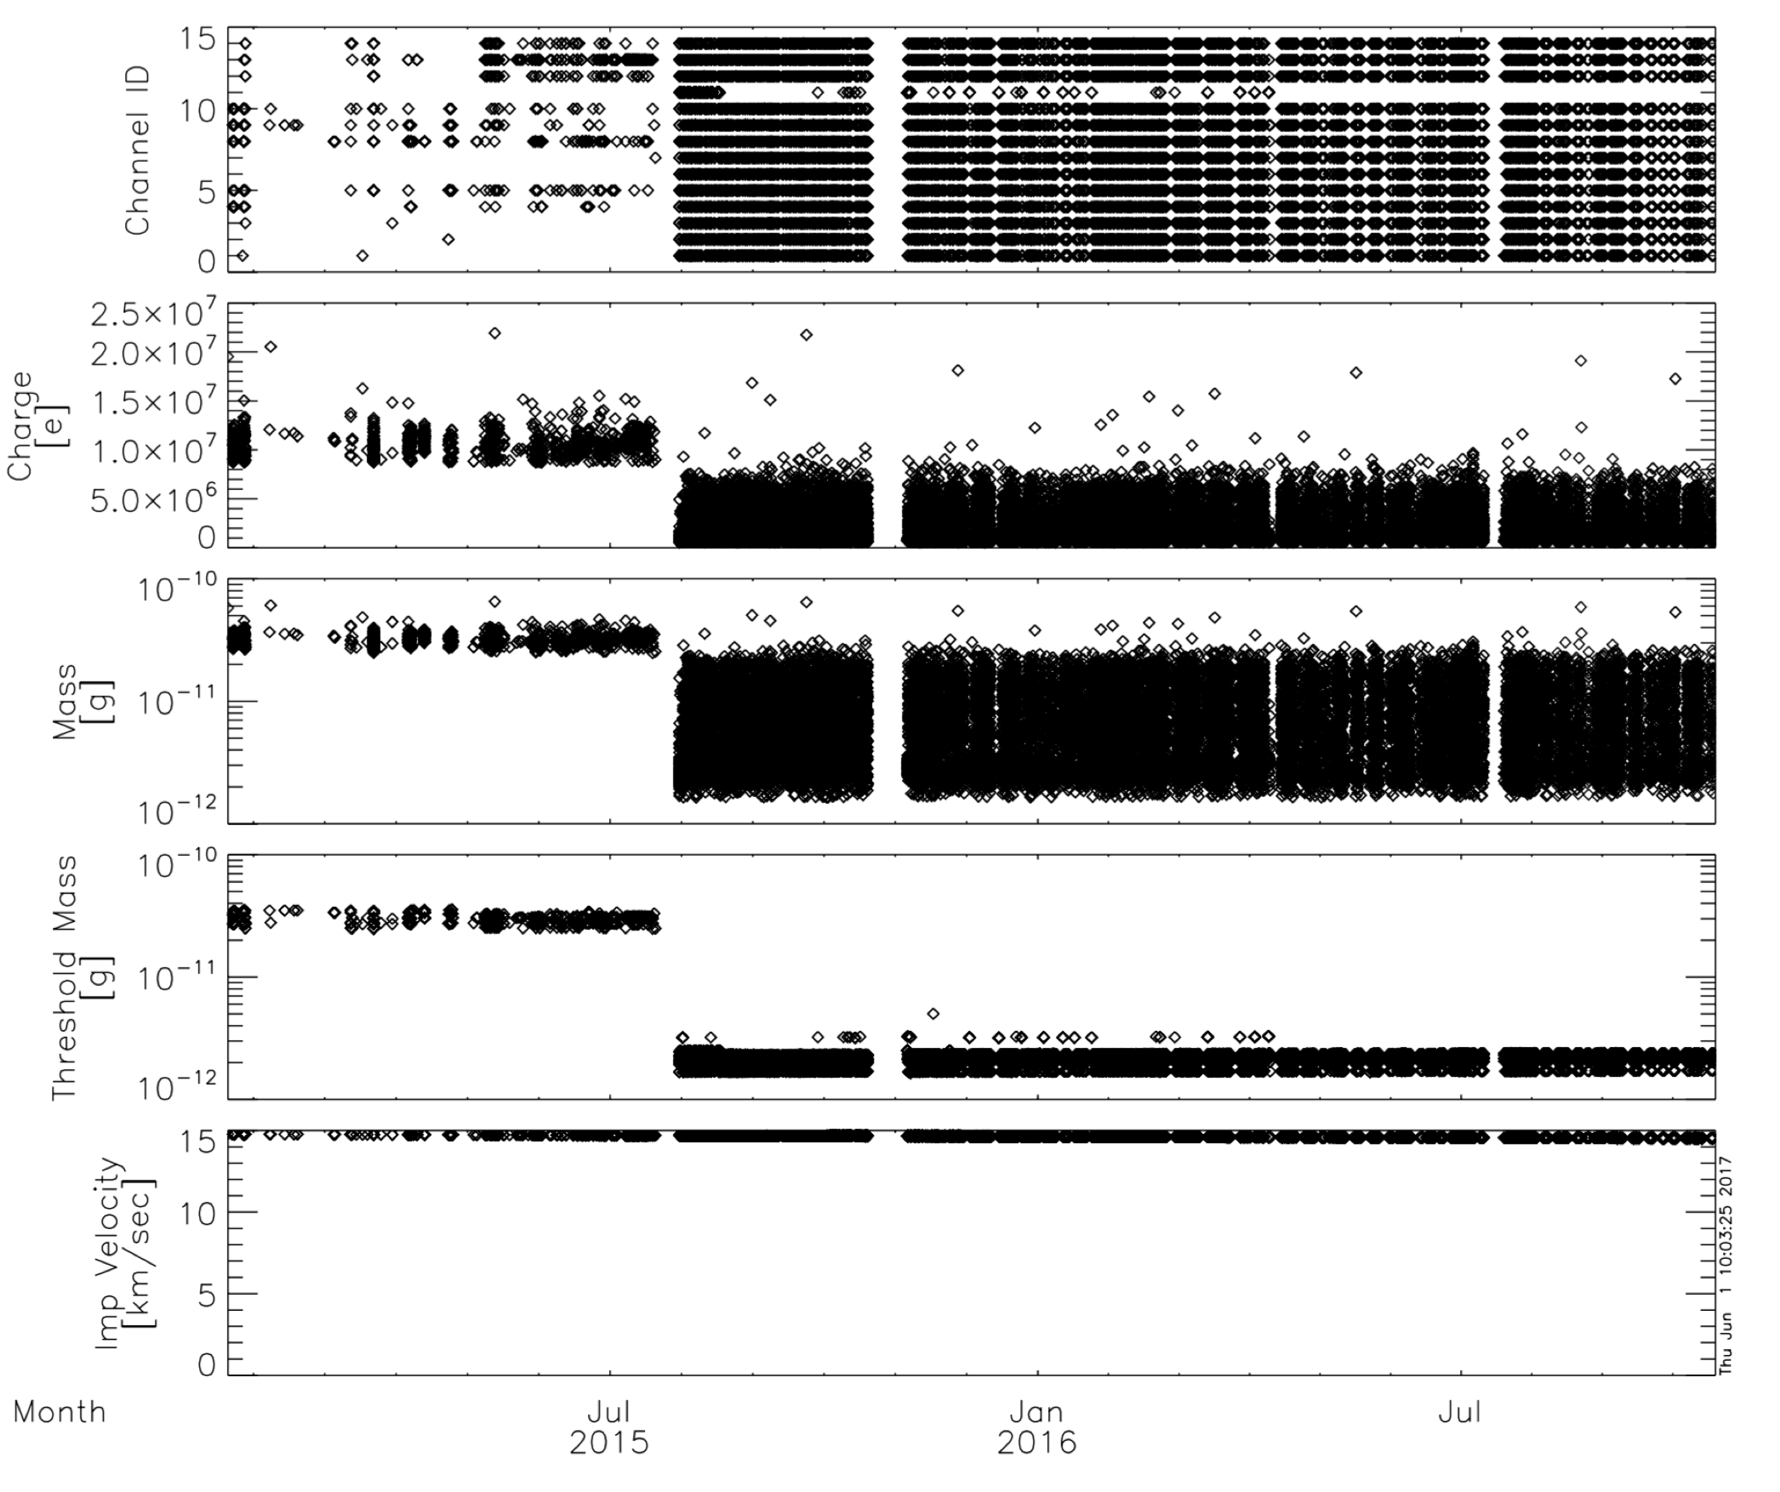
SDC Calibrated Data
Post Encounter
Pluto Encounter

Slide 10
Textual Edits: nh-p-sdc-[2,3]-pluto-v2
None noted.

Slide 11
Completeness:
Each time period (launch, jupiter, cruise, pluto) has a complete set of files and documentation
Adequate completeness of each data record (i.e., one dust hit)
Intelligibility:
Documentation is adequate and straightforward
SDC data are intelligibly formatted through FITS files, both raw and calibrated
Metadata are straightforward through ASCII implementation
Interpretability:
Given the relatively simple nature of SDC operations, the data are straightforwardly interpretable; no issues noted here
No liens noted.

