Slide 1
Rosetta CIVA PDS Delivery Review
Oct 6 2017

Slide 2
Summary of Data Under Review
CIVA-P images from the Philae lander
One image from each of the 7 cameras
CCD cameras. 1024 x 1024
Same detector as MESSENGER MDIS
Calibrated
Very large dynamic range
What are the units?
Appears valid
Uncalibrated data
Instrument ICD is provided and provides very useful information describing the calibration steps.
All calibration files appear to be included; and formatted as described. Based on pre-flight cal.
Unfortunately, was unable to read in an image to appear like the browse products
File sizes are unexpected
Calibration Data
Is present
However, I have not found how the instrument data is converted from DN to Reflectance.
Insufficient information on where the instrument is pointed

Slide 3
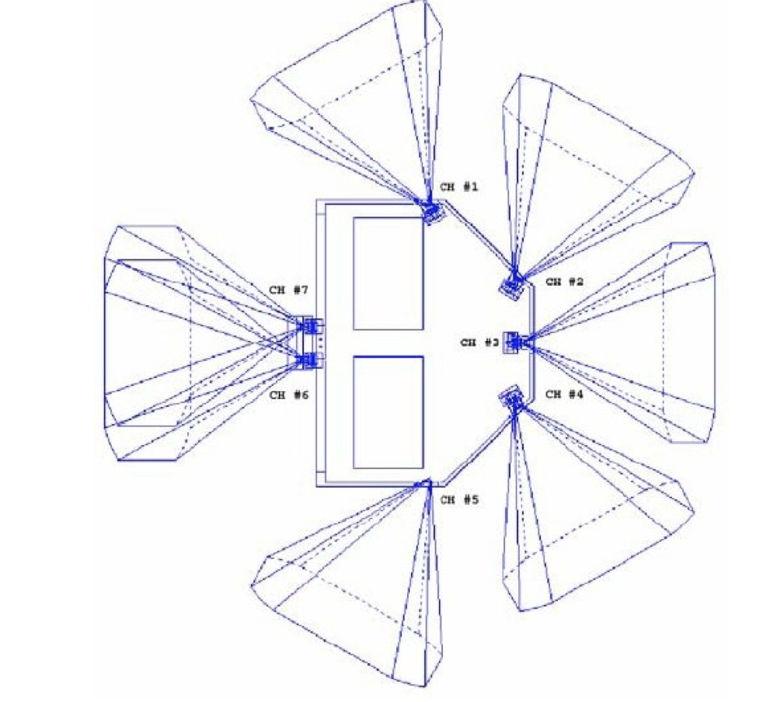
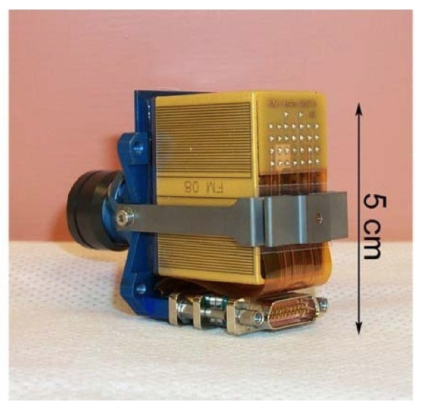
CIVA-P
ÇIVA-P is constituted of 7 identical cameras, implemented as 5 single cameras and one stereoscopic pair of two co-aligned ones, thus filling the 360° panoramic field of view by six overlapping FOV of 70° each, 60° apart one from the next (Figure 1). All cameras are mounted at the top of the side panels of the Lander.

Slide 4
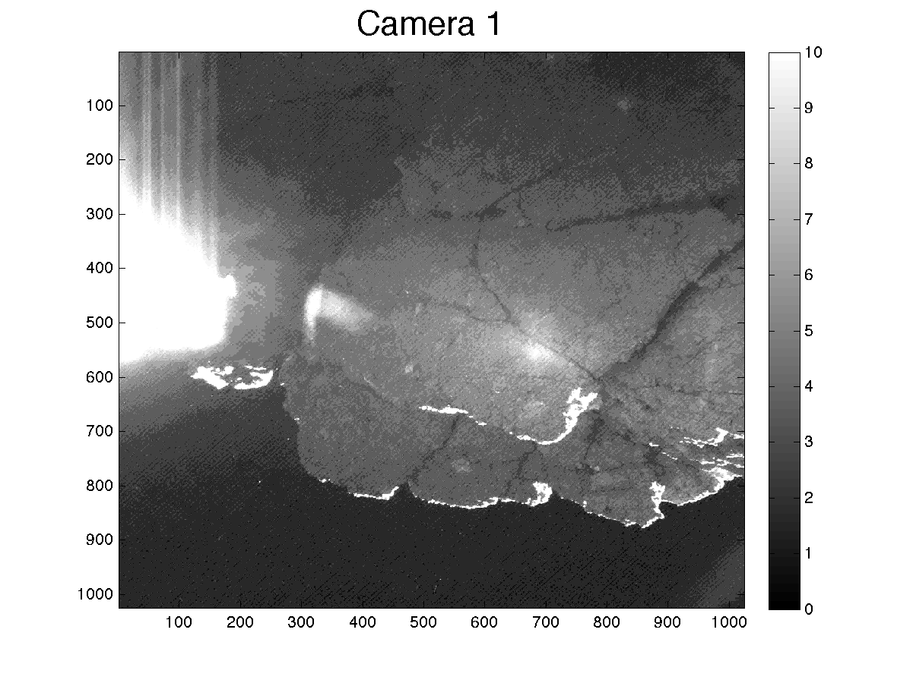
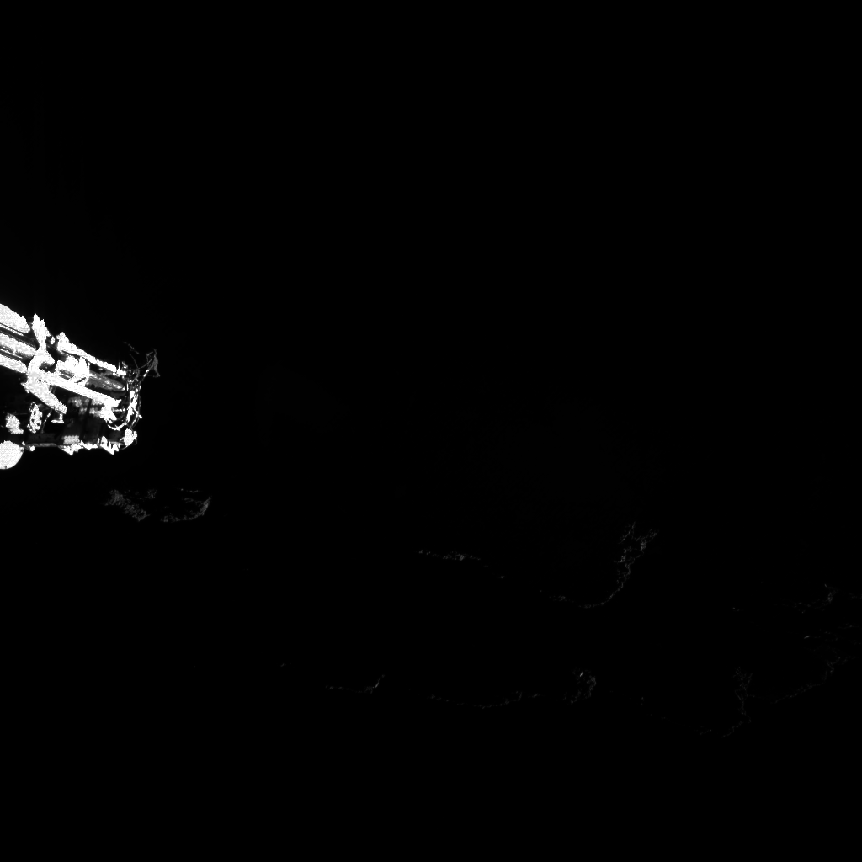
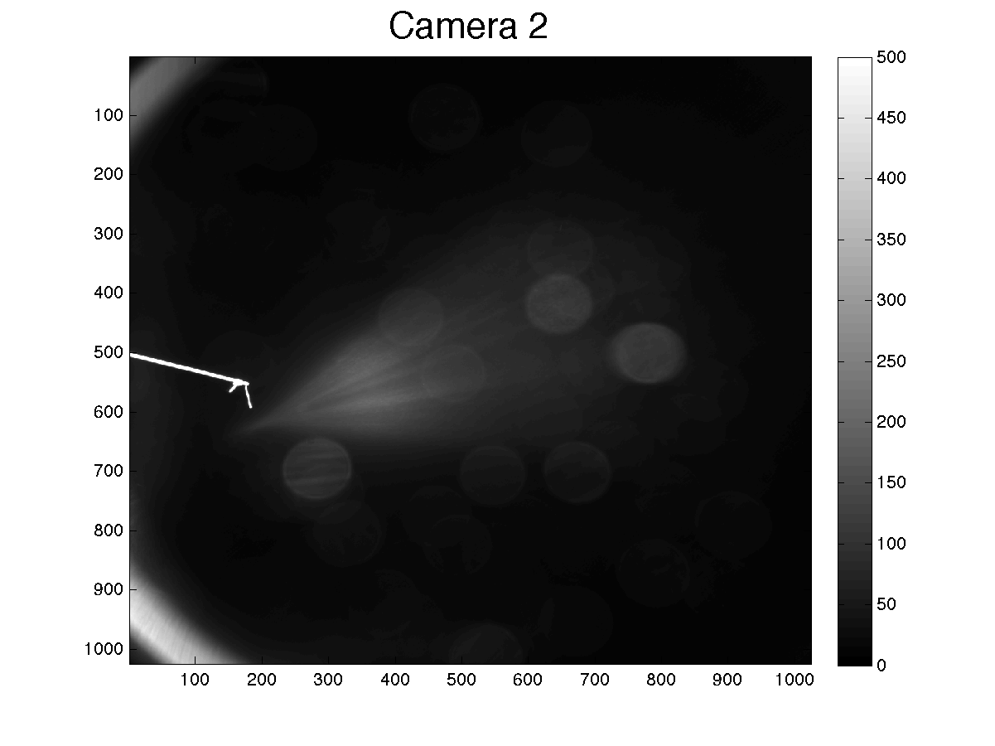
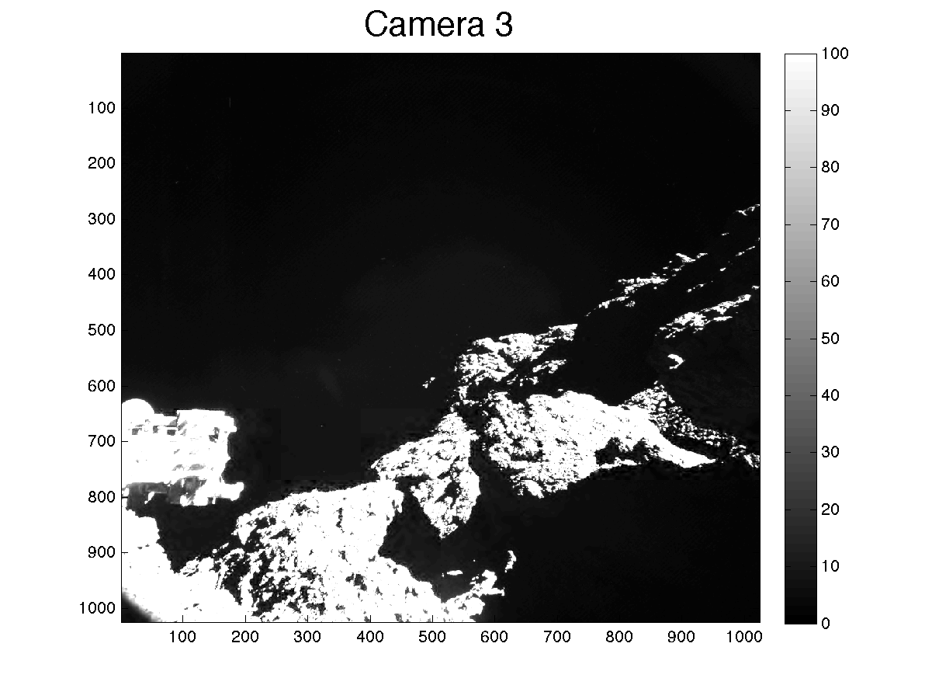
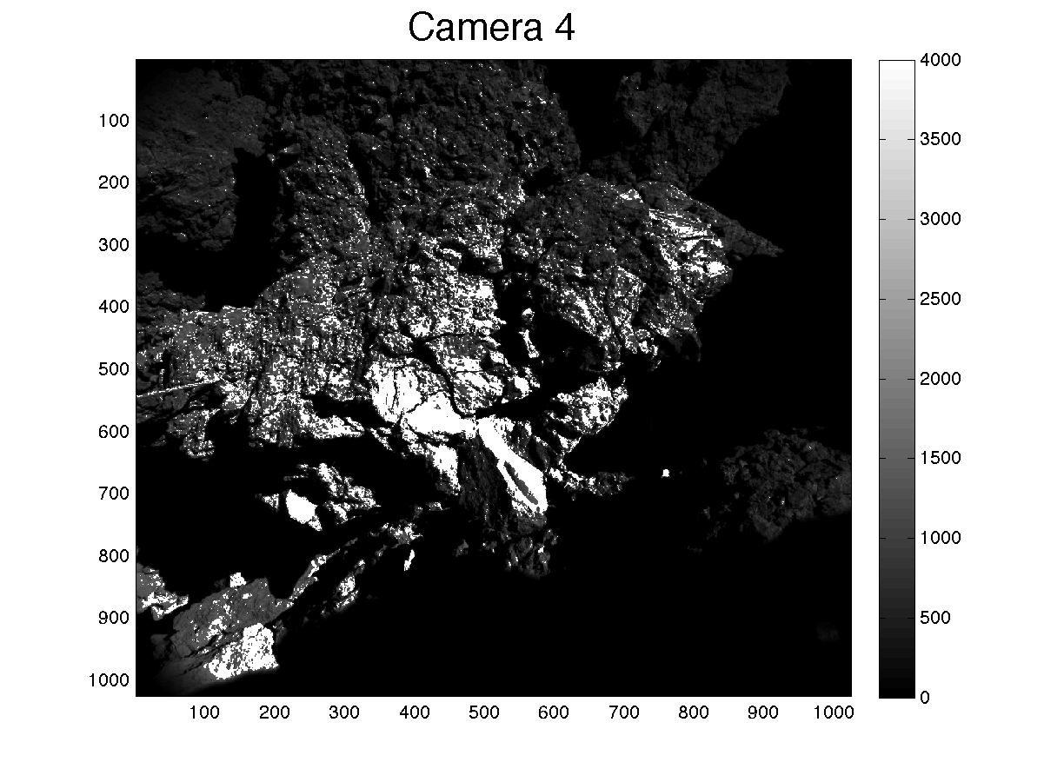
Calibrated Data
Browns image

Slide 5
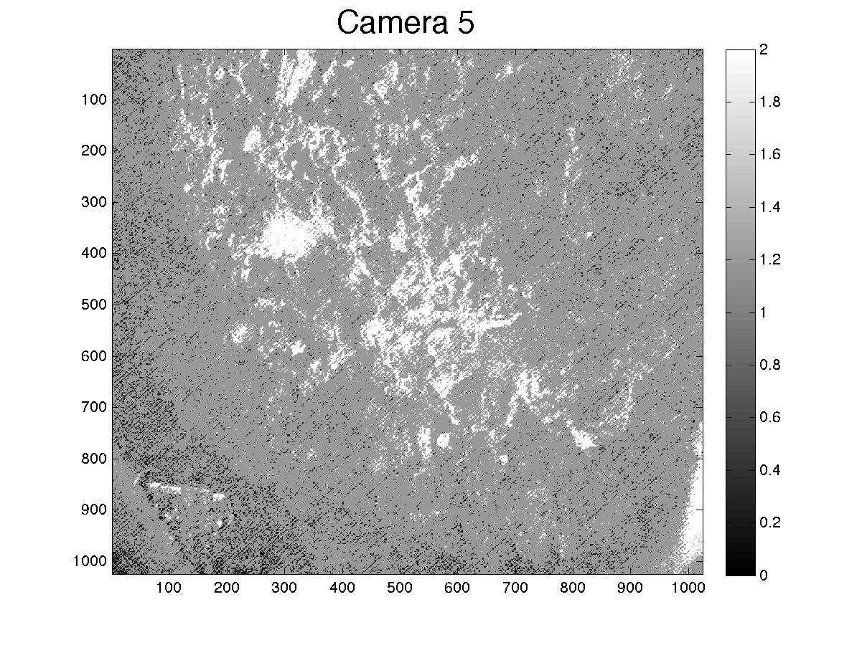
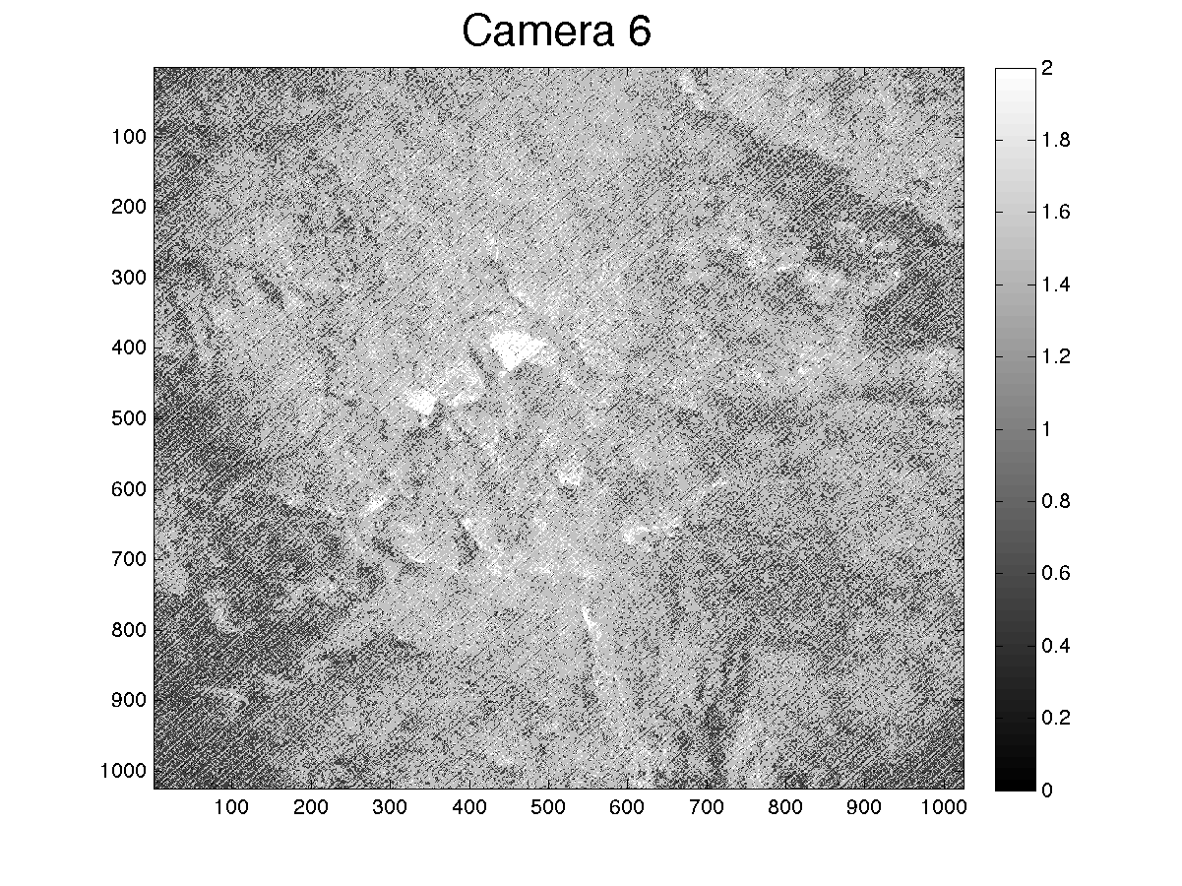
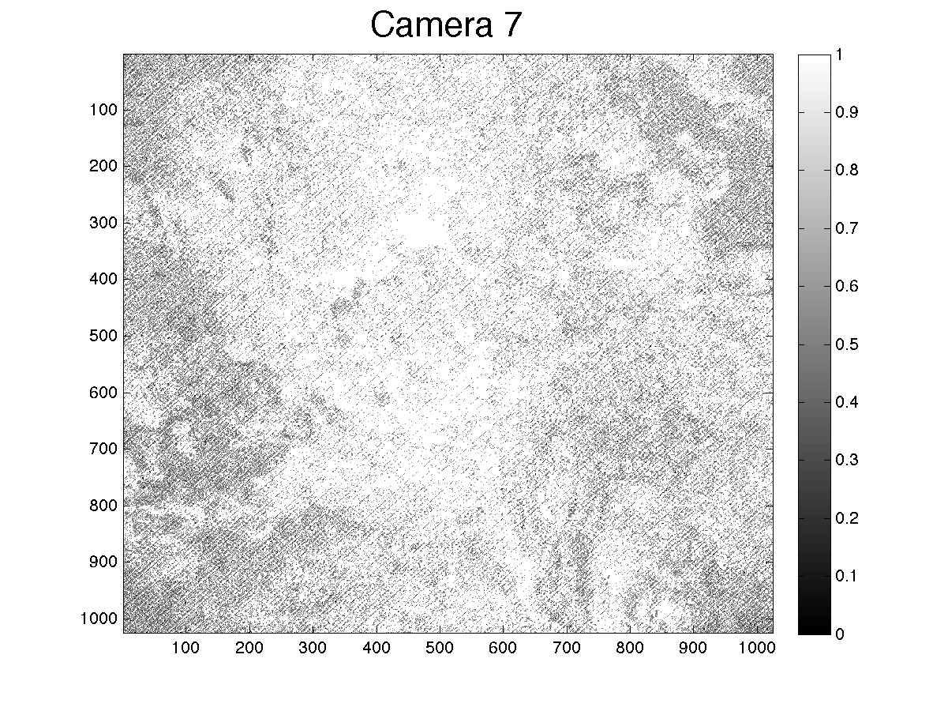
Calibrated Data
?
Stereo pairs
What are these images of?
Values [0, .5, 1]

Slide 6
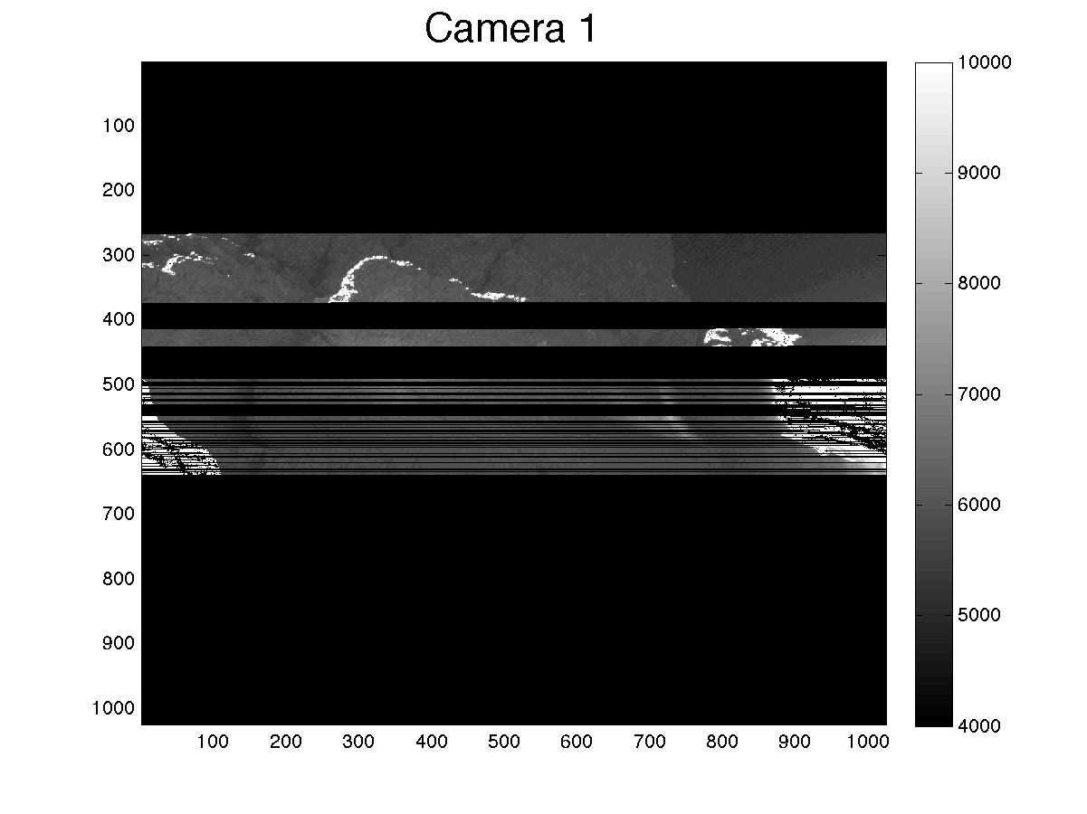
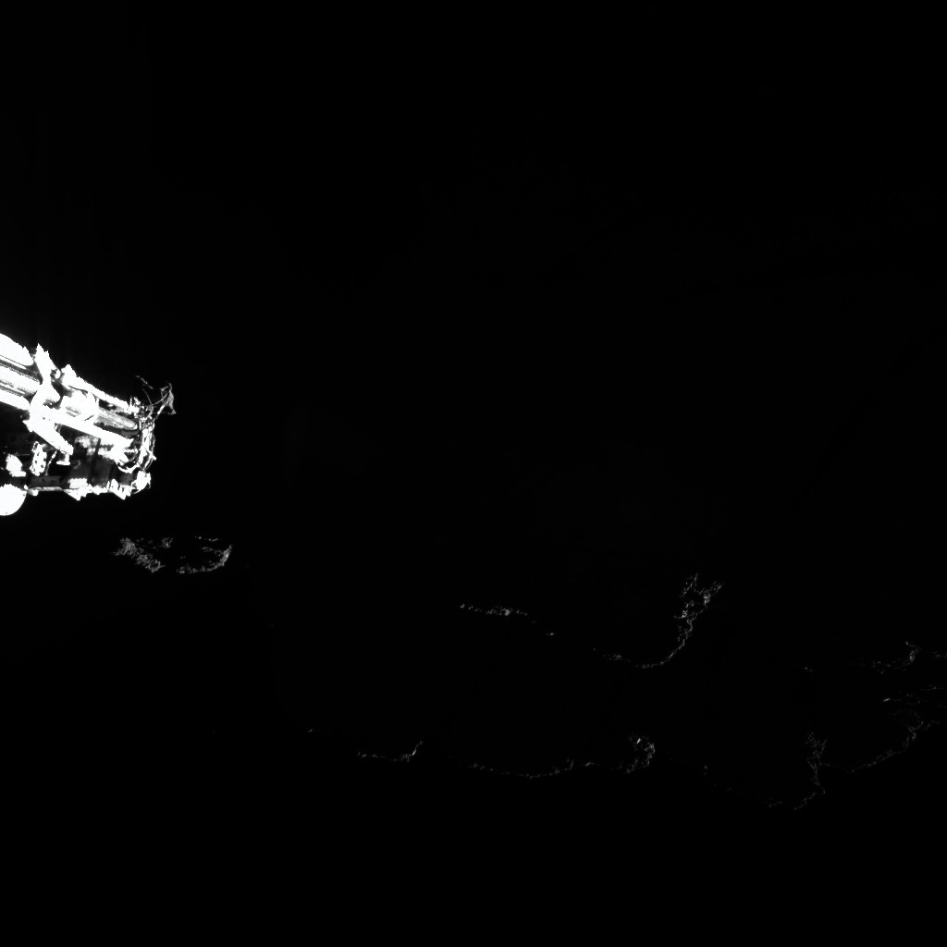
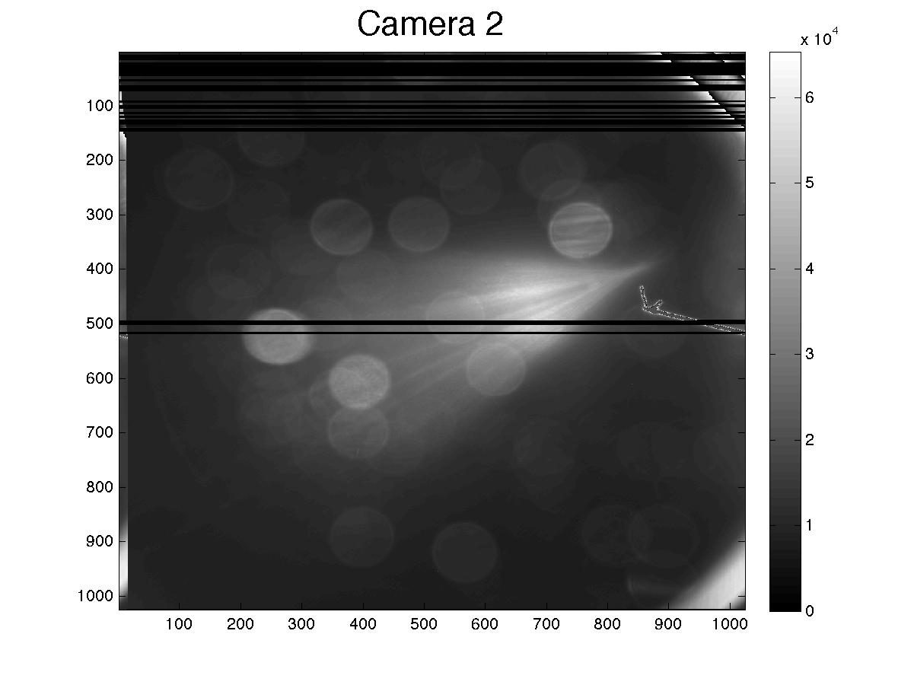
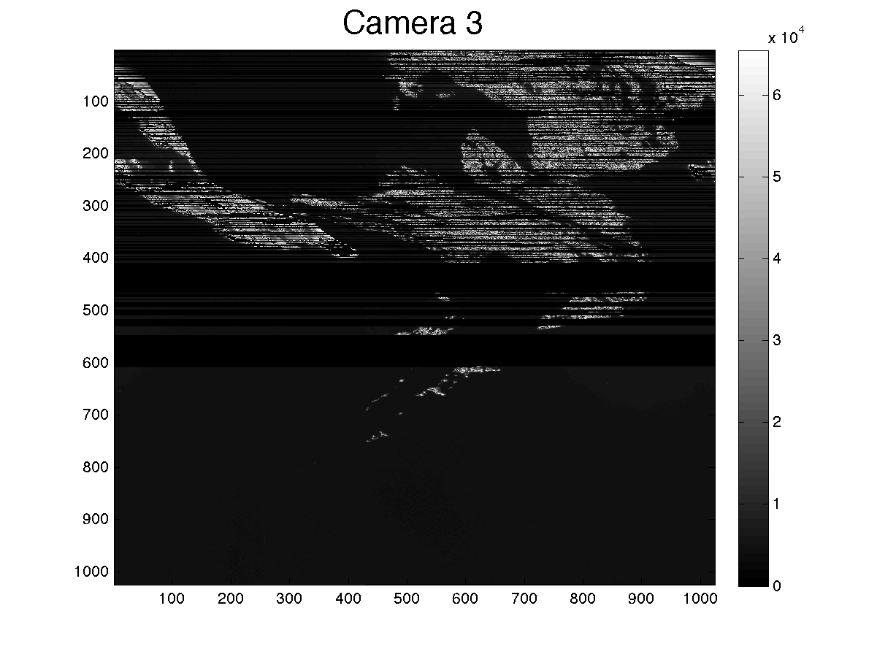
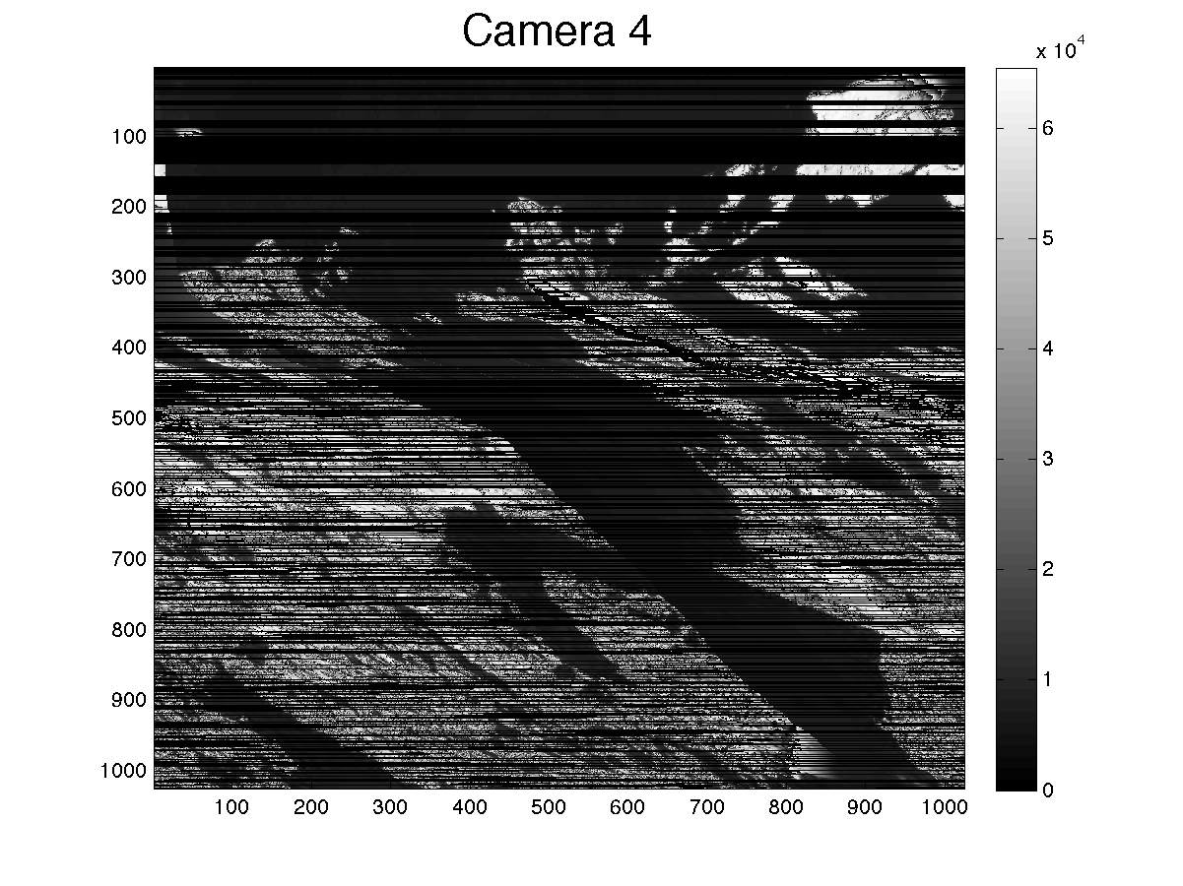
Uncalibrated Data
Browse image
Scattered light & ghosting?
Different file sizes
Apparent data drops
What units are these data?

Slide 7
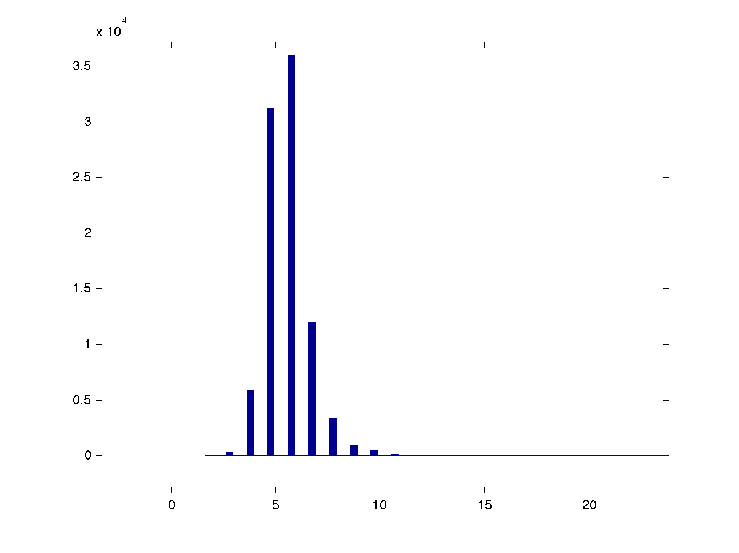
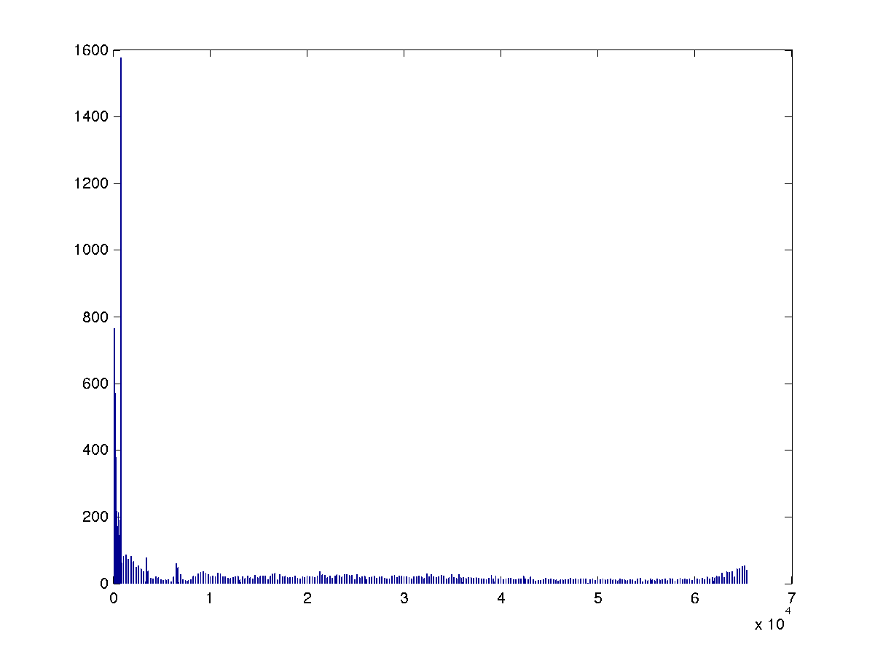
Calibrated Data
Raw Data
Histogram
Histogram
(data: 0 to ~6.5e4)

Slide 8
RID
There is information pertaining to all the cameras in each of the camera's labels. Including processing steps. it is confusing as two which step was performed on which camera. Are thee various processing steps somehow interdependent between cameras? there are references to 'camera cubes'...is that referring to the imaging spectrometer portion of the instrument?

