Slide 1
Rosetta – Miro PDS/PSA Review Joint European Session
Bryan Butler
National Radio Astronomy Observatory
October 11, 2017

Slide 2
MIRO
Despite some shortcomings the data is in pretty good shape, just needs a few fix-ups to get it into PDS-ready form.
One Major RID:
Zero-level offsets in Level 3 continuum data and IF offsets/rippling baselines in Level 3 spectroscopic data

Slide 3
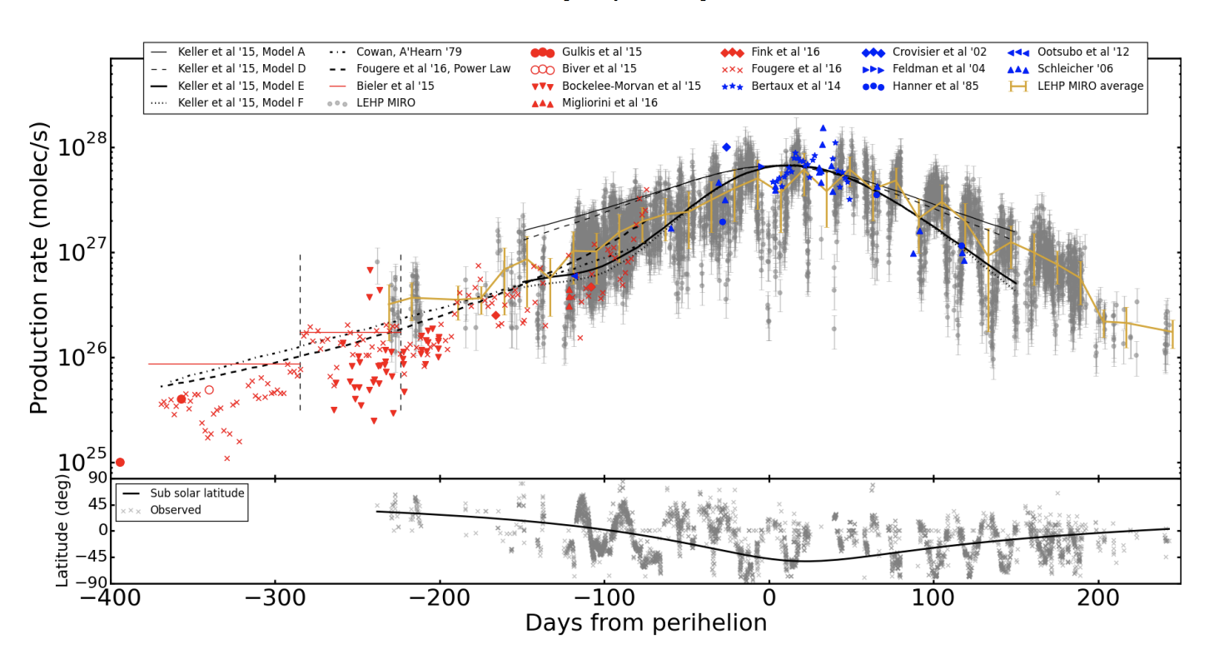
MIRO – Marshall et al. 2017
Marshall et al. 2017 presents H₂O production rates for 67P/C-G over time.

Slide 4
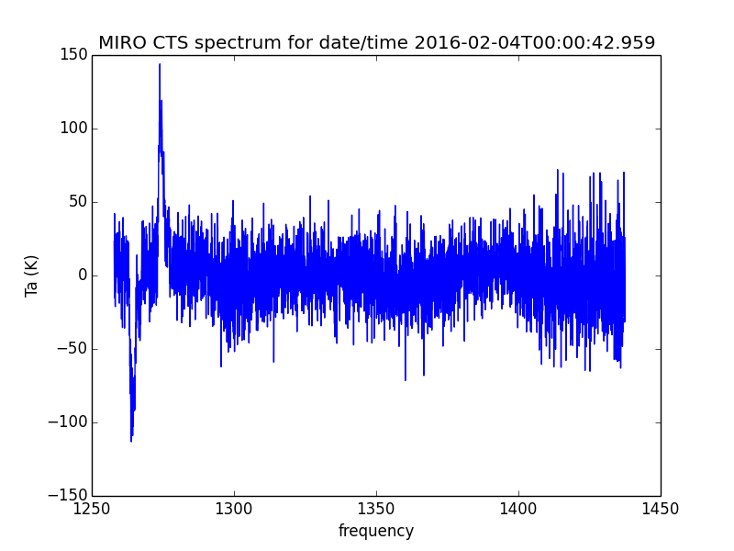
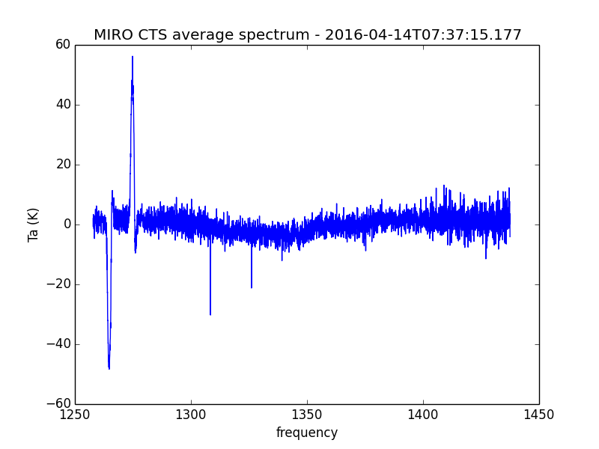
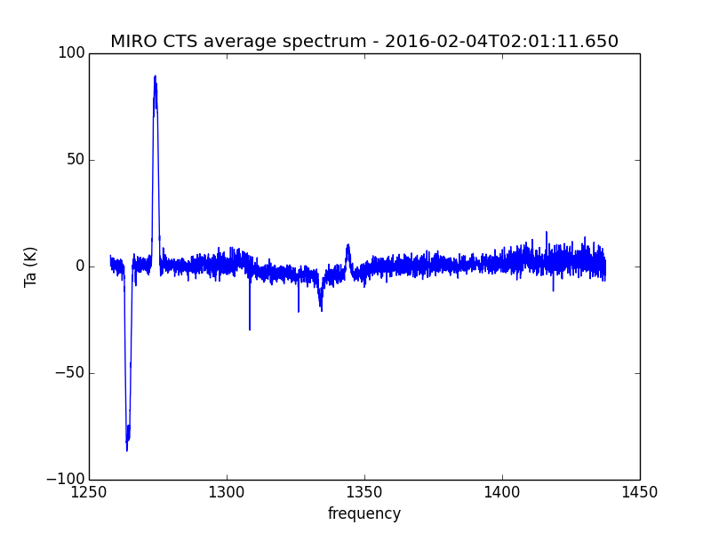
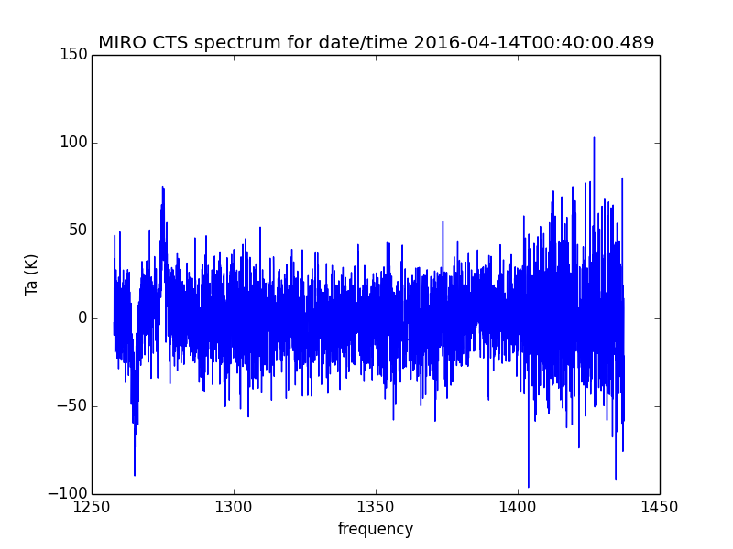
MIRO – Marshall et al. 2017
Spot-check a couple of spectra.
Amplitude and variation (on different days) looks about right.

Slide 5
MIRO – Level 3 Data Quality
There are artifacts in the data, mainly IF offsets/baseline ripple in spectroscopic data, that I believe exceed the claimed calibration accuracy of the data; this is in RID MIRO-US-BB-001.
catalog/dataset.cat states: “CONFIDENCE_LEVEL_NOTE = "The calibration algorithms used to generate these data are still being refined. See the Users Manual in the DOCUMENT directory for a discussion of error bars.”
For spectroscopic data, Section 9.7.3 states: “With frequency switching (all CTS science observations of Comet 67P/C-G were made with frequency switching), the rms noise level in a full-resolution spectrum is about ± 10 K.”
For continuum data, Table 9.7-1 states one-sigma measurement uncertainty of ± 1 K for submm and ± 0.4 K for mm (for antenna temperatures > 100 K).

Slide 6
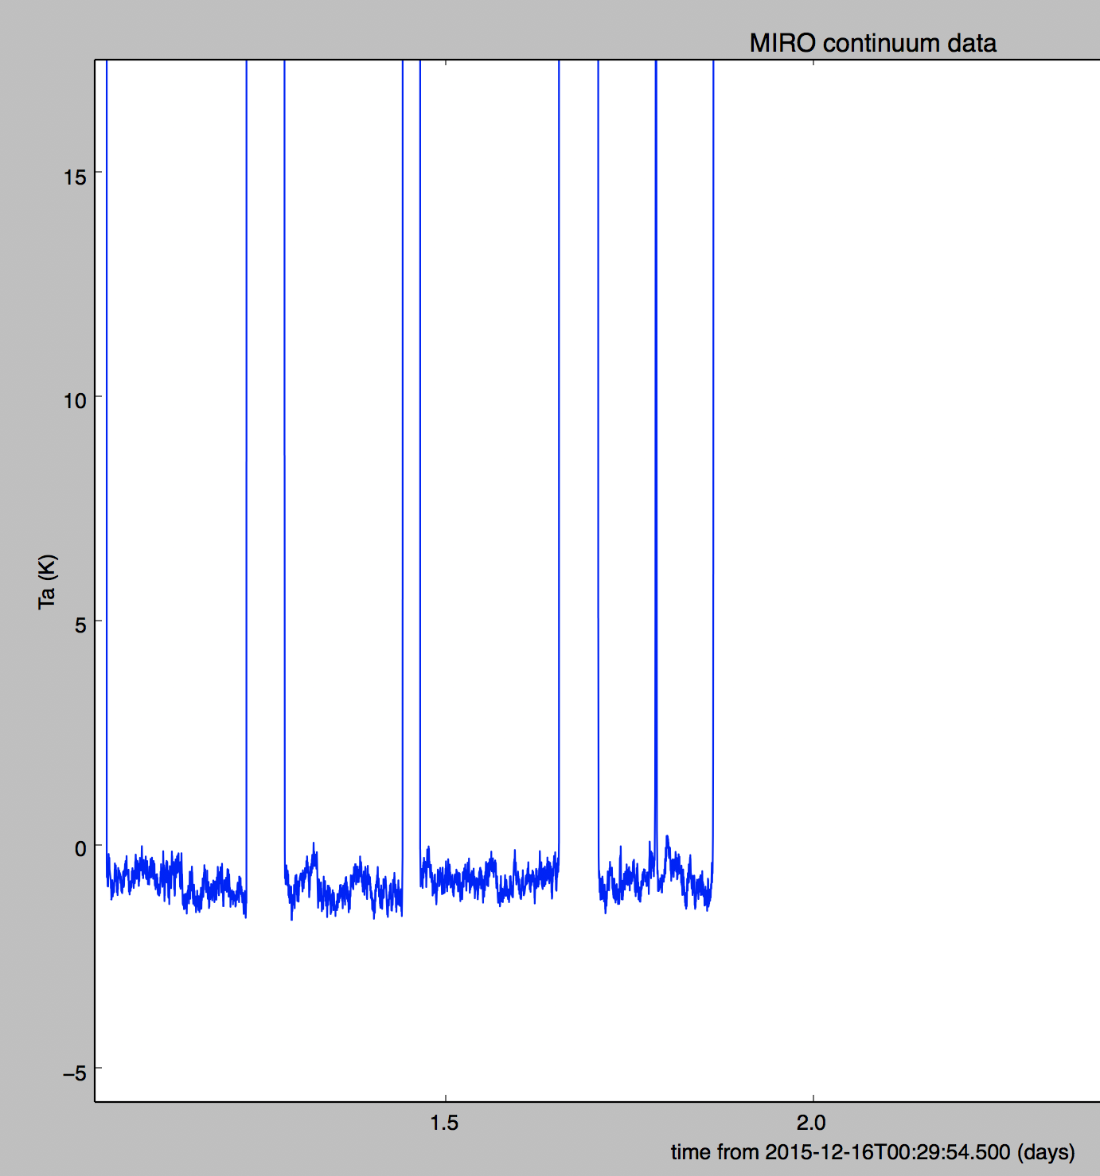
MIRO – Continuum mm – Level 3
Issues:
Offsets from 0 – this is an example from romir_1036/ro-c-miro-3-4-esc4-67p-v1.0/data/continuum/miro_3_mmcal_2015350.dat – offset is small, but really should be 0.
Similar examples are common in mm and submm level 3 data.
Baseline level should be 0, and is of the same order as the quoted one-sigma errors.

Slide 7
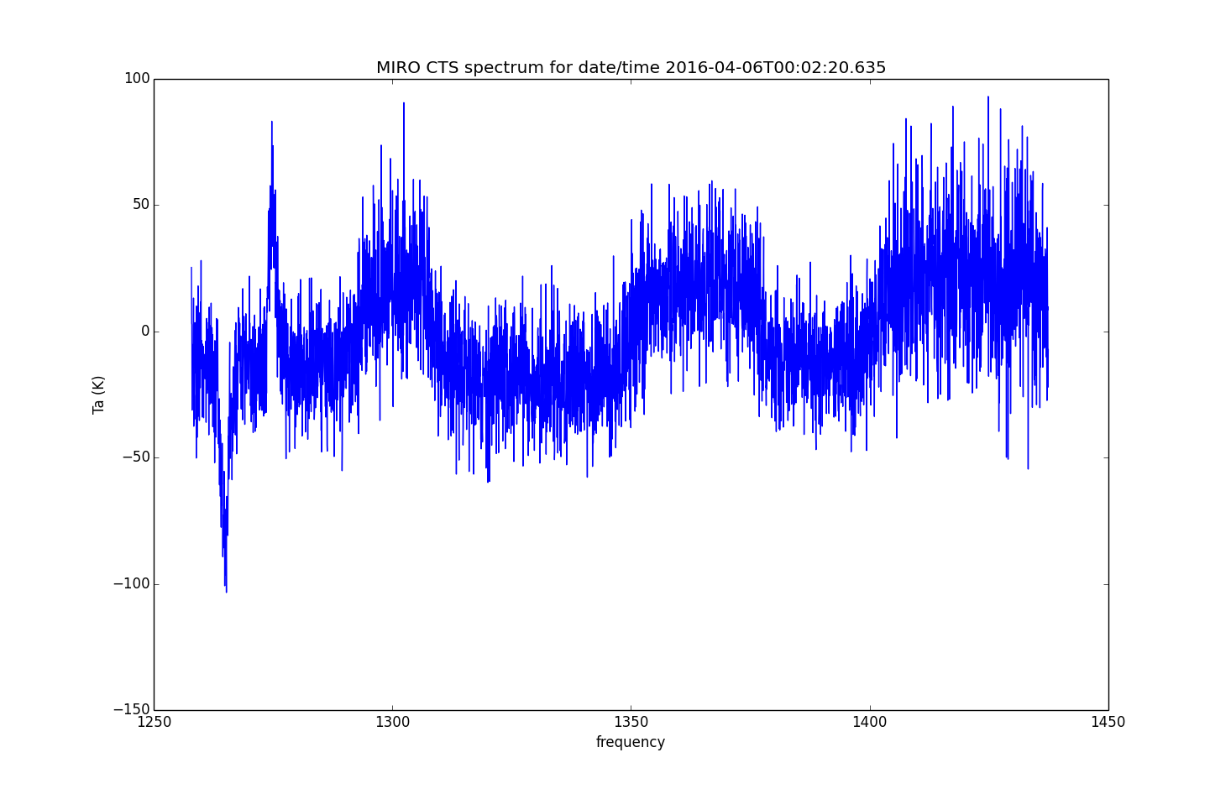
MIRO – Spectroscopic– Level 3
Issues:
“band” (or ”IF”) offsets are common in level 3 spectroscopic data. This is an example from romir_1038/ro-c-miro-3_4-ext2-67p-v1.0/data/spectroscopic/miro_3_ctscal_2016097.dat. These errors are often at the level of 10’s of K; much larger than the stated uncertainty.

Slide 8
MIRO – Minor RIDs
Software provided under …/document/miro_read_data.asc (a FORTRAN program) does not work with new level 3/4 data release. As noted in RID (MIRO-US-BB-002), it should be updated or deleted (or replaced). This was also noted in RID MIRO-EU-RM-001.
Date/time format for “UTC/GMT” columns in level 3 data is YYYYDDDHHMMSS when the more standard ISO 8601 format should be used (YYYY-MM-DDTHH:MM:SS.FFF). Also, fractional seconds are only in the “TIME” column and not in the “UTC” column – why? This is in RID MIRO-US-BB-003. [N.B. I have since found that the ISO 8601 standard allows for the used format, if a “T” is added between day of year and time – this is the so-called “day of year, basic” format. I still think it’s a good idea to use the more standard date/time representation.]
Data values of -999.9 are in the data, but no explanation is in the documentation (MIRO-US-BB-004).

Slide 9
MIRO - Summary
Despite the shortcomings noted above, the method for calculating brightness temperature, antenna temperature, the mapping from spectral channel number to sky frequency, and details on geometry are all clearly outlined in the user manual or contained in the data release itself. The documentation, labels, format files, and data itself is in good shape. There are just a few fix-ups to get the release into PDS-ready form.

