Slide 1
Rosetta – Miro PDS/PSA Review
Bryan Butler
National Radio Astronomy Observatory
October 10, 2017

Slide 2
MIRO

Slide 3
MIRO
Essentially three separate spectrometers:
Broadband radiometer @ 190 GHz,
Broadband radiometer @ 562 GHz,
High resolution spectrometer @ 562 GHz
(ν/Δν ≈ 10⁷).

Slide 4
MIRO
4 Data sets , covering Escort 4 (ESC4 – Oct-Dec 2015), Extension 1 (EXT1 – Jan-Apr 2016), and Extension 2 (EXT2 – Apr-Jun 2016) phases, Levels 2 and 3/4:
romir_1024/ro-c-miro-2-esc4-67p-v1.0
romir_1036/ro-c-miro-3-4-esc4-67p-v1.0 (romir_1036-2/ro-c-miro-3-4-esc4-67p-v1.0)
romir_1037/ro-c-miro-3_4-ext1-67p-v1.0
romir_1038/ro-c-miro-3_4-ext2-67p-v1.0

Slide 5
MIRO
Examine the root directories
Each dataset has the proper overall directory structure, which includes an aareadme.txt file (which correctly describes the file structure), errata.txt file, catalog/ data/ document/ index/ and label/ directories.
The data/ directories contain subdirectories:
continuum/ geometry/ spectroscopic/

Slide 6
MIRO
Read the catalog files
The catalog files look OK, though the ref.cat files don’t seem to have recent relevant publications (Marshall+ 2017; Choukroun+ 2015; Biver+ 2015; etc.) – is that OK (probably)?
Browse the documentation
Looks OK.

Slide 7
MIRO
Check for data-browsing help
Software provided under …/document/miro_read_data.asc (a FORTRAN program) does not work with new level 3/4 data release. As noted in RID (MIRO-US-BB-002), it should be updated or deleted (or replaced). This was also noted in RID MIRO-EU-RM-001.

Slide 8
MIRO
Rummage through the data
I have my own software (python), made and modified for previous PDS reviews. I used this software again for this review, though it needed some updating.
96 continuum datasets (each with ~50000 records) – plotted them all and visually inspected.
48 spectroscopic datasets (each with ~20000 records) – only plotted/examined a few.

Slide 9
MIRO
Documentation
Does the dataset contain all documentation needed to use and understand its data without prior knowledge?
Yes.
Is the provided documentation well organized, clear and self-consistent?
Yes.
Can the dataset be understood without any external documentation it references, or should the information in said external references be incorporated into the dataset?
It does not need external references incorporated.
If reviewing calibrated data, does the documentation fully explain the calibration process and contain all necessary parameters needed to repeat it?
Yes (…/document/user_manual.pdf Chapter 9 and Appendix A).

Slide 10
MIRO
PDS Labels and Meta Data
Are the descriptions and scientific content contained inside the PDS labels sufficient to understand their corresponding data products?
Yes.
Is all significant meta data included directly in the PDS labels?
Yes.
Do the labels provide all essential description of data values directly in the label, instead of deferring them to external references or documentation?
Yes.
Can the data be read programmatically using only the information contained in the PDS labels?
Yes.

Slide 11
MIRO
Data
Does the data look physically reasonable when examining it by eye or via a display tool?
Mostly.
When displaying the data as plots or images, are there any unexpected deviations?
Yes.
Formulate a scientific inquiry and attempt to use the data to answer the inquiry.
checked Marshall et al. 2017 (see following slides).
If reviewing both raw and calibrated data, attempt to calibrate a raw data file.
Was not reviewing raw data.

Slide 12
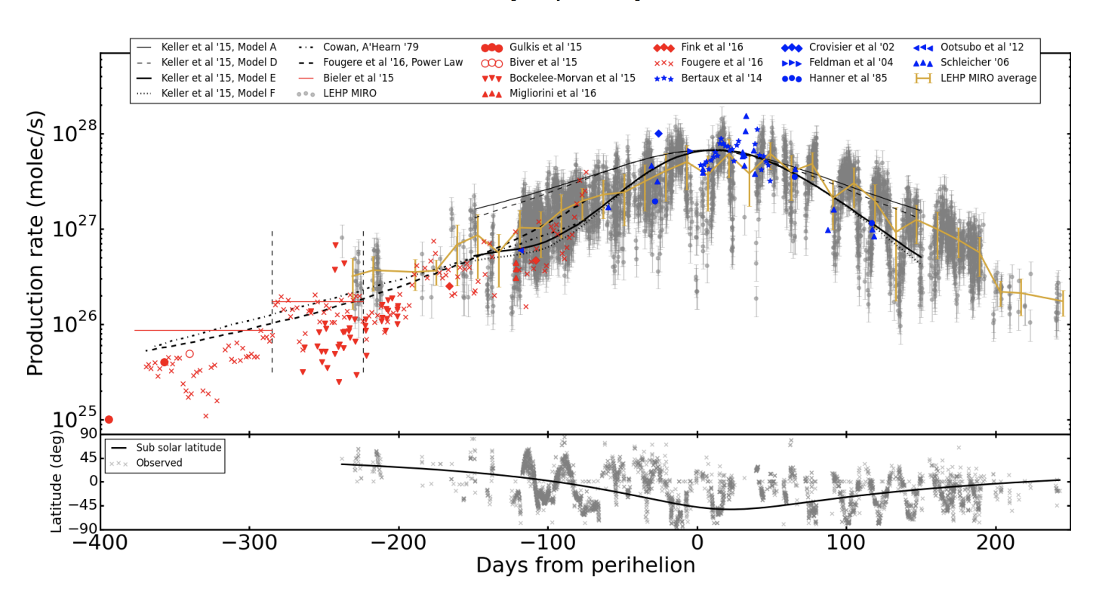
MIRO – Marshall et al. 2017
Marshall et al. 2017 presents H₂O production rates for 67P/C-G over time.

Slide 13
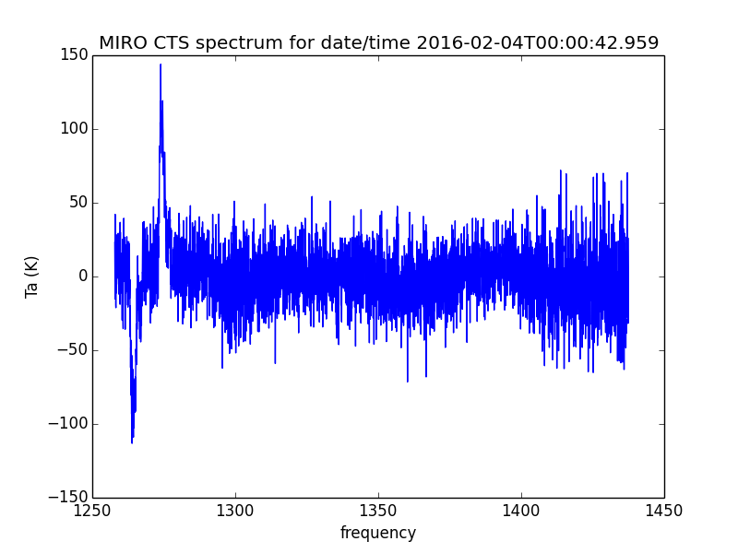
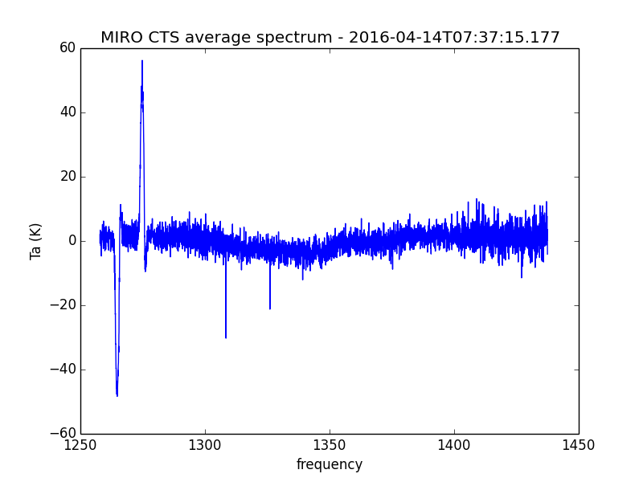
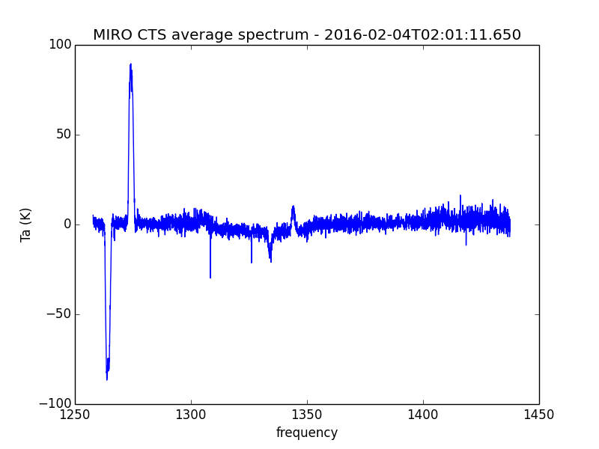
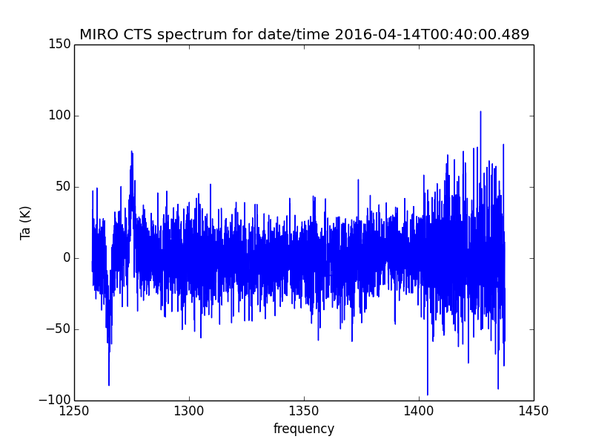
MIRO – Marshall et al. 2017
Spot-check a couple of spectra.
Amplitude and variation (on different days) looks about right.

Slide 14
MIRO
Issues:
There is no description of the difference between romir_1036 and romir_1036-2 datasets. At least that I could find. (A unix %diff between files shows no literally no difference.)
Data values of -999.9 are in the data, but no explanation is in the documentation (MIRO-US-BB-004).
Date/time format for “UTC/GMT” columns in level 3 data is YYYYDDDHHMMSS when the more standard ISO 8601 format should be used (YYYY-MM-DDTHH:MM:SS.FFF). Also, fractional seconds are only in the “TIME” column and not in the “UTC” column – why? This is in RID MIRO-US-BB-003.

Slide 15
MIRO
Issues:
I didn’t understand what “level 3/4” means? Apparently there will be another release of these data?
There are remaining artifacts in the supposedly calibrated data, perhaps above the level of calibration accuracy stated (10%).

Slide 16
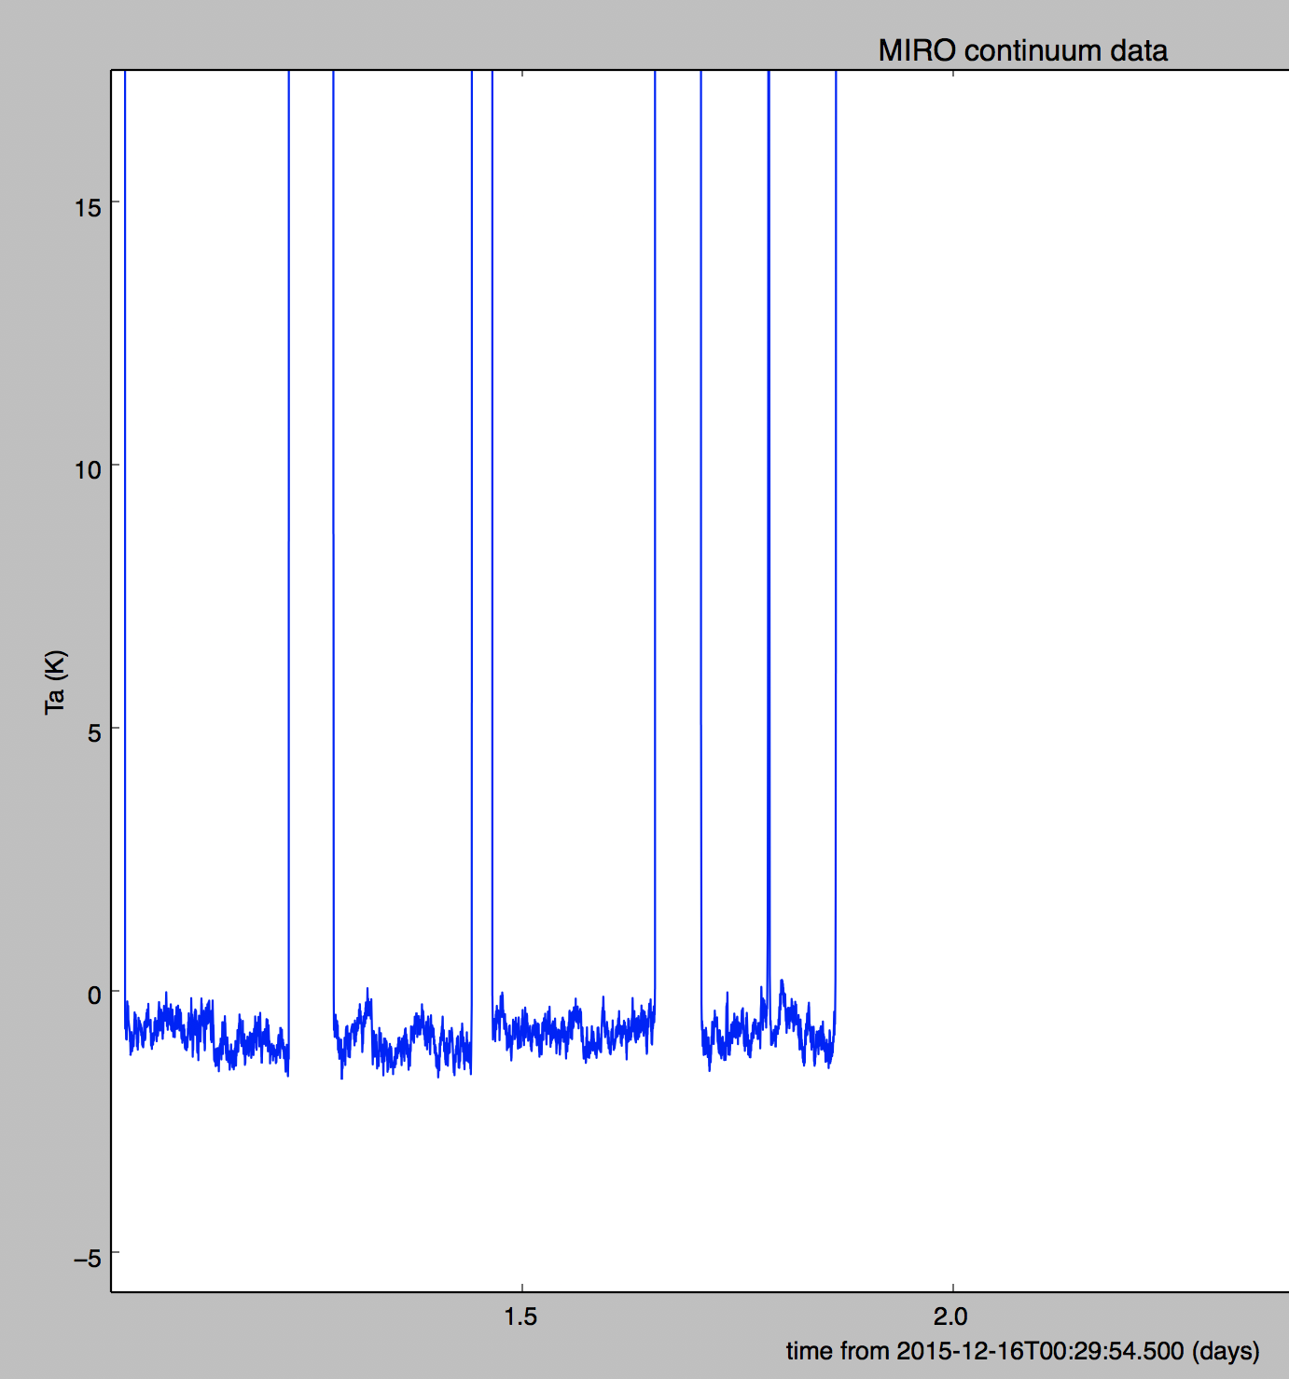
MIRO – Continuum mm – Level 3
Issues:
Offsets from 0 – this is an example from romir_1036/ro-c-miro-3-4-esc4-67p-v1.0/data/continuum/miro_3_mmcal_2015350.dat – offset is small, but really should be 0.
Similar examples are common in mm and submm level 3 data.
Below the 10% level, but really should be 0.

Slide 17
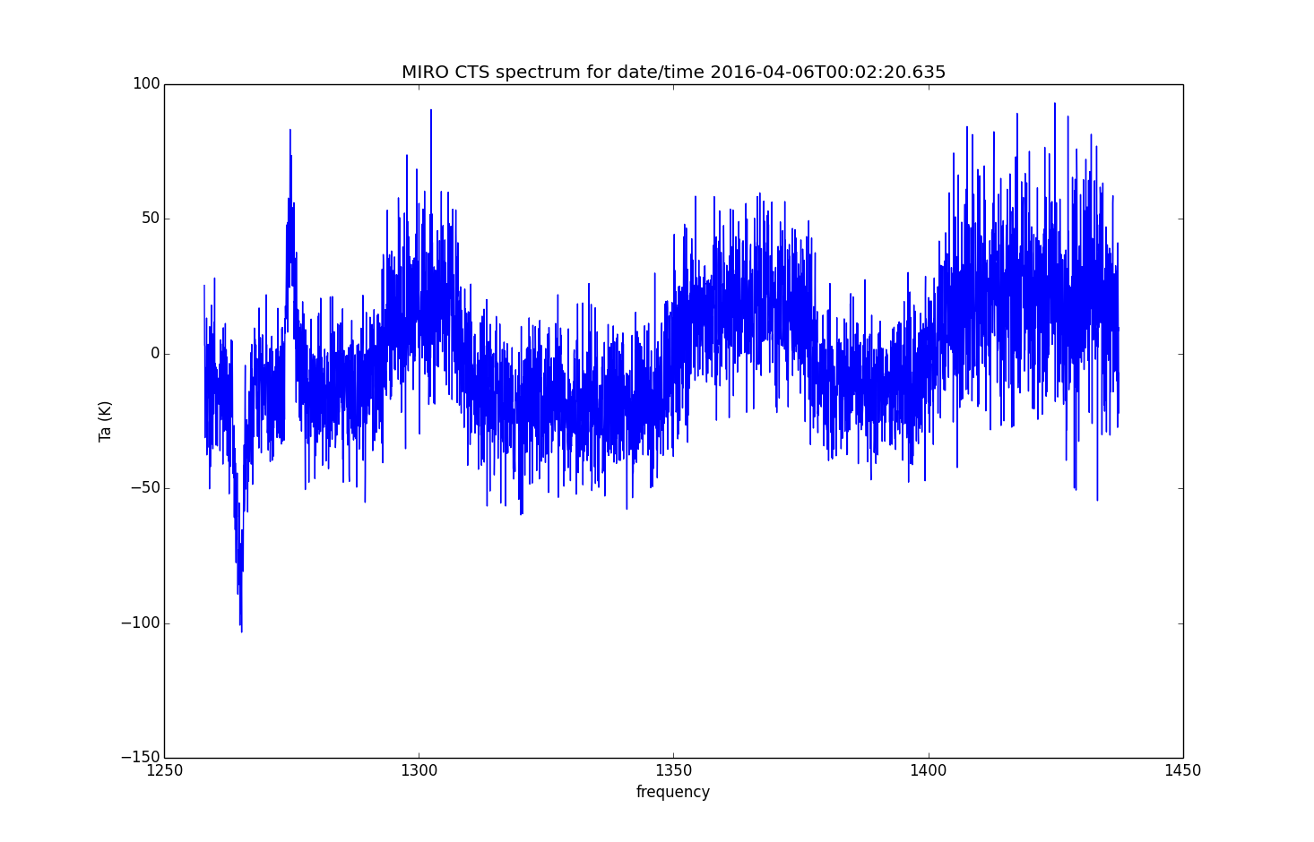
MIRO – Spectroscopic– Level 3
Issues:
“band” offsets are common in level 3 spectroscopic data. This is an example from romir_1038/ro-c-miro-3_4-ext2-67p-v1.0/data/spectroscopic/miro_3_ctscal_2016097.dat

Slide 18
MIRO - Summary
Despite some of the shortcomings noted above, the method for calculating brightness temperature, antenna temperature, the mapping from spectral channel number to sky frequency, and details on geometry are all fairly clearly outlined in the user manual or contained in the data release itself. The data is in pretty good shape, just needs a few fix-ups to get it into PDS-ready form.
N.B. I didn’t check geometry, gas velocity, or line-fitting.

