Slide 1
Rosetta/OSIRIS Dataset Review
Jian-Yang Li
Planetary Science Institute
October 3, 2017

Slide 2
Dataset Overview
A total of 100 OSIRIS datasets
  Two cameras: NAC and WAC
  Level 2 and level 3
  Groups m01 to m25 for each camera and each calibration level
All images from 2014-01-20 to 2016-02-09
76 datasets (m01-m19) are v2.0 that supersede the previous version
24 datasets (m20-m25) are v1.0, first release
OSIRIS instruments overview
  Contains two cameras: NAC and WAC
  Mounted on the instrument deck looking towards +z axis of S/C
  Both CCDs have 2048x2048 pixel active regions
  Both equipped with double filter wheel of 8 positions in each wheel
Review process
  Compare catalog files in all datasets, and analyze the difference
  Check all catalog files
  Read documents in document/ directory
  Collect aspect data from all image headers, check consistency between level 2 and level 3 datasets
  Calculate geometry parameters using SPICE kernels and target reference frame definition, and compare and analyze
  Check other ancillary information
What I didn’t do
  Check consistency of detached labels
  Run calibration software to check whether calibration is correct or consistent with references
  Test software in extras/ subdirectory
  Check index/ subdirectory

Slide 3
Quick Review Summary
Overall well organized datasets containing most information that is essential to understand and use the data
All images files, except for one corrupted, can be loaded with IDL readpds.pro and my proprietary python code with header information extracted, and can be displayed in correct orientation
The values of geometric parameters are confirmed except for phase angle, which seems to be wrong, probably affecting all images
Some images in level 2 datasets are missing from level 3 datasets without obvious explanations found
The ‘FILTER_NAME’ in PDS headers are inconsistent
The description of image orientation in the SIS document is somehow confusing, although it is correct and users should still be able to make sense of it
The descriptions of NORTH_AZIMUTH and PA_/PB_IMAGES are ambiguous or inconsistent
Some non-essential information is insufficient

Slide 4
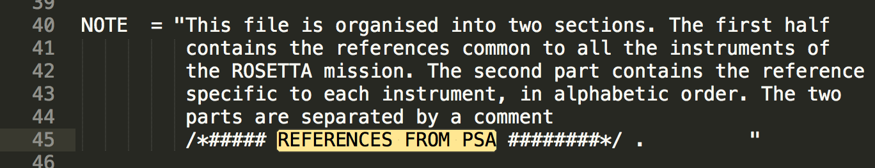
Catalog Files
Some catalogs are identical in all datasets
  insthost.cat, mission.cat, osinac_inst.cat (all NAC datasets), osiwac_inst.cat (all WAC datasets), personnel.cat, software.cat
Some catalogs are identical across datasets except for programmatic information
  catinfo.txt: only dates and text about instruments are different
  reference.cat: identical for those in m01-m22; those in m23-m25 are updated on 2017-08-18 to contain additional references about CONCERT. Should they all be identical and most up to date?
  target.cat: identical for those in m01-m22; those in m23-m25 are updated on 2017-08-07 to contain one additional target ”MAINTENANCE”. Should they all be identical and most up to date?
In dataset.cat, those in m23-m25 datasets have DATA_SET_RELEASE_DATE before START_TIME and/or STOP_TIME
mission.cat needs to be updated to contain complete information for all datasets to be released. The current one is dated 2015-08-18
reference.cat: the NOTE (lines 40-44) defines the section separator, and states that the second part is specific for each instrument. However, the actual section separator (line 460) is different, and the second part is nearly identical in all datasets (see 2nd bullet above) containing references for all instruments
Screenshot of reference.cat:

Slide 5
Geometry Information
Check the calculation of geometric keywords in PDS headers
  s/c-Sun vector, s/c-target position and velocity vector, s/c altitude (RA, Dec, solar elongation, north azimuthal parameters), phase angle, and sub-s/c and sub-solar coordinates
Calculated twice
  With the most recently released kernels, and use the body-fixed frame parameters of 67P as defined in the cheops_ref_frame_v1.pdf document in the shape model dataset (RO-C-MULTI-5-67P-SHAPE-V2.0), which includes rotation and nutation, but not change in period (Jorda et al. 2016)
  With only the kernels listed in PDS header keyword SPICE_FILE_NAME, where the body-fixed frame is defined through a CK frame in ROS_CHURYUMOV_V01.TF and its associated CK files (CATT_*.BC kernels)
Compared the results from two sets of calculations, and with the parameters collected from PDS headers in all level-3 images

Slide 6
Two Sets of Geometry Calculations
Two sets of calculation agree with each other except for the sub-s/c and sub-solar longitude
  1e-8 relative difference in position
  1e-7 deg in angles
  Praise the NAV team for the accuracy of their trajectory and s/c attitude kernels
  S/C and solar latitude calculation agree within -0.2 to +0.4 deg, consistent with the precession of pole (cone angle 0.28 deg)
  S/C and solar longitude agree within ±1 deg through 2014-Nov, then deviate from each other significantly, ranging from 0 to 360 deg
  The difference could be caused by the change in the rotational rate (Jorda et al. 2016), which appears to have been accounted for in the 67P CK frame (see slide 11)
Chose to compare the second set (derived with the kernel files listed in the PDS header for each image) to the data labels

Slide 7
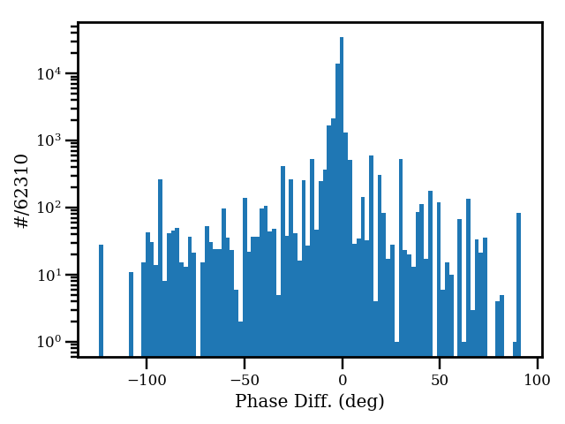
Geometry Information
Generally good agreement, except for phase angle
  Position information agree to 1e-7 relative accuracy
  Solar longitude within 0.1 deg, solar latitude and s/c lat/lon agree to ±2e-5 deg
  S/C attitude parameters agree to better than 0.3 deg for RA, Dec, and solar elongation, and to better than ±2e-5 deg for north azimuthal
  Phase angle agree within ±0.5 deg except for a few peculiar points until end of 2014-July, when the difference is in general 5-10 deg, with many points having difference as high as 125 deg
  Difference in phase angle plotted below, histogram to the right (y-axis in log scale)
WAC only

Slide 8
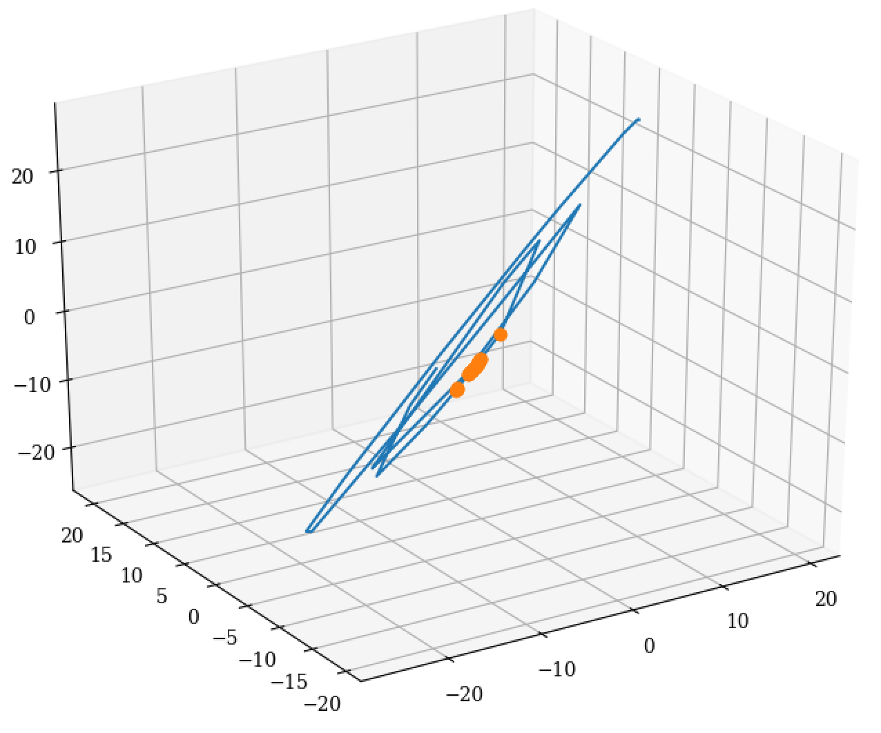
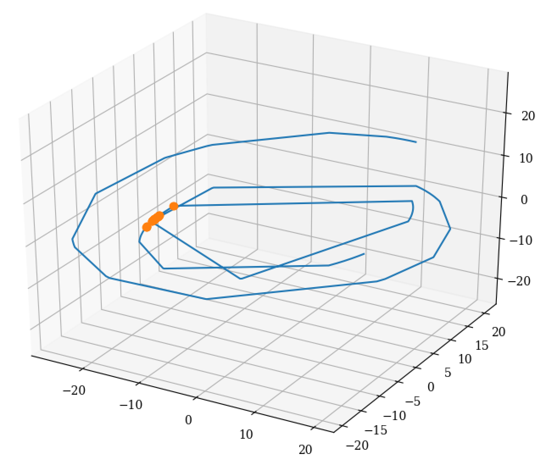
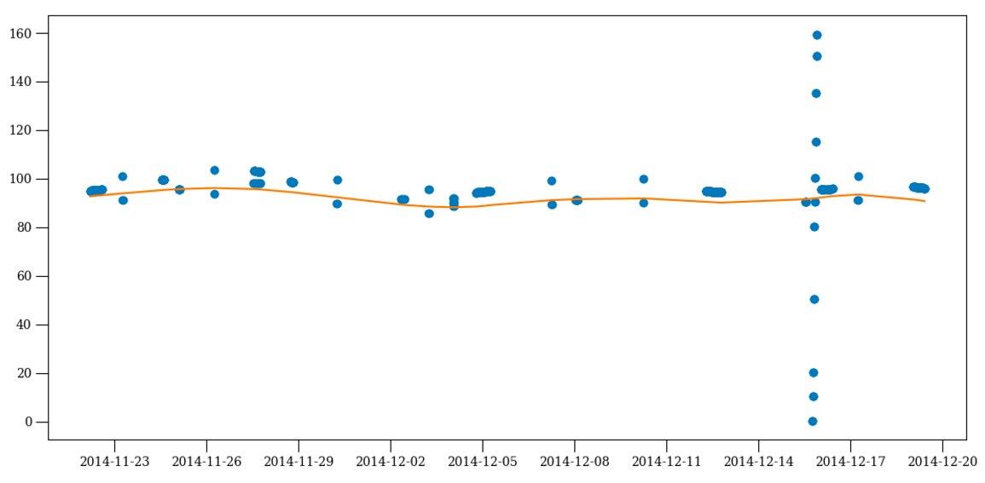
Phase Angle
  OSIRIS-US-JL-007
To confirm the problem, I looked at one dataset WAC-3-M10 for more details
On the right are two views of the comet-centric orbit of s/c
  Orange symbols are images with peculiar phase angles
Plot below shows the phase angles in this dataset
  Calculated values are much more stable than header values
  Mostly around 90 deg, consistent with s/c being on a terminator orbit around the comet
The peculiar phase angles don’t seem to make sense, given the position of s/c in the trajectory
The ~10 deg jumps of phase angles from one image to the next don’t make sense either
The ~10 deg jumps of phase angle from one image to the next don’t seem to make sense either
  Similar case is suspected for all other big jumps in phase angle in other datasets
Results: There are problems in the phase angle calculation in the data
~10 deg jump
Symbols: from headers
Line: calculated

Slide 9
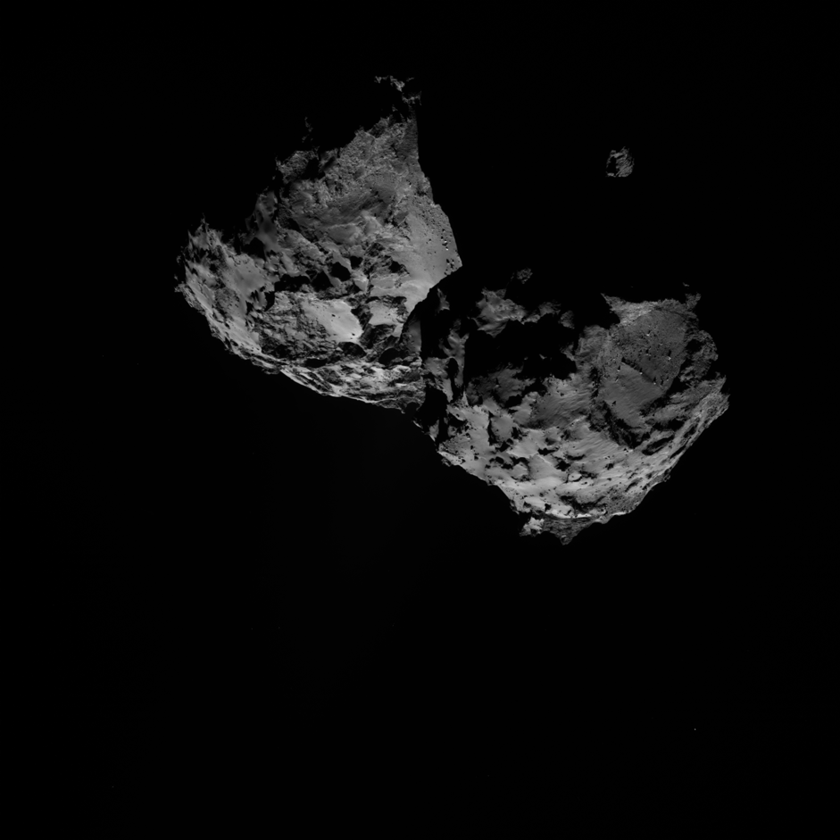
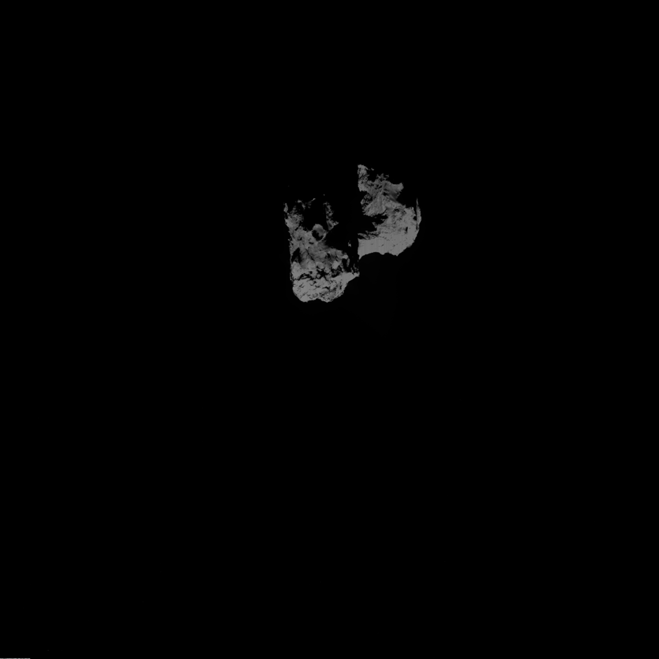
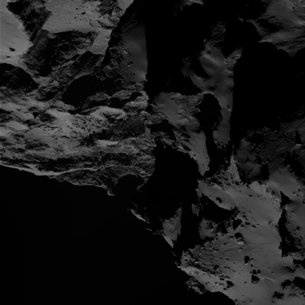
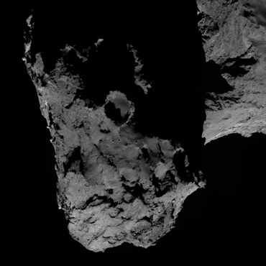
Image Orientation
The orientations of NAC and WAC images are consistent, when displayed based on LINE_DISPLAY_DIRECTION and SAMPLE_DISPLAY_DIRECTION.
Both IDL readpds.pro and my own python routine based on PDS standards display images in the same orientation.
Result: The left-right mirror between NAC and WAC are properly accounted for
w20141202t103902881id30f18
n20141202t103905488id30f22
w20160116t220739294id30f12
n20160116t222231503id30f22

Slide 10
Image Orientation
  OSIRIS-US-JL-001
This orientation is consistent with the description in the SIS document (osiris_l1_l2_sis_v01.pdf)
  “… To display the images in the standard Rosetta orientation, an additional 180° rotation has to be applied to both NAC and WAC images. In this orientation, the spacecraft +X axis is up and the spacecraft +Y axis to the right, meaning that the Sun is up in most images.”
After rotating 180º, the Sun does appear to be from up direction
Consistent with Fig. 6 in the SIS document
Question: Why not account for this additional rotation by the xxx_DISPLAY_DIRECTION keywords? The current setting is extremely confusing
Suggested change:
  LINE_DISPLAY_DIRECTION = UP
  SAMPLE_DISPLAY_DIRECTION = LEFT for WAC and RIGTH for NAC

Slide 11

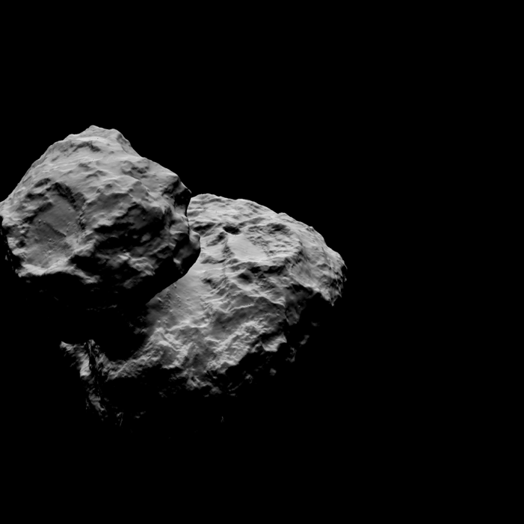
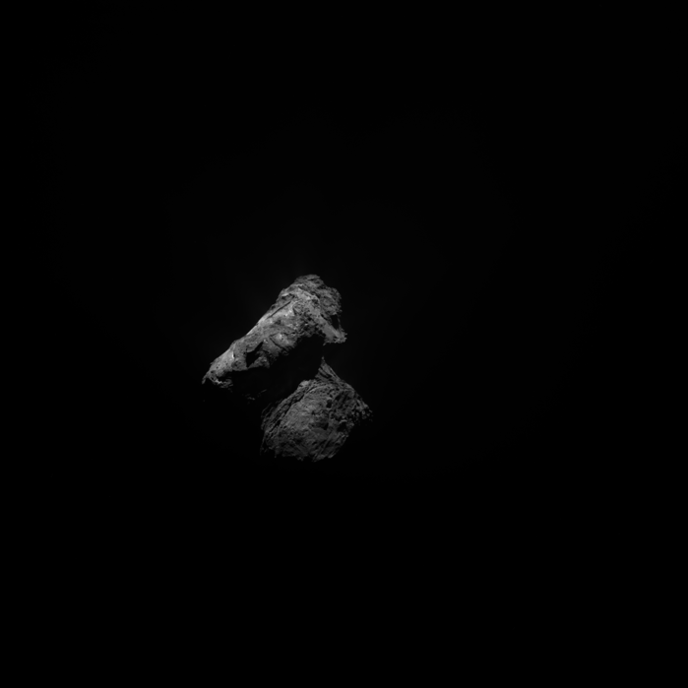
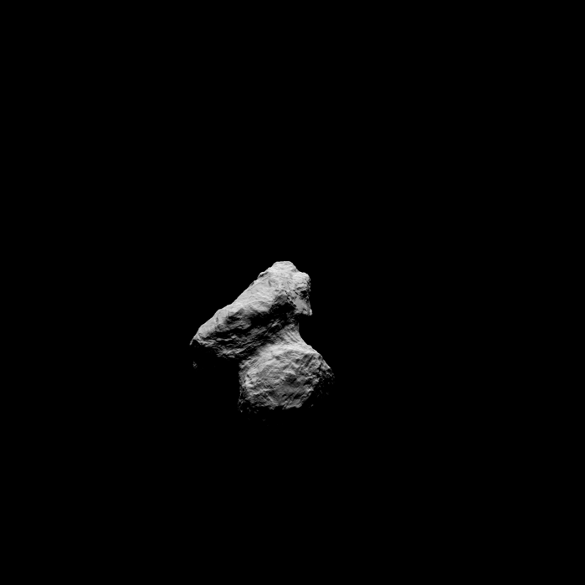
Compare with Simulation
real
simulated
wac-3-m10
w20141202t103902881id20f18
Simulate a few images from PDS shape model and observing geometry from image headers
  Boresight pointing are calculated with SPICE kernels
  Shadows are not included in my simulation
Good agreement, except for some offset in the boresight pointing (not a concern for this review)
Result: Both orientation and s/c and solar coordinates in the PDS header are correct
nac-3-m20
n20150830t100856344id30f16

Slide 12
Filter Names
‘OH-WAC’ filter appears to be ‘OH-WAC’ in m20 and m21 datasets, but as ‘OH’ m08, m10-m19, m23-m25 datasets
‘R’ appears to be ‘Red’ in all images
Suggestion: Preferably all filter names in image headers should be revised to be consistent with Keller et al. (2007) paper. The minimum would be to make the filter names consistent in all images (change OH to OH-WAC)
Table from Keller et al. (2007)

Slide 13
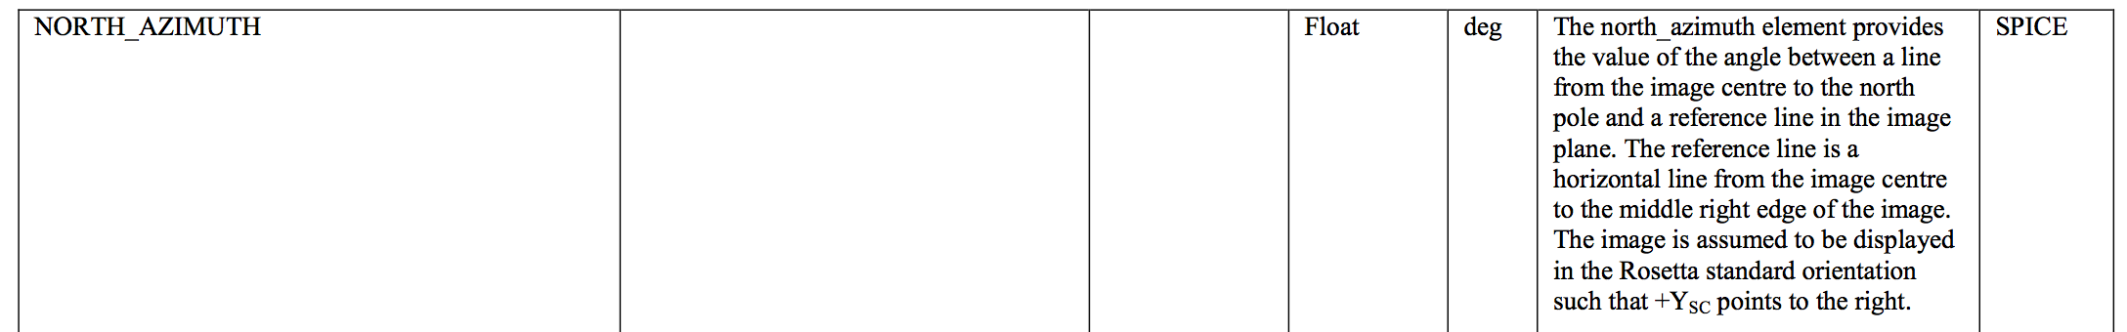
SIS Document
OSIRIS-US-JL-008
Definition of NORTH_AZIMUTH is ambiguous
  The direction of measurement between sky north and the reference line should be defined
  Phrase “north pole” is ambiguous: sky north or the north pole of target?
Description of PA_ and PB_IMAGE is not sufficient
  Figure 5 shows 2+48 pre-pixels in both amplifiers A and B
  Section 9.5 states that “… CCD first clocks out 48 pixels …”
  The size of PA_ and PB_IMAGE is (6, 256) or (3, 128)
  How to reconcile these differences?

Slide 14
Other Miscellaneous Problems
wac-2-m17 has one corrupted file: w20150627t170411566id20f13.img
  Suggestion: Fix it
Thumbnail images in browse/ directory are great, but they are currently too small (64x64) to be of any practical use
  Suggestion: Either make them larger (at least twice large), or remove them
Some images in level 2 are missing from level 3 datasets (a list is available if needed)
  OSIRIS-US-JL-012
  These are not those with IMAGE_OBSERVATION_TYPE==REGULAR or TARGET_TYPE==CALIBRATION. They all have TARGET_TYPE=COMET or STAR
  NAC datasets have 55 missing images in M03, M06, M07, M11, M15, M17, M18, M20, and M21
  WAC datasets have 73 missing images in M03, M07, M17, M18, M20, and M21
  Suggestion: Include the missing images, or provide explanations in corresponding dataset.cat
Insufficient information (non-essential)
  How the images are grouped to datasets?
  Imaging sequences and their corresponding science objectives
  Suggestion: Add such information in dataset.cat, or provide references

