Slide 1
PDS review of ROSINA, Rosetta Orbiter Spectrometer for Ion and Neutral Analysis (revised)
Three instruments
RTOF: Reflectance time of flight mass spectrometer
DFMS: Double focusing mass spectrometer
COPS: Pressure sensors
Mark Perry
Johns Hopkins Applied Physics Lab
9 October2017

Slide 2
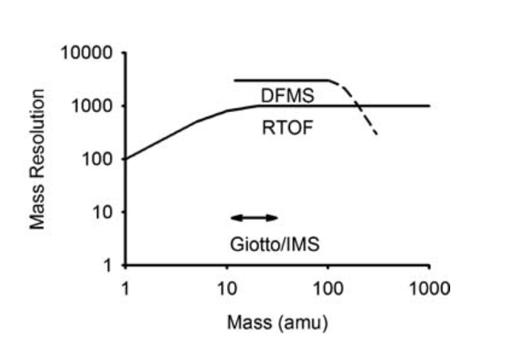
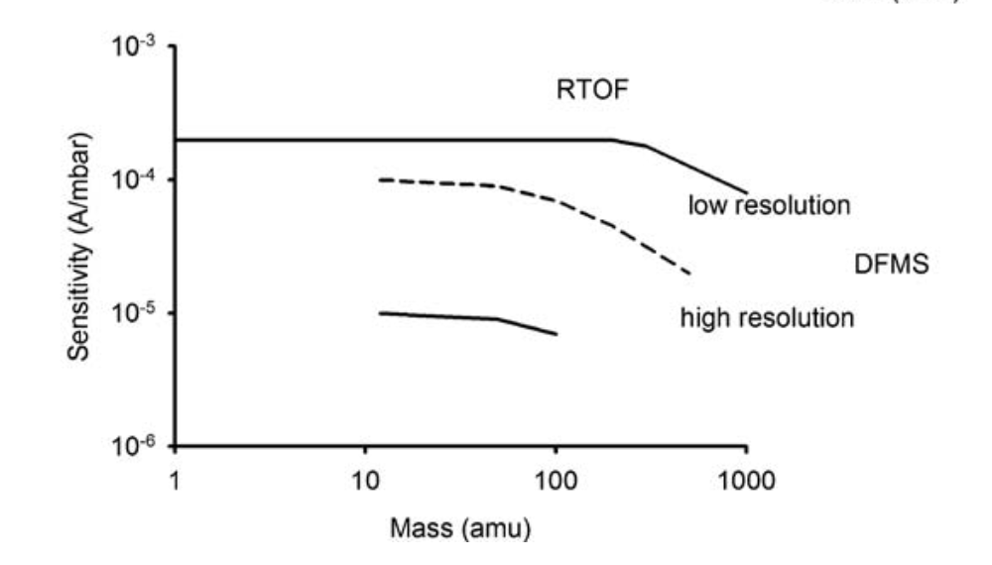
Both spectrometers measured neutrals or ions
The two spectrometers use different technologies, and they have different sensitivity, mass resolution, and mass range.
In general, mass-spec data do not have established standards such as those provided for images and spectra archived for use by or with ISIS.

Slide 3
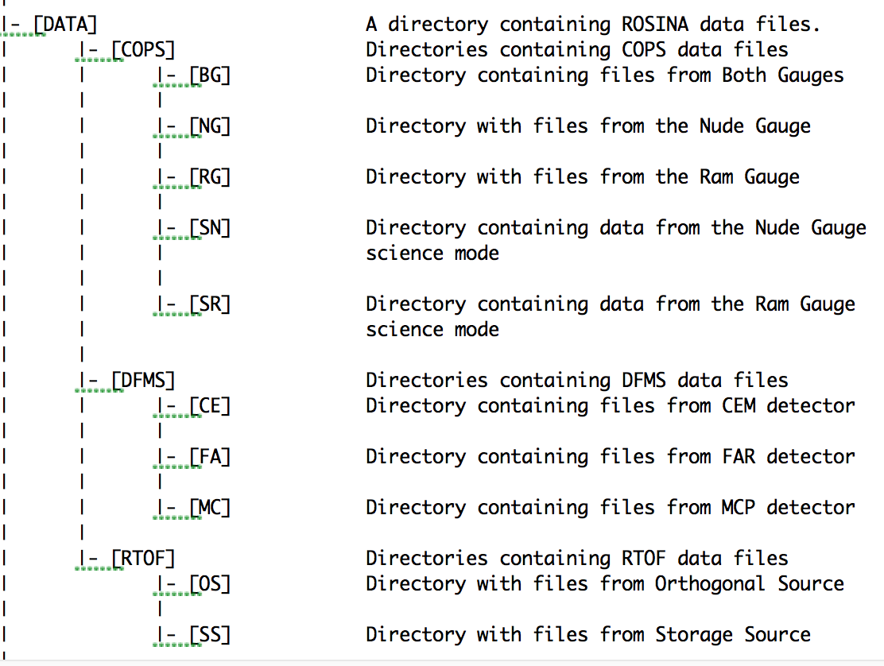
ROSINA raw PDS data; each 2 to 4 GB of small files
RO-C-ROSINA-3-PRL-V1.0 Rosetta-Orbiter ROSINA Prelanding 67P Calibrated Data
11 GB compressed, 89 GB uncompressed.
Only calibrated files, only RTOF.
RO-C-ROSINA-2-ESC3-V1.0 Rosetta-Orbiter ROSINA Escort 3 67P Raw Data
RO-C-ROSINA-2-ESC4-V1.0 Rosetta-Orbiter ROSINA Escort 4 67P Raw Data
RO-C-ROSINA-2-EXT1-V1.0 Rosetta-Orbiter ROSINA Extension 1 67P Raw Data
RO-C-ROSINA-2-EXT2-V1.0 Rosetta-Orbiter ROSINA Extension 2 67P Raw Data
RO-C-ROSINA-2-EXT3-V1.0 Rosetta-Orbiter ROSINA Extension 3 67P Raw Data

Slide 4
Improvements in documentation
The raw datasets do not contain all documentation needed to use and understand its data without prior knowledge.
The calibrated pre-landing dataset contained many more files, particularly calibration information, which should be included in the raw datasets.
Annexes of the user manual are referenced (e.g., D1 for calibration), but they are not provided.
The team could take more advantage of aareadme.txt, dataset.cat, and errata.txt.

Slide 5
Label parameters not fully described
The parameters in the data-file attached labels are identified in the ad4_rn_hk_monitoring.pdf file.
This is the only place that the hundreds of parameters in the label attached labels are defined.
This parameter-identification file should be specified in the .lbl or .fmt file, or the information should be included in an appendix of the ICD.
Some of the descriptions of the parameters are inadequate and should be enhanced.

Slide 6
Difficult to determine essential information about data
Essential information concerning the files is contained in the “mode” parameter.
This includes whether ions or gas (neutrals) were measured and whether the mass range was high or low resolution.
The readme file or the label should inform users of this and direct them to the file containing the mode definitions.
Alternatives
The file name, which is currently uninformative (contains only time), could contain this information.
The files could be organized by ions or gas, and by high or low resolution. This would also alleviate problems with large datasets.

Slide 7
File organization and description
Finding a file with the desired information requires exploration and time-consuming examination of the data files.
For example, each DFMS files are organized by amu.
This method of organizing the data is not described in any of the documentation.
There is no way to easily identify which files cover a specific mass.
Another example: the COPS files cover 5 minutes, and that is not described.
Another example: the files are not organized by high or low resolution, and there is no easy way to find data with a specific resolution.
Files in /ro-c-rosina-3-prl-v1.0/data/ folder are incorrectly described in aareadme.txt (‘mptn’ folders, not ‘rtof’, ‘dfms’, ‘cops’).
The data files are too large, making download and searching difficult.
11 GB compressed, 89 GB uncompressed.
There are many ways to correct these deficiencies. For example:
Information on file organization could be included in DATASET.CAT.
For DFMS, the central mass could be in the file name.
Files could be organized in separate folders for high and low resolution.

Slide 8
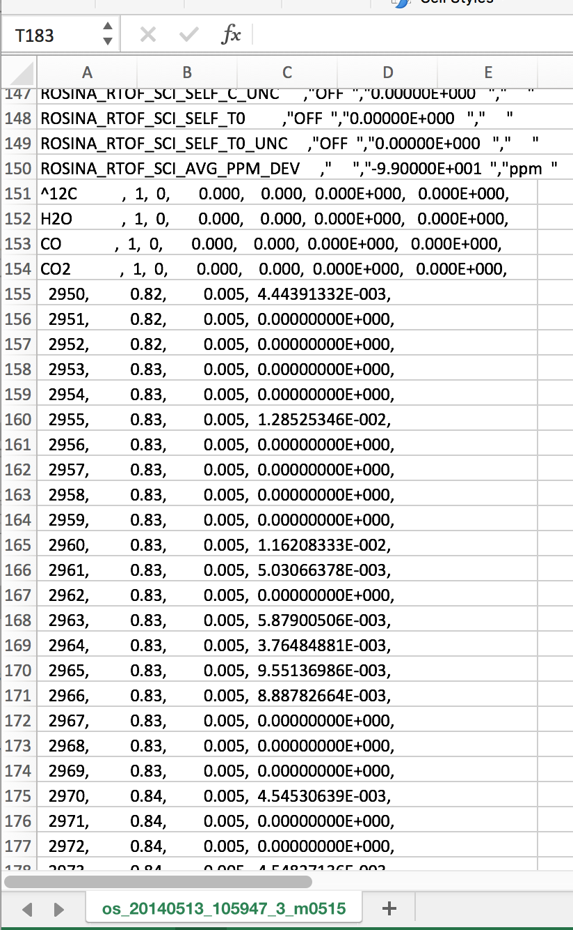
Need more significant figures in mass (calibrated data)
Mass resolution stated as a smaller fraction of amu.
For lower masses, insufficient significant figures.
Applies to both ss and os RTOF data files.
ss_20140424_083225_3_m0521

Slide 9
Missing calibration information
The raw files can use the information in the calibrated directory
The raw data can be useful with a rough calibration even without team calibration
As a initial point for deriving a higher-fidelity calibration.
Many scientists will want to repeat the calibration for themselves, too.
Even a rough calibration provides science; for example, it can permit identification of major species and relative abundances.
The equations for mass calibration are provided in the ICD, but the calibration parameters are only provided for DFMS CE.
Also, the equation for the RTOF has two typos.
Probably unnecessary with the RTOF mps files.
There are no data for converting counts (or events) to physical units.
Could find no information, no discussion.
Provide ranges if exact values are unavailable or inappropriate. Provide caveats, if appropriate.

Slide 10
Need a data analysis guide
These are complicated data, and a user guide is arguably necessary to facilitate analysis and generate a greater interest and use in these extraordinary data.
Examples of user-guide contents:
Provide basic descriptions of each data set
Define each parameter in the data files, and have an example on how to use them.
Include examples such as reproducing a published plot from PDS data.
The user manual included in the documentation folder is for operating ROSINA, and has little utility for data analysts.
The user guide does not have to be extensive, but it makes the data available to a much broader community and reduces the effort required to begin using the data.

Slide 11
Summary of findings for DFMS and RTOF
The ROSINA team has made great progress in archiving the data.
Primary needs are to guide users.
Data set is extensive and complex.
Need additional guidance to users for navigating the documentation and data files.
A users guide would fill most of the gaps; does not have to be extensive.
These are great instruments and great data, and a little more top-level documentation and file organization will make their data available and usable.

Slide 12
Additional detail follows

Slide 13
Calibration equations (red=typo, green=particularly useful)
2.5.3.2 Mass scale calculation for DFMS CE
m(stp)= m0-(wdth0*sqrt(m0)/stw) +(stp-1)*m0/stw
with m0: central mass, corresponds to commanded mass(ROSINA_DFMS_SCI_MASS), but may be sligthly shifted due to temperature effects, shift can be deduced from known masses, especially inflight gas calibration modes
wdth0: total scan width/2; =140 for LR; = 280 for HR
stw: =stepwidth; =4000 for LR and 40000 for HR
stp: step number
2.5.3.4 Mass scale calculation for RTOF
m(chn)=const*(chn*1.5-t0)^2
with chn: channel number const and t0 derived from (at least) two known mass peaks (m1 and m2 at channel chn1 and chn2) of the spectrum, temperatur dependent:
t0=(sqrt(m1/m2)*chn1-chn2)*1.5)/(sqrt(m1/m2)-1)
const=m1/(chn1*1.5-t0)^2

Slide 14
DATASET.CAT could contain much more information
Descriptions of the data coverage
Were data obtained continuously for all instruments, or only at certain times or in certain conditions? What were those times or conditions?
Are there gaps in coverage due to lost data or because not yet processed?
Descriptions of the data files and how they are organized.
For example, COPS files each cover 5 minutes and there are pressure readings every 2 seconds; why are there zeros in RTOF data changes 30 to 29000?; DFMC noise floor is 52,000; why is there a difference between LEDA rows A and B?; what mass ranges were commanded for the RTOF measurements?; etc.

Slide 15
Other missing information
No RTOF FAR data.
No ERRATA.TXT file
RTOF_MASS_CAL.FMT file referenced but not provided.

Slide 16
Other thoughts
Most problems are systemic and not adequately addressed by adding a few notes or by fixing only the specific examples provided.
COPS data (pressure) are calibrated and may be ready to use.
Missing some descriptions of the dataset such as time periods, parameters.
Did not do thorough review of the COPS documentation.
Could remove some repetition.
Example: instrument requirements and design are in three places: instrument.cat, ICD, operations manual. And also in the referenced SSR paper.
It is worth repeating:
The dataset is unique, valuable, and a great resource to the planetary-science community. It would be a shame if the dataset were not fully utilized.

