Slide 1
Rosetta Orbiter RPCLAP Archive Comments ro-c-rpclap-2-prl-com-v2.0 ro-c-rpclap-2-prl-mtp003-v2.0 ro-c-rpclap-2-prl-mtp004-v2.0 ro-c-rpclap-2-prl-mtp005-v2.0 ro-c-rpclap-2-prl-mtp006-v2.0 ro-c-rpclap-2-prl-mtp007-v2.0 ro-c-rpclap-2-prl-mtp008-v2.0 ro-c-rpclap-2-prl-mtp009-v2.0 ro-c-rpclap-2-esc1-mtp010-v2.0 ro-c-rpclap-2-esc1-mtp011-v2.0 ro-c-rpclap-2-esc1-mtp012-v2.0 ro-c-rpclap-2-esc1-mtp013-v2.0 ro-c-rpclap-2-esc2-mtp014-v2.0 ro-c-rpclap-2-esc2-mtp015-v2.0 ro-c-rpclap-2-esc2-mtp016-v2.0 ro-c-rpclap-2-esc2-mtp017-v2.0 ro-c-rpclap-2-esc3-mtp018-v2.0 ro-c-rpclap-2-esc3-mtp019-v2.0 ro-c-rpclap-2-esc3-mtp020-v2.0 ro-c-rpclap-2-esc3-mtp021-v2.0 ro-c-rpclap-2-esc4-mtp022-v2.0 ro-c-rpclap-2-esc4-mtp023-v2.0 ro-c-rpclap-2-esc4-mtp024-v2.0 ro-c-rpclap-2-ext1-mtp025-v2.0 ro-c-rpclap-2-ext1-mtp026-v2.0 ro-c-rpclap-2-ext1-mtp027-v2.0 ro-c-rpclap-2-ext2-mtp028-v2.0 ro-c-rpclap-2-ext2-mtp029-v2.0 ro-c-rpclap-2-ext2-mtp030-v2.0 ro-c-rpclap-2-ext3-mtp031-v2.0 ro-c-rpclap-2-ext3-mtp032-v2.0 ro-c-rpclap-2-ext3-mtp033-v2.0 ro-c-rpclap-2-ext3-mtp034-v2.0 ro-c-rpclap-2-ext3-mtp035-v2.0 ro-c-rpclap-3-ext1-calib2-v1.0
S. Joy

Slide 2
Overview
All of the ro-*rpclap* review volumes share a large number of common files: catalog files, documents, required files (Xxinfo.TXT), etc. rather than repeating comments on those files in every presentation my comments are all included here
Most of the common files have been previously reviewed so there is an expectation that the files would be in pretty good shape.

Slide 3
Root Directory Files (aareadme, voldesc)
ro-c-rpclap-2-prl-com-v2.0 Files are present and valid
ro-c-rpclap-2-prl-mtp003-v2.0 Files are present and valid
ro-c-rpclap-2-prl-mtp004-v2.0 Files are present and valid
ro-c-rpclap-2-prl-mtp005-v2.0 Files are present and valid
ro-c-rpclap-2-prl-mtp006-v2.0 Files are present and valid
ro-c-rpclap-2-prl-mtp007-v2.0 Files are present and valid
ro-c-rpclap-2-prl-mtp008-v2.0 Files are present and valid
ro-c-rpclap-2-prl-mtp009-v2.0 Files are present and valid
ro-c-rpclap-2-esc1-mtp010-v2.0 Files are present and valid
ro-c-rpclap-2-esc1-mtp011-v2.0 Files are present and valid
ro-c-rpclap-2-esc1-mtp012-v2.0 Files are present and valid
ro-c-rpclap-2-esc1-mtp013-v2.0 Files are present and valid
ro-c-rpclap-2-esc2-mtp014-v2.0 Files are present and valid
ro-c-rpclap-2-esc2-mtp015-v2.0 Files are present and valid
ro-c-rpclap-2-esc2-mtp016-v2.0 Files are present and valid
ro-c-rpclap-2-esc2-mtp017-v2.0 Files are present and valid

Slide 4
Root Directory Files, con’t (aareadme, voldesc)
ro-c-rpclap-2-esc3-mtp018-v2.0 Files are present and valid
ro-c-rpclap-2-esc3-mtp019-v2.0 Files are present and valid
ro-c-rpclap-2-esc3-mtp020-v2.0 Files are present and valid
ro-c-rpclap-2-esc3-mtp021-v2.0 Files are present and valid
ro-c-rpclap-2-esc4-mtp022-v2.0 Files are present and valid
ro-c-rpclap-2-esc4-mtp023-v2.0 Files are present and valid
ro-c-rpclap-2-esc4-mtp024-v2.0 Files are present and valid
ro-c-rpclap-2-ext1-mtp025-v2.0 Files are present and valid
ro-c-rpclap-2-ext1-mtp026-v2.0 Files are present and valid
ro-c-rpclap-2-ext1-mtp027-v2.0 Files are present and valid
ro-c-rpclap-2-ext2-mtp028-v2.0 Files are present and valid
ro-c-rpclap-2-ext2-mtp029-v2.0 Files are present and valid
ro-c-rpclap-2-ext2-mtp030-v2.0 Files are present and valid
ro-c-rpclap-2-ext3-mtp031-v2.0 Files are present and valid
ro-c-rpclap-2-ext3-mtp032-v2.0 Files are present and valid
ro-c-rpclap-2-ext3-mtp033-v2.0 Files are present and valid
ro-c-rpclap-2-ext3-mtp034-v2.0 Files are present and valid
ro-c-rpclap-2-ext3-mtp035-v2.0 Files are present and valid
ro-c-rpclap-3-ext1-calib2-v1.0 Files are present and valid

Slide 5
Root Directory Files, con’t (aareadme, voldesc)
Editorial Comment:
There is next to no useful information for the user in either the aareadme.txt or voldesc.cat files. These volumes would be improved if either of the two root level files provided the date/time range covered by the volume. This could be done by placing a table of mtp00xx start/stop times in the aareadme (least work), including a line at the top of the aareadme file with just the current volume start/stop times (i.e. “RCP-LAP volume rolap_XXXX contains (raw/calibrated) data from start to stop.”), or adding the above text to the to the DESCRIPTION in the voldesc.cat file

Slide 6
/CATALOG Files
catinfo.txt
rosetta_mission.cat (various typos, content fine)
rosetta_insthost.cat (various typos, content fine)
rosetta_ref.cat
rosetta_target.cat
rpcmag_inst.cat
rpcmag_software.cat
rpcmag_pers.cat

Slide 7
/CATALOG dataset.cat files
ro-c-rpclap-2-prl-com-v2.0 File is present and valid
ro-c-rpclap-2-prl-mtp003-v2.0 File is present and valid
ro-c-rpclap-2-prl-mtp004-v2.0 File is present and valid
ro-c-rpclap-2-prl-mtp005-v2.0 File is present and valid
ro-c-rpclap-2-prl-mtp006-v2.0 File is present and valid
ro-c-rpclap-2-prl-mtp007-v2.0 File is present and valid
ro-c-rpclap-2-prl-mtp008-v2.0 File is present and valid
ro-c-rpclap-2-prl-mtp009-v2.0 File is present and valid
ro-c-rpclap-2-esc1-mtp010-v2.0 File is present and valid
ro-c-rpclap-2-esc1-mtp011-v2.0 File is present and valid
ro-c-rpclap-2-esc1-mtp012-v2.0 File is present and valid
ro-c-rpclap-2-esc1-mtp013-v2.0 File is present and valid
ro-c-rpclap-2-esc2-mtp014-v2.0 File is present and valid
ro-c-rpclap-2-esc2-mtp015-v2.0 File is present and valid
ro-c-rpclap-2-esc2-mtp016-v2.0 File is present and valid
ro-c-rpclap-2-esc2-mtp017-v2.0 File is present and valid

Slide 8
/CATALOG dataset.cat files, con’t
ro-c-rpclap-2-esc3-mtp018-v2.0 File is present and valid
ro-c-rpclap-2-esc3-mtp019-v2.0 File is present and valid
ro-c-rpclap-2-esc3-mtp020-v2.0 File is present and valid
ro-c-rpclap-2-esc3-mtp021-v2.0 File is present and valid
ro-c-rpclap-2-esc4-mtp022-v2.0 File is present and valid
ro-c-rpclap-2-esc4-mtp023-v2.0 File is present and valid
ro-c-rpclap-2-esc4-mtp024-v2.0 File is present and valid
ro-c-rpclap-2-ext1-mtp025-v2.0 File is present and valid
ro-c-rpclap-2-ext1-mtp026-v2.0 File is present and valid
ro-c-rpclap-2-ext1-mtp027-v2.0 File is present and valid
ro-c-rpclap-2-ext2-mtp028-v2.0 File is present and valid
ro-c-rpclap-2-ext2-mtp029-v2.0 File is present and valid
ro-c-rpclap-2-ext2-mtp030-v2.0 File is present and valid
ro-c-rpclap-2-ext3-mtp031-v2.0 File is present and valid
ro-c-rpclap-2-ext3-mtp032-v2.0 File is present and valid
ro-c-rpclap-2-ext3-mtp033-v2.0 File is present and valid
ro-c-rpclap-2-ext3-mtp034-v2.0 File is present and valid
ro-c-rpclap-2-ext3-mtp035-v2.0 File is present and valid
ro-c-rpclap-3-ext1-calib2-v1.0 File is present and valid

Slide 9
/CATALOG dataset.cat files, con’t
RID (minor): There is an inconsistency in the text of the dataset.cat regarding the usablility of the -2- data for doing science (see text below with proposed solution).
B. Dataset status
-----------------
This dataset contains scientifically useful data from the Rosetta
RPC-LAP instrument.
C. Scientific use
-----------------
The edited science data files are supplied mainly for long-term
archiving and reference purposes, and are not intended or suitable
for regular scientific use.
Proposed Update:
C. Scientific use
-----------------
While the edited data are scientifically useful to instrument experts, these data files are supplied mainly for long-term archiving and reference purposes and are not intended or suitable for scientific use by the wider community.

Slide 10
Document
docinfo.txt (all volumes)
eriksson2007a.pdf (.lbl) - ok, no changes requested
eriksson2008a.pdf (.lbl) - ok, no changes requested
ro-irfu-lap-eaicd-1_11.pdf (.lbl) - ok, no changes requested
ro-irfu-lapmac-150703.pdf (.lbl)… ro-irfu-lapmac-160804.pdf (lbl) - ok, no changes requested
Flight Reports Subdirectory
irfu-ros-opr-prl_v10.pdf (lbl) ..
irfu-ros-opr-ext3_v10.pdf (lbl) – all ok, no changes requested

Slide 11
Index Files
indxinfo.txt
RID (minor): This files does not mention the checksum file or its usage. In addition, this file describes BROWSE_INDEX and GEO_XXXX, neither or which are present on volumes. Please fix both issues so that the file describes the contents of the directory on these volumes.
index.tab (.lbl)
checksum.tab (.lbl)

Slide 12
Data Directories

Slide 13
ro-c-rpclap-2-*-*-v2.0
The data are still dispersed over thousands of files per day making them very difficult to work with or validate. This statement has been made in all previous reviews so there is no expectation that there will be changes to the data set structure now or in the future.
This issue is mostly addressed by the dataset.cat file

Slide 14
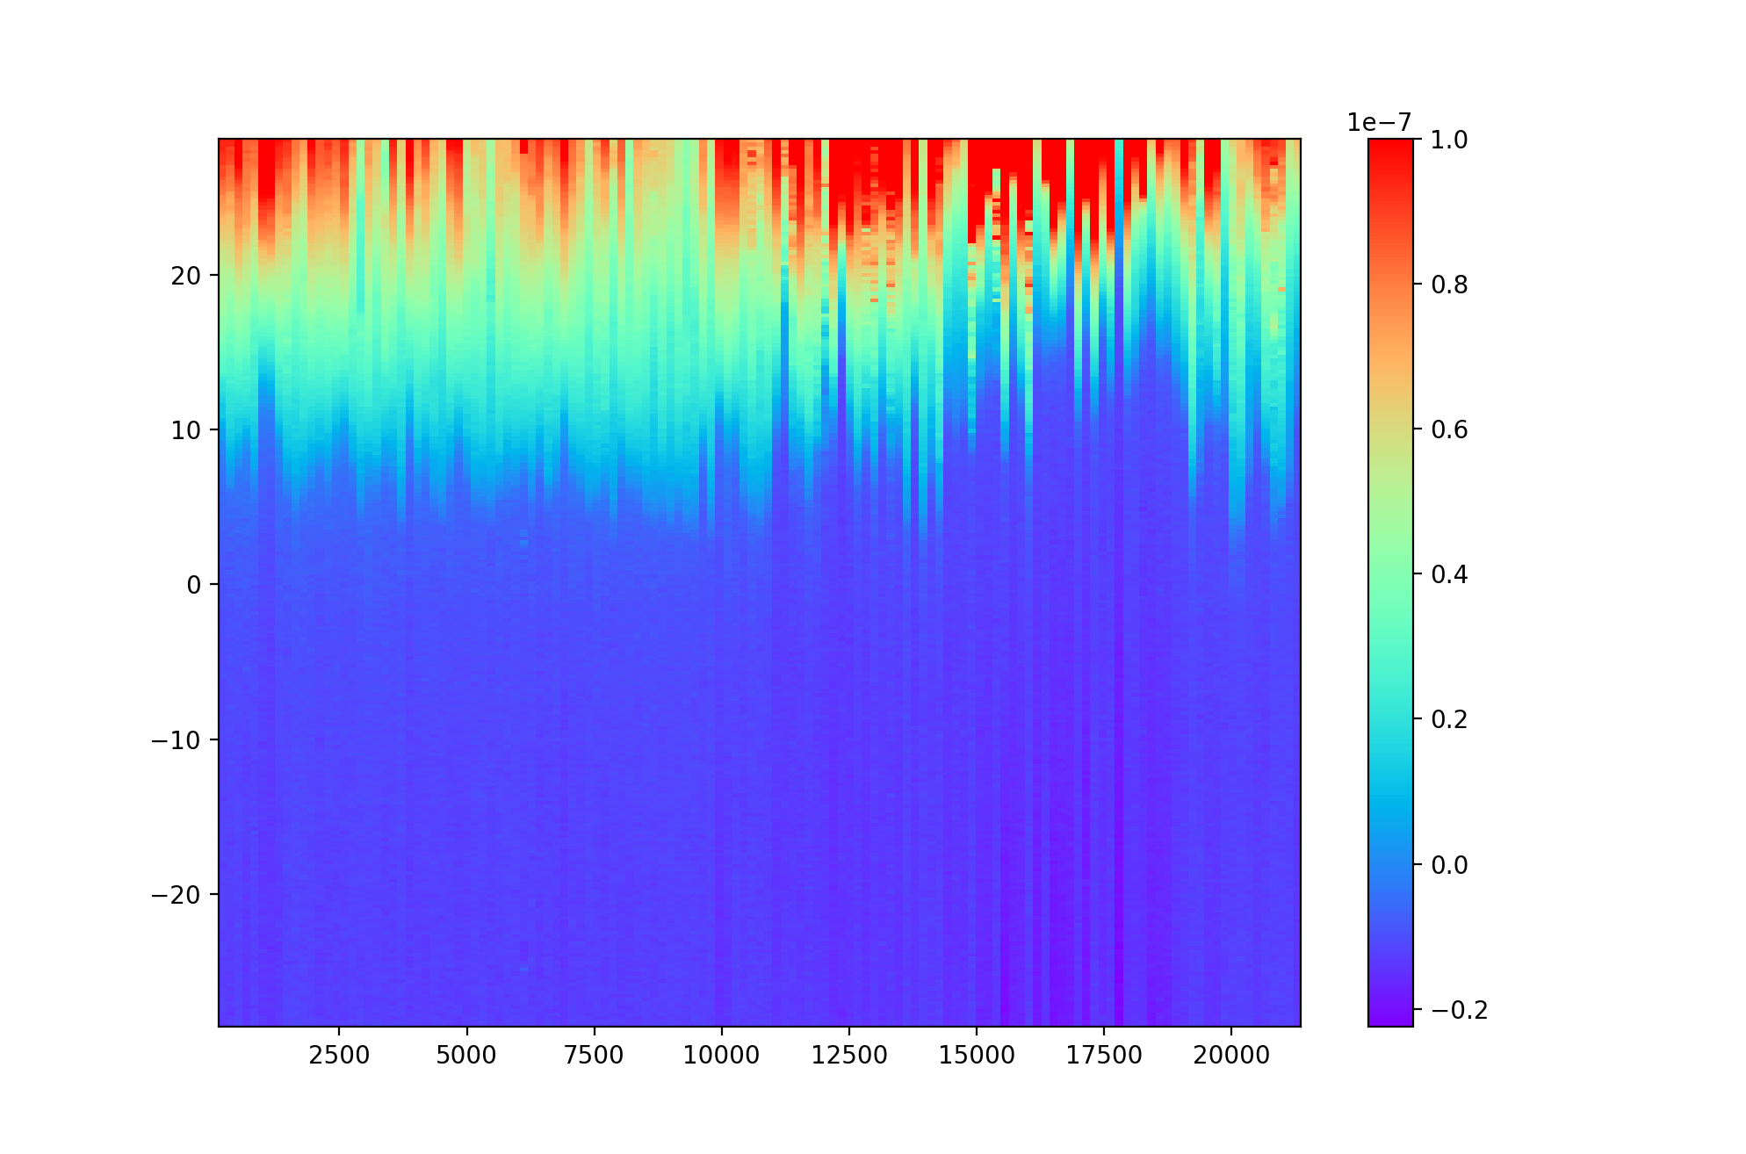
ro-c-rpclap-3-ext1-calib2-v1.0_2105
lap_20160120_000000_914_i1s.tab shows the currents from a 240 voltage step sweep early on Jan 20, 2016
1e-7
-28
Ampere
Volts
0
28
00:00
03:00
06:00
1e-10

Slide 15
ro-c-rpclap-3-ext1-calib2-v1.0_2105
These data are much easier to work with despite the many caveats regarding their usage.
Main concern here is the lack of comet coverage
Only one data set was provided for EXT1 (Jan-Apr, 2016).

Slide 16
Summary
Other than fixing a few minor spelling errors to some of the mission catalog files, and in the indxinfo.txt files, things are in good shape.
RID: (minor): There is an inconsistency in the text of the dataset.cat regarding the usablility of the -2- data for doing science
RID: (minor): Issue with indxinfo.txt on all volumes
RID: (editorial) There is next to no useful information for the user in either the aareadme.txt or voldesc.cat files. These volumes would be improved if either of the two root level files provided the date/time range covered by the volume. This could be done by placing a table of mtp00xx start/stop times in the aareadme (least work), including a line at the top of the aareadme file with just the current volume start/stop times (i.e. “RCP-LAP volume rolap_XXXX contains (raw/calibrated) data from start to stop.”), or adding the above text to the to the DESCRIPTION in the voldesc.cat file
All of these data sets can be “certified” with liens
Additional -3- data would be very helpful to the community

