Slide 1
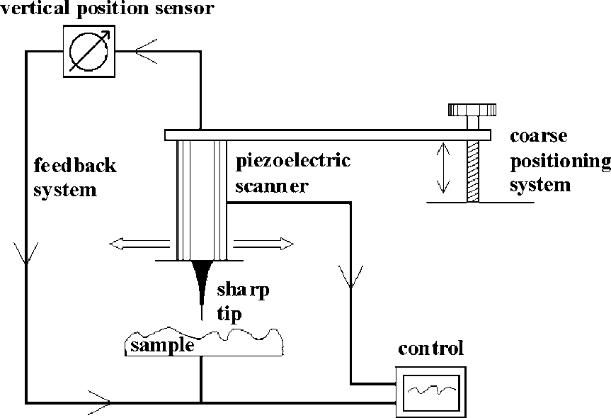
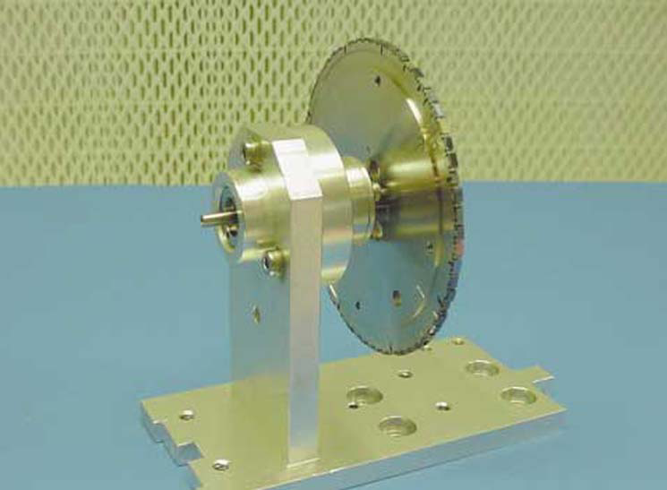
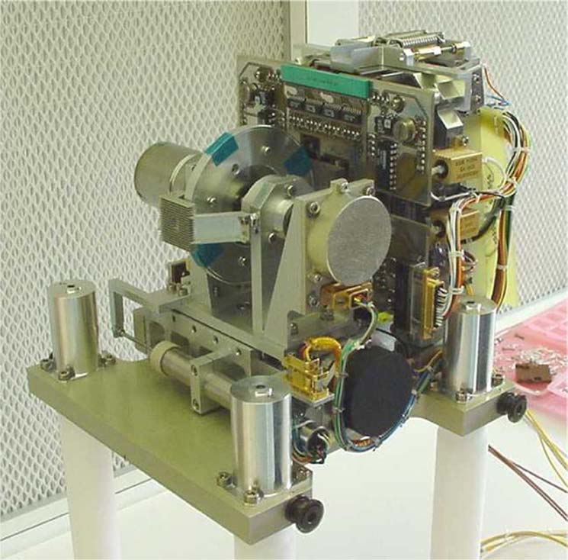
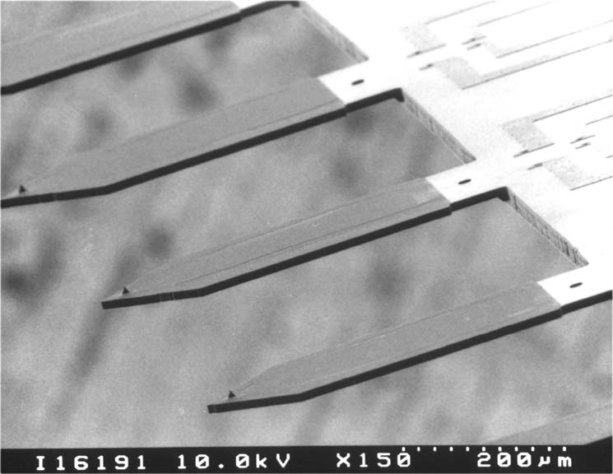
The Rosetta/MIDAS AFM/MFM
MIDAS – THE MICRO-IMAGING DUST ANALYSIS SYSTEM FOR THE ROSETTA MISSION
W. Riedler et al., Space Sci. Revs. (2007) 128: 869–904
AGGREGATE DUST PARTICLES AT COMET 67P/CHURYUMOV-GERASIMENKO
M. Bentley et al., Nature (2016) 537:73-75

Slide 2
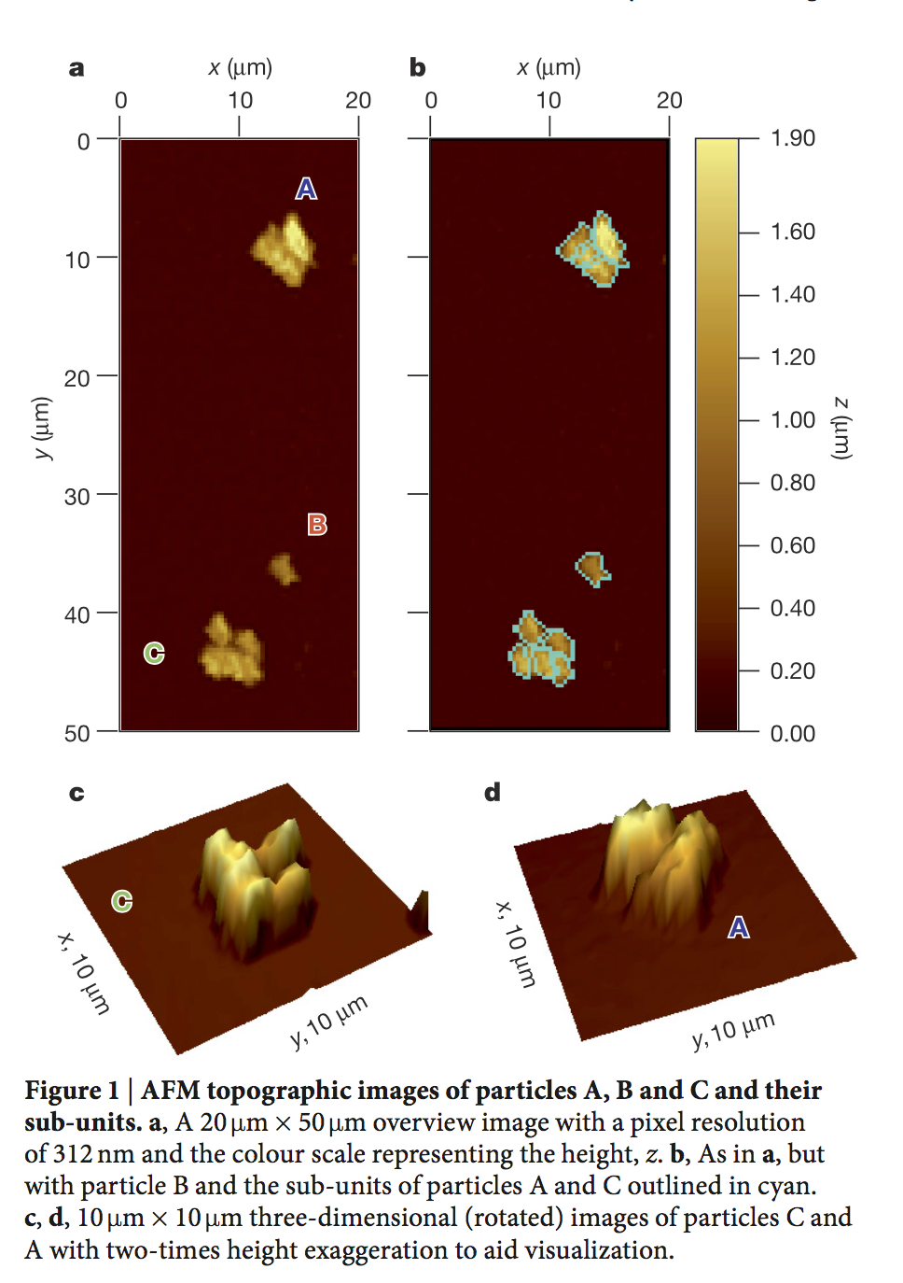
Characteristics of MIDAS AFM/MFM
64 targets with resin surfaces
16 cantilevers/tips (4 magnetic), 1.6 mm apart
100µ x 100µ x 7µ range
Mechanical coarse approach
Piezoelectric scanner
Piezoresistive feedback
Piezoelectric oscillators (dynamic mode)
Bentley et al. (2016) Nature 537, 73

Slide 3
Review material
Data to be reviewed
RO-D-MIDAS-3-ESC4-SAMPLES-V1.0
RO-D-MIDAS-3-EXT1-SAMPLES-V1.0
RO-D-MIDAS-3-EXT2-SAMPLES-V1.0
RO-D-MIDAS-3-EXT3-SAMPLES-V1.0
Data Types
CAH – CANTILEVER (TIP) HISTORY
EVN – EVENT RECORD
FSC – FREQUENCY SCAN
HK1 – STANDARD HOUSEKEEPING
HK2 – EXTENDED HOUSEKEEPING
LIN – LINE SCAN
ROI – REGION OF INTEREST (FEATURE VECTOR)
SPA – SINGLE POINT APPROACH
SPS – SINGLE POINT SCAN
TGH – TARGET HISTORY
IMG – IMAGES
Documentation
User manual
ICD
Coordinates
Other
IDL Code (MID-BROWSE)
AAREADME.TXT
Calibration files
Catalog files
Index Files
Label (format) files

Slide 4
Review objectives
Confirm the completeness and scientific integrity of the data sets :
Data quality (e.g. signal-to-noise ratio, radiance level, instrument artifacts).
Data processing levels.
Usage of proper units.
Whether the needs of the scientific community are met.
Confirm that the datasets contain the necessary instrument science, instrument housekeeping, spacecraft housekeeping and science operations information necessary to execute instrument, cross-instrument and cross-mission data analysis.
Verify that the documentation is complete and sufficient for data processing and analysis.
Confirm that calibration information provided is complete, and that the reviewer can obtain the same results as in the data set if he/she follows the described procedure.
Confirm the long-term scientific usability of the data, e.g. against already existing planetary archives.
Confirm the usefulness of the provided data sets for analysis by the science community e.g. by attempting to read/manipulate the data (without team-provided software) to produce or reproduce scientifically published results (if feasible)
Check the closeout of science RIDs raised from the previous reviews:
Shortcomings - including detailed recommendations and their implementation period.

Slide 5
Review comments
M. Hecht

Slide 6
Review activities
Reviewed March, 2012 findings
Verified that files can be read by:
NASAView
Minimum capability, one file at a time
Displays labels, tables, etc.
READPDS
IDL-based
Similar utility to NASAView
SPIP
Commercial scanned probe image analysis capability
Image manipulation, 3D rendering, filtering metrology, etc.
Allows browsing of full directory of images
Displays text files (e.g. labels)
Reviewed documentation & provided IDL code
Examined selection of files with observed particles

Slide 7
1. Completeness & Scientific Integrity
Data quality is consistent with typical laboratory AFM experience. Most of the scans are not scientifically useful, but an acceptable number contain images of particles that can be associated with accumulation at the astronomical target.
For these, scientific and measurement context are appropriate, and the images are compatible with common scientific analysis methods and tools.
Images cited in Nature paper were reproduced:
Fig 1: IMG_1509813_1512600_054_ZS (ESC2: target 15/solgel, tip #9)
Fig 2: IMG_15070011506923_1508813_005_ZS (ESC2 Target 13/solgel, tip #9)
Fig 3: IMG_1501323_1504200_013_ZS (ESC1: target 13/solgel, tip #7)
These were not in the datasets to be reviewed.
Note error in Nature image citation
Note that Nature citation is not in Reference catalog

Slide 8
Other images examined with SPIP (commercial software)
ESC4
1529232_1532200_009_ZS (Target 3, Tip #14, Calibration)
1529232_1532200_021_ZS (Target 4 Tip #18 Calibration)
1529323_1532200_089_ZS (Target 11/Solgel, Tip #9)
1532123_1535000_103_ZS (Target 11/Solgel, Tip #9)
EXT1
IMG_1601223_1604100_003_ZS (Tip imaging; Target 4, Tip #14, Calibration)
IMG_1601223_1604100_036_ZS (Tip imaging; Target 4, Tip #11, Calibration)
IMG_1604023_1606900_068_ZS (Target 11/solgel, Tip #9)
EXT2
IMG_1609623_1612500_001_ZS (target 14/solgel, tip #1)
IMG_1609623_1612500_009_ZS (target 14/solgel, tip #1)
IMG_1609623_1612500_079_ZS (target 14/solgel, tip #1)
IMG_1615223_1618100_255_ZS (target 14/solgel, tip #4)
IMG_1615223_1618100_340_ZS (target 14/solgel, tip #4)

Slide 9
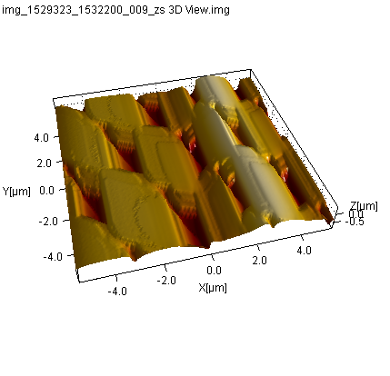
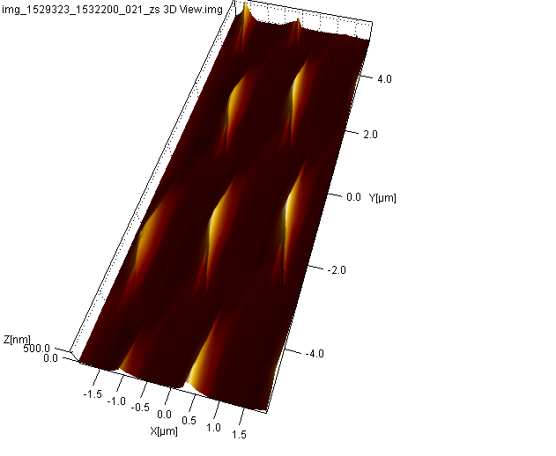
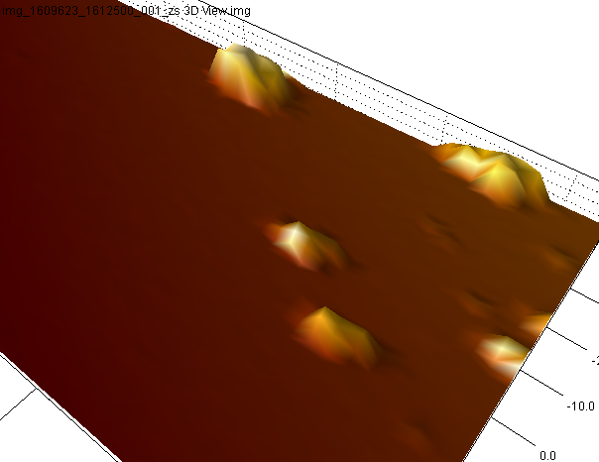
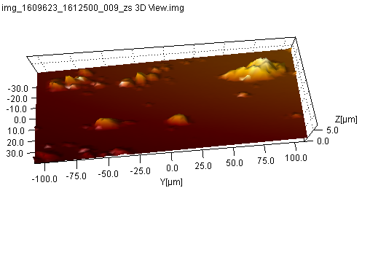
ESC4
1529232_1532200_021_ZS
(Target 4 Tip #18 Calibration)
1529232_1532200_009_ZS
(Target 3, Tip #14, Calibration)
EXT2
IMG_1609623_1612500_001_ZS
(target 14/solgel, tip #1)
IMG_1609623_1612500_009_ZS
(target 14/solgel, tip #1)

Slide 10
2. Instrument Science, housekeeping, and operations
These can all be read and appear to be complete
Could not operate the IDL-based MID_BROWSE software (IDL version compatibility problem?)
Without this software, it is painstaking to assemble and display the measurements associate with a particular image.

Slide 11
3. Documentation (1 of 2)
While many documentation concerns from prior review have been addressed, some remain -- particularly in the EAICD. Select items are listed below.
Coordinate System document:
The term “row” is still poorly defined
User Manual
Still refers to “silicon” damping material and “silicon” rubber, where silicone is clearly intended
EAICD
Terms such as “Observation,” “sequence,” “scenario” or “segment” are still poorly defined.
Without the IDL software, it is difficult to collect the various data items associated with a particular scan
The term “TARGET” refer both to the substrate or coupon being imaged and to the astronomical object under study, often in the same label files.

Slide 12
Documentation (2 of 2). More from EAICD
Section 2.5 (Overview of Data Products)
Image Scan Data description would benefit by a discussion of the scan algorithms utilized (forwards, backwards, interleaved, etc.).
I couldn’t find anything about completion status of the image.
The Channel Number is indicated only in the filename. It would be useful to have as a keyword.
Section 3.2.4 (Other Applicable Standards)
Oddly, this is where the description of the IMG format is found. It should be placed in a more appropriate Section.
The IMG format includes several optional header items, among them “current,” which defines the tunneling current – a parameter inapplicable to an AFM. Extraneous parameters such as this should be removed from the description if they are not part of the MIDAS dataset, or at least prefaced by an indication that they are part of the SPIP standard but not used here.
Section 3.4.2.2 (Calibration Directory)
Here, description and offsets are listed but there is not description of the governing equation, hence the sign of the offset is unclear. It can be inferred that “value = data*calibration factor + offset,” but this should be explicit.
Within the “description” column are (presumably) parenthetical ranges, but this is not indicated in the column header.
Many calibration values don’t indicate data type (real, integer, etc.) or number of bits. This is presumably in the corresponding detailed descriptions, but a prose description would be appropriate as well since the data word type does not necessarily reflect the content (e.g. a 16-bit unsigned value may only have 12 bits of useful information).

Slide 13
4. Calibration
Confirmed that image files carry proper xyz physical dimensions and have usable dynamic range
Calibration check verified against cal grid
Able to reproduce published results in Nature (Bentley et al., Nature 537, p. 73, 2016). Note that it’s not mentioned in the Reference catalog.

Slide 14
5. Long-term Scientific Usability
This is a unique dataset that stands alone with respect to other planetary archives.

Slide 15
6. Usefulness
Confirmed that the data can be read by NASAVIEW & READPDS (for PDS 3)
Confirmed that the images can be manipulated by SPIP
Confirmed that the data can be read independently by a Matlab program
This reviewer was not able to read the data with the user-provided IDL software. It is suspected that the software was developed under an earlier version of IDL and is no longer compatible. This made it difficult to check all the data types.
This reviewer was unable to discern the relationship between the list of files in Dataset.CAT and the data files themselves (see next page)
Ambiguous use of the term “TARGET,” as noted above
It would be useful if CAH files and TGH files were put into their own folders, like the other data types.

Slide 16
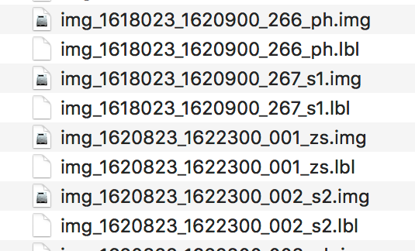
Dataset.cat compared to IMG files (EXT3 volume)
Dataset.cat
Scenario ID DAQ (YYDDDhhmm) Target Tip ImgSize StpSize D Mode
------------------------------------------------------------------------
MTP031 STP115 000 161810729-161811410 4 CAL 2 256x256 4x 11 Y DYNA
004 161811937-161820517 4 CAL 4 448x448 2x 6 Y DYNA
006 161821310-161821358 2 CAL 5 256x 32 10x 27 X DYNA
010 161821524-161821611 2 CAL 5 256x 32 10x 27 X DYNA
014 161821738-161821824 2 CAL 5 256x 32 10x 27 X DYNA
“The images listed in the DATSET.CAT file can be found in the /DATA/IMG directory and have corresponding IMG_<start>_<end>_<ID>_ZS.LBL labels, where <start>/<end> are denoting the medium term planning period (MTPxxx in the listing) and <ID> is a sequential number which is reset for each new planning period.”
The following file naming scheme will be used for all data sets… {data type}_{start}_{stop}[_{extra}].{ext}
{data type} = {CAH, EVN, FSC, HK1, HK2, IMG, LIN, ROI, SPA, SPS, TGH}
{start} = begin of observation rounded to nearest hour, format = yydddhh
{stop} = end of observation rounded to nearest hour, format = yydddhh
{extra} = more specific information about the file content:

Slide 17
7. Closeout to March 31, 2012 Items
See notes under “Documentation”

Slide 18
8. Shortcomings
Narrative portion of documentation needs some improvement
IDL mid_browse code needs to maintain IDL compatibility

Slide 19
RIDS filed
Science Panel 253
Dataset.CAT relationship to data files is obscure
Accepted but noted that: The images listed in the DATSET.CAT file can be found in the /DATA/IMG directory and have corresponding IMG_<start>_<end>_<ID>_ZS.LBL labels… This does not seem to be the case for the dataset inspected.
Science Panel 254:
Dual use of term “Targets” is confusing (partly accepted)

