Slide 1
Deep Impact Photometry of Comet 103P/Hartley 2 by Bodewits et al.
PDS SBN Data Review, 06 Oct 2013
Michael S. P. Kelley

Slide 2
Overview
This data set consists of derived photometry from Deep Impact Medium-Resolution Imager (optical CCD) images of comet 103P/Hartley 2.
The data were collected as part of the DIXI mission, a subset of the EPOXI mission, from 1 Oct to 26 Nov 2010.
The photometry was derived from data using the following filters: CLEAR1, OH, CN, C2, UV continuum, Green continuum (~300 to ~530 nm).
Images taken when the nucleus was resolved by the MRI were not analyzed.

Slide 3
Review Summary
The data set and documentation is in good order.
The documentation includes a well-written description of the data analysis.
The data look great.
There are some details in the documentation that are needed, mostly for clarification.
The data set has an unusual format, but it is not wrong or esoteric.

Slide 4
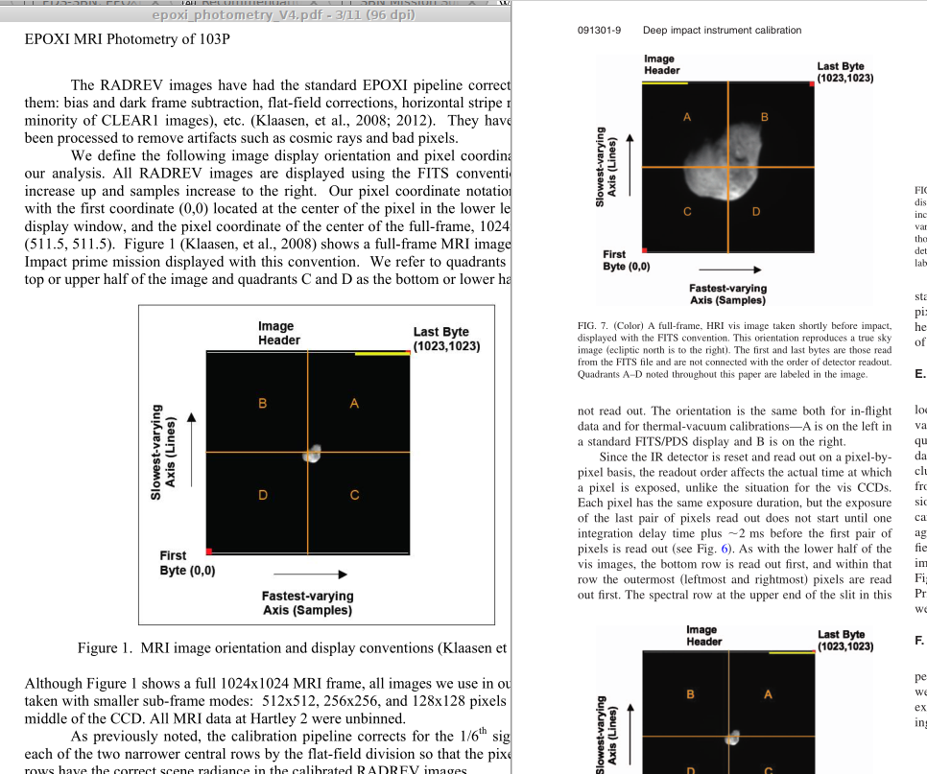

Slide 5
Recommended Liens
(All liens have been emailed in a separate text file.)
1) Identification_Area - Fix name of comet "103P/Hartley 2" in title: EPOXI MRI-VIS 103/Hartley 2 Encounter Photometry Collection
2) Modification_History (in all labels) - This data set labeled v1.0, but v1.0 was a PDS3 data set by Williams et al. I recommend v2. Is it OK for PDS4 to start with v2?
3) Does Modification_Detail "Initial conversion from PDS3 to PDS4" make sense in this dataset's context? This is a whole new dataset/version. It is not a conversion from the Williams et al. PDS3 dataset.
There should be some note that explains this is a new version of the Williams et al. data set. It seems like Modification_Detail is the right place.

Slide 6
Recommended Liens
4) overview.txt a) character encoding is off: There are UTF-8 characters, but emacs displayed it as iso-latin-1-dos? I got an error with "mousepad". Please correct.

Slide 8
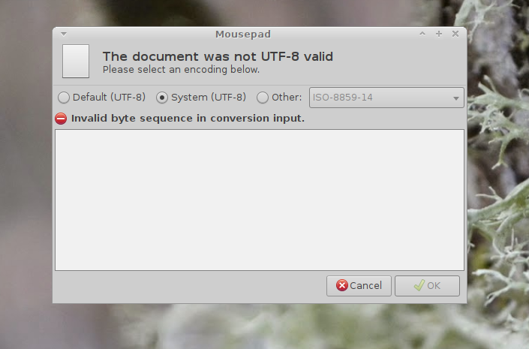

Slide 9
Recommended Liens
4b) overview.txt is missing discussion of the prior version: Williams, J.L., Li, J.-Y., Bodewits, D., and McLaughlin, S.A., EPOXI 103P/HARTLEY2 ENCOUNTER - MRI PHOTOMETRY V1.0, DIF-C-MRI-5-EPOXI-HARTLEY2-PHOTOM-V1.0, NASA Planetary Data System, 2012.

Slide 10
Recommended Liens
4c) overview.txt and in the main documentation:
Apertures in the files are: 0, 1, 2, 3, 4, 5, 6, 7, 8, 9, 10, 12, 14, 16, 18, 20, 25, 30, 35, 40, 45, 50, 55, 60, 80, 100, 120, 140, 160, 180, 200, 220, 240, 248 pixels.
All aperture photometry at > 20 pixel radius are invalid.
All profile photometry at < 10 pixels are invalid.
All photometry at <3 pixels are invalid.
These columns should just be deleted, no? It is a strange way to save data (i.e., not space efficient), but it is fine.
At a minimum, I recommend the reasoning behind the data structure be added to guide the user.

Slide 11
Recommended Liens
5d) The background is a major source of error for some data. This is due to the comet filling the field of view.
Aside from celestial sources, I think the background is dominated by bias residuals and associated noise (Klaasen et al. 2013).

Slide 12
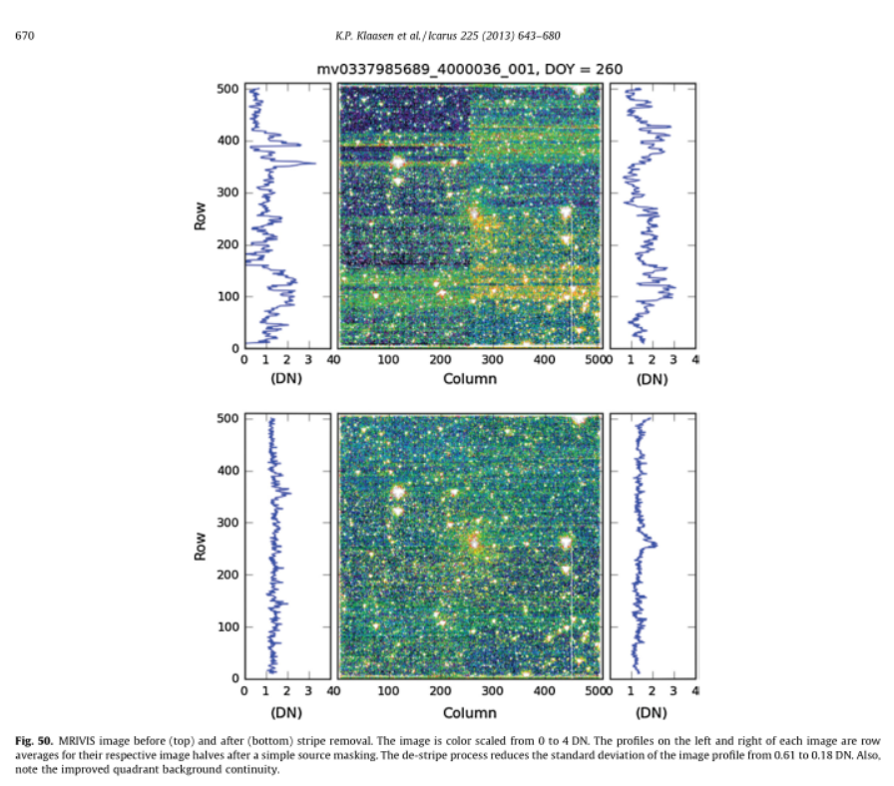

Slide 13
Recommended Liens
5d, continued)
The bias residuals are correlated noise with levels somewhere around 1 to 3 DN.
The background discussion quotes flux densities, but if the bias is the main source, then it should be described in DN first.
The conversion from DN to spectral irradiance depends on the exposure time and filter, so it will vary from frame to frame.
I recommend that this background source be described in units of DN, and converted to W/m2 μm as an example.

Slide 14
Recommended Liens
5d, continued)
The document estimates the background, but not for all the filters.
If the background is described as DN first, then one would be able to estimate the background for the C2, OH, GC, and UC images.

Slide 15
Analysis time...

