Slide 1
EPOXI MRI-VIS 103/Hartley 2 Encounter Photometry Collection
Review by Matthew Knight
October 6, 2017

Slide 2
Overview
Version 2 of EPOXI encounter photometry of 103P/Hartley 2
Data consists of several large tables (and associated XML files)
Documentation good, XML has all info I looked for
Minor comments/questions about documentation
Minor typos given elsewhere
Overview.txt does not explain differences with respect to v1 (given on p. 10 of PDF)
No mention of “Anomalous behavior of MRI” document in other documents
Does not appear to be any data at these affected phase angles
Should there be names/references for the datasets from which these data are derived (images, calibration, etc.)?
PDF p.5 says “We do not recommend using apertures with a radius smaller than 3 pixels for photometry” but plots photometry in a 2 pixel radius in Fig. 2 immediately above it!

Slide 3
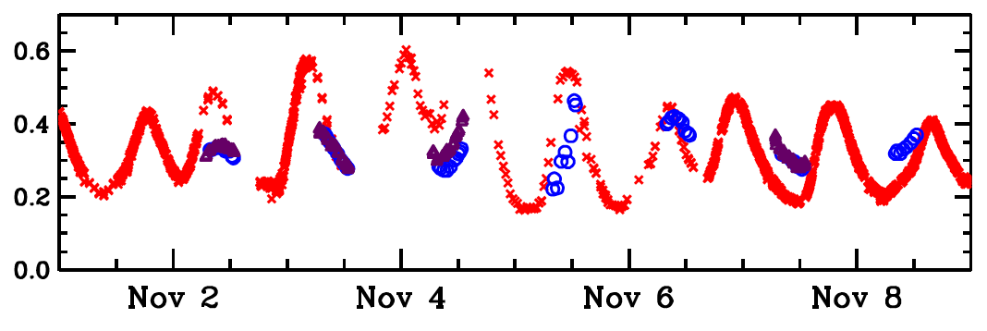
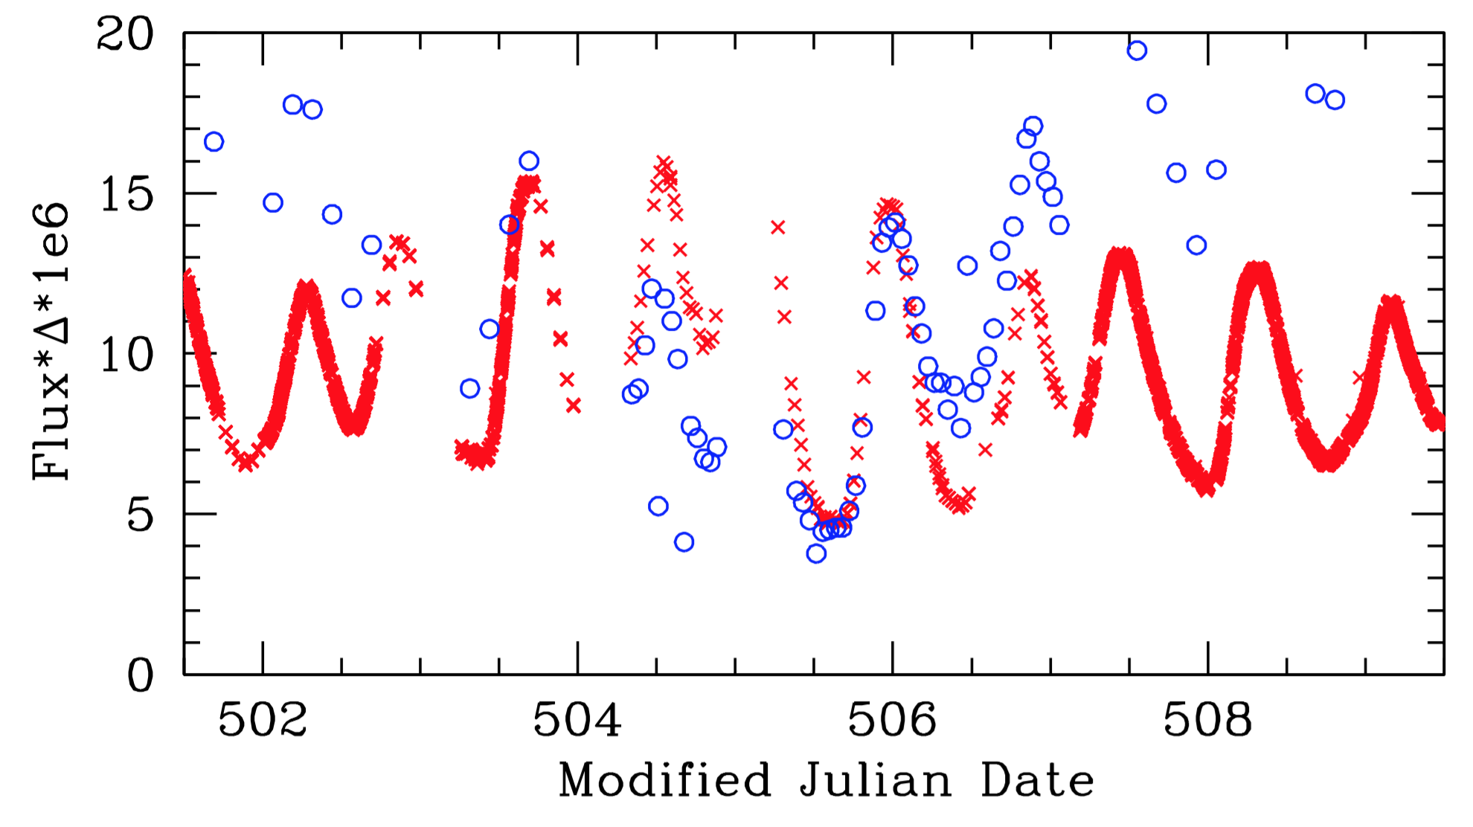
Photometry comparison
Compare V2 small aperture photometry (bottom) with V1 as published in Knight et al. 2015 (top)
Red = clear filter, blue = CN (from ground in top panel)
Data are in good agreement
Easy to find exactly the columns I needed in the XML labels

Slide 4
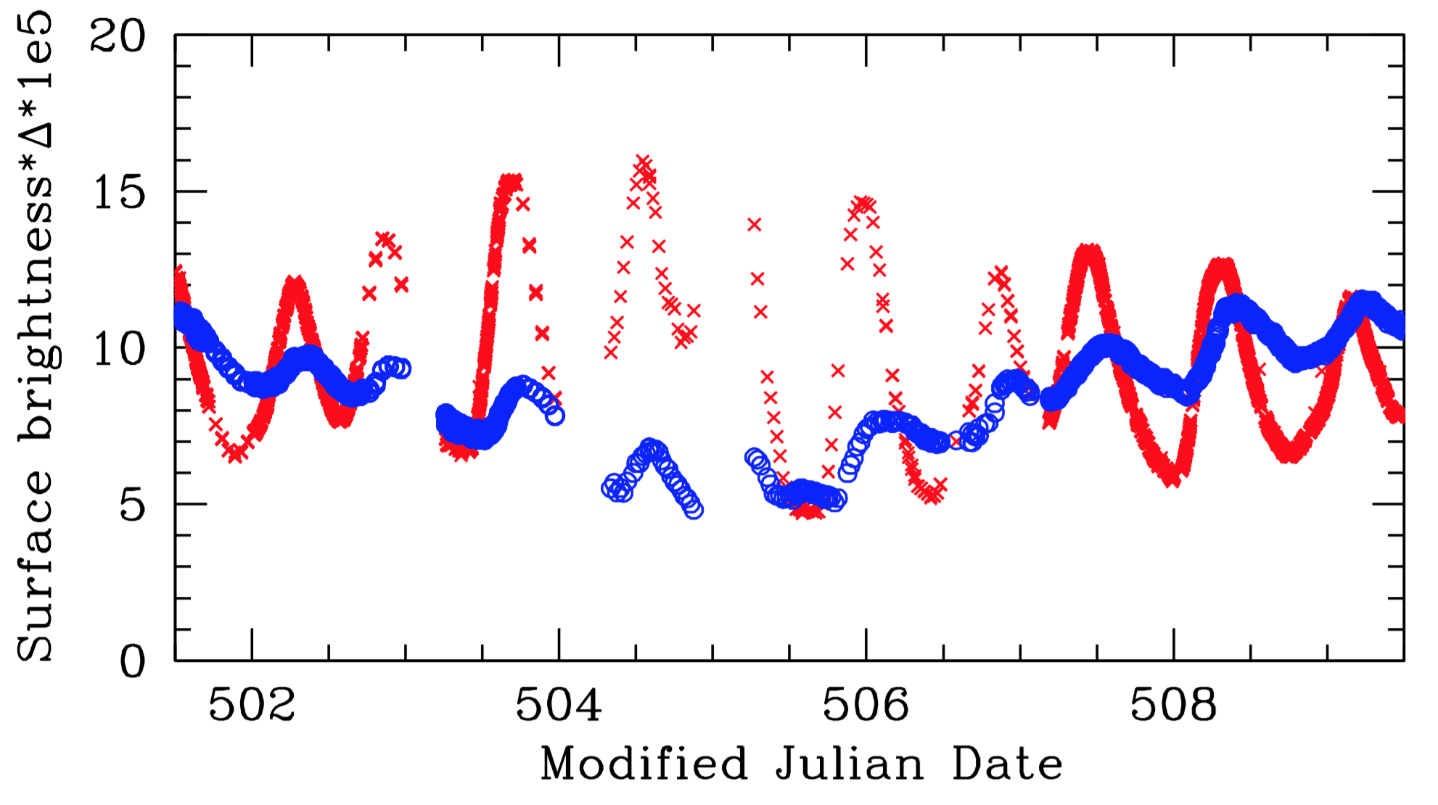
Photometry comparison (2)
Compare V2 small aperture photometry (red) with large aperture photometry derived from profiles (blue)
All are CLEAR1 filter
Behaviors look reasonable
Peaks shifted later in larger apertures
Amplitudes smaller in larger apertures

