Slide 1
Comet ISON Spectroscopy and Imaging
by Safonova et al.
PDS SBN Data Review, 2013 Oct 06
Michael S. P. Kelley

Slide 2
Overview
The data set contains optical imaging and spectroscopy of comet C/2012 S1 (ISON) from a few different telescopes:
2-m Himalayan Chandrayaan Telescope (HCT), Indian Astronomical Observatory
2.3-m Vannu Bappu Telescope (VBT), Indian Vannu Bappu Observatory
1-m at Wise Observatory, Tel Aviv University
The observations range from January to November 2013.

Slide 3
Review Summary
I focused primarily on the spectroscopy data, but did look at some of the images.
The raw data are in good order, and all the calibration data needed to reduce the data are there.
The documentation has many of the necessary details, but it does need to be made clearer.
The calibrated spectra do not have the necessary metadata for archiving.
Some derived data are unusual and need clarification.

Slide 4
Recommended Liens
(All liens have been emailed in a separate text file.)
1) The data collections are independent, but the abstracts, except for Jan, are incomplete. Please update to make them stand are on their own. For example, always name the comet C/2012 S1 (ISON), expand acronyms such as HCT, IIA, OMR.

Slide 5
Recommended Liens
2) There is a lot of variation in quality among documents and labels, even though each data set contains similar data from the same authors. I recommend one of two actions:
(1) that the datasets be combined so that there is only one description for each of the spectral and imaging reductions, with specific details for individual observing runs as needed, or
(2) that the main documentation be collected into a separate documentation collection.
It could help the data provider with addressing the liens, and could help the data user understand the data better if the heterogeneity between documents was reduced.

Slide 6
Recommended Liens
6) documentation/*.cl in Jan, Feb, Sep, and Nov collections - Generally software is not appropriate for documentation, but it can be if it is well-commented.
The reduction procedure description seems typical for these types of data. Perhaps the software does not need to be archived?
Would it be better to describe the code with a narrative form in the documentation?

Slide 7
Recommended Liens
7a) "albedo" according to the documentation is “obtained by dividing the comet continuum with that of a solar continuum, obtained from the solar analog…”
Isn't reflectance the correct term? Without an absolutely calibrated spectrum, and without the scattering cross section of the dust or the thermal emission, how is the albedo obtained?

Slide 8
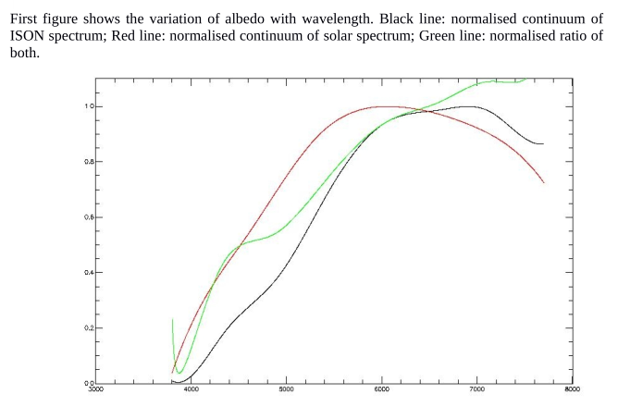
Note missing axis labels.

Slide 9
Recommended Liens
7a) continued…
These appear to be polynomial fits to the continuum. It is unusual to present the fits without the data. This process needs to be clarified and the actual data presented in the figure.

Slide 10
Recommended Liens
7f) "ison_continuum_subtracted" description
The continuum subtracted comet spectrum results in "relative normalized flux." But a subtraction operation does not normalize the flux. This item needs to be clarified.

Slide 11
Recommended Liens
7g) Missing data?
The May spectra refer to the reduction of solar analog stars from 2014-05-31. There is not may31 directory. Are these files missing or is this date incorrect?

Slide 12
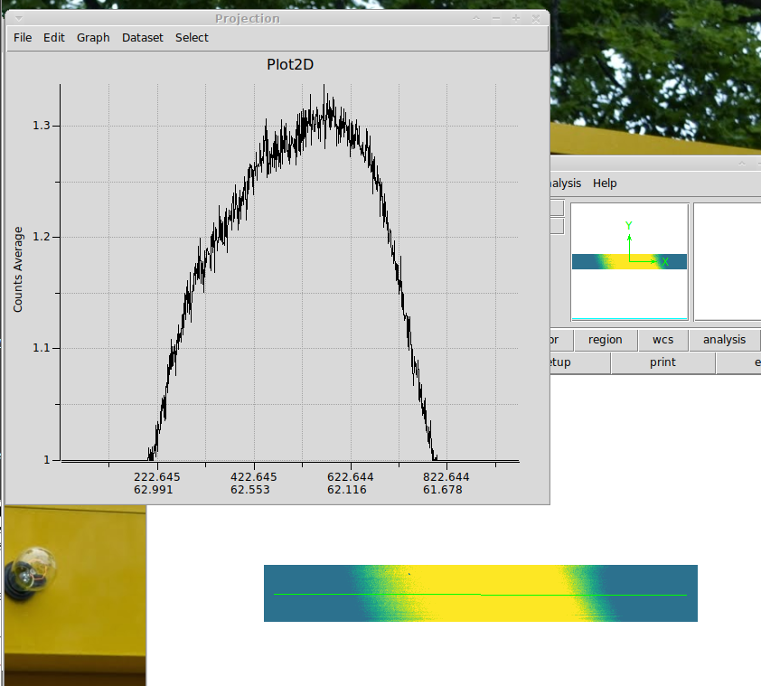
Recommended Liens
9a) May 02 normflat does not look good. If this is a normalized flat, should it not have a mean of 1.0 and a more flat shape? Why the constant regions at the edges?
Other flats in the May data set look good.

Slide 13
Recommended Liens
9b) Spectral_Characteristics metadata needs to be revised. For example:
hfosc_nov2013/spectroscopy/nov13/calibratedspectra/13nov2013_ison_2.xml
The array is 991 elements long,
The PDS label has a wavelength range from 3900 to 9200 Å with a 5 Å step.
However, 3900 + 990 * 5 = 8850, which does not equal 9200.

