Slide 1
Comet ISON *** 2013 HFOSC Observations Collection
Review by Matthew Knight
October 6, 2017

Slide 2
Overview
Monthly (Jan, Feb, May, Sep, Oct, Nov) datasets of Comet C/2012 S1 ISON from observatories in India and/or Israel
Contains imaging and spectra
From a quick literature search there are no published low resolution optical spectra of ISON, so this is a particularly valuable addition
Documentation generally good, with a useful overview text file and more detailed PDF listing specific image information
Some additional information provided such as IRAF scripts, one instrument manual
Clear and consistent layout of subdirectories
XML accurate as far as I can tell
Data inconsistent at time (discussed subsequently)
Processing appears to not always be correct
Some “calibrated” spectra appear to be useless
Some calibration data acquired on different dates (not ideal, but nothing that can be done about this now)

Slide 3
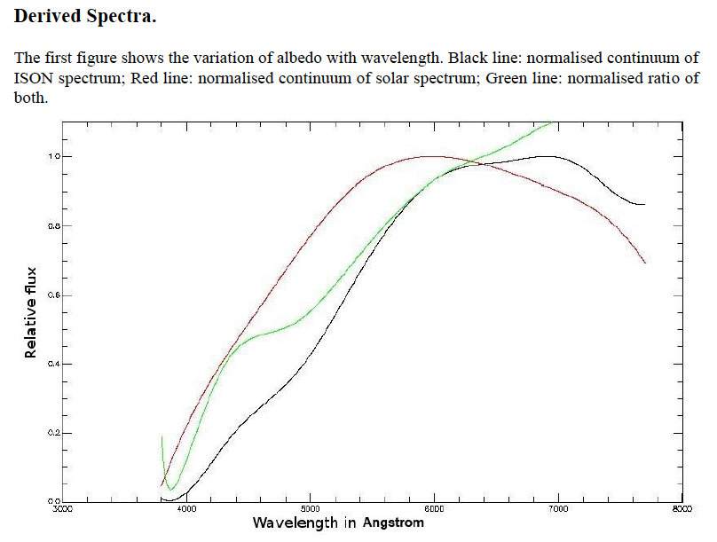
Documentation (1)
A few minor typos noted elsewhere
References in overview.txt not listed
Were images observed at the sidereal rate or comet’s rate?
Looks like comet’s rate, but I didn’t see in documentation
Derived spectra is confusing (right)
This isn’t “albedo”
What has been applied to smooth this?
Not clear how the ”relative flux” plot (next slide) was derived
Jan documentation

Slide 4
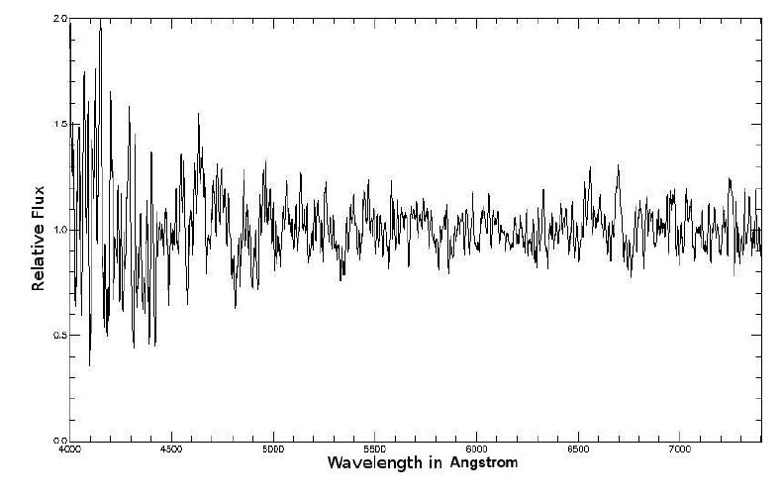
Documentation (1)
A few minor typos noted elsewhere
References in overview.txt not listed
Were images observed at the sidereal rate or comet’s rate?
Looks like comet’s rate, but I didn’t see in documentation
Derived spectra is confusing (right)
This isn’t “albedo”
What has been applied to smooth this?
Not clear how the ”relative flux” plot (next slide) was derived
Jan documentation

Slide 5
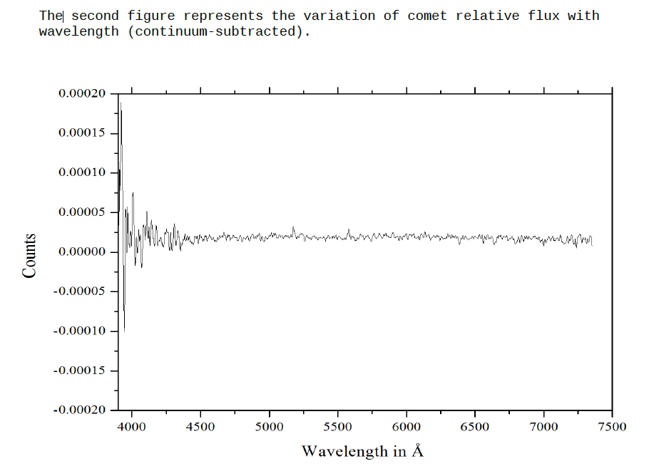
Documentation (2)
Units not always consistent
February (right) shows “counts” but numbers are way too low to be counts
The sentence before the figure is the same as January, but something different is plotted
Feb documentation

Slide 6
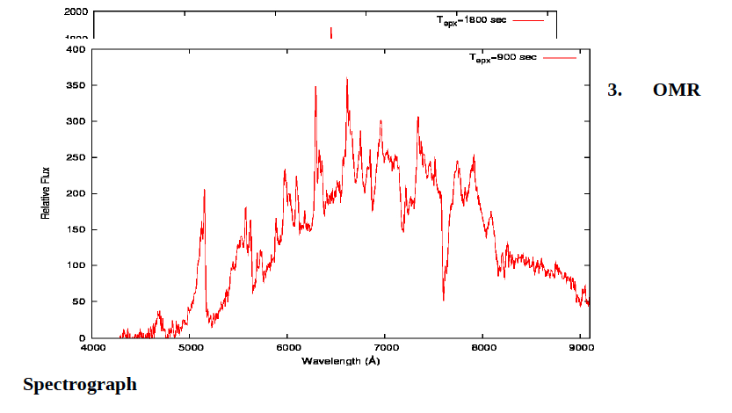
Documentation (3)
2013november_spectroscopy.pdf has layout issue
Science question: what are these lines? (next slide)
Nov documentation

Slide 7
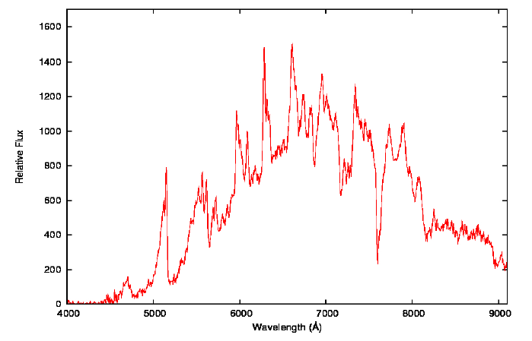
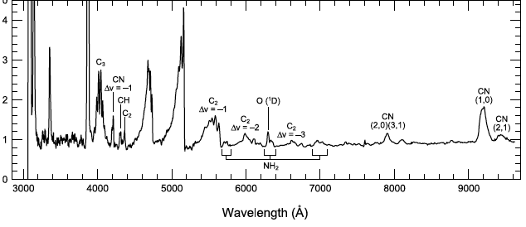
Documentation (4)
NH₂+O(¹D)
C₂
NH₂
November spectroscopy looks plausible (my annotations on top panel)
But amplitudes of lines at longer wavelengths look strange
Looks like some absorption lines (e.g., ~7600 Ang)?
Reference solar spectrum used in calibration seems to be available so could dig into processing more (but I didn’t get a chance to as I focused on imaging)
C₂
CN?
C₂
C₂
NH₂
C₂
Feldman et al. (2004)

Slide 8
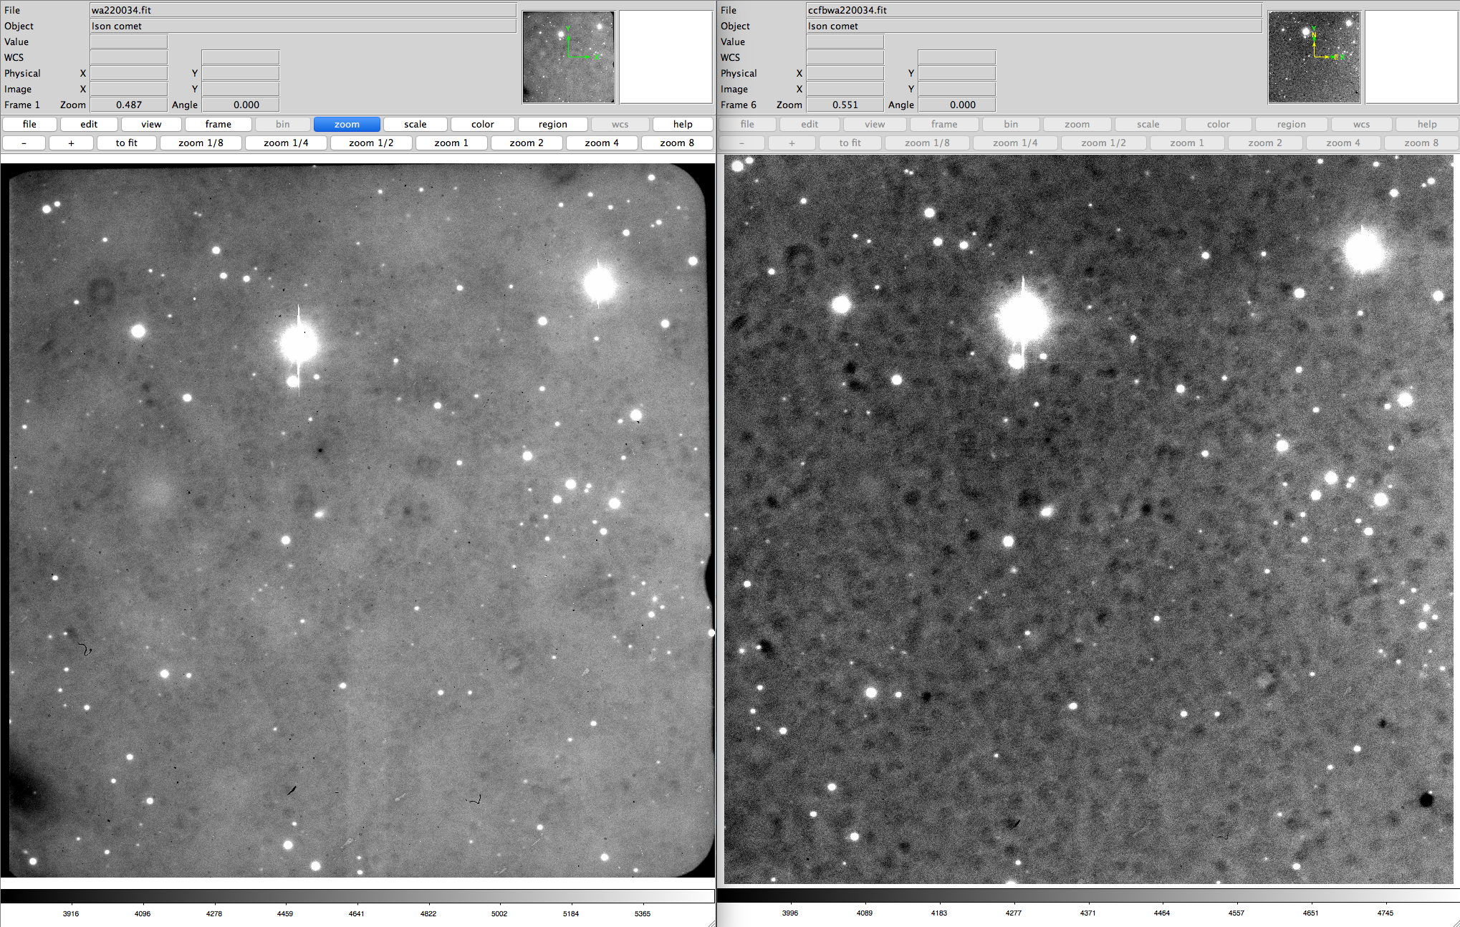
Bias and flatfielding
Major structures removed
Variations appear to be suppressed but not removed in some images (right)
Most images look good so probably not a systematic problem
Weird images highlighed later
raw
Bias and flat-fielded

Slide 9
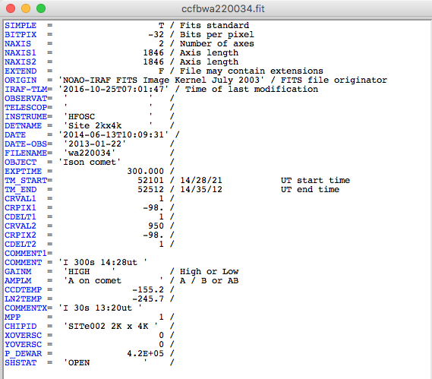
Is header useful?
Exposure time = 300
Start/end time differ by 411
Is readout time really 111 sec?
Object = ISON
Filter = I
But given as part of COMMENT, not it’s own keyword
Gives date, time that are consistent with RA/Dec (not shown)
Airmass not given but can be determined retroactively with some work

Slide 10
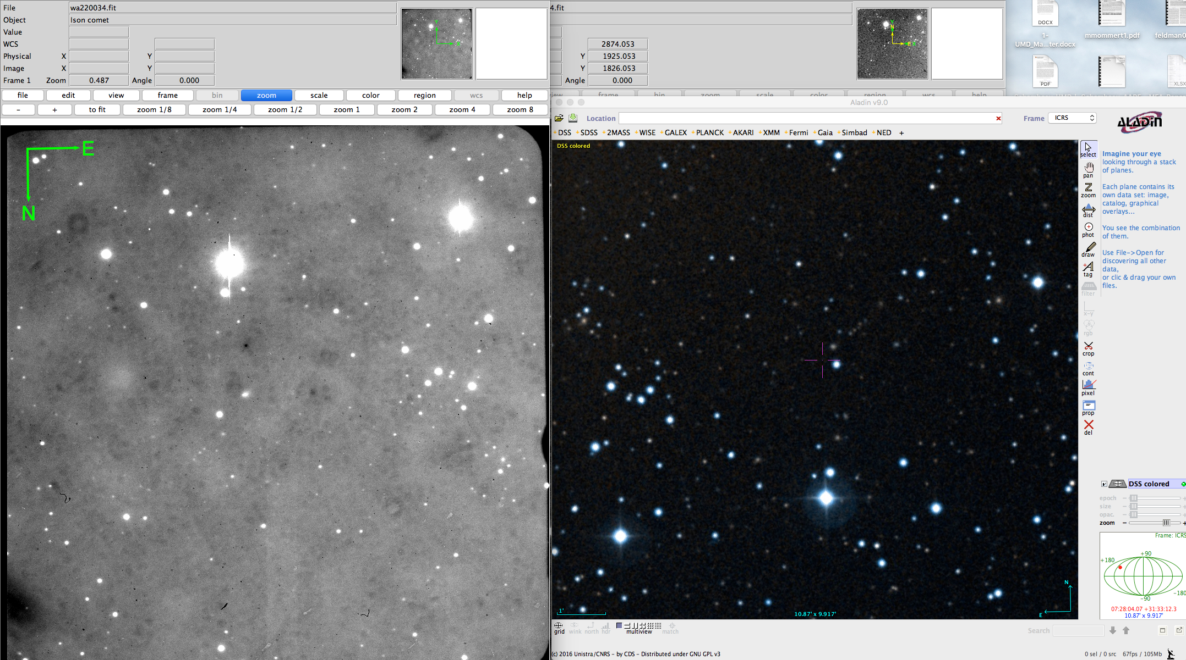
Is FOV accurate?
RA/Dec in header are accurate
Image dimensions appear to be accurate (~10x10 arcmin)
Image needs 180 deg rotation in ds9 for N up and E left
Horizontal_display_direction = left to right
Vertical_display_direction = bottom to top
Documentation implies E right and N up (I think?)

Slide 11
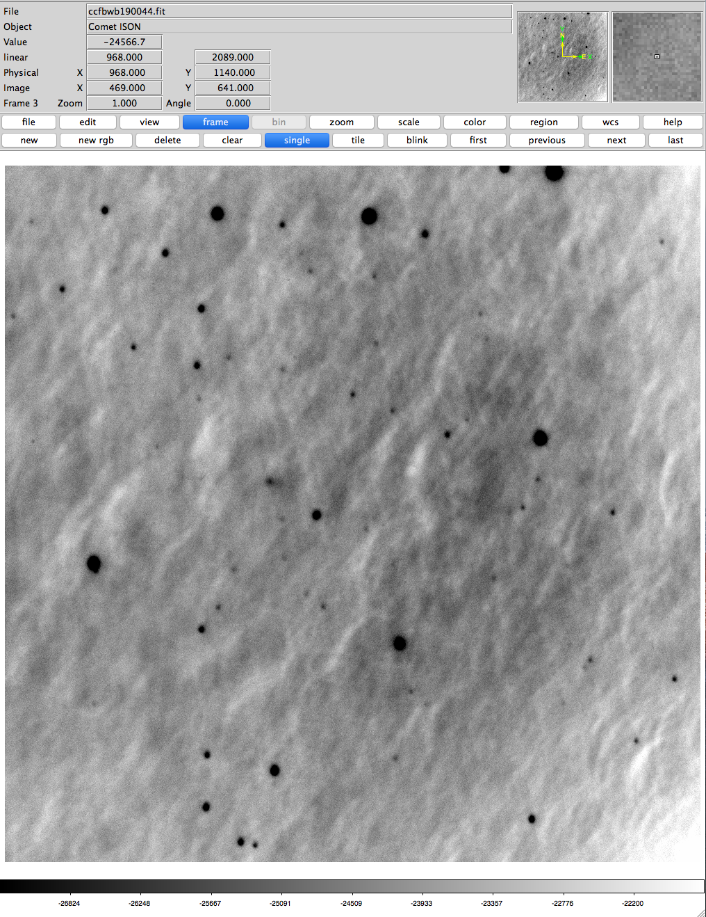
Feb 19
Something went wrong in processing
Sources negative (black)
Worse background than in raw images
Background is constant in all frames
Flats have counts ~27k (usual custom is to normalize to ~1). Maybe these were not constructed/applied correctly?
Feb 21, 22 flats have similar counts but processed images look okay

Slide 12
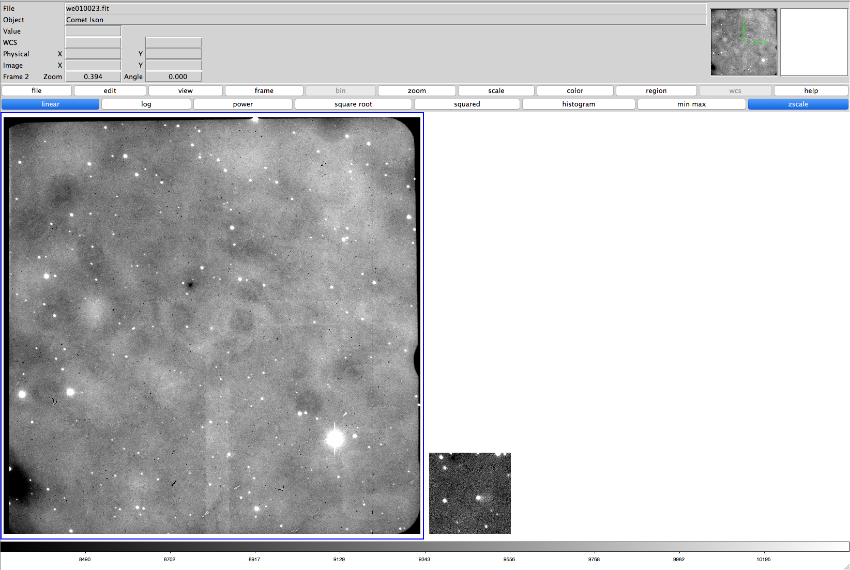
May
Some images not full size. Documentation does not say why
We10023.fit, we010025.fit, Zero.fits
Processed full size images look good

Slide 13
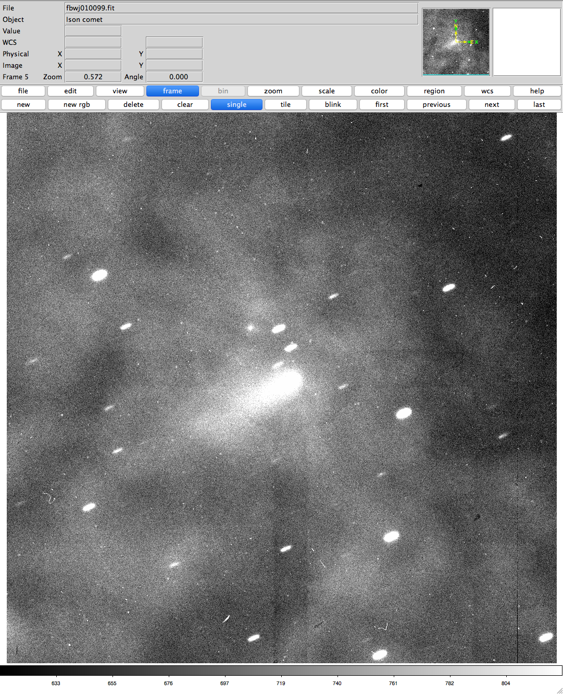
Oct 1
Processed images look ugly. Why?
Oct 3 looks okay

Slide 14
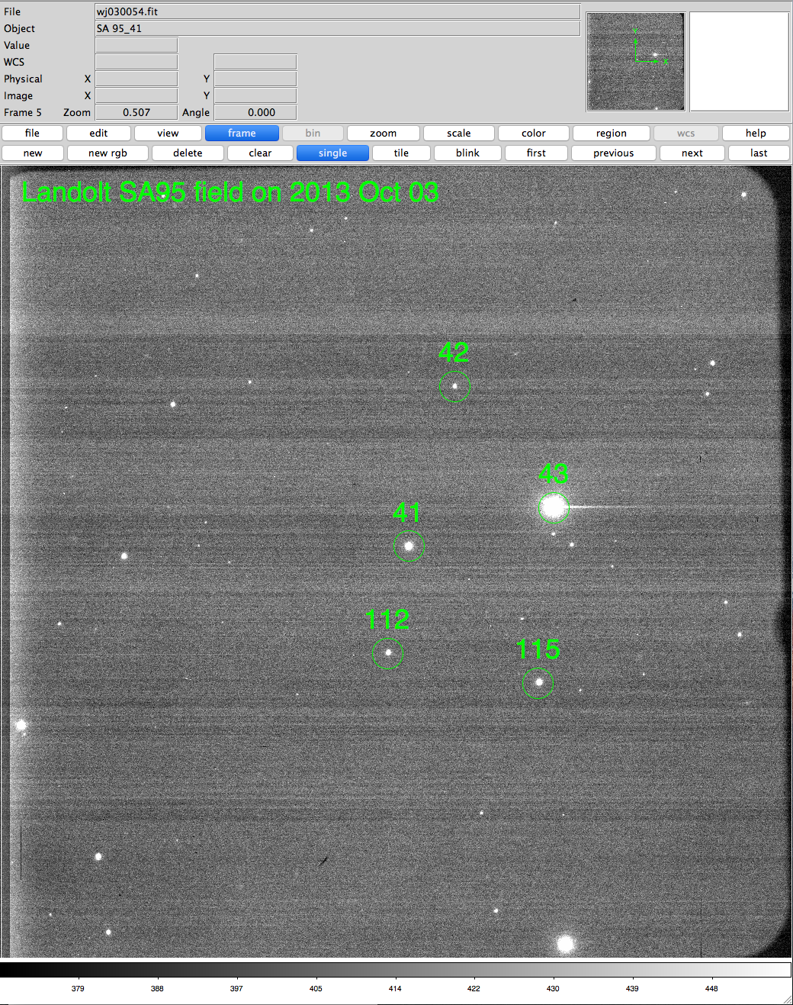
Oct 3
Landolt standard star SA95-41 (and others) identified
Documentation never says this is a “Landolt” field?
Add reference to Landolt paper?
Landolt (1992)

Slide 15
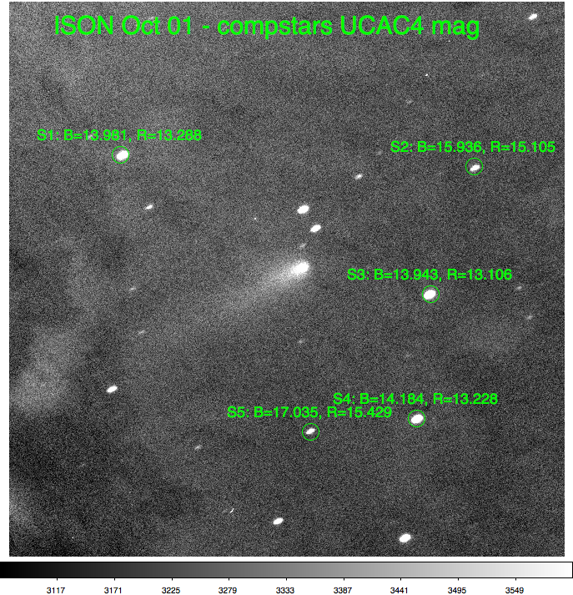
Do I get reasonable magnitudes for ISON?
Calibrate Oct 1 data with field stars from UCAC4 catalog (B and R)
Yields R=13.8, B=14.5 in r=50 pix aperture
Consistent with community magnitudes at the time which are 13.5-15
But I have some concerns:
Different exposure times for B yielded different zero point magnitudes by ~0.2
Should not have been due to aperture size (chosen to be beyond trailing in both frames)
Airmasses not given, but I calculate 2.30 vs 2.07; effect should not be this large, but does go in correct direction
Zero points from Landolt fields with same instrument two nights later differ by 0.7-1.3 mag
I did not determine airmasses, but difference is implausibly large for any reasonable airmass
Possibly related to different shape/appearance of background? E.g., were these processed in the same way?

Slide 16
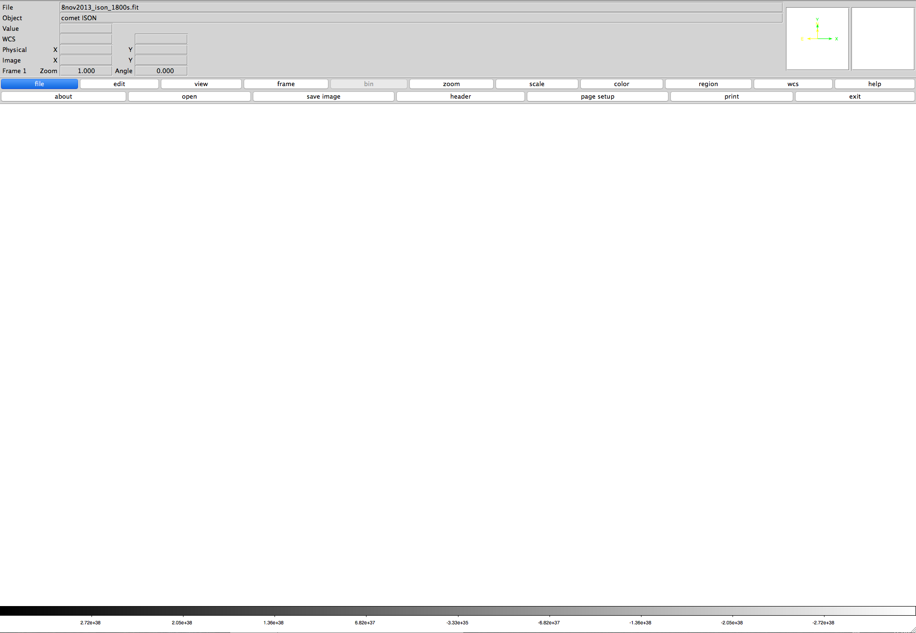
Blank “calibrated” spectra
What is going on on Nov 8, 11, 12, 13 (comet); Feb (all but flat); Jan (continuum)?
Calibrated spectra look blank
Units are ~10³⁸!
Raw image looks like expected
Accompanying *.tab files look reasonable
Nov 9 and most other spectra are a data cube with 4 extensions
Extensions explained in xml, but not in documentation?
Explanations still confusing (right):
Says it’s HR3951, not ISON?
Found at least one other image with only 3 extensions (October)
Nov 8 spectral image

