Slide 1
Review: Hale-Bopp Visual Lightcurve Bundle urn:nasa:pds:halebopp::1.0
Tony Farnham

Slide 2
Dataset Description
Set of visual magnitudes of comet Hale-Bopp, collected from ICQ publications over the entire apparition
Magnitudes unified into a composite dataset by applying corrections for:
Geocentric distance
Phase function
Observer offsets (systematic)
Cleaning the data
Remove problematic measurements of various types
Measurement methods, catalogs, multiple points, etc.
Remove observers who show statistical biases from the consensus

Slide 3
Review
I did a preliminary review of this dataset earlier, and presented some suggestions at that time to improve the dataset
Submitters addressed all the suggestions and resubmitted
Overall, the data and documents look good.
Able to read and manipulate the measurements
Reproduced the plots given in the documents directory + others
Discussion of statistical analyses was clear and very informative
Only a few minor issues, and one request

Slide 4
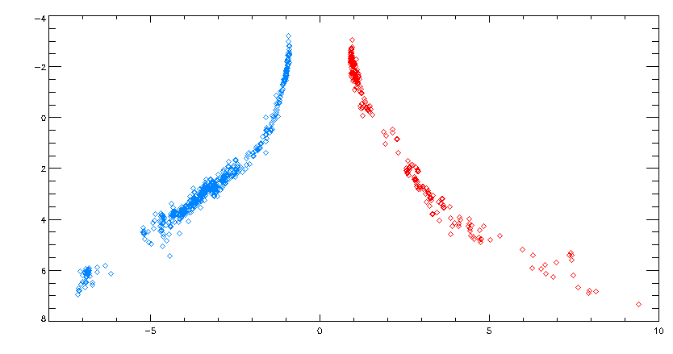
Manipulating data
M vs r: Reproduces the figure shown in the documents directory

Slide 5
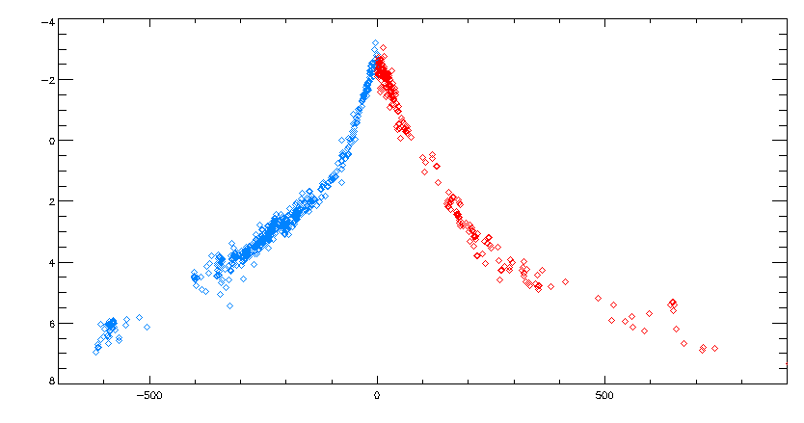
Manipulating data
M vs time: Clearly shows the pre-perihelion break in slope discussed in statistical analysis document

Slide 6
Minor Issues
Discrepancies in the Data files and Documentation:
Data file: whypointsremovedfromdata.csv
(Column Y) includes the entries: "Used a telescope under 5.5 magnitude" and "Used binoculars under 3.3 magnitude"
Document: REASONS_DATA_WERE_REMOVED.PDF
Says "If telescopes were used under 5.4 magnitude or binoculars used under 1.4 magnitude.” (5.4 and 1.4 also used in the statistics list in that file)
Pre/Post Data files and labels:
“mph” column lists the phase correction as coming from “Schleicher et al 2011”
Document: SCHLEICHERDUSTPHASEHM_TABLE.TXT
Cites it as “Schleicher (May 2010)”
I didn't see anywhere that specified where it actually came from (note that it was captured from his website?)

Slide 7
Typo
File hblcpostperihelion.csv
"Comet phase angle in degrees at reported date as per aJPL HORIZONS Ephemeris query”
--> "date as per a JPL HORIZONS Ephemeris query”
Warning note: the phrase "as per a JPL HORIZONS Ephemeris query” isn’t particularly meaningful without a reference to the orbit solution that was used there. Not an issue for H-B, but in other situations, the elements can change.

Slide 8
Request
The only time entry is given in the “T” format, which is perfectly acceptable
Difficult to use, especially in EXCEL
It would be nice to have a second, linear time entry
JD or time from perihelion

Slide 9
Final Result
Dataset can be certified

