Slide 1
Review: Comet ISON HFOSC Observations urn:nasa:pds:ison_gbo:hfosc_jan2013::1.0 urn:nasa:pds:ison_gbo:hfosc_feb2013::1.0 urn:nasa:pds:ison_gbo:hfosc_sept2013::1.0 urn:nasa:pds:ison_gbo:hfosc_oct2013::1.0 urn:nasa:pds:ison_gbo:hfosc_nov2013::1.0
Tony Farnham

Slide 2
Dataset Description
Multiple data sets, separated by date (month)
Differences within each, due to different sites
Raw, processed images and spectra of comet ISON
Obtained at different telescopes at different times
Observations in Bessel V, R and I bands
Spectral coverage from 380 to 830 nm
Includes some derived products derived from these observations
Extracted spectra, relative flux units

Slide 3
General Comments
Data seem to be in fairly good shape
FITS files and ASCII tables are readable
Some issues reading files via XML labels, especially for spectra
Documentation
General OVERVIEW.TXT file
Summarizes the multiple data sets, dates, observatories, etc
PDF files describing the imaging and spectra
Descriptions of the data, image/spectra “logs”, directory structure, and outline of the processing steps that were taken
Overall they provide sufficient information for understanding and using the data, with a few concerns outlined below.

Slide 4
Documentation Issues
Documentation states that the data are calibrated, but it appears that this only consists of bias removal, flat fielding and cosmic ray removal (and relative fluxes for spectra)
The term “calibrated” suggests that they have converted to flux or magnitude units, which does not seem to be the case.
I would suggest that the terminology refer to the final archived products as “processed” or “reduced”, rather than calibrated.
This has implications on the directory names and some of the discussions as well.
Alignment of images
In imaging document, "All images are aligned on the brightest pixel of the comet (optocentre)" suggests the brightest pixel is used (integer shifts), but later it says a linear interpolation is used, which suggests sub-pixel shifts.
If the latter is true, I suggest the terminology “All images are aligned on the comet optocentre” and stating that the images are aligned at the sub-pixel level to make this clear.

Slide 5
Documentation Issues
In Jan & Sept spectroscopy documents, raw and calibrated data don’t always match
Images seem to list a different star
In Jan, Raw lists HR1544, while processed and derived list HD195034
In Sept, no stars listed in raw while processed and derived list HD195034
Is this a default star from some other time?
If so, need to include more info

Slide 6
Data - Images
Reading imaging data
IDL
Able to read, display and manipulate all of the FITS files using IDL FITS readers
Suggests the data files are all good
After getting Ed Shaya to fix a bug, I was able to read, display and manipulate data using the XML labels with the PDS4 version of READ_PDS
See later discussion of READ_PDS issues
PDS4_VIEWER
Read and display from XML labels using the PDS4_viewer
NASAView
Not able to read XML files using NASAview v 3.17.0

Slide 7
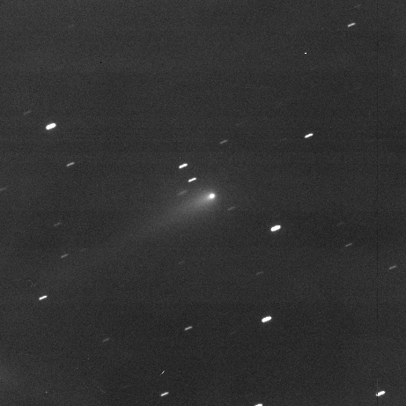
Image Examples
Good Image and Spectrum

Slide 8
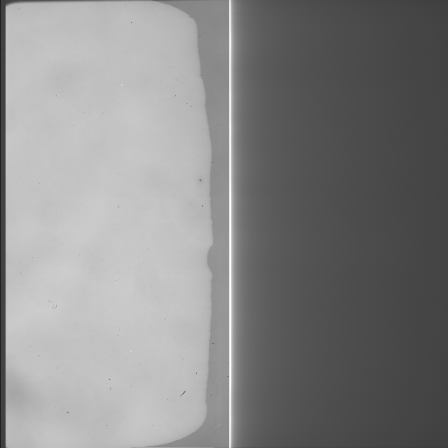
”Bad” images
Found a few images that appear to be bad
Documentation talks about some frames with half the chip not responding – presumably explains these images
Also discusses some images being out of focus, which I also noticed

Slide 9
Data – Image Filenames
In datasets with more than one nights’ observation, the master calibration frames have XML labels that don't match the FITS image name (presumably legal but annoying).
Even worse is on Feb 21, the FITS files have numbers rather than "r" or "i" so there is no obvious link between them without opening the label.

Slide 10
Imaging – READ_PDS issues
Raising issues with READ_PDS because it is the only means of manipulating data read from XML label
I don’t know if these are label errors or software errors…..
Frequently get a ”no END statement” error
Doesn’t seem t affect reading of the data

Slide 11
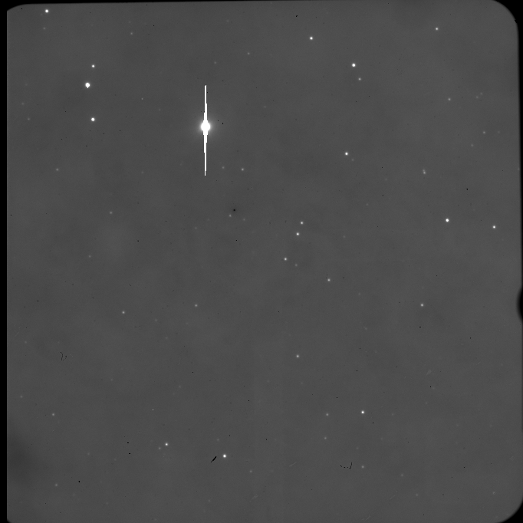
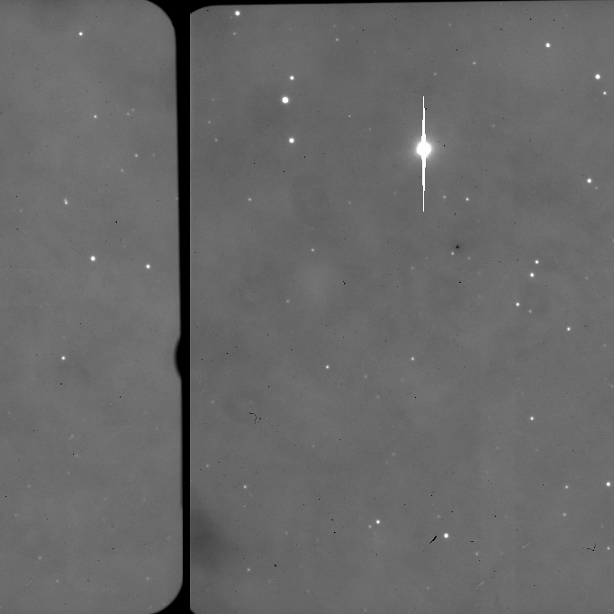
Imaging – READ_PDS issues
Some files get a READU error (unformatted binary read error)
The FITS files are read by FITS readers with no error.
Has an effect on the way the data are read
List of affected files in READU_ERROR.TXT
FITS reader, no error
read_pds, READU error

Slide 12
Data - Spectra
Reading spectral data – Reading with different routines is hit & miss
IDL
Read, display and manipulate all the FITS files using IDL FITS readers
Suggests the data files are all good
Able to read, display and manipulate some of the data using the XML labels with the PDS4 version of READ_PDS
Other files cause IDL (not just READ_PDS) to crash horribly
No error info, due to crash
Files listed in READPDS_CRASH_FILES.TXT
PDS4_VIEWER
Able to read and display from XML labels using the PDS4_viewer (spot-checked)
NASAView
Not able to read XML files using NASAview v 3.17.0

Slide 13
Spectra Labels
Problem with a “quote” in a description field in the labels
Doesn’t seem to have an effect on the viewers (field closing ends the quote?)
Fixing this doesn’t affect the READ_PDS or PDS4_Viewer responses

Slide 14
Final Result
Dataset not yet certifiable
FITS and TAB files seem to be ok
Need to clarify that data are not calibrated to flux/magnitude units
XML labels (or READ_PDS software) have some issues

