Slide 1
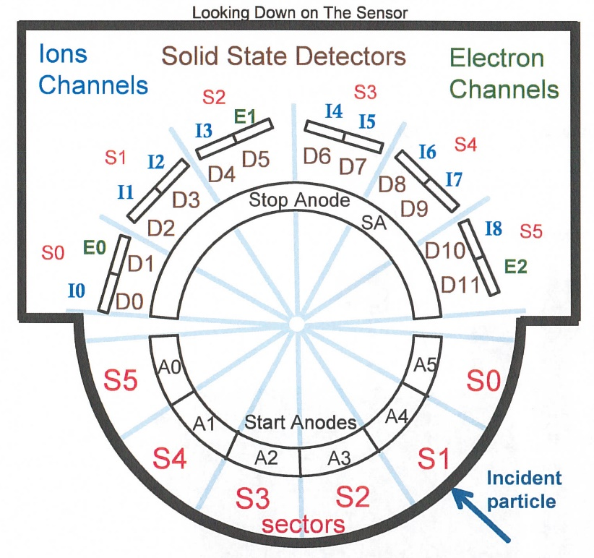
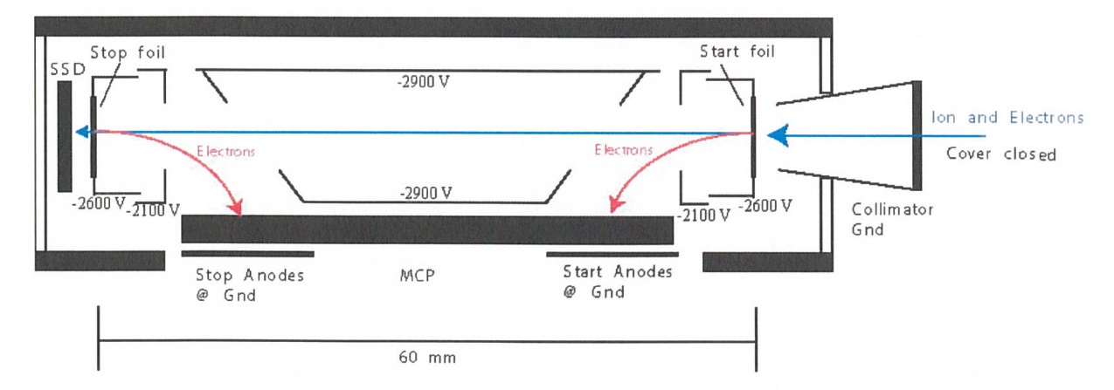
New Horizons Pluto Energetic Particle Spectrometer Science Investigation (PEPSSI)
Reviewed by S. Joy (primary)
PRINCIPAL INVESTIGATOR: Ralph McNutt, APL
DESCRIPTION: Medium Energy Particle Spectrometer
ENERGY RANGE: 25-1000 keV (protons)
60-1000 keV (atomic ions)
25-500 keV (electrons)
FIELD OF VIEW: 160 deg x 12 deg
ANGULAR RESOLUTION: 25 deg x 12 deg
ENERGY RESOLUTION: 0.25 keV
SENSOR SIZE: 7.6 cm dia. x 2.5 cm thick
POWER: 1.4 watt
MASS: 1.5 kg

Slide 2
New Horizons PEPSSI Data Sets
Derived Data ->
NH-P-PEPSSI-5-PLASMA-V1.0

Slide 3
New Horizons PEPSSI Data Set Evaluation Tools
All Data Processing and Evaluation -
Machine: Dell Precision M4800
Operating System: Windows 10

Slide 4
Documentation
Evaluation

Slide 5
Root level files
AAREADME line 31: “New Horizons Pluto Encounter plasma and particles science theme team” line 43: “data products for the Plasma and Particles Science Theme Team.” Inconsistent capitalization. Is this a formal name (caps) or an informal grouping (lc)? If informal, I suggest dropping the word “theme”. VOLDESC No issues found

Slide 6
Catalog files
CATINFO.TXT – no changes required
All multi-volume catalog files except appear to be latest versions (nh, nhsc, pepssi)
DATASET.CAT
Since there is no document describing how the L5 data are derived from the L3 data, and this information has not been added to the soc_icd, I’d suggest adding a lot more detail to this file. In particular, the coordinate system/frames used in the “attitude” data file need to be defined.
Lines 85-94: PEPSSI S1 Pluto Cone Angle Please list columns in the order that they
PEPSSI S1 Pluto Clock Angle appear in the data file
PEPSSI S1 Sun Clock Angle (Cone?)
PEPSSI S1 Sun Clock Angle
PSH X
PSH Y Define PSH acronym and frame somewhere in text
PSH Z
PSH R
SC-Sun-Pluto Line
HCI R (distance to the Sun)

Slide 7
Catalog files – dataset.cat con’t
DATASET.CAT Lines 145-146 This data set contains higher level products derived from data taken by
the PEPSSI instrument, and more details about how PEPSSI data is
Replace with
This data set contains higher level products derived from data taken by
the PEPSSI instrument. Details about how PEPSSI data are

Slide 8
Document files
DOCINFO.TXT – no changes required
All PDS documents are properly formatted as PDF/A All document labels appear to be valid
FOV.png provides the FOV of the boresighted remote sensing instruments rather than the PEPSSI FOV that is included in the soc_icd. My recommendation is to either remove this file or create one that shows the PEPSSI FOV.

Slide 9
Data
Evaluation

Slide 10
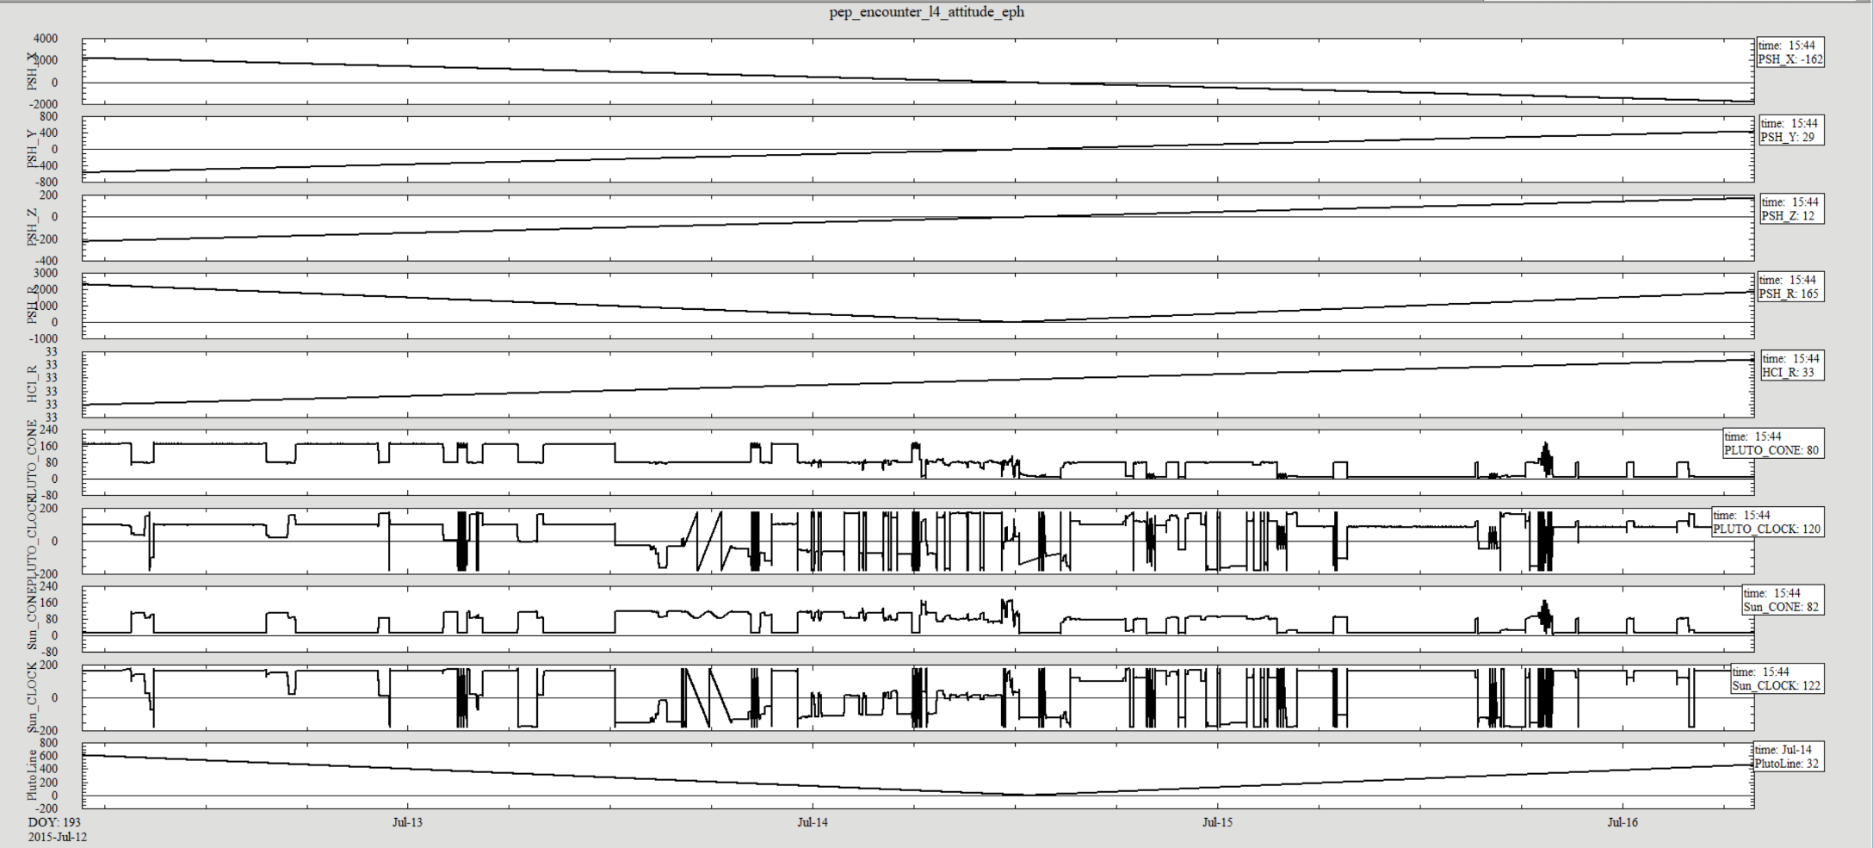
Data: pep_encounter_l4_attitude_eph
The spacecraft position and attitude file looks reasonable for the time period near Pluto C/A.
Data file would be slightly easier to use with a one line header of column names. If added, this header would need to be described in the label.

Slide 11
Data: pep_encounter_l4_attitude_eph
pep_encounter_l4_attitude_eph.csv
Data columns are typically reported to 10-15 decimal places. This suggests a measurement precision that is unrealistic for most columns.
Record 109810 is empty (no time or other fields). Please remove
pep_encounter_l4_attitude_eph.lbl
Column “Epoch” has DESCRIPTION = " Timing” which is incomplete. Please be explicit as to the meaning of the time tag (SCET/UTC), something else?
Column PSH_X has FORMAT = "F21.18" but values of FORMAT = "F22.19" can be found in the data file. Note for columns PSH_Y ,Z have FORMAT = "F22.19".
Columns PSH_X,Y,Z,R have UNIT = "Rp" and DESCRIPTION = " PSH_x “ I suggest changing this to DESCRIPTION = " PSH_x in units of Rp where Rp = XXX.X km" to remove the ambiguity in the distance units.
Column HCI_R has UNIT = “AU" and DESCRIPTION = "HCI R (distance to the Sun)" I suggest changing the description to include the definition of AU used in the conversion from kilometers as above.

Slide 12
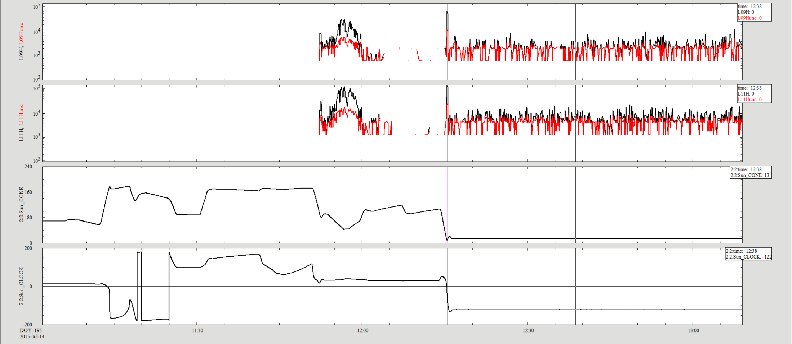
Data: pep_encounter_l4_doubles_5sec
L09H L09Hunc
L11H L11Hunc
Sun Cone Angle
Sun Clock Angle
The L09H (low rate box 9, averaged over look directions 0-2) values are roughly half of the L11H values, probably just geometry. L09h and L11H are highly correlated during the Pluto flyby, less so otherwise.
Data file would be slightly easier to use with a one line header of column names. If added, this header would need to be described in the label.

Slide 13
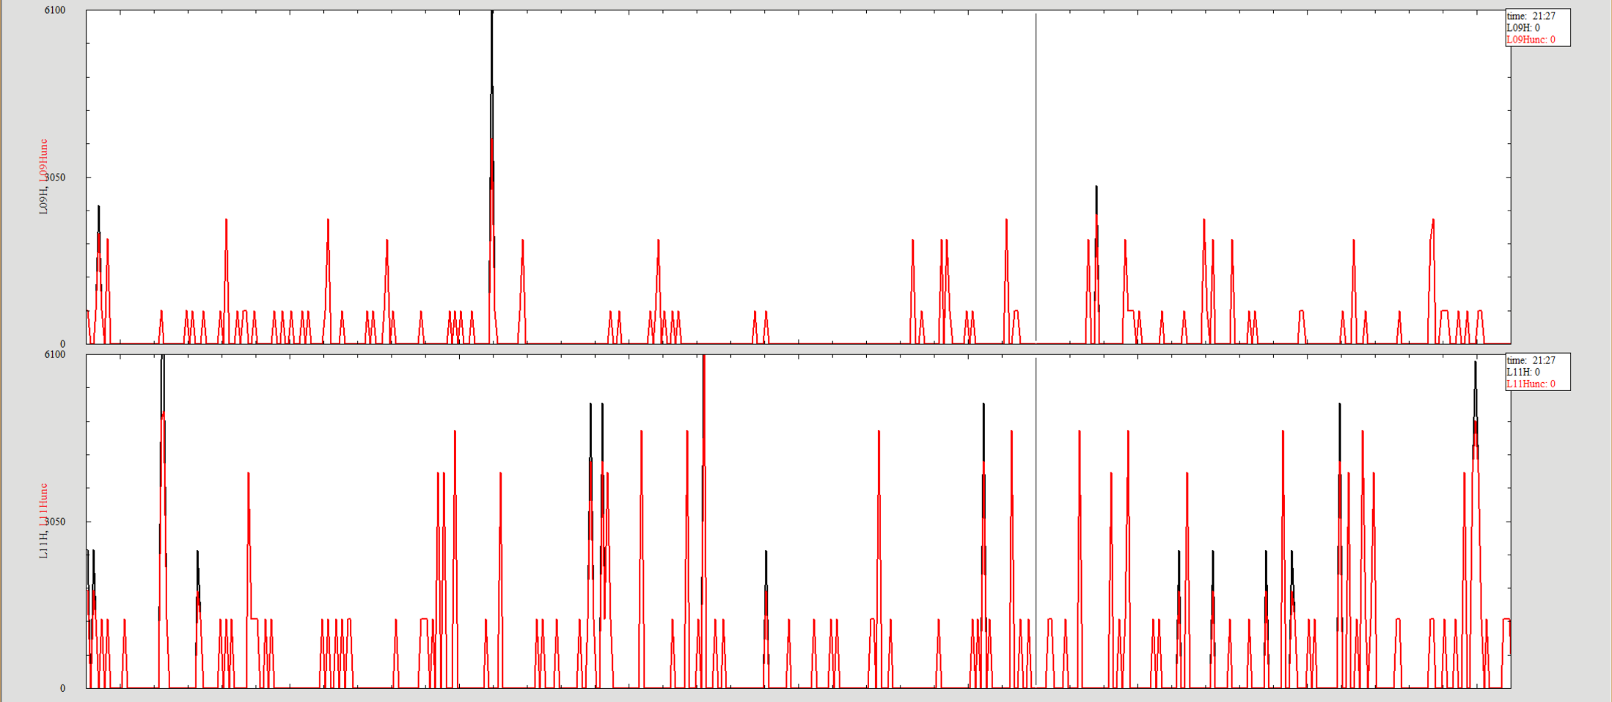
Data: pep_encounter_l4_doubles_5sec
L09H L09Hunc
L11H L11Hunc
When the data are sparse, it appears as though the L09H have a quantization factor of about, but not exactly 610 keV (solid line, minor tick interval) while the L11H have double that value. This behavior is not discussed in either the label or the dataset.cat file and it should be mentioned/explained somewhere.

Slide 14
Data: pep_encounter_l4_doubles_5sec
pep_encounter_l4_doubles_5sec.csv
The first 2880 and last 321 records of the data file are null (,,,,) filled while the remainder of the records are zero filled (0,0,0,0). Was this intended?
pep_encounter_l4_doubles_5sec.lbl
Column “Epoch” has DESCRIPTION = " Timing” which is incomplete. Please be explicit as to the meaning of the time tag (SCET/UTC), something else. Where is the time tag placed, start/stop/center of average?
The label DECRIPTION (file) refers to 5 minute averages rather than 5 second average
The label DESCRIPTION (file) does not explain the difference in the meaning of null values vs. zero values in the data columns.
The column description for the uncertainty columns say that the value represents the “statistical uncertainty” without explaining further. Either the label or the dataset.cat should
tell the user how this value was determined.

Slide 15
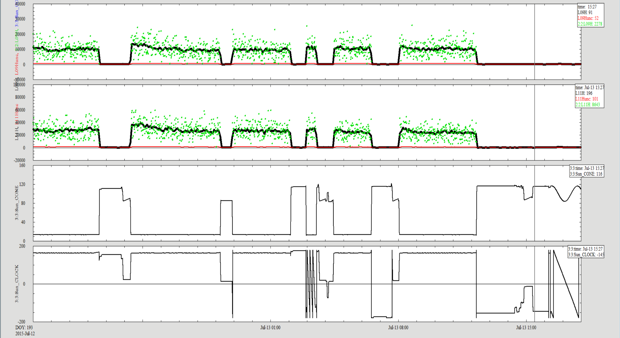
Data: pep_encounter_l4_doubles_5min
L09H L09H - 5sec, decimated L09Hunc
L11H - 5min L11H - 5sec, decimated L11Hunc
Sun Cone Angle
Sun Clock Angle
Five minute average data (heavy black lines) look reasonable given the scatter in the five second average data (green dots, decimated to 1 minute samples). The apparent dropouts in the data are clearly correlated with the spacecraft attitude.
Data file would be slightly easier to use with a one line header of column names. If added, this header would need to be described in the label.

Slide 16
Data: pep_encounter_l4_doubles_5min
pep_encounter_l4_doubles_5sec.csv
Good
pep_encounter_l4_doubles_5sec.lbl
Column “Epoch” has DESCRIPTION = "Timing” which is incomplete. Please be explicit as to the meaning of the time tag (SCET/UTC), something else. Where is the time tag placed, start/stop/center of average?
The column description for the uncertainty columns say that the value represents the “statistical uncertainty” without explaining further. Either the label or the dataset.cat should
tell the user how this value was determined.

Slide 17
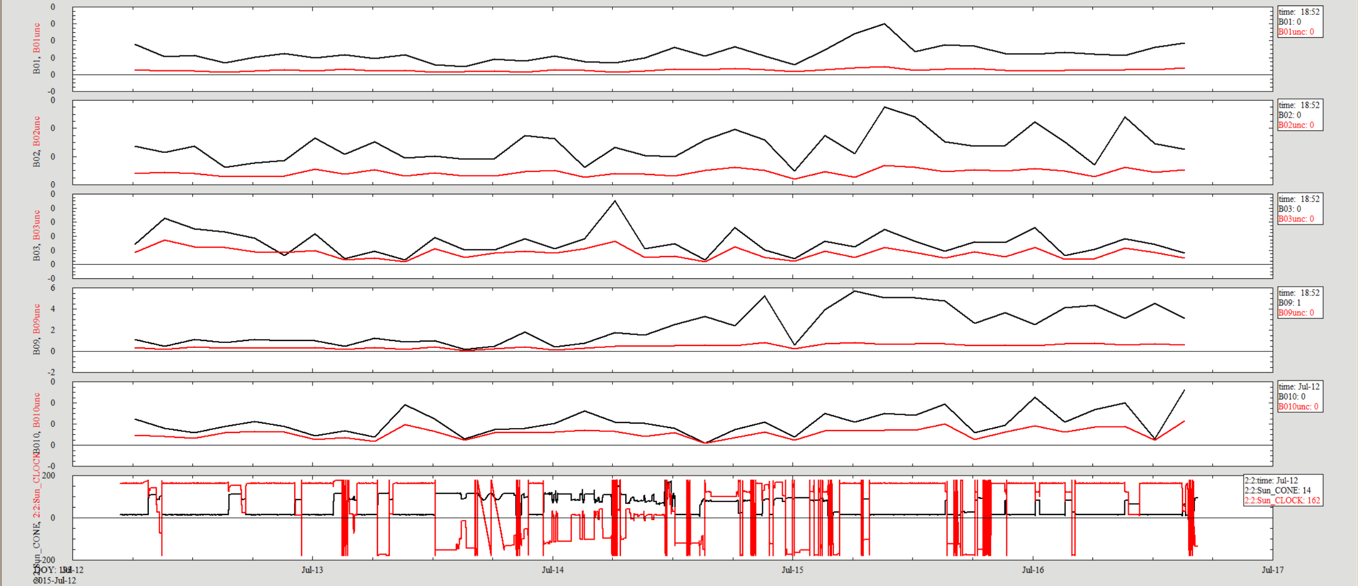
Data: pep_encounter_l4_triples_3h
B01 B01unc
B02 B02unc
B03 B03unc
B09 B09unc
B10 B10unc
Sun Cone Angle Sun Clock Angle
Three hour data are a bit difficult to interpret because they have averaged out the Pluto signal and the time scale of the spacecraft turns is short compared to the averaging interval. However, there is no reason to believe that the data have any issues.
Data file would be slightly easier to use with a one line header of column names. If added, this header would need to be described in the label.

Slide 18
Data: pep_encounter_l4_triples_3h
pep_encounter_l4_triples_3h.csv
Good
pep_encounter_l4_triples_3h.lbl
Column “Epoch” has DESCRIPTION = "Timing” which is incomplete. Please be explicit as to the meaning of the time tag (SCET/UTC), something else. Where is the time tag placed, start/stop/center of average?
The column description for the uncertainty columns say that the value represents the “statistical uncertainty” without explaining further. Either the label or the dataset.cat should
tell the user how this value was determined.

Slide 19
Summary of Liens
Add detail to the dataset.cat file describing the data processing and the determination of the uncertainties associated with the data values
Correct minor issues to catalog files are described on slides 5-7
pep_encounter_l4_attitude_eph.csv – remove bad record at 109810 and fix issue of excess significant digits
All data labels – fix description of the time column
All PEPSSI data labels – fix description of the uncertainty columns or add a definition of statistical uncertainty to the file description
pep_encounter_l4_attitude_eph.lbl – define Rp and AU in terms of km
pep_encounter_l4_doubles_5sec.lbl – fix file description replacing 5 min with 5 sec and the difference between null and zero filled values, or make the data file uniform. Lastly, either describe here or in the dataset.cat the apparent quantization in the flux data columns.
Given the number of issues reported, these data probably require a delta review
Editorial Comments 1) I would find the data files easier to use if they contained a one line header that provided column names. If provided, the labels would need to be updated to correctly describe the modified files.
2) In the documents directory, having the FOV picture for the remote sensing instruments is not particularly useful. This file could be removed. The team might consider adding the picture of the PEPSSI FOV that is contained in the soc_icd as a stand-alone image since the data are highly sensitive to the spacecraft orientation.

