Slide 1
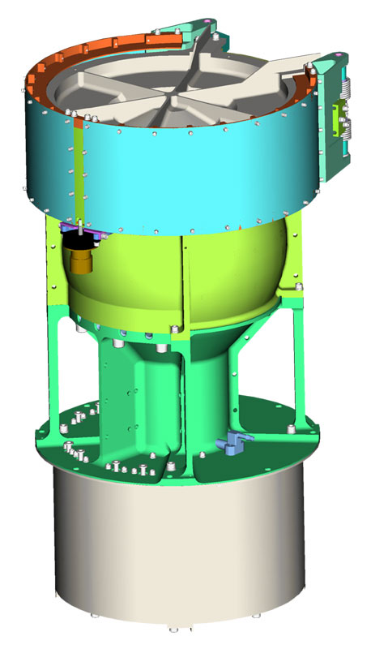
New Horizons Solar Wind Around Pluto
SWAP
Reviewed by S. Joy (secondary)
Low Energy Plasma Instrument consisting of a Retarding Potential Analyzer (RPA), and Electrostatic Analyzer (ESA), and a deflector (DFL).
Mass: 3.29 kg
Power: 2.84 W
Energy (min,max): 30-7700 eV
Energy Resolution: 1 eV
Field of View: 270º x 10º
Angular Resolution: N/A
Geometric Factor 1.8x10⁻³cm² sr eV/eV
Sweep Time (128 steps) 64 s
Accumulation Time 0.39 s

Slide 2
NH-SWAP Data Set Evaluation Tools
Evaluation -
Machine: Dell Precision M4800
Operating System: Windows 10

Slide 3
Dataset: nh-x-swap-2-pluto-v2.0 NH-P-SWAP-5-DERIVED-SOLARWIND-V1.0
Volume:
NHPEDP_0004 Volume Level Files
AAREADME
“a single table of derived” ➔ “two tables of derived” “spacecraft position and speed” ➔ “spacecraft position”
VOLDESC - good

Slide 4
Catalog Directory:
catinfo.txt, nh.cat, nhsc.cat, ref.cat, swap.cat - good
dataset.cat
Line 21: missing comma “the solar wind speed, proton density,
Line 24: “spacecraft position and speed in” ➔ “spacecraft position in”
Line 28: “spacecraft position and speed in” ➔ “spacecraft position in”
Line 29: Provide either reference or SPICE frame names/ids for “ Pluto J2000, Pluto IAU”. If SPICE frames are provided, modify the text to say that these are SPICE frames (i.e. “in the SPICE frames … and”. The IAU periodically updates frame definitions so you should provide a date at a minimum for this definition.
Frames section, lines 110 – 146, add references for these definitions. These are probably:
Burlaga, L.F., 1984. MHD processes in the outer heliosphere. Space Sci., Rev. 39, 255–316 (for HGI) and
Expl. Suppl., 1961. Explanatory supplement to the astronomical ephemeris. H.M Nautical Almanac Office, HM Stationary Office, London, corrected imprint 1977 (for HAE-J2000 and HG, called HGC therein)
Add DATA_SET_REFERENCE_INFORMATION objects for the references and include them in the ref.cat file

Slide 5
Catalog Directory:
dataset.cat (continued)
Lines 139-146 (Pluto J2000) Text describes 2 frames (Pluto J2000 and Pluto IAU) under a single frame heading. You should probably separate these out to make it clear that Pluto J2000 is an inertial frame while Pluto IAU is not. Pluto IAU needs a reference since the IAU updates it frame definitions periodically.
Line143 missing word “frame is fixed” ➔ “frame is body-fixed”
Line 160: Unclear phrasing “Each product compiles the CODMAC level 2 source data used”

Slide 6
Document Directory:
docinfo.txt - good
error_notes.txt - good
Index Directory:
indxinfo.txt - good
index.tab - good
index.lbl - good
checksum.lbl - good
checksum.tab - good
nh-x-swap-2-pluto-v2.0

Slide 7
Data Directory:
nh_heliocentric_sw_2015-07-14.lbl
No issues
nh_plutocentric_sw_2015-07-14.lbl
Lines 33-37 describe the two plutocentric frames but does not mention the heliocentric data contained in fields 21-25. These values are repeated from the heliocentric data set. It is unclear if this was intended.
While I don’t have any strong objection to the way that the data are organized, I do feel that it would be better to have a single data file containing the s/c position data in both the heliocentric and planetocetric coordinate systems. Repeating data in two files could lead to configuration management issues down the road.

Slide 8
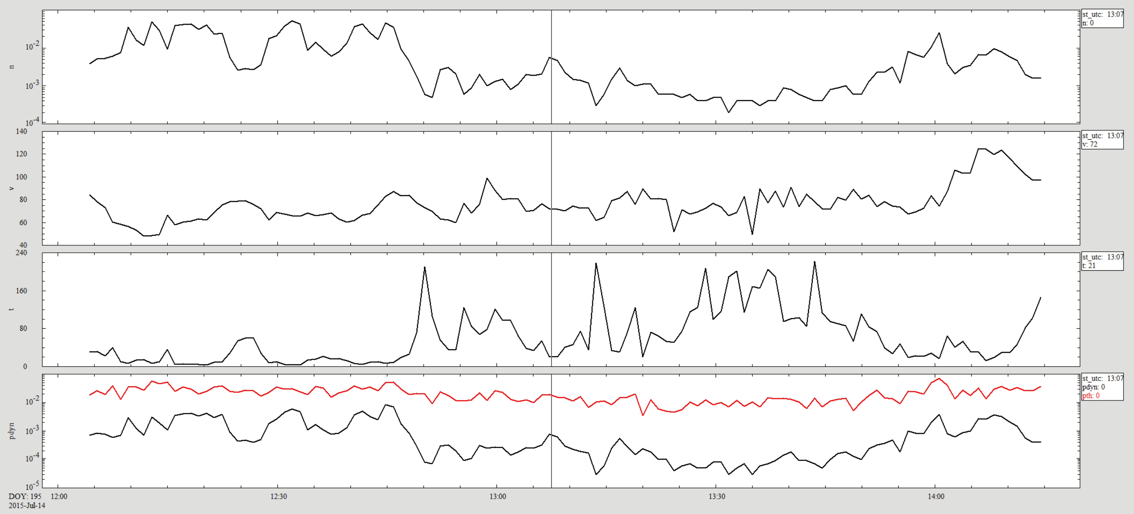
nh_heliocentric_sw_2015-07-14
Density – cm⁻³
Speed - km/s
Temperature - converted to eV
Pressure - Dynamic nPa, Thermal pPa
Plasma data look reasonable, position data have expected properties (HGI Z,LAT = HG Z,LAT ≠ HAE Z,LAT) and values appear reasonable.

Slide 9
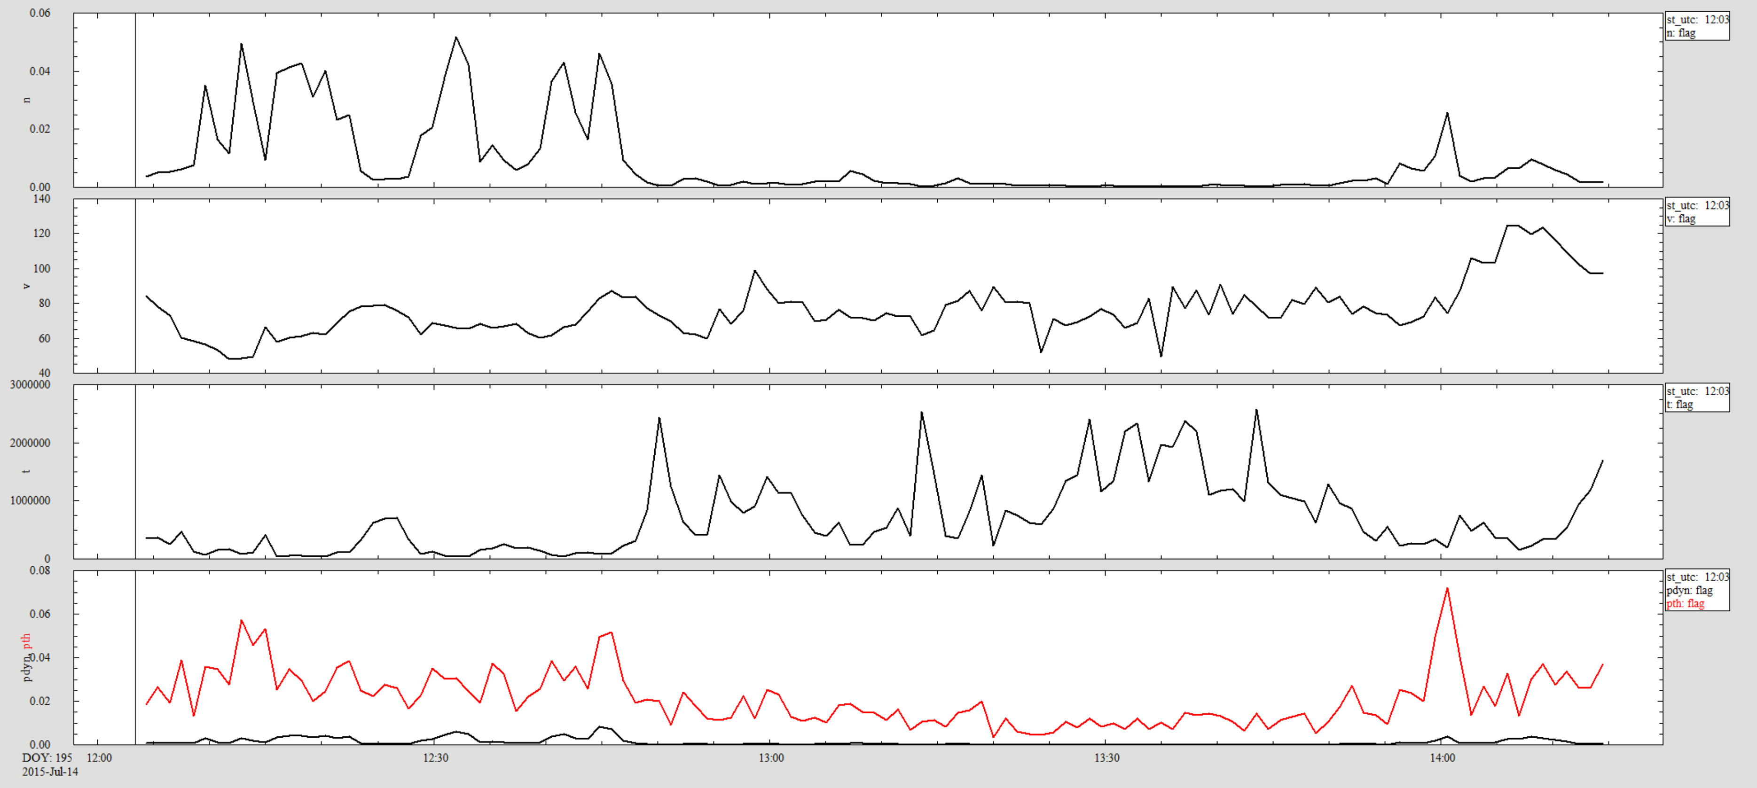
nh_plutocentric_sw_2015-07-14
Density – cm⁻³
Speed - km/s
Temperature - ºK
Pressure - Dynamic nPa, Thermal pPa
As expected, the plasma data values are identical to those in the heliocentric coordinates, only the s/c position data are different. Pluto relative position data (not shown) also look reasonable.

Slide 10
Recommendations
Data are in good shape and can be certified with liens in my opinion. The documentation issues that remain would not prevent a user from being able to use these data as they are.
There are a few issues in the aareadme.txt and dataset.cat that should be corrected.

