Slide 1
Hale-Bopp Visual Lightcurve Bundle by Womack, et al.
PDS SBN Review
15 May 2018
Emily Kramer

Slide 2
Overview
Visual magnitudes of Hale-Bopp compiled from 17 observers submitted to the International Comet Quarterly
Data were corrected for geocentric distance and phase angle
Data were processed using a statistical analysis method to produce a secular lightcurve

Slide 3
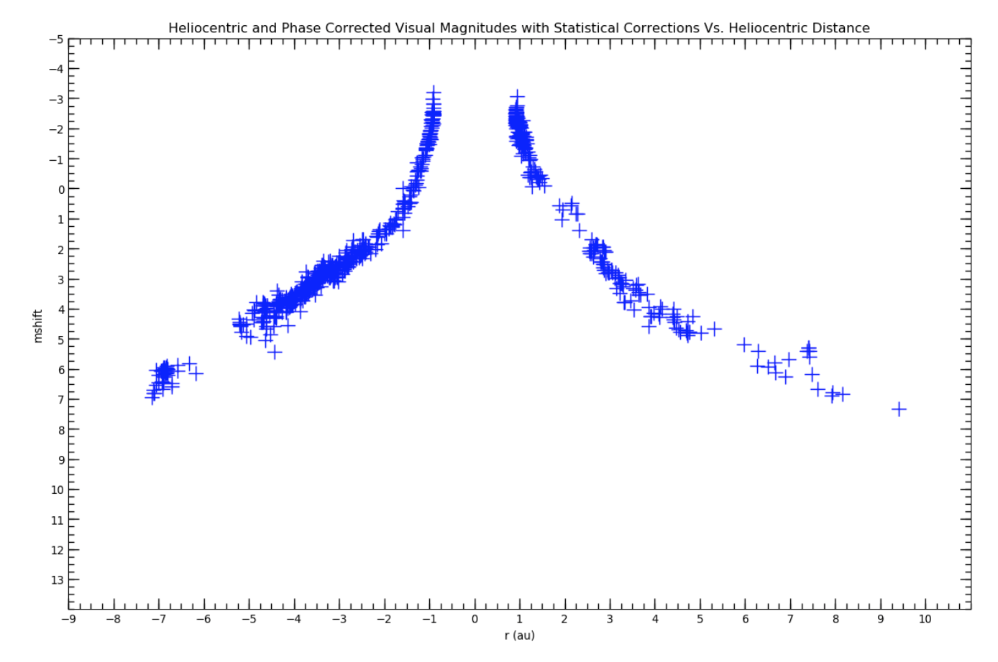
Final result

Slide 4
Data descriptions missing
While the nature of the data is described within the .csv files (and on the PDS website), the data set is missing "collection_description.txt" and "collection_description.xml” so that the data can be easily understood just from the archived files

Slide 5
input_column_meanings.pdf
The information on the linked websites should be included directly in the archive to ensure that the information will be preserved
I wasn’t able to access it already!
This documentation doesn’t seem to be directly related to the data in this set; rather it appears to be related to how the data are submitted to the ICQ

