Slide 1
Comet ISON 2013 Ground-Based Observations Bundle by Safonova, M. et al.
PDS SBN Data Review
15 May 2018
Emily Kramer

Slide 2
Overview
This dataset contains optical spectroscopic and photometric imaging data of comet C/2012 S1 (ISON)
Taken at three different facilities
2.0-m Himalayan Chandra Telescope (HCT)
90-inch Vainu Bappu Telescope (VBT)
40-inch T40 telescope, Wise Observatory
Data collected during five months in 2013
January, February, September, October, November

Slide 3
Imaging data
All from 2.0-m HCT
Flags in file names indicate what processing has been done
cc = cosmic ray removal
f = flat fielded
b = bias corrected
ic = illumination corrected (February only)
r = registered on comet position, or t in October
While the documentation files clearly state which processing has been done to which frames, it was unclear why image registration wasn’t done for all data
e.g., wj010098.fits (Oct. 1), November data, September 19 data
September data appears to already be registered?

Slide 4
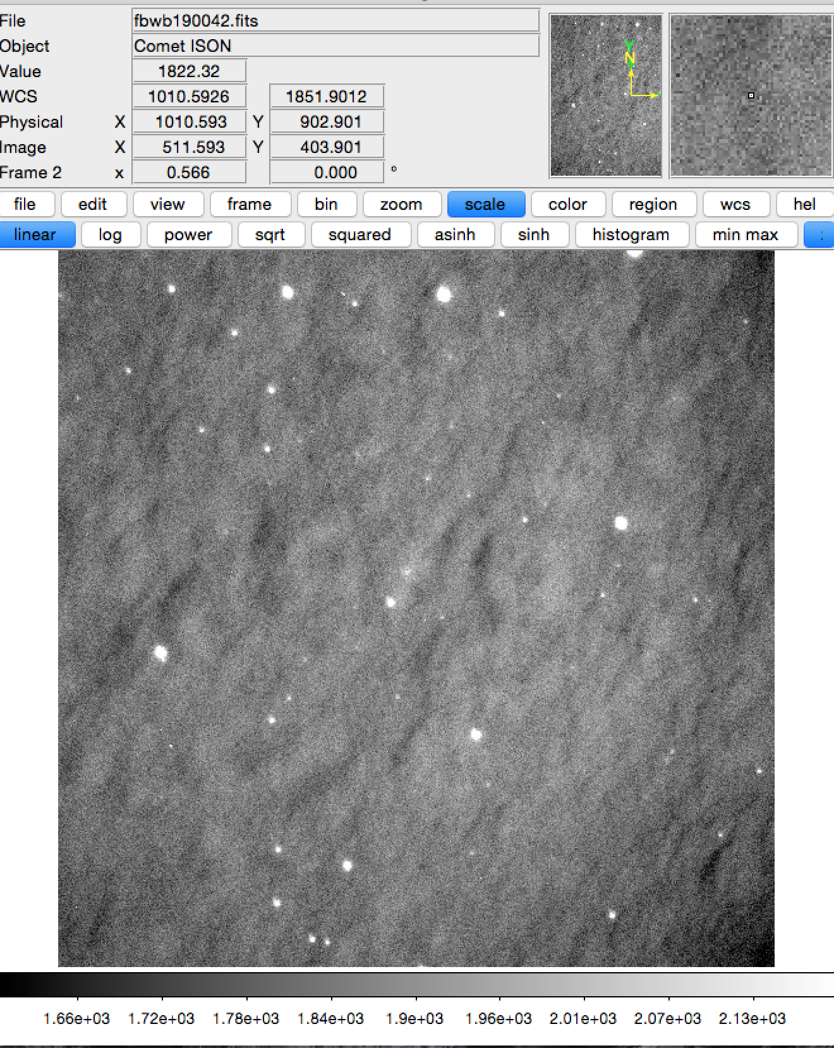
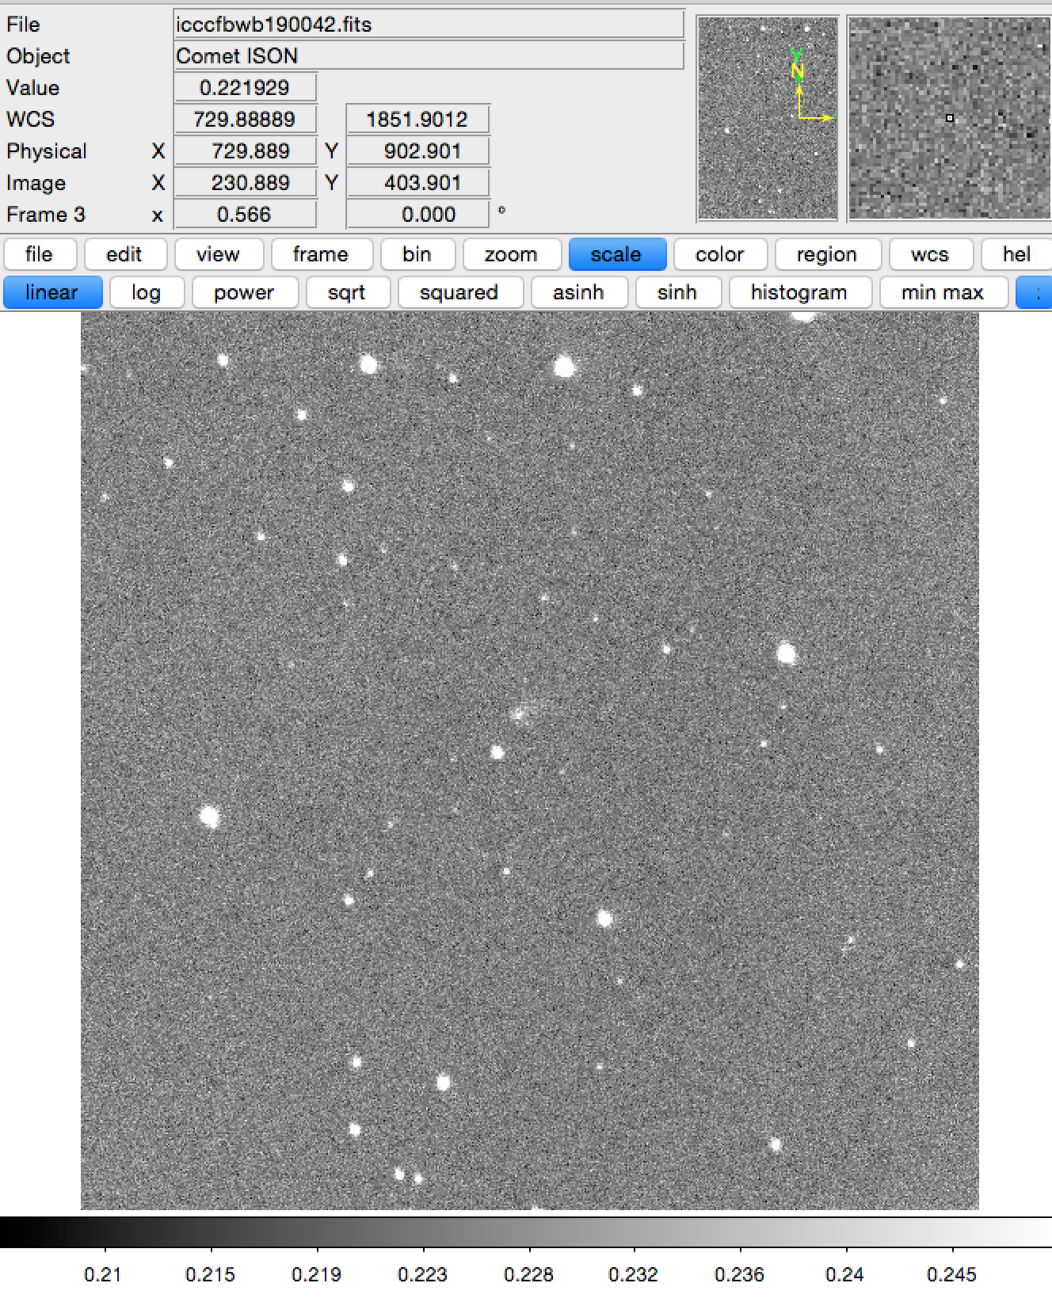
Imaging data
Processed to remove cosmic rays and uneven background illumination (in February data)

Slide 5
Spectroscopy
Data from all three telescopes
Note: VBT referred to as 90” in overview docs, but 2.34-m in spectroscopy documentation. This should be rectified

Slide 6
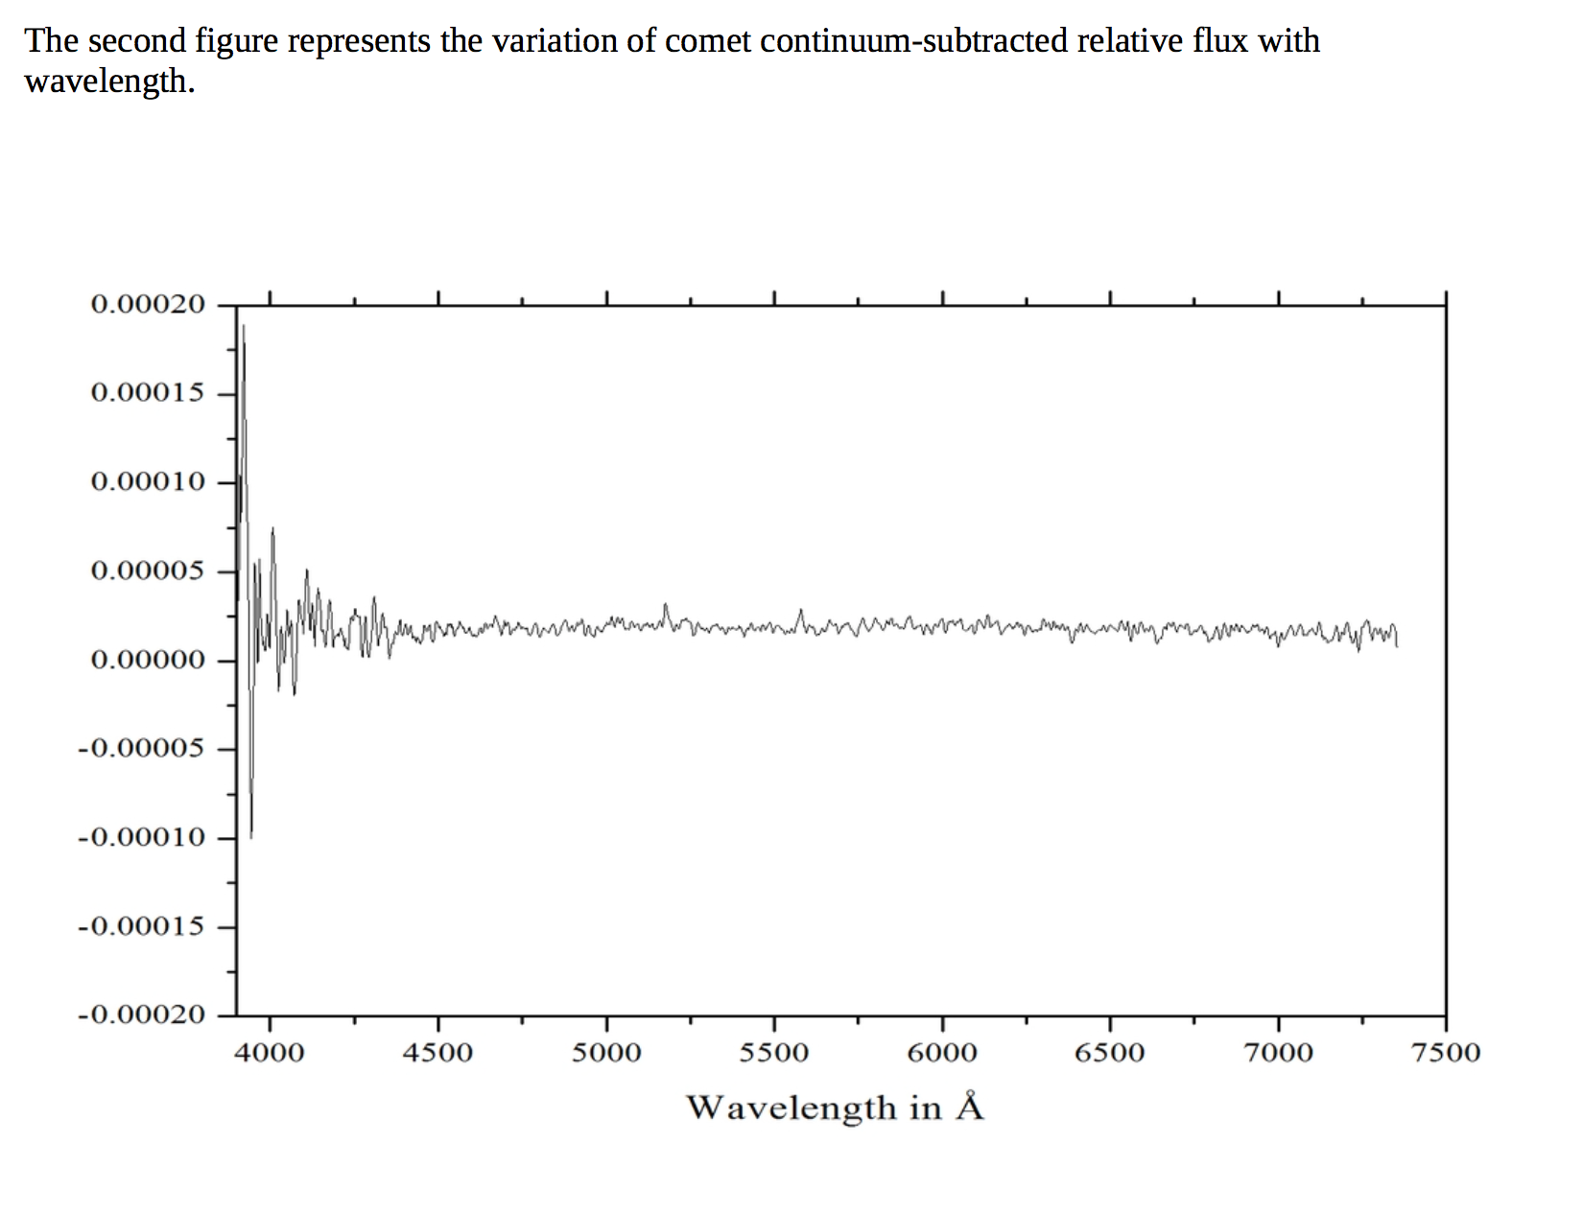
Spectroscopy
Missing y-axis label in February spectroscopy documentation

Slide 7
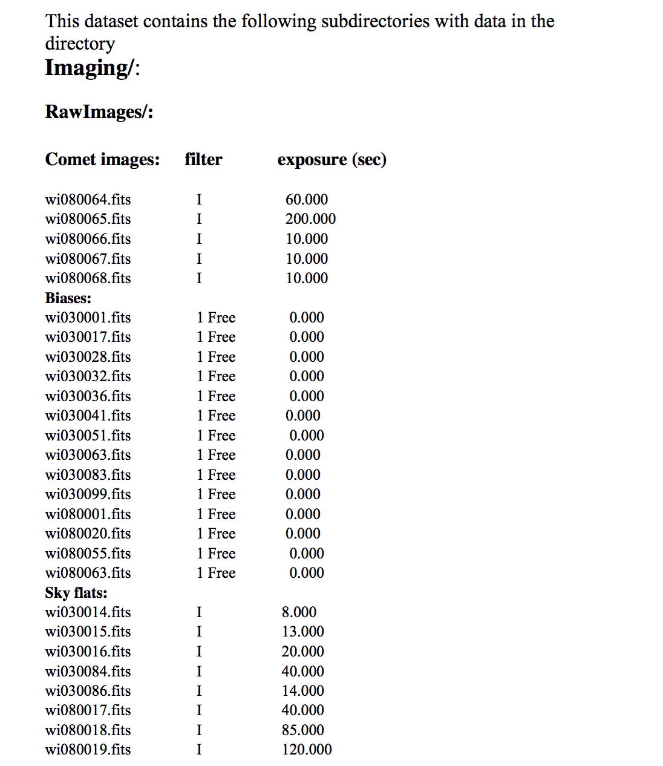
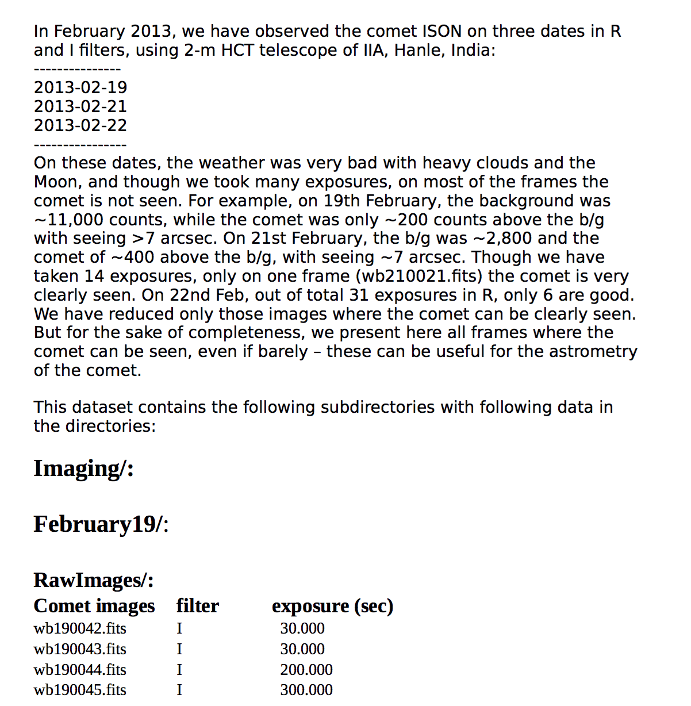
Documentation (imaging and spectra)
Would be helpful to have each document structured in the same format for all months
-VS-

Slide 8
Typos
overview.txt (comments on parts that are common to all folders)
till ==> until
"Photometric data was obtained" ==> "Photometric data were obtained”

