Slide 1
Hew Horizons Data Review nh-p_psa-leisa_mvic-5-comp-v1.0 nh-p_psa-lorri_mvic-5-geomaps-v1.0
Jian-Yang Li
Planetary Science Institute
May 15, 2018

Slide 2
Dataset Overview
nh-p_psa-leisa_mvic-5-comp-v1.0
  Include four high level data products in four separate subdirectories: absorp/, color/, mosaic/, spec/
  Three products are included in this review: color/, mosaic/, spec/
  color/ contains the MVIC four-color image cubes for Pluto, Charon, Nix, and Hydra
  mosaic/ contains projected four-color global mosaics of Pluto and Charon from MVIC
  spec/ contains the 1.25 – 2.5 µm spectral image cubes for Pluto, Charon, Nix, Hydra, and Kerberos from LEISA
nh-p_psa-lorri_mvic-5-geomaps-v1.0
  Include three high level data products in subdirectories: mosaic/, dtm/, albedo/. All products are reviewed here
  mosaic/ contains projected monochromatic mosaics of Pluto and Charon from LORRI
  dtm/ contains the digital terrain model of Pluto and Charon derived from LORRI and MVIC data
  albedo/ contains Bond albedo maps of Pluto and Charon derived from LORRI and MVIC data
Review process
  Check dataset.cat and dataset_projection.cat files
  Check PDS labels (detached or attached to data files) and the consistency with corresponding data files
  Load all data files with my own python code and IDL readpds
  Check associated supporting data (wavelength and geometry)
  Display data and make some simple science product with the data
What I didn’t do
  Calibration of data products
  Reproduce data products
  Download SPICE kernels to check the calculation of geometric data
  Check mission and instrument catalog files

Slide 3
Quick Review Summary
Overall very useful high level data products
However, all data products that I reviewed have some problems, some could be serious
Product | Lien Summary | Certified?
nh-p_psa-leisa_mvic-5-comp-v1.0/color | Inconsistency, incomplete information, FITS format | Yes
nh-p_psa-leisa_mvic-5-comp-v1.0/mosaic | PDS3 format compliance, incomplete information | No
nh-p_psa-leisa_mvic-5-comp-v1.0/spec | Inconsistency, FITS format | Yes
nh-p_psa-lorri_mvic-5-geomaps-v1.0/mosaic | Inconsistency, incomplete information | Yes
nh-p_psa-lorri_mvic-5-geomaps-v1.0/dtm | Wrong information? | Yes
nh-p_psa-lorri_mvic-5-geomaps-v1.0/albedo | Wrong data | No

Slide 4
Hew Horizons Data Review nh-p_psa-leisa_mvic-5-comp-v1.0 color/

Slide 5
nh-p_psa-leisa_mvic-5-comp-v1.0/color
dataset.cat line 106 claims that this dataset contains data of "All Satellites", but this is not true as the color cubes only include Nix and Hydra.
For Pluto and Charon data, no information for which band is which layer in the data cube
In mvic_*_geom_pl.lbl: the definitions of "observation angle" and "illumination angle" are not found. While it is not hard to guess their definition, they need to be clearly defined in order to avoid confusion in 50 years
Some FITS files have “missing END” error, therefore do not comply with FITS standards. IDL readpds doesn’t seem to have problem loading those data.
  mvic_0298824437_0x545_geom_pl.fit
  mvic_0298853042_0x545_geom_pl.fit
  mvic_0298853212_0x536_geom_pl.fit
  mvic_0298891582_0x545_geom_pl.fit
  mvic_0298939122_0x545_geom_pl.fit
  mvic_0298939122_0x545_sci_pl.fit
  mvic_0298939292_0x545_geom_pl.fit
  mvic_0298939292_0x545_sci_pl.fit
  mvic_0299176432_0x536_geom_ch.fit
Otherwise a good dataset
Certified

Slide 6
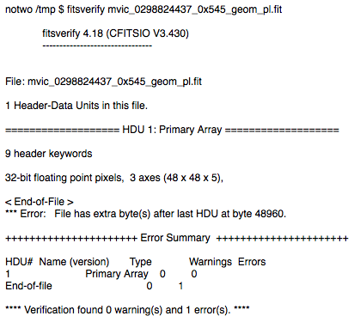
FITS Problem
When load, e.g, `mvic_0298824437_0x545_geom_pl.fit`, astropy.io.fits.open returns an error message: “OSError: Header missing END card.”
Mike Kelley ran `fitsverify`, and received “End-of-file” error (shown on the right). Tilden Barnes checked and found one extra byte after the expected end of file.
But this is a FITS format problem. IDL readpds doesn’t seem to be affected, and can load the data correctly.
Is it a lien?

Slide 7
Nix and Hydra Color Cubes
Nix
Hydra
Images of Nix and Hydra in all four MVIC bands, and the composite color images
Two color composite: R, G, B = (NIR, Red, Blue) and R, G, B = (CH4, Red, Blue)
Good

Slide 8
Pluto Color Cube mvic_0299162512_0x536_sci_pl
Four band images and composite color images
(Same as previous slide)
Geometry backplanes
Good

Slide 9
Color Composite Images Sequence of Pluto
Color composite images of Pluto
  (R, G, B) = (NIR, Red, Blue)
From mvic_0298719172_0x545_sci_pl.fit to mvic_0299178092_0x536_sci_pl.fit
Is the slight blue halo in the third frame of the second row due to PSF effect or real? (Just curious)
Good

Slide 10
Hew Horizons Data Review nh-p_psa-leisa_mvic-5-comp-v1.0 mosaic/

Slide 11
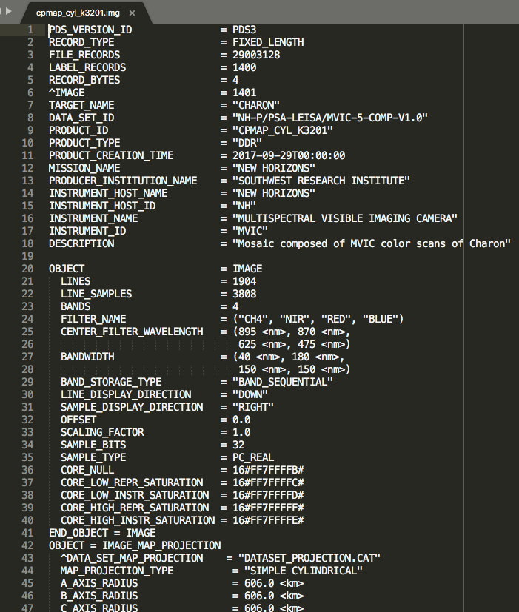
nh-p_psa-leisa_mvic-5-comp-v1.0/mosaic
Data label does NOT comply with PDS3 format definition?
  IDL readpds cannot correctly load the whole mosaic cube, but just loads the first band
  In PDS labels, OBJECT key is set as `IMAGE` rather than `QUBE`. Is this the reason that readpds doesn’t load the whole cube?
It is not clearly defined how the data cube is stored, row-major order or column-major order?
Not certified

Slide 12
nh-p_psa-leisa_mvic-5-comp-v1.0/mosaic
Wrote my own python code to load the data
  Following the LINES, LINE_SAMPLES, and BANDS keys, and LINE_DISPLAY_DIRECTION and SAMPLE_DISPLAY_DIRECTION keys
  Assuming that the storage of array elements has dimensions (LINES, LINE_SAMPLES, BANDS), with LINES the fastest changing index and BANDS the slowest changing index
  The cube can now be loaded and displayed correctly
Color composite shown to the right
  (R, G, B) = (CH4, Red, Blue)
Both mosaics look good to me
Pluto
Charon

Slide 13
Hew Horizons Data Review nh-p_psa-leisa_mvic-5-comp-v1.0 spec/

Slide 14
nh-p_psa-leisa_mvic-5-comp-v1.0/spec
dataset.cat it states that all spectra are calibrated to I/F, which seems to be consistent with data value. But in all .lbl files, CORE_UNIT = WATT*M**-2*SR**-1*uM**-1, which is incorrect.
Same FITS format error as those in the color/ data product reported for below files:
  0299026199_charon_geometry.fit
  0299064869_charon_cube.fit
  0299064869_pluto_cube.fit
  0299064869_pluto_geometry.fit
  0299144829_pluto_cube.fit
  0299144829_pluto_geometry.fit
  0299146219_charon_geometry.fit
  0299176809_pluto_cube.fit
  0299176809_pluto_geometry.fit
Certified

Slide 15
Example: Pluto, spec/0299172889_pluto_cube.fit
Good
Image at 2.0 µm

Slide 16
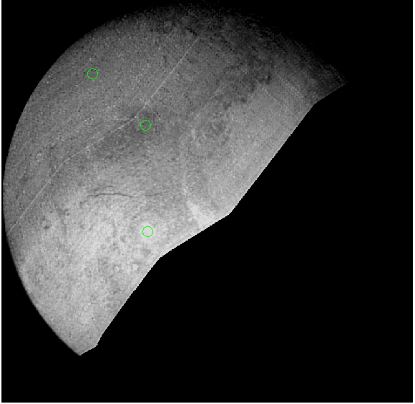
Example: Pluto, spec/0299172889_pluto_cube.fit
(640, 178)
(540, 281)
(332, 285)
Good

Slide 17
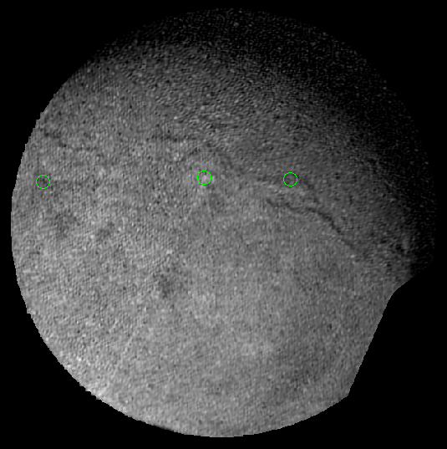
Example: Charon, spec/0299175509_charon_cube.fit
(384, 295)
(378, 67)
(381, 417)
Good

Slide 18
Example: Nix, spec/0299173908_nix.fit
Good

Slide 19
Problem? Kerberos, spec/0299153775_kerberos.fit
I don’t see Kerberos in the data. Is it too faint? Or is it not in the frame? Should be described somewhere in the dataset (maybe dataset.cat?)

Slide 20
Hew Horizons Data Review nh-p_psa-lorri_mvic-5-geomaps-v1.0 mosaic/

Slide 21
nh-p_psa-lorri_mvic-5-geomaps-v1.0/mosaic
Inconsistency between descriptions in dataset.cat and data
  Description (lines 41 & 46): “The original 32bit pixel values were stretch to 8bit (1-255)”. But data are all 32-bit floating point
  Description (lines 43 & 47-48): Stretch of data values, Pluto from 0.03344 to 0.99981, Charon from 0.10892 to 1.3745. But the actual ranges of values are different (see next slide)
Dataset.cat, lines 79-81, says that photometric correction was performed with Lambert model, but didn’t mention to what standard geometry the correction was made. This should be specified in order to make the absolute values in the mosaics meaningful
Both mosaics look good to me
Certified

Slide 22
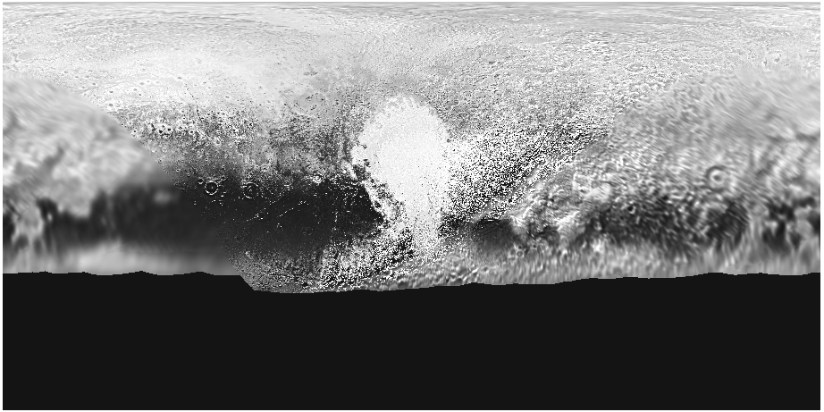
Pluto Mosaic: mosaic/nh_pluto_mosaic.img
Pluto high-res mosaic
Histogram
Range of values: 0 – 0.9998
Good

Slide 23
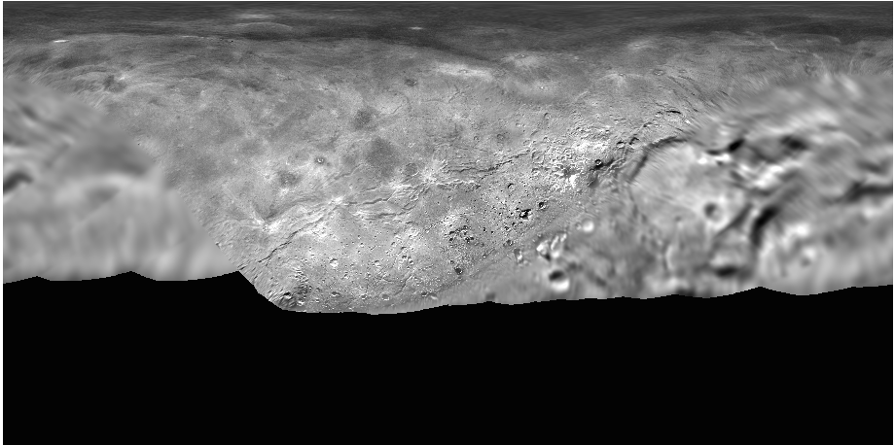
Charon Mosaic: mosaic/nh_charon_mosaic.img
Charon high-res mosaic
Histogram
Range of values: -0.07 – 1.3661
Good

Slide 24
Hew Horizons Data Review nh-p_psa-lorri_mvic-5-geomaps-v1.0 dtm/

Slide 25
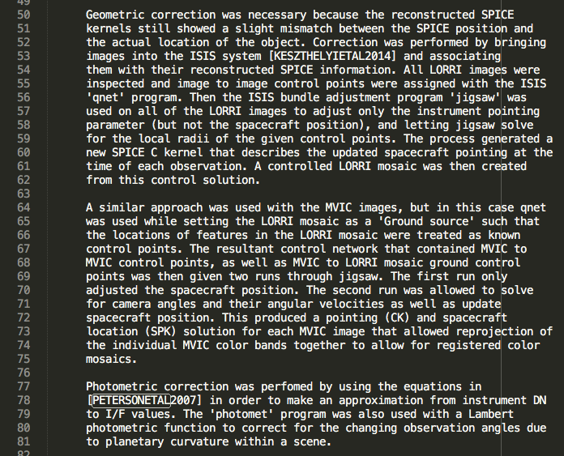
nh-p_psa-lorri_mvic-5-geomaps-v1.0/dtm
In dataset.cat, lines 50-81 and lines 133-164: the text in subsections “XXX Processing Parameters” are exactly the same for XXX=Mosaic and XXX=DTM, except for one typo. Is it correct?
Certified

Slide 26
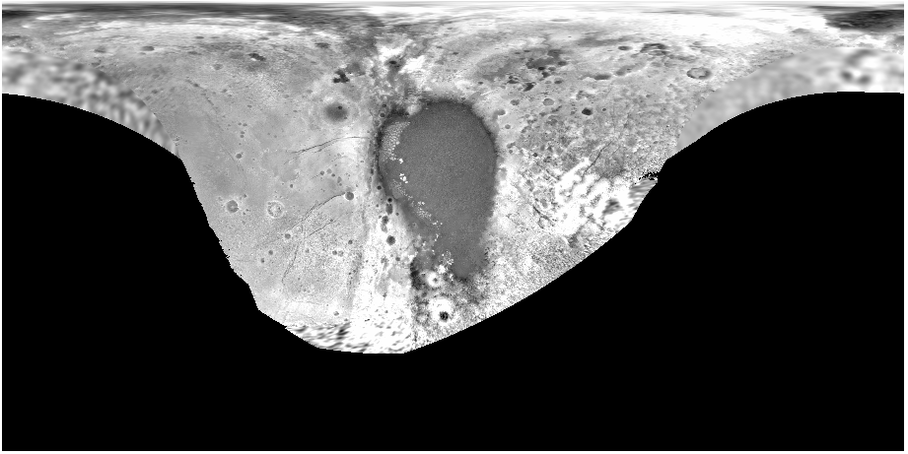
Pluto DTM: dtm/nh_pluto_dtm.img
Good

Slide 27
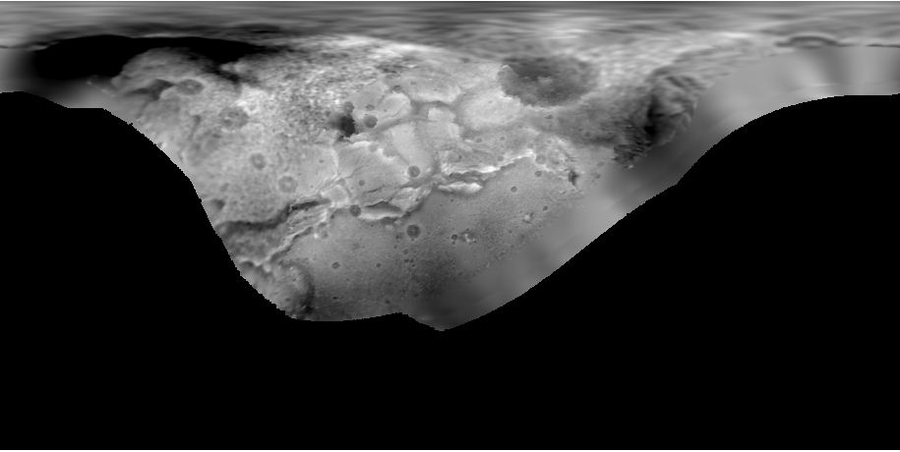
Charon DTM: dtm/nh_charon_dtm.img
Good

Slide 28
Hew Horizons Data Review nh-p_psa-lorri_mvic-5-geomaps-v1.0 albedo/

Slide 29
nh-p_psa-lorri_mvic-5-geomaps-v1.0/albedo
In dataset.cat, it is stated that this product contains the Bond albedo maps of Pluto and Charon. However, the actual maps in the data contain 8-bit integers with values 0-255. There is no definition for the unit of pixel values in the albedo maps in either dataset.cat or corresponding .lbl files.
It looks like the maps are simply a digital version of 8-bit images of Figs. 5 and 6 as published in Buratti et al. (2017), rather than the actual Bond albedo values as one would expect for this product.
Plus, the color bar and tick marks in the maps are certainly not surface features on Pluto and Charon, and should not be part of the maps. (see following slides)
Not certified

Slide 30
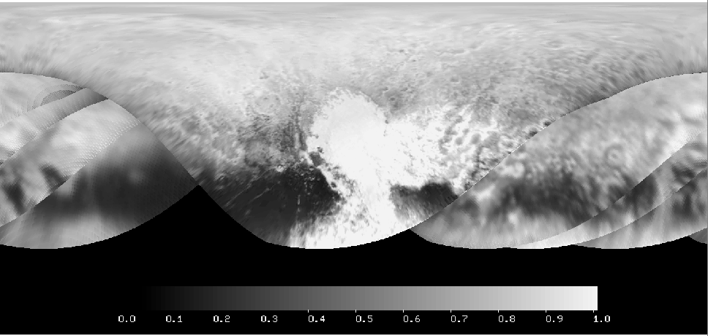
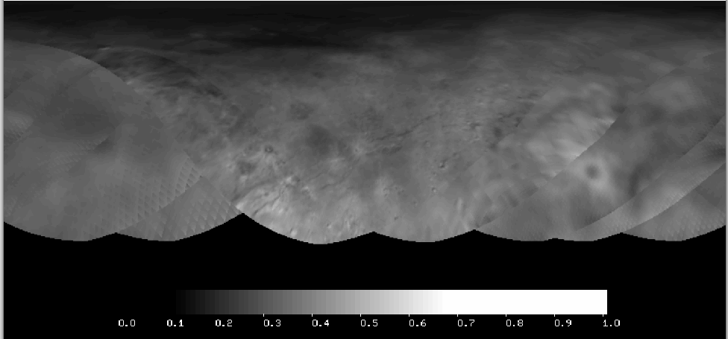
Albedo Maps
Pluto
Charon
albedo/nh_pluto_bond.fit
albedo/nh_charon_bond.fit
Fig. 5, Buratti et al. (2017)
Fig. 5, Buratti et al. (2017)

