Slide 1
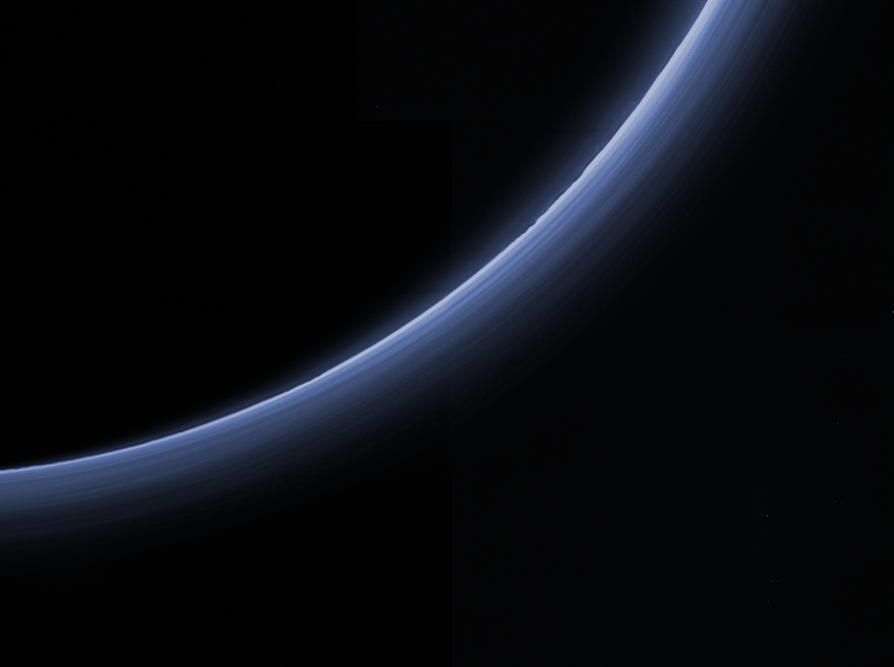
NH/PDS4/Comet Review May 15, 2018 Data Set nh-p_psa-lorri_alice_rex-5-atmos-v1.0
Additional Reviewer – Lori Feaga (UMD)

Slide 2
Suggested Liens on Documentation
catalog/dataset.cat –
Very long and seems like much of the methods and calculation descriptions should go into a text in document/ rather than a basic data set catalog file in catalog/
Typos:
“photocahode gape” should be “photocahode gap”
are the feature names still informal?
“informally named Sputnik Planitia”
“abudance” should be “abundance”
“measureable” should be “measurable”
close parentheses after “see [YOUNGETAL2017]”
“wich” should be “which”
“aleady” should be “already”
close parentheses after “Fig. 9 of [YOUNGETAL2017]
“line-of- sight” should be “line-of-sight”, i.e., remove the extra space

Slide 3
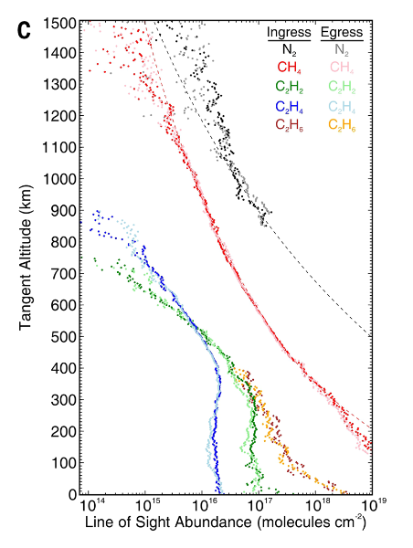
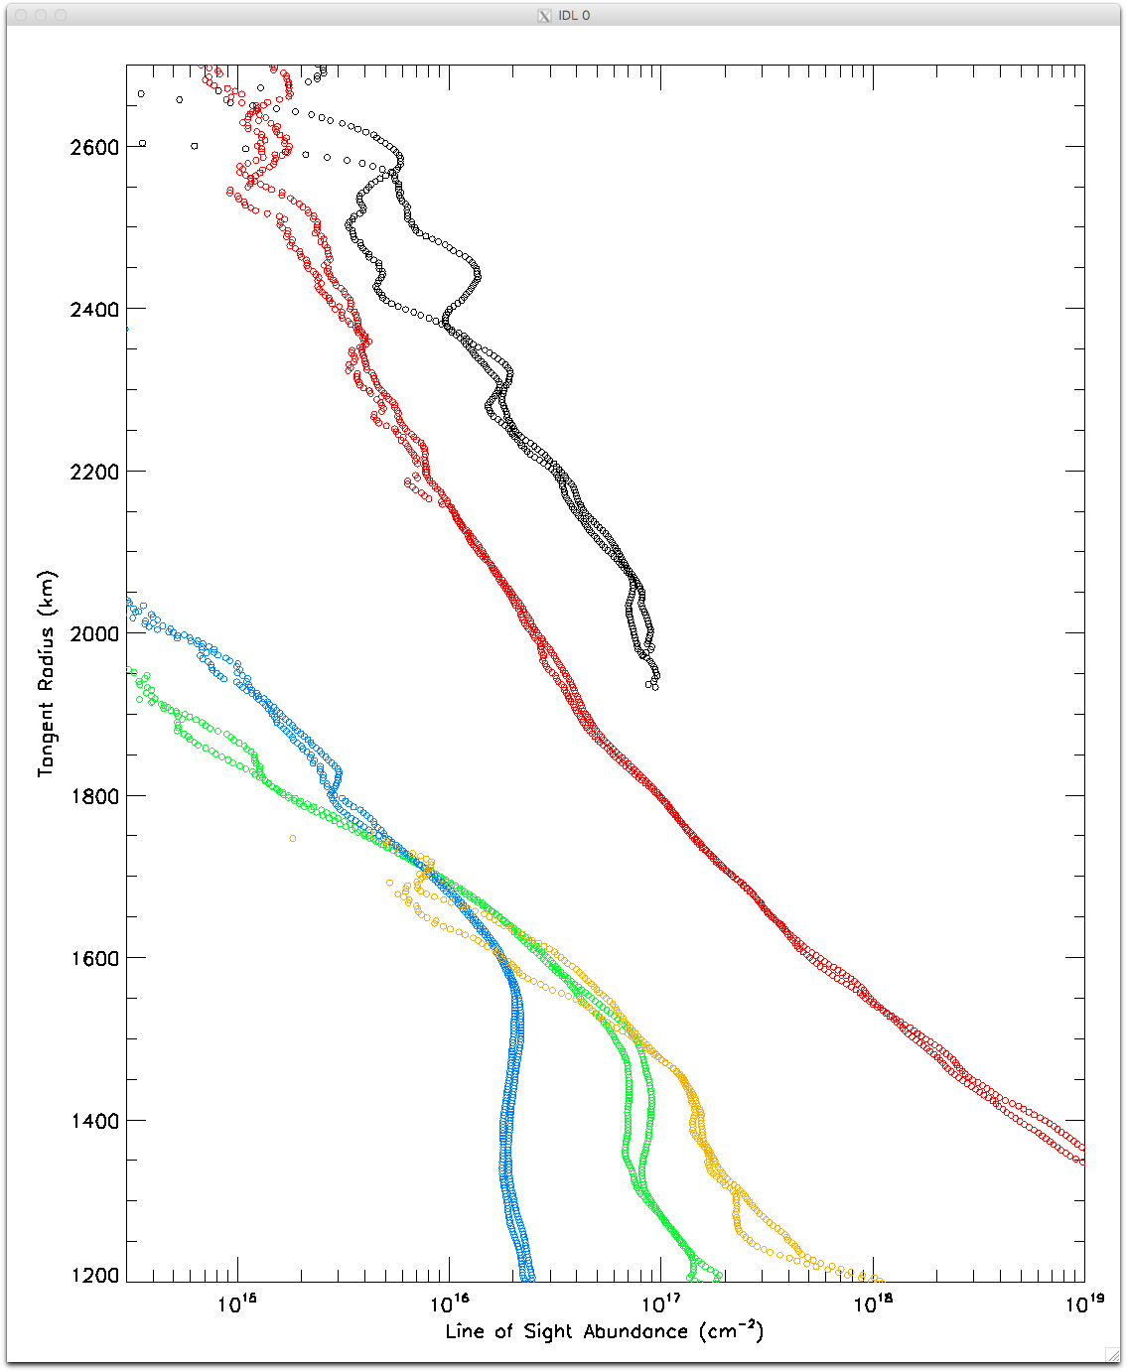
Data Verification (Gladstone et al. 2016)

