Slide 1
NH/PDS4/Comet Review May 15, 2018 Data Collection urn:nasa:pds:compil-comet:unid-emis::1.0
Secondary Reviewer – Lori Feaga (UMD)

Slide 2
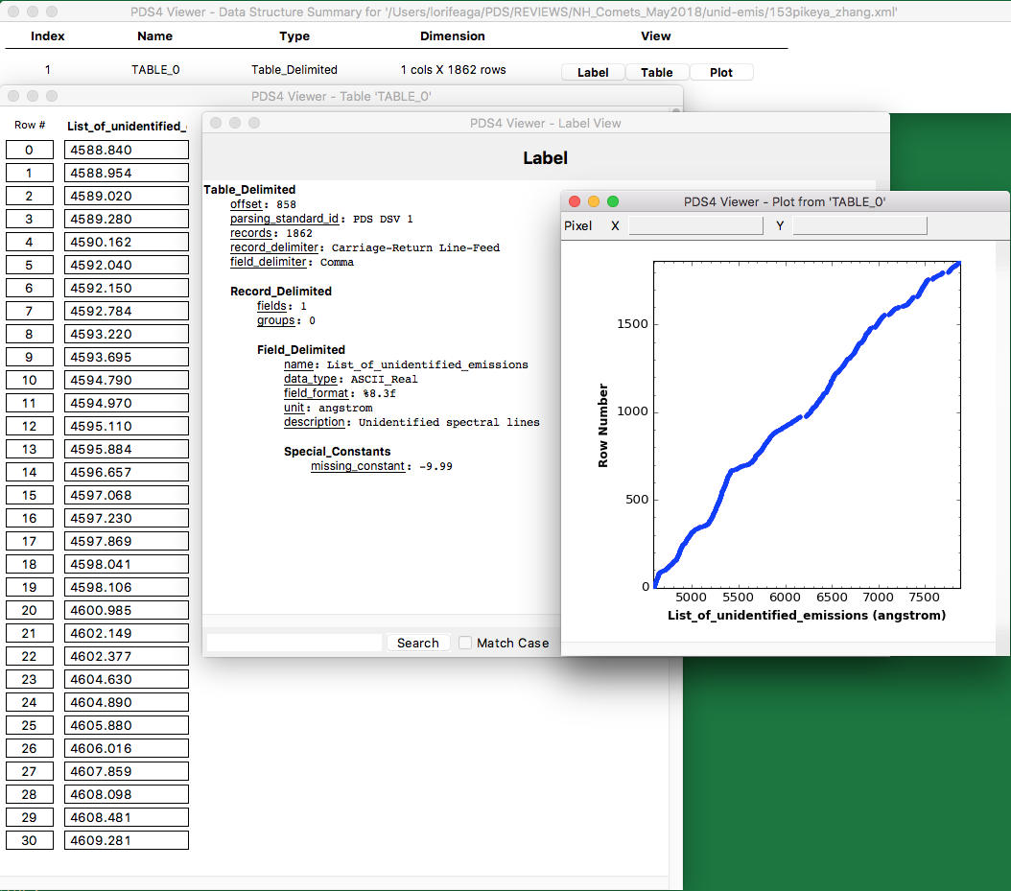
PDS 4 Viewer
Can open the labels and are correctly directed to the tabular files
19P/Borrelly example

Slide 3
Scientific Usefulness of the Data
Collection of visible spectral emission lines from the literature that occur/recur in observations of comets but are not yet attributed to specific molecular/atomic bands/emission lines
Helpful in modeling composition
As database builds, with better resolution, can lead to identification of the species

Slide 4
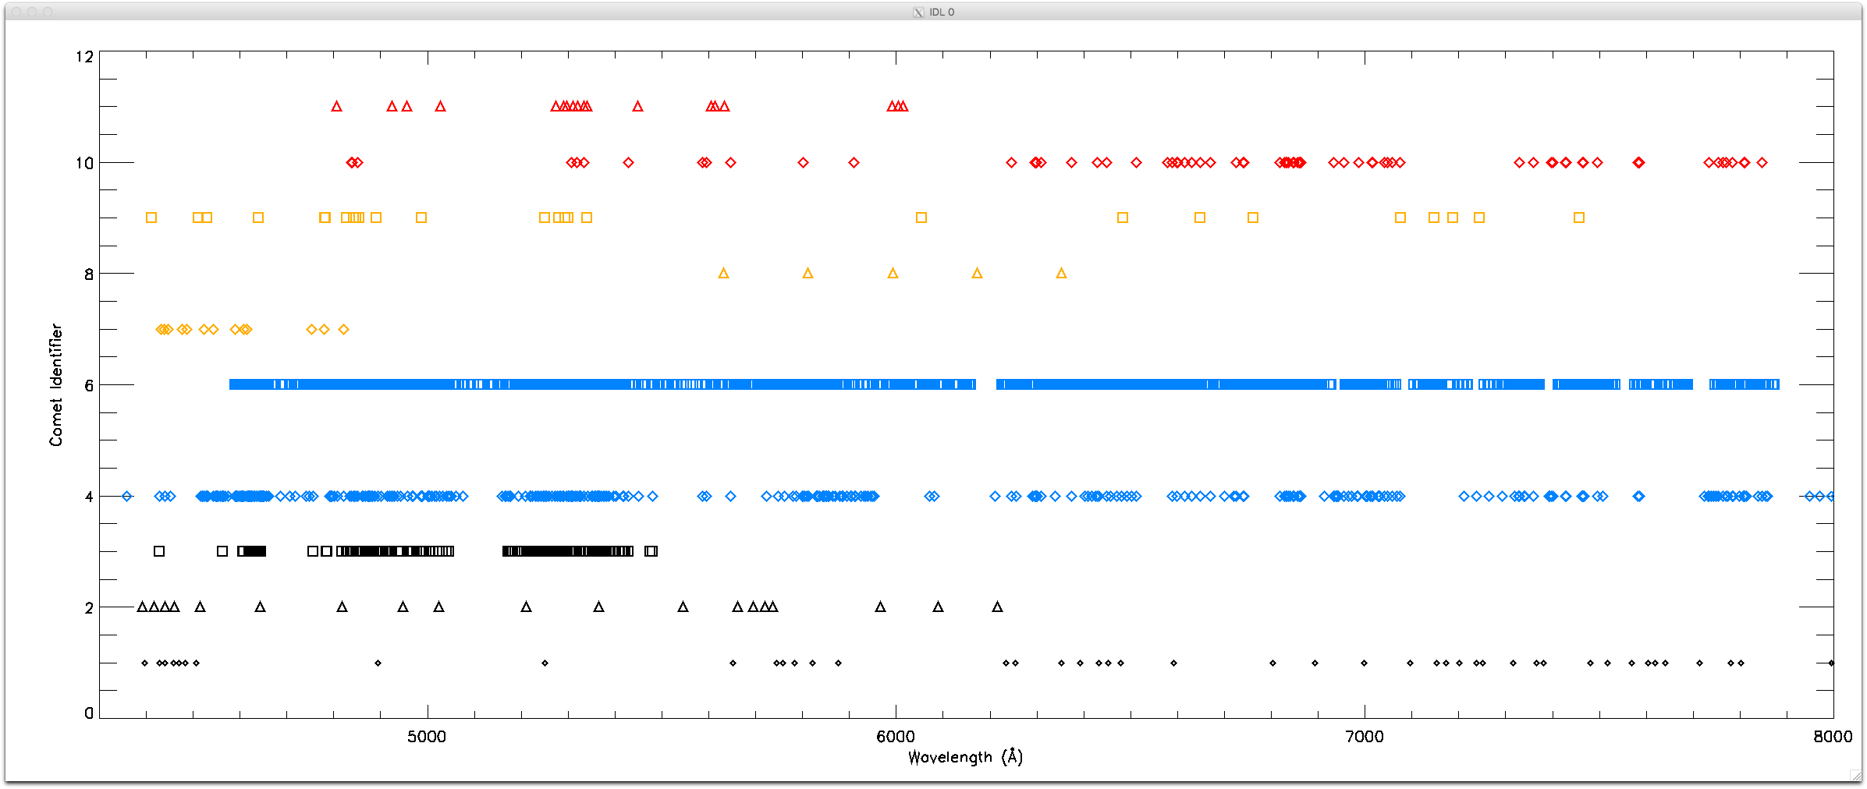

Slide 5
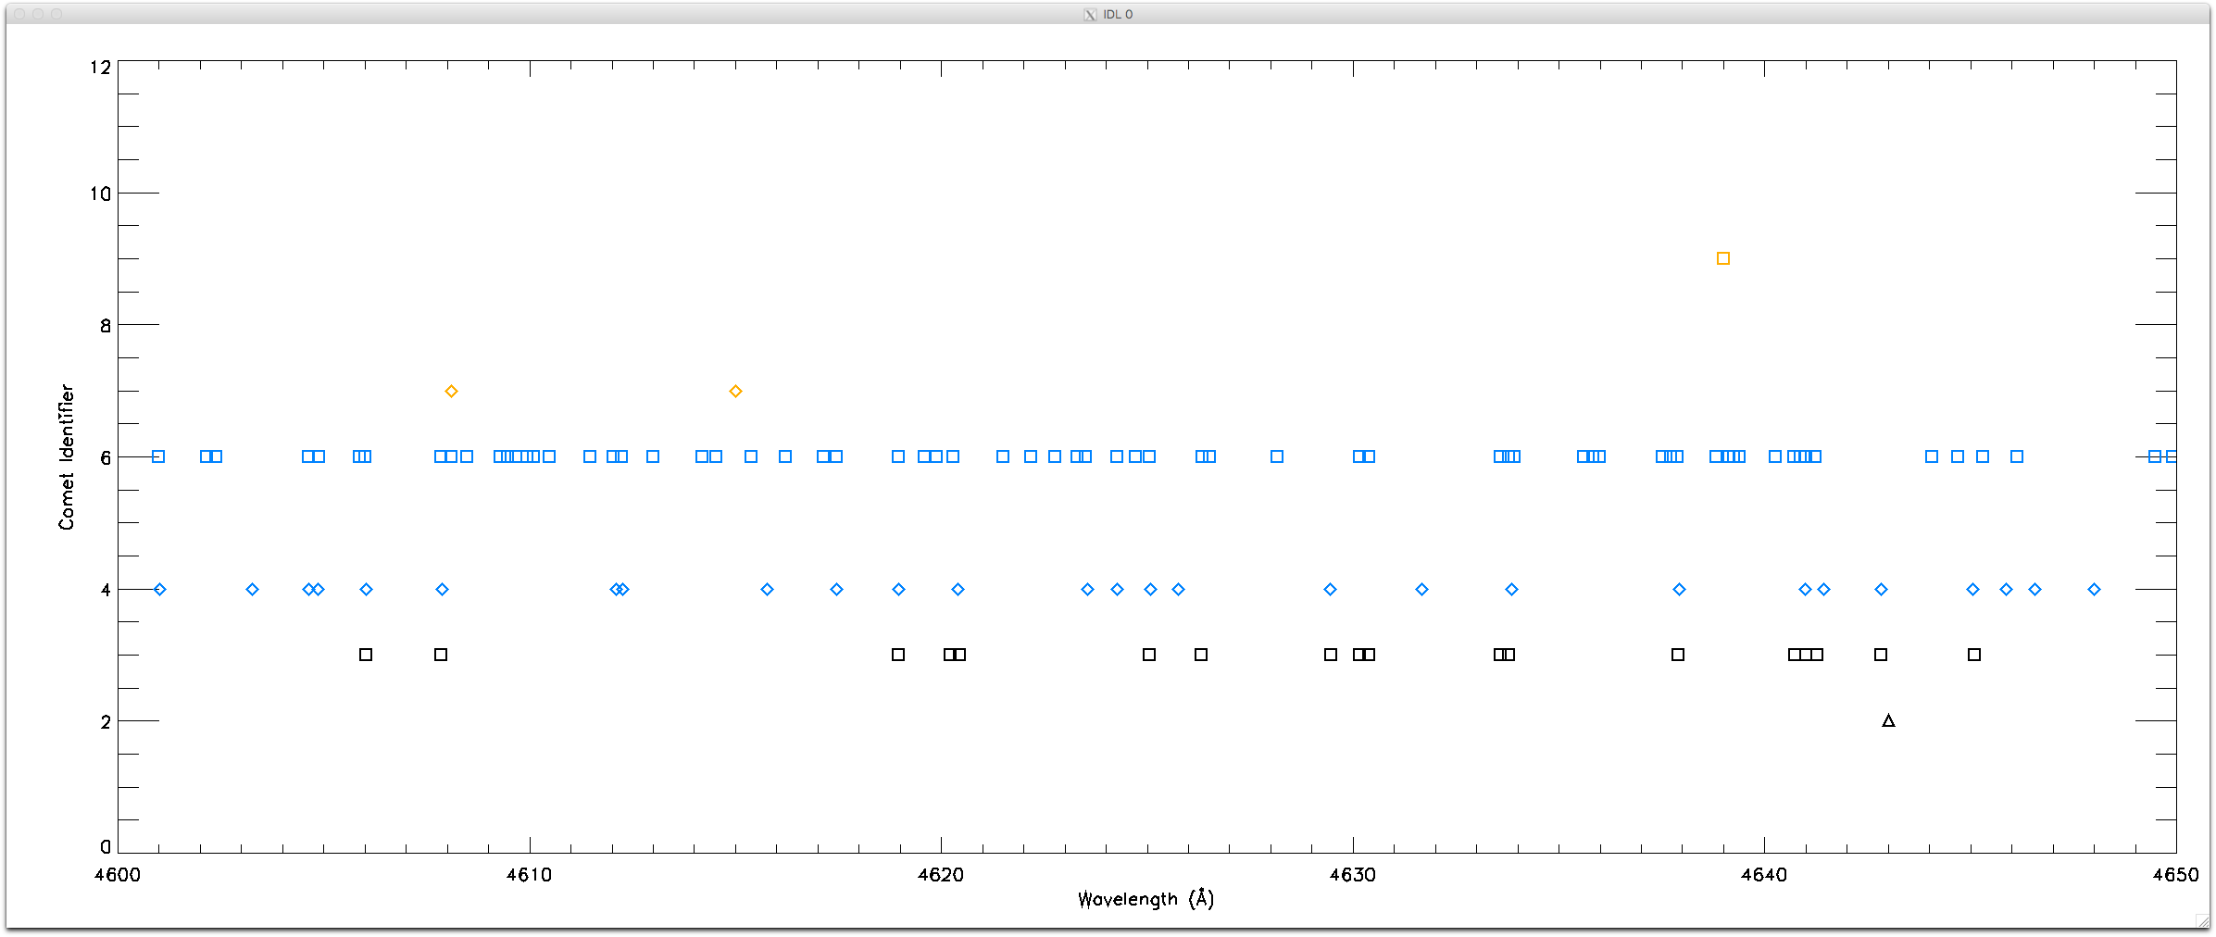

Slide 6
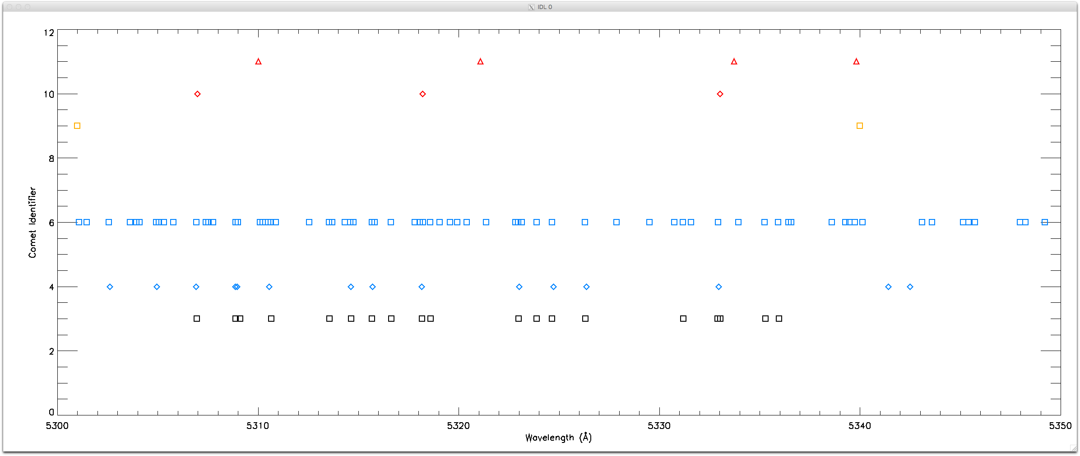
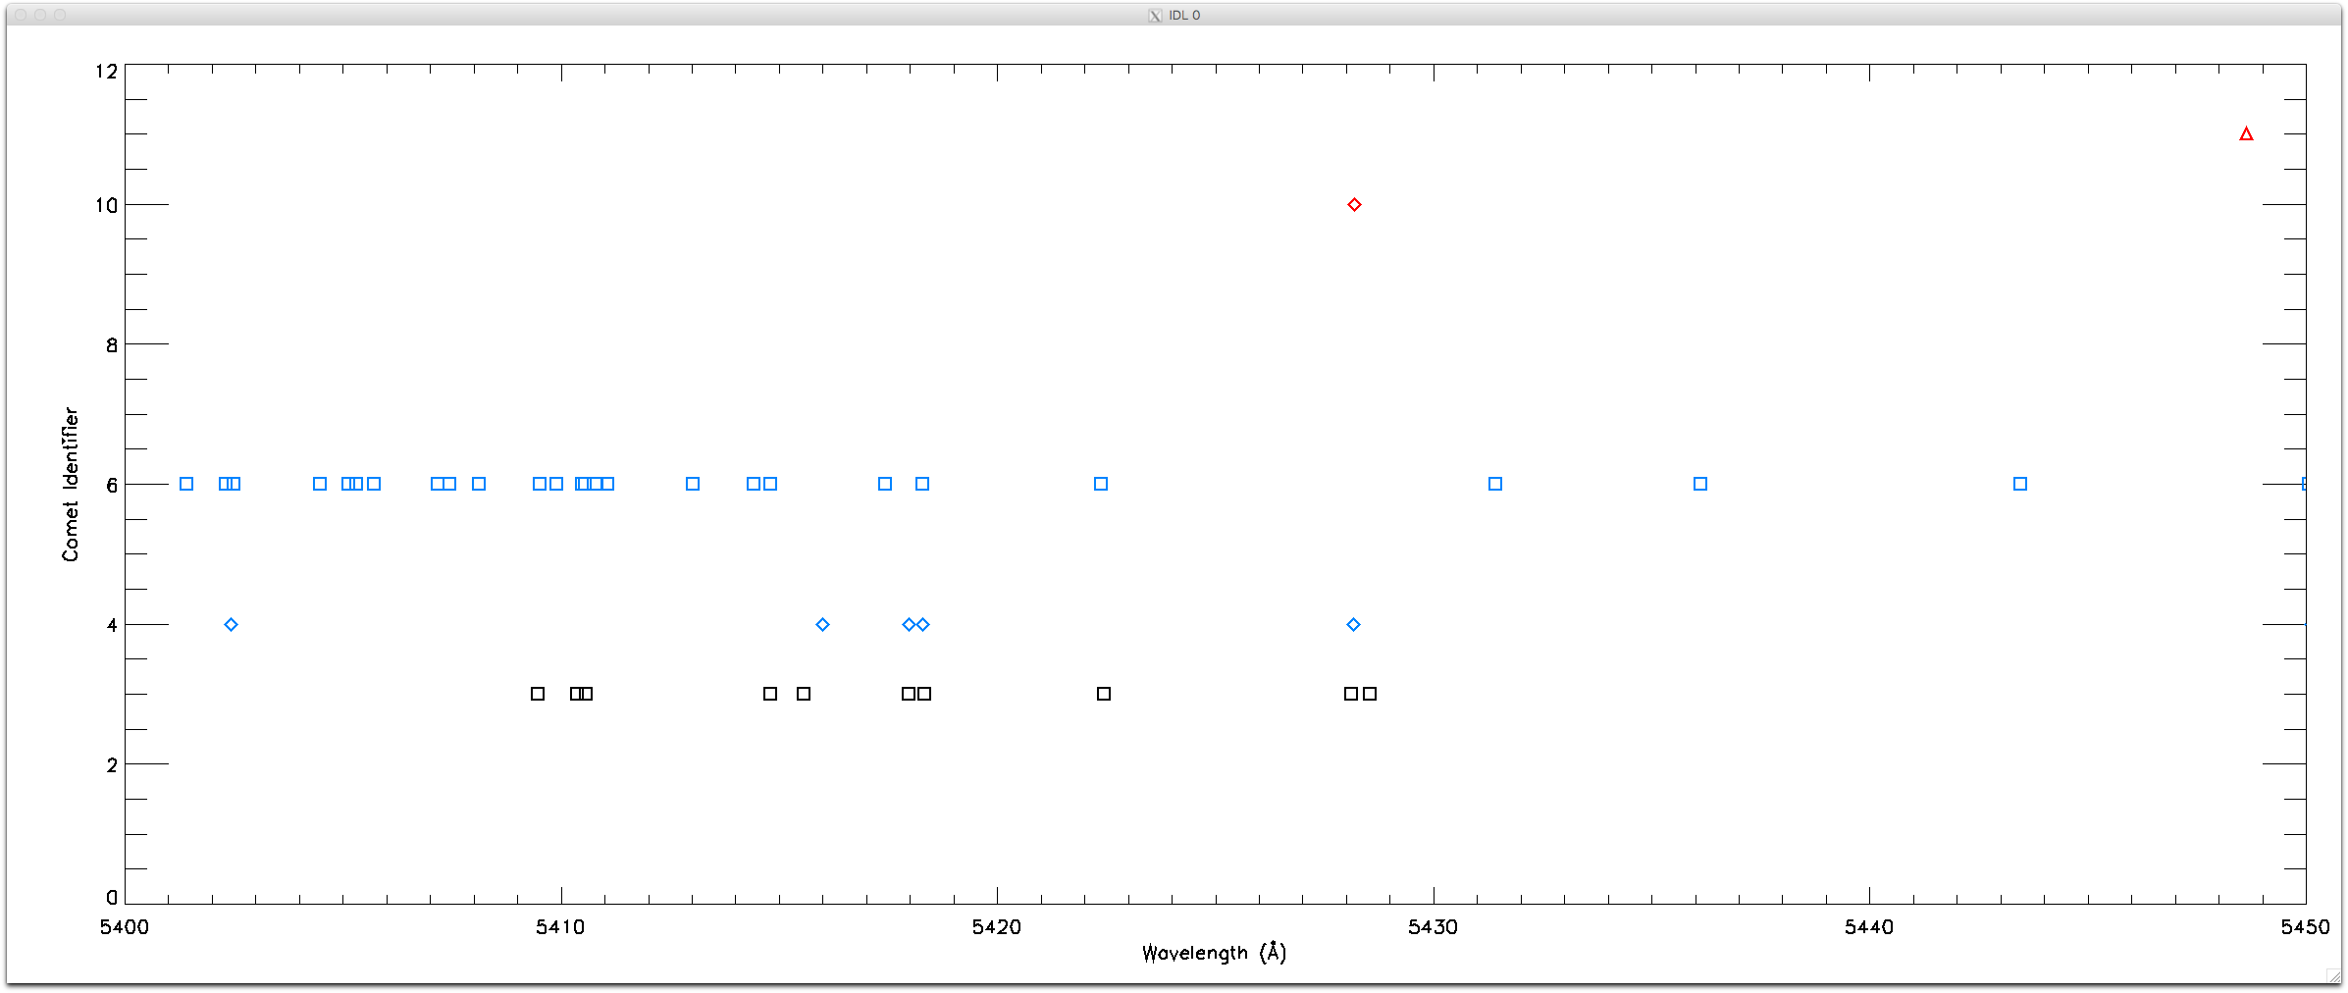

Slide 8
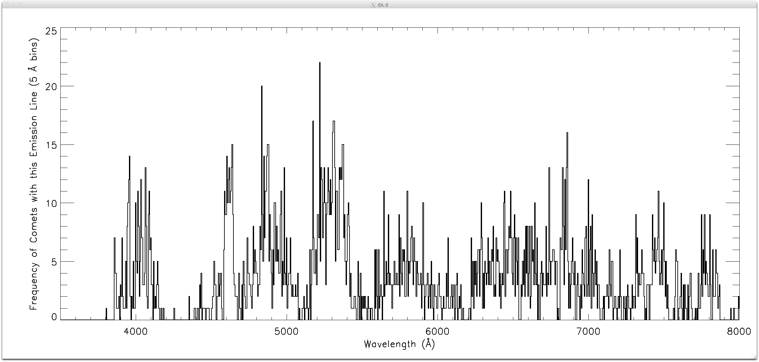
What are the Common Lines?
Used a wavelength bin of 5 Å

Slide 9
Problems & Suggested Liens
What is the Data Set Overview saying about format in the collection.xml?
“There are two different formats used for the tables. The first format is to separate all information into two tables; data and observation. This is done when the observation information cannot be paired with specific data. The second format is to have a single table when the information can be paired with the data.”
Only saw one format for the tables, one table per comet, tables each have one column of wavelengths of unidentified lines

Slide 10
Problems & Suggested Liens (con’t)
3 of the label files (comets 23P, 109P, and 153P) have a <start_date_time> but do not have a <stop_date_time>
<stop_date_time xsi:nil="true" nilReason="inapplicable" />
Why not if they have start times and exposure lengths given in the reference papers (23P and 109p in particular)?
Is stop_date_time allowed to have same value as start_date_time (153P)?
Add stop times to these 3 labels
<start_date_time> and <stop_date_time> likely incorrect for 21P because reference is dated 1992, but start_date_time is 2001
Correct these values
122P/deVico not only has a paper, but also a PDS3 data set that should/could be referenced
Add reference

Slide 11
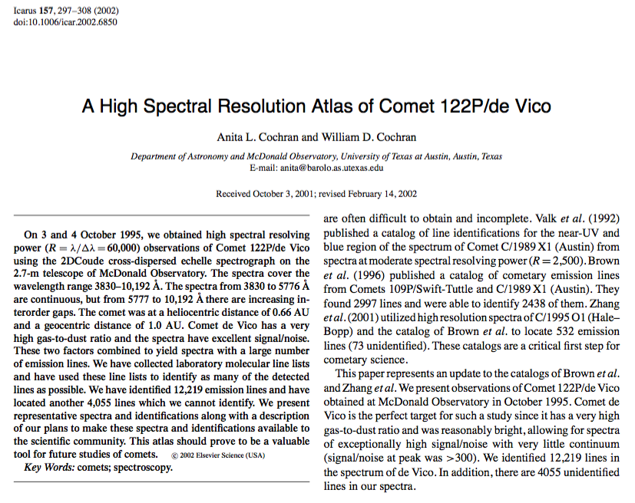
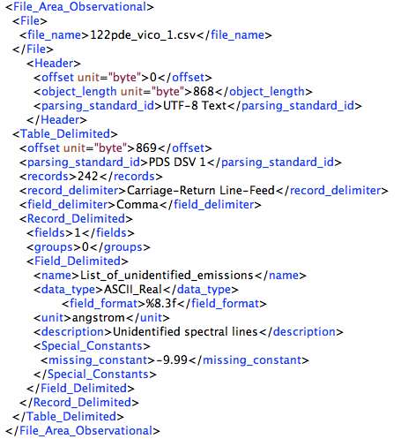
Problems & Suggested Liens (con’t)
How are the unidentified lines down selected?
122P/deVico has 4055 unidentified lines
Only 242 lines are included in this collection
If there is a selection rule or criteria, please state in documentation

Slide 12
Problems & Suggested Liens (con’t)
In <File_Area_Observational> area, the header <object_length> and table <offset> are the same values in 19pborrelly_1.xml and 9 bytes different in 109pswift_tuttle_1.xml
Should be different by 1 in both cases??
For comet cross id consistency, all periodic comets are “_1” except for 153P.
Add the “_1” to 153P files

Slide 13
Problems & Suggested Liens (con’t)
Typos:
In 19pborrelly_1.xml reference_text ‘Poceedings’ should be ‘Proceedings”
In 153pikeya_zhang.xml reference_text ‘De Santes’ should be ‘de Sanctis’

