Slide 1
Apache Point PDS Delivery Review
May 15,2018
Karl Hibbitts

Slide 2
Summary of Data Under Review
Apache Point spectra of Uranian satellites observed in 2013
Ancillary data is present
Scan of the Completed Observer’s LogSheet
APO TripleSpecTool User’s Guide
List of data files, the “inventory”
Overview text of data acquisition and processing, including references
Data is present
Arranged in three directories: raw, processed, and calibration.
Very easy to load and display. Appears as expected.
Issues
Wavelength calibration of processed spectra is suspect

Slide 3
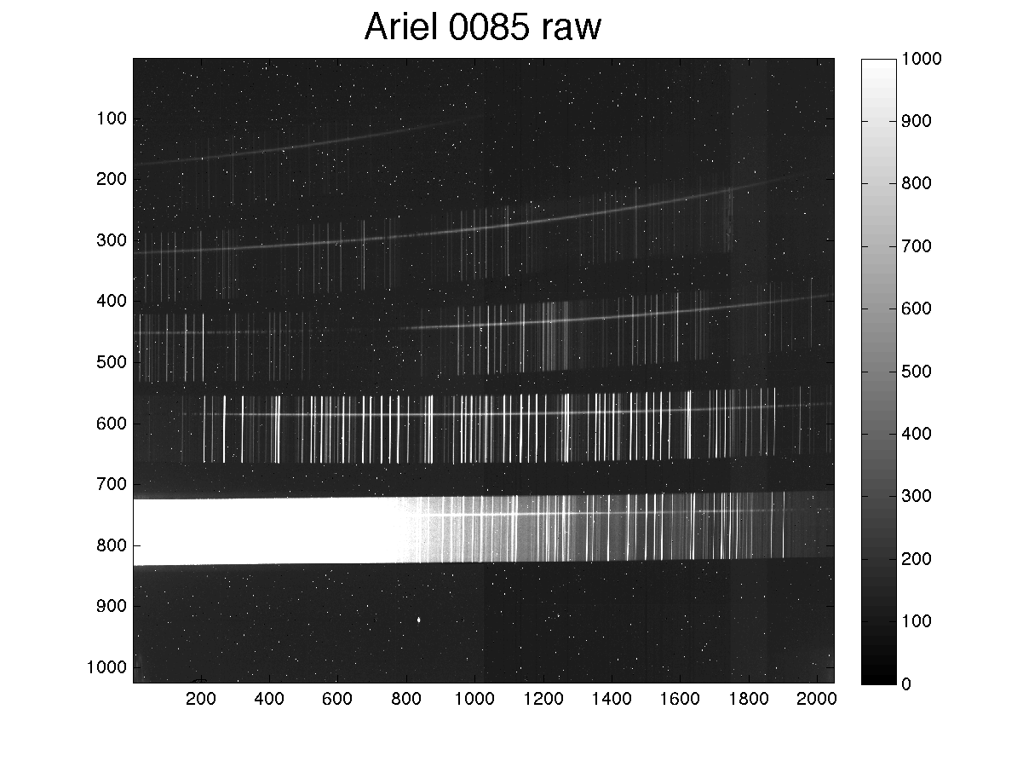

Slide 4
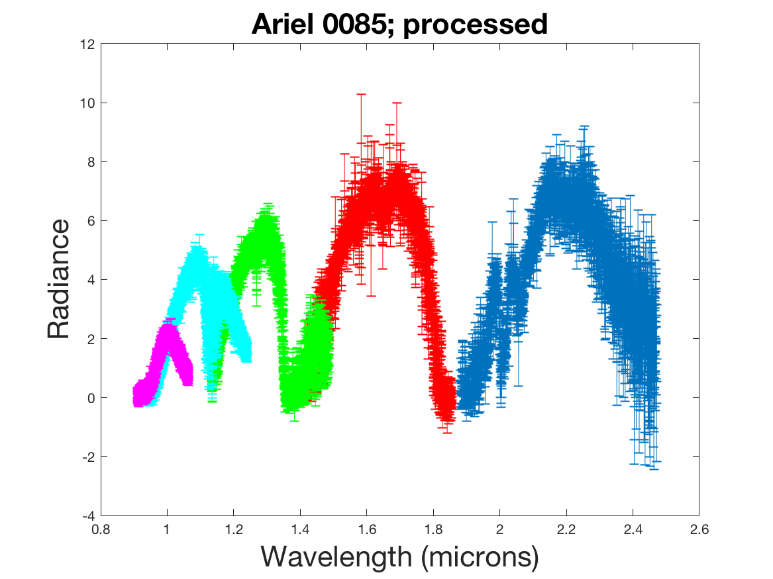
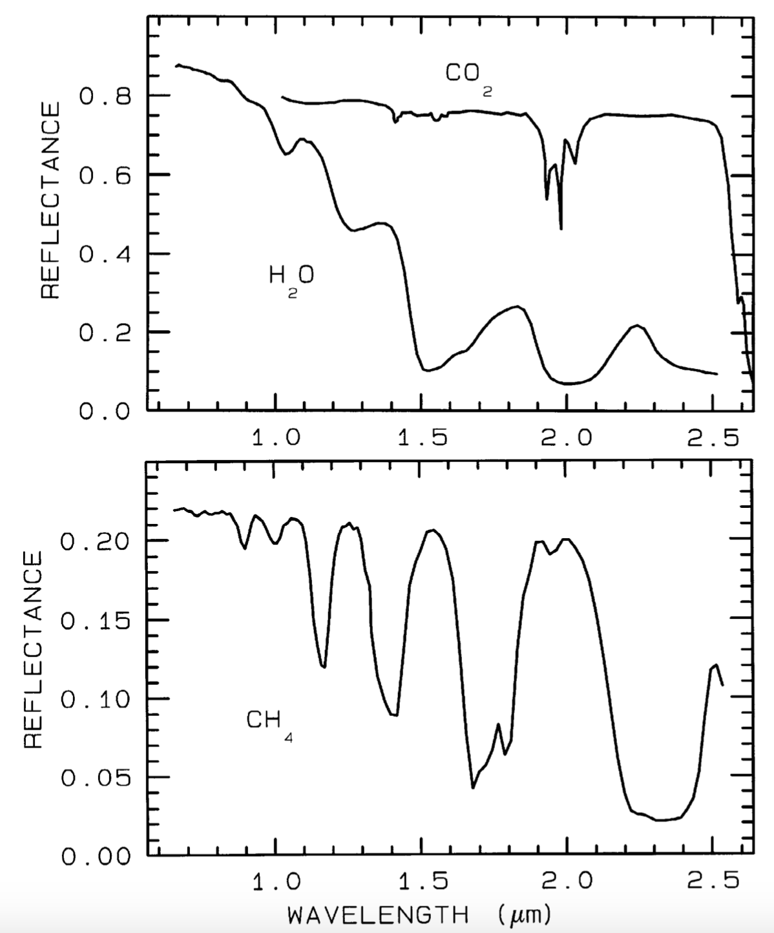
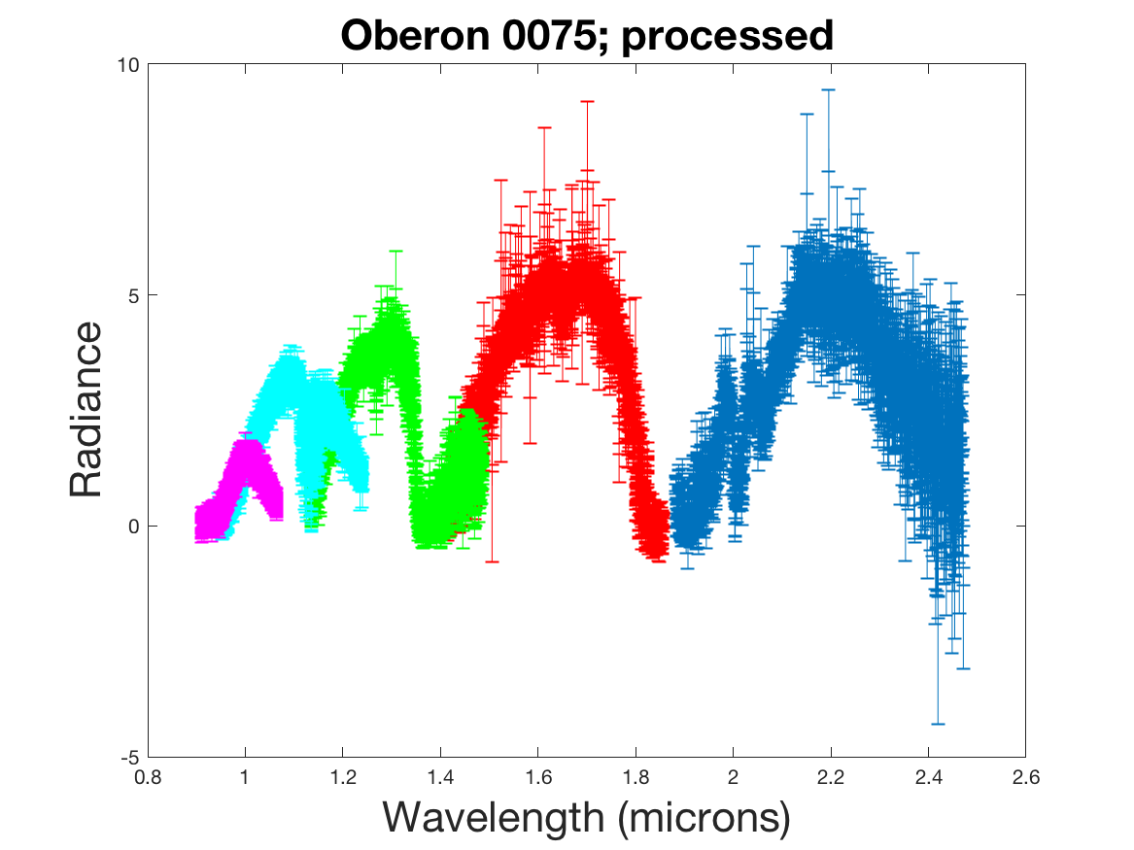
Wavelength calibration is suspect

