Slide 1
LEISA Absorption Maps PDS Delivery Review
May 15,2018
Karl Hibbitts

Slide 2
Summary of Data Under Review
Data
PDS 3
Absorption band depth from 0 to 1 (sometimes even <1)
Mosaic of 3 observations
Description of data
Data is straight-forward to interpret and is adequately described in the supporting documentation.
Description of how is provided in the dataset.cat file
Simple cylindrical at 0.0482 degrees/pix resampling corresponding to 1 km/pix sampling at the equator
Input files specified
Methodology for each band depth map described
SNR limitations and qualitative statement of reliability is provided

Slide 3
Summary of Data Under Review
Description of data
It’s not possible from the description for the user to reproduce this data set exactly (I have no issue with that in principle). However, nor can a user fully understand the level of and nature of potential artifacts. For instance, LVF’s have a spectral/spatial registration issue because of the physical curvature in the filter regions; this has been removed to the best of the ability of team, but it’s not clear if spectral/spatial artifacts in the band depth maps persist.
Labels are not specific about exactly which bands were used to generate the band depth map, nor on the exact methodology (equation) to derive a band depth. Having that information may help users understand how to best use the BD maps. Also, state if BD map were created first then mosaicked. Note to user that features that are linear in the original projection may be artifacts.
FWIW, was unable to open in NASA view or PDS reader (caveat: could be user error in installing these programs)

Slide 4
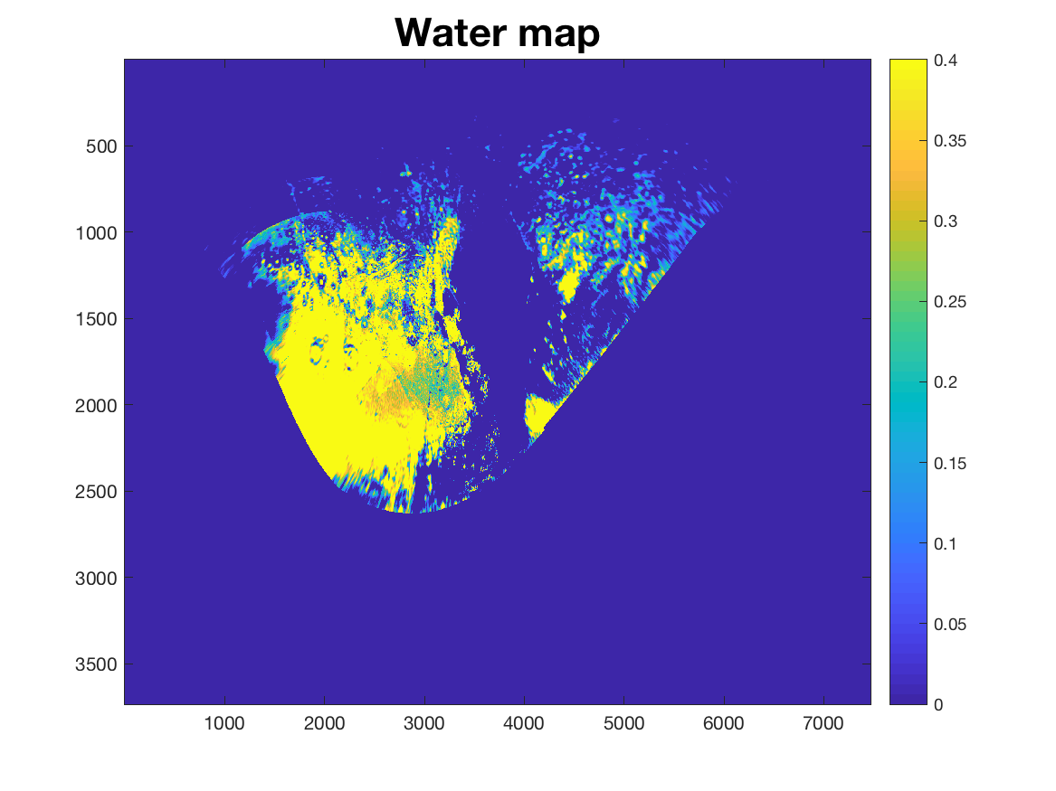
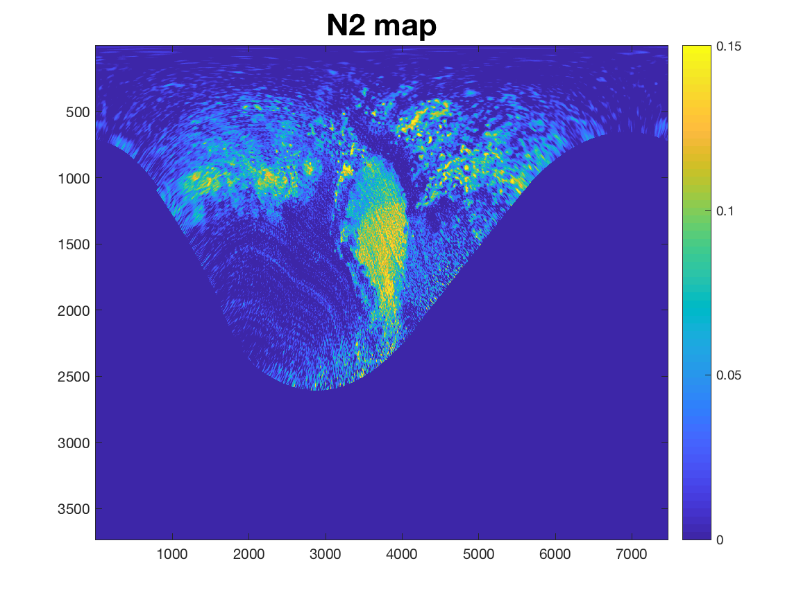
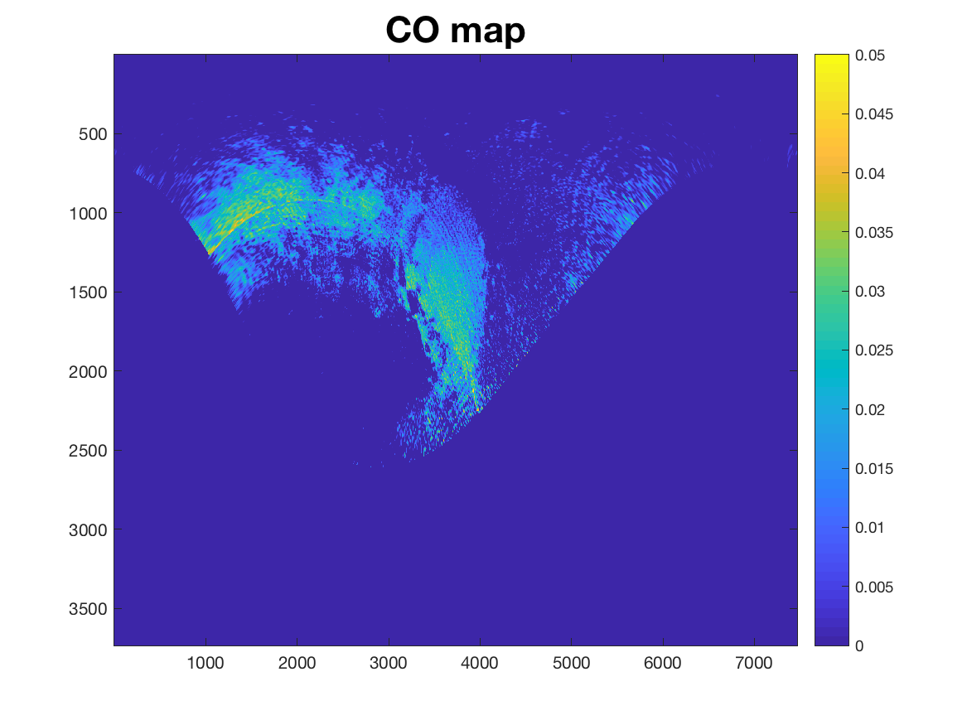
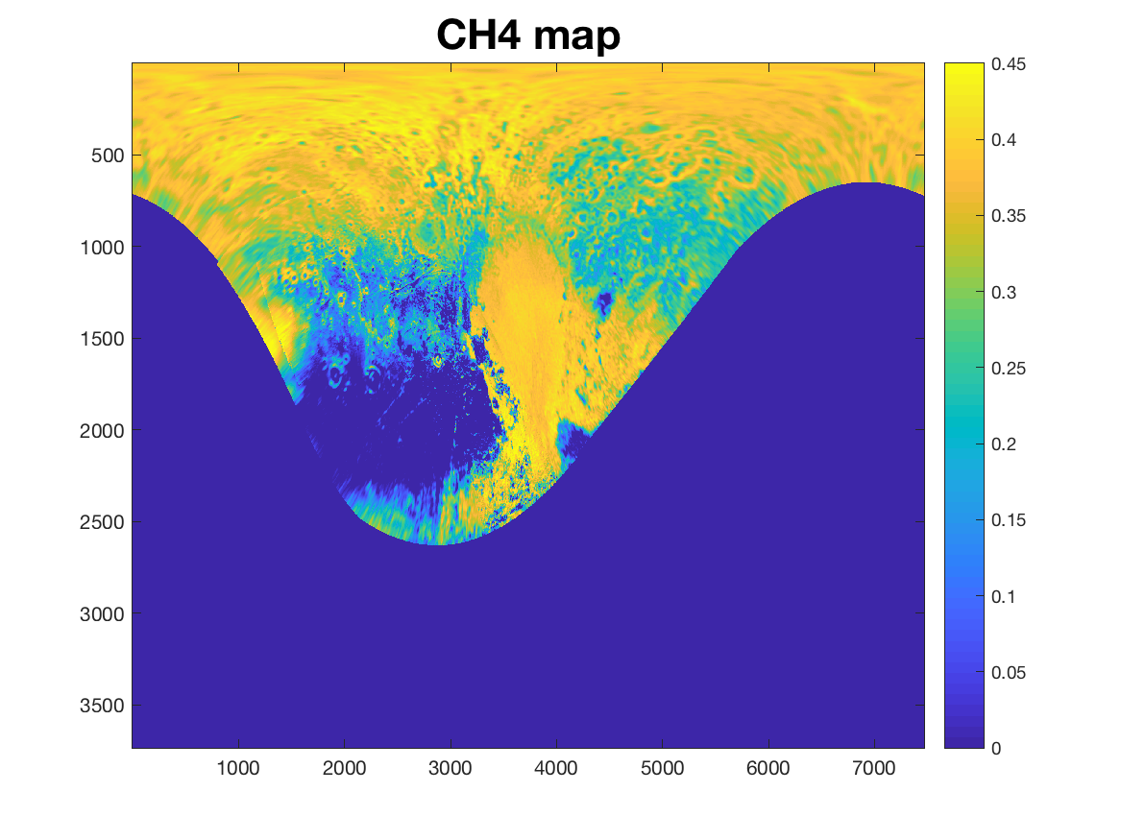

Slide 5
