Slide 1
Rosetta – Miro PDS/PSA Review
Bryan Butler
National Radio Astronomy Observatory
July 9, 2018

Slide 2
MIRO

Slide 3
MIRO
Essentially three separate spectrometers:
Broadband radiometer @ 190 GHz,
Broadband radiometer @ 562 GHz,
High resolution spectrometer @ 562 GHz
(ν/Δν ≈ 10⁷).

Slide 4
MIRO
16 Data sets , covering all of Prelanding, Escorts 1-4, and Extensions 1-3, and a “Calibrated” (V3.0) and “Resampled” (V1.0) version for each. The resampled datasets are only spectroscopic data.
~225 GB of data!

Slide 5
MIRO
Dataset | Comment | Size (GB)
RO-C-MIRO-3-PRL-67P-V3.0 | Rosetta-Orbiter MIRO Prelanding 67P Calibrated Data v3.0 | 36.9
RO-C-MIRO-4-PRL-67P-V1.0 | Rosetta-Orbiter MIRO Prelanding 67P Resampled Data | 12.0
RO-C-MIRO-3-ESC1-67P-V3.0 | Rosetta-Orbiter MIRO Escort 1 67P Calibrated Data v3.0 | 16.7
RO-C-MIRO-4-ESC1-67P-V1.0 | Rosetta-Orbiter MIRO Escort 1 67P Resampled Data | 5.4
RO-C-MIRO-3-ESC2-67P-V3.0 | Rosetta-Orbiter MIRO Escort 2 67P Calibrated Data v3.0 | 26.1
RO-C-MIRO-4-ESC2-67P-V1.0 | Rosetta-Orbiter MIRO Escort 2 67P Resampled Data | 8.3
RO-C-MIRO-3-ESC3-67P-V3.0 | Rosetta-Orbiter MIRO Escort 3 67P Calibrated Data v3.0 | 27.0
RO-C-MIRO-4-ESC3-67P-V1.0 | Rosetta-Orbiter MIRO Escort 3 67P Resampled Data | 8.6
RO-C-MIRO-3-ESC4-67P-V3.0 | Rosetta-Orbiter MIRO Escort 4 67P Calibrated Data v3.0 | 18.5
RO-C-MIRO-4-ESC4-67P-V1.0 | Rosetta-Orbiter MIRO Escort 4 67P Resampled Data | 5.9
RO-C-MIRO-3-EXT1-67P-V3.0 | Rosetta-Orbiter MIRO Extension 1 67P Calibrated Data v3.0 | 24.8
RO-C-MIRO-4-EXT1-67P-V1.0 | Rosetta-Orbiter MIRO Extension 1 67P Resampled Data | 7.8
RO-C-MIRO-3-EXT2-67P-V3.0 | Rosetta-Orbiter MIRO Extension 2 67P Calibrated Data v3.0 | 14.8
RO-C-MIRO-4-EXT2-67P-V1.0 | Rosetta-Orbiter MIRO Extension 2 67P Resampled Data | 4.7
RO-C-MIRO-3-EXT3-67P-V3.0 | Rosetta-Orbiter MIRO Extension 3 67P Calibrated Data v3.0 | 5.9
RO-C-MIRO-4-EXT3-67P-V1.0 | Rosetta-Orbiter MIRO Extension 3 67P Resampled Data | 2.1

Slide 6
MIRO
Examine the root directories
Each dataset I examined has the proper overall directory structure, which includes an aareadme.txt file (which correctly describes the file structure), errata.txt file, catalog/ data/ document/ index/ and label/ directories.
The data/ directories contain subdirectories:
continuum/ geometry/ spectroscopic/
(the continuum/ data directory is not there for the resampled datasets).

Slide 7
MIRO
Read the catalog files
The catalog files look OK, though the ref.cat files don’t seem to have recent relevant publications (Marshall+ 2017; Choukroun+ 2015; Biver+ 2015; etc.) – is that OK (probably)? [This was noted last review – does it matter?]
Browse the documentation
Looks good. The User Manual has been continuously improving, and is very good by now, especially chapter 9. One note of possible improvement – it is a large document (318 pages!), so a clickable TOC would be quite useful.

Slide 8
MIRO
Check for data-browsing help
ReadPDS (for PDS 3 – all MIRO data are PDS 3) supposedly works, but requires IDL, which I don’t have (regular) access to. The MIRO documentation states that NASAVIEW will also read MIRO datasets, but I didn’t test that.
Software is provided under /document/miro_read_data.asc (a python script for reading the data). I have my own similar software, but this provided python script is a great starting point for somebody that doesn’t have their own software. There are some issues – especially capitalization (the supplied datasets all have lowercase filenames, while the software assumes uppercase), but also input parameters (optparse should be replaced with argparse), but this is a vast improvement over the FORTRAN program supplied previously, which only worked with early data.

Slide 9
MIRO
Rummage through the data
I have my own software (python), made and modified for previous PDS reviews. I used this software again for this review, though it needed some updating (yet again).
As noted above, I only checked some of the datasets, but for those datasets, I examined them pretty fully.

Slide 10
MIRO
Documentation
Does the dataset contain all documentation needed to use and understand its data without prior knowledge?
Yes.
Is the provided documentation well organized, clear and self-consistent?
Yes.
Can the dataset be understood without any external documentation it references, or should the information in said external references be incorporated into the dataset?
It does not need external references incorporated.
If reviewing calibrated data, does the documentation fully explain the calibration process and contain all necessary parameters needed to repeat it?
Yes (…/document/user_manual.pdf Chapter 9 and Appendix A).

Slide 11
MIRO
PDS Labels and Meta Data
Are the descriptions and scientific content contained inside the PDS labels sufficient to understand their corresponding data products?
Yes.
Is all significant meta data included directly in the PDS labels?
Yes.
Do the labels provide all essential description of data values directly in the label, instead of deferring them to external references or documentation?
Yes.
Can the data be read programmatically using only the information contained in the PDS labels?
Yes.

Slide 12
MIRO
Data
Does the data look physically reasonable when examining it by eye or via a display tool?
Mostly.
When displaying the data as plots or images, are there any unexpected deviations?
Mostly not.
Formulate a scientific inquiry and attempt to use the data to answer the inquiry.
I did not try this, but have done so twice before successfully.
If reviewing both raw and calibrated data, attempt to calibrate a raw data file.
Was not reviewing raw data.

Slide 13
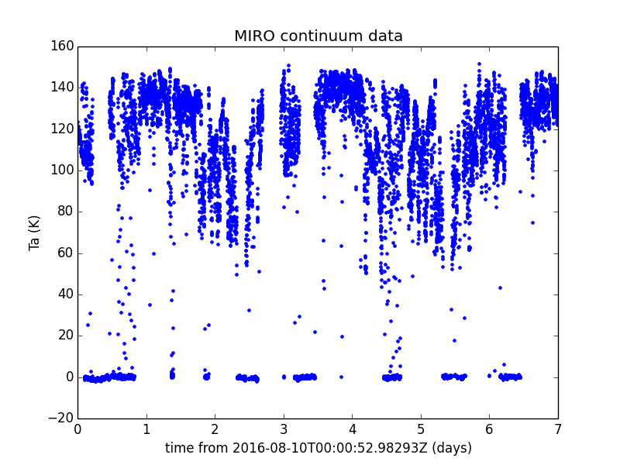
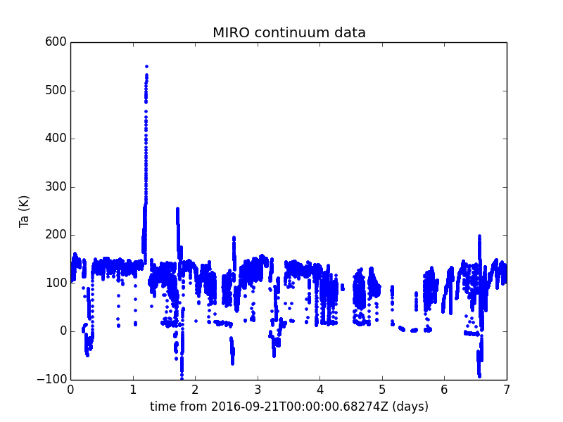
MIRO – Example continuum
Mostly they look like this.
But found this one oddball from miro_3_submmcal_2016265.
But the zero-level offset that has been present previously is gone, and they have addressed the documentation of the “-999.0” values.

Slide 14
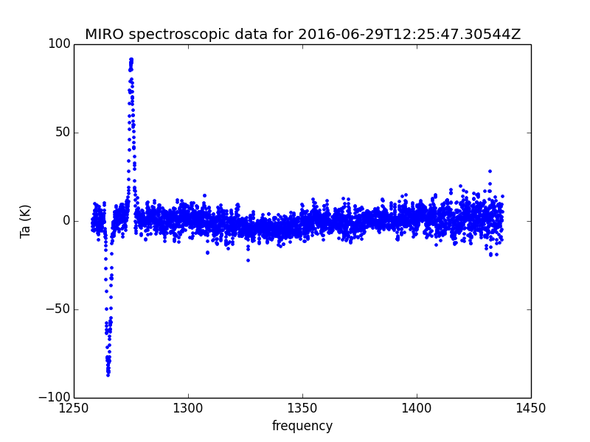
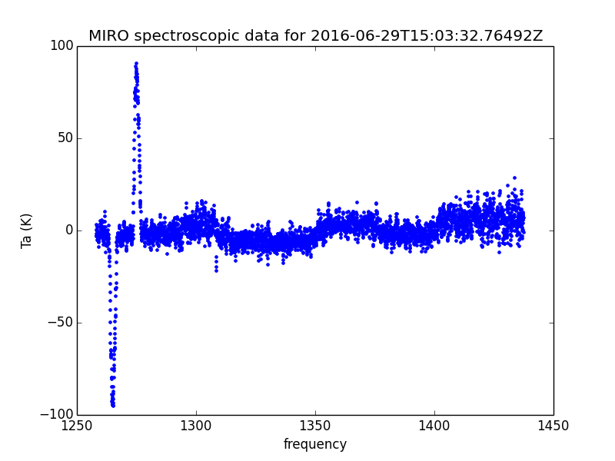
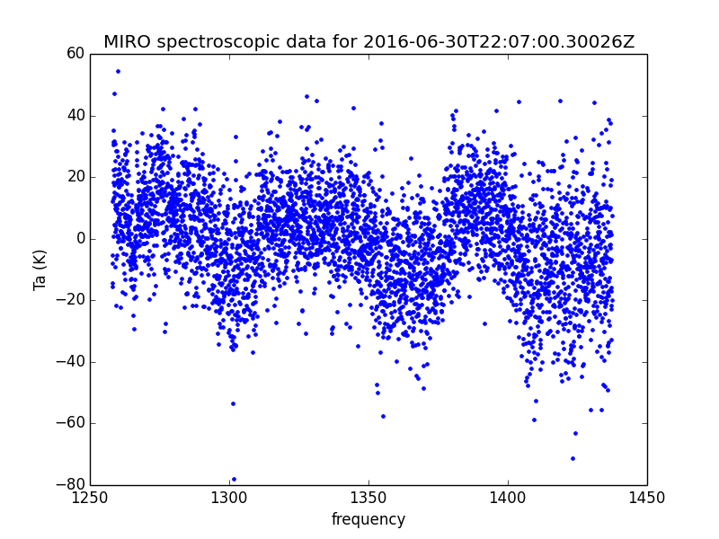
MIRO – Example spectroscopy
In the level 3 data, some look really good, and the band offsets are not as bad as they have been, but they are still there.
Not sure how they have addressed this, or if they even meant to with this release, but it doesn’t seem to be working all of the time.

Slide 15
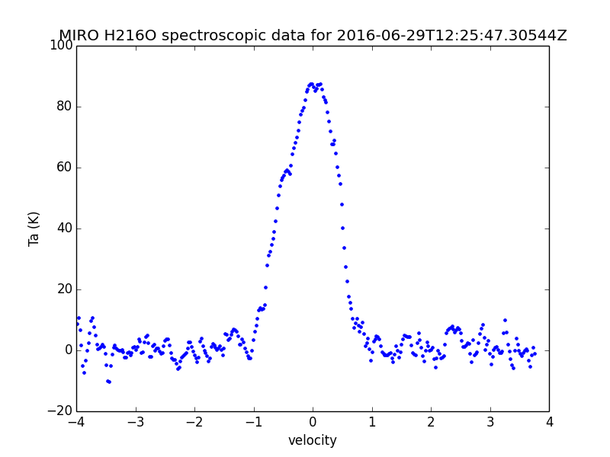
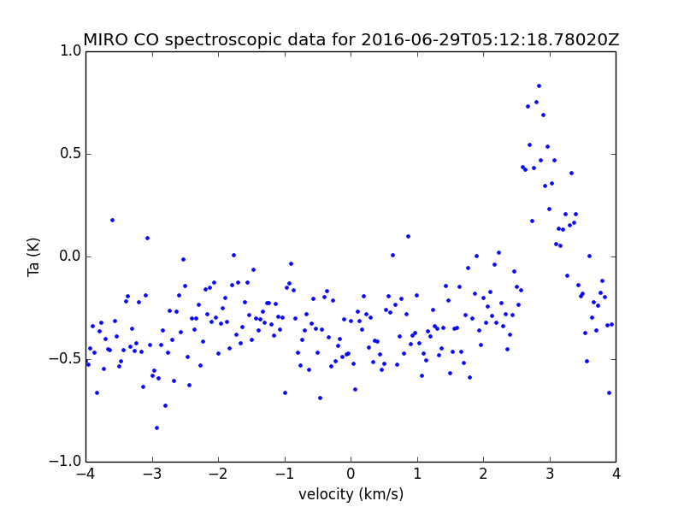
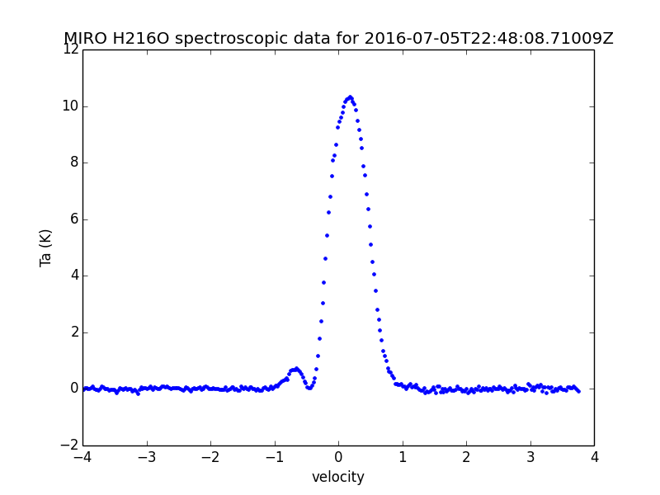
MIRO – Example spectroscopy
The level 4 data is “folded” (really a shift and subtract). This looks really good in the data I investigated.
Single spectrum
Average for a whole dataset

Slide 16
MIRO
Previous issues:
Calibration quality (RO_AR-RID_MIRO_116_AL) – has been addressed and documented.
Continuum data “zero-offset” (RO_AR-RID_MIRO_117_AL) – seems to have been addressed.
Data values of -999.9 in the data (MIRO-US-BB-004) – has been addressed in documentation.
Date/time format and precision for “UTC/GMT” columns (MIRO-US-BB-003) – has been addressed.
No python reader (MIRO-EU-RM-001, MIRO-EU-RM-002, MIRO-US-BB-002) – has been addressed.
Extended quantities (RO_AR-RID_MIRO_121_AL) – personally I think this is beyond what the instrument team is supposed to deliver to PDS.
Artifacts in level 3 data (RO-AR-RID-MIRO-103-BJB, MIRO-US-BB-001) – unclear if has been addressed (but perhaps this is the point of level 4?).

Slide 17
MIRO - Summary
This data release is the best by far I have seen from the MIRO team. I believe the structure of the PDS quantities, the documentation, and the data itself are of high quality. I see no reason for a re-review of this particular release.
N.B. I didn’t check geometry, gas velocity, or line-fitting.

