Slide 1
MIRO PDS review July 2018
Martin Cordiner
CUA / NASA GSFC

Slide 2
MIRO (Microwave Instrument for Rosetta Orbiter)
First microwave instrument sent to study a Solar System body
Combined ultra high-resolution heterodyne spectrometer, and radiometer
Two wavebands: 190 GHz (1.6 mm) and 562 GHz (0.5 mm)
Single-pixel sub-mm receiver with beam size 7.5’
Sensitive to thermal emission as well as ground-state spectral lines from H₂O and NH₃
Can detect CO and CH₃OH

Slide 3
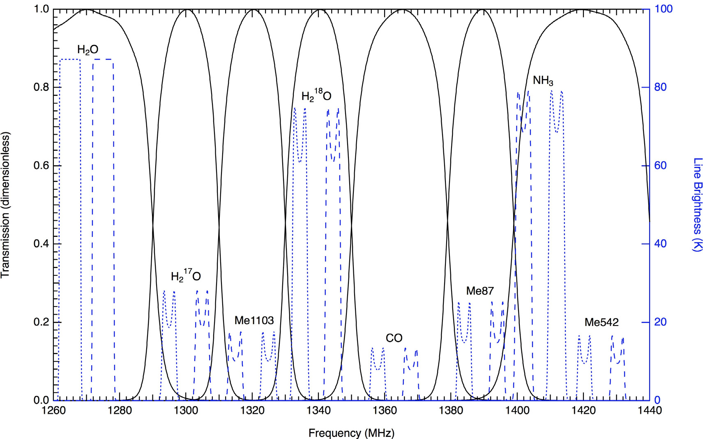
The Data
Simultaneous 1.6 mm and 0.5 mm continuum and spectroscopy of the region 556-580 GHz (divided into 8 spectral windows)
Frequency-switched spectra with integration time 30 s

Slide 4
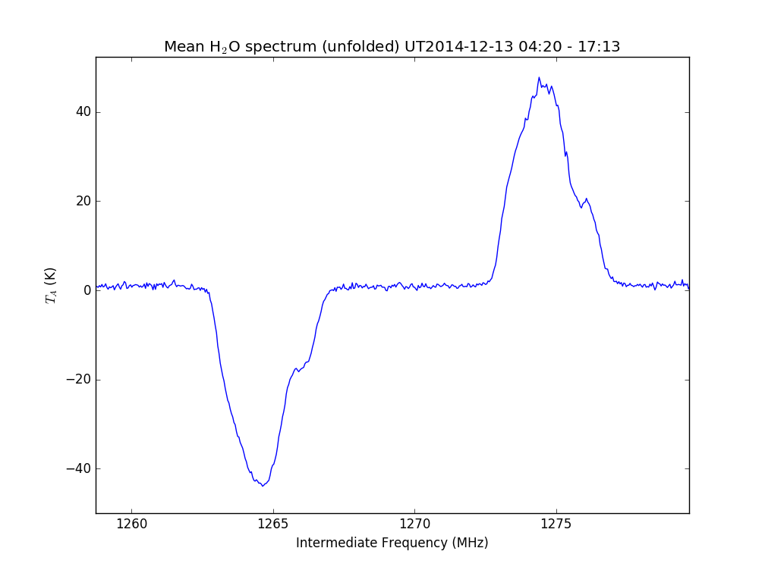
Average of 1000 H₂O spectra on UT2014-12-13
Level 3 data product
ro-c-miro-3-esc1-67p-v3.0

Slide 5
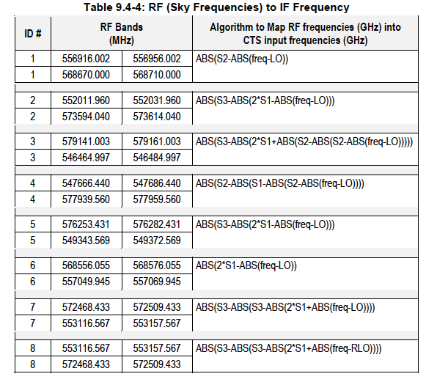
Converting IF to Sky frequency

Slide 6
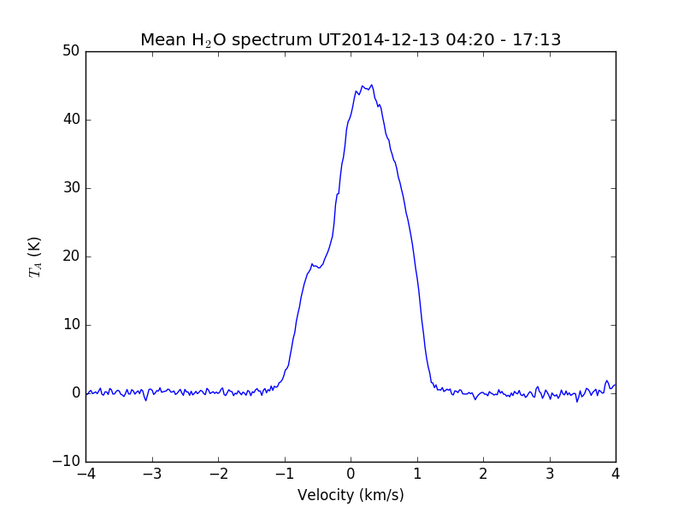
Level 4 ‘folded’ H₂O spectrum
Tdv ~ 70 K km/s → N(H₂O) ~ 10¹⁴ cm⁻² (at 100 K)

Slide 7
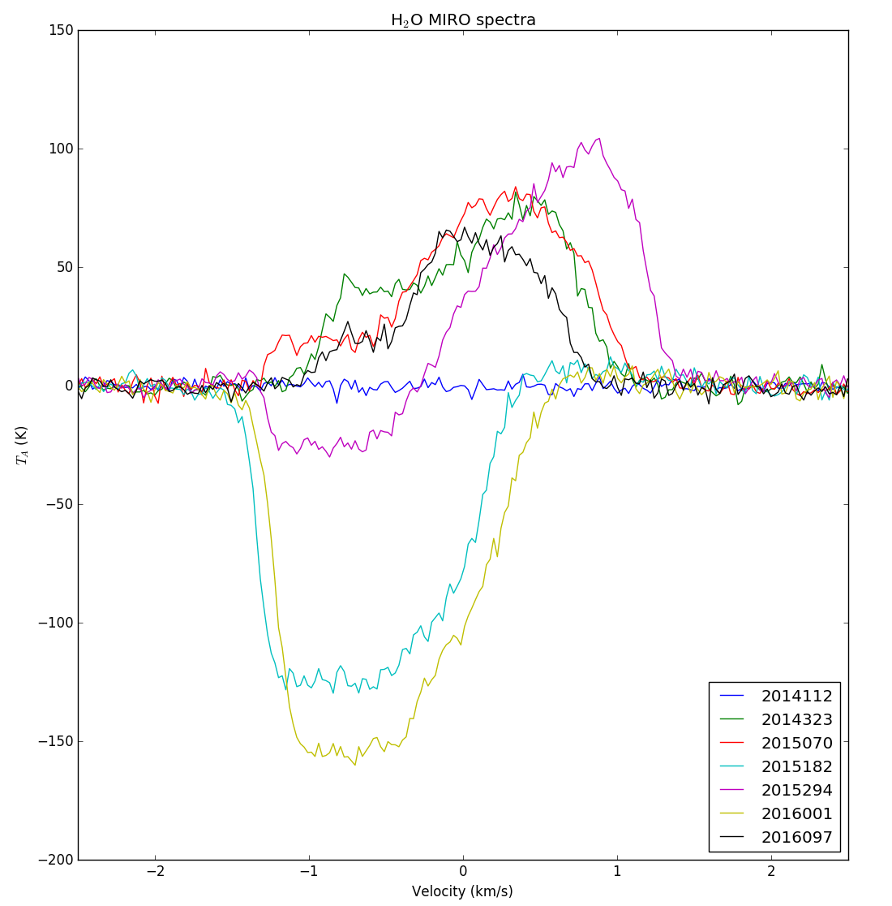
Time series H₂O

Slide 8
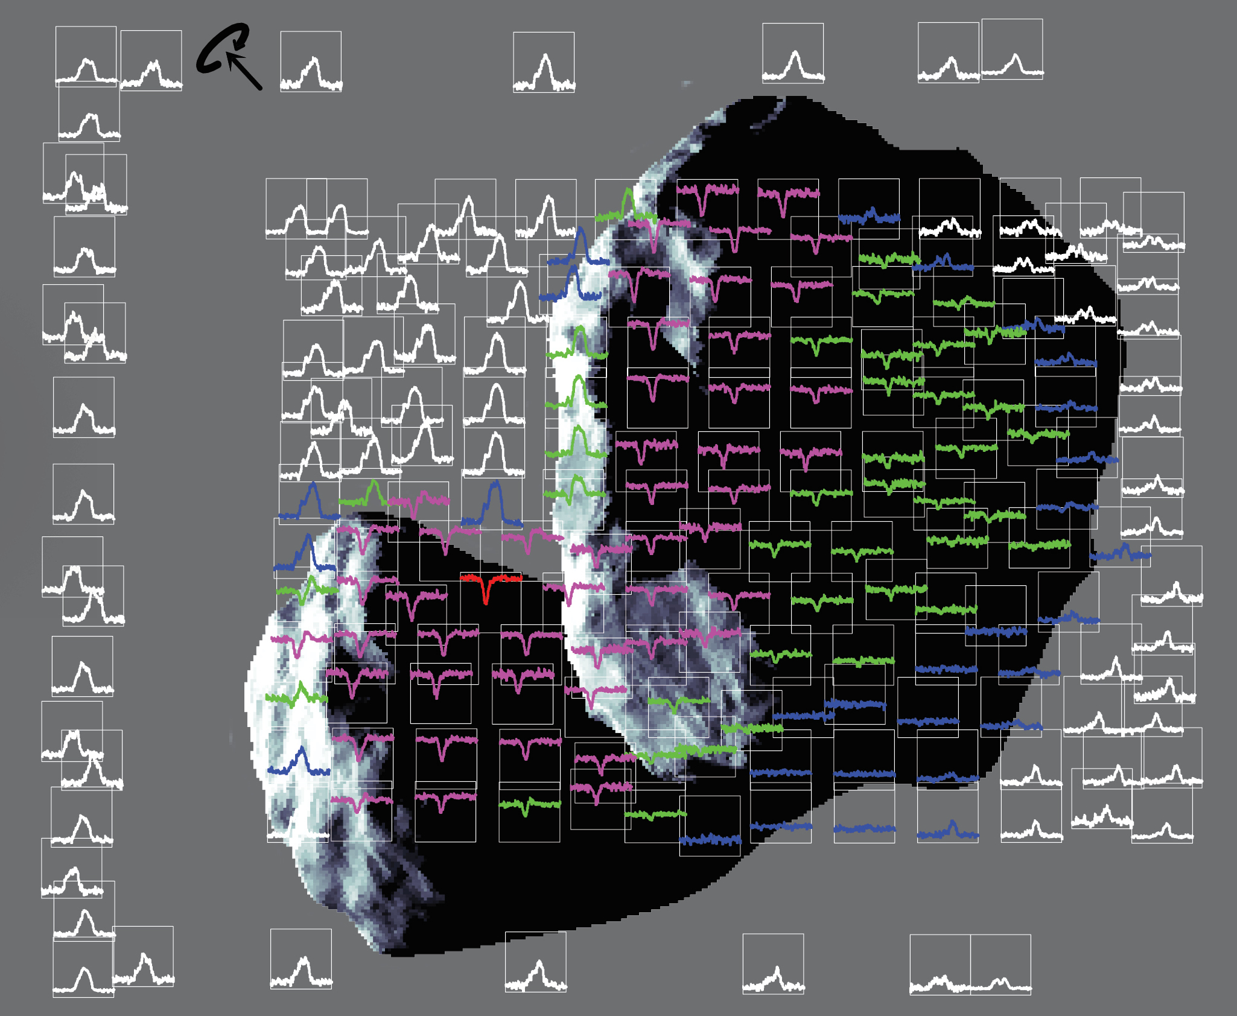
MIRO spatial scans

Slide 9
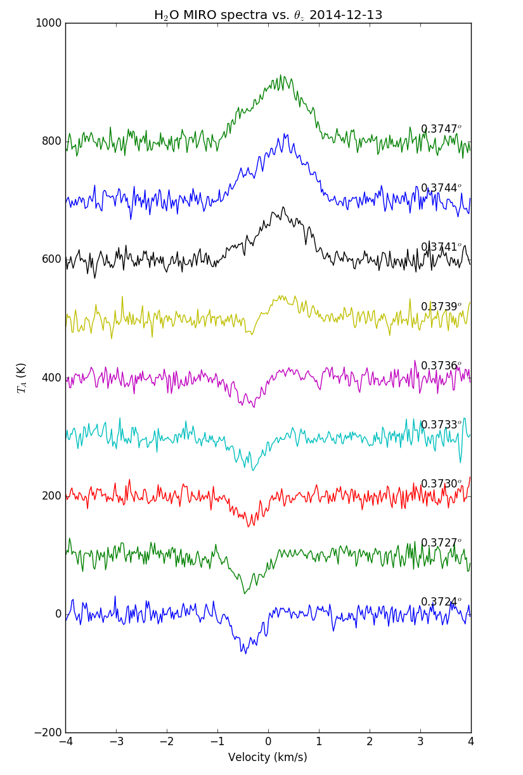
Continuous sequence of spectra over ~ 5 min period
Angle between comet and boresight obtained from geometry file
Comet-MIRO distance = 19.2 km
-> r = 0.13 km cf. comet size of ~ 2 km
Shape model (FOUND_INTERSECTION = 1) indicates we are still inside the geometrical limits of the comet

Slide 10
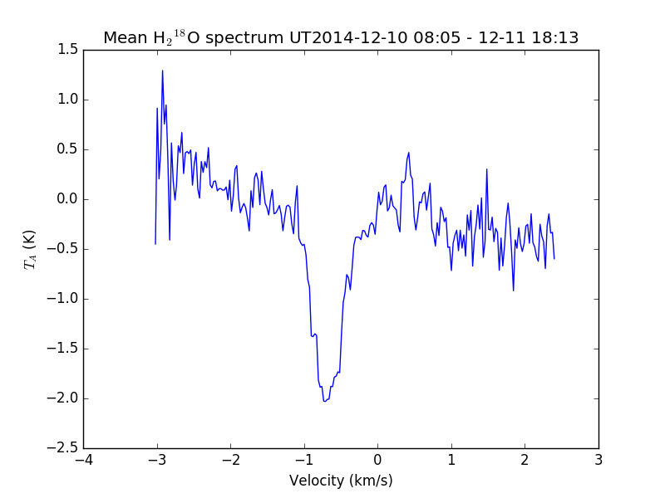
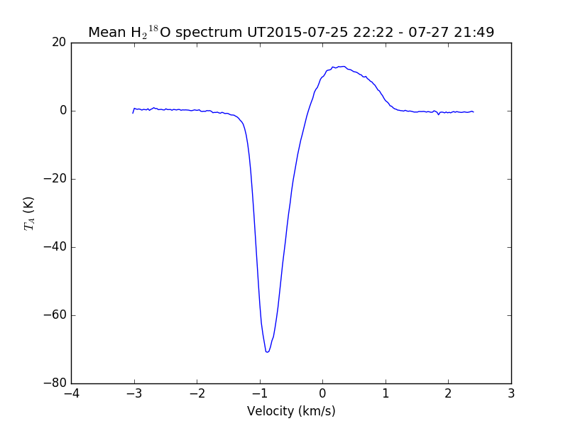
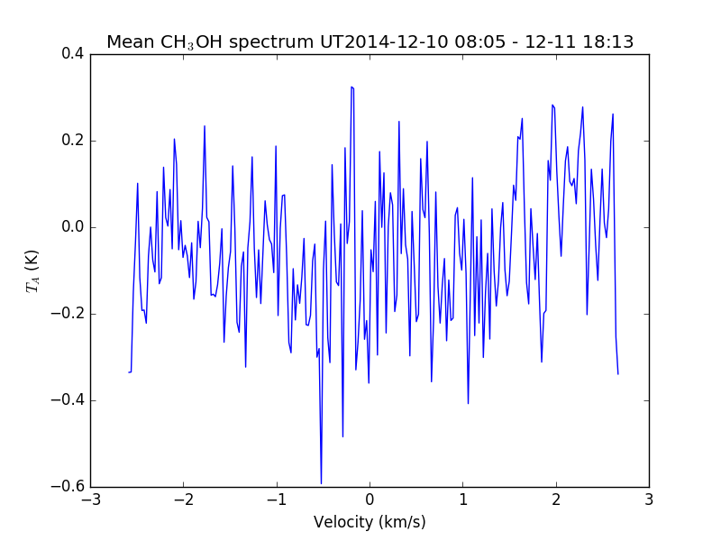
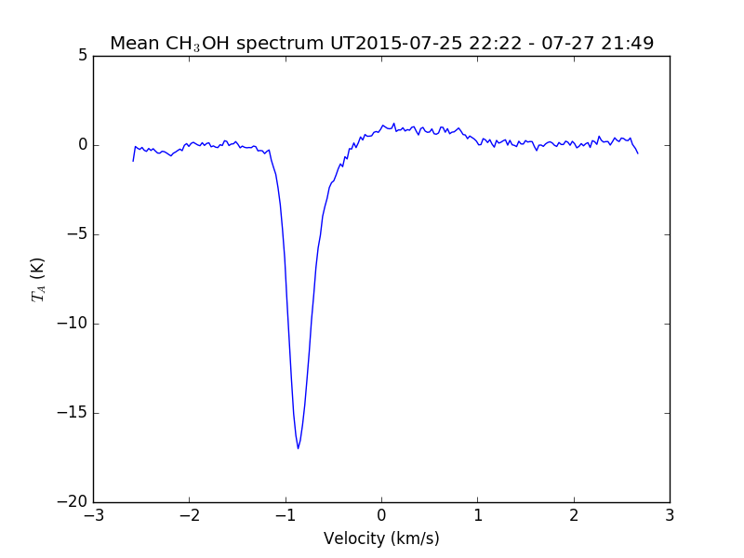
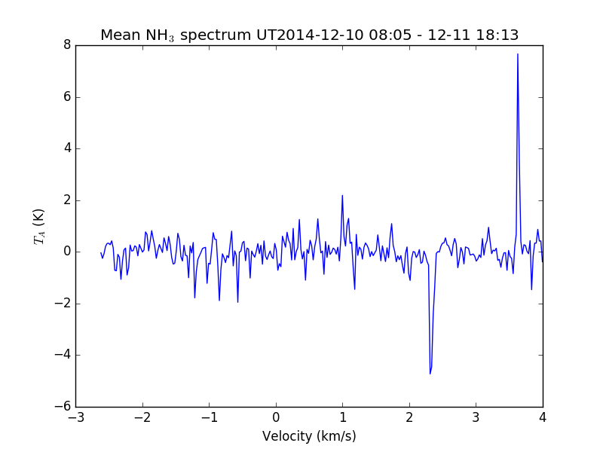
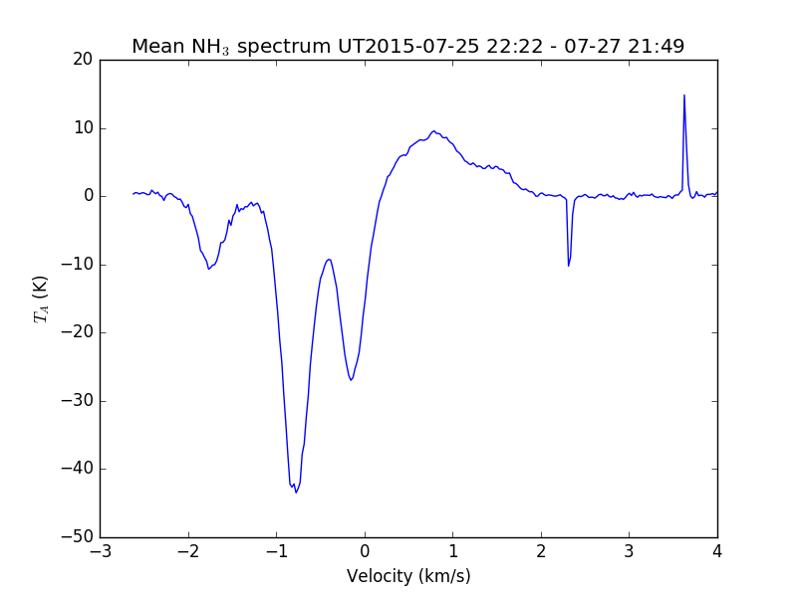
H₂¹⁸O
CH₃OH
NH₃

Slide 11
Review summary
+ Documentation is complete, comprehensive and well written
+ Data can be understood without external documentation
+ Calibration process is explained in sufficient detail
+ Data labeling is comprehensive
+ Python routine is provided for data access
Documentation file names could be more descriptive
Abbr. “S/C” on p1 of “ro_mir_if_0001.pdf” not defined
Label description typo in geom_level_4_format.fmt: "Doppler shift velocities” --> "Doppler shifted"?
Meaning of data versions (ver-1.0, 2.0, 3.0) not described
Each dataset could benefit from a description/summary. What does it contain? Could be useful for someone not familiar with the CODMAC levels or mission phases (although these are detailed in ro_mir_if_0001.pdf)
Rest frequencies of the individual spectral windows are not given (or not obvious to me). I believe these are required for a full analysis
Python routine needs to give easier access to individual data columns (very tedious to separate spectral arrays from the binary stream)
Python routine does not work on case-sensitive (ie. most) file systems

