Slide 1
Review: Rosetta OSIRIS NAC/WAC Observations ro-c-osinac-2-esc1-67pchuryumov-m12-v2.1 ro-c-osinac-3-esc1-67pchuryumov-m12-v2.1 ro-c-osinac-4-esc1-67pchuryumov-m12-v1.0 ro-c-osiwac-2-esc1-67pchuryumov-m12-v2.1 ro-c-osiwac-3-esc1-67pchuryumov-m12-v2.1 ro-c-osiwac-4-esc1-67pchuryumov-m12-v1.0
Tony Farnham

Slide 2
Dataset Description
Multiple data sets of the comet, coma and stars from the Comet Escort 1 phase of the Rosetta mission
Narrow Angle Camera
Raw Data, Calibrated Data, Resampled Data
Wide Angle Camera
Raw Data, Calibrated Data, Resampled Data
Also included
Catalog files (same for all datasets, including OSINAC_INST.CAT & OSIWAC_INST.CAT)
Browse images (jpg)
Calibration files (same for all datasets, except for DATA_SET_ID)
Documentation (same for all datasets)
Software (IDL routines; same for all datasets)

Slide 3
General Comments
Data seem to be in good shape
FITS files are readable via multiple routes
IDL FITS reader (FITS files; need to correct display direction)
READPDS (using detached labels; corrects display direction)
P_READ (used both FIT and LBL route; need to correct display direction)
IMG files are readable with some routines
P_READ (need to correct display direction)
NASAview (random samples; corrects display direction)
Many IMG files are not readable with READPDS
Select files in NAC and WAC raw data sets (can provide a list if needed)
All files in calibrated and resampled data sets
Seems to be a header issue that READPDS chokes on
Is this a standards issue?

Slide 4
Tested and Compared FITS and IMG files
Used a program to test images in each dataset (used index file as input)
Read in images with different routines
FITS files (READFITS; READPDS; P_READ)
IMG files (P_READ; READPDS when possible)
Displayed and manipulated each image
Compared IMG and FIT versions of each image
Compared each image read in with different routine
Subtracted one from another and looked for deviations from 0.0000
Took ratios and looked for min/max deviations from 1.0000
All images are readable, can be displayed and manipulated
All versions of each image are the same

Slide 5
Catalog Files
Some catalog files seem way too long (at least to me).
Should have a summary, with the rest of the text moved to the documents directory.
Generally understandable, but many files could use some editing
Typos, subject-verb agreement, etc.
Sentences that don’t make sense (In INSTHOST file: “During cruise the instruments would serve for survival.”)
Some files also have outdated information
Describe “future” events that have now passed

Slide 6
Calibration/Documents
I didn’t try to reproduce the calibrations, but values look reasonable
CALIB/FLATFIELDS
Provided as IMG files
Can these be converted to FITS as well?
Documentation looks good
Describes different aspects of data planning, execution and calibration
SCIENCE_USER_GUIDE looks very valuable

Slide 7
Geometry in Labels/Headers
Spot checked geometry data using SPICE
Some kernels listed in the image labels are more recent than I have
Not available at NAIF
Used the kernels I have as a check
Label data look reasonable
Small differences in some of the values
Likely due to the improved kernels used for the labels
Presumably the new kernels will be available at some point….

Slide 8
Data Inspection
During image inspection, found a few missing data
Followed up – found documentation in the labels
Lost packets are noted
“Good data” blocks are given
Missing data set to zero

Slide 9
Testing Images
Looked at jet structures changing with time
Looked at large dust grains moving in the coma
Able to measure positions of jets and grains
Could map the motions of both….

Slide 10
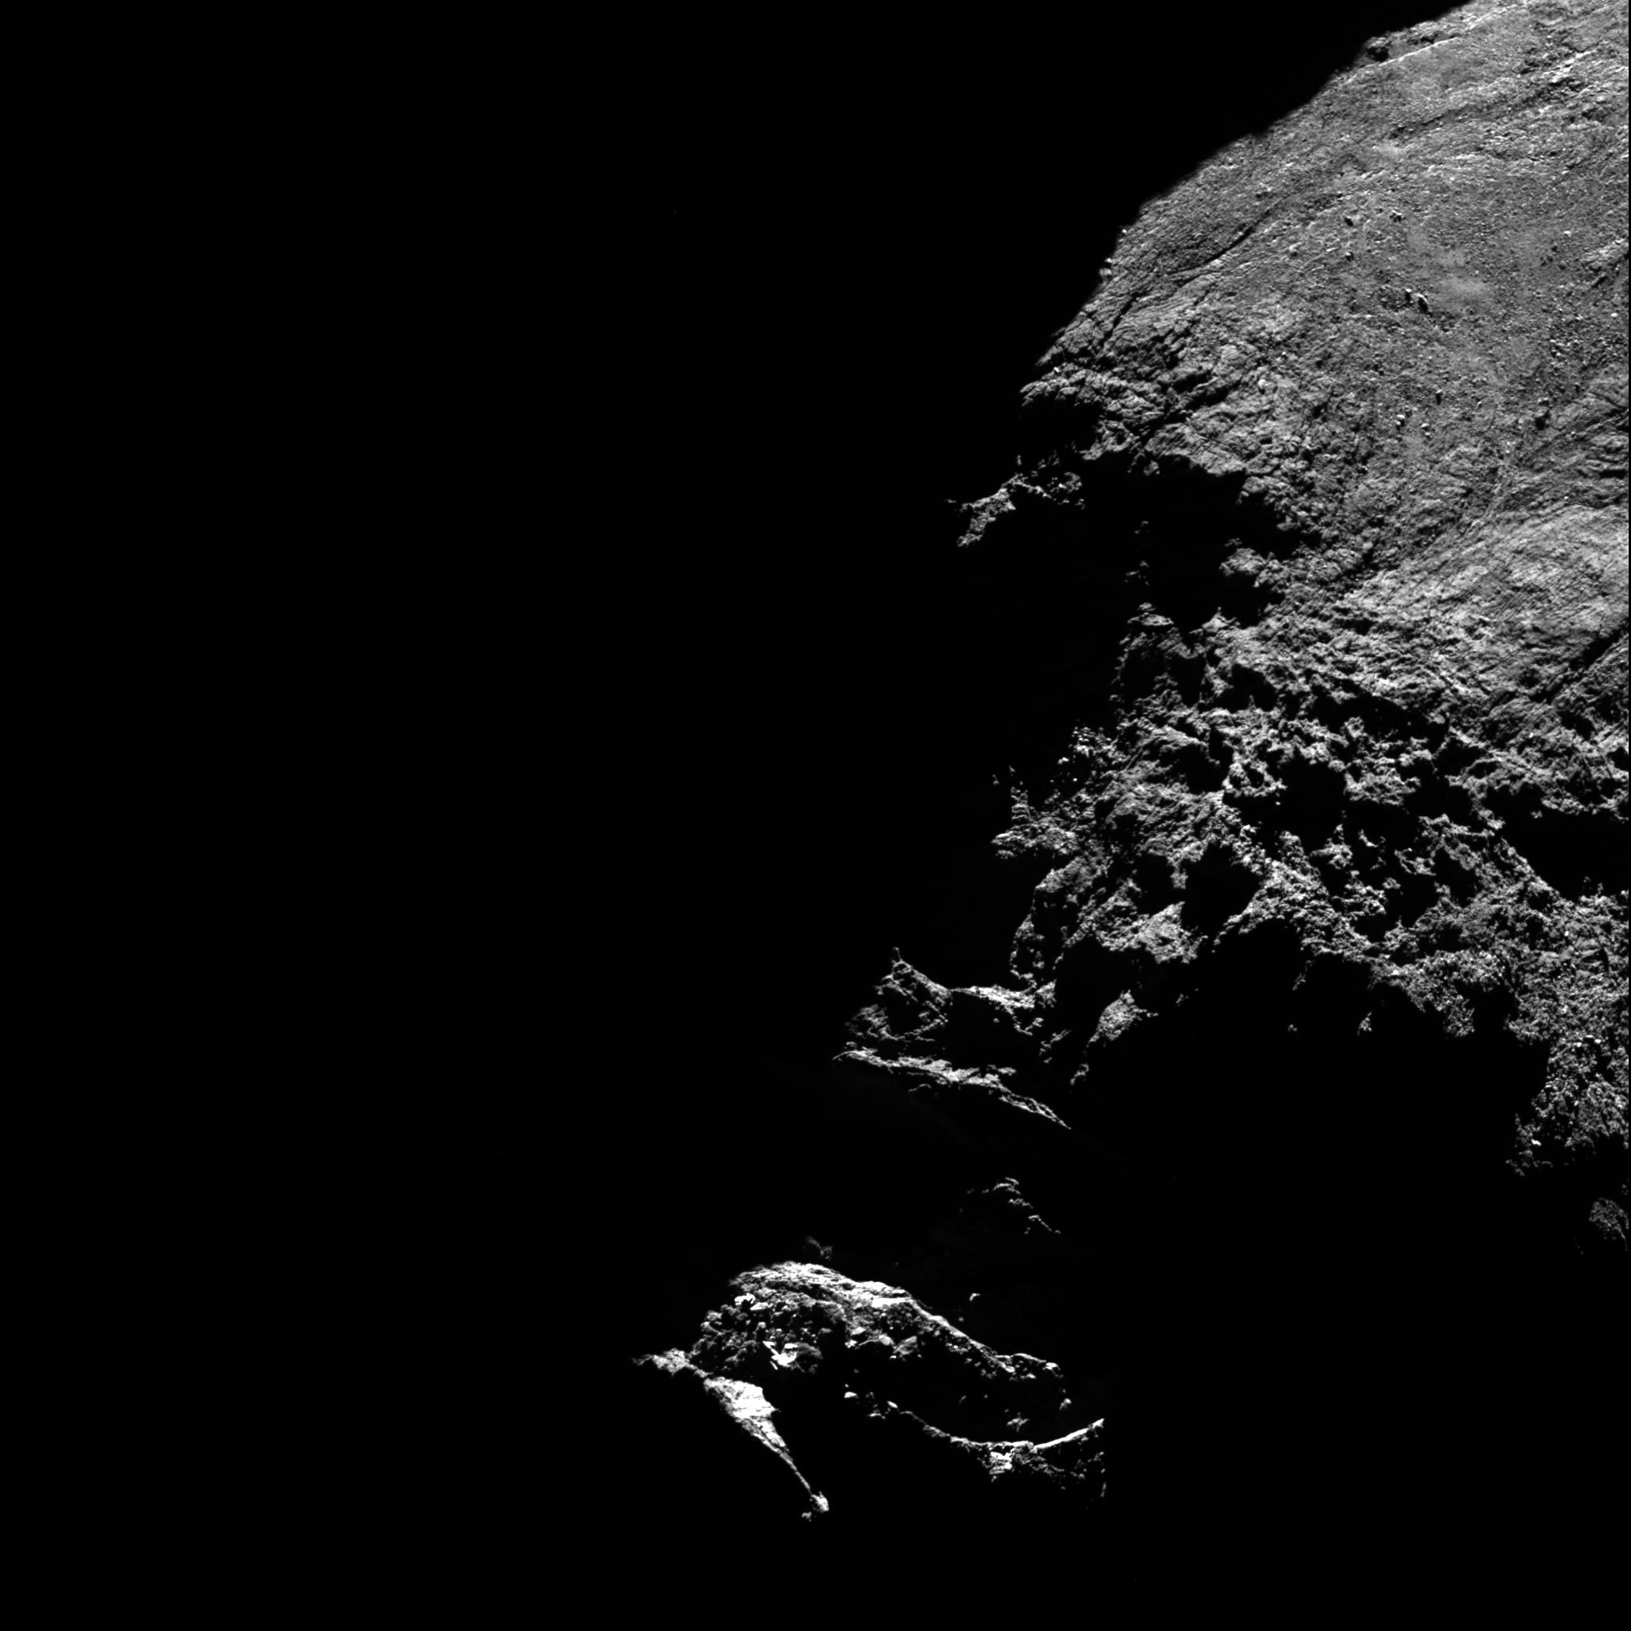
Browse Images
Browse images are not presented in the proper orientation
They seem to use IDL orientation regardless of directions given in the labels
Example: File "N20150115T072017361ID40F22.FIT"
Image displayed as described in label
Corresponding browse image

Slide 11
Final Result
If READPDS issue does not cause concern, then datasets are certifiable
If the problem is a standards issue that needs corrected, then the data will need to be fixed, and will require a delta review

