Slide 1
Rosetta Orbiter RPCICA Archive Comments ro-c-rpcica-2-ext3-raw-v1.0 (ROICA_1016) ro-c-rpcica-3-ext3-calib-v1.0 (ROICA_2016) ro-c-rpcica-4-ext1-corr-v1.0 (ROICA_3014) ro-c-rpcica-4-ext1-phys_mass-v1.0 (ROICA_3514) (updated volume reviewed)
S. Joy

Slide 2
Overview
There were too many volumes of data to review each of them thoroughly so I selected the most recent data from each of the data processing levels and reviewed them
All of the ro-c-rpcica* review volumes share a large number of common files: catalog files, documents, required files (Xxinfo.TXT), etc. rather than repeating comments on those files in every presentation my comments are all included here
Most of the common files have been previously reviewed so there is an expectation that the files would be in pretty good shape.

Slide 3
Root Directory Files
ro-c-rpcica-2-ext3-raw-v1.0
aareadme.txt and voldesc.cat present and acceptable voldesc.cat has some line lengths longer than 80 chars
ro-c-rpcica-3-ext3-calib-v1.0
aareadme.txt and voldesc.cat present and acceptable
ro-c-rpcica-4-ext1-corr-v1.0 (roica_3014)
aareadme.txt and voldesc.cat present and acceptable
ro-c-rpcica-4-ext1-phys_mass-v1.0
The underscore is not an allowable character in a PDS3 data_set_id
aareadme.txt and voldesc.cat present and acceptable

Slide 4
Catalog Files
I began by using BeyondCompare3 to verify that all volumes contain the same versions of the common catalog files (all but dataset.cat). Some volumes contain older versions of catalog files (see below). The comments that follow pertain to the most current version of the files.
“raw” data volume has out of date versions of mission, software, and ref.cat
“corr” and “calib” volumes have out of date versions of ref.cat
“phys_mass” appears to have a complete set of current files
catinfo.txt – no issues found
mission.cat (minor typos, content fine, consider setting MISSION_STOP_DATE to value other than NULL now that mission has ended)
insthost.cat (minor typos, content fine)
reference.cat
inst.cat (minor typos, content fine)
software.cat
pers.cat

Slide 5
Catalog Files – data set catalog files
dataset.cat - ro-c-rpcica-2-ext3-raw-v1.0
RID: This file describes the changes from version 1 to version 2 but the DSID and DSNAME retain the v1.0. This should probably be changed. Comment: The description in this file is sparse but the EAICD and USER_GUIDE documents provide sufficient detail to make the data usable. Text has been added to describe abundant zeros in data files.
dataset.cat - ro-c-rpcica-3-ext3-calib-v1.0.
The descriptions in this file are sparse but the documents make the data usable.
dataset.cat - ro-c-rpcica-4-ext1-corr-v1.0.
RID: The text in this file (TERSE, ABSTRACT, DESC) are all identical to those in the “-3-XXX-calib” files. The text should be modified enough to understand why these are -4- files (corrected and calibrated).
The descriptions in this file are incorrect but the documents make the data usable.
dataset.cat - ro-c-rpcica-4-ext1-phys_mass-v1.0
RID: The text in this file (TERSE, ABSTRACT, DESC) are inconsistent. The ABS says “corrected and CALIBRATED DATA” which sounds appropriate for the “corr” data. The TERSE says “CALIBRATED DATA” which applies to the -3- dataset, and the main description also sounds appropriate for the -3- dataset. All of these descriptions should be modified to briefly describe this data set.
The descriptions in this file are incorrect but the documents make the data usable.

Slide 6
Document
docinfo.txt (all volumes)
ica_eacid Subdirectory
ica_eaicd.pdf (.lbl,.pdf) - good, no changes requested comment: PNG files left over from ASCII version of document that is no longer present. These files could be deleted and their description removed from the label.
software Subdirectory
Various MATLAB programs to initialize, read, and plot the ICA data described by the PDS labels as ASCII documents
Softinfo.txt – RID: Please add a statement providing the version of MATLAB used to produce the code, another indicating that the software is unsupported, and lastly, add a brief statement of how to use the programs provided (issue remains uncorrected from previous review).
This file also fails to mention IMPORT_L3.* and READICA3.*
ica_cal.pdf (lbl) – good, no changes requested
ica_cmd_brief.pdf (lbl) – ok, some blue text describing commands “not yet implemented” could be updated or removed.

Slide 7
Document – con’t
icatables.pdf (lbl) – ok, various typos should probably be corrected
icma_tctm.pdf (lbl) – ok, cover page date says 2004-10-28 in red but the PDS label has a publication date of 2006-05-15 and a product creation time of 2006-06-28.
ICA_USER_GUIDE.PDF (.LBL) - Very helpful document
Minor typos, should finalize discussion of L4 corr data files.
The caption for Figure 6 should be improved to explain the Vx, Vy, Vz frame used here. All of the other detector frame drawings (EACID, ICA_CAL) use an X,Y,Z frame that shows sectors 0 and 1 on the left and sectors 4 and 5 on the bottom. In the “V” frame, these sectors are on the right and top.
From User Guide
From ICA_CAL

Slide 8
Calib Directory
calinfo.txt – Better than previous versions. I like separating the different table types into their own sub-directories. A table of when the software version updates occur would be helpful.
elevation/ica_el_table_v0*.tab (.lbl) ok
energy/ica_energy_table_v0*.tab (.lbl)
gfactor/gfactor_heavy_v0*.tab (.lbl)
gfactor/gfactor_light_v0*.tab (.lbl)
mass_lookup/ica_mass_look_up_table*_v0*.tab (.lbl)
mass_mask/ica_mask_heavy_bst_p*_v0*.tab (.lbl)
mass_mask/ica_mask_heavy_nm_p*_v0*.tab (.lbl)
mass_mask/ica_mask_light_bst_p*_v0*.tab (.lbl)
mass_mask/ica_mask_light_nm_p*_v0*.tab (.lbl)

Slide 9
Geometry Files
geominfo.txt – ok, minor typos Add statement that says that these figures are extracted from the EACID or ICA_CAL document.
ica_fov.jpg (.lbl)
ica_location.jpg (.lbl)
sectors.pdf (.lbl)

Slide 10
Index Files
indxinfo.txt
Does not mention checksum file or its usage, consider adding
index.tab (.lbl)
browse_index.tab (.lbl) – raw data volume only, some line lengths longer than 80 char in the label.
checksum.tab (.lbl)

Slide 11
Data: ro-c-rpcica-2-ext3-raw-v1.0
For each hour that contains data, there are 3 data files plus labels for each
Data - rpcica141130t00_000_96l2.tab (.lbl) - ~150 MB each
Values are likely to be correct, difficult to compare to browse plots provided
8192 records per sweep (16x16x32 azimuth x elevation x mass)
Data that were binned onboard the spacecraft have been “unbinned” by evenly distributing the counts over the valid bins in the range which produces fractional counts in some cases.
HSK - rpcica141130t00_000_hk.tab (.lbl)
Geom - rpcica141130t00_000_geom.tab (.lbl)
Spacecraft position, velocity, altitude, etc.
Labels have been updated to include list of SPICE kernels used as requested at the last review (lien resolved). The number of significant digits has also been reduced to a sensible number that more realistically describes the accuracy of the measurements (lien resolved).
All files are simple ASCII tables
Nearly every record contains value of 00000 for the counts in all 96 channels. Text was added to the documentation to describe the reason for this (lien resolved)
Data are difficult to work with because of their size in this format but no changes are proposed at this time
Browse plots suggest that there should be more non-zero values in some data files than I find when scanning those files

Slide 12
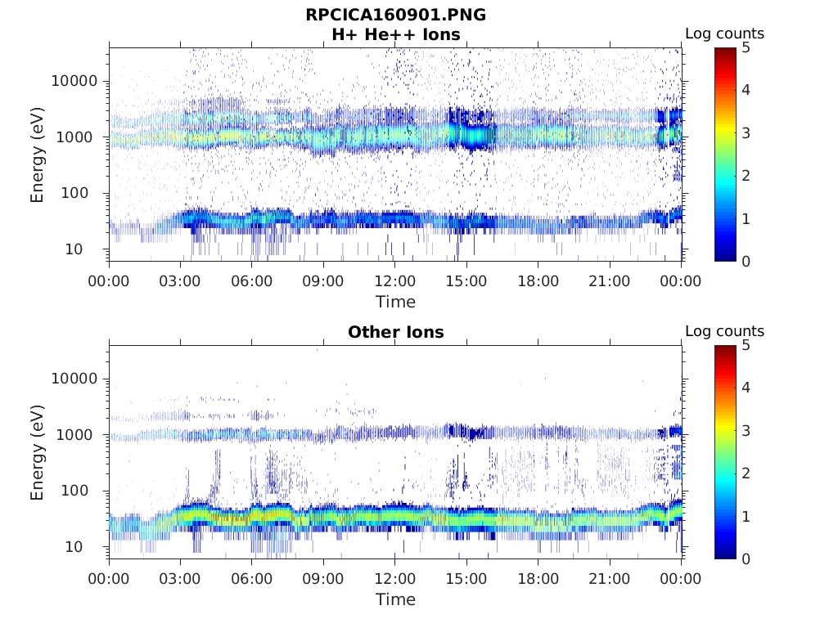
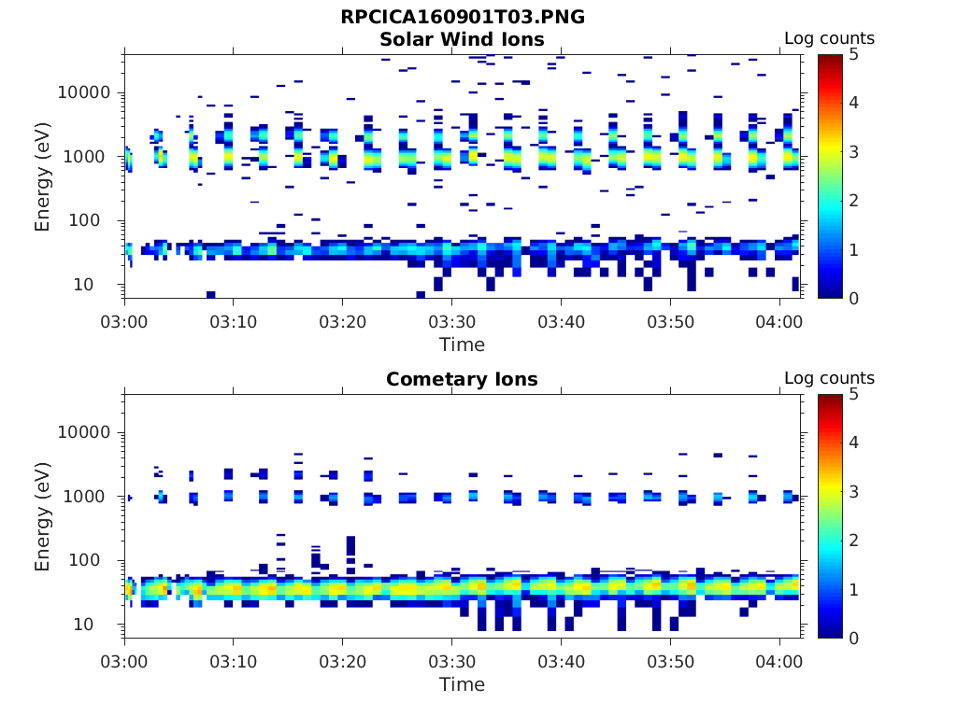
Browse: ro-c-rpcica-2-ext3-raw-v1.0
Browinfo.txt – present, somewhat improved since last review.
Plots include full day and each hour of the day that contain data
Plots show the raw counts at each of the 96 energy steps vs time, summed over the various elevation and azimuth angles, and separated by masses.
Full day
Hour 3 - 4

Slide 13
Data: ro-c-rpcica-3-ext3-calib-v1.0
For each hour that contains data, there is a data file and label
Data - rpcica141128t05_000_96l3.tab (.lbl) - ~150 MB each
8192 records per sweep 16x16x32 (azimuth x elevation x mass)
Onboard binning reversed by distributing the data over the valid onboard bins.
Values are likely to be correct, difficult to compare to raw data for same time period
Browse plots would be nice
All files are simple ASCII tables
Nearly every record contains value of 0.000E+00 for the counts in all 96 channels. This has now been explained in the documentation (lien resolved).
Broken pointers in labels: pointer to document/ica_eaicd.pdf document/and rather than to document/ica_eaicd/ica_eaicd.pdf. Also contain pointers to RPC_USER_GUIDE.PDF that is not on this volume
Data are difficult to work with because of their size in this format but no changes are proposed at this time

Slide 14
Data: ro-c-rpcica-4-ext1-corr-v1.0
For each hour that contains data, there are data and “zero level” files and their labels.
Data - rpcica160227t08_000_l4_corr.tab (.lbl) ~165 MB each - rpcica160227t08_000_l4_zero.tab (.lbl) ~160 MB each
8192 records per sweep 16x16x32 (azimuth x elevation x mass)
Onboard binning reversed by distributing the data over the valid onboard bins.
Zero levels have been subtracted from the data files. In some cases, this results in negative flux values. This is explained in the documentation, as well as the reasoning for not setting negative values to zero.
Values are likely to be correct, difficult to compare to raw data for same time period
Browse plots would be nice
All files are simple ASCII tables
Nearly every record contains value of 0.000E+00 for the counts in all 96 channels. This has now been explained in the documentation (lien resolved).
Data are difficult to work with because of their size in this format but no changes are proposed at this time.

Slide 15
Data: ro-c-rpcica-4-ext1-phys_mass-v1.0
For each hour that contains data, there are 3 data files and their labels. Data are separated by mass into Hydrogen, Helium, and “Heavies”.
Data - RPCICA160115T00_000_L4_H.TAB (.LBL) ~5 MB each - RPCICA160115T00_000_L4_HE2.TAB (.LBL) ~5 MB each - RPCICA160115T00_000_L4_HVY.TAB (.LBL) ~5 MB each
512 records per sweep 16x16 (azimuth x elevation)
Onboard binning reversed by distributing the data over the valid onboard bins.
Noise is suppressed by setting any channel with fewer than 2 counts to zero.
Values are likely to be correct, difficult to compare to raw data for same time period
Browse plots would be nice
Broken pointers in labels: pointer to document/ica_eaicd.pdf document/and rather than to document/ica_eaicd/ica_eaicd.pdf. Also contain pointers to RPC_USER_GUIDE.PDF that is not on this volume.
All files are simple ASCII tables
Nearly every record contains value of 0.000E+00 for the counts in all 96 channels. This has now been explained in the documentation (lien resolved).
Data are difficult to work with because of their size in this format but no changes are proposed at this time.

Slide 16
Summary
The data contain a very large number of zeros with only a few non-zero, non-flag values. This is inconsistent with my expectations given the richness of some of the browse plots.
RIDs:
Make sure that all volumes have the most recent version of the various catalog files.
The dataset.cat for ro-c-rpcica-2-ext3-raw-v1.0 describes the changes from version 1 to version 2 but the DSID and DSNAME retain the v1.0. This should probably be changed.
The text in the dataset.cat for ro-c-rpcica-4-ext1-corr-v1.0 contains descriptions (TERSE, ABSTRACT, DESC) are all identical to those in the “-3-XXX-calib” files. The text should be modified enough to understand why these are -4- files (corrected and calibrated).
The dataset.cat for ro-c-rpcica-4-ext1-phys_mass-v1.0 has inconsisten descriptions (TERSE, ABSTRACT, DESC). The ABS says “corrected and CALIBRATED DATA” which sounds appropriate for the “corr” data. The TERSE says “CALIBRATED DATA” which applies to the -3- dataset, and the main description also sounds appropriate for the -3- dataset. All of these descriptions should be modified to briefly describe this data set.
Softinfo.txt – Please add a statement providing the version of MATLAB used to produce the code, another indicating that the software is unsupported, and lastly, add a brief statement of how to use the programs provided (issue remains uncorrected from previous review). This file also fails to mention IMPORT_L3.* and READICA3.*
The ICA_USER_GUIDE document should be updated to finalize discussion of L4 corr data files and add explain the frame used in figure 6 that gives the detector geometry.
Typos in various files should be corrected (list provided).
Suggestions:
Browse plots would be useful with all of the data files, not just the raw data.
For the -4- data files, the addition of a collection of files that summed the data over the various azimuth, elevation, and mass bins (energy spectra) would be useful to the end users.

