Slide 1
PDS Review Rosetta RPC-ICA
Yaxue Dong
CU-Boulder/LASP
University of Maryland, College Park, MD
July 9, 2018

Slide 2
Overview
L2 data: raw data, counts
L3 data: calibrated, differential fluxes (cm⁻² s⁻¹ sr⁻¹ eV⁻¹)
L4 data:
Corr: differential fluxes, cross talk/background removed
Phys_mass: mass separated differential fluxes: H⁺, He⁺, He⁺⁺, and heavy ions
Data sets (~3.8TB)
Rosetta-Orbiter RPCICA Commissioning: L2, L3
Rosetta-Orbiter RPCICA Earth Swing-by 1, 2, 3: L2, L3
Rosetta-Orbiter RPCICA Cruise 2, 4: L2, L3
Rosetta-Orbiter RPCICA Mars Swing-by 1, 2, 3: L2, L3
Rosetta-Orbiter RPCICA Lutetia: L2, L3
Rosetta-Orbiter RPCICA Prelanding 67P: L2, L3
Rosetta-Orbiter RPCICA Escort 1, 2, 3 67P: L2, L3
Rosetta-Orbiter RPCICA Extension 67P 1: L2, L3, L4 (corr), L4 (phys_mass)
Rosetta-Orbiter RPCICA Extension 67P 2, 3: L2, L3

Slide 3
Read the data
Tools:
PDS3 IDL software
MATLAB software in the data archive (/document/software/)
My operating system and software:
MacOS Seirra Version 10.12.2
IDL 8.3.0
MATLAB 2016b

Slide 4
Use PDS3 IDL tool to read the data
L2 and L3 data (including house keeping, geometry, and calibration data) can be read correctly
Some issues with L4 data

Slide 5
L4 Corr data ”ZERO” files cannot be read correctly
rpcica*l4_zero.lbl
It should be 9
Works after changing 11 to 9.

Slide 6
L4 Phys_mass data files cannot be read correctly
rpcica*l4_h.lbl
rpcica*l4_he.lbl
rpcica*l4_he2.lbl
rpcica*l4_hvy.lbl
It should be 9
Works after changing 11 to 9.

Slide 7
Use MATLAB codes in the archive to read the data
readica*.m and plot_ica.m don’t work.
MATLAB (the 2016b version on Mac) cannot recognize the path with “../../”
Problems with upper or lower case of file names
Import_l2.m works if manually set the data file path
Not able to read and plot data using the provided MATLAB codes, probably due to different MATLAB versions?

Slide 8
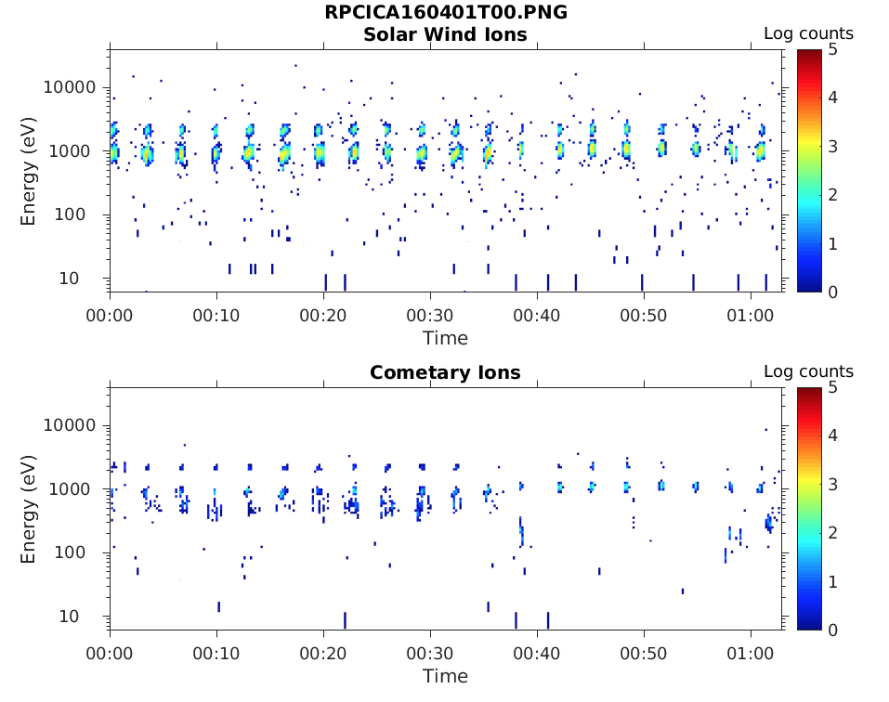
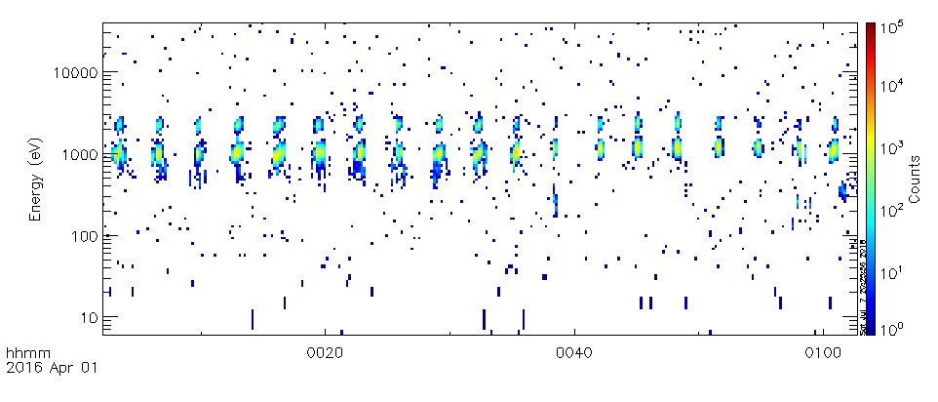
Plot the data
L2 browse images from the archive
My plot (L2 data, all masses) using IDL

Slide 9
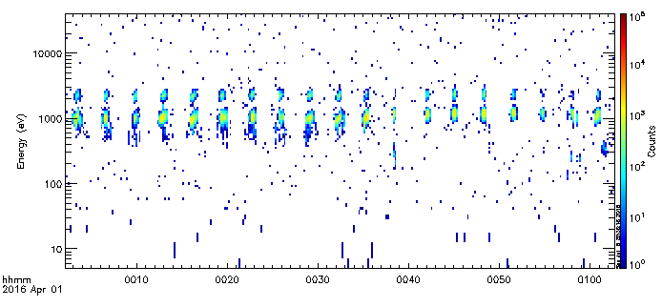
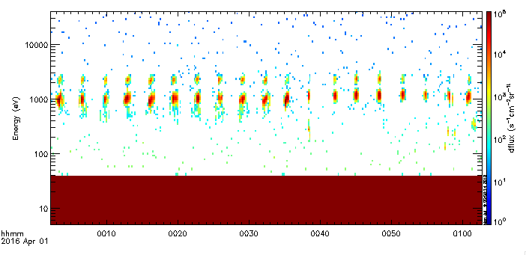
L2 data, all masses
White pixels:
0 values
L3 data, all masses
99e99
missing constant
S/C distance from the comet is >500 km
These data should be taken in mostly undisturbed solar wind, which looks reasonable.

Slide 10
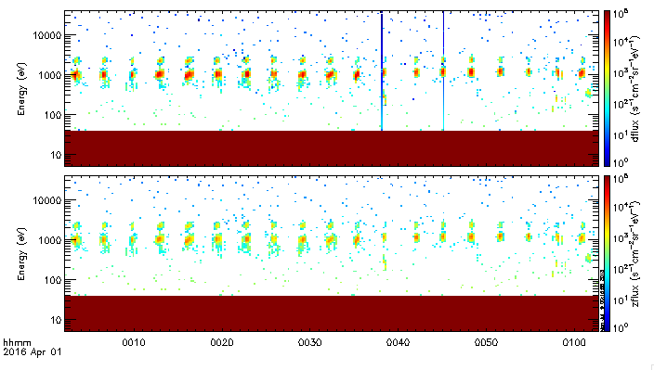
L3 data, all masses
White pixles:
0 values
99e99
missing constant
L4 data, all masses
Some negative values in L4 Corr data?
Corrected
“ZERO”

Slide 11
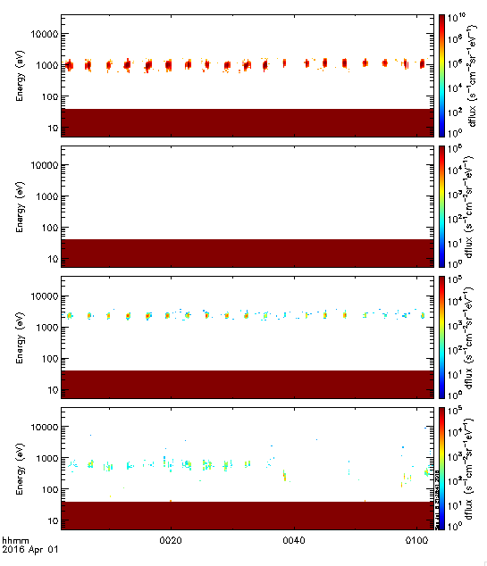
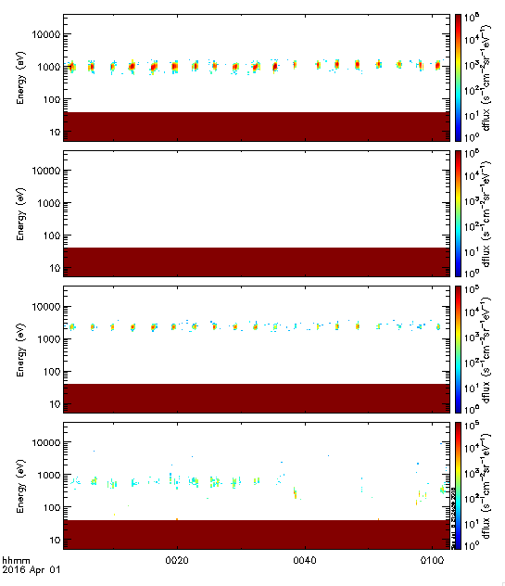
L4 data, mass separated
New version (corrected) from Hans Nilsson
Old version
H+
He+
He++
Heavy
No He+ at all?

Slide 12
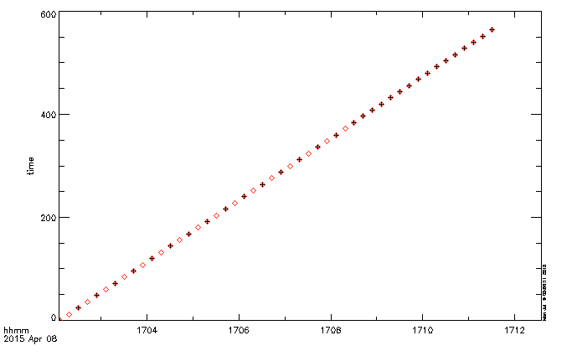
Other inconsistencies/issues in data and documents
Sometimes different time resolution between l2 and l3 data
Seconds from starting time
L3
L2
Exactly same data between the two adjacent time points for L3

Slide 13
ICA User Guide
Section 3.3 in EAICD
Not not found
in EAICD

Slide 14
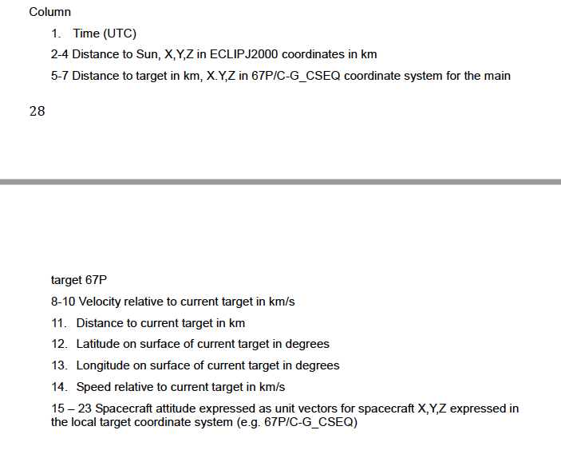
ICA User Guide
Only 9 columns in l2 geometry data
It’s altitude in the data

Slide 15
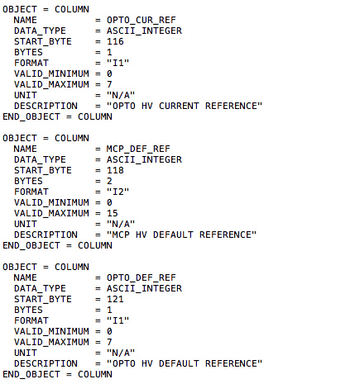
ICA User guide
Inconsistent with data

Slide 16
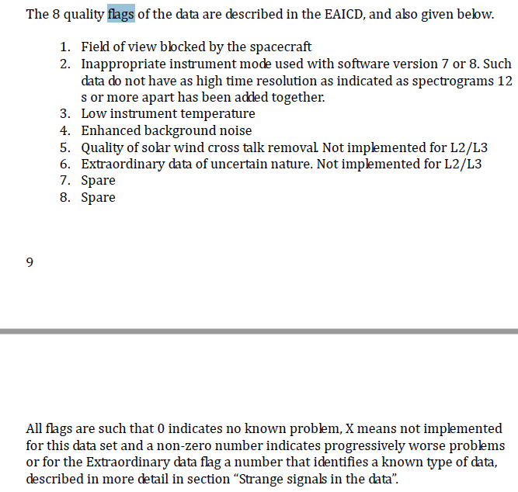
ICA User guide
Quality flag in data:
“0000xxxx”
Reading with PDS3 IDL tool gives 9 characters 0000xxxx”

Slide 17
Summary
Incorrect numbers of columns in L4 data labels
MATLAB codes in the archive not working properly with MATLAB version 2016b
Negative values in L4 ”corr” data
Some inconsistencies between data and some descriptions in the documents
Can the archive be released?
Yes, after fixing some minor issues

