Slide 1
Rosetta Orbiter RPCIES Archive Comments ro-c-rpcies-4-esc1-v1.0 samples only
S. Joy

Slide 2
Overview
This review includes only a few sample data files and their labels. It is not a fully developed archive so the comments provided here are those that I’d like to see implemented in the archive later on
Root Directory Files – none
Index Directory Files – only checksums provided
Catalog Directory Files – none
Please make sure that the most recent versions of the catalogs that are common to other volumes (mission, insthost, inst, ref, etc.) are included on the volume
dataset.cat – Make sure that the description field describes at least briefly how the moments were generated including any data that were excluded from the calculation and why. Also make sure that there is a brief description of the coordinate system used from the velocity vector.

Slide 3
Document
This directory contains two documents without PDS labels:
flux_calculation.pdf (v2) – This document describes how the -L3- data are generated from the -L2- data. The document is in good shape and should be included on this volume (set) as well as the various -L3- data volumes.
rpc_user_guide.pdf (draft) – This is a useful overview of the complete RPC package and its component instruments. The document is currently in draft form with missing sections and various comments in red. Once complete, this document should be included on at least the higher order data volumes for all of the RPC instruments if possible.
However, this is not a IES user’s guide like the one provided on the ICA volumes. This does not provide that level of detail regarding the IES data processing which would be very helpful.
Some level of documentation regarding the data processing of the moment data should be provided. A small amount of this information should be included in the dataset catalog file while the bulk of it should probably be contained in the document that would go in this directory.

Slide 4
Data: ro-c-rpcies-4-esc1-v1.0
The dataset is organized date and species into two files per day (plus labels), one for ions and one for electrons
I might suggest moving to either one file or three files.
The two files currently have the same structure (columns, column bytes) including columns for mass and charge. In the electrons files, the mass column is set to 0 and the charge to -1. In the ions file, these same columns either have 1 and 1 for H⁺ or 4 and 2 for He⁺⁺.
The electrons could easily be folded into the same file with the ions
-OR-
The ions could be separated into H⁺ and He⁺⁺ files. My preference would be the latter (or no change)
All of the files are fixed length ASCII tables, with one line of column headings, comma delimiters between columns, and detached PDS labels.
The data are easy to use and understand

Slide 5
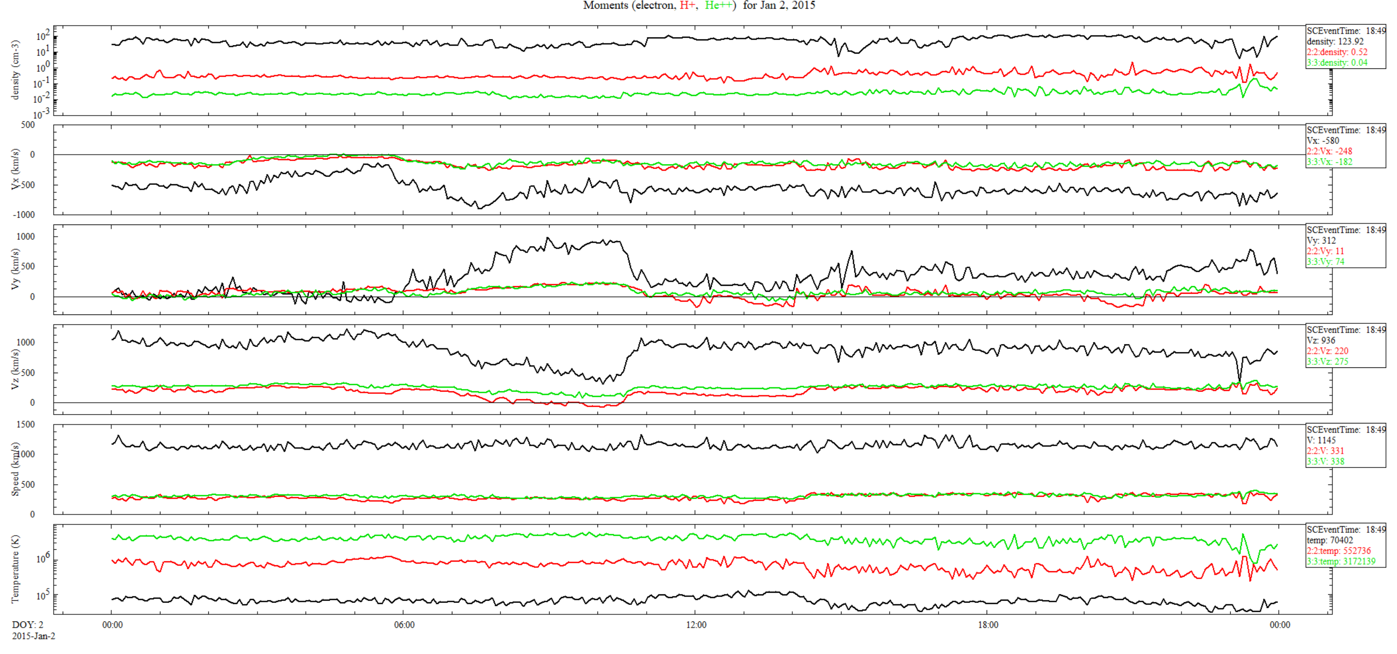
Data: ro-c-rpcies-4-esc1-v1.0 (Jan 3, 2015)
The electrons are faster (x3) and colder (1/5) than the ions. Typically solar wind (SW) values are closer with electrons being slightly hotter than ions.
These data are from the comet escort phase and are not normal SW data
The plasma should be charge neutral (or close) but the density of electrons is orders of magnitude larger then the sum of protons and twice the helium.
It may be that ions are being shielded or otherwise excluded from the moment calculations. This will need to either be explained in the documentation or corrected in the data.

Slide 6
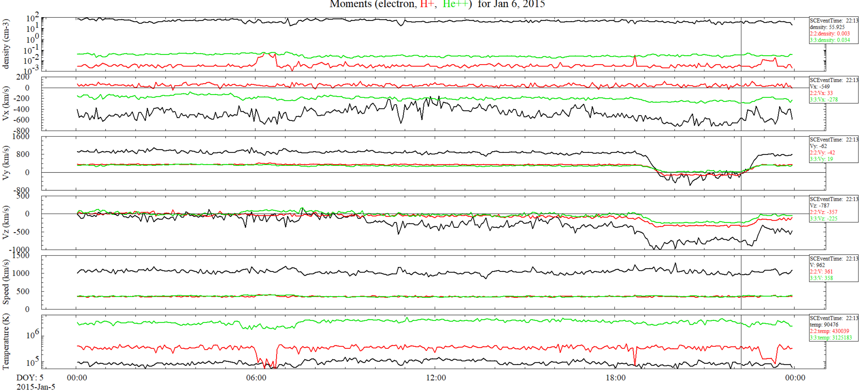
Data: ro-c-rpcies-4-esc1-v1.0 (Jan 6, 2015)
This slide shows another day of data just to be sure that the problems described on the last slide weren’t restricted to that single day. They weren’t. The issues with density and temperature are also observed here.

Slide 7
Summary
Level 4 data
This is a sample data set that has issues that will either need to be corrected or thoroughly explained in the documentation.
Currently there is no explanation of the moment data provided.
There will need to be a dataset.cat file and should be either a IES specific user’s guide or moments document that describes this particular dataset in detail, including caveats and limitations in its usage.
I have looked for published plots of plasma moments from the escort phase but have been unsuccessful in finding anything that would help me to understand the observed discrepancies between the ion and electron moments.
References in the draft user’s guide show energy spectra and some distribution functions but nothing that allows the ions and electrons to be easily compared to the sample values provided.

