Slide 1
PDS Review Rosetta RPC-IES
Yaxue Dong
CU-Boulder/LASP
University of Maryland, College Park, MD
July 9, 2018

Slide 2
Overview
Data:
Rosetta-Orbiter RPCIES Escort 1 67P Resampled Data (1 week Sample): RO-C-RPCIES-4-ESC1-V1.0
rpcies201500*_l4elc_mom_v1.lbl
rpcies201500*_l4elc_mom_v1.tab
rpcies201500*_l4ion_mom_v1.lbl
rpcies201500*_l4ion_mom_v1.tab
Documents
rpc_user_guide.pdf
flux_calculation.pdf

Slide 3
RPC-IES l4 sample data

Slide 4
labels
All data can be read correctly using the PDS ILD software
Instrument mode?
Quality flag description not clear
Some documentats not found
?
?

Slide 5
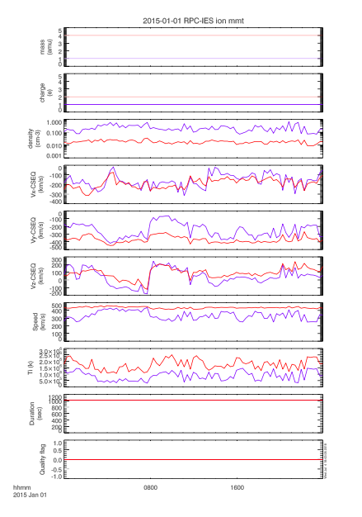
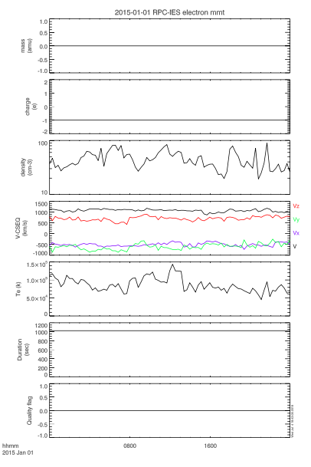
Data plots

Slide 6
Data plots
Identify different ion species from IES?
ni<<ne?
Quality flags always 0?

Slide 7
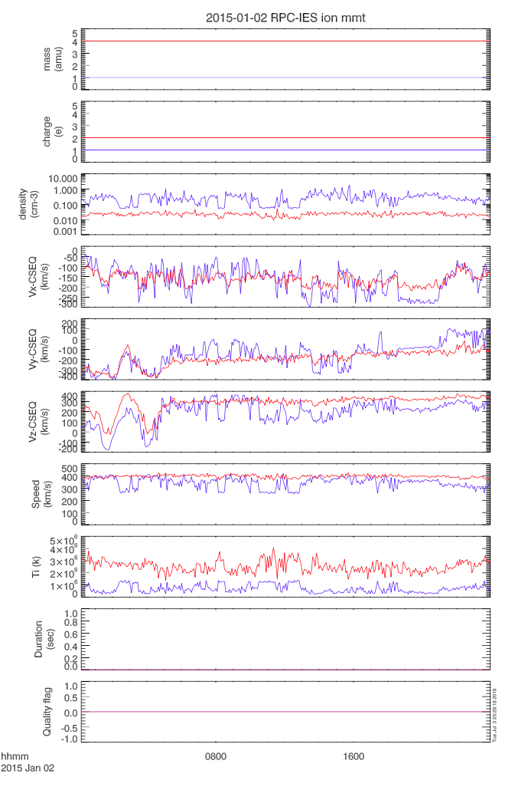
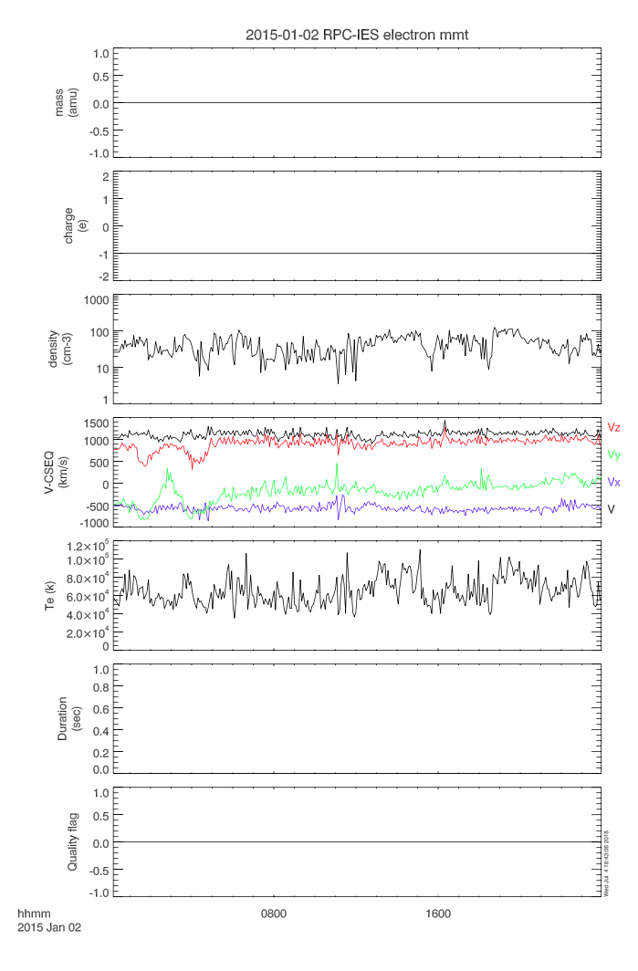
Duration all 0?

Slide 8
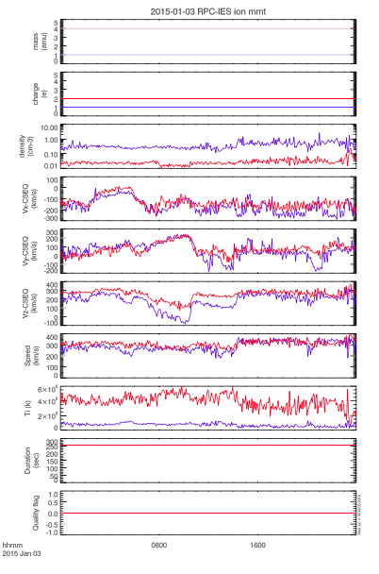
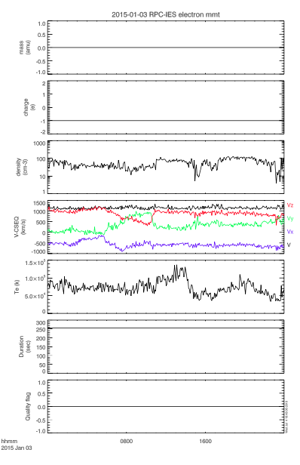

Slide 9
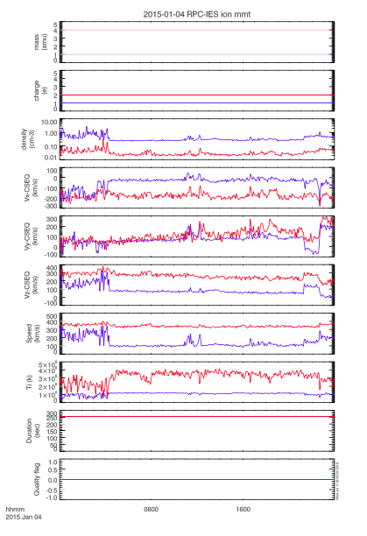
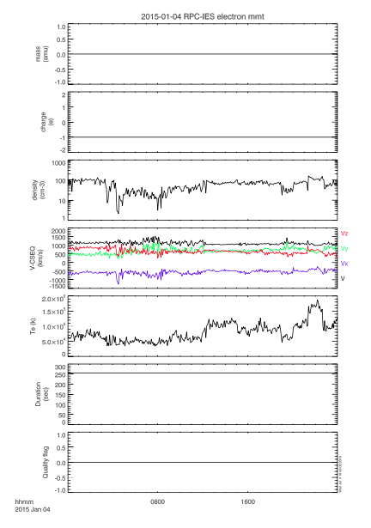

Slide 10
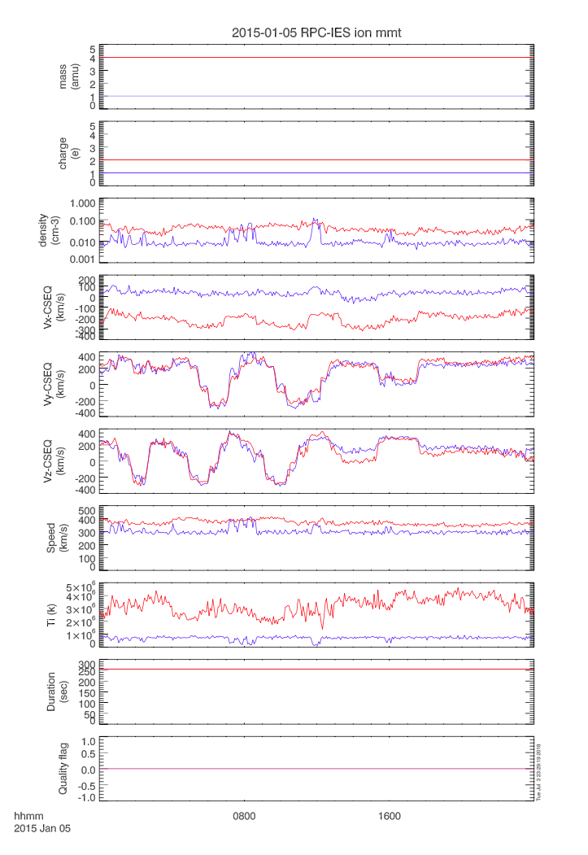
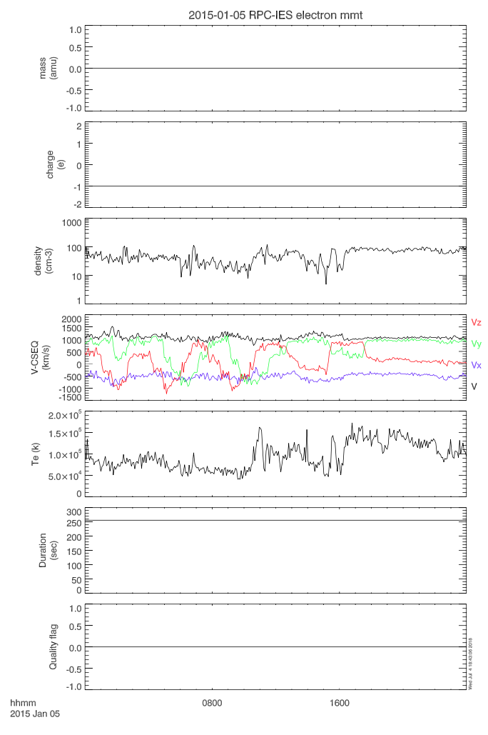

Slide 11
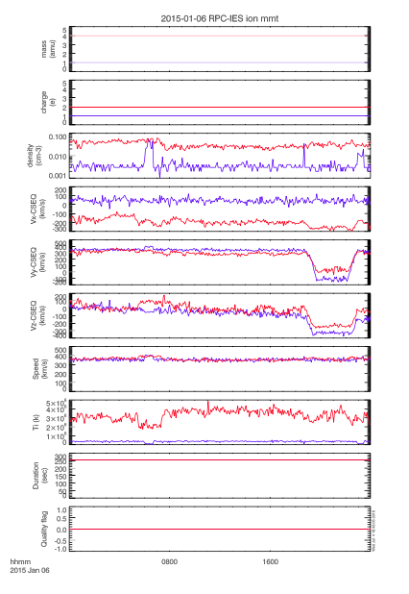
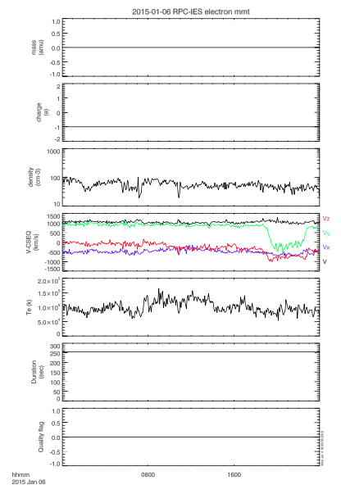

Slide 12
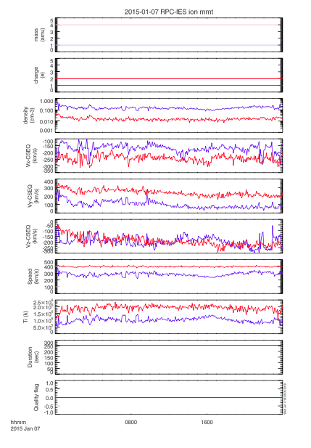
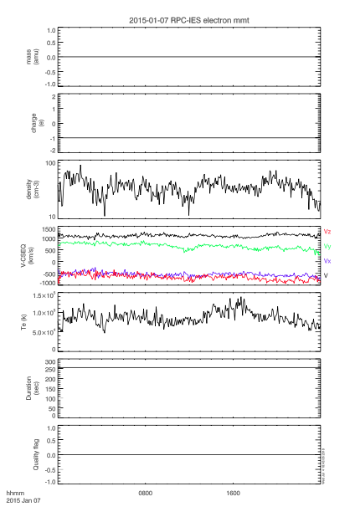

Slide 13
Summary
Labels
Worked well. All data can be read successfully using the PDS3 IDL software
No instrument mode information
Unclear quality flag description
Some documents mentioned in the labels cannot be found
Ion and electron moment data
Quality flag all 0
How to identify different ion species (Q/m) from IES data?
ne >> ni
2015-002 (Jan 2): all durations are 0

Slide 14
Documents
rpc_user_guide.pdf
flux_calculation.pdf

Slide 15
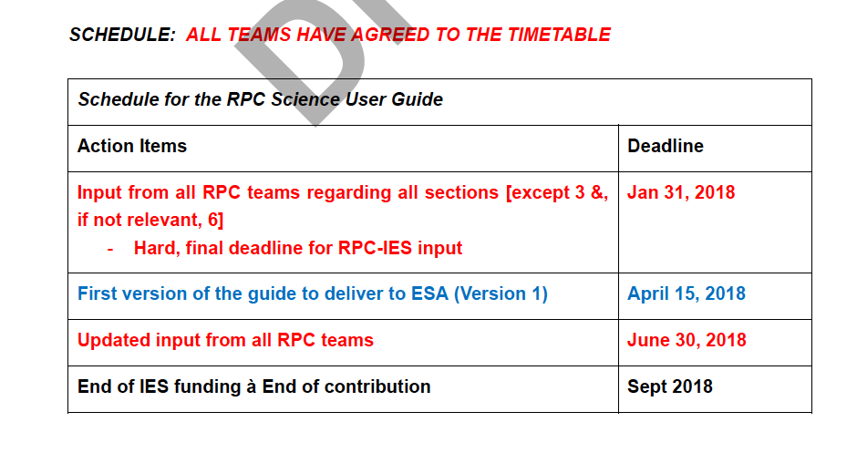
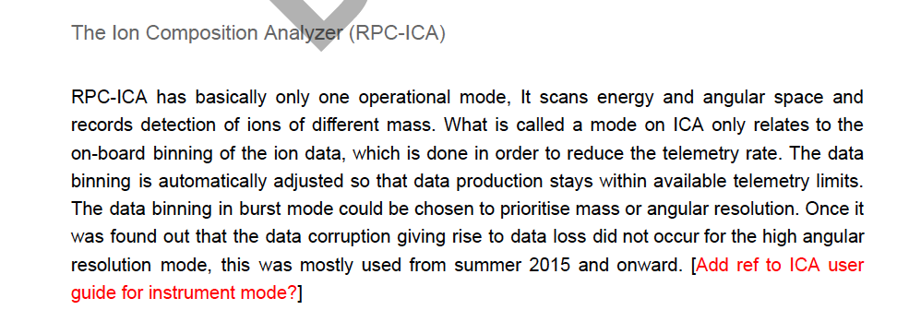
The user guide is a draft version that needs lots of editing and inputs
There is no description at all for the l4 ion/electron moment data. May need a documentation to describe how to calculate moments (l3 to l4)
e.g.

Slide 16
rpc_user_guide.pdf

Slide 17
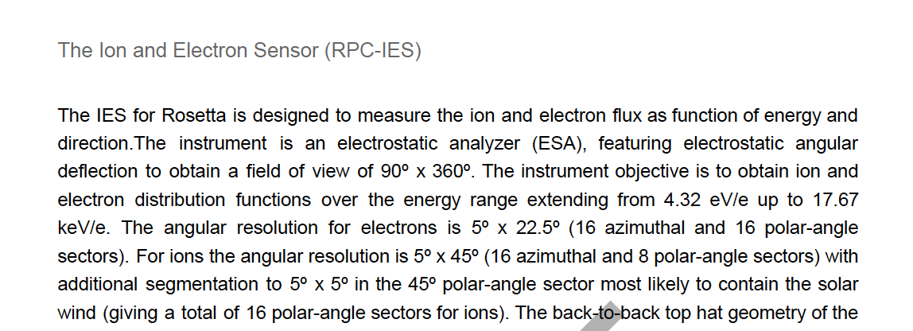
Inconsistent IES angular channel descriptions
Page 2
Numbers don’t match. 18 azimuthal angles as in the instrument paper (Burch et al., 2007)
Burch et al., 2007

Slide 18
Page 36
Page 40
IES electrons
Numbers don’t match
Inconsistent definitions of azimuthal, polar, and deflection angles from Section 1 and Burch 2007 instrument paper

Slide 19
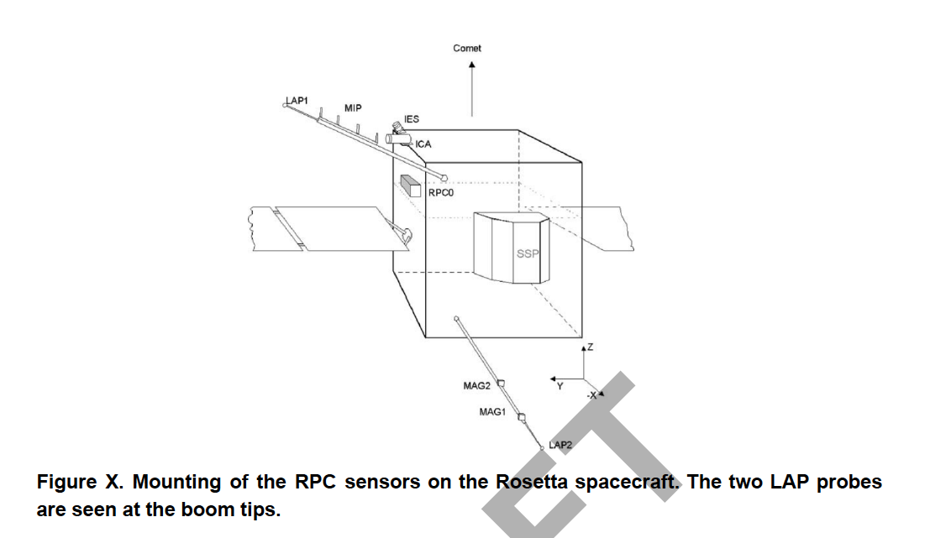
Page 4
Most figures in this documentation are not numbered
RPC0? SSP?
Better to have figures for each instrument, especially for IES and ICA

Slide 20
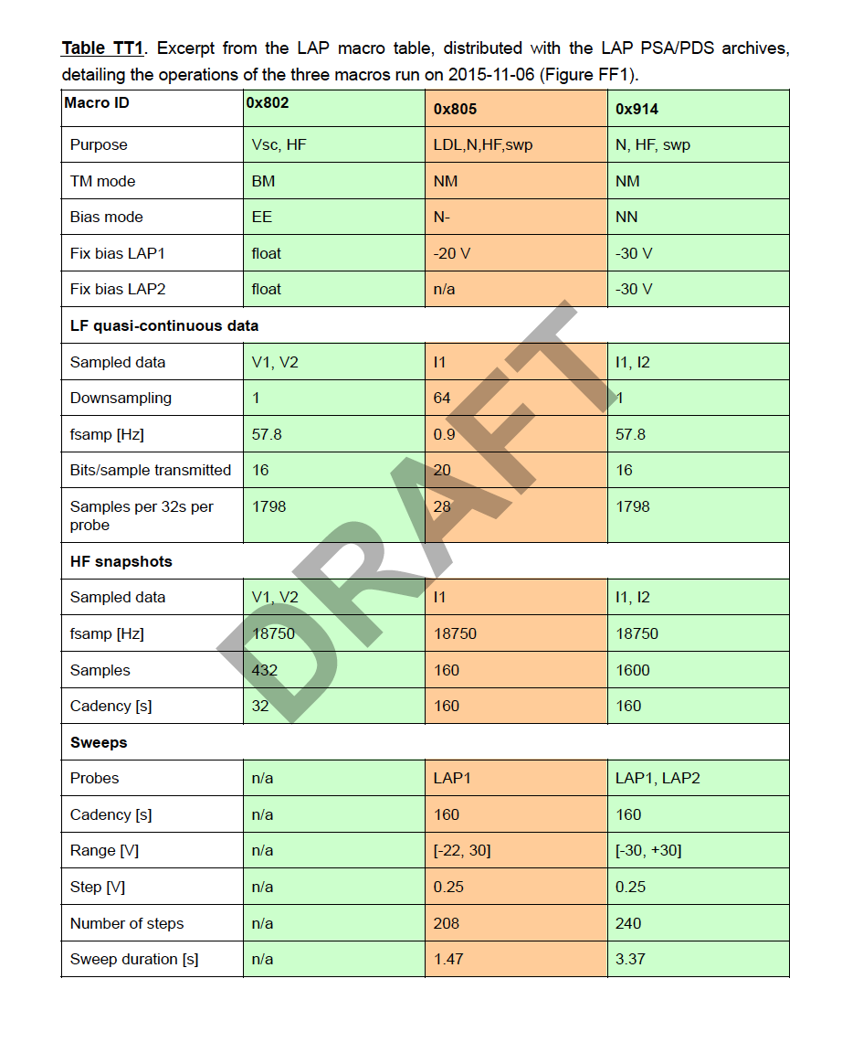
Page 15
Page 12
Inconsistent LAP Macro IDs
Not explained

Slide 21
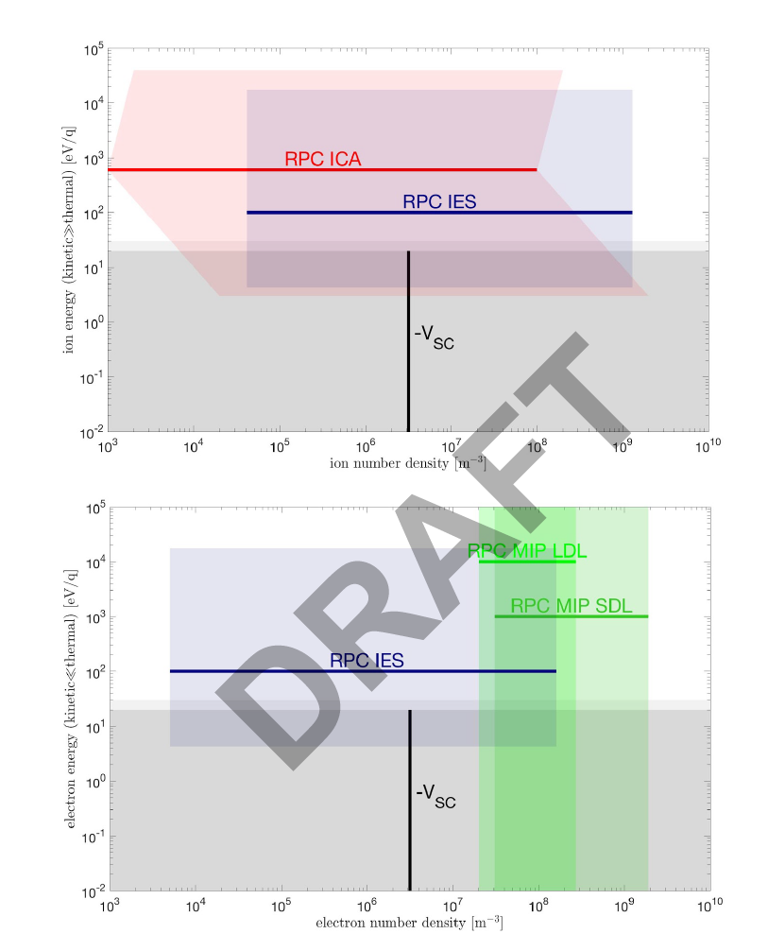
Page 42
Page 45
Inconsistent symbols for s/c potential:
Vs or Vsc

Slide 22
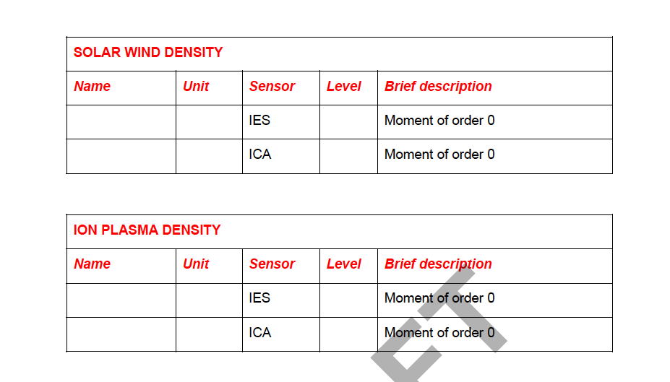
Page 46
?
?
?
?
?
?
Probably put the IES l4 moment data descriptions here?

Slide 23
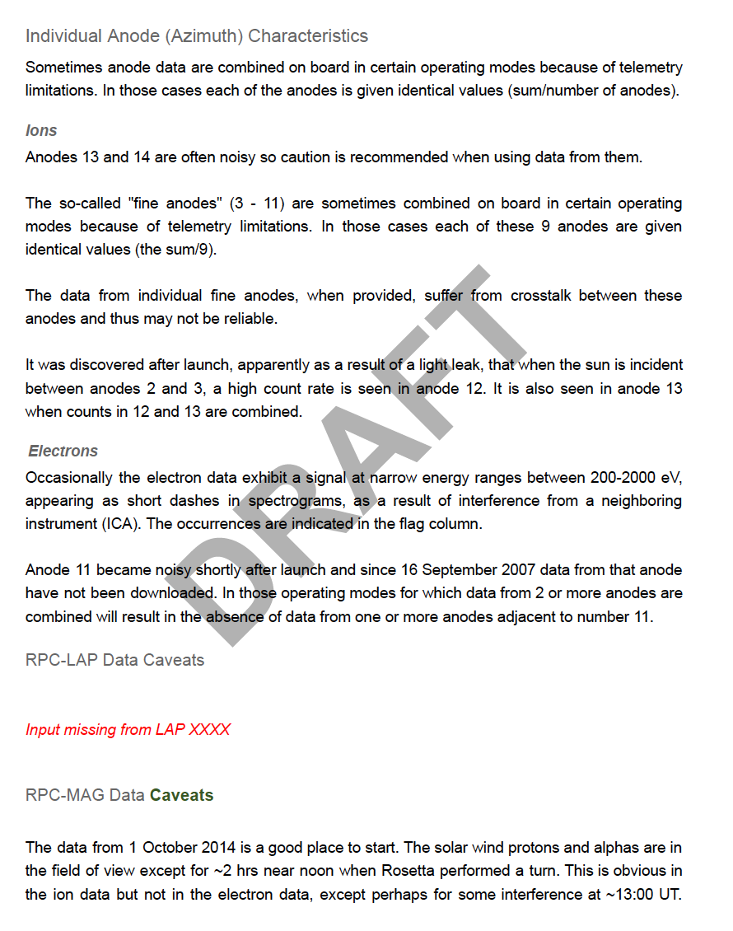
Page 78
Why?
Why?

Slide 24
Page 78-79
This paragraph is not related to MAG data, but a duplicate of some IES description from page 72.

Slide 25
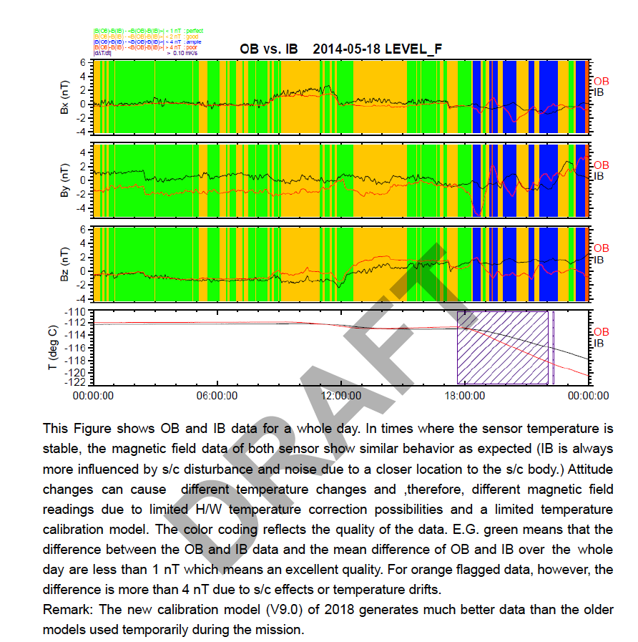
Page 80
Big difference between OB and IB. Why still green flag?
?
Red and blue?

Slide 26
Unexplained abbreviations
Page 3
Page 4
Provide full name or where to find it
Page 5
Page 6
Page 7

Slide 27
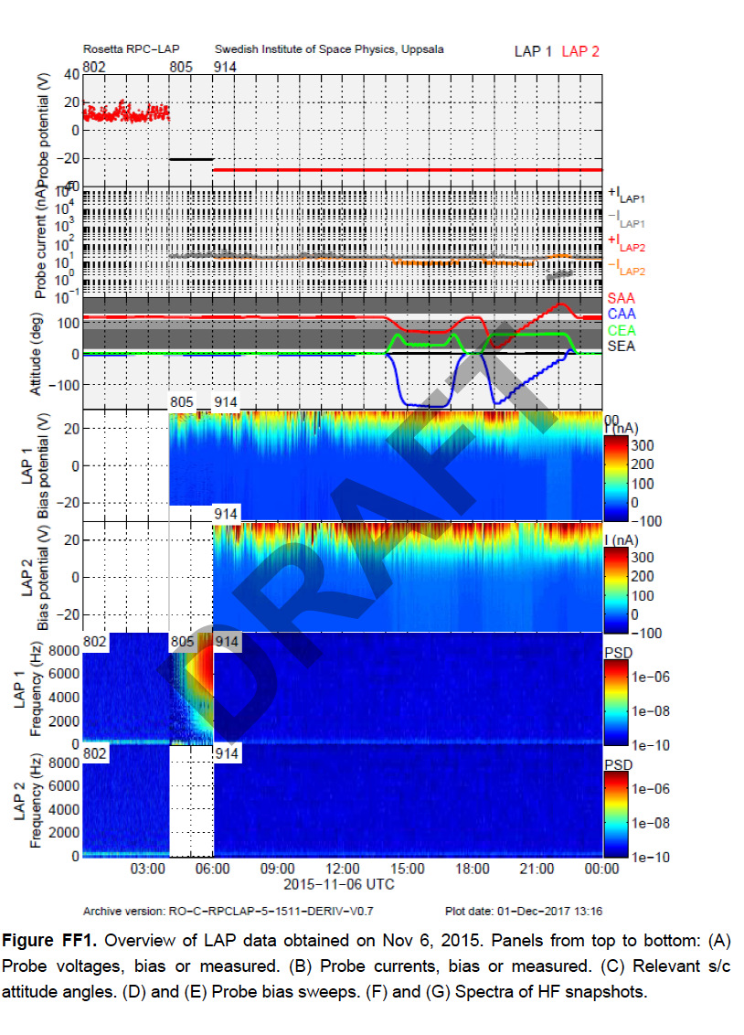
Page 14
?
Unit?

Slide 28
Page 27
Page 79
Page 85
?

Slide 29
Page 87-101
Some references are missing doi

Slide 30
flux_calculation.pdf

Slide 31
This is well written without major problems.
Minor comments:
Page 1
Suggest to add units

Slide 32
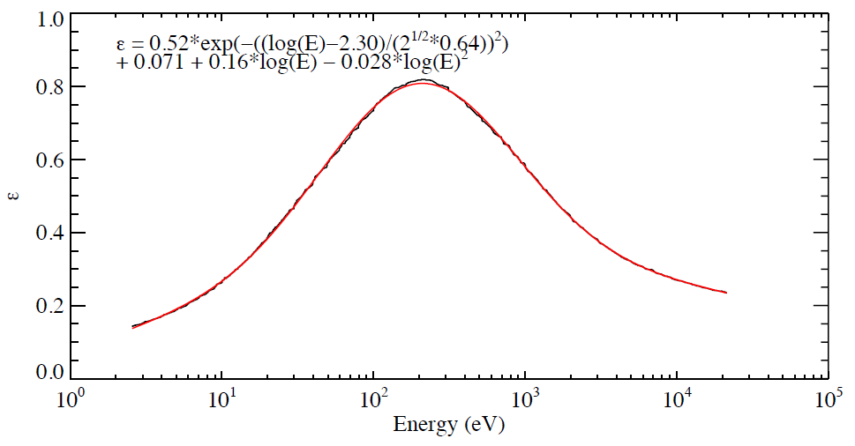
Page 5
What is it?
Gaussian + quadratic polynomial
6 parameters to fit?

Slide 33
Page 7
doi missing

Slide 34
Can the data and documentation be released?
Level 4 data:
Yes, but need some more explanation
Documents
rpc_user_guide.pdf: No
flux_calculation.pdf: Yes
Need to add documents for l4 data

