Slide 1
CONSERT PDS Review
David Hollibaugh Baker
9 October 2018

Slide 2
Documentation
I examined the data and documentation without prior knowledge of the instrument or data.
Relied heavily on the Planetary Science Archive Interface Control Document pdf (PSA ICD).
While the PSA ICD was helpful, was initially confused by the data product design – improved description of the mapping of the IQ signal table with the CHAR table would be very helpful.

Slide 3
Documentation

Slide 4
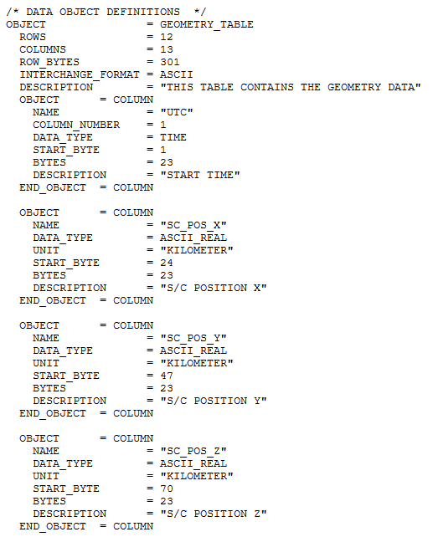
PDS Labels
cn_g_l_fssrng_61.lbl
Generally looked good.
Geometry label files lacked column numbers.
Geometry file names need description in PSA ICD.

Slide 5
Data
Used IDL v8.3 and ReadPDS tools to investigate the data:
cn_o_4_20141114t103623.dat, cn_o_4_20141112t185640.dat, cn_l_long_4_20141112t185640.dat, cn_l_4_20141113t220624.dat, cn_l_4_20141112t185640.dat, cn_a_4_20141112t185640.tab
Helped to better understand the data and structure.
Nothing obviously unusual about the data values (brief scan through the data values).
After reading with ReadPDS, was able to manipulate the data and display as plots.

