Slide 1
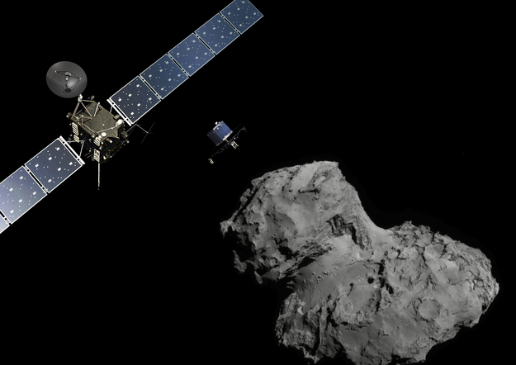
EOM Rosetta data Committee Meeting
EOM Rosetta Ground-based campaign science data release level 2 and 3 assessment
J. Lasue, A. Guilbert-Lepoutre

Slide 2
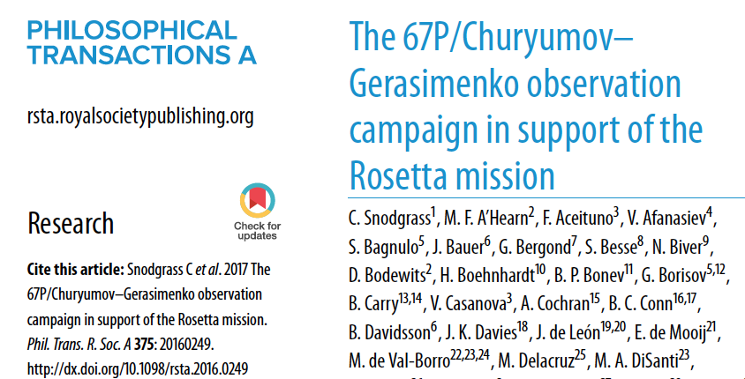
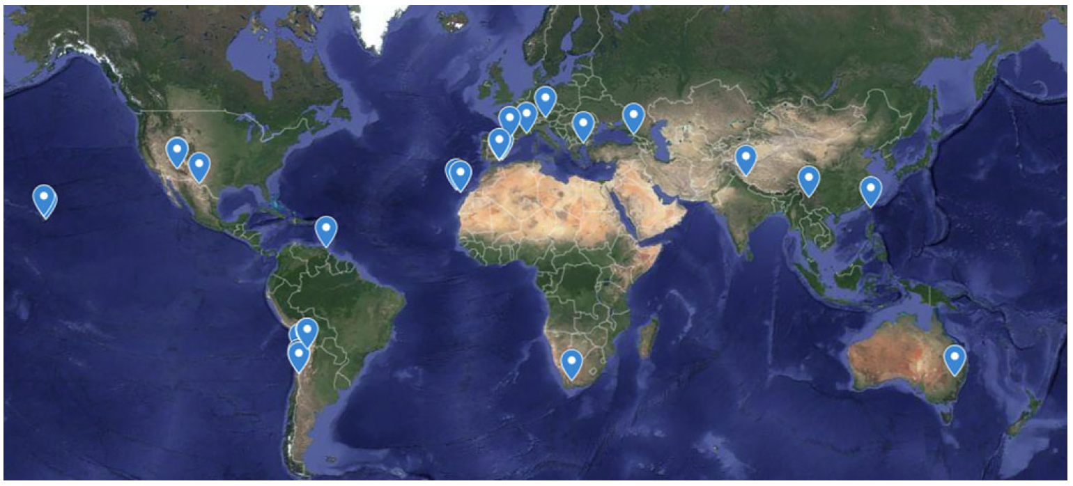
Context
This is a draft v2 data from the ground-based campaign that followed 67P during the Rosetta mission measurements lead by C. Snodgrass (Snodgrass et al. 2017).
The data is presented in raw format level 2 with calibration data and calibrated level 3.
Not all data is yet in all formats (2/3 level 2; 1/3 level 3).
The Rosetta archive will be crucial for the future (Caesar)

Slide 3
Context
Type of data | IFS | POL | SPEC | IMG | Total
Number of instruments | 2 | 5 | 16 | 41 | 64
Number available at level 2 | 2 | 5 | 13 | 22 | 42
Number available at level 3 | 1 | 1 | 2 | 10 | 14
Number of files | 363 | 4707 | 7237 | 50041 | 62348
Size of dataset | 90Gb | 23Gb | 14Gb | 253Gb | 380Gb
IFS POL SPEC IMG

Slide 4
Context
Type of data | IFS | POL | SPEC | IMG | Total
Number of instruments | 2 | 5 | 16 | 41 | 64
Number available at level 2 | 2 | 5 | 13 | 22 | 42
Number available at level 3 | 1 | 1 | 2 | 10 | 14
Number of files | 363 | 4707 | 7237 | 50041 | 62348
Size of dataset | 90Gb | 23Gb | 14Gb | 253Gb | 380Gb
Some datasets are so large, they cannot be archived (e.g. ALMA). Archiving is mostly interesting for small observatories without the capacity to keep the data and the information for a long time.
The size of the dataset is also a challenge to review and just to get the data (1 week of download… at 0.5Mb/s).
We were not able to assess all data files one by one, few were looked at and some randomization occurred.
The diversity of the instruments that took the data is also challenging.

Slide 5
Review procedure
Data architecture : OK
Links to the data not archived : Need discussion
Quality of the documents included, especially the Archive Interface Control Document: !
We checked the validity of .LBL files and determined whether all required information is present: !
We checked that all data is readable with fits viewers (SAO DS9, recommendations in some cases): OK
Tested some calibration procedures: !
Tested some science assessments: OK

Slide 6
RIDs – Major - General
science-153: the point of contact for the dataset is N. Ligier (who is doing a great work!). A permanent point of contact would be important to mention (someone from ESA, PSA?).
=> good point TBD
science-170: PDF files named EAICD_C67PEARTH_POL_V1_0.PDF and such offer some basic characteristics for the instruments. Should those characteristics be as general as possible, or reflect the settings actually used for acquiring the data within the campaign? (For instance with SINFONI only 250mas used)
=> Keep it general (easier and may be useful later on)
science-173: found a reference: Snodgrass C. et al., MNRAS, 2017 (in press) which should be updated .
=> corrected

Slide 7
RIDs – Major - General
science-159: The observer names are generally absent from the LBL files. They are usually given in the documentation, but it would be nice to have it in the LBL. The name is usually given in the FITS header, but for example it is not given for the BNAO FORERO2 POL data.
Should we provide the PI’s name ? We think that would be good. But there are more issues behind this…

Slide 8
RIDs – Major - General
science-171
Non-uniform information within Tables 2 of general .pdf documents
IFS
SPEC
POL
Who the PI and the observer(s) are may be relevant in the future for finding information relevant to data reduction (for instance weather, cloud coverage, what happened during the observations in general...) The distinction could be made, or just list the PIs’ name, and get tables uniform as much as possible

Slide 9
RIDs – Major - General
science-171
Non-uniform information within Tables 2 of general .pdf documents
IFS
A special case for IFS/MUSE:
issue the 2nd night: change of program
Info is only found in :
C67PEARTH-C-IFS-2-V1.0/DATA/VLT/MUSE/INFORMATION.TXT
Program IDs are: 096.C-0160(A) and 096.C-0855(B)
Program PI and observers are different, but this is not specified.
Just list the PIs’ name, and get tables uniform as much as possible ?
What about the observer’s names ?
=> Give a complete and consistent table with PI name, program ID, etc.

Slide 10
RIDs – Major - General
science-183-182-186-169-168-167-166: Many informations are missing from the LBL files and in a number of cases they cannot be found in the FITS headers. This raises the questions:
Is the information important? Where do we find it ?
E.g.: - CA MOSCA: missing system info - HCT HFOSC: missing coord system and airmass value - LIJIANG : issue with the RA and DEC format - LULIN: problem of RA, DEC and AIRMASS - SPITZER: many missing informations. Not found in FITS Header.
including EXP time, DEC and RA.
=> Need to contact the PI and provide the information as much as possible
=> Will need to be considered on a case-by-case basis.

Slide 11
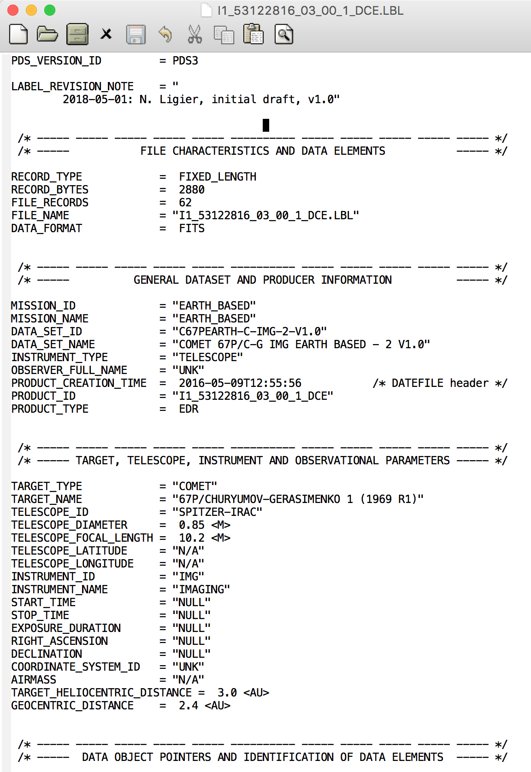
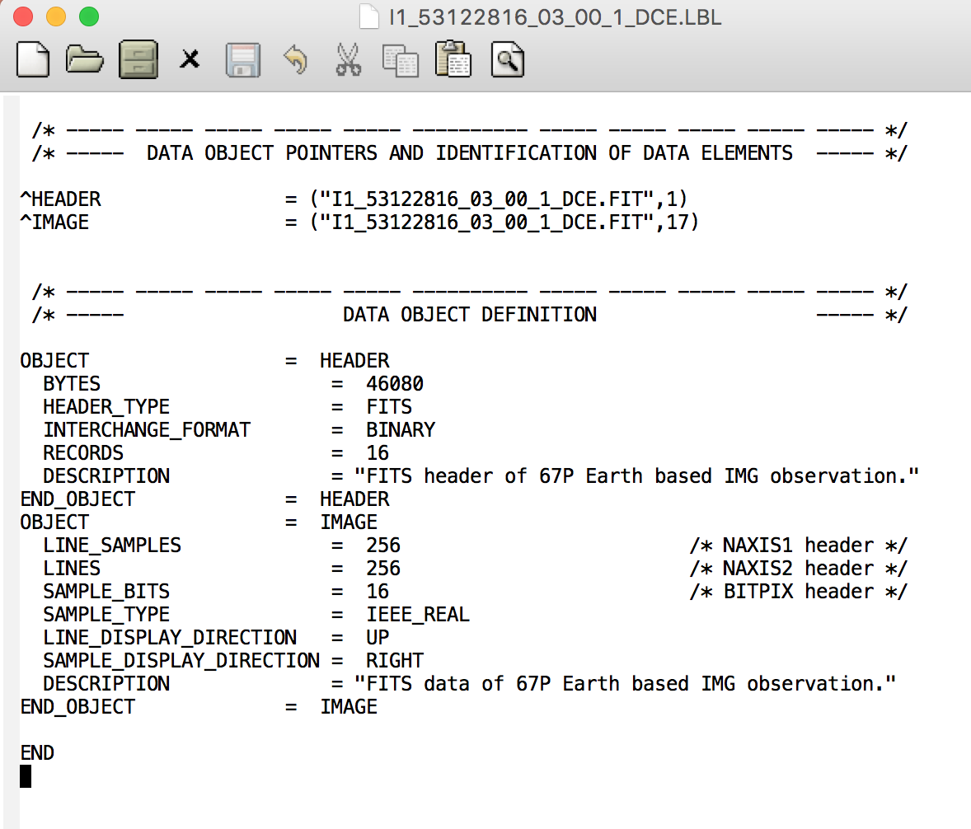
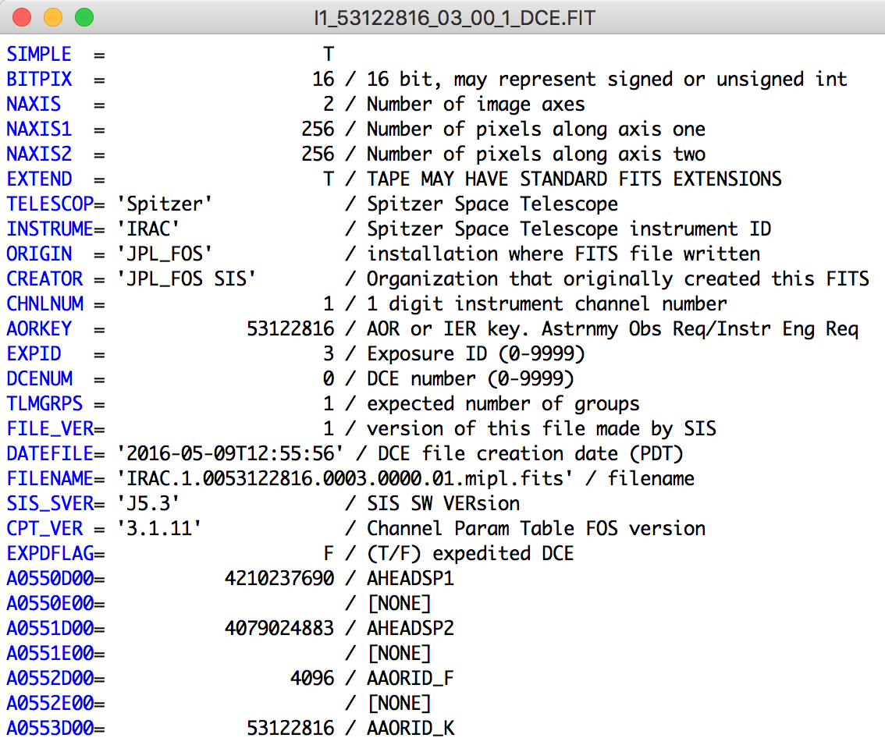
RIDs – Major - General

Slide 12
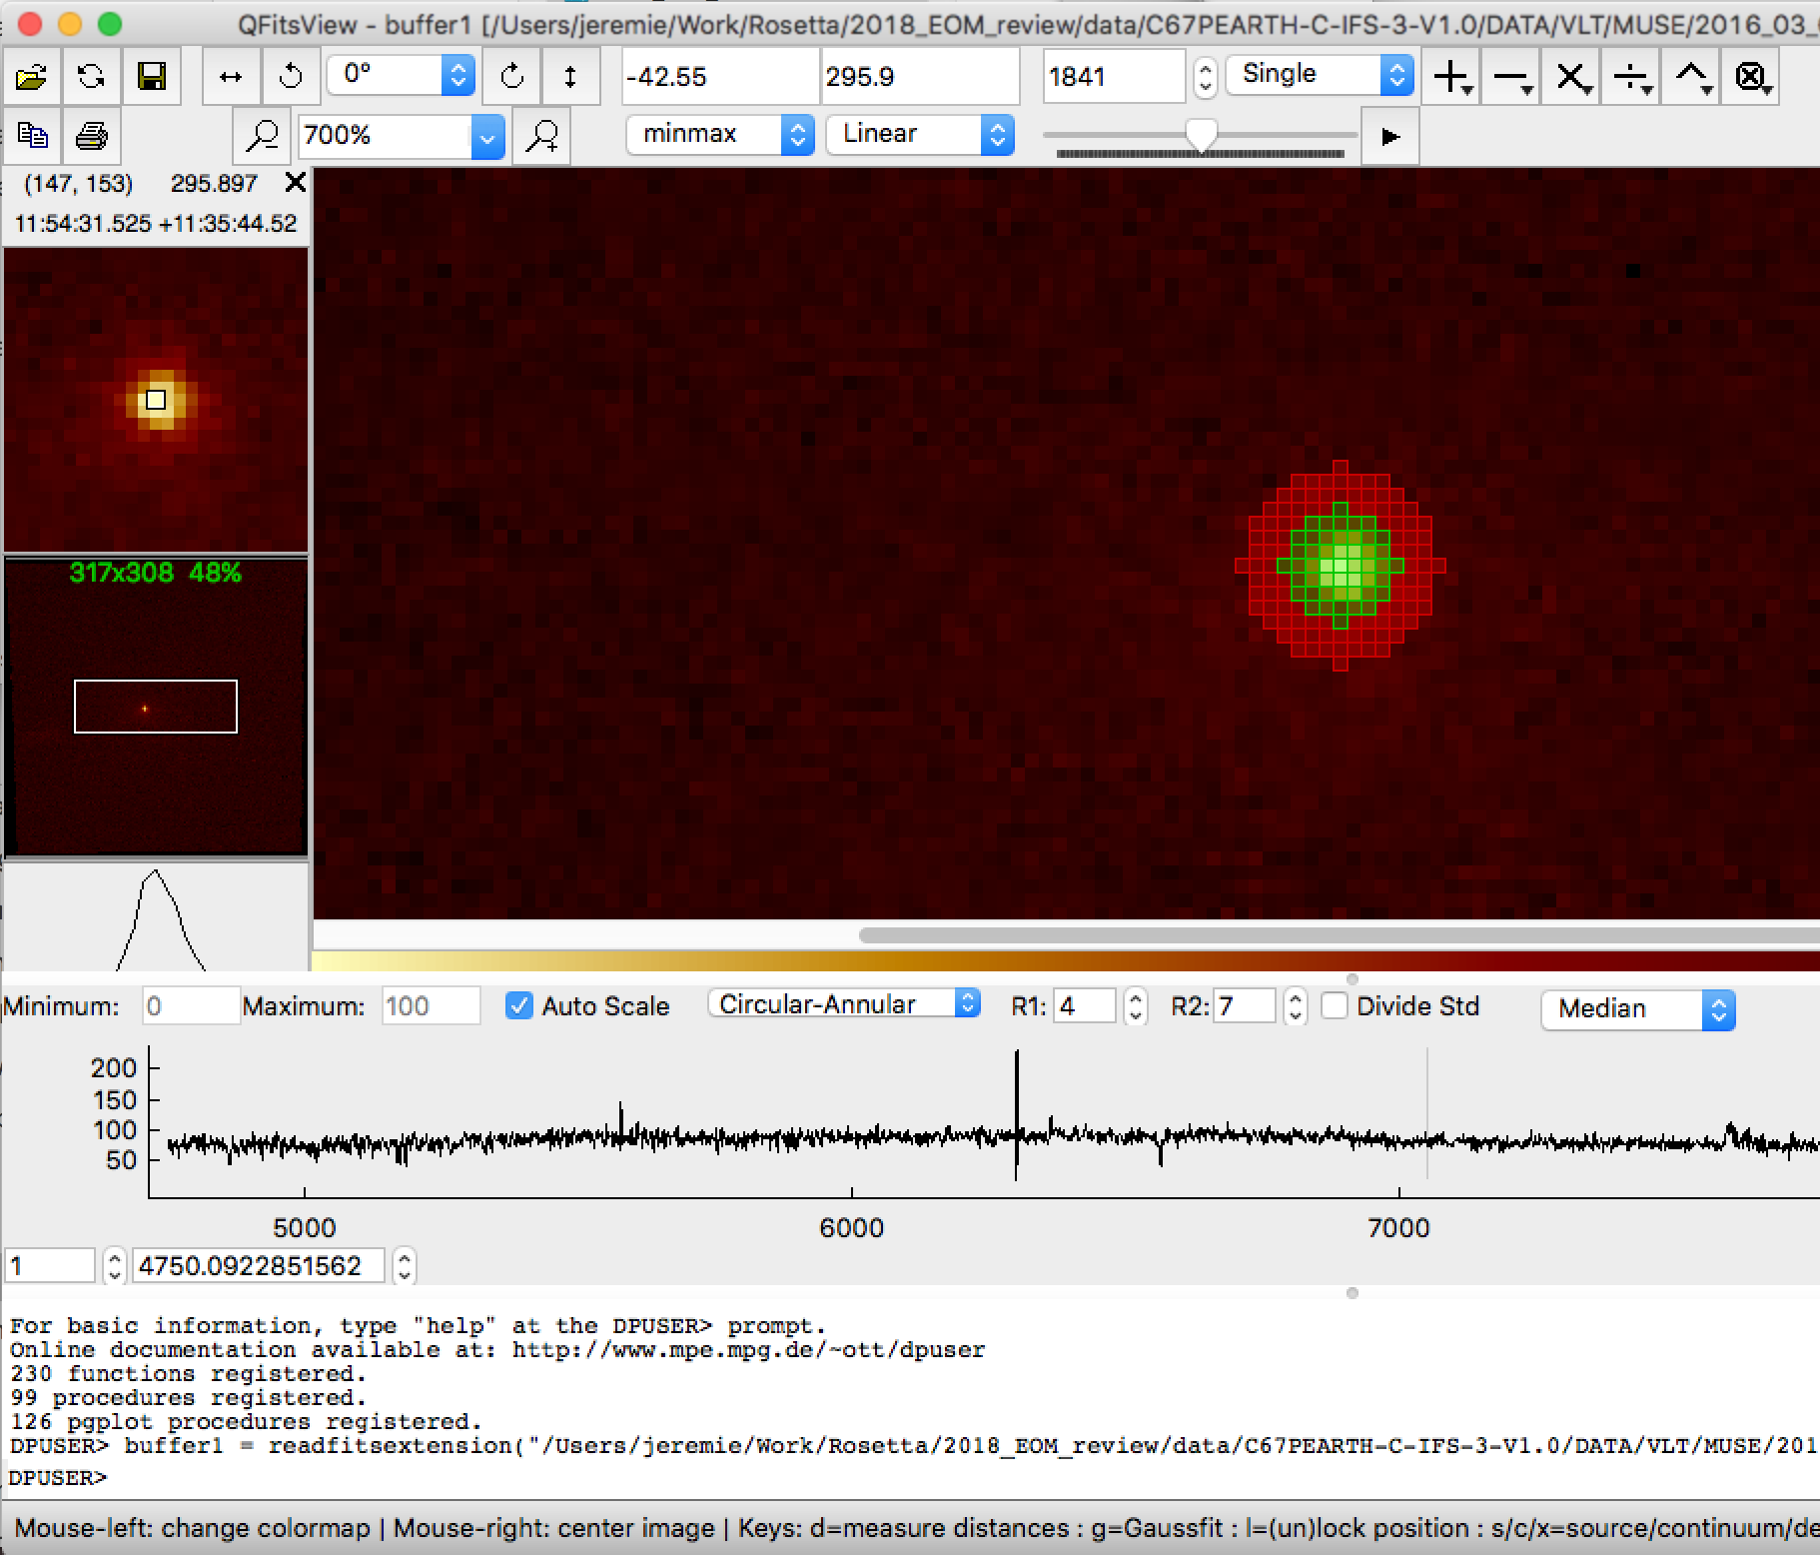
RIDs – Major – IFS data
science-154 : The IFS datacubes are not easily explored or visualized using regular fits viewers. Qfitsview is better adapted to the IFS dataset.
=> OK in EAICD
science-155 : In document : EAICD_C67PEARTH_IFS_V1_0.PDF - section 2.4.5 'Every MUSE product is an image of 4224×4240 pixels' => Needs to be corrected : Each Muse product contains 24 images of 4224x4240 pixels each ; with one more image of 1024x1024 and SGS_cube of 1024x1024x17 and additional data in the form of tables. => OK will be done
science-157 : add a description of the account generation procedure. http://www.eso.org/UserPortal/pre-authenticationSecure/registration.eso
Only in the EAICD or also in the INFORMATION.TXT file ?
=> Information will be provided.

Slide 13
RIDs – Major – POL - SPEC
science-163 : geometric description of the POL observations (phase angle from the Sun) not available for BNAO FORERO2
In the end, maybe we just leave the user to find it with ephemeris ?
=> contact the PI for information
science-162 : Calibration lamps are not correctly mentioned. The arc lamps used are not only Neon, but also for ISIS : Cu-Ar and Cu-Ne for FORS (VLT): Hg, He, Ar, Cd, Ne for SCORPIO-2 SAO NAS: He-Ne-Ar calibration lamp for FORERO2: not found. To the best of my knowledge, ACS uses standard stars for calibration.
=> correction done

Slide 14
RIDs – Major – POL - SPEC
science-160 : Attempted to do the processing of the data files for the SAO-RAS SCORPIO instrument using the IFPWID processing routines of the institute. But this is not working since we are missing the log files with the parameters for processing the files. In itself, this processing and the software associated are already public and do not take much space. Since currently this is hosted in a personal page, it is recommended that a copy is hosted with the database.
=> Ask the PI for the log files
=> The IDL routines available online can be archived as is - .TXT files - in the DOCUMENT directory.

Slide 15
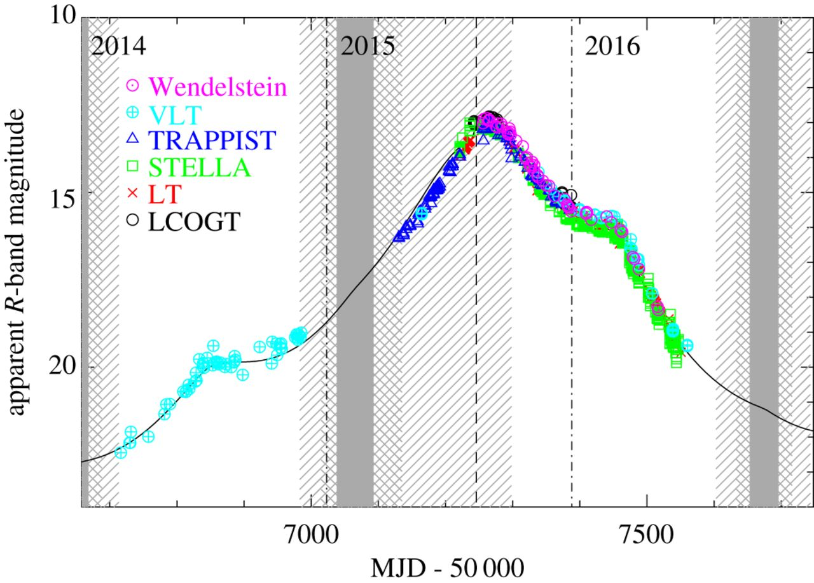
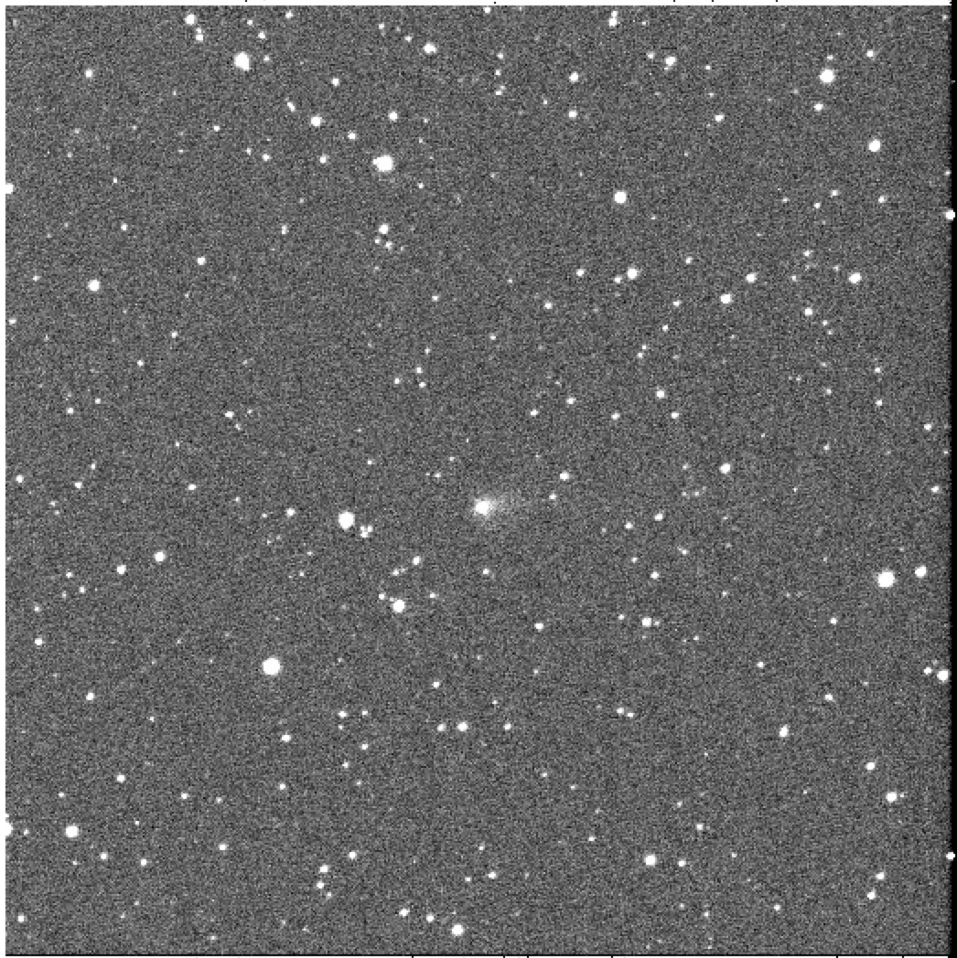
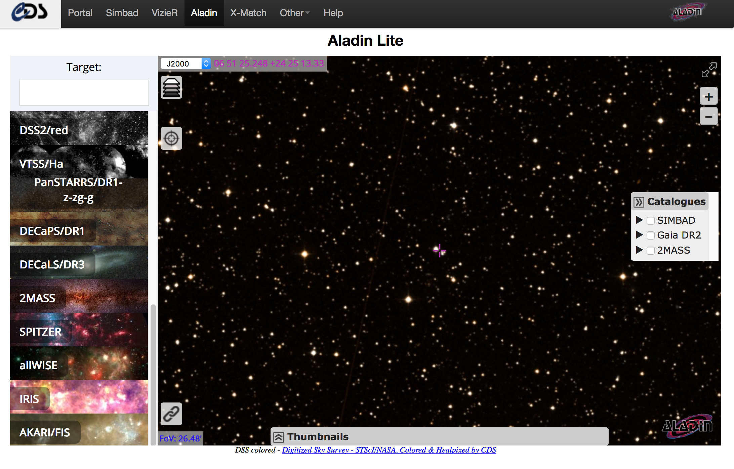
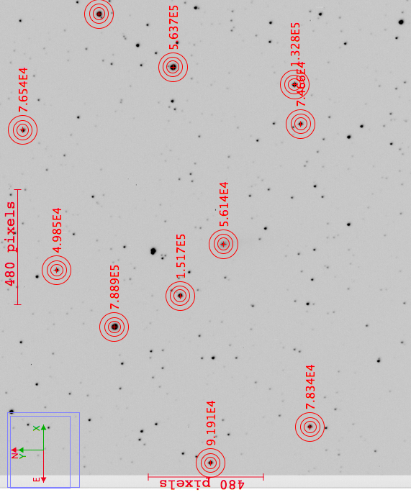
RIDs – Major – IMG
Using Lowell data on 18-08-2015
quick and dirty estimate of 67P mag
gives value of ~ 13.5 very close to 13.6
OK

Slide 16
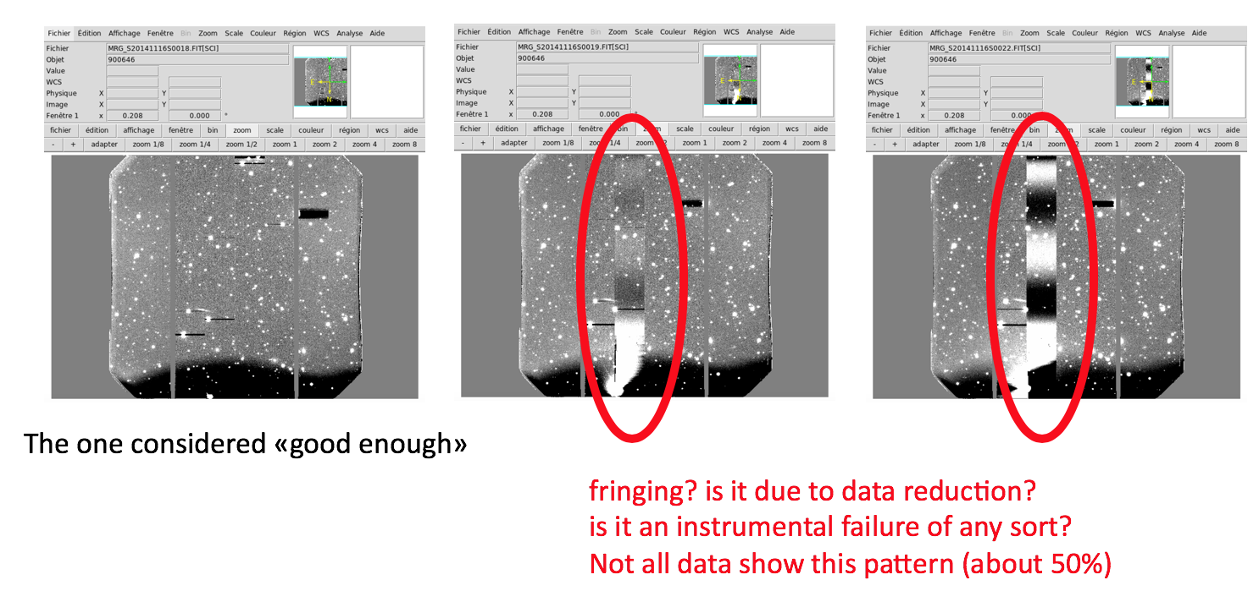
RIDs – Major – IMG
science-172 : It is not clear in the documents that the 3 arms of xshooter do observe simultaneously the UVB, VIS and NIR spectra.
=> Need to specify the information clearly
science-174 : Gemini South / GMOS -- quality of data reduction?
=> Need to contact the PI

Slide 17
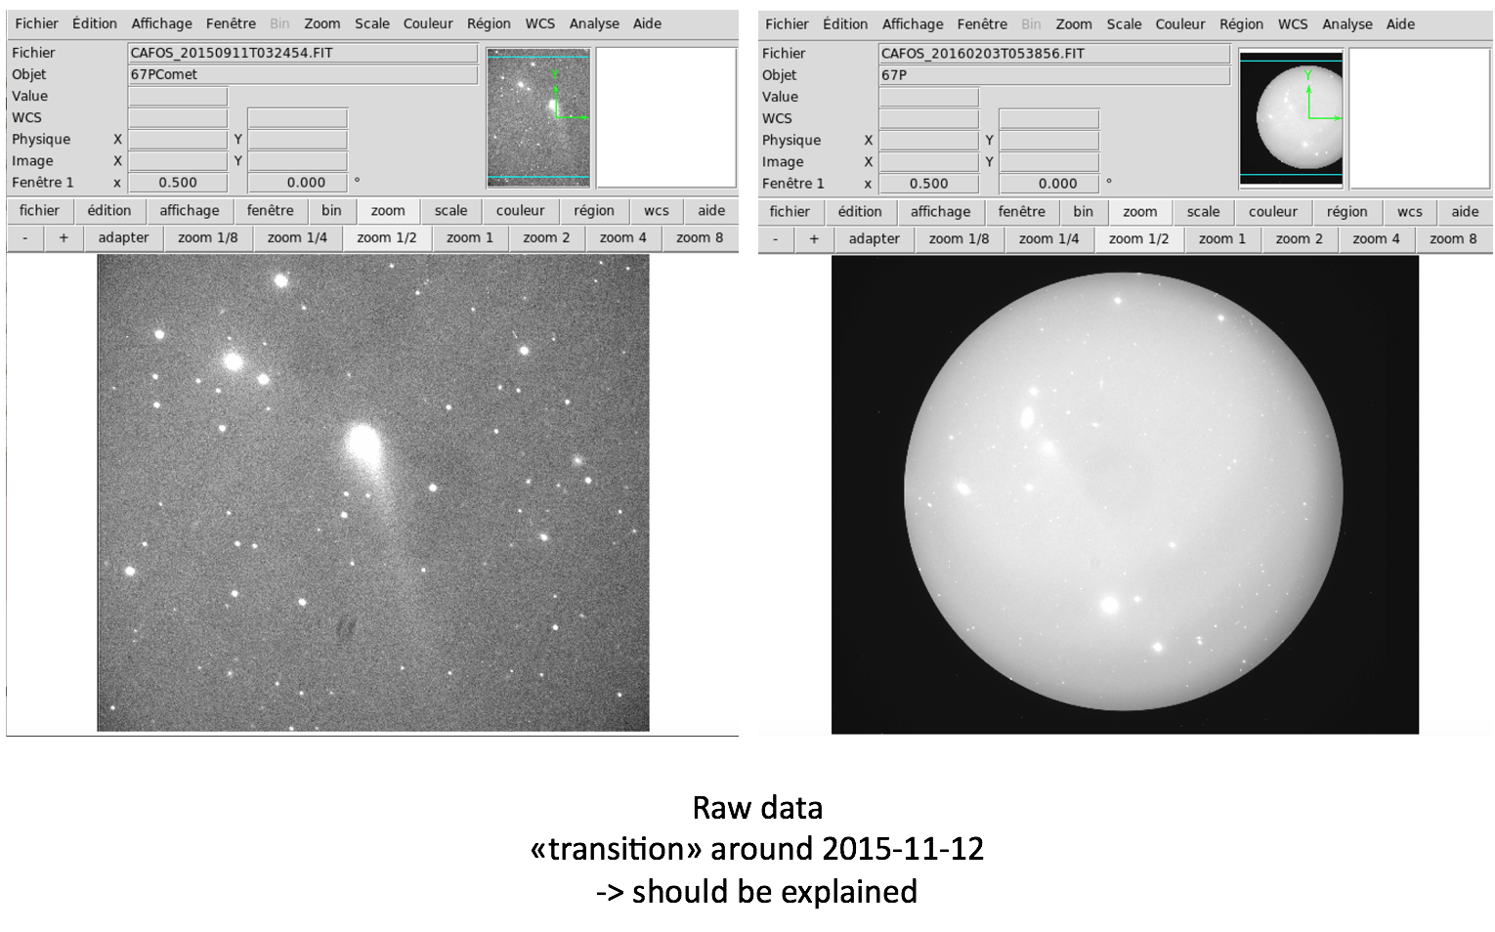
RIDs – Major – IMG
science-175 : CAFOS images - discrepancy in imaging technique?

Slide 18
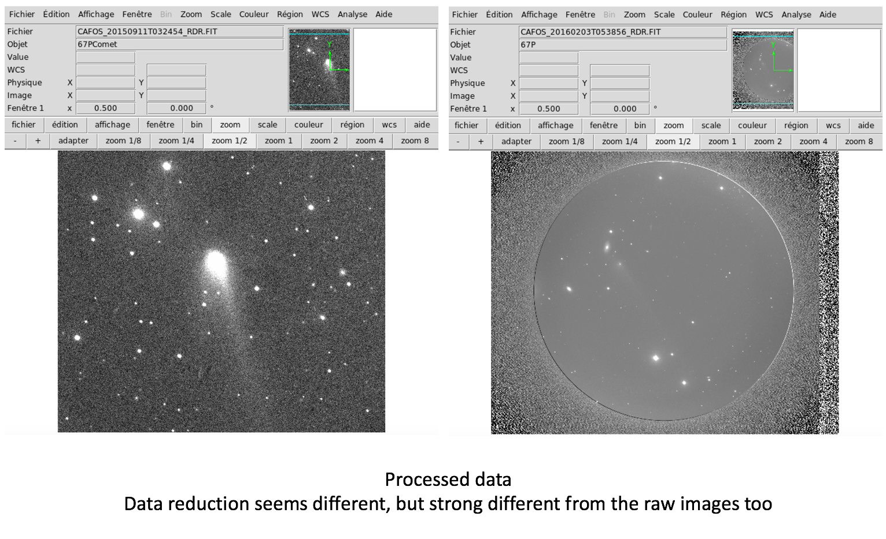
RIDs – Major – IMG
science-175 : CAFOS images - discrepancy in imaging technique?
=> Need to contact the PI

Slide 19
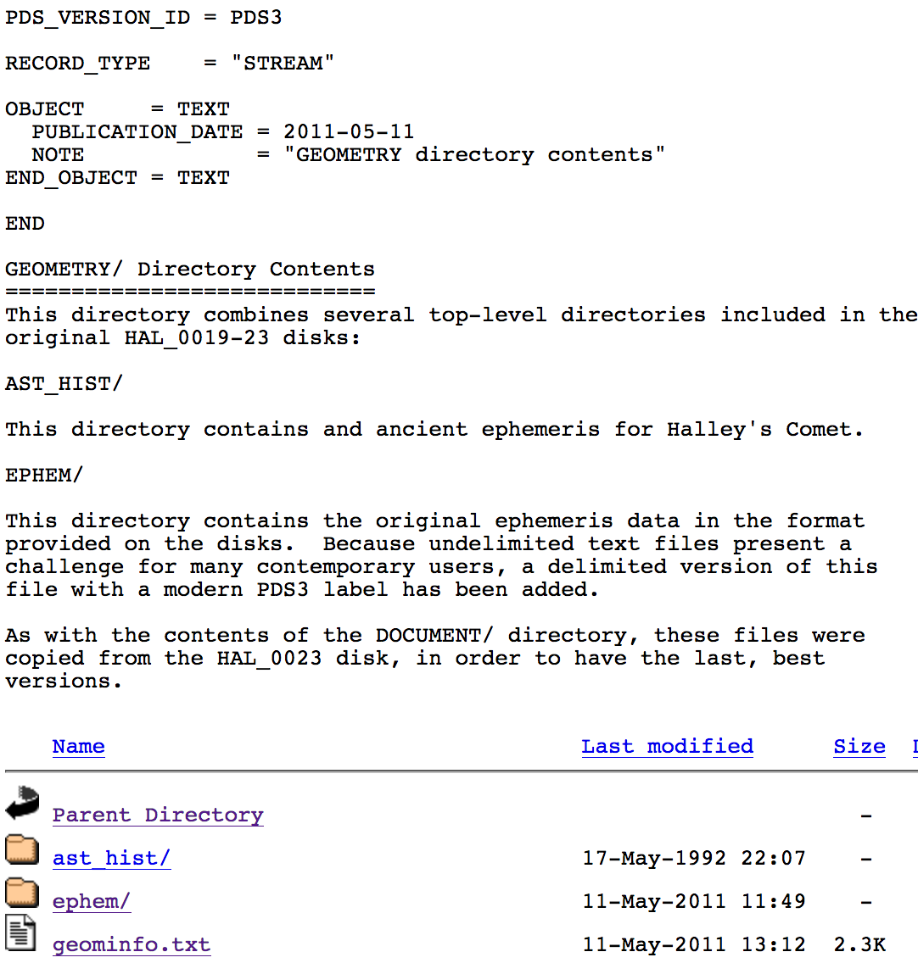
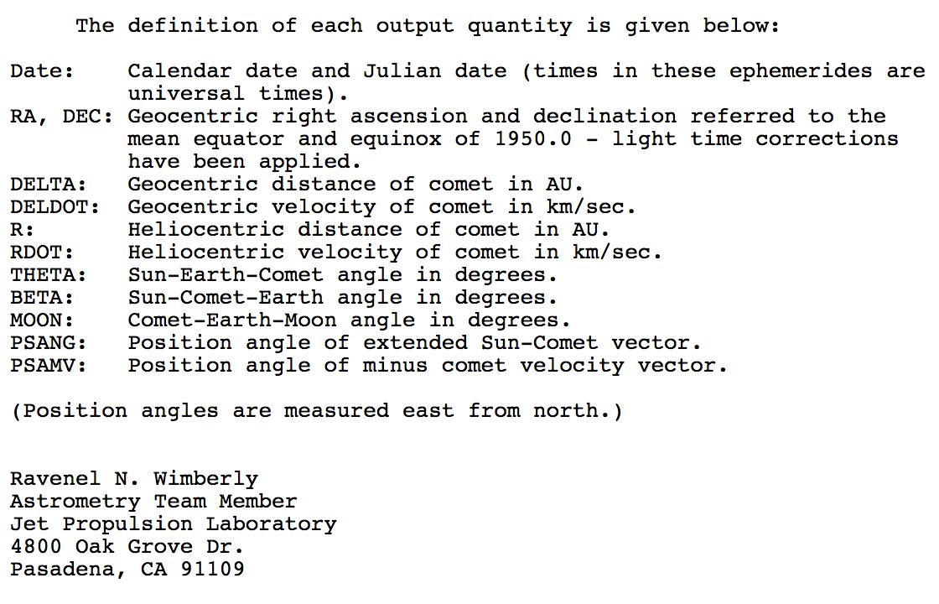
Review of RIDs - Minor
science-152 : would be good to have a 67P ephemeris file (similar to spice kernels provided on other datasets).
It raises a lot of questions on what to provide: to be discussed.
=> link to the spice kernels or geometry file (Halley watch)

Slide 20
Review of RIDs - Minor
science-152 : would be good to have a 67P ephemeris file (similar to spice kernels provided on other datasets).
It raises a lot of questions on what to provide: to be discussed.
=> link to the spice kernels or geometry file (Halley watch)
science-158-161-164: mostly corrections for the EAICD document file.
=> will be corrected
science-156 : missing the description of 67P, SKY and STD in the arborescence.
=> will be corrected
science-165 : Note that : registration for Subaru takes a couple of working days, and up to a week. Need to notify users. http://smoka.nao.ac.jp/register
=> will be specified

Slide 21
Conclusions
Huge dataset with lots of information: very important to archive because some small observatories may not have the capacity to do so and it is important for the future.
Not all data is yet in all formats (2/3 level 2; 1/3 level 3) for a current total of 60,000 files and about 400Gb (expect it to increase with the next round !)
Many RIDs raised:
- Lack of important informations in LBL and FITS headers, need to take decisions for standardization
- inconsistencies in arborescence, names of PI etc.
- some level 3 data can be used for science
- processing pipelines and calibration remain difficult to assess and some issues are raised.

Slide 22
Backup
￼
￼

Slide 23
Context

Slide 24
MUSE observation
Data is 24 image frames of
48 mini-slice spectra.

Slide 25
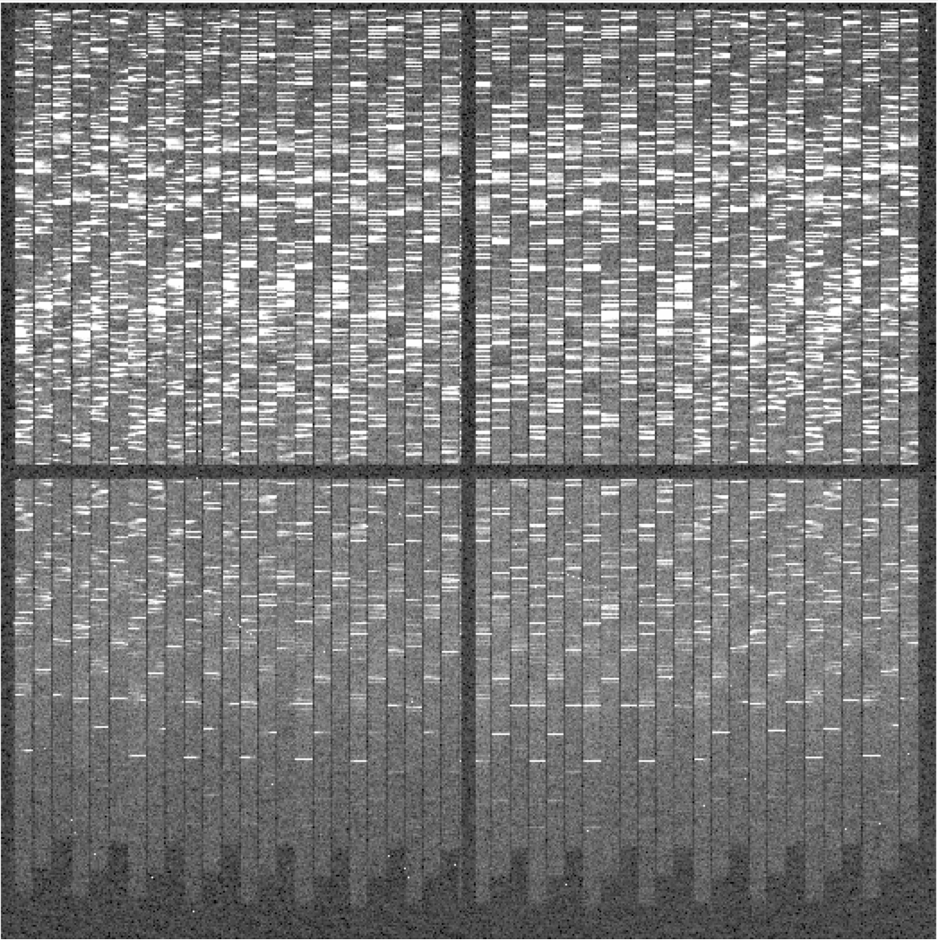
MUSE observation
24 x
Data is 24 image frames of
48 mini-slice spectra.

Slide 26
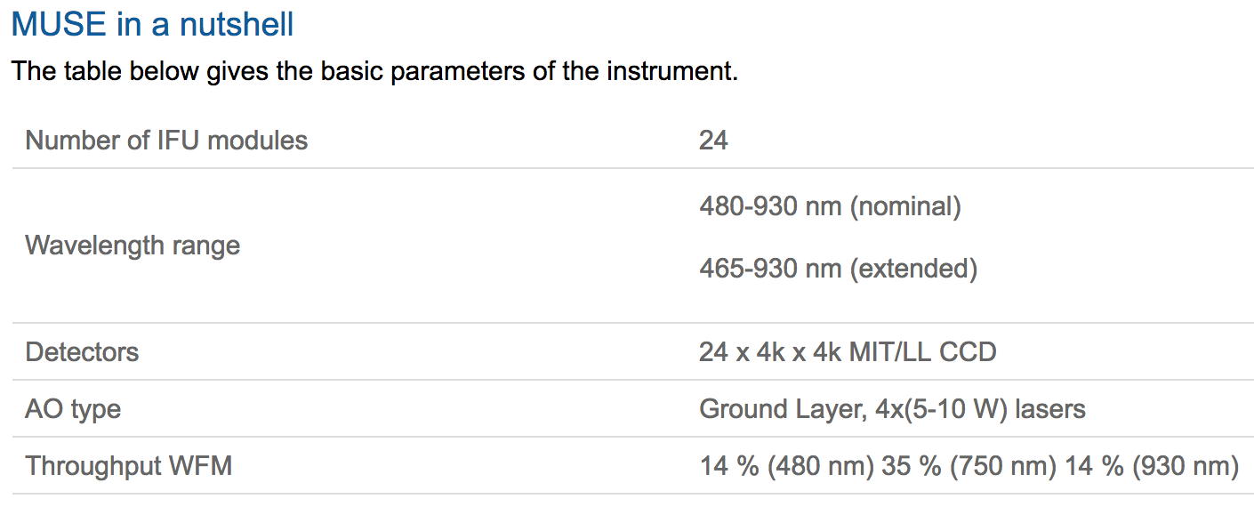
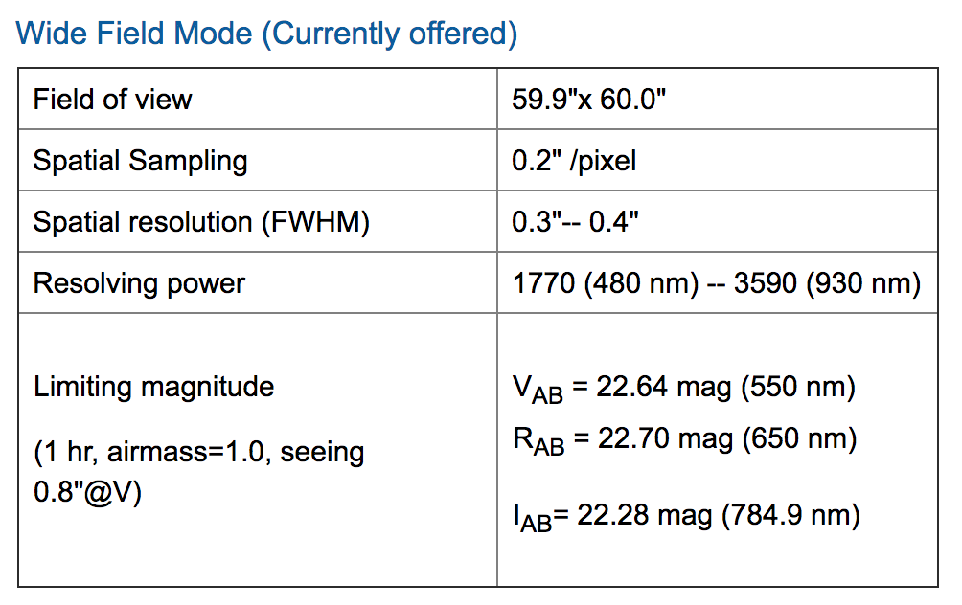
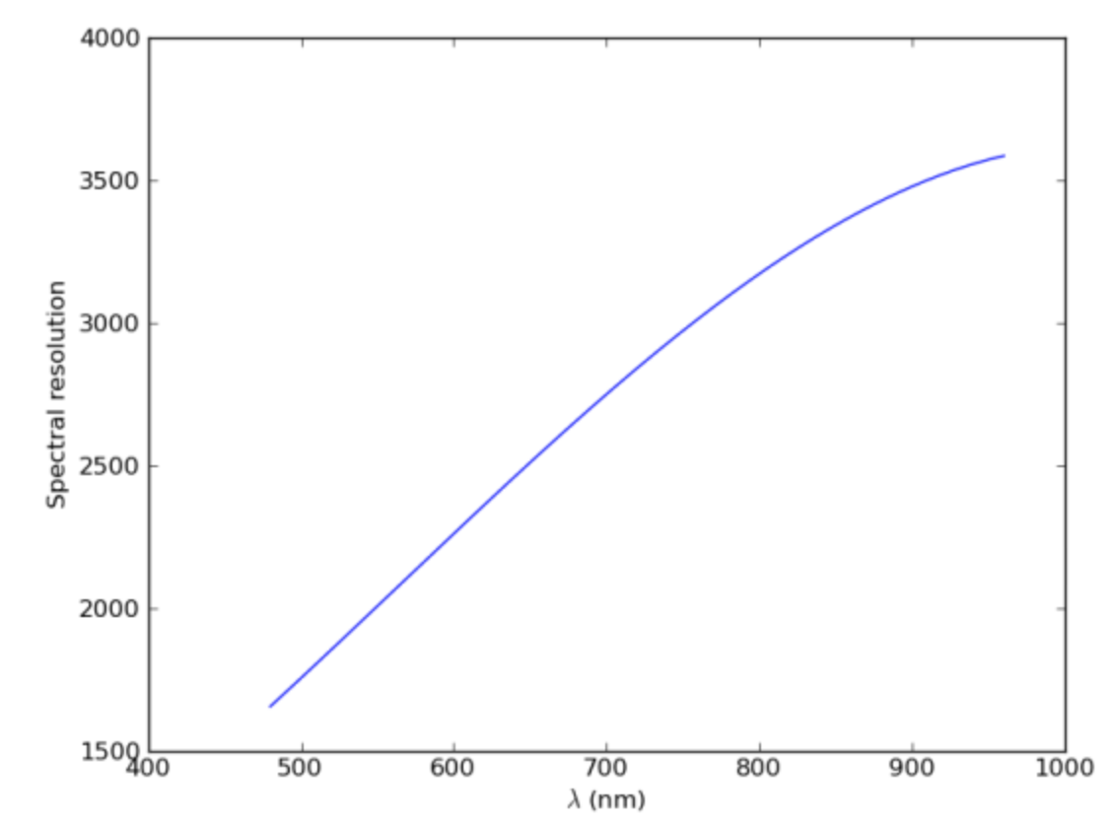
MUSE observation

Slide 27
SINFONI observation
Data is 1 image frame of 32 slices spectra.

Slide 28
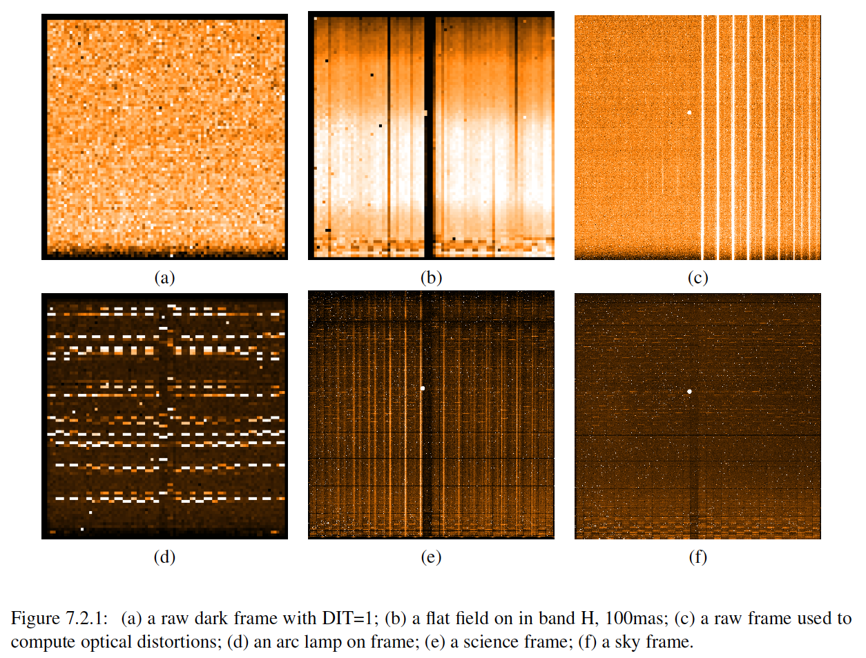
calibration
Example SINFONI calibration data.
Due to size, and redundancy:
calibration data is not part of the release.

