Slide 1
GIADA Data Review
Amara Graps
graps@psi.edu
Planetary Science Institute (USA),
and Baltics in Space (Latvia)

Slide 2
GIADA DATA OVERVIEW
Dust Detector
Three different detection subsystems:
(1) Grain Detection System (GDS) to optically detect the transit of a single grain entering GIADA without affecting its dynamic properties;
(2) Impact Sensor (IS) to evaluate the momentum released by each grain upon impact and
(3) Micro-balances System (MBS) to measure the cumulative dust deposition from five different directions relative to the instrument.
Bussoletti etal, 1999

Slide 3
ZEROTH LOOK
The data under review is a new dataset of level 5 (Derived Data) which include dust particles maps and new documents. It is the first time that these type of GIADA data set is reviewed.
My review: The five datasets are –very useful- for dust comet science. I didn’t use the data for a scientific problem, though. This review is about verifying and checking the files for a valid PDS3 archive.

Slide 4
ZEROTH LOOK
The data under review is a new dataset of level 5 (Derived Data) which include dust particles maps and new documents. It is the first time that these type of GIADA data set is reviewed.
My review: The five datasets are –very useful- for dust comet science. I didn’t try to use the data for a scientific problem, though. This review is about verifying and checking the files for a valid PDS3 archive.

Slide 5
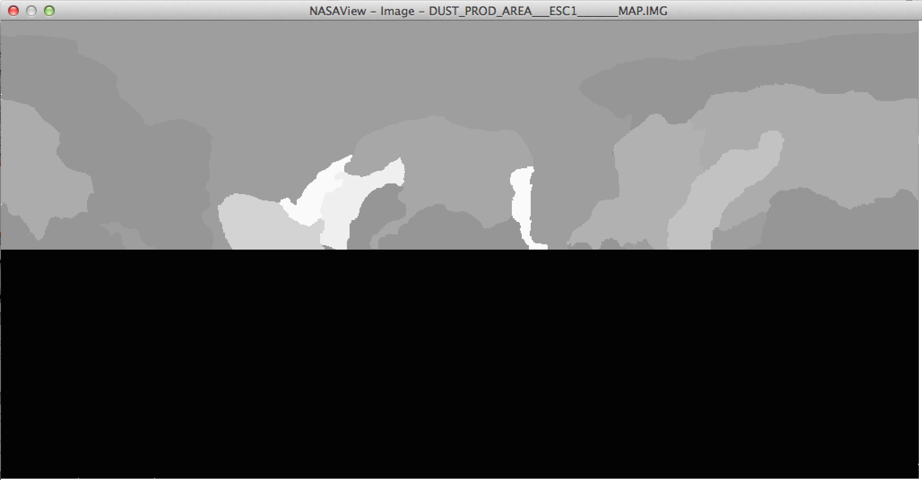
FIRST LOOK

Slide 6
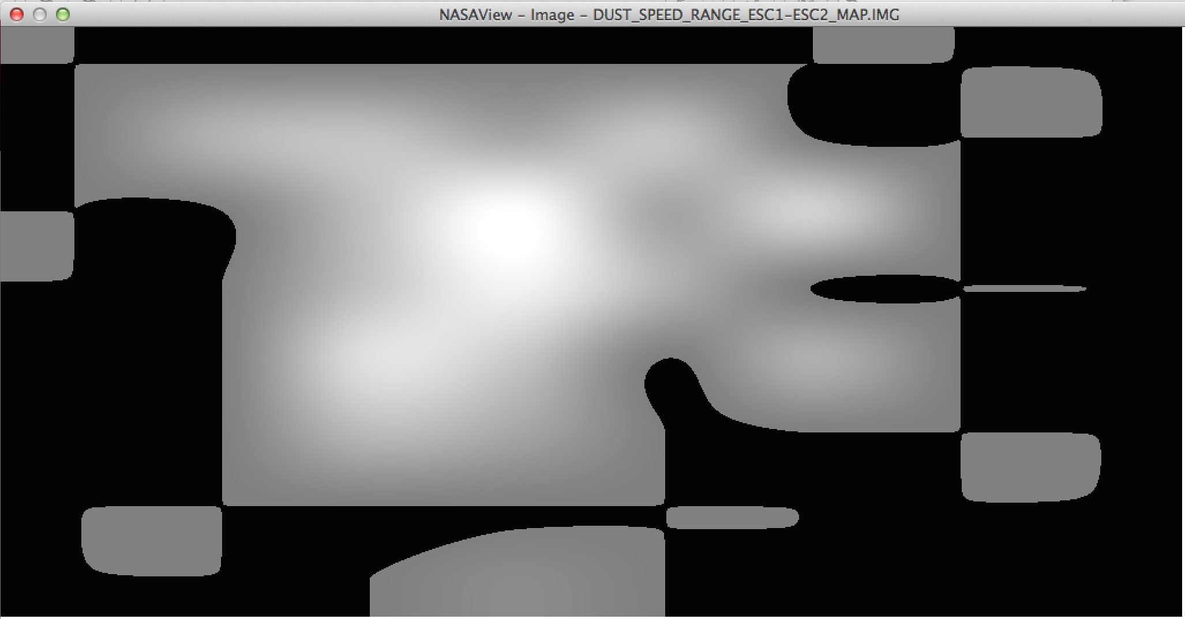
FIRST LOOK

Slide 7
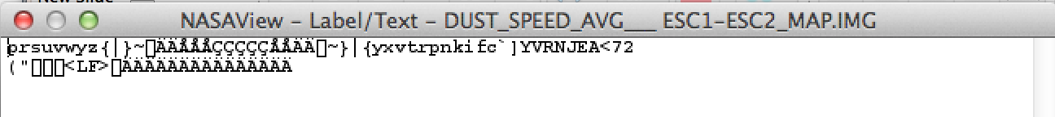
FIRST LOOK
NASAView did not think that the Label File:
DUST_SPEED_AVG____ESC1-ESC2_MAP.LBL
Existed and therefore could not display.
It stated that it couldn’t find and would open as text.
The Label file exists however.

Slide 8
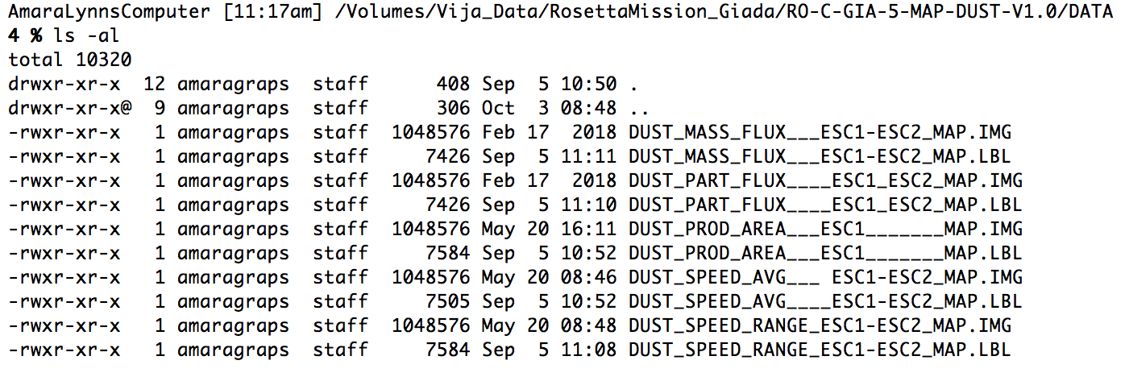
FIRST LOOK
Space
RO-XX-RID-GIADA-126-AG MINOR RID
3 Underscores
Label and Object filenames don’t match

Slide 9
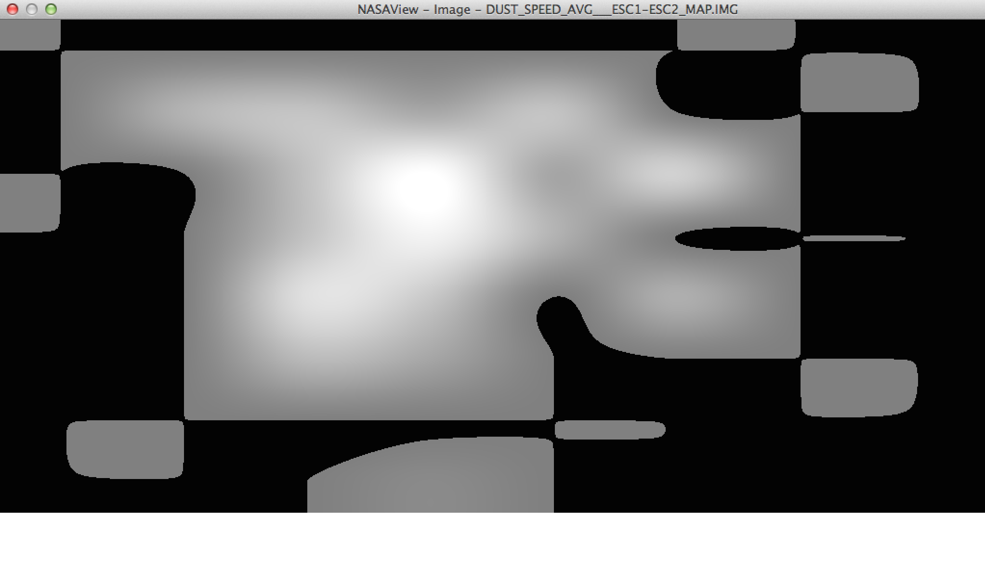
FIRST LOOK

Slide 10
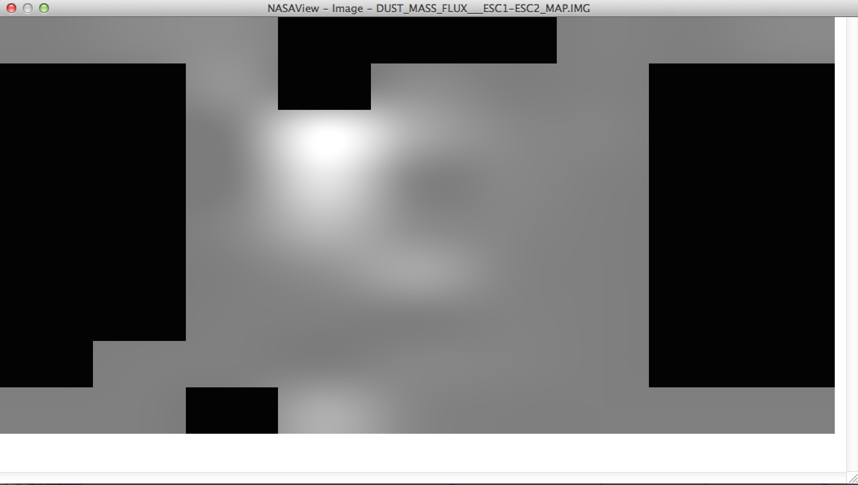
FIRST LOOK

Slide 11
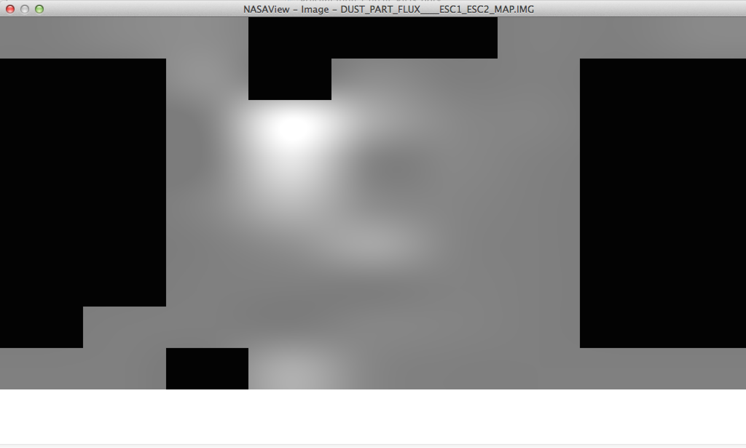
FIRST LOOK

Slide 12
SECOND LOOK
20 Editorial RIDS related to validating the datasets.
pvvlng, to give full error lists and NASAView to read and display showed different errors.
NASAView – PDS3? And pvvlng – PDS4

Slide 13
SECOND LOOK
5 Minor RIDS related to missing keywords, missing file descriptions in dataset description file, directory content list inaccurate in DOCINFO.TXT and one instance of object and label filename mismatch.

Slide 14
SECOND LOOK
2 Major RIDS related missing derivation of the
five new maps.
"For more information on how this map was produced and how it can be best interpreted, please refer to the original publication available in the DOCUMENT directory of this data set." Which is what dataset?
it should point to the specific publication. There is a (highlighted in yellow.. is that acceptable by PDS?)
Section 2.3.6 of
/DOCUMENT/RO_GIA_IAPSUPA_IF_013_DRAFT.PDF that lists the five level 5 products, but no details.
The closest details are in the .LBL files associated with the maps. The user learns that "The GIADA Flight Experiment Data Records (EDR) are the source for this data product.”

