Slide 1


MIDAS PDS Review
Alison Murray, Ph.D.
Desert Research Institute, Reno NV
and
Roger Proksch
Asylum Research, Santa Barbara, CA

Slide 2
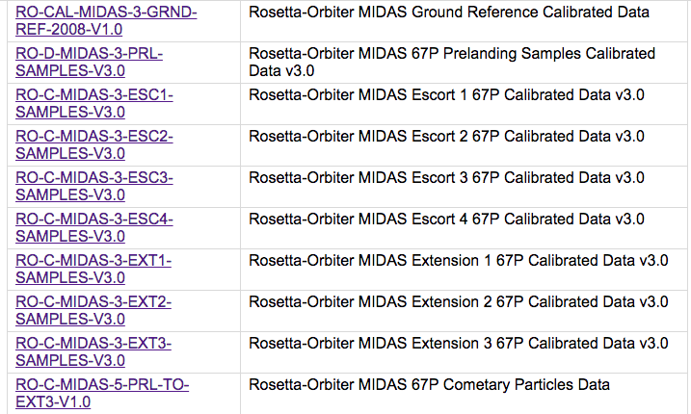
Directory structure
(3.68 GB; ~47900 files)
new
new

Slide 3
Directory structure – repeated contents for all directories
Aareadme.txt
Browse dir (jpg and label files (mask, z, and scan area) for all .img files) ** NEW
Calib dir: calinfo.txt, midcalib.lbl, midcalib.tab
Document dir:
code in .pro format IDL source files
MIDAS PSA Interface Control Document – EAICD
  Describes data products and derived data products, calibration, file naming conventions…
MIDAS Analysts Notebook
MIDAS Enhanced Calibration Report
MIDAS co-ordinate systems document
MIDAS Experimenter to PSA Interface Control Document
ASCII table providing the list of MIDAS dust sampling images taken during the comet escort phase
MIDAS Reconstructed Images Report
MIDAS Tip Image Catalogue
Riedler et al. 2008 paper
MIDAS Instrument User Manual
Index dir (not checked)
Label dir
Data dir: [new: recalibrated img files, mk. Files, and other elements]
cantilever utilization history (cah) [tbl]
event data (evn) [tbl]
frequency scan data (fsc) [dat]
housekeeping data for standard (ESC) mission (HK1) [dat]
Housekeeping data for extended mission (HK2) [dat]
calibrated image scan data (img) [NASAView, Gwiddion]
Line scan data (lin) [dat]
Feature vector data (regions of interest (roi) [dat]
Single point approach (Control data; spa) [dat] *not in esc4
Single point sampling data (high resolution data; sps) [dat]
target utilization history (tgh) [tbl]
Catalog dir:
file for the dataset provided by MIDAS
file describing MIDAs instrument.
file for the ROSETTA spacecraft.
file for the ROSETTA mission.
file for the references used on the data set and its products.
file describing the provided IDL software for browsing the dataset.
file describing the targets explored by the ROSETTA mission.
Did not verify *.dat files
Notes:
This is “information” only; not sure whether this would help in introductory remarks to let the panel know what we were provided to review; could be better organized.

Slide 4
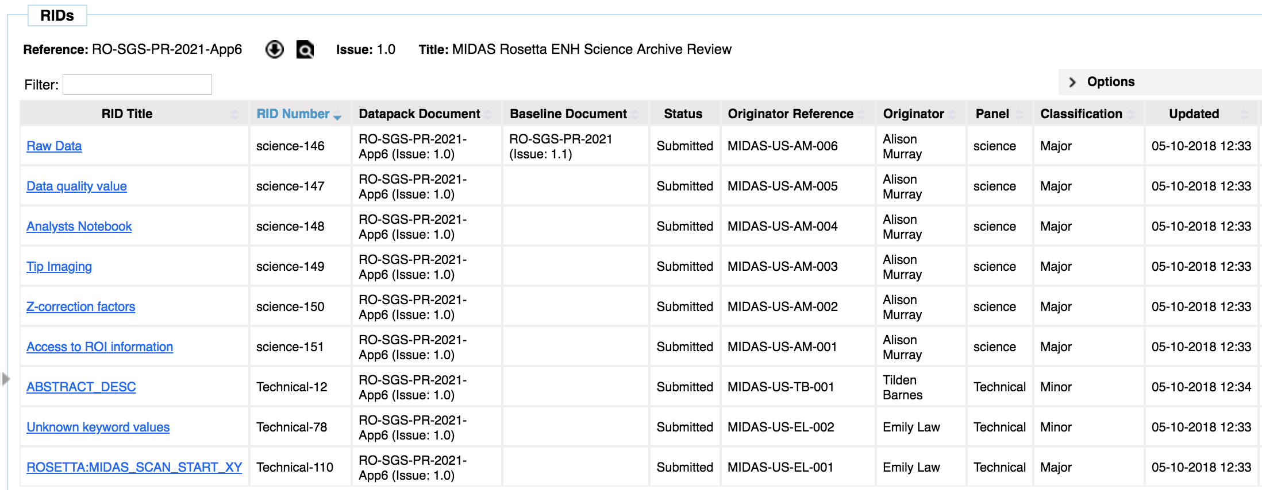
RIDS Submitted to the Eclipse system
https://sre-polaris.esa.int/eclipse/i-layout!view.action – screenshot 7 Oct 18

Slide 5
RID SCIENCE 146: Raw Data
It is not clear to the user whether the raw data is available; it appears at this level of review that only calibrated data is available.
Responsible:Harald Jeszensky
Position: Rejected - All images in the MIDAS data sets (located in the */DATA/IMG directory) are provided in raw format. The images are calibrated by means of the HORIZONTAL_PIXEL_SCALE, VERTICAL_PIXEL_SCALE and SCALING_FACTOR parameters in the respective label files.
Calibrated and/or derived images are provided in the */BROWSE directory. The file names in this directory correspond to the respective raw image file names (IMG_*.IMG --> PRV_*.JPG).
* Reviewer response: OK. This information may be able to be more effectively communicated, especially access to images and alternative platforms for viewing data and associated calibration factors. It’s not immediately clear that the img file is raw and that only with correction factors in lbl file that it is calibrated. Future users may want to apply alternative corrections, e.g. take tip imaging into consideration.

Slide 6
RID SCIENCE 149: Tip Imaging
How was tip imaging was taken into consideration or aberrations were corrected over the mission. Tip images were taken only sporadically, but still how was poor quality tip information utilized?
Improve documentation in the EAICD and enhanced calibration reports to make the procedure for data processing and what is available on the archive clear, in addition to explaining where appropriate (perhaps analysts notebook?) what steps were taken, if any, to mitigate poor/used tips.
Example – next slide
Response follows

Slide 7
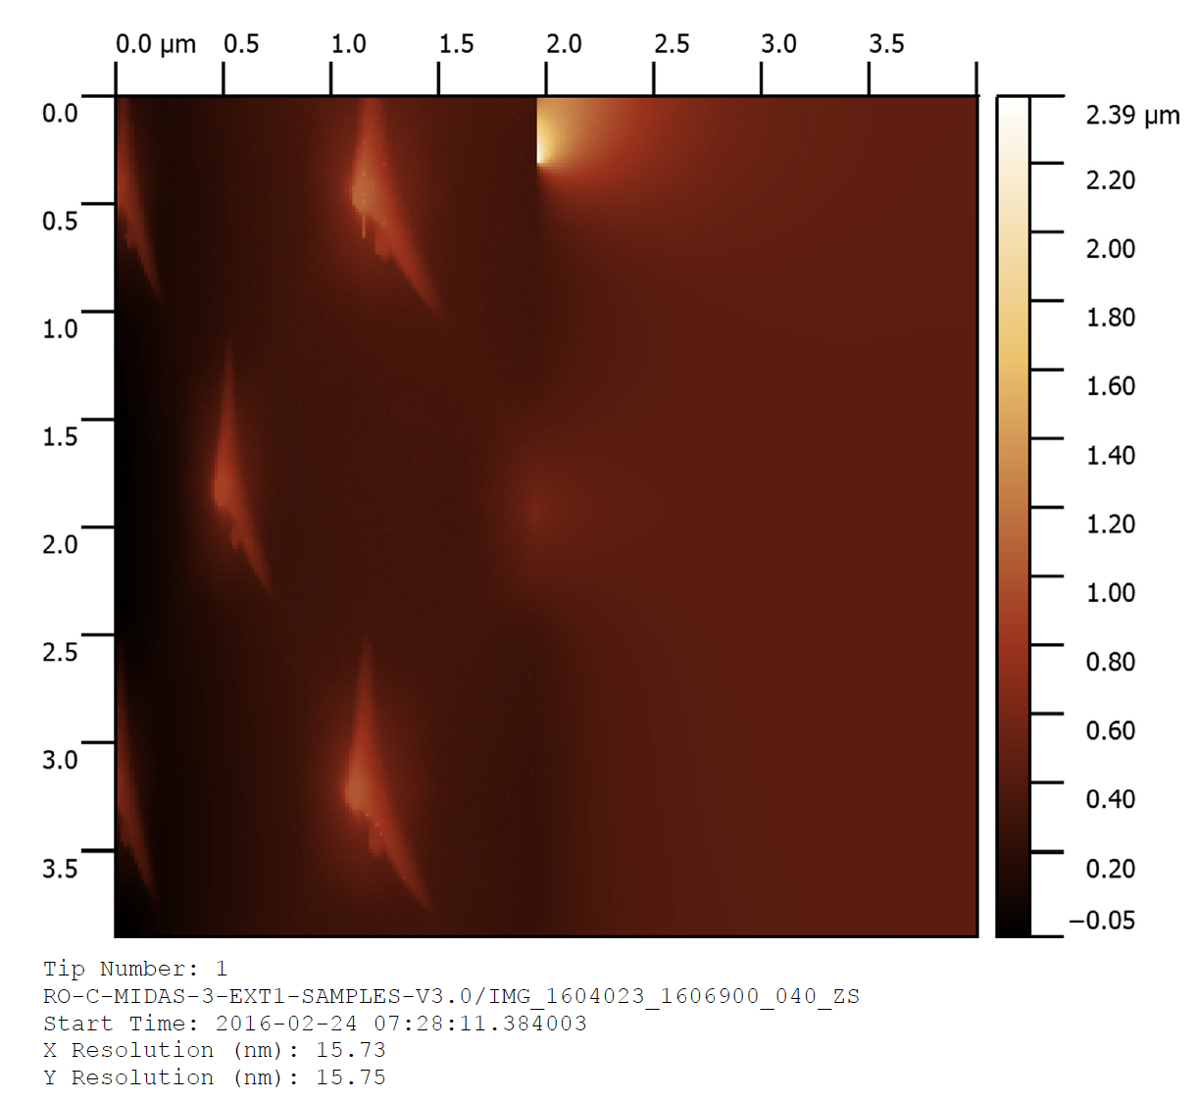
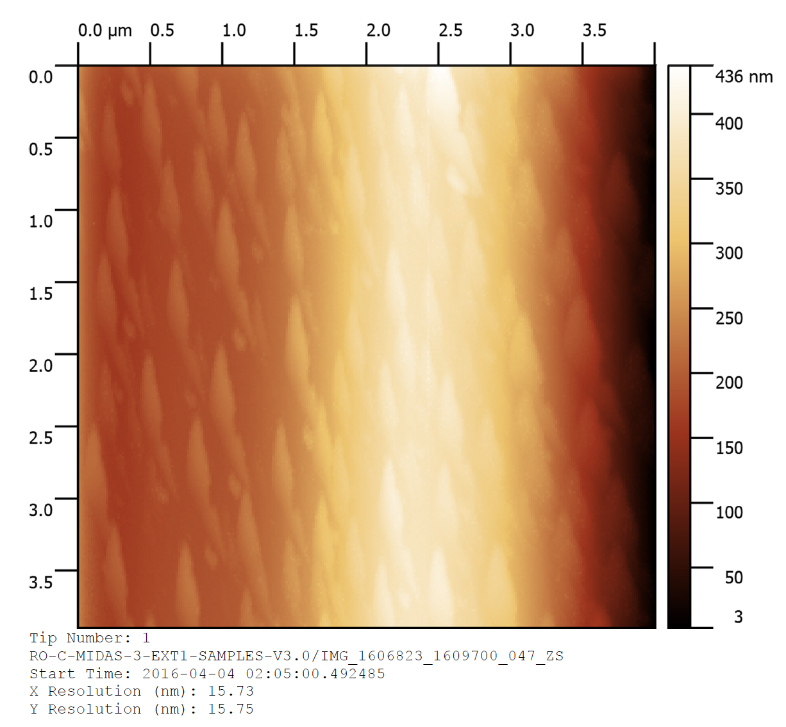
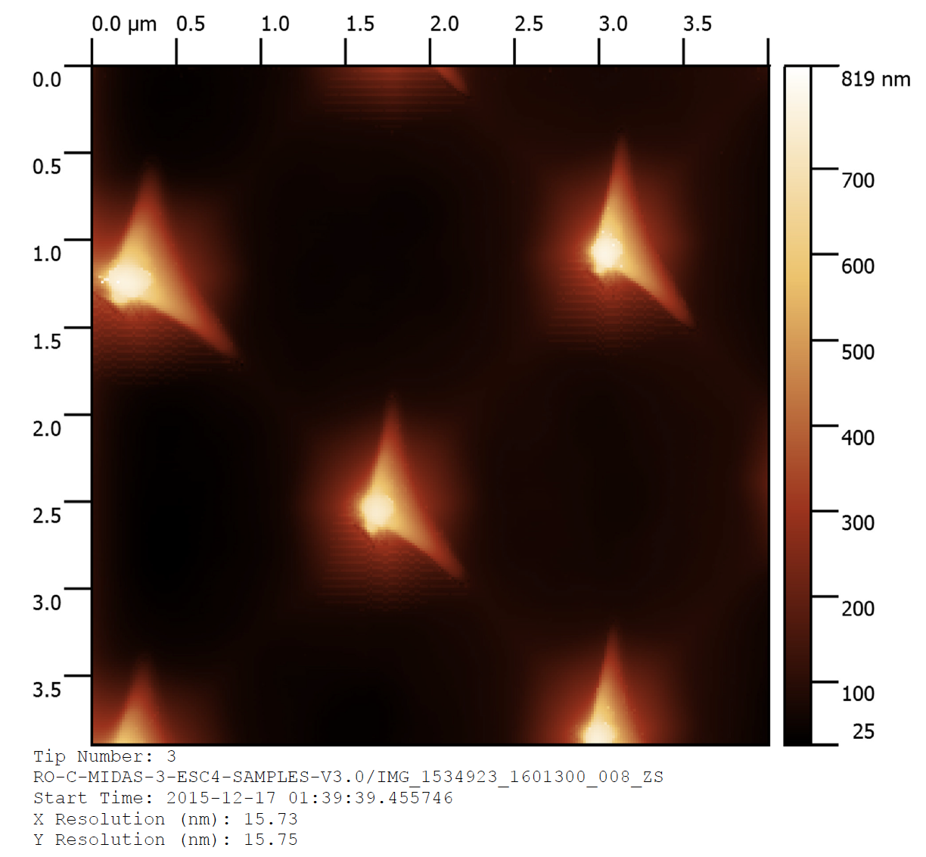
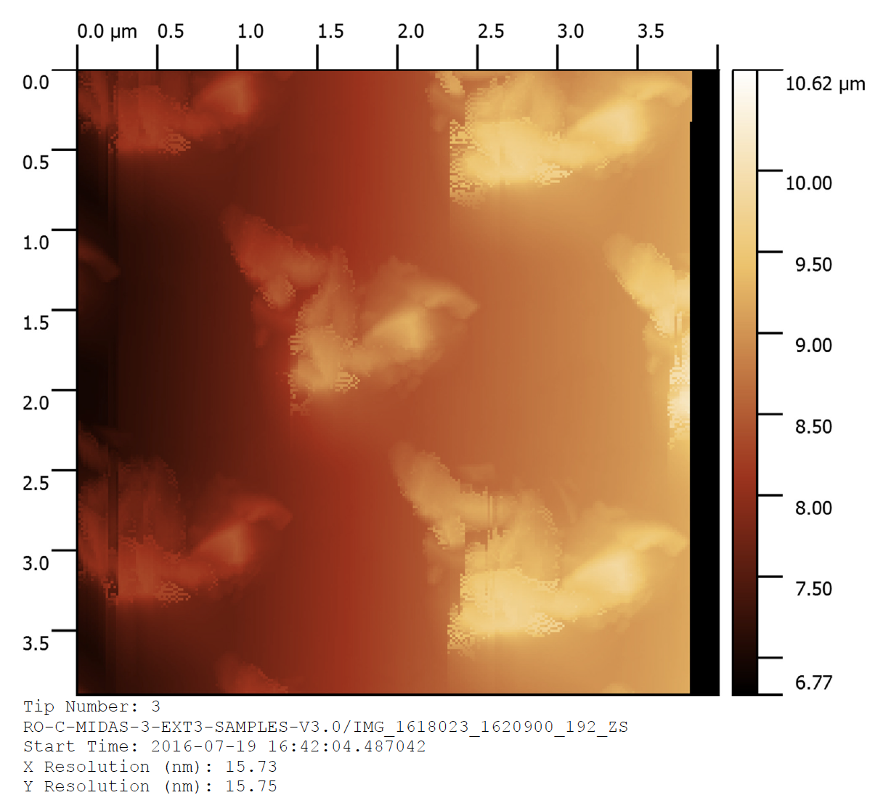
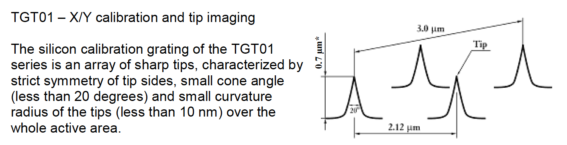
RID 4. Tip imaging
Tip 1
The tip image catalog doesn’t show the TGT01 (so user doesn’t quite know what a “perfect tip” should look like).
Tip image catalog could include a synthesis table of time periods when tip was considered to be in optimal condition for imaging/ and suspect periods with respect to periods that the tip was in use.
The calibration report does not go into detail about the tip imaging (or even mention it)
Tip 3
EACID.pdf page 17

Slide 8
RID SCIENCE 149: Tip Imaging
Responsible:Harald Jeszensky
Position:Accepted - The documentation (MID_TIP_IMAGES.PDF, EAICD.DOC and MID_CALIBRATION.PDF) will be supplemented as far as possible.
Additional notes concerning the RID:
- Tip imaging was performed when the imaging quality of a given tip became suspect, or after instrument anomalies that may have resulted in unwanted tip/sample interactions.
- Due to the limited time available, tip images could not be obtained more regularly. The decision on which tip to use was based partly on these tip images, but also on the requirement to revisit particular target locations, which was found to be challenging when switching tips.
Therefore a poor tip was sometimes used in order to perform more accurate positioning.
- In addition, the individual properties of some tips (e.g. high vs. low Q factor, magnetic coated or not) led to some tips being preferred for certain scan types.
Reviewer response: Improving the documentation will help.
See suggested additional points on previous slide
For clarification – it sounds like it was not possible to “reach” all the cantilevers to the targets; so that certain tips were better “fit” for given targets? If this is the case, include this in the documentation.

Slide 9
Not-submitted RID: Flight Spare Summary
(recognized post-RID submission deadline)
Flight Spare summary (mid_fs_summary.pdf)
  File is not complete; introduction missing; conclusion is super brief [how was this information applied to the mission/interpretations etc.]
  For first table (or in the table of contents)– that lists what is on each target [is has no number, e.g. Table 1] include the page number(s) in which the target is imaged.
  File should include more interpretation – why are initial calibration targets contaminated?
  Incomplete descriptions of targets and different light microscopy/SEM/AFM imaging and what the purpose of different experiments were.
  Figures should be numbered, and legends complete
  File has typos – suggest thorough proofreading
  Note: The images of tips before and after imaging are useful (pages 30-45)

Slide 10
MIDAS Particle Catalogue – not provided with original data for review; provided 1 Oct 2018
Includes: Particle Catalogue Document (pdf)
MID_Particle_Table.tab
MID_Particle_Table.lbl

Slide 11
Unsubmitted RID 1 Particle Catalog documentation and organization
Dust Particle Catalogue document and the catalogue (tbl) files should be better organized, information made more accessible, and text be more complete. For example:
  Different flags could be numbered successively for clarity– flag 1, flag 2 etc.
  Suggest a prioritization of the flags – or descriptors such that the user can readily get to the high quality particle data.
  Add a table to the Dust Particle Catalouge Document – it’s difficult to read the text as it is (which provides all the flag numbers for various issues) and get a picture that is more easily conveyed in the table (see next slide)
  It’s not clear whether the numbers provided in the text are out of 1480 non-unique particles; or out of the 1091 unique particles total.
  Importing the tbl file into excel and incorporating headers is complicated; suggest simple comma-delimited file (not “ “); adding headers was a pain. Given the value of this document, it would be easy to include a .csv file that includes the column headers and descriptions. [realize that may not be PDS3 requirements, but it would improve the data accessibility and usability]

Slide 12
Category | Particles | Images
Total particle identifications | 1480 | 230
Prescan of same region a particle was identified | 146 | 33
Target address cross-correlated with prescan | 11 | 3
Target address not cross-correlated with prescan | 89 | 19
Artifact Inhibiting confirmation of prescanned particle | 11 | 2
Particle introduced by tip since prescan (no space exposure) | 35 | 9
Particle flag - high confidence (scored 1) though not prescanned | 1200
Particle flag - lower confidence (scored 2) | 32 | 19
Particle flag – low confidence (scored 3) | 222 | 58
Particle flag – tip contamination (scored 4) | 26 | 5
Unique particles | 1091
Linked Flag – particle smashed during scanning – remnants apparent | 277 | 28
Flag – high quality, whole particle (score 1) | 867 | 168
Flag – partial particle scanned (score 2) | 278 | 123
Flag – imaging issue (score 3) | 335 | 101
Flag 2 – particle mask with multiple fragments – origin unknown | 79 | 42
Trust Height flag - height estimate compromised (score 1) | 1038
1480
1480

Slide 13
Unsubmitted RID2 Particle Catalogue Mask and Scan Position Linking
The text of the Dust Particle Catalogue Document mentions (p. 4, line 3) that the particle mask forms a part of the catalogue.
  The Mask is not further described in the document, and it is not entered into the catalogue tbl file (we would expect a column with the mask filenames in this case).
  This document should also note that the mask is used to number particles – and the mask image that should be referenced to know which particle is which.
Clarify the difference between prescan and linked scan in the documentation. Make it clear that prescans never had samples deposited (but may have had contamination from tip or otherwise).
The linked scan flag 2 text could be refined (or flags added) if the reason for artifact is known – “Probably the same particle but visible differences seen which may be caused by a number of possibilities e.g., the scan resolution has changed, a different tip has been used, the particle has been damaged or moved during scanning, there is an imaging/failed scanning in some regions.”
The targets (labeled *._sp.jpg e.g prv_1429710_1432600_084_sp.jpg) in some cases have particles imaged multiple times at different levels of resolution; it would be more than helpful to have a way to easily get access to all the different resolution images of the given particles (the linked scan approaches this, but this doesn’t seem complete). As a use case, I attempted this (following slides).

Slide 14
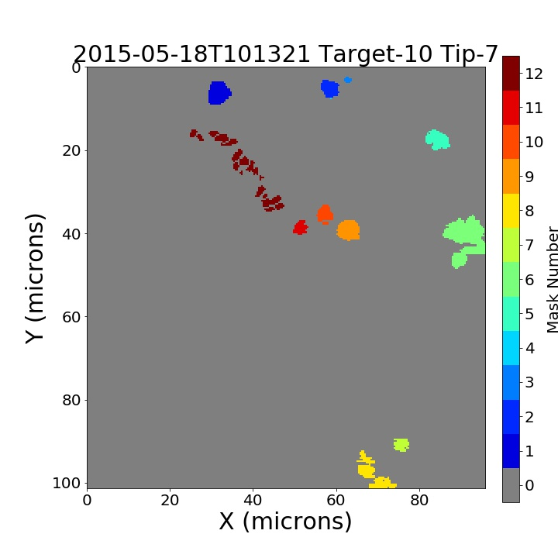
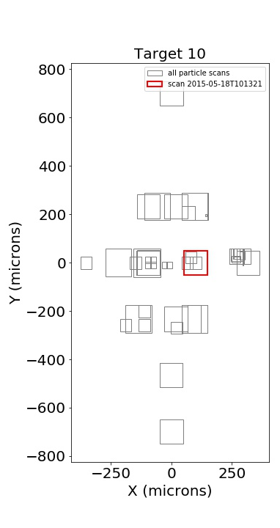
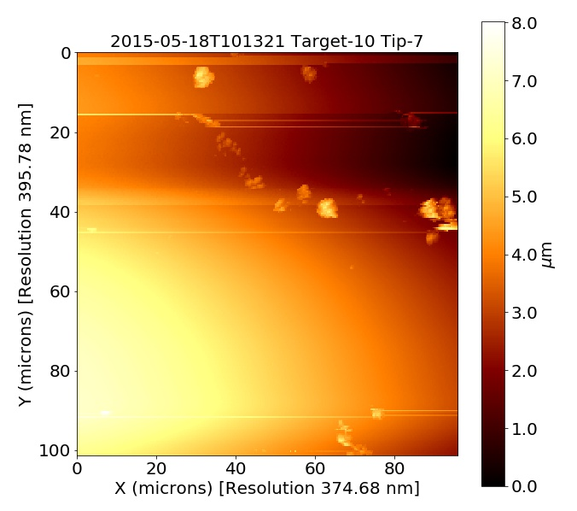
Example Particle Catalogue Mask and Scan Position Linking (slide 1 of 4)
prv_1512523_1515400_031_sp
prv_1512523_1515400_031_mk
prv_1512523_1515400_031_zs
Particle catalog: Particle 12 -
Image flag: Whole particle/imaged;
Image flag 2: 12 – multiple fragments contained in particle mask; there is a previous scan of same area;
Particle flag: probably cometary in origin;
Trust Height Flag: good
This effort attempts to find these linked scans
Particle 12: shows tip artifacts; other particles show tip convolution; and particle fragment(s) being swept along
Looks like whole image should be flattened?
Were any scans flattened in image processing?
How does this scan relate to the linked scan 5 months previous of same area which had much larger particles? How does catalogue count these?

Slide 15

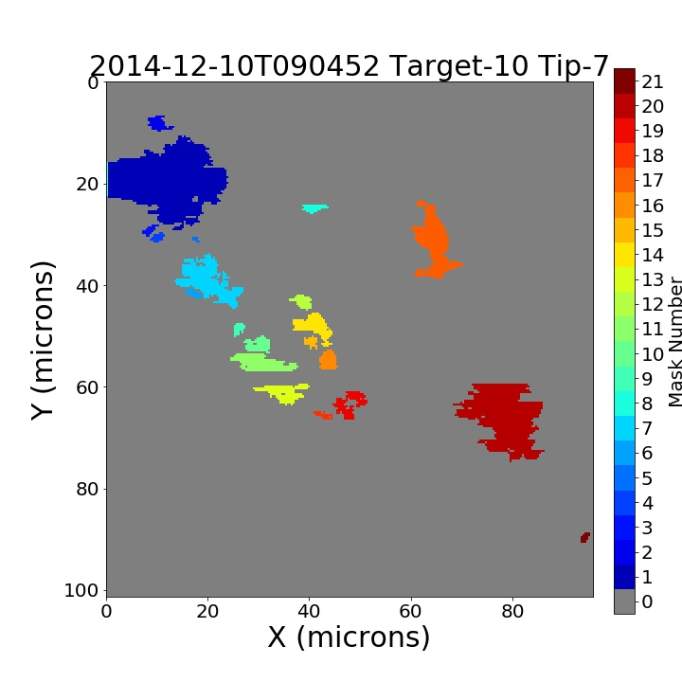
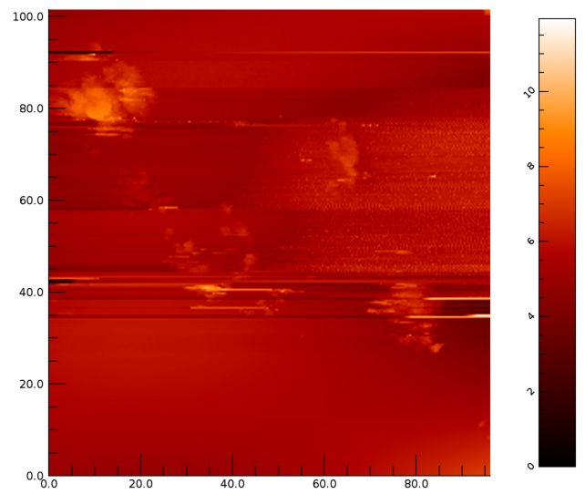
Example Particle Catalogue Mask and Scan Position Linking (slide 3)
2014-12-10
Linked scan - to image on previous slide 1 of 4
RO-C-MIDAS-3-ESC1-SAMPLES V3.0/IMG_1432523_1435400_039_ZS
Linked Scan Flag: 3: Probably the remnants of particles in the linked scan but unable to link to specific particles
2014-12-10T090452_P0_T10
Same part of target scanned as 15-05-18; no way to know that same area was scanned 2X
Image flag: Score 3. Imaging artefacts or issues in the scanning
Image flag 2: Score 2. [uninformative flag text - previous scan of the same area, which is either a contact mode scan (physically touching the particle) or a failed scan which looks like a large particle is being hit.
Particle flag 1: Probably cometary in origin
Trust Height flag 2: do not trust

Slide 16
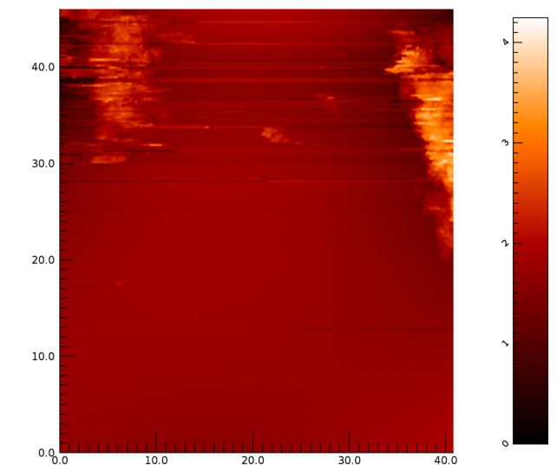
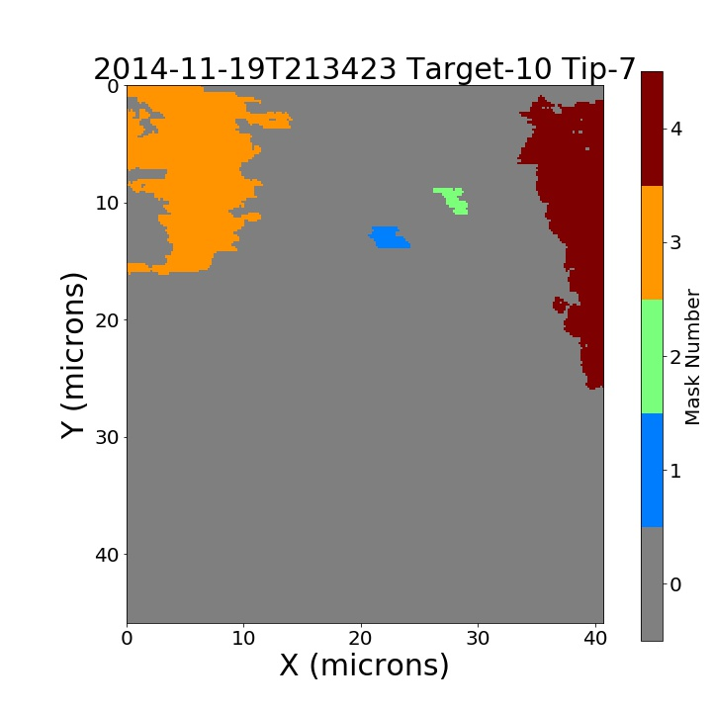
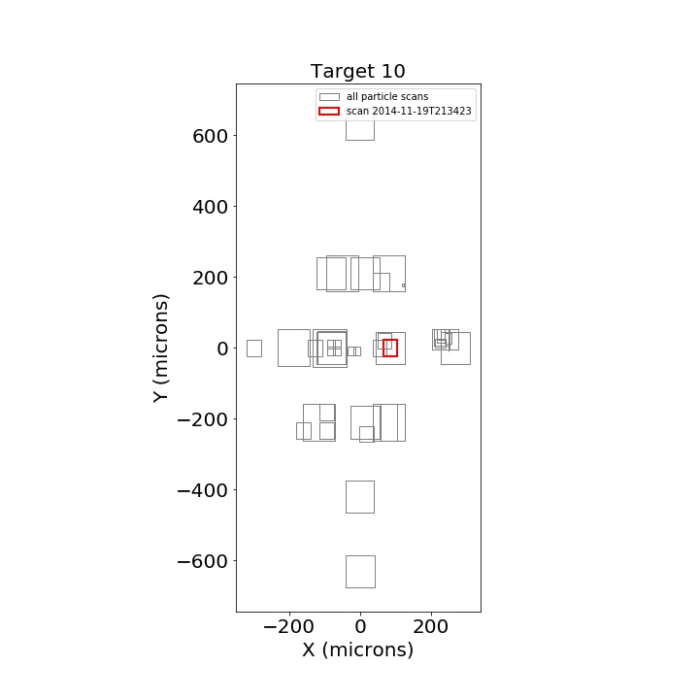
Example Particle Catalogue Mask and Scan Position Linking (slide 4)
Particle catalogue information on this scan (linked to from previous slide 1 of 3)
There is a prescan (RO-D-MIDAS-3-PRL-SAMPLES-V3.0/IMG_1429710_1432600_033_ZS ); Flag 2: The same region has been scanned (by the commanded scan coordinates) but no features available to confirm, and the particle feature is not present. Prescan shows no particles; some small particle contamination.
Linked Particle ID 2014-11-19T213423_P0_T10 (from linked scan slide 3 of 4)
Linked Scan File: RO-D-MIDAS-3-PRL-SAMPLES-V3.0/IMG_1429710_1432600_084_ZS
Linked Scan Flag: 3: Probably the remnants of particles in the linked scan but unable to link to specific particles
Image flag: 3: Imaging artefacts or issues in the scanning.
Particle flag 1: probably cometary in origin
Trust height flag 2: do not trust
Prelanding phase 2014-11-19
Different region from later two scans

Slide 17
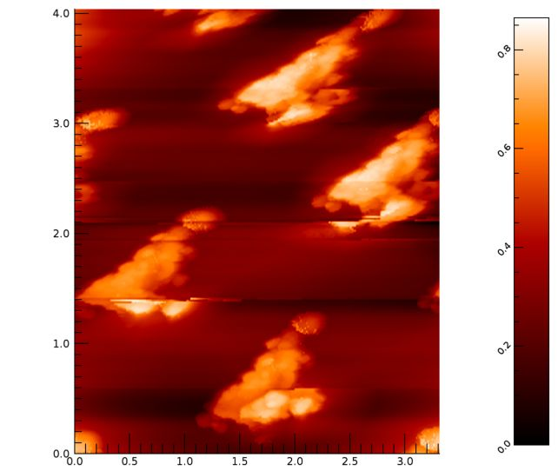
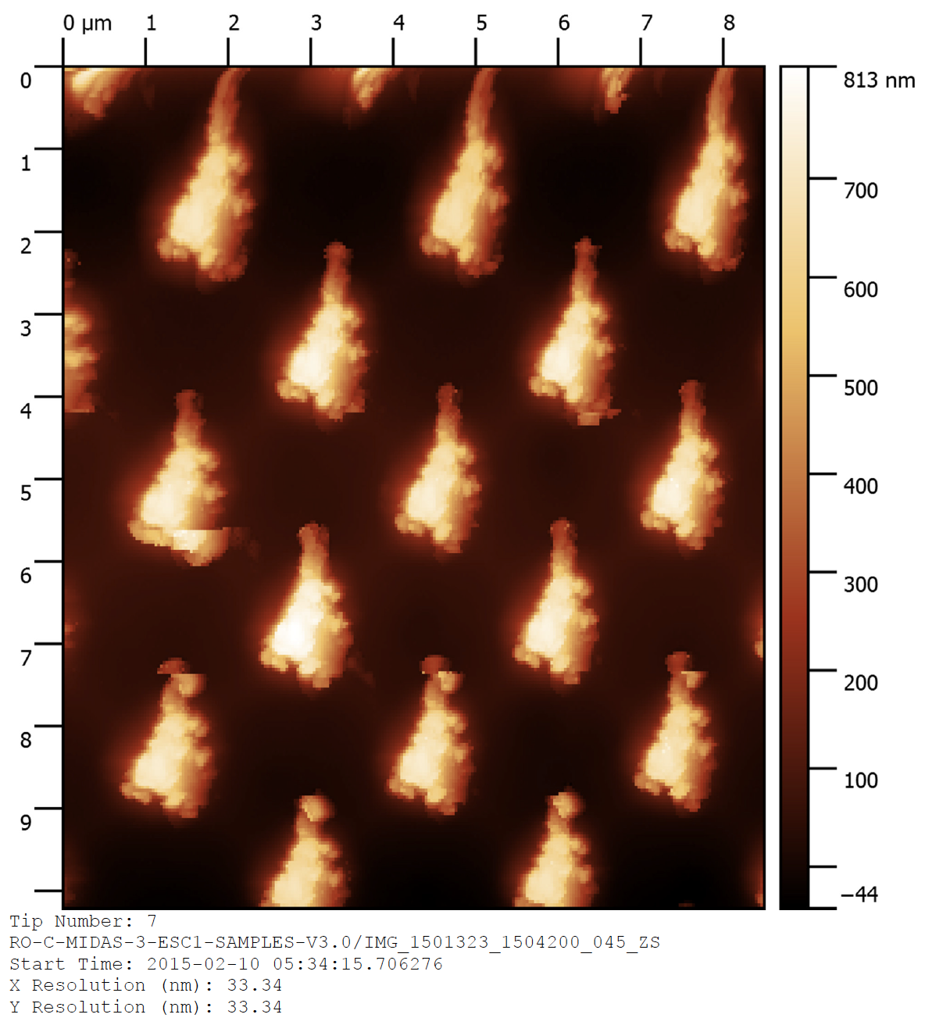
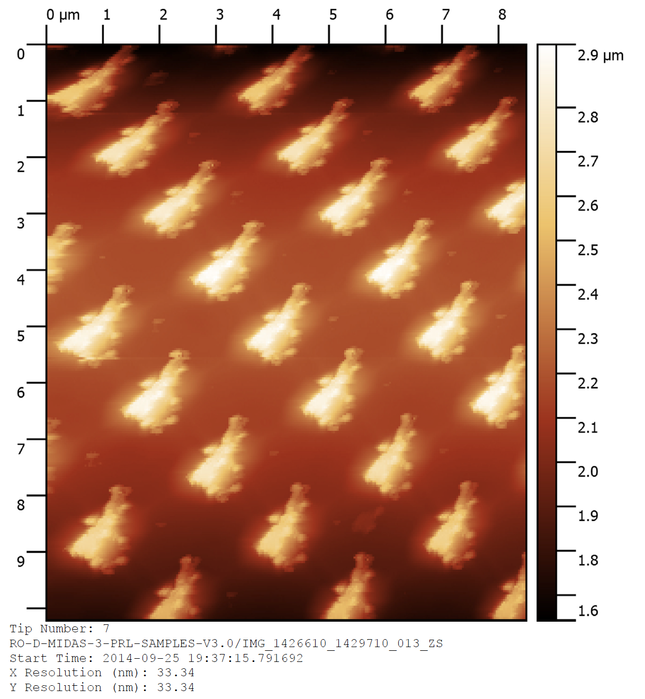
Example Particle Catalogue Mask and Scan Position Linking (slide 2)
Tip 7 history – total of 3 scans over mission life
Linked scans
Scan previous slide
Tip 7 scan history:
2015-04-11T03:41:48.041
Tip 7 scan history:
2015-02-10
Tip 7 scan history:
2014-09-25
suggests tip contamination issues throughout scan history

Slide 18
Unsubmitted RID 3 Particle catalogue Flags
The Particle flag refers to particles which are similar in size to contamination and not differentiated; clarify what contamination looks like and what sizes are contaminants (there are a lot of small particles identified)
Flag category is straightforward; but Flag 2 is confusing as explained
Why isn’t there a tip artifact flag?
-> It would be useful in the Dust Particle Catalogue to show the user what contamination looks like, and describe the features (Is this information is collected anywhere?).
-> It could be useful to make an artifact and contamination library of images (this could be a tbl with flags noting the different artifacts and suspected contaminants and user could go look them up).

Slide 19
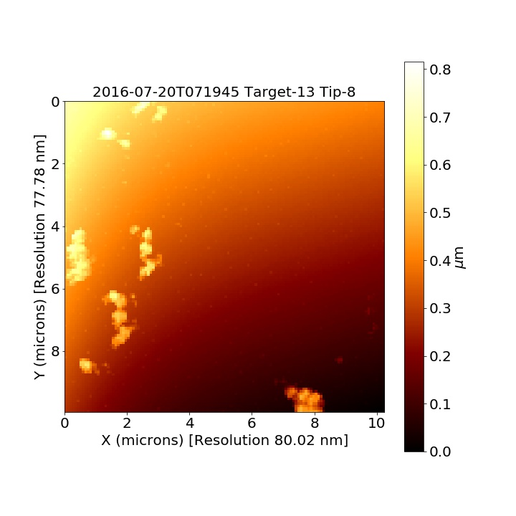

Example Scan Artifact 1 – tracking associated information:
“Cookie-cutter” particles indicative of tip artifacts.
Particle Catalog – did not flag this; questions associated with tip
prv_1618023_1620900_196_zs
Particle Catalog Unique IDs
How do you know what particle is what number?

Slide 20
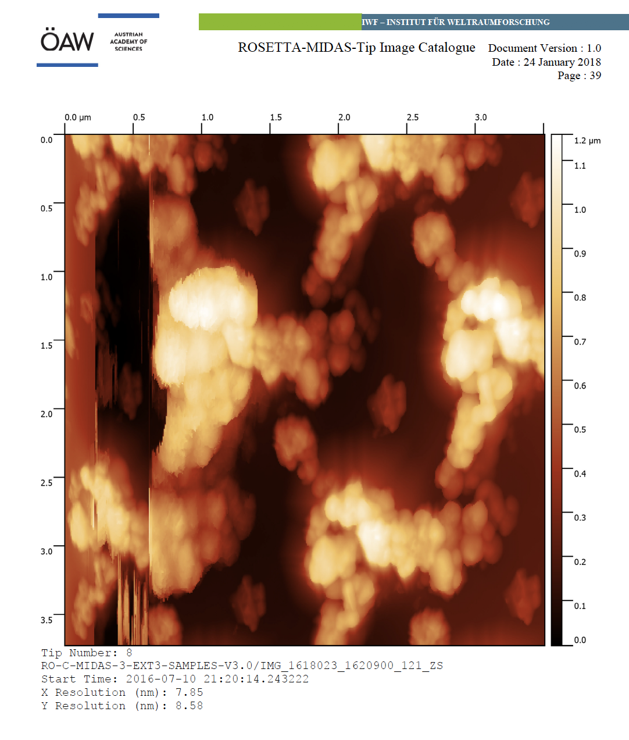
Tip is in bad shape 10 days prior to the imaging of the region on the previous slide.
It is non-trivial to deconvolve the tip.

Slide 21
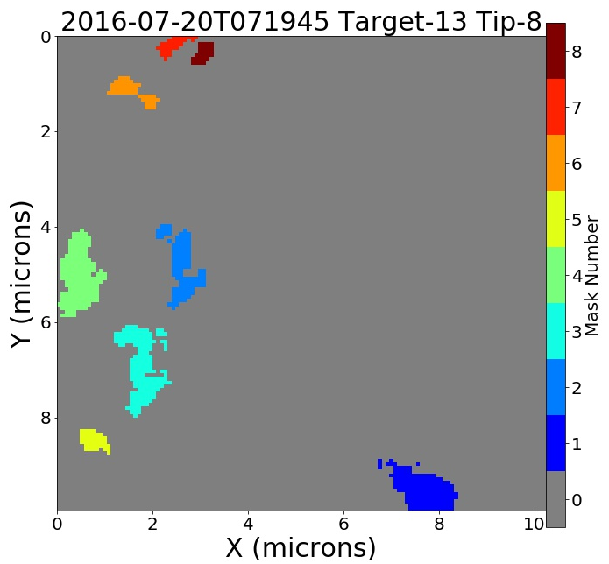
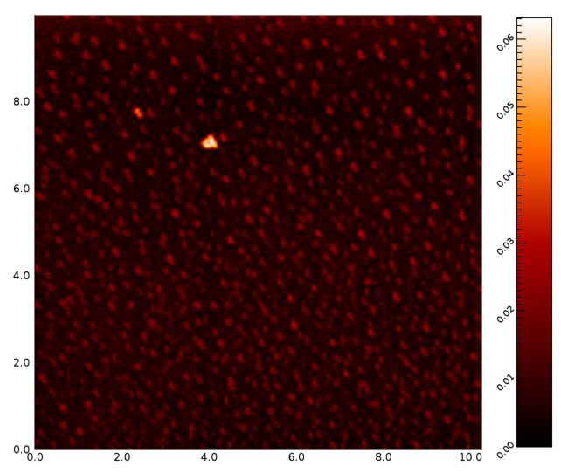
Artifact 1 Tracing the particles in the particle catalogue
Notes from Particle Catalogue:
For all 8 particles Linked particle ID PO – particles could be linked to a scan, but not specific particle; they have been fragmented [2016-07-03T105636_P0_T13]
  Linked scan file name: RO-C-MIDAS-3-EXT3-SAMPLES-V3.0/IMG_1618023_1620900_065_ZS
This is the linked Particle Scan file associated with the particles imaged in the mask to the left it was imaged 17 days before the scan represented by the mask Linked scan flag 3: Probably the remnants of particles in the linked scan but unable to link to specific particles
  Master IDs: 2016-07-20T071945_P2_T13
  2016-07-20T071945_P3_T13
Image flag: 1: whole particle imaged
Image flag2: 12 – both : There are multiple fragments contained with this particle mask. 2: There is a previous scan of the same area which is either a contact mode scan (physically touching the particle) or a failed scan which looks like a large particle is being hit.
Particle Flag: Probably cometary in origin
Trust Height Flag: 1 OK
Don’t understand how this linked scan with particles relates to the later scan; but this scan is pretty weird – looks like tip must be an issue
Notes:
I think that there is a difference between the lbl file for trust height and the pdf file

Slide 22
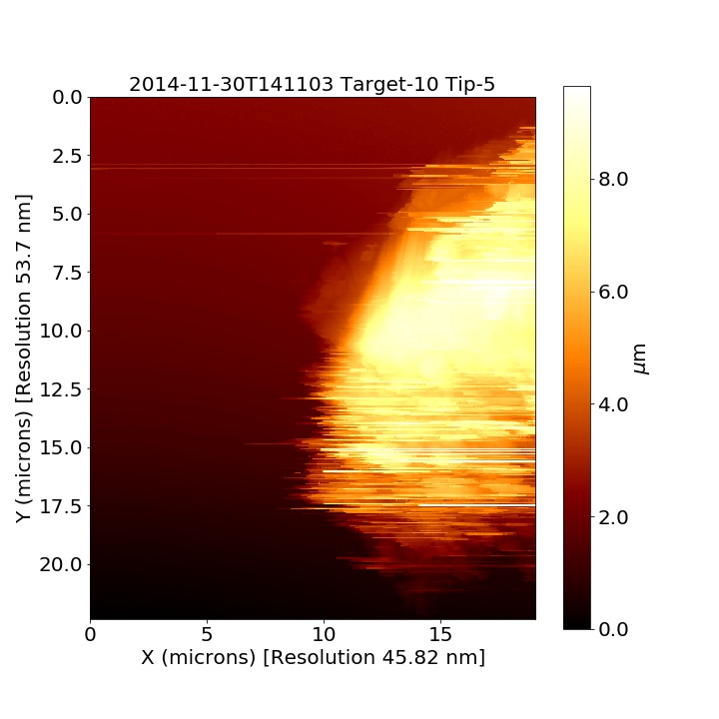


Example Scan Artifact 2 – tracking associated information: Particle that is so large it is imaging the tip shape rather than being measured.
Particle Catalog flagged this; questions associated with linking target areas scanned and tip
prv_1432523_1435400_031_zs
Edges – likely from the tip sidewall, not the “particle”
Unstable image. Perhaps an aggregate of particles rather than a single one? Changing tip/tip damage? A rescan might have clarified, could not find the next image in the sequence.

Slide 23
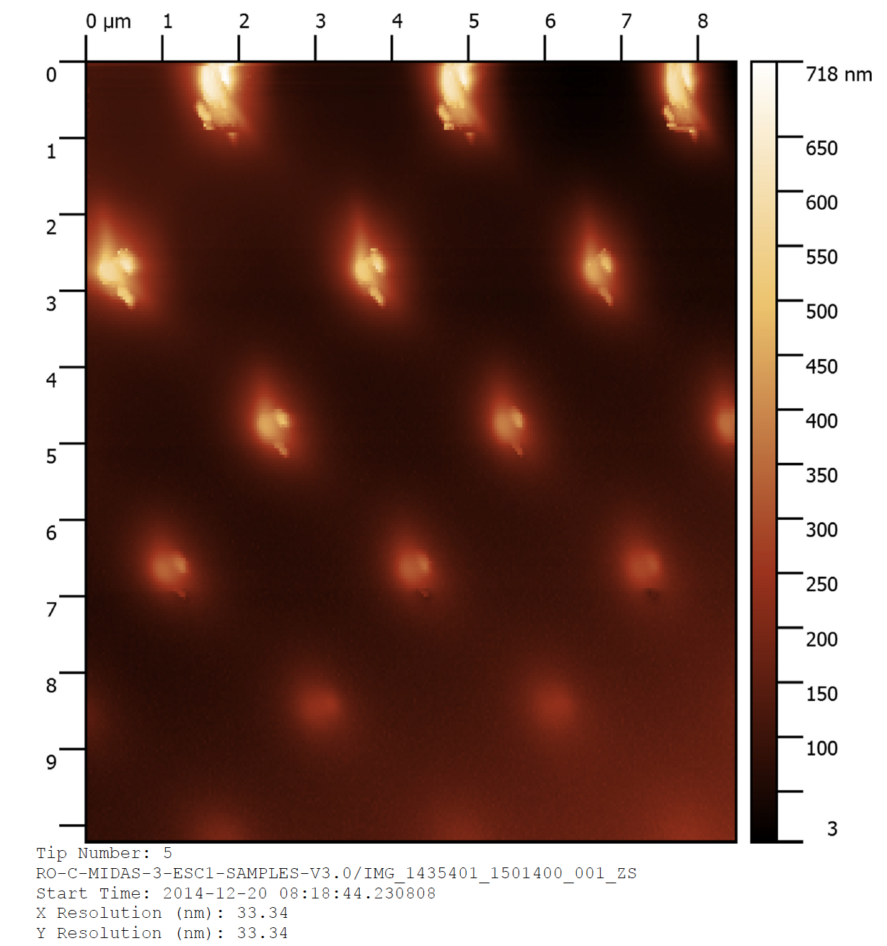
Tip Scan – there was no tip scan in the particle catalogue (but there was a tip scan 20 days after the particle was scanned (beginning of escort phase 1)

Slide 24
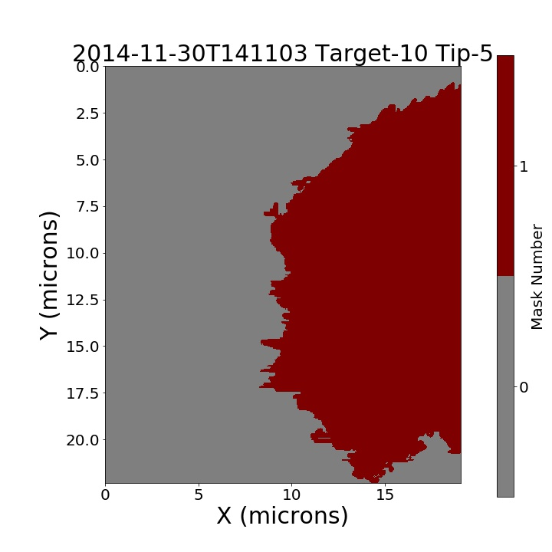
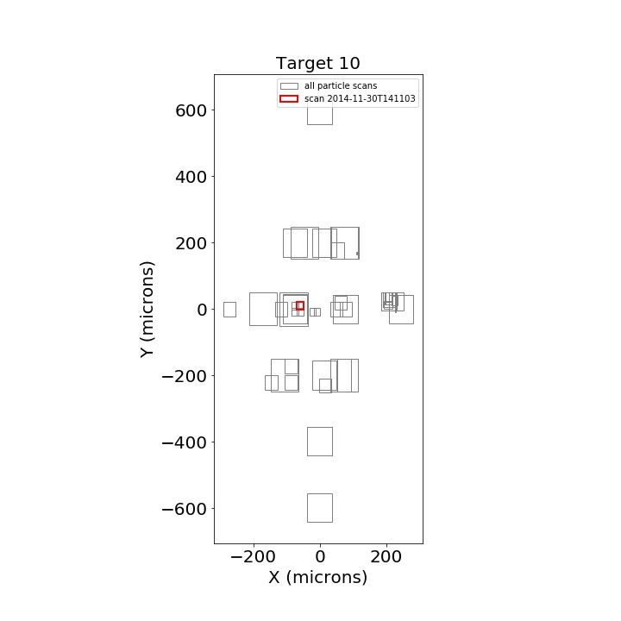
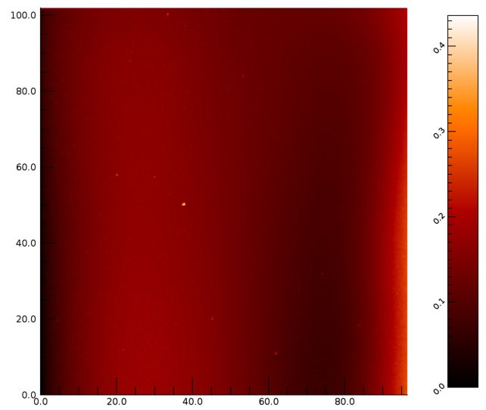
Prescan
RO-D-MIDAS-3-PRL-SAMPLES-V3.0/IMG_1429710_1432600_045_ZS
Master ID: 2014-11-30T141103_P1_T10 (same as this particle/prev. slide)
Particle Catalogue info:
Prescan flag 2: The same region has been scanned (by the commanded scan coordinates) but no features available to confirm, and the particle feature is not present.
Image flag 3: Imaging artifacts or issues in the scanning
Particle flag 1: Probably cometary in origin
Trust height flag 2: do not trust height.

Slide 25
Concluding remarks
For a public data set, it seems that all the data should be viewable in open source data systems and that the MIDAS documentation would be directed to users who do not have access to commercial software
Providing clear direction to all linked scans for given target areas would greatly improve the access to data and quality assessment.
Addition of a tip artifact flag to the Particle Catalogue would provide helpful information to evaluate data.
RIDs: FS Summary file; 3 RIDs regarding the particle catalogue

Slide 26
Editorial Comments – Dust Particle Catalog Document (not uploaded)
For headers on the Catalogue Description, the words “linked ID” - Linked Particle ID is not intuitive as to what this is referencing. Suggest revising to “Target Prescan ID”.
Column positions are only labeled through 6 in the pdf file; having the column headers and columns unquestionable in terms of fit would be helpful; if list those positions in the pdf file then also list them in the lbl file.
P. 2 & 3, and 4-5: If suggestion for numbering ALL flags sequentially in addition to descriptive flag header is adopted, then carry that through the pdf Dust Particle catalogue document. It might be helpful to use these as headers for sections in the text pages 4-5.
P. 2 & 3Typo in the table listing columns, names and Description/Values.
P. 4. line 2 – this run-on sentence should be revised.
P. 4, line 7 – analysis should be analyze
P. 4. Line 8: Table X – needs a number 1
P. 4 lines 10-11 (it must be a bigger particle like feature than the typical contamination, discussed above, seen on the target). It is not clear what was discussed above – this should be here; the size of typical contamination should be mentioned
P. 4. citations to Bentley et al. 2016 – this is not included at the end of the document; and it could be either the Nature paper or the Lessons Learned paper.
P. 4 Paragraph 2 – line 19; the word “be” should be changed to “been”.
P. 4. pargraph 2 – line 22 – the text refers to a separate flag value being used – this should be clarified which flag. (What is called flag2?); this is not that well defined in terms of how the flag is identified in the column header (lbl file).
P. 4. paragraph 2 lines 23-28 – This last section of the pargraph describes the instances when particles appear on targets that were prescanned and were clean, were not exposed to space, but then were scanned, and particles were observed; which are suspected particles resulting from tip contamination falling on to the target – what Flag is used to identify these 35 particles on 9 scans?
P. 5. line 4 – after contamination pattern see, add the word “or”, we have seen the particle previously.
P. 5. paragraph 2 line 9, The sentences says Fig shows the total number of unique particles in the catalogue (1091) and the number of time each was scanned in separate images by MIDAS. There is no figure, though this would be helpful.

Slide 27
Following slides: RIDs submitted and rejected/accepted; low priority for discussion

Slide 28
RID SCIENCE 147: Data quality value
Quality control of this data set does not appear to have been entered into the archive record; all values checked for quality appear to be quality 2; data ok, regardless of actual quality.
Update archive to include most reasonable estimates of the quality values of this data set.
Responsible: Harald Jeszensky
Position: Partly Accepted - The quality values in the L3 data file labels are corresponding to the completeness of the underlying telemetry data source and are not supposed to provide a quality statement for the data product itself.
For what concerns the L5 data set, we agree that the quality values provided in the image labels shall be related to the quality of the acquired image. The quality values in the L5 image labels will be updated.
* Reviewer response: this will be helpful

Slide 29
RID SCIENCE 148: Analysts Notebook
This Analysts Notebook, Preliminary issue, though a potentially highly valuable addition to the archive, is not really intelligible to the reviewer.
Suggest revision to the level that this document becomes useful. In particular, discussion of how tip imaging was used to inform tip selection and use would be highly valuable, in addition to other decision making steps along the mission.
Response – next slide

Slide 30
RID SCIENCE 148: Analysts Notebook
Responsible: Harald Jeszensky
Position: Accepted - The Analysts Notebook will be revised and supplemented to the extent possible and feasible.
Nevertheless, the MIDAS team would like to note the following:
- Originally it was planned that the PI of the instrument at the time of the proposal, who completed the MIDAS operations, planning and decision making process, would compile the analysts notebook from their notes and knowledge.
- The analyst has since left the project and no scientists who were involved in operations have been available to compile the notebook, which presently has been compiled from the notes that are available. Specific information on the use of tips was not found, though a description behind the rational of tip choice and the limited availability of tip images will be added, along with additional operational decisions from available reports.
- While the notebook will be limited compared to its originally intended scope, it is hoped, with the addition of new information, that it will provide the users with some useful background into operations.
* Reviewer response: this will be helpful

Slide 31
RID SCIENCE 150: Z-correction factors
The Z-correction factors are only listed in this table; and not in the lbl files associated with the images. The text in the lbl files reads "Z piezo position set value, recalibrated in XY, rescaled in Z" SCALING_FACTOR = 2.4578E-001" ; thus you might think that the factor listed is Z correction, but it is the XY.
Include the Z correction factor associated with the images listed in Table 2 of the Enhanced Calibration Report.
Example next slide
Response – follows

Slide 32
Example of lbl file with confusing scaling information:
Z piezo position set value, recalibrated in XY, rescaled in Z"
SCALING_FACTOR = 2.4578E-001 ro-c-midas-3-ext2-samples-v3.0 /data/IMG/1612423_1615300_111_ZS.lbl
From this you might think that the scaling factor is the Z-scaling factor; but it is actually the X-Y factor.
For those images that have been rescaled in Z, rather than just including that data in the Enhanced Calibration Report, Table 2, why not include that data also in the lbl file so that the reader can understand what’s been adjusted in Z, and by how much? It’s too many different places to look to figure this out, otherwise.
PDS_VERSION_ID = PDS3
RECORD_TYPE = FIXED_LENGTH
RECORD_BYTES = 2048
FILE_RECORDS = 5
DATA_SET_ID = "RO-C-MIDAS-3-EXT2-SAMPLES-V3.0"
DATA_SET_NAME =
"ROSETTA-ORBITER 67P MIDAS 3 EXT2 SAMPLES V3.0"
PRODUCT_ID = "IMG_1612423_1615300_111_ZS"
PRODUCT_VERSION_ID = "3.0"
PRODUCT_CREATION_TIME = 2018-06-08T12:00:00
PRODUCT_TYPE = RDR
PROCESSING_LEVEL_ID = "3"
//file break
DATA_QUALITY_ID = "2"
DATA_QUALITY_DESC = "Data ok."
HORIZONTAL_PIXEL_SCALE = 1.5858E-006
VERTICAL_PIXEL_SCALE = 1.2500E-006
ROSETTA:MIDAS_TIP_NUMBER = 8
ROSETTA:MIDAS_TARGET_NUMBER = 14
ROSETTA:MIDAS_LIN_STAGE_POS = 0.439 <V>
ROSETTA:MIDAS_SEGMENT_NUMBER = 208
ROSETTA:MIDAS_SCAN_START_XY = (34004, 3968)
ROSETTA:MIDAS_SCAN_STOP_XY = (54668, 60668)
ROSETTA:MIDAS_SCAN_DIRECTION = {MAIN_Y, X_LTOH, Y_LTOH}
ROSETTA:MIDAS_SCANNING_MODE = "DYNAMIC"
ROSETTA:MIDAS_SCAN_DATA_TYPE = "Z_SET_VAL"
^BCR_HEADER = "IMG_1612423_1615300_111_ZS.IMG"
^BCR_IMAGE = ("IMG_1612423_1615300_111_ZS.IMG",2)
OBJECT = BCR_HEADER
BYTES = 2048
HEADER_TYPE = TEXT
INTERCHANGE_FORMAT = BINARY
RECORDS = 1
DESCRIPTION = "
BCR-STM format used by the Image Metrology SPIP application.
See /DOCUMENT/MID_EICD.PDF section 3.2.4 for details."
END_OBJECT = BCR_HEADER
OBJECT = BCR_IMAGE
LINES = 64
LINE_SAMPLES = 64
SAMPLE_BITS = 16
SAMPLE_TYPE = LSB_INTEGER
DESCRIPTION =
"Z piezo position set value, recalibrated in XY, rescaled in Z"
SCALING_FACTOR = 2.4578E-001
OFFSET = 0.0000E+000
END_OBJECT = BCR_IMAGE
RID SCIENCE 150: Z-correction factors

Slide 33
RID SCIENCE 150: Z-correction factors
Responsible:Harald Jeszensky
Position:Accepted - The SCALING_FACTOR is used for calibrating the height (Z dimension) of the images and is not related to XY. It is calculated by multiplying the default scaling factor (0.164) by the Z-correction factor given in table 2. The Z-correction factor for an image not listed in table 2 is always 1.
E.g.: The Z-correction factor of image IMG_1606823_1609700_047_ZS in the data set RO-C-MIDAS-3-EXT1-SAMPLES-V3.0 is 1.31772803. This results in a SCALING_FACTOR of 0.164*1.31772803 = 0.21611.
We agree that the text given in the DESCRIPTION of the BCR_IMAGE object can be misleading. The description will be re-phrased in order to clearly separate the description of the image content from the applied re-calibration steps (if any).
A possible re-scaling in Z will be complemented by adding the Z correction factor to the description.
* Reviewer response: this will be helpful

Slide 34
RID SCIENCE 151: Access to ROI information:
  User without IDL does not have access to ROI information; this makes access to derived data products impossible.
  Consider making this information available in flat files, provide the raw data, or the img files readable by Gwyddion or similar open access software.
Responsible:Harald Jeszensky
Position:Rejected - ROI files are binary tables which don't require specific software (e.g. IDL) to be read. The given information is supplemental to the data set and just related to the feature detection and auto-zooming capabilities of the MIDAS on-board S/W. The data is not used for deriving any data products. The image raw data related to the ROIs are located in the */DATA/IMG directory.
Nevertheless, a cross-link to the respective image files could be added to the ROI labels.
* Reviewer response: Reviewers do not know how to open *.dat files; import into the following failed: text, excel, numbers, octave, matlab. Documentation/readme file should provide user with information as to how to open/view all .dat files.

Slide 35
Editorial comments (submitted online):
ROSETTA-MIDAS-Enhanced Calibration Report -
P. 4. “There are 12 scans of the XY calibration target made on the FM with Y in closed loop mode for which we are able to determine a mean correction factor in the Y direction. These are shown in Figure 4, the red points show scans made with the fast direction in X (5 scans) and the blue points with fast direction Y (7 scans).” There are 11 red and blue points in the Fig 4a and the red has 6 and blue has 5).
P. 8. For each of the three scanning modes, the mean correction factor is determined in three image length ranges (), to which we then apply a linear fit (shown by the solid lines Figures 5 d, e, g) to determine the average relationship between correction factor and image/scan length. – no range in the ()’s.
P. 14. “average temperature is increasing over the time scale of the three series of calibration scans made by approximately 4 degrees”. Can you clarify whether the temperature increases over 1 scan or over the 3 month period between scans?
P. 14 “Therefore, we only apply updated height calibration to scans made within three months of the series of Z calibration scans (2016-04-01 until 2016-12-14)”. – that is more than 8 months? Date wrong? Should be 2016-09-27.
Notes:
Don’t need to be discussed

