Slide 1
MIRO PDS review
October 2018
Martin Cordiner
CUA / NASA GSFC

Slide 2
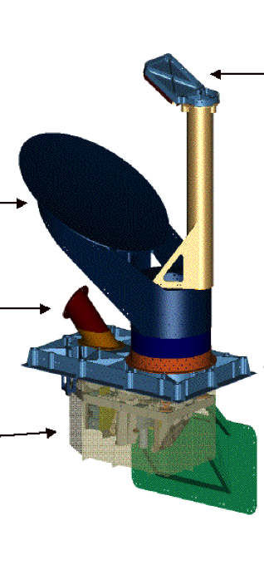
MIRO (Microwave Instrument for Rosetta Orbiter)
First microwave instrument sent to study a Solar System body
Combined ultra high-resolution heterodyne spectrometer, and radiometer
Two wavebands: 190 GHz (1.6 mm) and 562 GHz (0.5 mm)
Single-pixel sub-mm receiver with beam size 7.5’
Sensitive to thermal continuum emission as well as ground-state spectral lines from H₂O and NH₃, CO and CH₃OH
  Thermal and spectroscopic raster mapping
High spectral resolution of 44 kHz → R~10⁷
  Detailed spectral line profiles
  Gas kinematics and excitation

Slide 3
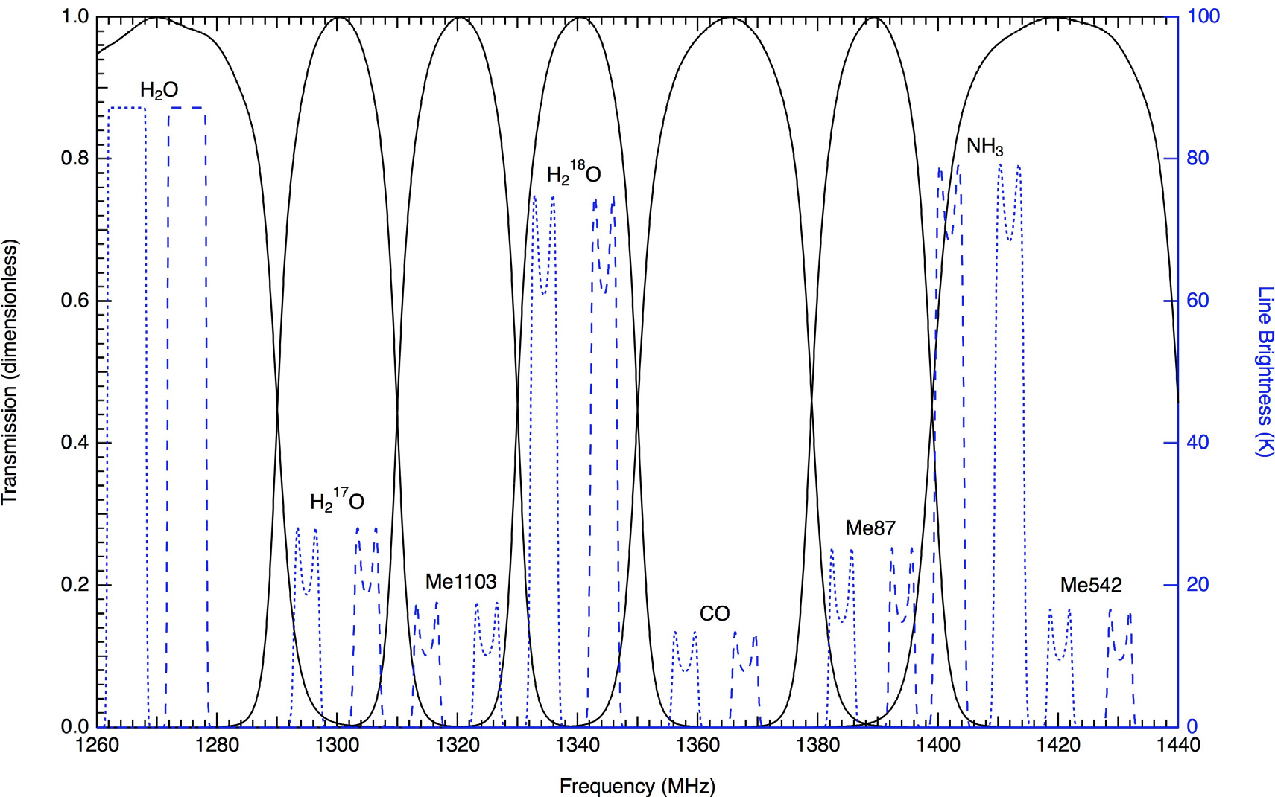
The Data
Simultaneous 1.6 mm and 0.5 mm continuum and spectroscopy of the region 556-580 GHz (divided into 8 spectral windows)
Frequency-switched spectra with integration time 30 s
Data obtained throughout mission phases: PRL, ESC1-4, EXT1-3

Slide 4
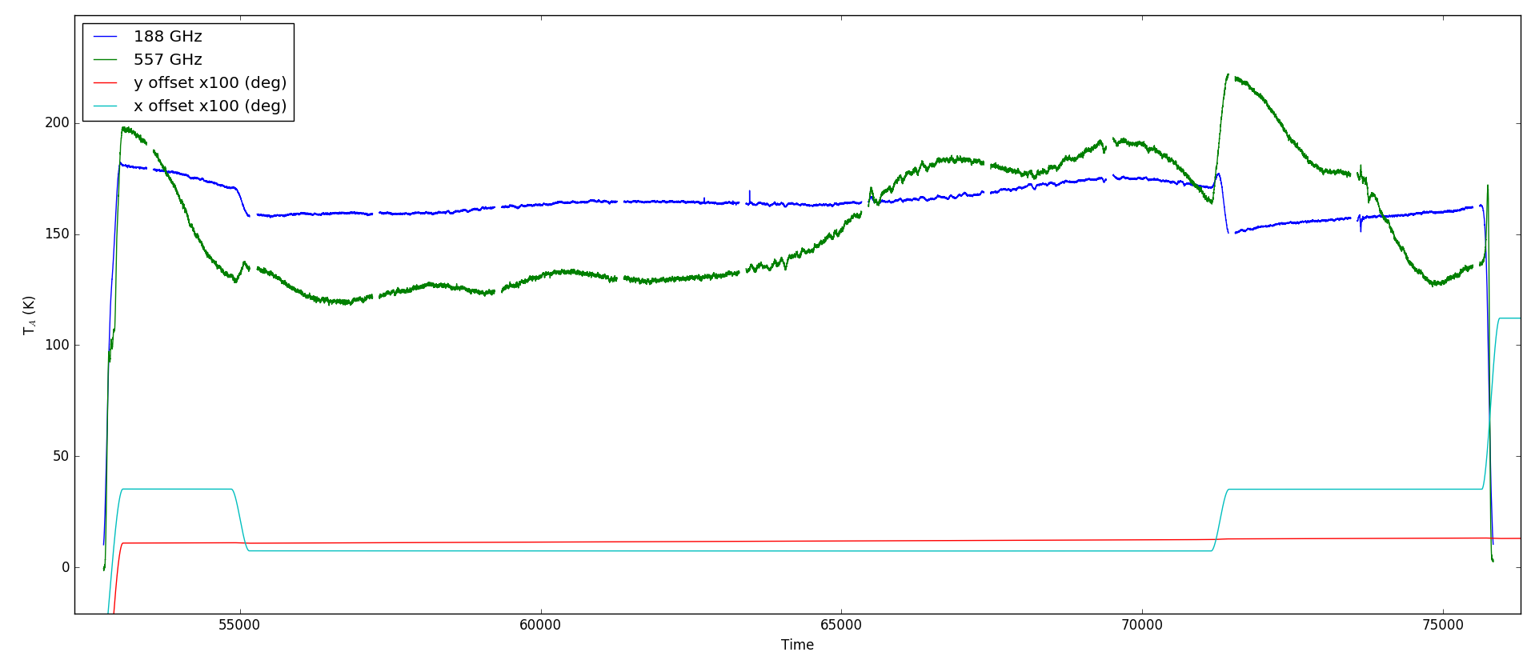
Continuum data
Level 4 data product:
ro-c-miro-4-esc3-67p-v2.0

Slide 5
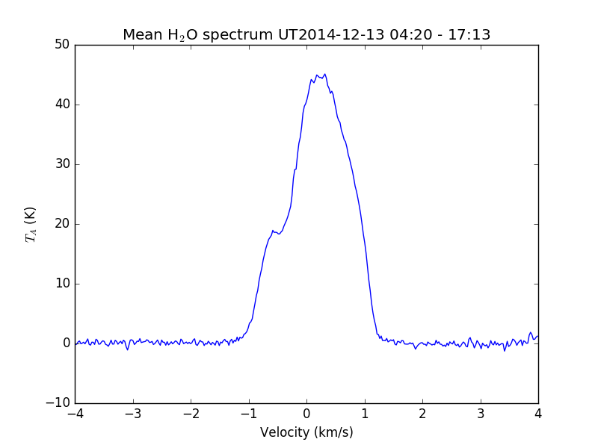
Level 4 ‘folded’ H₂O spectrum
Level 4 data product
ro-c-miro-4-esc1-67p-v2.0
Tdv ~ 70 K km/s → N(H₂O) ~ 10¹⁴ cm⁻² (at 100 K)

Slide 6
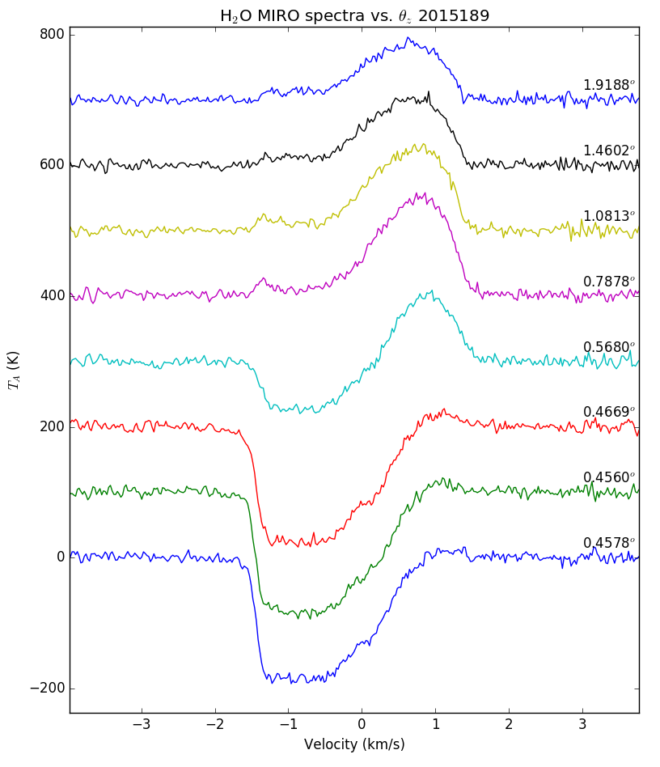
Time series H₂O
Continuous sequence of spectra over ~ 16 min period
Angle between comet and boresight obtained from geometry file
ro-c-miro-4-esc3-67p-v2.0

Slide 7
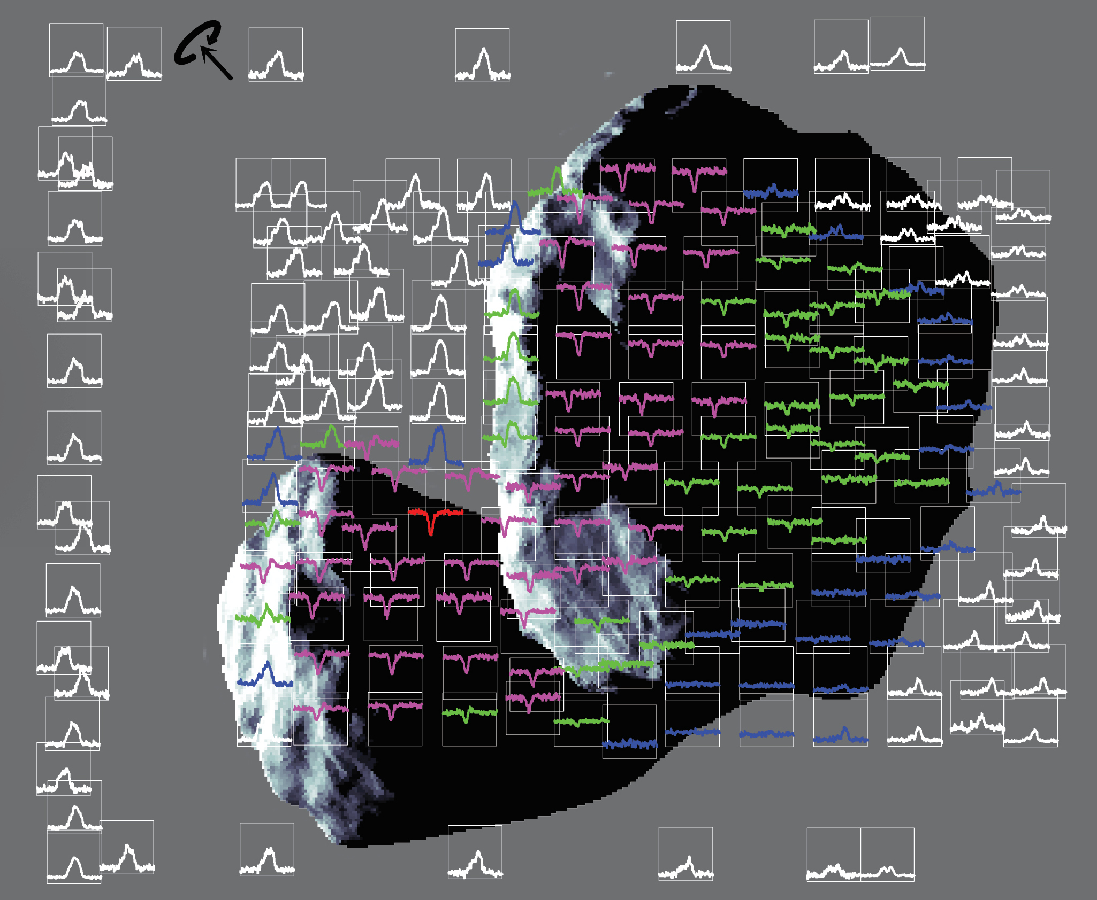
MIRO spatial scans

Slide 8
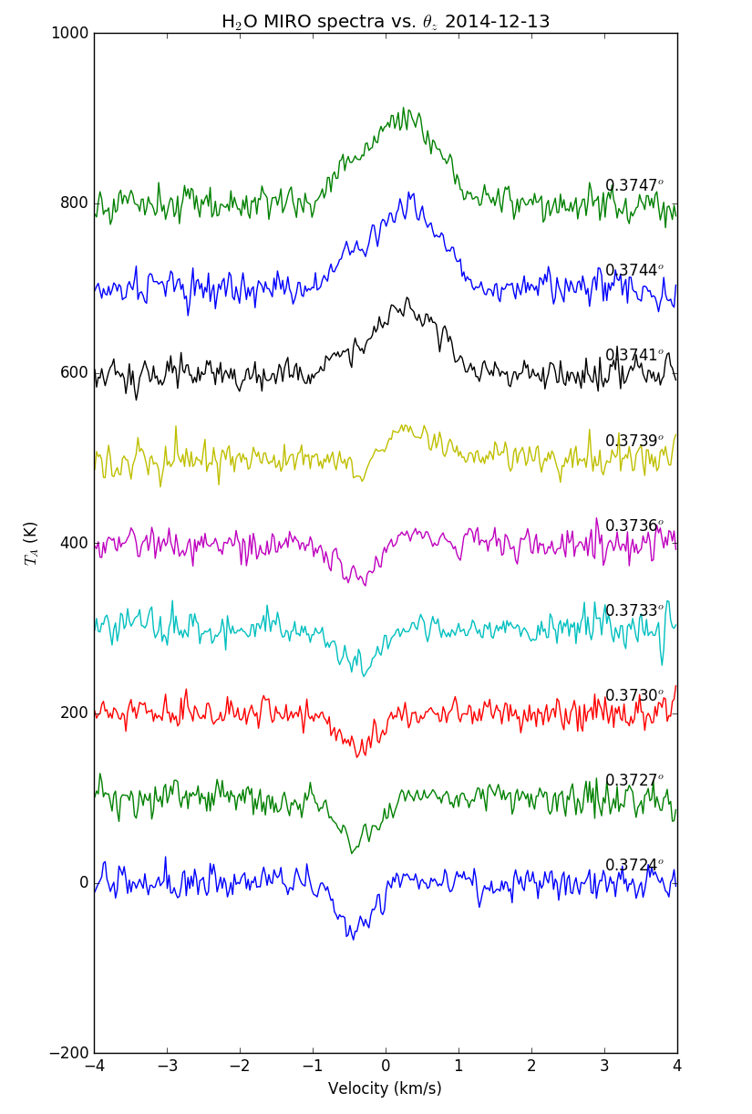
Spectroscopic
Data tests
Continuous sequence of spectra over ~ 5 min period
Angle between comet and boresight obtained from geometry file

Slide 9
Escort 2 – pre-perihelion
Escort 3 – around perihelion
H₂O
CH₃OH
NH₃

Slide 10
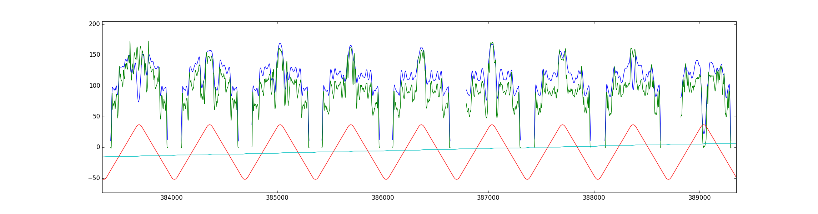
Continuum mapping test
Ro-c-miro-4-ext1-67p-v2.0 2016-050 188 GHz and 562 GHz continuum emission vs time.
X-Y scanning across comet to construct a raster map

Slide 11
Continuum mapping test

Slide 12
Review summary
  + Documentation is complete, comprehensive and well written
  + Data can be understood without external documentation
  + Calibration process is explained in sufficient detail
  + Data labeling is clear and comprehensive
  + Detailed geometry information is provided to help understand the observation context
  + Python routine is provided for data access
  + Data can also be read using IDL readPDS
  Meaning of data versions (ver-1.0, 2.0, 3.0) not described
  Rest frequencies of the individual spectral windows are not. I believe these are required for a full analysis
  Python routine described in document/miro_read_data.asc does not work on the lower-case PDS file format
  Data cannot be opened in NASAView - crash on data file (.lbl) read
  Geometry data provided with the continuum data but not the line data. Makes interpretation of the line data much more difficult.
  Asteroid Lutetia mentioned in the target.cat file but all geometry info seems to be related to the comet. Is the asteroid data actually present at all?
  Problem with baseline discontinuity in H2O window at high-velocity end (e.g. ro-c-miro-4-esc2-67p-v2.0 miro_4_ctsfolded_2015084, 105, 175, 112 ...)

