Slide 1
Rosetta Data Review OSIRIS
Zou Xiao-Duan
Planetary Science Institute
October 2018 @UMD

Slide 2
OSIRIS Dataset Overview
14 datasets
Two cameras: NAC and WAC
Lutetia flyby (AST2) data (3 datasets/cam):
Representative sample for cruise phase
Level 2 (V2.0), Level 3 (V2.0) and Level 4 (V1.0)
67P M12 data (4 datasets/cam)
V 0.1 (Representative sample)
Level 4 (Reflectance, Straylight, Str-Refl)
Level 5 (Georeferenced)

Slide 3
Review Process
Read all .img and .fit (all can be read correctly).
Compare catalog files in all datasets, and analyze the difference
Check all catalog files
Read documents in document/directory
Collect aspect data from all image headers, check consistency between levels
Calculate geometry parameters
Check georeferenced data

Slide 4
OSIRIS Catalog files
Identical in all datasets:
insthost.cat, mission.cat, reference.cat, targets.cat, osinac_inst.cat (all NAC datasets), osiwac_inst.cat (all WAC datasets)
personnel.cat, software.cat are the same as previous archived OSIRIS level3 m12 datasets.
ABSTRACT_DESC of dataset.cat
should add the units, such as “[W/m^2/sr/nm]” and “[1]” for m12 L4 and L5 datasets
It’s should be more obvious how the L5 image relate to L4s. (I dig out the information from one of the 46 files (osiris_cal_pipeline_v05.pdf) from the /document/calib folder)
“This version V0.1 supersedes previous deliveries of the same dataset.”
And a few editorial RIDs attached at the end of this presentation

Slide 5
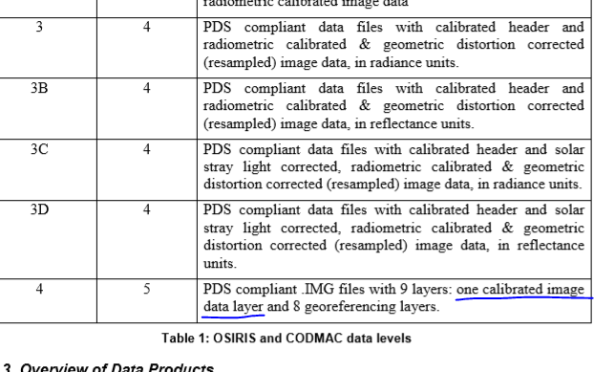
Documents
There’s no operational activity of the cruise phase mentioned in the “OSIRIS science user guide”, only details of the after hibernation phases.
Clearify the discription of L5 data in higher level documents, such as “osiris_eaicd_v05.pdf”.
Suggestion: To add “in radiance units, and 8 georeferencing layers, including...” to description of the L5 data

Slide 6
DATA
Readable data
All .IMG files can be read by idl readpds.pro.
All .fit files can be read by readfits.pro.
Header
duplicated SPICE kernel names
When using “idl readpds.pro” to read the .img, “object HISTORY” in header appeared as an layer/extension, not consistent with “geo_product_v01.pdf”
There is no sigma/quality maps in fits files, and history in label.

Slide 7
Lutetia dataset
67P M12
Missing data from L2 to L3/L4
NAC: 419 files in L2, 411 files in L3 and L4.
n20100707t191600946id20f81
n20100707t192309173id20f31
n20100710t121539052id20f82
n20100710t153114822id20f51
n20100710t154805938id20f23
n20100712t003923702id20f81
n20100712t004131227id20f31
n20100712t004304185id20f38
WAC: 335 files in L2, 312 files in L3 and L4.
w20100707t033443305id02f12
w20100707t043443306id02f12
w20100707t044943287id02f12
w20100707t050443293id02f12
w20100707t051943325id02f12
w20100707t061943323id02f12
w20100707t070443330id02f12
w20100707t073443343id02f12
w20100707t083443369id02f12
w20100707t091943363id02f12
w20100707t093443402id02f12
w20100707t094943383id02f12
w20100707t100443418id02f12
w20100707t101943386id02f12
w20100707t103443426id02f12
w20100707t104943416id02f12
w20100707t110443401id02f12
w20100707t111943419id02f12
w20100707t053443341id02f12
w20100707t090443363id02f12
w20100707t151155849id02f12
w20100710t101440244id02f17
w20100710t102440223id02f17
3 different type of Level 4 data have different number of files.
NAC missing files in reflect and str-refl:
n20150120t151330487id4bf71
n20150120t151221570id4bf15
n20150120t151233635id4bf16
n20150120t151244757id4bf27
n20150120t151256292id4bf41
n20150120t151307502id4bf51
n20150120t151319077id4bf61
n20150120t151342406id4bf82
n20150120t151353952id4bf83
n20150120t151405843id4bf88
n20150120t151417937id4bf84
n20150120t151429838id4bf87
WAC missing files in reflect and str-refl:
w20150120t151330559id4bf12
w20150120t151222018id4bf18
w20150120t151230892id4bf17
w20150120t151242093id4bf16
w20150120t151253353id4bf15
w20150120t151302543id4bf14
w20150120t151316427id4bf13
w20150120t151338380id4bf21
w20150120t151355571id4bf31
w20150120t151427572id4bf41
w20150120t151525240id4bf51
w20150120t151558003id4bf61
w20150120t151705887id4bf81
NAC | L3 | 319
 | L4-reflect | 307
 | L4-strlight | 319
 | L4-str-refl | 307
 | L5 | 183
WAC | L3 | 734
 | L4-reflect | 721
 | L4-strlight | 734
 | L4-str-refl | 721
 | L5 | 592
Would all the image with 67P in frame be provide in L5 or only those involved in ShapeModel building?

Slide 8
Data
2 different structures in L2 .IMG data.
data.image
data.images.image
No similar issue in L3 and L4 L5
Unit of reflectance in header is [1/nm]?

Slide 9
Other minor issues
dataset names
“67p” or “67pchuryumov”?
if target name, why not “lutetia” instead of “lutetiaflyby”
better add data description such as “raw”, “calibrated”, “reflect”, “geo”…
Data time range confusing
All Lutetia data were in the time range between 2010-06-07 to 2010-07-12
In aareadme, the data covered the period from 2010-05-17T00:00:00.000 to 2010-09-03T23:59:59.000.
“Tubiana et al. 2015” seems to be the only paper about the calibration pipeline, it only discussed datasets to L4(osiris L3b), is there any other reference about the pipeline for L4 (L3c, L3d) and L5?

Slide 10
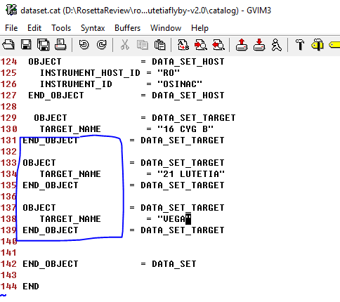
Editorial RIDs
This is dataset.cat
Add space to the front of some of the lines

Slide 11
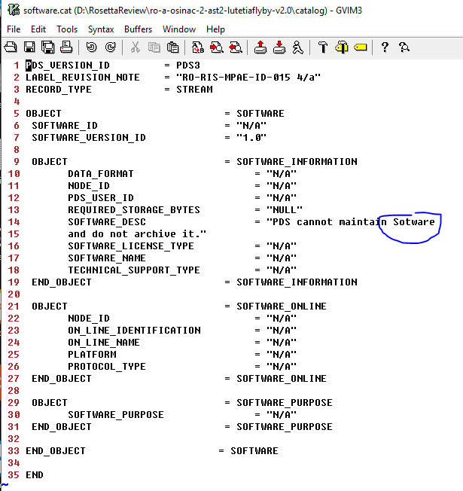
Typo in software.cat

Slide 12
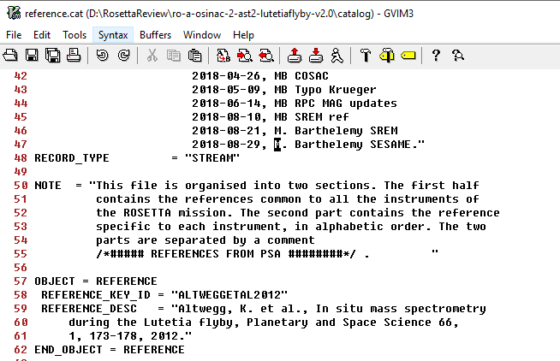
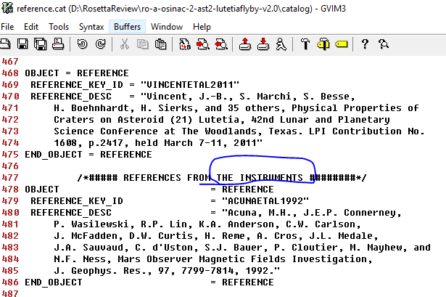
reference.cat
Comment not consistent with the note
The real comment that separate the two parts of reference

Slide 13
The unit of Flux in the documents are
It should be:
W/(m² sr nm) or
W/m^2/sr/nm

