Slide 1
Rosina PDS Review ENH

Slide 2
Procedure
Read documents, especially
Rosina EAICD
AD1_INST_OP_DFMS
AD2_INST_OP_RTOF
rosina_data_user_manual_draft
Read AAREADME.TXT, check Directory structure corresponds to data set for:
RO-C-ROSINA-3-PRL-V1.0 – Level 3 including MPT 8
RO-C-ROSINA-4-ESC3-V1.0 – COPS level 4
RO-C-ROSINA-5-EXT-V1.0 – DFMS, RTOF level 5
Check data formats for DFMS (MCP) and RTOF (SS and OS)

Slide 3
Rosina Data User Manual – calibration overview
DFMS and RTOF
y - ADC Value
x - pixels
y - ion counts
x - mass
y - density
x - species
COPS
Gas pressure (mbar), assuming N₂
Gas density (m⁻³)
Level 2
Level 3
Level 4
Level 5

Slide 4
Rosina Data User Manual – DFMS L2 to L3
Detector gain
Mode table
Determine pixel0
Sci Data
y - ADC Value
x – pixels
LEDA offset subtraction
Ions s⁻¹ (px)
Determine zoom factor, z
HK data mass
LEDA Gain
Individual pixel gain
Overall gain
Gain table in CALIB \ Date folder
\ Pixgain file
Gain table in CALIB \ DFMS_GAIN_TABES \FS
Level 2
Level 3

Slide 5
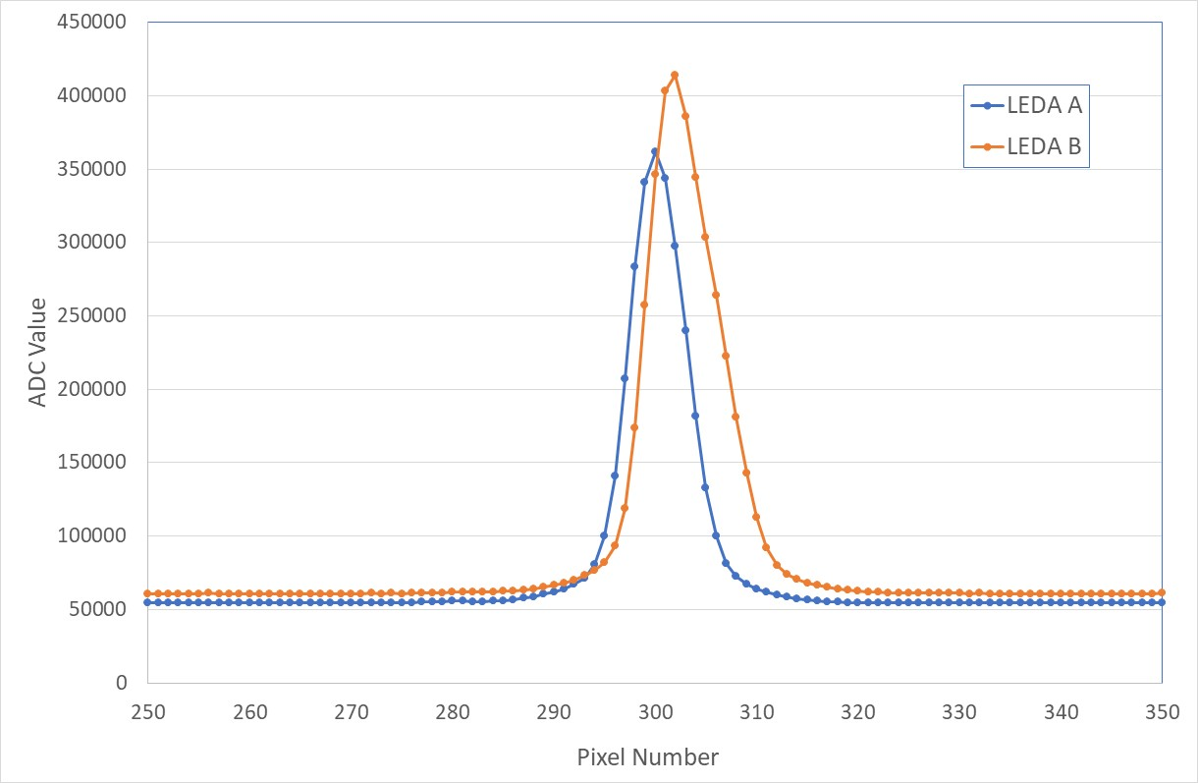
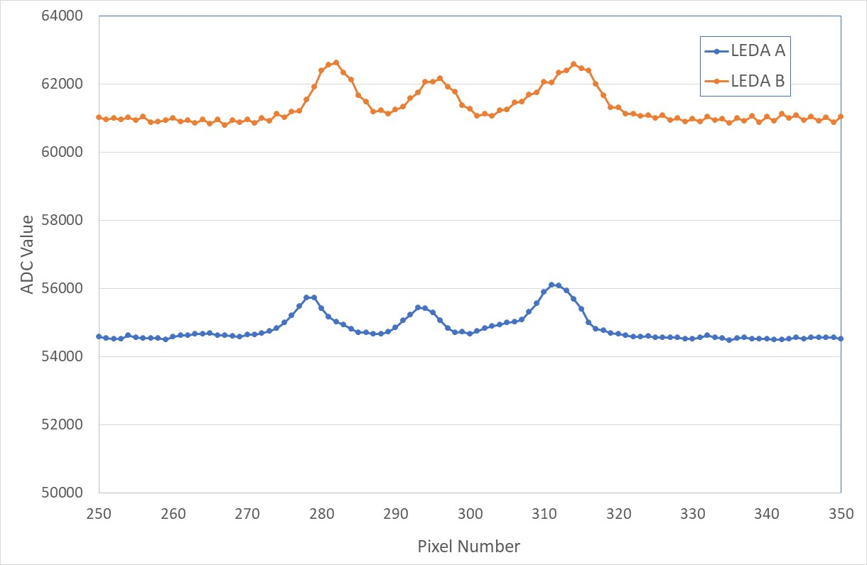
Example L2 to L3
MTP8 23-Sept to 24-Oct 2014
Mode 502, High resolution, z = 6.4
MC_20140928_230530152_M0502
MC_20140928_230608164_M0502
Mass 18 Gain 15
Mass 19 Gain 16
Note – LEDA A and LEDA B require separate calibration

Slide 6
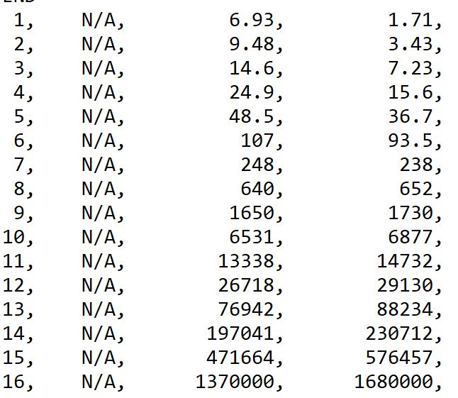
Example L2 to L3
Mass calibration: m = m₀ x exp{(x-x₀) x 25/(125000 x 6.4)}
LEDA A x₀ = 281
LEDA B x₀ = 283
Gain table: GAIN_TABLE_20141228_FS
Pixel Gain Table:
PIXGAIN_20141114_D_FS_GS07

Slide 7
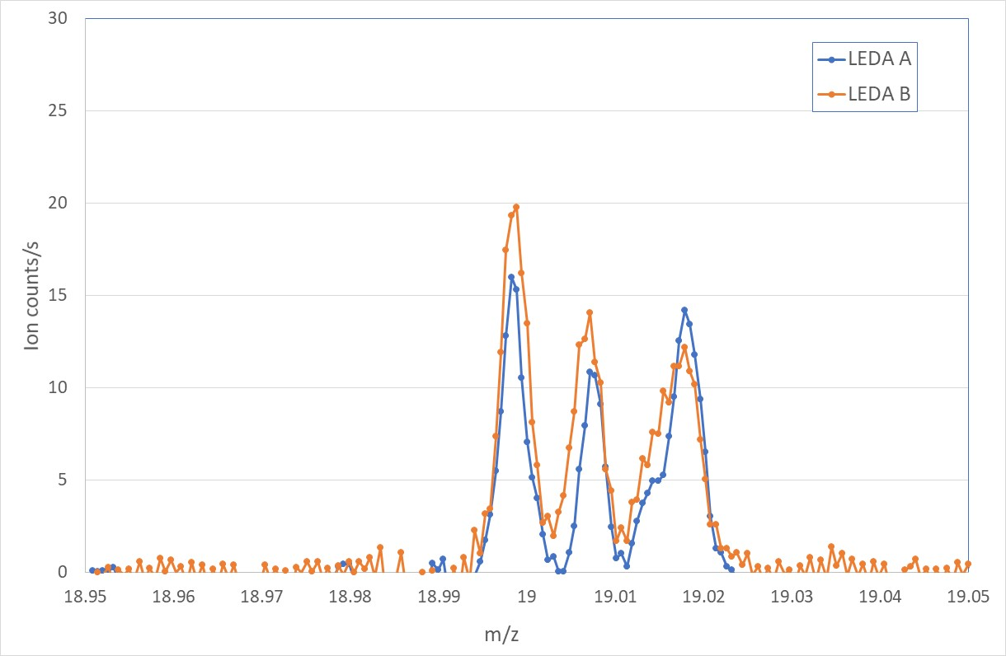
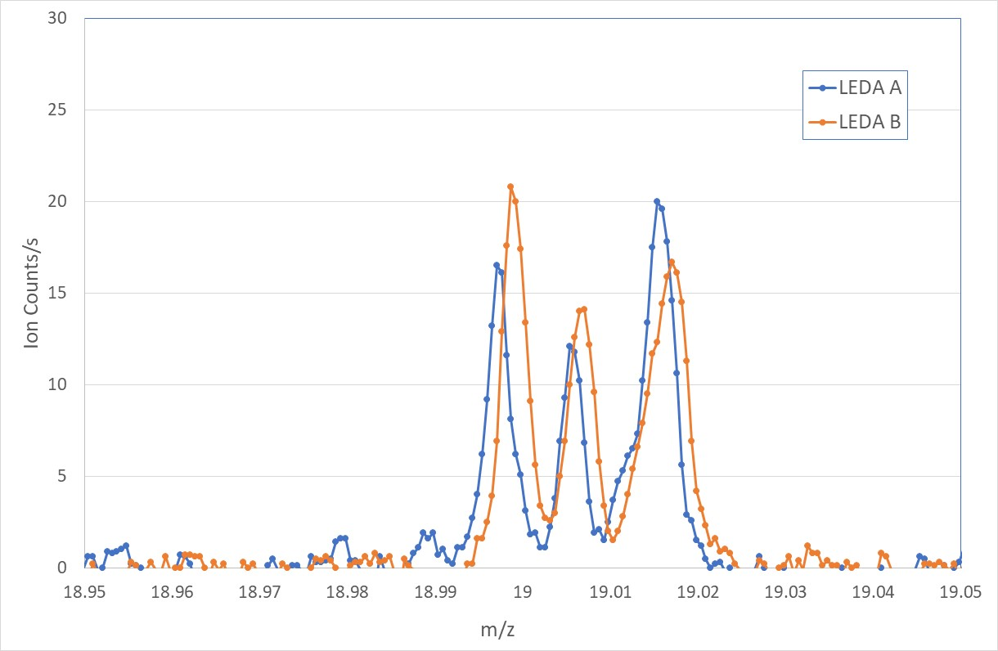
Comparison mass and sensitivity calibration
L2 -> L3 Review
L3 Archive
H¹⁸O, 19.007
H¹⁸O, 19.007
F, 18.998
H₂¹⁷O, 19.015
HDO, 19.017
F, 18.998
H₂¹⁷O, 19.015
HDO, 19.017
Background subtraction just a constant value
Pixel gain not interpolated
Gain table not interpolated
Used approximate sensitivity = 1/m^{0.8}

Slide 8
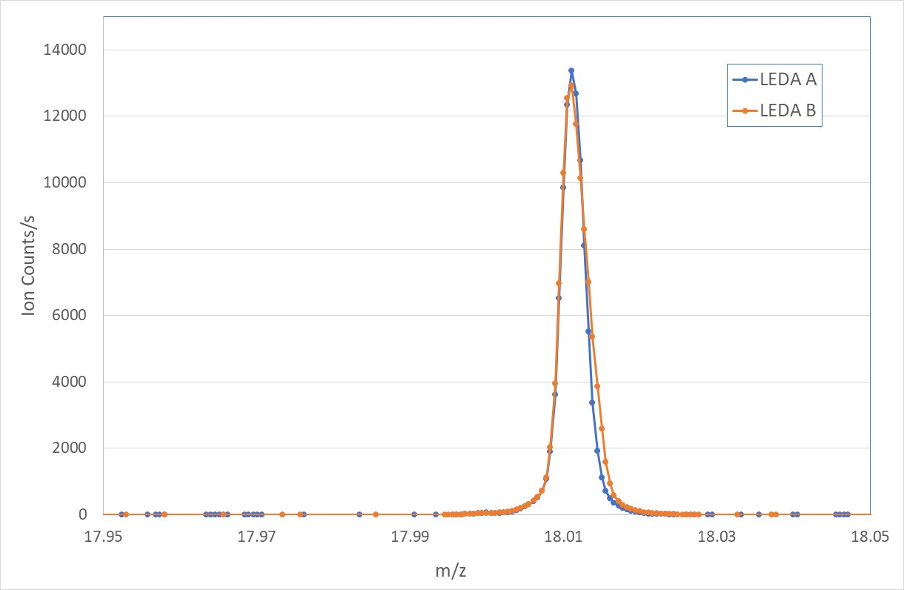
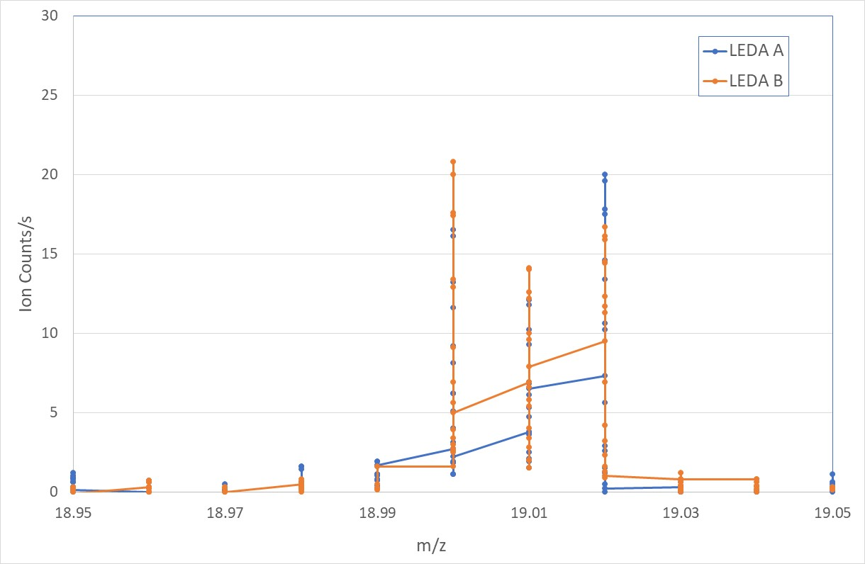
L3 Data
MTP8 23-Sept to 24-Oct 2014
MC_20140928_230530_3_M0502_m18
MC_20140928_230608_3_M0502_m19
H¹⁸O, 19.007
F, 18.998
H₂¹⁷O, 19.015
HDO, 19.017
Mass 18
Mass 19
Measured DHO/H₂O ratio 1480 ppm (c.f. terrestrial 310 ppm)

Slide 9
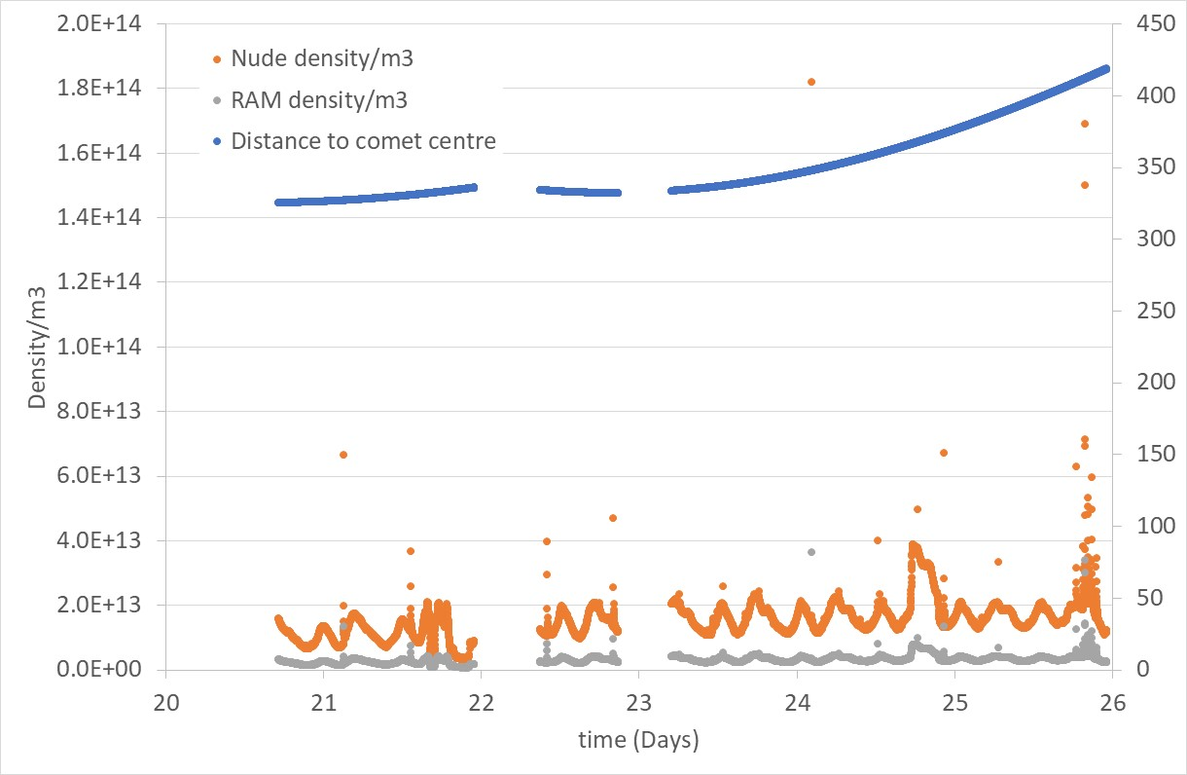
COPS Data – Level 4
Plot of COPS_L4_MTP19
Data structure matched label files except RAM units density/m3 not Pressure mBar

Slide 10
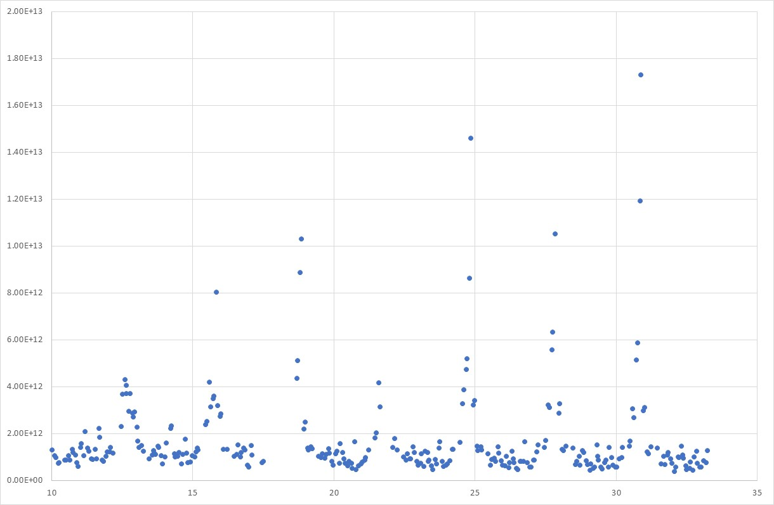
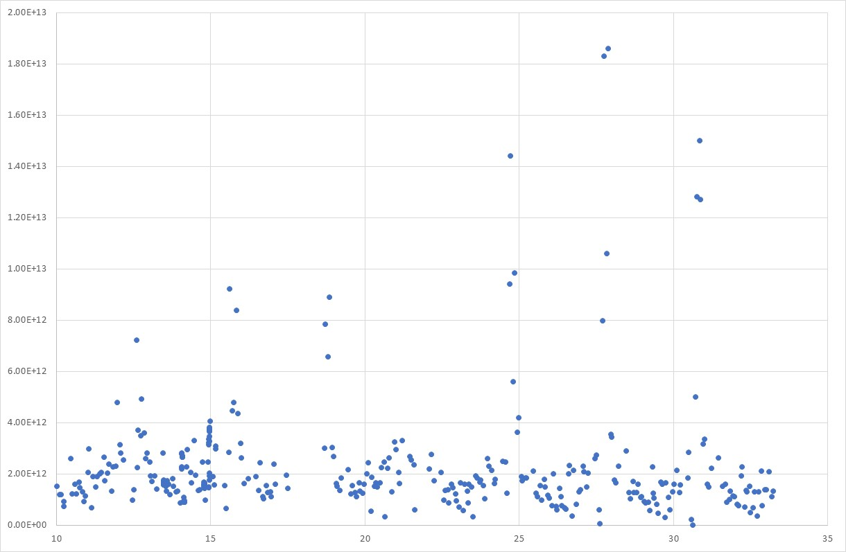
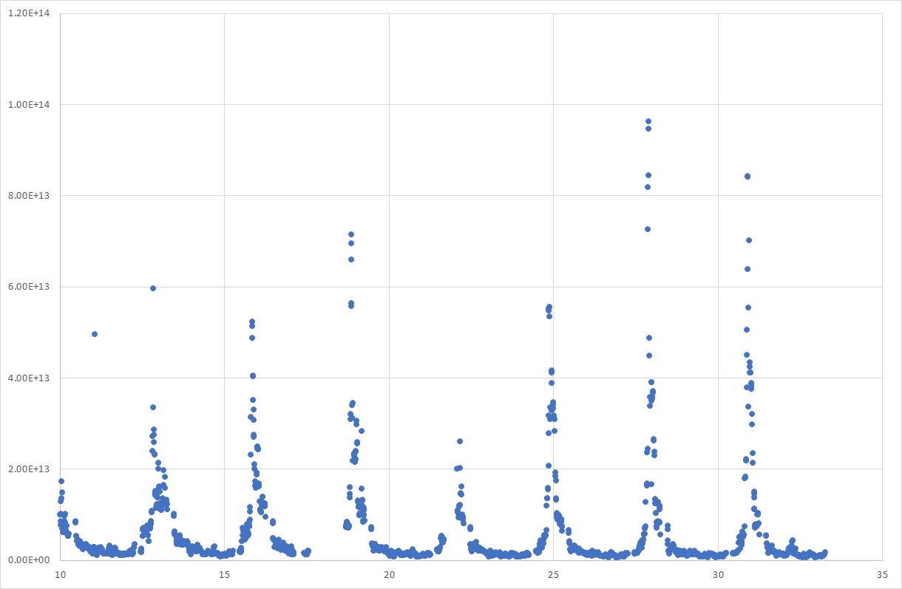
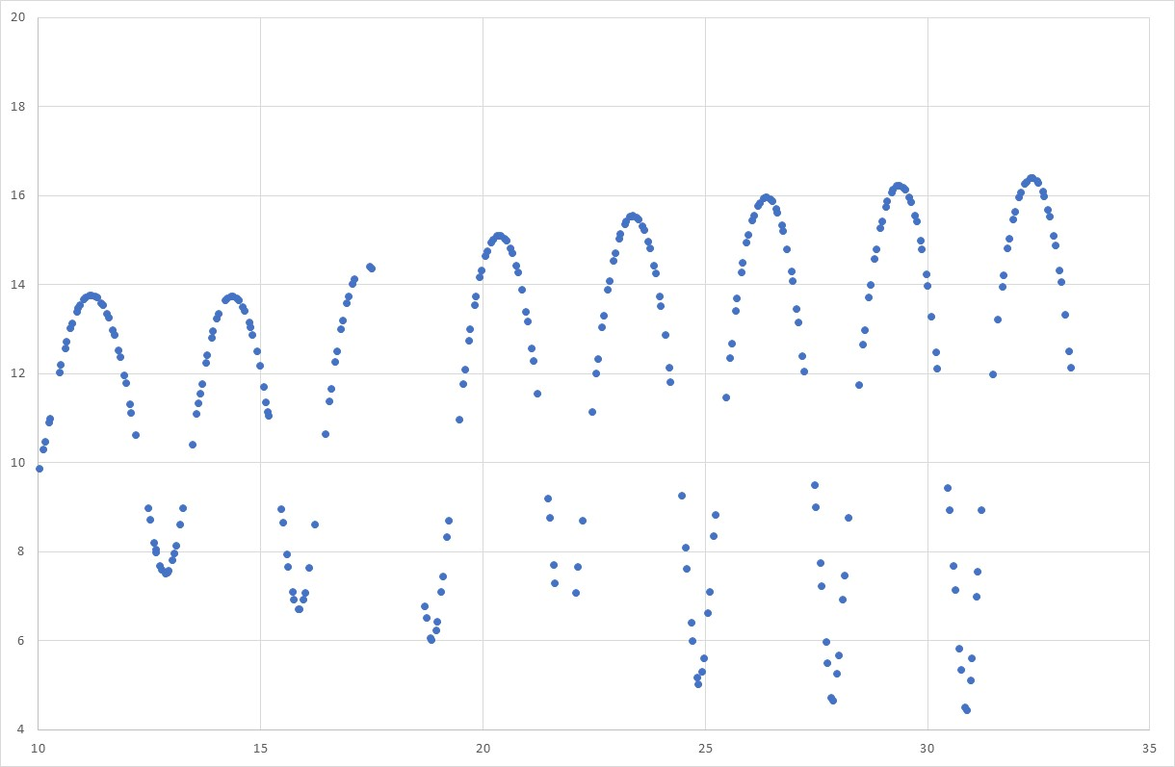
MTP 33 – Level 5
O2
CO
H2O
Distance to comet centre (km)

Slide 11
RIDS
ROSINA-EU-AM-001 Timestamp DFMS_GAIN_TABLES
The DFMS Gain tables do not include a time when calibrated (there is a time in the file name)
ROSINA-EU-AM-002 rosina_data_user_manual_draft – comments
ROSINA-EU-AM-003 AAREADME.TXT missing file in directory structure
DFMS_MASS_PEAK_SEARCH_TABLE in the directory structure. File is in data archive
ROSINA-EU-AM-004 Incorrect location Calib files.
The text states that calibration data for COPS can be found in Level 3 data. No COPS Calibration files in Level 2 3 data. User manual states that it is L2 data.
ROSINA-EU-AM-005 Incorrect column description in LABEL file
DESCRIPTION = "Ram gauge local pressure [mBar]." data files looks like the values are density in m^-3
ROSINA-EU-AM-006 AAREADME.TXT directory structure
AAREADME.TXT -> DATA -> MTP35 -> RTOF. There are no data files in the RTOF data directory as RTOF was not operated in MTP35

