Slide 1
PDS Review Rosetta RPC-ICA
Yaxue Dong
CU-Boulder/LASP
University of Maryland, College Park, MD
Oct 8-9, 2018

Slide 2
Overview
ro-c-rpcica-5-ext1-moment-v1.0
Rosetta Plasma Consortium – Ion Composition Analyzer
Extension 1: Jan 01 2016 to Apr 5 2016
L5 data: ion moments (density and velocity)
No description for the generation of L5 data
“rpc_user_guide.pdf” cannot be opened (damaged file)

Slide 3
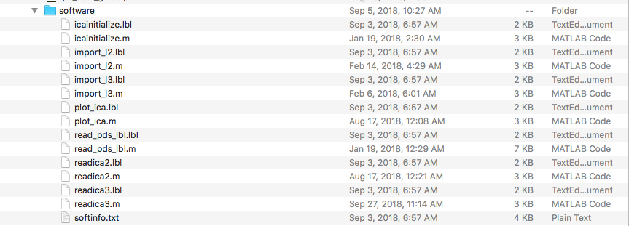
Read the data
Tools:
PDS3 IDL software: works well
Provided MatLab software: only works for label files and lower level of data

Slide 4
Data Structure
SPACECRAFT EVENT TIME UTC
MASS
CHARGE
DENSITY
VX
VY
VZ
DURATION
QUALITY FLAGS

Slide 5
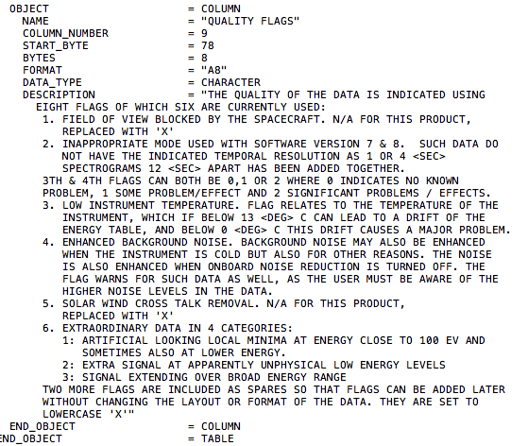
Quality flag description
1 or 0 ?

Slide 6
Plot the data
Separated by mass/charge
1/1: H+
4/2: He++
4/1: He+
18/1: H2O+, other water group ions? O+? (should be in L5 data description)
H+, He++, He+ ?

Slide 7
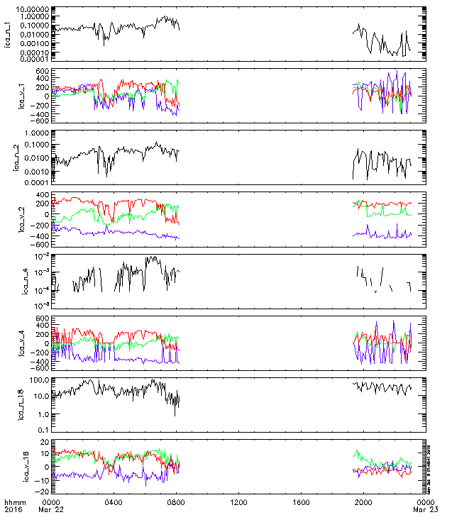
n (cm-3)
V (km/s)
n (cm-3)
V (km/s)
n (cm-3)
V (km/s)
n (cm-3)
V(km/s)
Close to the comet
Alt ~12 km
Dominated by heavy ions
m/q = 1/1
m/q = 4/2
m/q = 4/1
m/q = 18/1

Slide 8
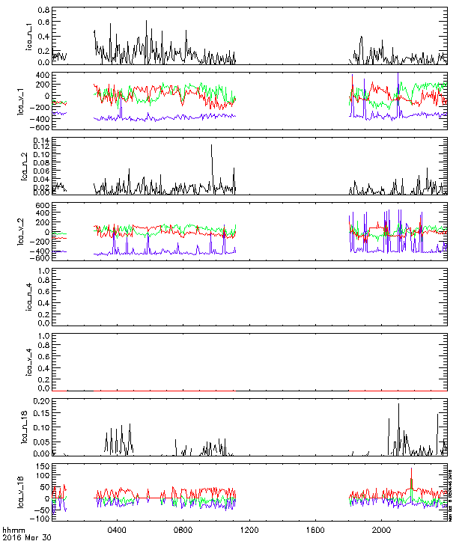
n (cm-3)
V (km/s)
n (cm-3)
V (km/s)
n (cm-3)
V (km/s)
n (cm-3)
V(km/s)
Far away from the comet
Alt >900 km
Dominated by solar wind protons
m/q = 1/1
m/q = 4/2
m/q = 4/1
m/q = 18/1

Slide 9
Summary
Generally the data looks great.
Only one major RID:
No description for the generation of L5 data: Please add descriptions or provide a reference.
Minor RID:
“rpc_user_guide.pdf” does not open correctly
Unclear data quality flag description
The provided MatLab software only works for lower level data and label files
Editorial:
“areadme.txt”: “solar wind ions (H+,H2+,He+)” → “(H+, He++, He+)”

