Slide 1
Rosetta Enhanced Archive Review
RPC-PIU Illumination Maps
Colin Forsyth
UCL Mullard Space Science Laboratory

Slide 2
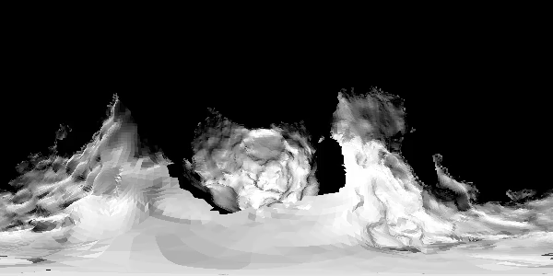

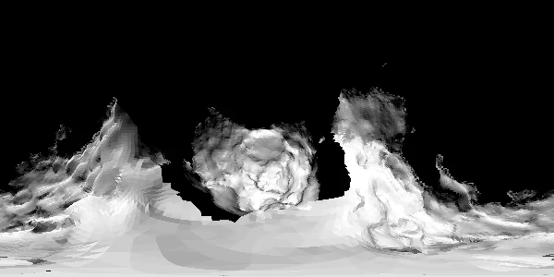
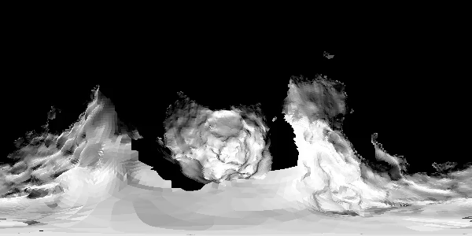
Data from FIT files

Slide 3
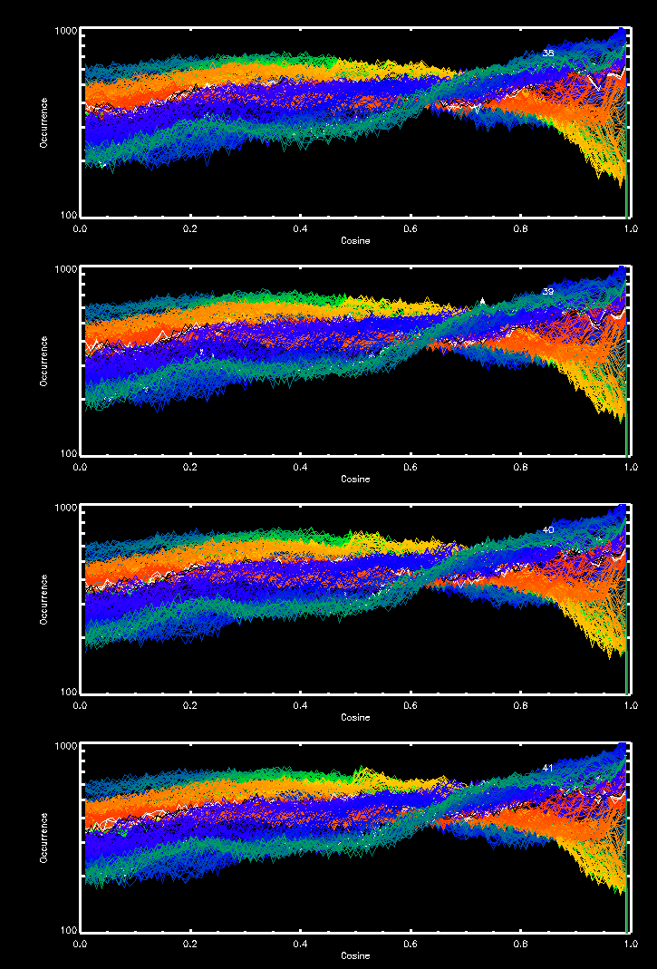
Data from ASCII files
Data values are within expected limits and vary with angle

Slide 4
Summary & Editorial Issues
FIT and ASCII files loaded and appear to have values in the correct ranges.
Values vary with solar illumination angles
TIME2SUN.TAB data could not be read by READPDS
  “Error: Improper START_BYTE or BYTES specification in PDS label, or data file missing carriage return and/or line feed characters.”
Some typos in the ILLUMINATION_UG file (e.g. “Information bout the …”

Slide 5
Rosetta Enhanced Archive Review
RPC-ICA
Colin Forsyth
UCL Mullard Space Science Laboratory

Slide 6
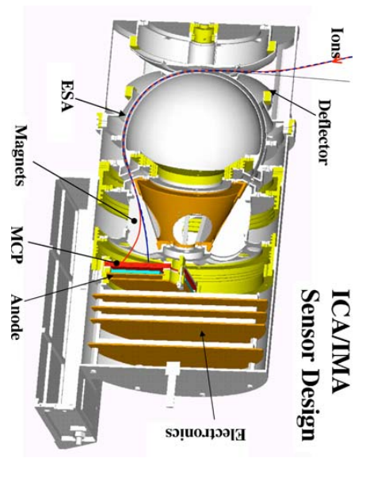
RPC Ion Composition Analyser
Heritage from the IMA and ASPERA-4 instruments on MEx and VEx
Top-hat ion detector
  ‘External’ deflector plates enable selection of elevation angles
  Internal permanent magnets enable mass selection
Typical operation has
  16 azimuth angles
  16 elevation angles
  32 mass channels
  96 energy channels

Slide 7
Data under review
RPC-ICA ion moments
01 January – 05 April 2016
Data in PDS files:
  Mass
  Charge
  Density
  Velocity (X,Y,Z) in CSEQ frame
  Duration of voltage sweep
  Quality flag
Methodology
Rosetta will have spent some time in the solar wind
Ions species concentrated on are predominantly solar wind species
Compare RPC-ICA with NASA OMNI dataset
Notes:
  Direct comparison not possible, but similar distributions of e.g. velocity expected
  Densities should be lower, but for an object at ~2 AU these should be factor ~4 lower
  Ratios of ion species should be close to what we would expect for the solar wind

Slide 8
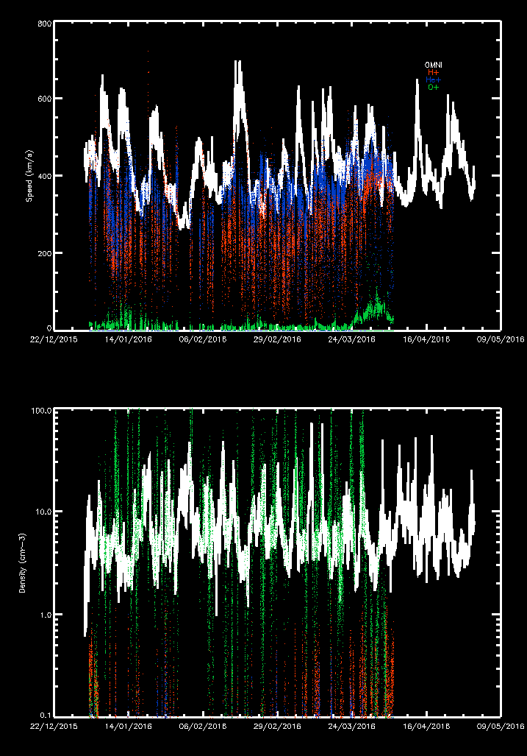
‘Direct’ comparison with OMNI
OMNI data comes from L1 point, so not directly comparable to ICA
However, on longer timescales :
  He+ velocity follows OMNI relatively closely, but misses largest values
  OMNI provides upper limit for H+ velocity, but there seems to be much more variability
Oxygen is generally much slower (cometary origin?)
Densities are all over the place! Genuinely don’t know how much these can be relied on
OMNI
H+, He+, O+
Speed (km/s)
Density (cm⁻³)

Slide 9
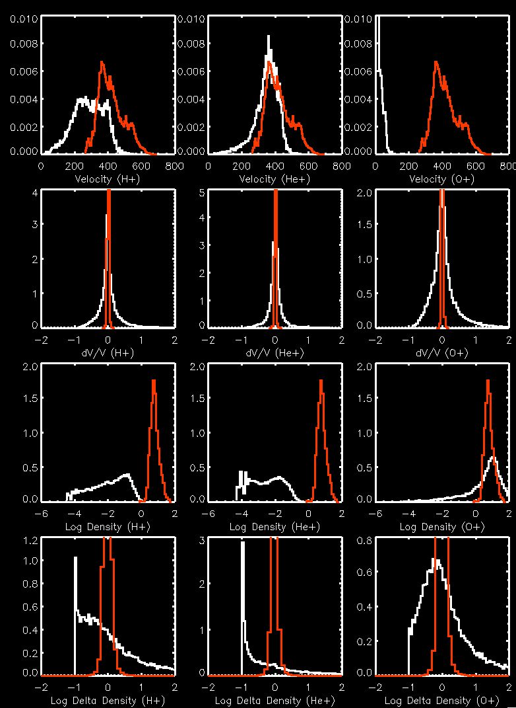
Comparison of distribution of values
H+ He+ O+
If Rosetta spent a lot of time in the solar wind, distributions from OMNI and ICA would be similar
Comparing data when there are no quality flags flagged
  He+ velocities somewhat similar, but missing high values
  H+ velocities look like they are off by ~0.5
  Velocities show a lot of variability
  H+ and He+ densities 1-2 orders of magnitude lower than OMNI
  O+ densities similar to OMNI
  Frequently see 100% drop in density
dn/n density dv/v Velocity

Slide 10
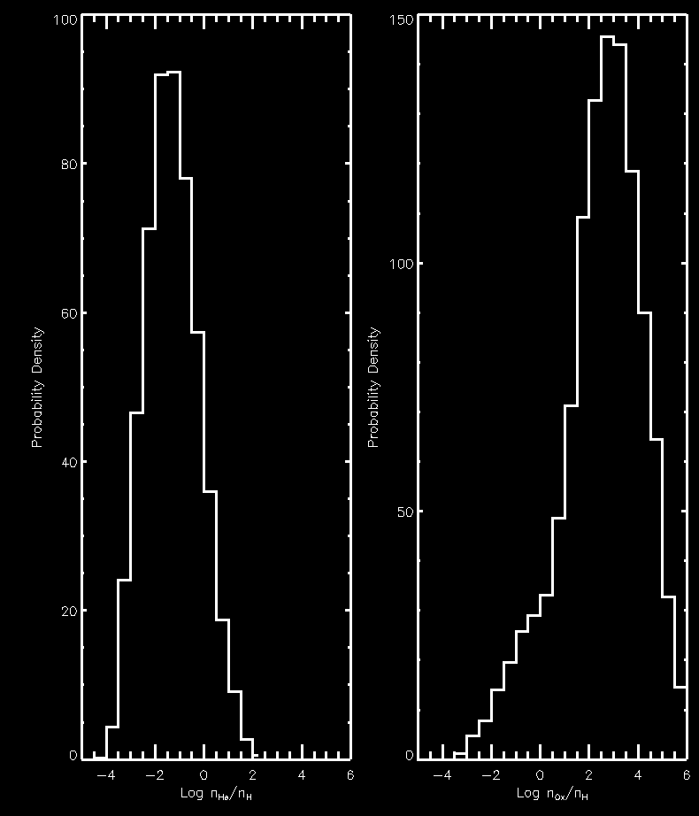
Comparison of density ratios
He+/H+ O+/H+
He+/H+ looks about right for solar wind (~100x more H+ than He+), but width of distribution is concerning
O+/H+ looks high (100-1000x more O+ than H+ on average). May be as a result of large amounts of O+ coming from the comet
Some information from the team would be useful for all these issues. Given Rosetta’s orbit, what sorts of ball-park values for velocities and densities do they expect in these regions and how do the observed values compare?
Probability Density
Log(n_{He}/n_{H})
Log(n_{O}/n_{H})

Slide 11
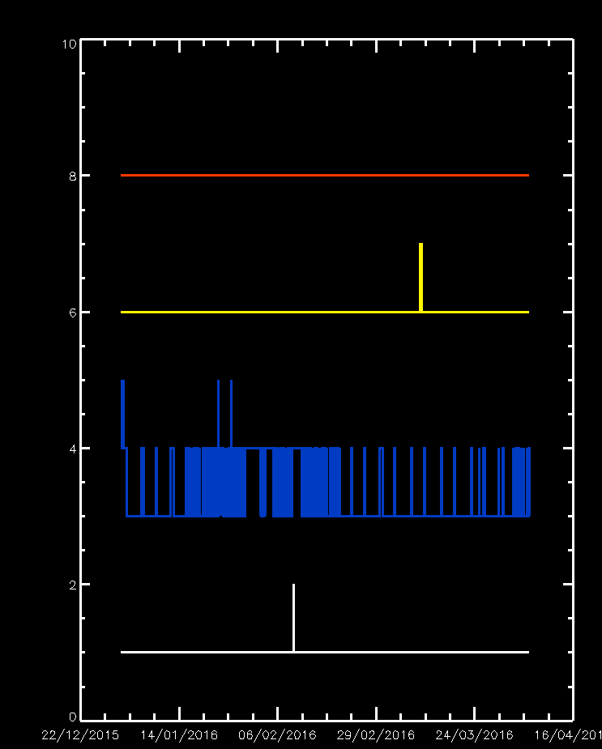
Quality Flags
Four quality flags populated:
  2 – Inappropriate Mode
  3 – Low Temperature
  4 – Enhanced Noise
  6 - Extraordinary Data
78% of the data had no flag
Low temperature flag most common (21% of observations)
Given results on previous slide, perhaps a quality flag based on instrument counts/confidence in moments

Slide 12
Summary & Editorial Issues
RPCICA-EU-CF-001
  ICA_USER_GUIDE contains no details of L5 moments
RPCICA-EU-CF-002
  RPC_USER_GUIDE corrupted
RPCICA-EU-CF-003
  Issues with density moments
RPCICA-EU-CF-004
  Issues with velocity moments

