Slide 1
PDS Review Rosetta RPC-IES
Yaxue Dong
CU-Boulder/LASP
University of Maryland, College Park, MD
Oct 8-9, 2018

Slide 2
Overview
ro-c-rpcies-5-ext2-v1.0
Rosetta Plasma Consortium – Ion and Electron Sensor
Extension 2: Apr 6 2016 to Jun 30 2016
L5 data: Ion and electron moments (density, velocity, and temperature)

Slide 3
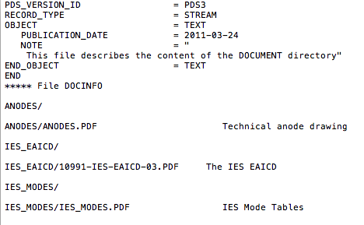
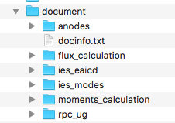
voldesc.cat
moment data
/document/docinfo.txt
Not listed in docinfo.txt

Slide 4
Read the data
Tools:
PDS3 IDL software: works well
Data structure for both electron and ions:
SPACECRAFT EVENT TIME UTC
MASS
CHARGE
DENSITY
VX
VY
VZ
VELOCITY
TEMPERATURE
DURATION
QUALITY FLAGS

Slide 5
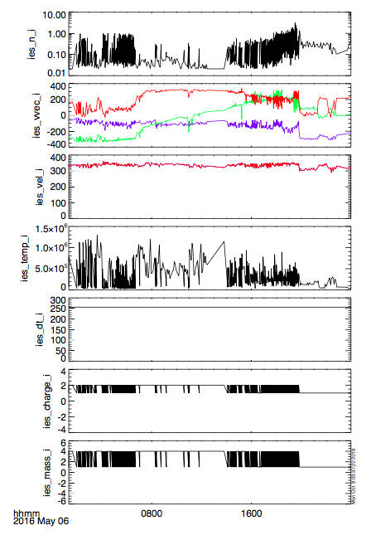
n (cm-3)
Velocity (km/s)
Speed (km/s)
Ti (K)
Duration (s)
Charge (e)
mass (amu)
Ion data
q = 1, 2 e
m = 1, 4 amu
Identifying and separating H+ and He++ signals explained in “moments_calculation.pdf”

Slide 6
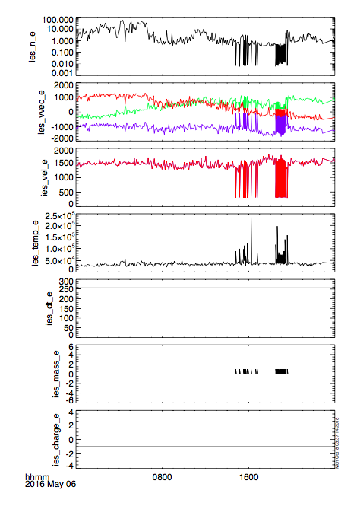
n (cm-3)
Velocity (km/s)
Speed (km/s)
Ti (K)
Duration (s)
mass (amu)
charge (e)
Electron data
q = -e
m = 0 for electrons
m = 1 amu: negative ions (H-)?
ne >> ni explained as photo-electron density much larger than solar wind electrons (moments_calculation.pdf)

Slide 7
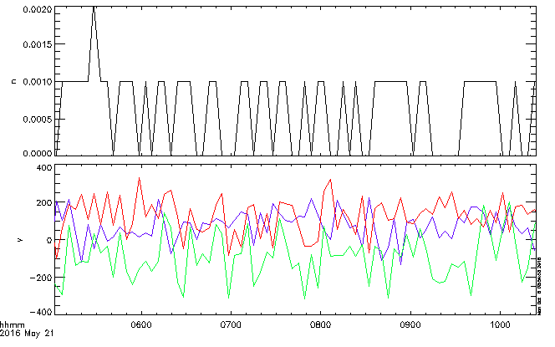
Negative ions?
n (cm-3)
V (km/s)
In electron moment data
m = 1 amu, q = -e
No descriptions of how to identify these negative ions (H-) from electron
Very low density with repeating values: 0, 0.001, and 0.002 cm-3
When density is 0, there is still non-zero velocity data

Slide 8
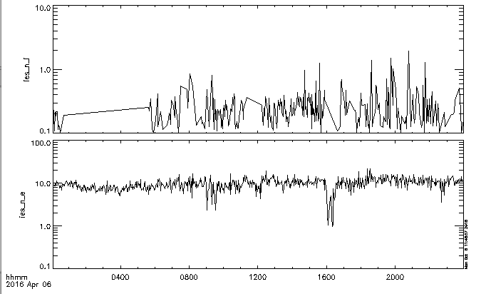
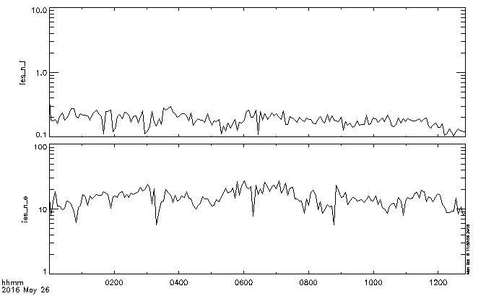
Far away from the comet:
Alt ~200 km
Close to the comet:
Alt ~ 5km
ni (cm-3)
ne (cm-3)
ne >> ni explained as photo-electron density much larger than solar wind electrons (moments_calculation.pdf)
Comparable electron density between far away from the comet and the closest approach. Shouldn’t there be much more photo-electrons at the closest approach
Photo-electrons?
Can we tell it from the energy spectra?
How does the electron density compare to total the ion density including heavy ions from ICA?

Slide 9
Summary
One major RID:
The negative ion data in electron moment files doesn’t look right.
One minor RID:
“/document/docinfo.txt”: some documents not listed
Editorial:
In “voldesc.cat”: counts data → moment data
Others: more explanation needed for photo-electrons

Slide 10
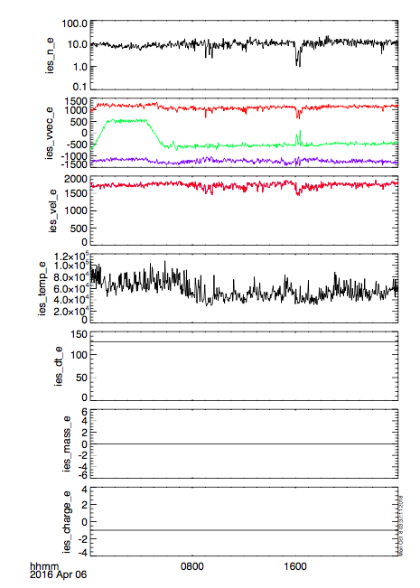
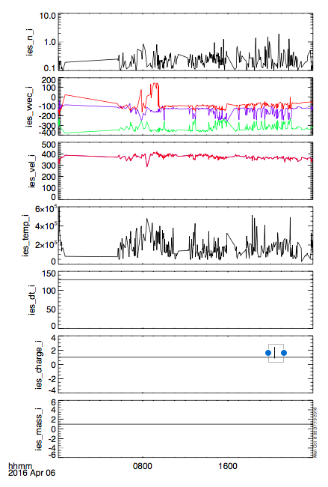

Slide 11
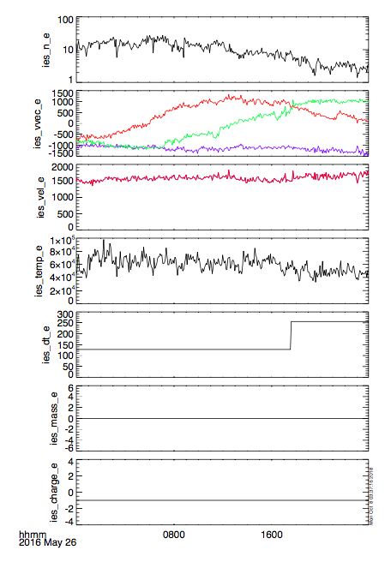
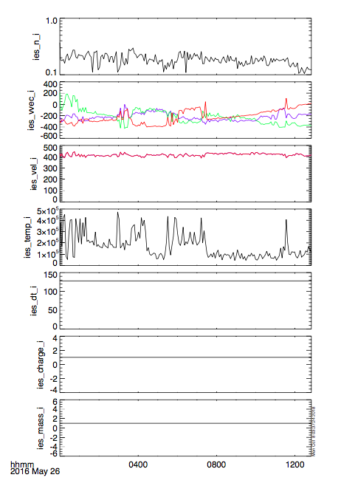

Slide 12
RPC-MIP
RPC-IES

