Slide 1
Rosetta Orbiter RPCLAP Archive Comments ro-c-rpclap-2-ext1-edited2-v2.0 ro-c-rpclap-3-ext1-calib2-v1.0 ro-c-rpclap-5-ext1-deriv2-v1.0
S. Joy

Slide 2
Overview
All of the ro-*rpclap* review volumes share a large number of common files: catalog files, documents, required files (Xxinfo.TXT), etc. rather than repeating comments on those files in every presentation my comments are all included here
Most of the common files have been previously reviewed so there is an expectation that the files would be in pretty good shape.

Slide 3
Root Directory Files (aareadme, voldesc)
ro-c-rpclap-2-ext1-edited2-v2.0 – files are present and valid
ro-c-rpclap-3-ext1-calib2-v1.0
ro-c-rpclap-5-ext1-deriv2-v1.0

Slide 4
/CATALOG Files
catinfo.txt
rosetta_msn.cat – typos corrected since last review
rosetta_insthost.cat (file is one revision out-of-date on the -2- and -3- volumes, no 2018-08-30 update. Updated file still has a few remaining typos but many less than the last review)
rosetta_ref.cat
rosetta_target.cat
rpclap_inst.cat
rpclap_software.cat
rpcmlap_pers.cat

Slide 5
/CATALOG dataset.cat files
ro-c-rpclap-2-ext1-edited2-v2.0 – file is present and acceptable
ro-c-rpclap-3-ext1-calib2-v1.0 – file is present and acceptable
ro-c-rpclap-5-ext1-deriv2-v1.0 – file is present and acceptable
Note: The dataset catalogs for the raw and calibrated data refer to the derived data in the future tense. While this is still appropriate for now, the derived data are merely a small collection of sample files, care should be take to change all of the catalogs to present tense when the derived data are finalized.

Slide 6
Document
docinfo.txt (all volumes)
eriksson2007a.pdf (.lbl) - ok, no changes requested
eriksson2008a.pdf (.lbl) - ok, no changes requested
ro-irfu-lap-eaicd.pdf (.lbl) – Previous change request not implemented:
From EACID: “From May 2016 to end of mission, LAP probe 2 (P2) occasionally exhibits very strong and intermittent currents when at negative bias voltage. These are not yet well understood, and are therefore not considered to be reliable plasma measurements.”
This statement should be expanded upon a bit. What day in May was this first observed? Are the impacted data excluded from the archive, or otherwise identified? Etc.
ro-irfu-lap-eaicd_delta.pdf – sections that are available are good, need to complete section 4.
RID: Finalize the ro-irfu-lap-eaicd_delta.pdf document before archiving.
ro-irfu-lapmac-160804_ext1.pdf (lbl) - ok, no changes requested
Flight Reports Subdirectory
irfu-ros-opr-ext1_v10.pdf (lbl) – ok, no changes requested

Slide 7
Index Files
indxinfo.txt
index.tab (.lbl)
checksum.tab (.lbl)

Slide 8
Data Directories

Slide 9
ro-c-rpclap-2-ext1-edited2-v2.0
The data are still dispersed over thousands of files per day making them very difficult to work with or validate. This statement has been made in all previous reviews so there is no expectation that there will be changes to the data set structure now or in the future.
Please ignore this comment that was presented during the review. In addition to the v2.0 zip file, I inadvertently downloaded an old v1.0 file which was the source of this comment.
This issue is mostly addressed by the dataset.cat file

Slide 10
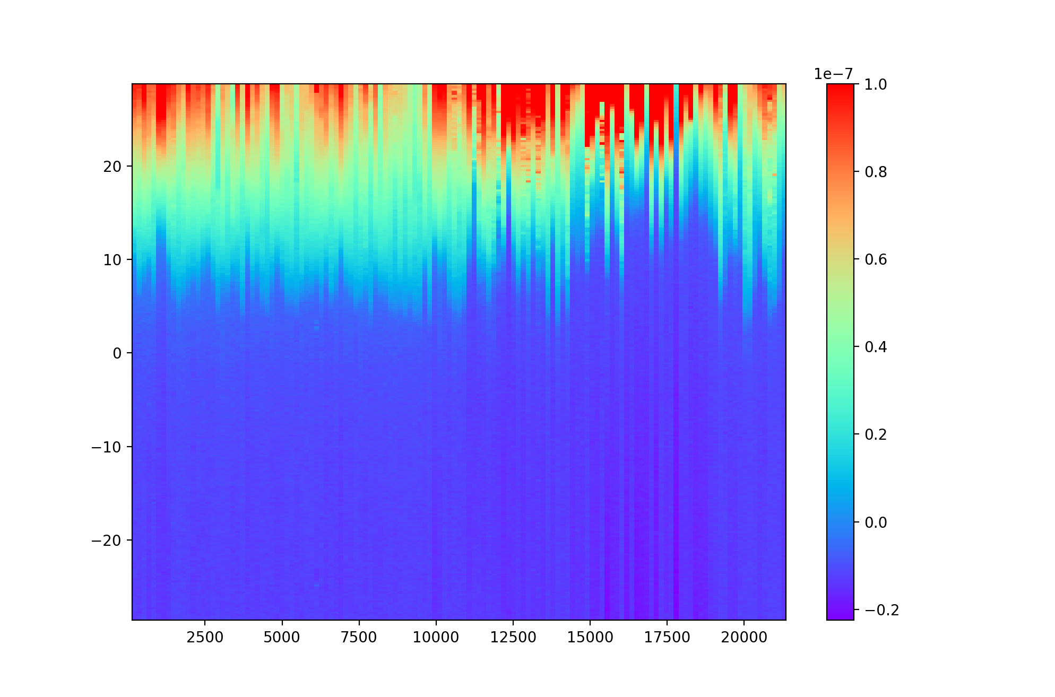
ro-c-rpclap-3-ext1-calib2-v1.0_2105
lap_20160120_000000_914_i1s.tab shows the currents from a 240 voltage step sweep early on Jan 20, 2016
1e-7
-28
Ampere
Volts
0
28
00:00
03:00
06:00
1e-10

Slide 11
ro-c-rpclap-5-ext1-deriv2-v1.0
These data are potentially very useful to the science community. At present, there are a large number of missing data (flag) values in the “asw” files. In addition, some of the asw files are not in time-order.
2016-02-03T09:51:58.080814, 2016-02-03T09:52:01.343953, 413113835.266564, 413113838.529711, -1.0000000e+03, 1.0, -1.6107430e-08, 1.0, -1.0000000e+03, 1.0, -1.0000000e+03, 1.0, -1.0000000e+03, 1.0, -5.6953709e+00, 1.0, 00000
2016-02-03T09:54:38.080867, 2016-02-03T09:54:41.344006, 413113995.266564, 413113998.529711, -1.0000000e+03, 1.0, -1.6310562e-08, 1.0, -1.0000000e+03, 1.0, 1.0020627e+01, 1.0, -1.0000000e+03, 1.0, -5.3471241e+00, 1.0, 00000
2016-02-02T16:29:18.060129, 2016-02-02T16:29:21.323268, 413051275.266564, 413051278.529711, -1.0000000e+03, 1.0, -2.0613276e-08, 1.0, -1.0000000e+03, 1.0, 1.0974690e+01, 1.0, -1.0000000e+03, 1.0, -3.3899471e+00, 1.0, 00000
2016-02-02T16:31:58.060181, 2016-02-02T16:32:01.323320, 413051435.266564, 413051438.529711, -1.0000000e+03, 1.0, -1.8777351e-08, 1.0, -1.0000000e+03, 1.0, 1.0930492e+01, 1.0, -1.0000000e+03, 1.0, -5.0887612e+00, 1.0, 00000
RID: Makes sure that all of the data files are provided in ascending time order.

Slide 12
Summary
The raw (-2-) and calibrated (-3-) data are in good shape and can be certified. There are no new liens (RIDs) on these data sets.
The documentation for these datasets refer to the derived data in the future tense. Once the derived data are archived, these documents (dataset.cat, etc.) should be updated.
When assembling the archive volumes, please make sure that the most recent version of the rosetta_insthost.cat file is included.
The sample derived data show that these data will be extremely useful to the community in the future. These data are not ready to be certified in their present state. There are 2 liens/RIDs on these data:
The EACID that describes these data (ro-irfu-lap-eaicd_delta.pdf) is incomplete (missing section 4). This document should be completed before archive
In a scan of only a few sample data files, I was able to locate one (lap_20160203_000000_914_asw.tab) that had data out-of-time-order. The data processing software should be updated to ensure that the data are properly provided in time order.

