Slide 1
Rosetta Orbiter RPCMAG –ext3- Archive Comments ro-c-rpcmag-2-ext3-raw-v9.0 ro-c-rpcmag-3-ext3-calibrated-v9.0 ro-c-rpcmag-4-ext3-resampled-v9.0
S. Joy

Slide 2
Overview
All of the ro-*ext3* review volumes share a large number of common files: documents, required files (Xxinfo.TXT), etc. rather than repeating comments on those files in every presentation my comments are all included here
Most of the common files have been previously reviewed so there is an expectation that the files would be in pretty good shape.

Slide 3
Root Directory Files (aareadme, errata, voldesc)
ro-c-rpcmag-2-ext3-raw-v9.0 – All files present and acceptable
ro-c-rpcmag-3-ext3-calibrated-v9.0 – All files present and acceptable
ro-c-rpcmag-4-ext3-resampled-v9.0 – All files present and acceptable
Minor error in AAREADME file on -4- volume: PUBLICATION_DATE = 201-08-30

Slide 4
Catalog Files (common files reviewed in “raw” dataset)
catinfo.txt
rosetta_mission.cat
rosetta_insthost.cat (various typos, content fine)
rosetta_ref.cat
rosetta_target.cat
rpcmag_inst.cat (various typos, content fine)
rpcmag_software.cat
rpcmag_pers.cat
dataset.cat: RO-C-RPCMAG-2-EXT3-RAW-V9.0
dataset.cat: RO-C-RPCMAG-3-EXT3-CALIBRATED-V9.0
dataset.cat: RO-C-RPCMAG-4-EXT3-RESAMPLED-V9.0

Slide 5
Document
docinfo.txt (all volumes)
logbook_20140323_20141121.asc … logbook_20160629_20160930.asc – all ok, no changes requested
rpcmag_instrument.pdf - ok, no changes requested
Archiving Subdirectory
ro_igep_tr0009_eaicd – ok, no changes requested (not PDF/A)
ro_igep_tr0074_mag_usrguide – Excellent, no changes requested (not PDF/A)
rpc_user_guide – Better, still lots of “red text” noting missing information. This is a good start but the document should be completed, MAG section complete. (not PDF/A)
Calibration Subdirectory
ro_igep_tr0028_calproc.pdf – ok, no changes requested (not PDF/A)
ro_igep_tr0065_cavity_model – Nice, no changes requested (not PDF/A)
ro_igep_tr0072_phase_check – Too bad that this technique doesn’t work, , no changes requested (not PDF/A)
ro_igm_tr0002_cal_report.pdf – ok, no changes requested
ro_igm_tr0003_cal_analysis.pdf – ok, no changes requested
ro_iwf_tr0001_ac_analysis.pdf – ok, no changes requested

Slide 6
Document
Flight Reports Subdirectory
ro_igep_tr0013_mcrr – ok, no changes requested
ro_igep_tr0047_data_summary – ok, no changes requested (not PDF/A)
Interference Subdirectory
ro_igep_tr0055_wol_ext3 - ok, spell-check requested (not PDF/A)
ro_igep_tr0063_ocm_ext3 - ok, no changes requested (not PDF/A)
ro_igep_tr0070_currents - ok, no changes requested (not PDF/A)

Slide 7
Calib Directory
calinfo.txt (All)
infcal_off__ib_20180305_009 - no changes requested
infcal_off__ob_20180305_009 - no changes requested
infcal_para_ib_20180305_009 - no changes requested
infcal_para_ob_20180305_009 - no changes requested
rpcmag_boom_align_corr_ef1 - no changes requested
rpcmag_gnd_calib_fsdpu_fmib - no changes requested
rpcmag_gnd_calib_fsdpu_fmob - no changes requested
rpcmag_sc_align - no changes requested

Slide 8
Index Files
indxinfo.txt - - no changes requested
index.tab (.lbl) - no changes requested
checksum.tab (.lbl) - no changes requested

Slide 9
Data Directories

Slide 10
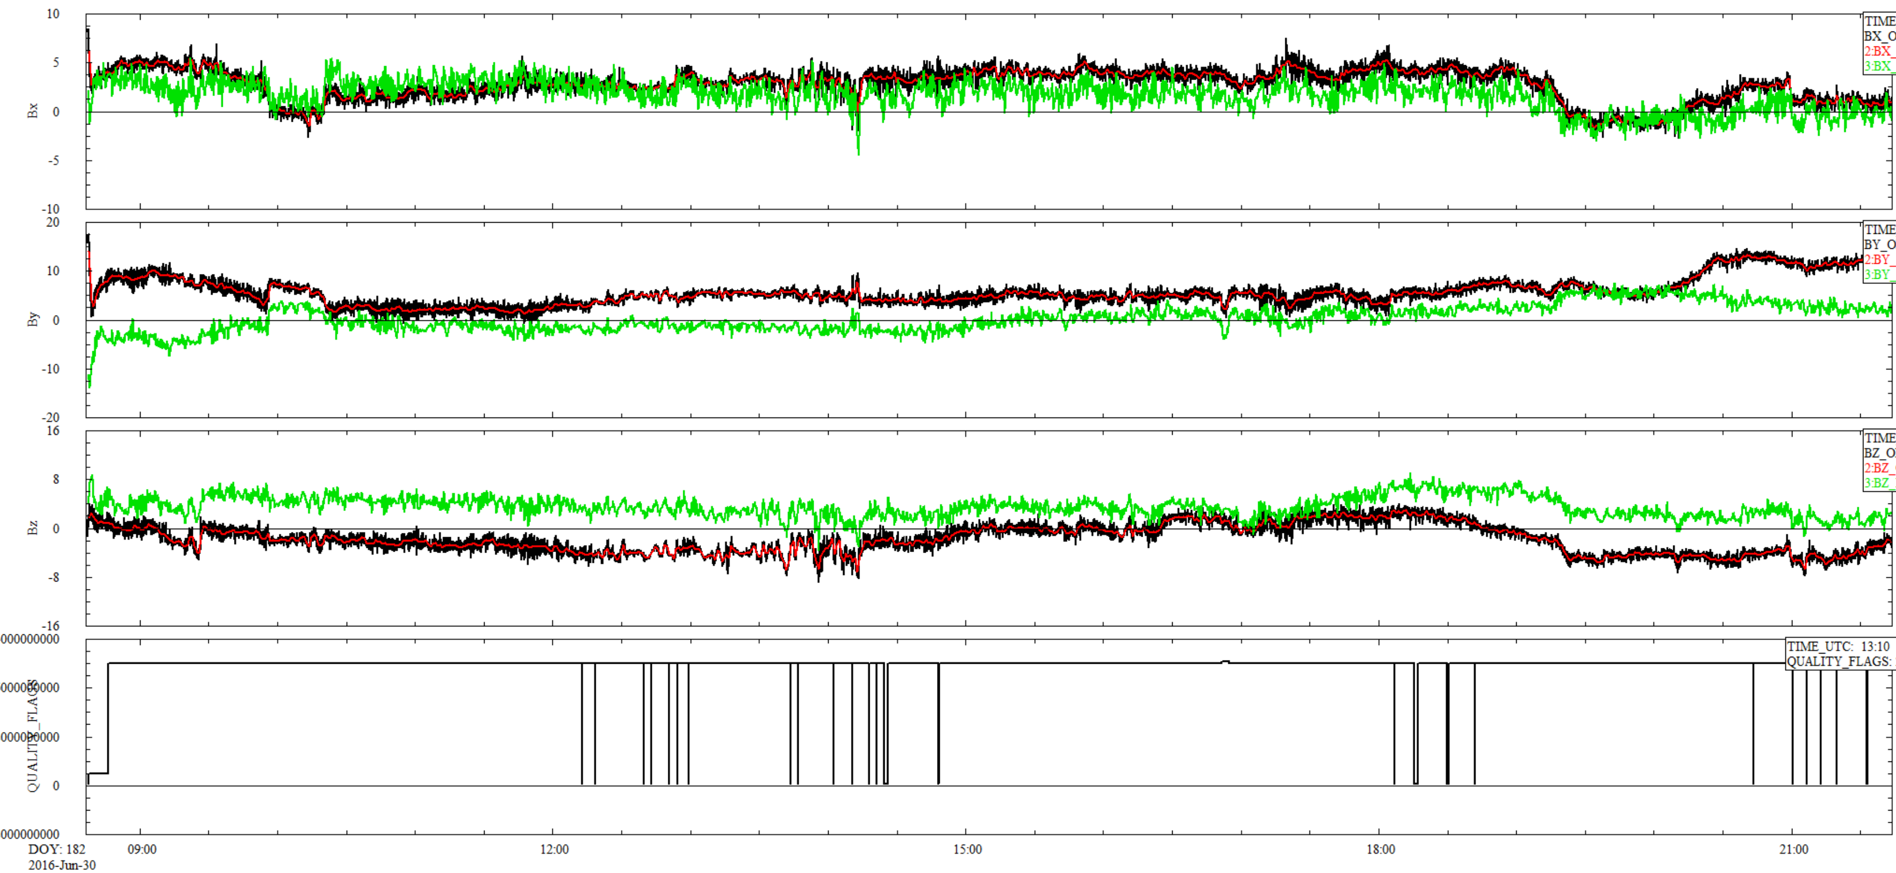
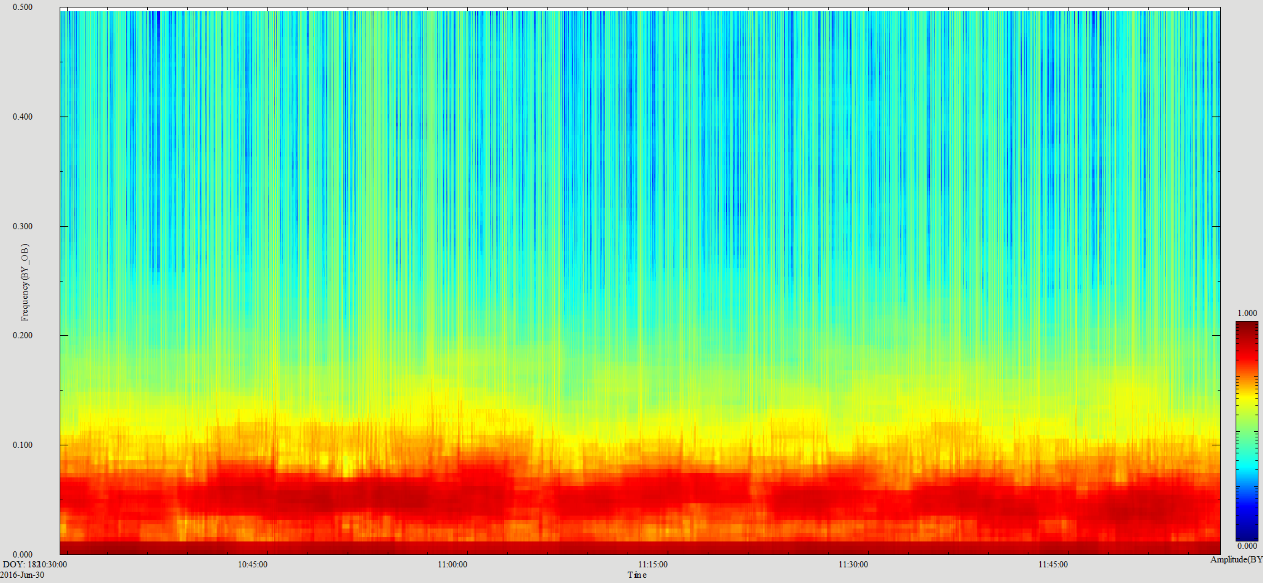
ro-c-rpcmag-4-ext3-resampled-v9.0
1 sec outboard By spectra 10:30 – 12:00 0 – 0.5 Hz
Red: Outboard 1 min, Black Outboard 1 sec, Green Inboard 1 min
2000004403F
March 2, 2015 00:00 -> 24:00
Comparison of rpcmag160630_clf_ob_a1 (black) and rpcmag160630_clf_ob_a60 (red) rpcmag160630_clf_ib_a1(green)
All files read into software using PDS labels – labels valid for all!
Resampled data look good, some residual offsets & noise in the data

Slide 11
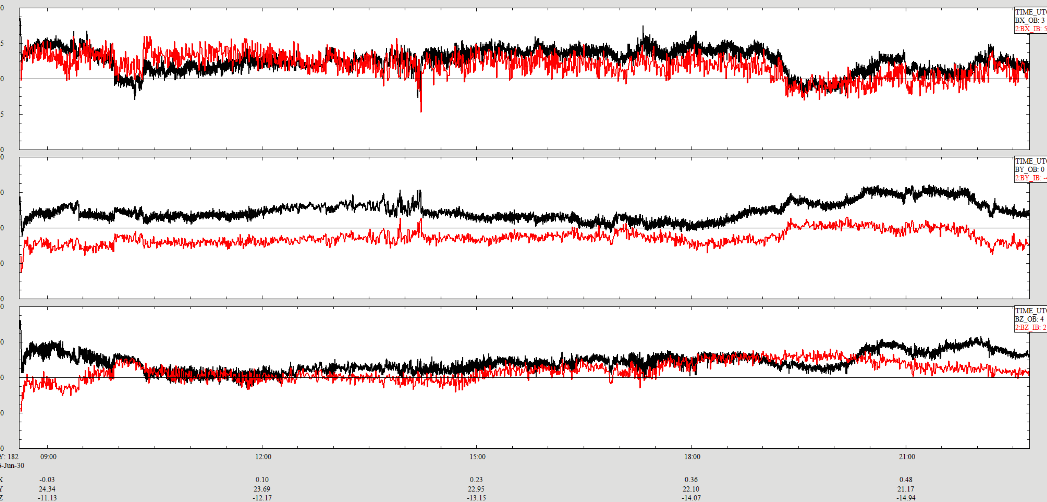
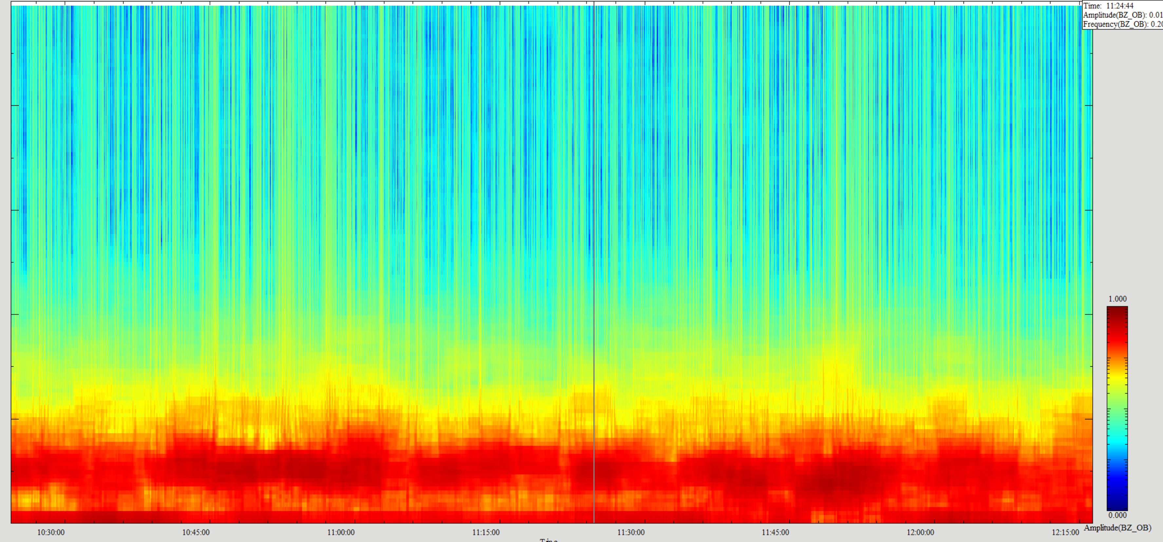
ro-c-rpcmag-3-ext3-calibrated-v9.0
Outboard Bz Amplitude Spectra 10:20 – 12:15 Note ~1nT power below 0.1 Hz
Bx
By
Red: Outboard 1 min, Black Outboard 1 sec, Green Inboard 1 min
Bz
2000004403F
March 2, 2015 00:00 -> 24:00
Comparison of rpcmag160630t0837_clc_ob_m2 (black) and rpcmag160630t0837_clc_ib_m2 (red) All files read into software using PDS labels – both labels valid!
Low frequency content of the inboard and outboard Y and Z sensors are only loosely correlated while the X sensors behave more as expected.

Slide 12
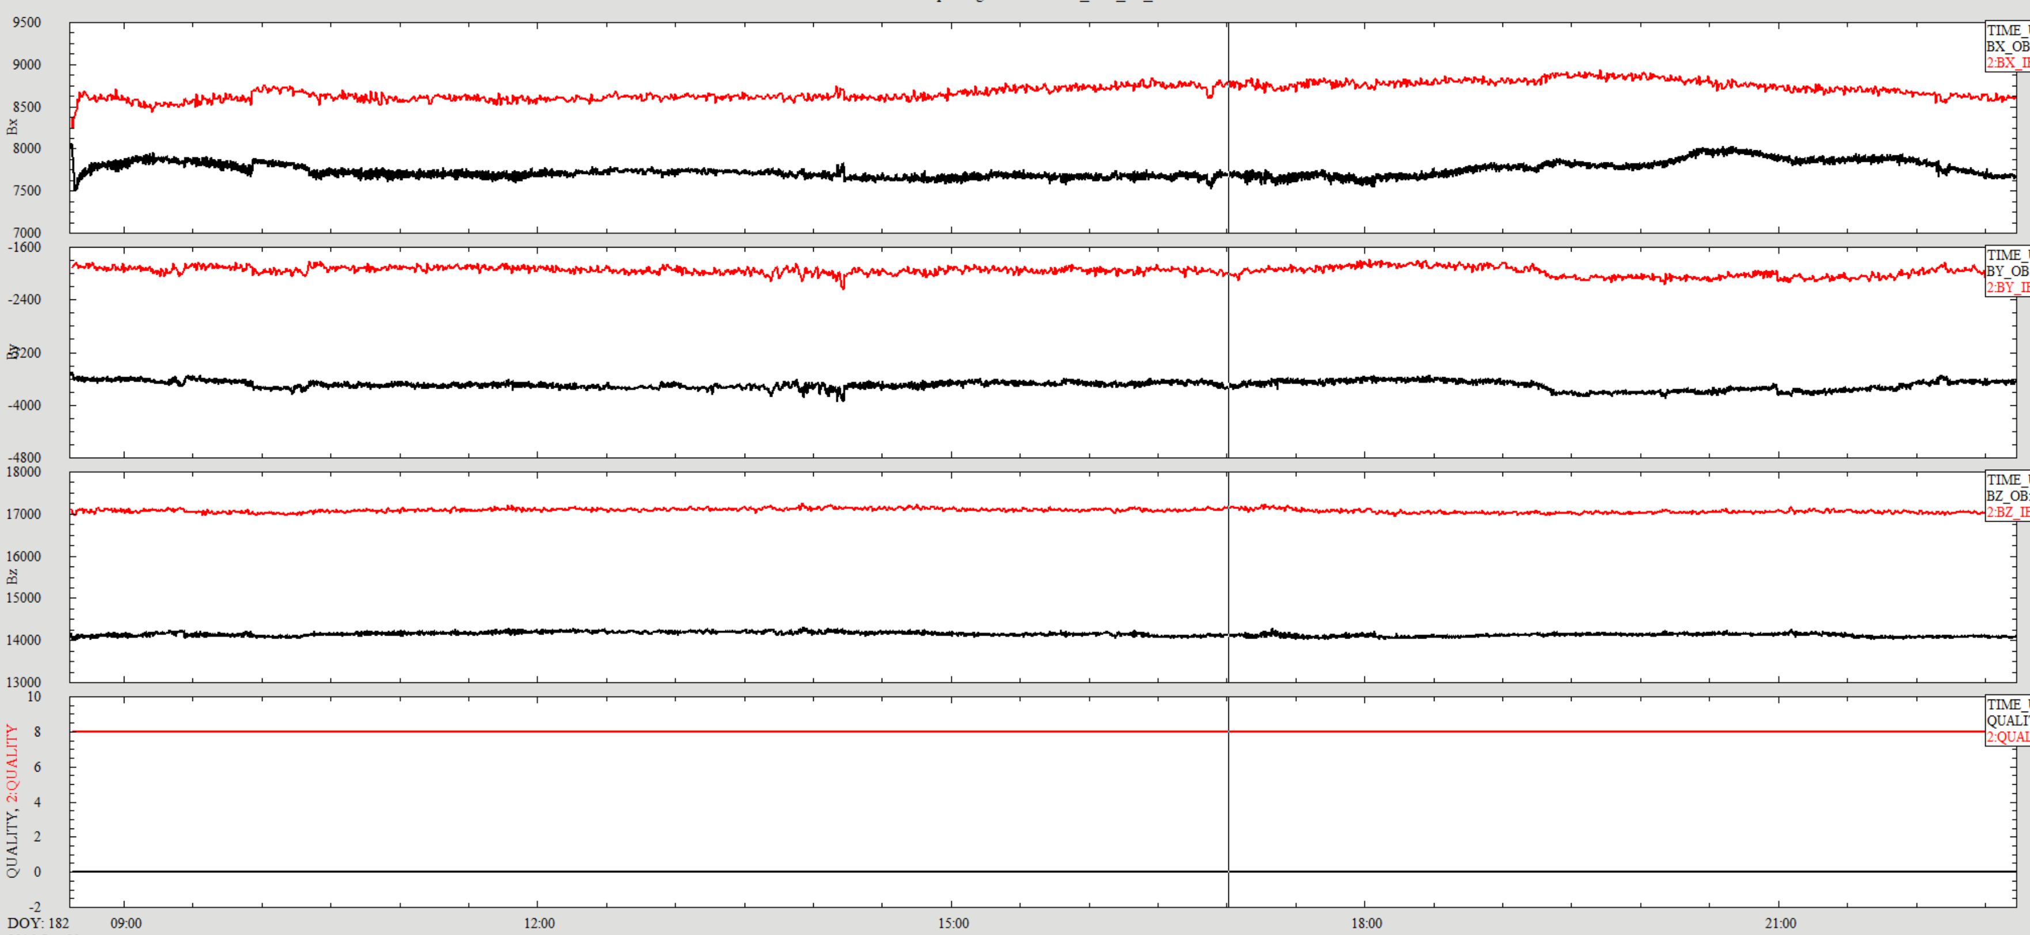
ro-c-rpcmag-3-ext3-raw-v9.0
Comparison of rpcmag160630t0837_raw_ob_m2 (black) and (red) rpcmag160630t0837_raw_ib_m2 All files read into software using PDS labels – both labels valid!
Differences between inboard and outsensor much more pronounced in the raw data than in the calibrated data.

Slide 13
Summary
Other than fixing a few minor edits to some of the documentation things are in pretty good shape.
The data look fine
Some of the documents need to be converted to PDF/A
RIDs: None
All of these data sets can be “certified”.

