Slide 1
ROSETTA RCP MIP
Enhanced Science Archive Review
ESAC Oct 9, 2018
Patrick CANU
LPP- Laboratoire de Physique des Plasmas
CNRS/Ecole Polytechnique,
France

Slide 2
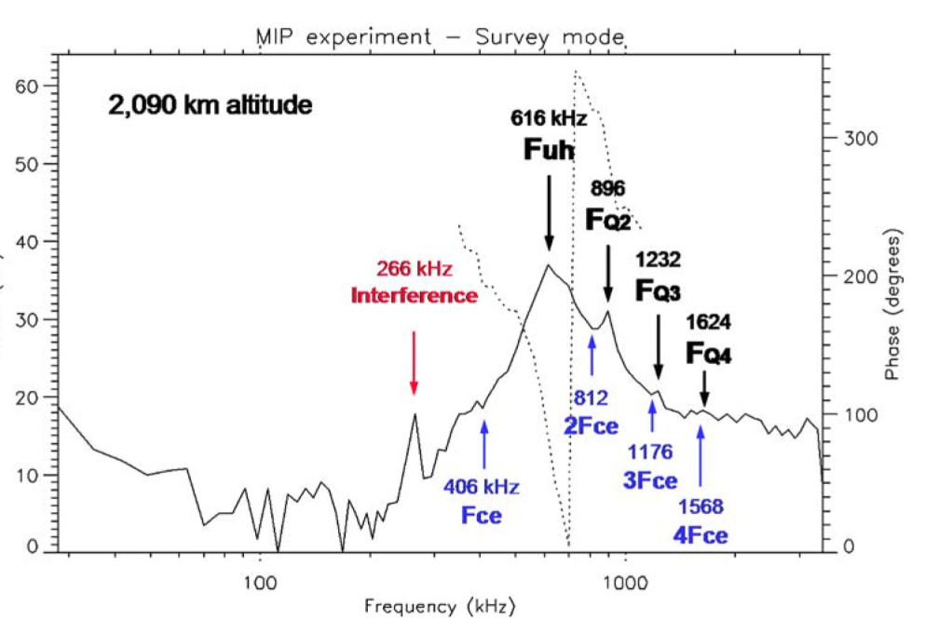
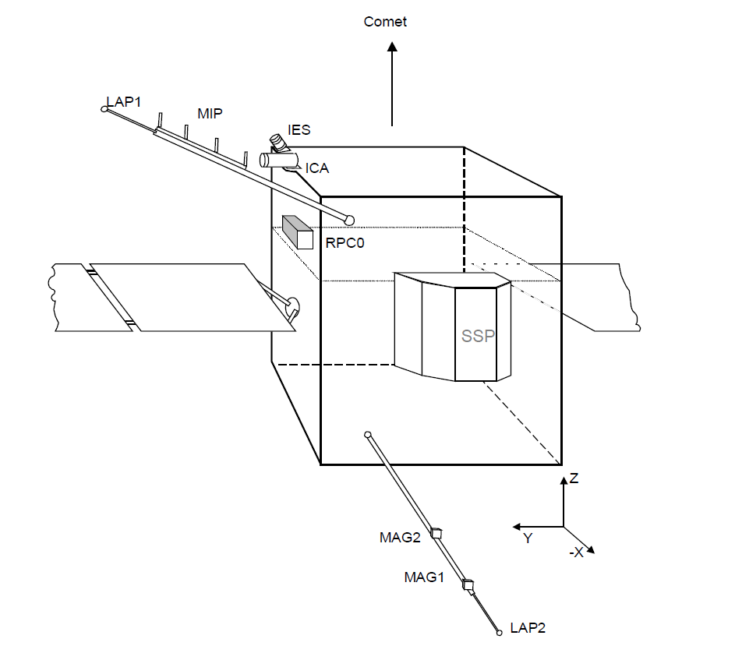
RCP MIP Enhanced Science Archive Review
MIP Mutual Impedance Probe Provides:
Diagnosis of Electron density and temperature through analysis of active wave spectra (emitter on)
Analysis of natural plasma emissions (emitter off)
Active MIP Spectrum
Earth Fly-By March 4, 2005
From Trotignon et al, 2006

Slide 3
Enhanced Science Review PackageReviewed External user point of view
Level 5 MIP:
Electron density values : one file/day
From Aug 2014 (PRL) to Sept 2016(EOM)
688 days – 630 MB
Level 5- MIP/LAP data :
Cross Calibrated electron densities : one file/day
Limited coverage:
PRL: 1 day
ESC4: 3 days Total: 2.4 GB
EXT1: 4 days
EXT3: 3 days

Slide 4
DATA Quality and use
Both data sets can be read with ReadPDS
Plotted values reproduce published data
CrossCalibrated MIP-LAP data too preliminary
(almost empty UG, too few days) to be fully reviewed
UG: Planned to be availabe summer 2019
Content suggests rather a LAP data file recalibrated by MIP:
time resolution ~ 0.0169 is LAP one
~ 2.65-32 s for MIP

Slide 5
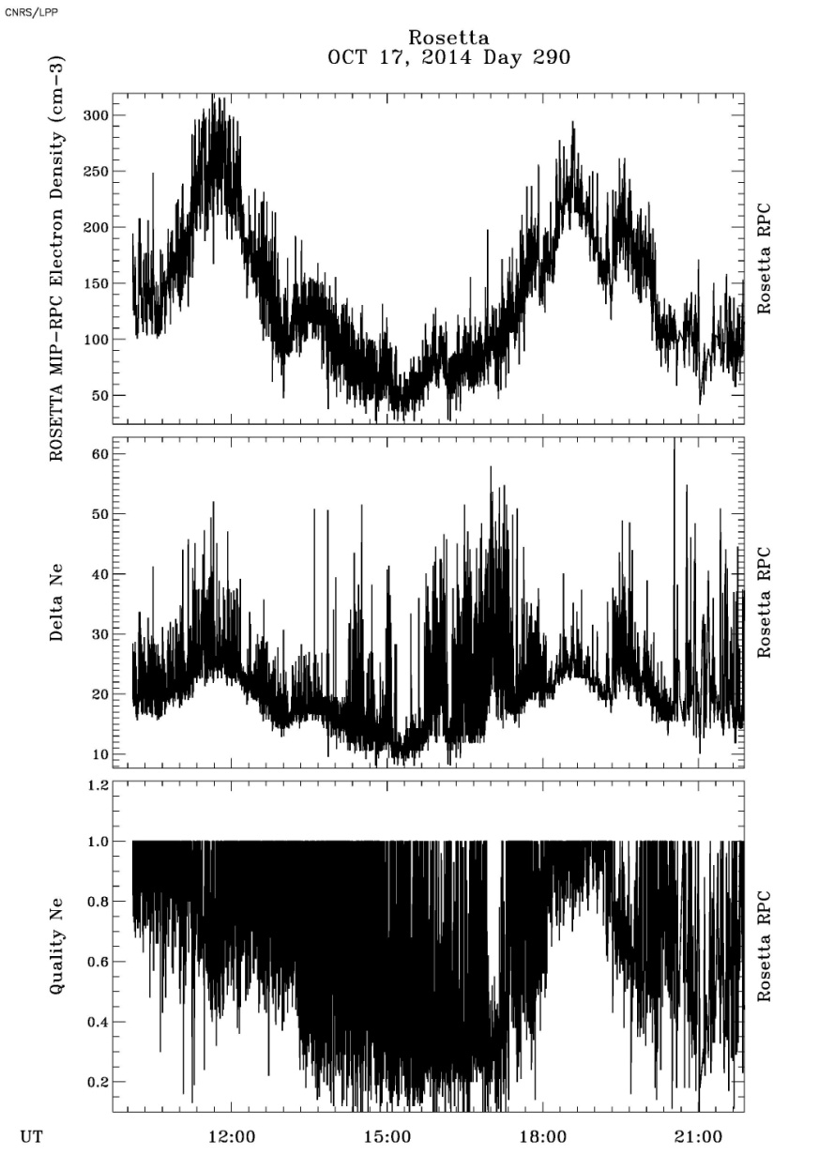
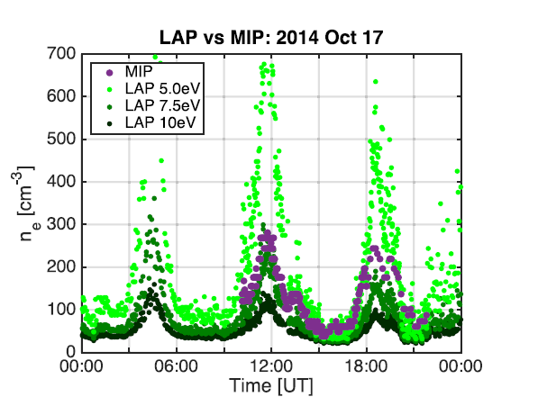
MIP files and plots
Ne
ΔNe
Qual
From Galand et al., 2016
MIP-L5 File

Slide 6
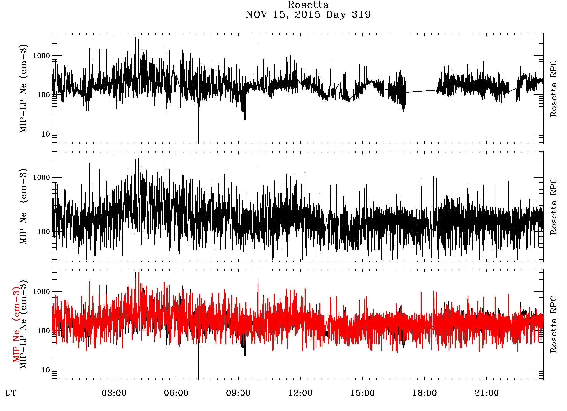
MIP-LAP Cross Calibrated files
MIP
MIPLAP
MIPLAP+LAP

Slide 7
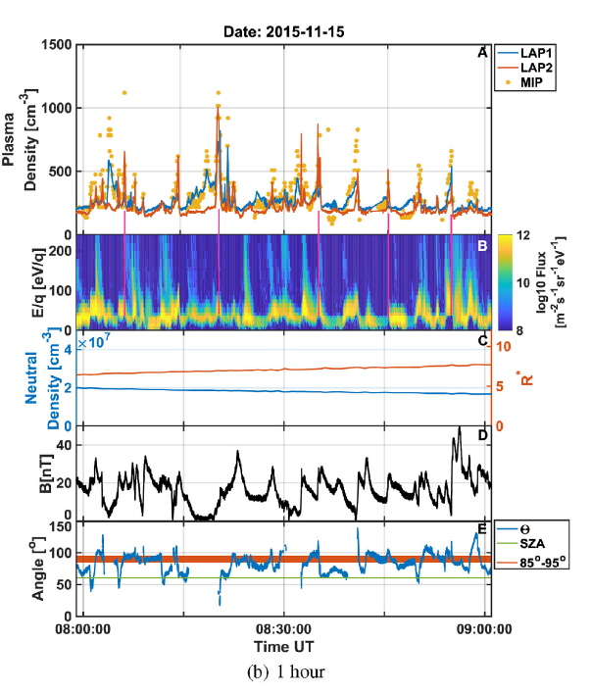
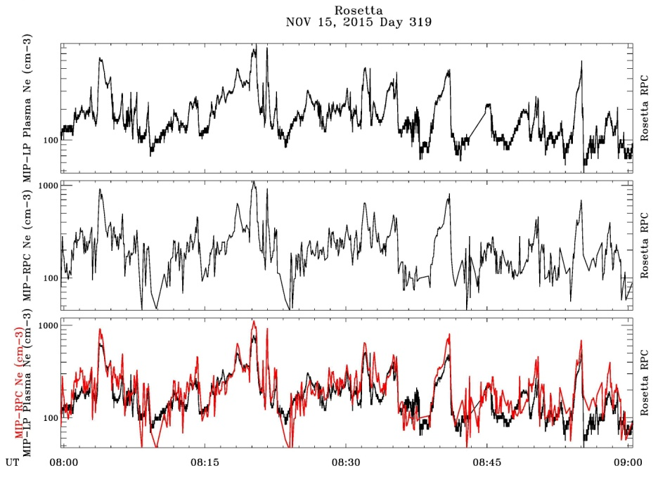
Reproduction of published data
From Engelhardt, 2018
MIP
MIPLAP
MIPLAP+LAP

Slide 8
Minor RIDs
Science- 27: Some L5-MIP files are missing
ie EOM day Sept 30, 2016 data were published in Heritier et al. (2017)
No exhaustive search for missing files
=> Check if all processed files were delivered
Rep: Missing published data obtained from specific analysis, not from the pipeline used for the delivered L5 files: Delivery considered for future release
Science- 29: MIP-LAP CrossCalibrated files content unclear
Both document and file content too preliminary to be reviewed
Document ‘’Cross Calibration Report’’ almost an empty file
No description of the file content, respective role of MIP and LAP
From file size seems to mainly be a LAP data file recalibrated by MIP
Rep:Document will be completed
Science-28 : MIP-LAP data files could be too big for easy process
Typical file size: + 300MB/day
Can generate the ‘’not enough Memory’’ in IDL
Rep: Files will be regenerated with a different time span

Slide 9
Summary
Production/delivery of L5-Density files represents a significant effort well underway
Files already delivered can be used by users outside the Rosetta community
Cross Calibrated MIP/LAP density file is a welcome addition to RCP data set, still in an early stage of production/documentation.
UG:to be completed summer 2019
Production of electron temperature file still expected in the EAICD seems more difficult to deliver on a systematic basis.
UG V1.5: It is no more foreseen to provide this parameter in the MIP archive

Slide 10
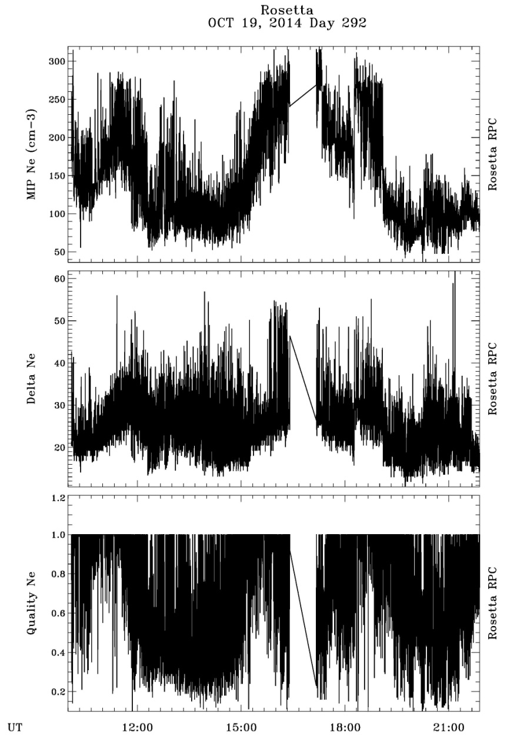
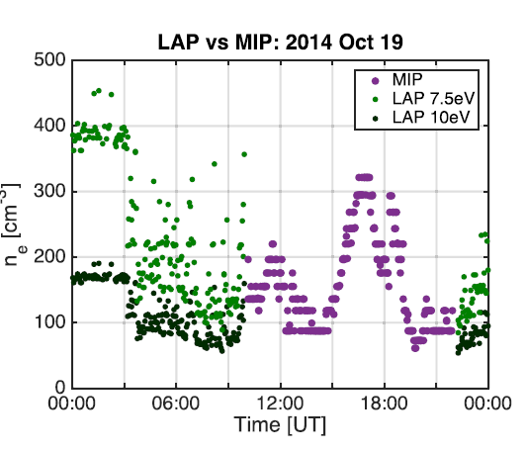
From Galand et al., 2016

Slide 11
