Slide 1
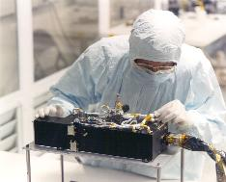
P-Alice PDS Data Review Kuiper Belt Extended Mission 1 Phase
Cesare Grava
Southwest Research Institute

Slide 2
Characteristics of P-Alice
520-1870 Angstroms (though only 780 columns are active, starting from 130th)
Spectral dispersion: 1.832 Å/pixel
Lollipop-shaped slit: 0.1x4.0° for the AirGlow Channel (AGC) + 2.0x2.0° for the Solar Occultation Channel (SOCC)
Two modes of operation:
Pixel list mode: preserves time information
Histogram: 2D histogram of previous
You can create a histogram from pixel list but not vice versa
Very similar to the LRO/LAMP UV spectrograph I work with.

Slide 3
Objectives of P-Alice
To determine or constrain:
The mixing ratios of N2, CO, CH4 and noble gases;
The vertical density and temperature structure (e.g., gradient) of the upper atmosphere;
The atmospheric haze optical depth;
The atmospheric escape rate and escape regime;
The brightness of airglow emissions from Pluto’s atmosphere

Slide 4
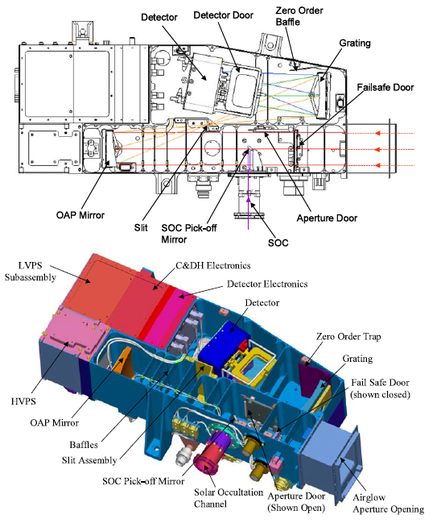
P-Alice’s scheme

Slide 5
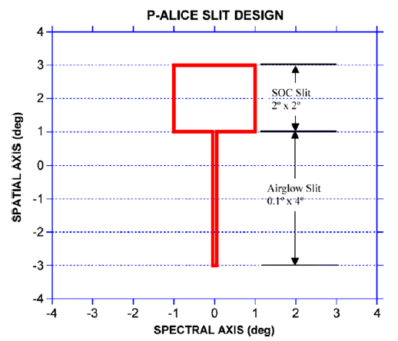
P-Alice’s two slits

Slide 6
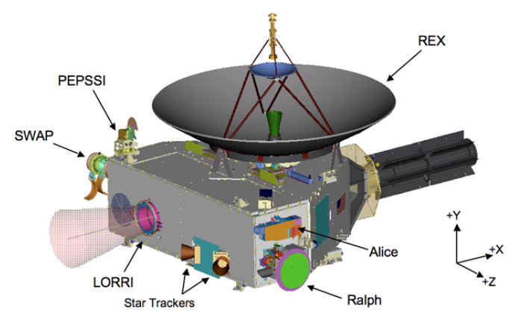
Alice’s location in New Horizons

Slide 7
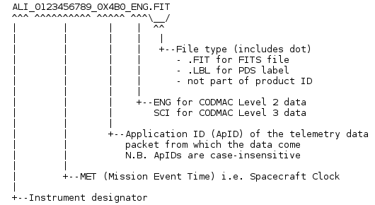
Datasets Reviewed
nh-x-alice-2-kemcruise1-v1.0
nh-x-alice-3-kemcruise1-v1.0
The first Kuiper Belt cruise 1 dataset delivery for the P-Alice instrument covers the data that had been downlinked to the ground by 12/31/2017.
Naming convention:

Slide 8
Aareadme.txt
Diff between versions 2 & 3 of aareadme.txt show that the file is identical except for the appropriate changes (referencing calibrated vs raw data). OK

Slide 9
Document\
Docinfo.txt, which explains what’s in here and recommends the following 3 files;
nh_obs_geom.pdf, which has 3 figures from Payload_ssr.pdf
Payload_ssr.pdf (it is basically the Weaver et al. 2008 SSR paper), which includes figures from nh_obs_geom.pdf and additional references;
Soc_inst_icd.pdf: no links to external sites – good!
The 2 SSR papers (Alice and NH payload)+ lunineetal1995.pdf: ok
No AAREADME_BU.TXT file, although it is mentioned in docinfo.txt;
Nh_mission_trajectory.tab: file is ok.
Nh_met2utc.tab: converts MET to date (neat, but wouldn’t it be better if they included a routine? Times are provided every 500,000 seconds…)
nh_fov.png: ok
nh_alice_v200_ti.txt: OK
Quat_axyz_instr_to_j2k.asc: OK
Codmac_level_definitions.pdf: OK

Slide 10
Index\
Slimindx.tab: useful to know the target of each file! There are only two types of targets: “SPICA” and “CALIBRATION”. Does the latter include “Rho Leo”? It is impossible to distinguish an “HV test” from “Rho Leo”. Moreover, “Spica” is never mentioned in dataset.cat.
The slimindx.tab of nh-x-alice-3-kemcruise1-v1.0/index has the order of the spectra not in sequential order:

Slide 11
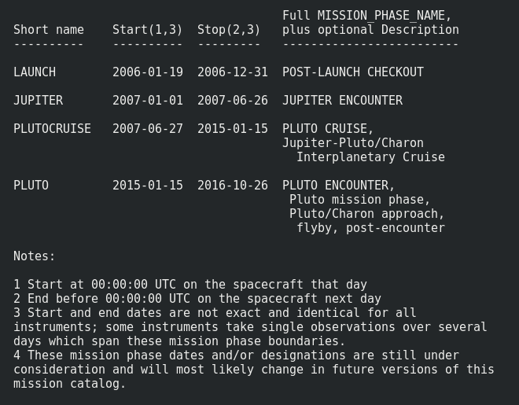
Catalog\
Alice.cat: describes the instrument and its 2 operating modes and explains the PHDs; does not mention MU69 as next target of NH mission; instead it refers to “Kuiper Belt objects”.
Catinfo.txt : explains the files contained here
Ref.cat: references
Nh.cat: explains the New Horizons mission goals and phases. There is a reference to a missing note: “4 These mission phase dates and/or designations are still under consideration and will most likely change in future versions of this mission catalog.”
Both in raw and in calibrated folders.
It should be deleted because note 4 refers to KEM phase.

Slide 12
Cfr. With nh_kem.dat
NH.dat
NH_KEM.dat

Slide 13
Catalog\
Nh_kem.dat (this is new): explains the New Horizons Extended mission goals and phases.
Nhsc.cat: explains the s/c (I read just Alice section). Good that they have added the wavelength of Alice.

Slide 14
Catalog\
Dataset.cat:
Line 83 of dataset.cat: “A list of these sequences has been provided in file DOCUMENT/SEQ_ALICE_PLUTO.TAB.” but there’s no such file… This is probably a leftover from the Pluto encounter phase.
Line 472: “The quantum efficiencies of the photocathode- coated surfaces are about an order of magnitude more sensitive to sensitive to H Lya wavelengths than the bare, uncoated MCP glass”.
Lines 55: “It includes functional testing during the wakeup check from hibernation, high voltage (HV) dark tests, Lyman-Alpha upstream and downstream measurements, InterPlanetary Medium (IPM) upstream and downstream measurements”. But then in line 548: “It includes Lyman-alpha Sky and Interplanetary Medium observations”. Lyman-Alpha and InterPlanetary are spelled differently. But, most of all, the Lyman-Alpha emission, too, comes from the Interplanetary medium. Maybe the team meant “Helium from Interplanetary Medium”?
Lines 52: “The first Kuiper Belt cruise 1 dataset delivery for the P-Alice instrument covers the data that had been downlinked to the ground by 12/31/2017”. But then in line 543: “This data set includes data downlinked between 10/26/2016 and 12/31/2017.” Maybe the starting date could be added to the sentence in line 52.
Both in raw and in calibrated folders.

Slide 15
Calib\
All files OK.

Slide 16
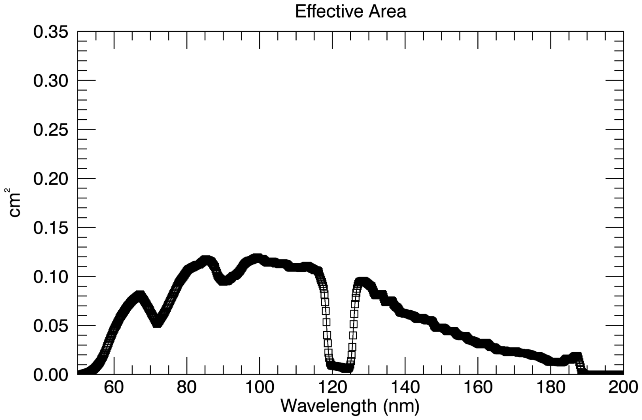
Calib\
Effective area airglow (pa_aeff_007.tab):
Good: slightly more sensitive than what reported in fig. 21 (top) of Stern et al. 2008

Slide 17
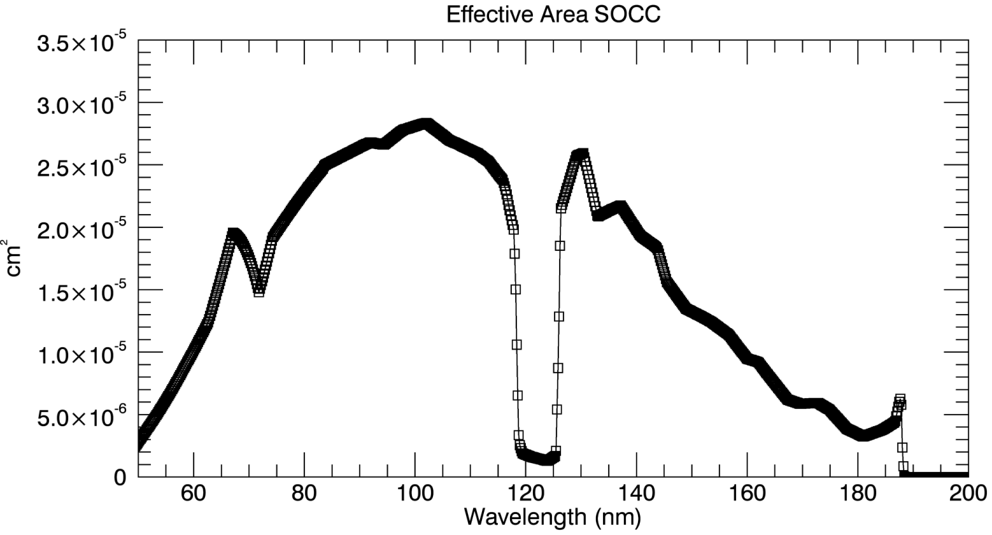
Calib\
Effective area SOCC (pa_aeff_002_socc.tab):
OK.

Slide 18
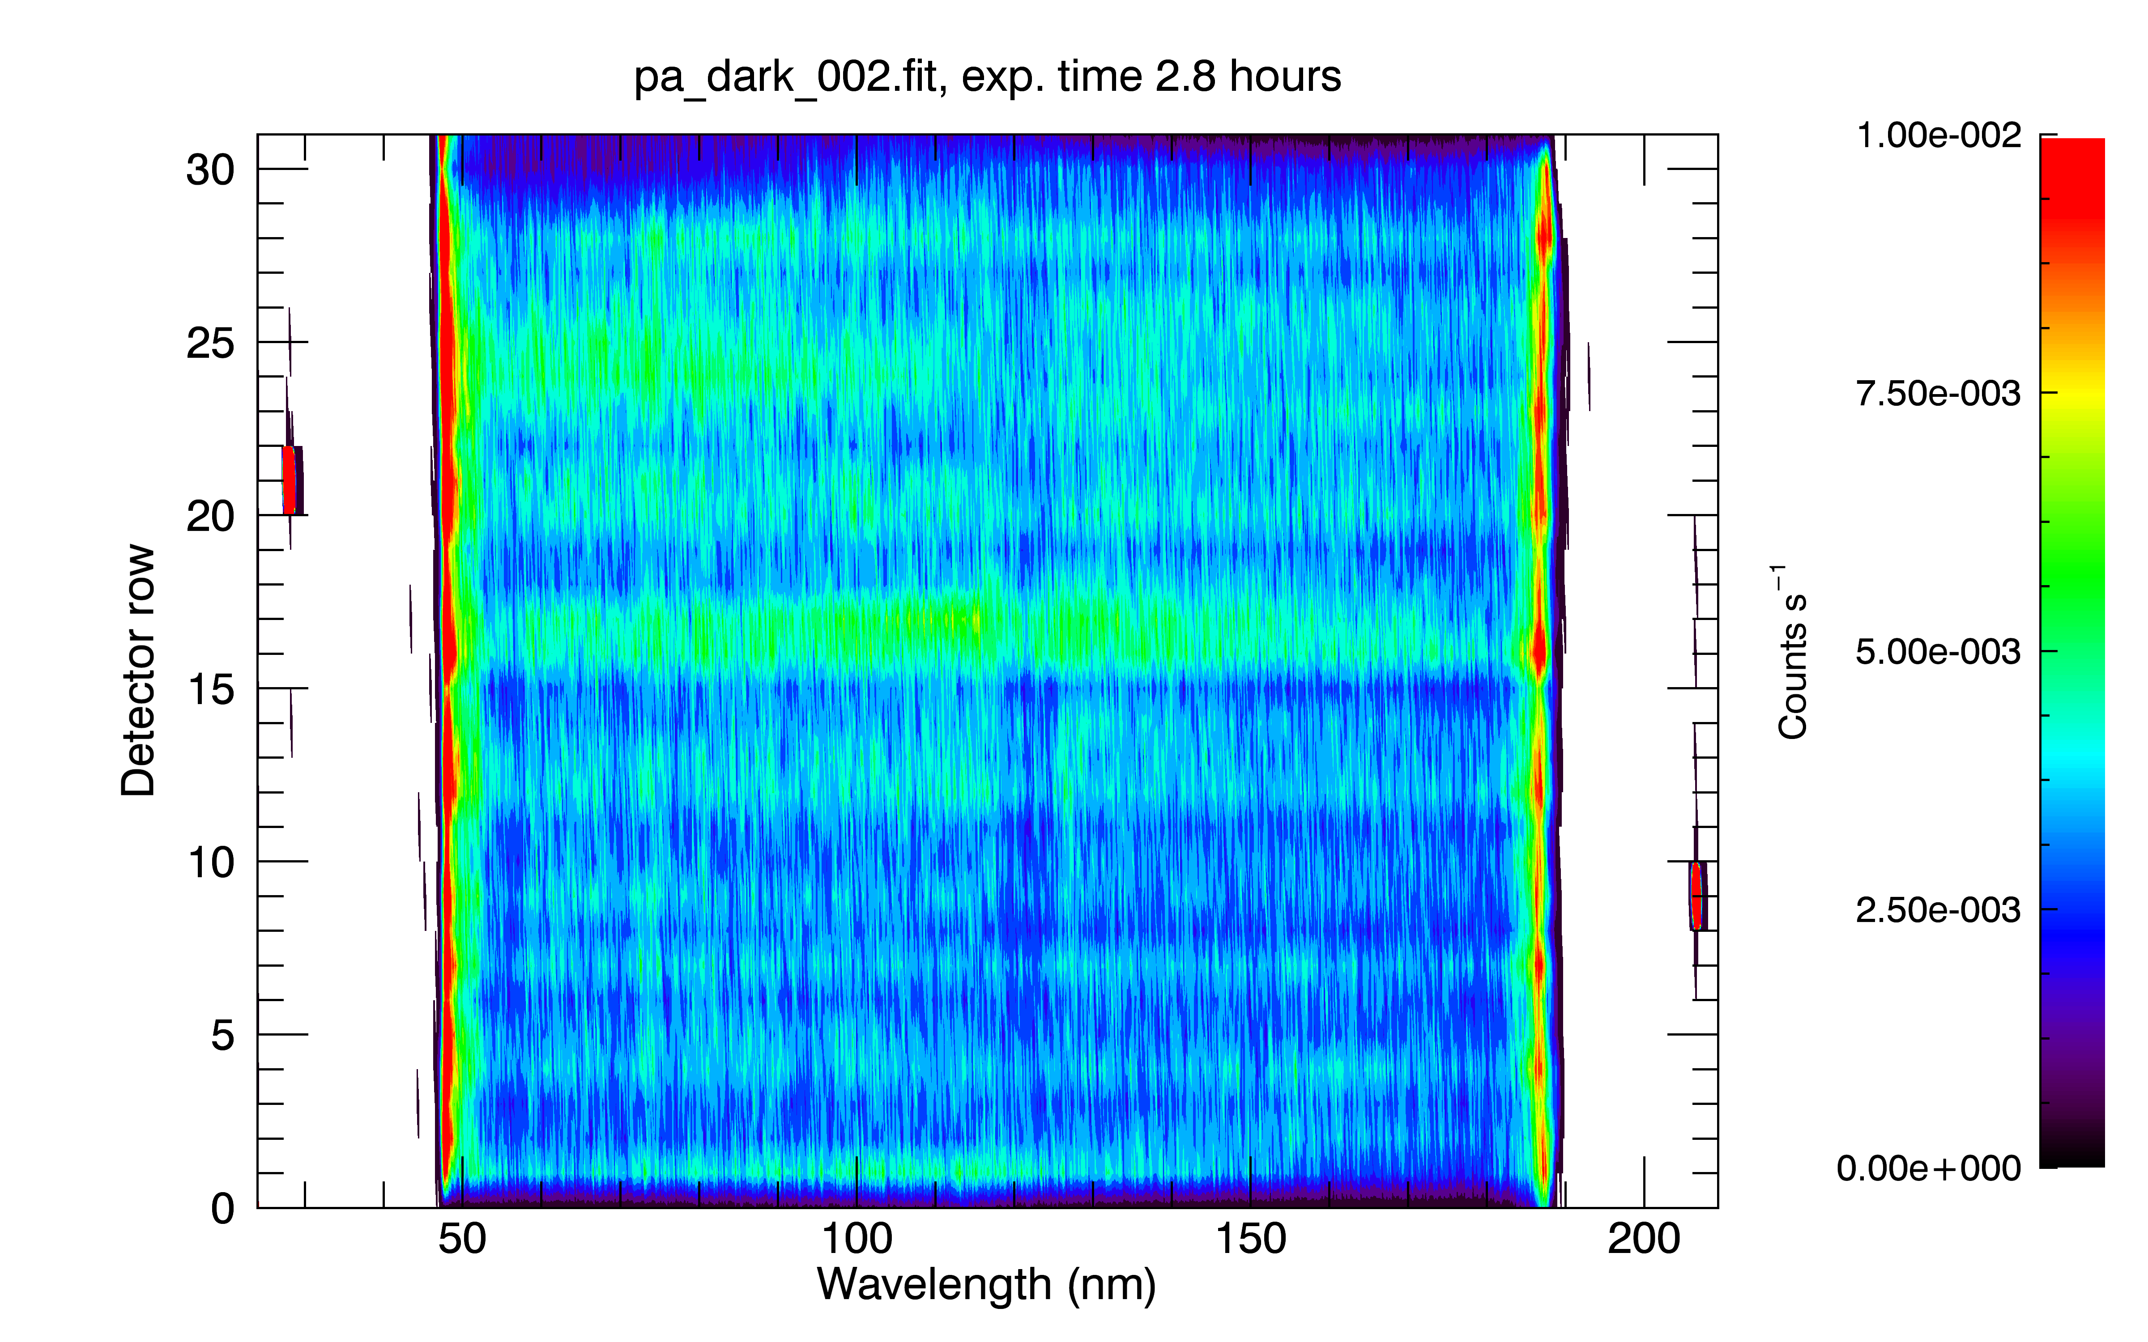
Calib\
nh-x-alice-3-kemcruise1-v1.0\calib\pa_dark_002.fit
Dark: ~3 hrs integration time; mean ~0.004 counts/sec. OK.

Slide 19
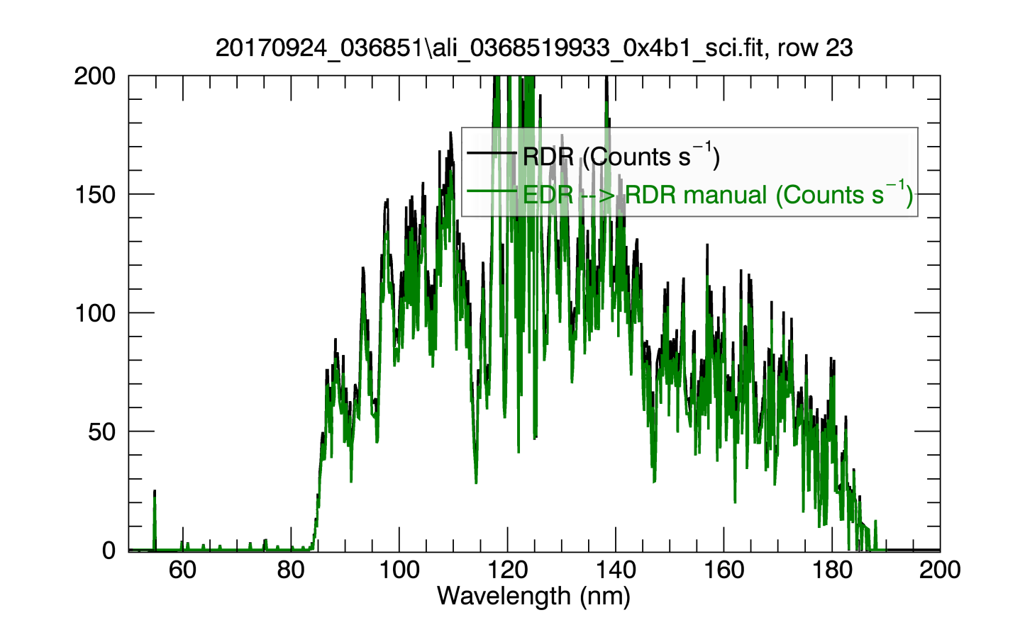
Data\
nh-x-alice-3-kemcruise1-v1.0\data\20170924_036851\ali_0368519933_0x4b1_sci.fit
SAPNAME: K1AL_RHOLEO_719-X-SLIT-SCANS_CL_2017266: 719-X-SLIT-SCANS
SAPDESC:
VISITNAM: K1AL_RHOLEO_719-X-SLIT-SCANS_CL_2017266
VISITDSC: ---
TARGET: CALIBRATION
APERTURE: AIRGLOW
DATE: 2018-06-30T16:47:32
EXPTIME: 6.3040631
Possible to reconstruct the RDR from ENG file: good.

Slide 20
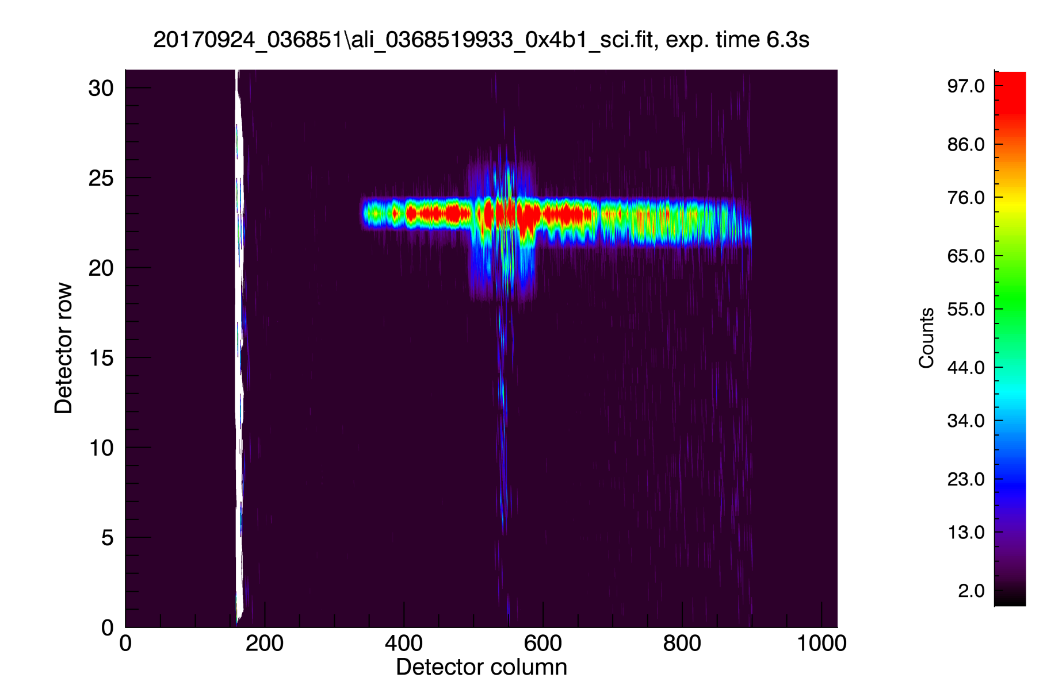
Data\
nh-x-alice-3-kemcruise1-v1.0\data\20170924_036851\ali_0368519933_0x4b1_sci.fit
KBr photocathode
CsI photocathode
Lollipop-shaped fuzz is SOCC aperture

Slide 21
Evaluation Tools
Laptop Lenovo Thinkpad:
Virtual Machine Oracle Fedora 17x86_64
Windows 7
IDL 8.4
Readpds v4.8
NASA’s Astronomical library

Slide 22
RIDs

Slide 23
RID 101
RID Classification: Major
Location: Document
Dataset: Calibrated data only
Title: spectra not in sequential order
Description: The slimindx.tab of nh-x-alice-3-kemcruise1-v1.0/index/ has the order of the spectra not in sequential order
Recommended Solution: rearrange the order of the list of slimindx.tab

Slide 24
RID 102
RID Classification: Minor
Location: Catalog/
Dataset: ALL
Title: missing file
Description: The file AAREADME_BU.TXT mentioned in in docinfo.txt is not present
Recommended Solution: add AAREADME_BU.TXT to Document, or remove reference to it in docinfo.txt.

Slide 25
RID 103
RID Classification: Minor
Location: Catalog
Dataset: ALL
Title: missing file
Description: The file DOCUMENT/SEQ_ALICE_PLUTO.TAB” mentioned in dataset.cat is not present;
Recommended Solution: since SEQ_ALICE_PLUTO.TAB refers to Pluto encounter, remove mention to it In Catalog/dataset.cat

Slide 26
RID 104
RID Classification: Minor
Location: Catalog
Dataset: ALL
Title: reference to non-existing note
Description: In nh.cat, there is a footnote which isn’t never used;
Recommended Solution: delete footnote # 4.

Slide 27
RID 105
RID Classification: Typo
Location: Catalog
Dataset: ALL
Title: duplicate word
Description: In dataset.cat, Line 472: “The quantum efficiencies of the photocathode- coated surfaces are about an order of magnitude more sensitive to sensitive to H Lya wavelengths than the bare, uncoated MCP glass”;
Recommended Solution: delete one “sensitive to”.

